Slide 1
Navigating HR: The Art of Problem-Solving and Conflict Resolution
Chapter 1: It Comes with the Territory

Slide 2
1.0 Learning Objectives
In this chapter, we will:
Explore the concept of workplace conflict from an HR perspective.
Explain how an HR professional engages in problem-solving and conflict resolution.
List common factors that influence workplace conflict.

Slide 3
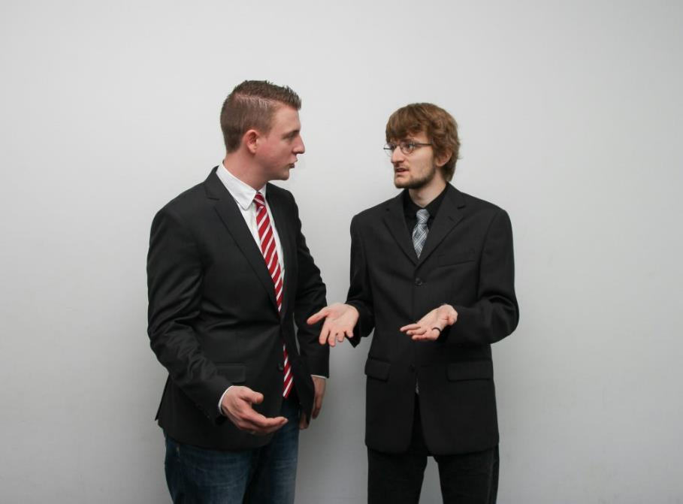
1.1 Workplace Conflict
Conflict is an active disagreement between people with opposing views or principles.
It can occur between individuals, departments, or with external parties like customers and suppliers.
Workplace conflict often disrupts productivity and can create an unhealthy environment.
Understanding conflict is essential for Human Resources professionals to manage and resolve issues effectively.
Photo by Sebastian Herrmann, Unsplash License

Slide 4
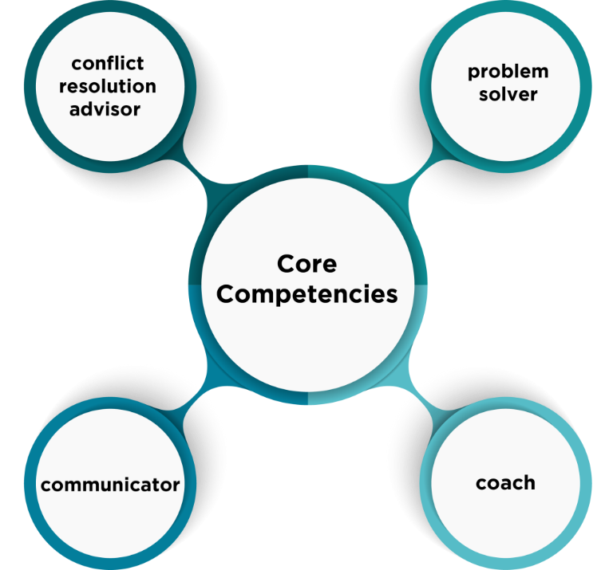
1.2 Human Resources Core Competencies
The Problem Solver:
  You are known for brainstorming solutions and addressing concerns and challenges in a timely manner.
The Conflict Resolution Advisor:
  You can identify disagreements between individuals and act as an advisor.
The Coach:
  You provide people leaders with useful tips and approaches to address workplace conflict.
The Communicator:
  You can communicate with others using verbal and non-verbal communication.
“Core Competencies” by Sanaz Habibi CC BY-NC-SA

Slide 5

1.3 What is Behind Workplace Conflict? II
HR professionals may encounter employees acting poorly or unusually, which can signal underlying issues.
Exploring an employee’s behaviour often reveals workplace or personal factors impacting them.
Workplace factors are predictable across organizations, while personal factors are common but unique to each employee.
When an individual is facing the pressure of taking care of their children and aging parents simultaneously, this is the sandwich generation.

Slide 6

1.3 What is Behind Workplace Conflict? I
Workplace Factors
Co-workers disagreements: about how to complete a project.
Lack of resources: finances or time
Job insecurity: concern a company will close or a job will be eliminated.
Workplace conduct: harassment, teasing or bullying.
Work overload: unrealistic amount of work.
Unfair practices: treatment, favouritism, pay.
Lack of career opportunities: promotions, training, mentoring.

Slide 7
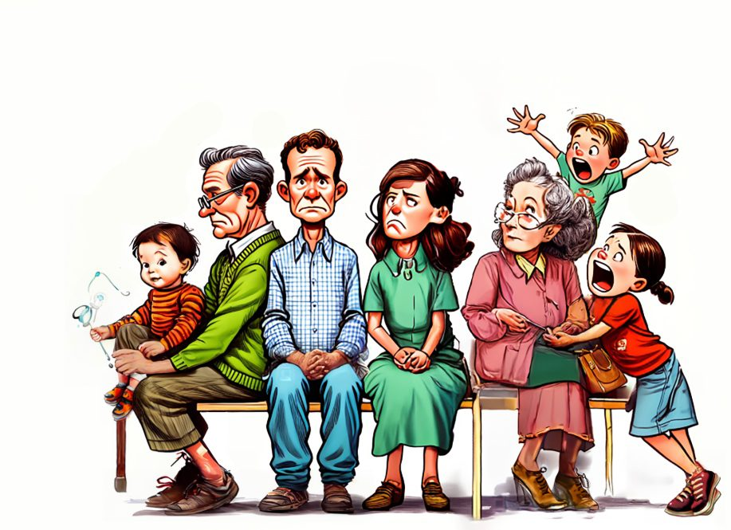
1.3 What is Behind Workplace Conflict?
Personal Factors
Grief: loss of a partner, family member, or friend.
Financial issues: bankruptcy.
Marital issues: separation or divorce.
Caretaking issues: childcare or parental care.
Addiction: medication or alcoholism.
Health issues: illness, injury, and mental health concerns.
Work-life balance concerns: inability to enjoy downtime away from work.
“The Sandwich Generation” by Sanaz Habibi, CC BY-NC-SA 4.0

Slide 8

1.4 Does Healthy Conflict Exist?
Characteristics of a Healthy Conflict
Those involved remain calm
It can move a project forward
There is a focus on the problem
The situation remains respectful
You hear professional language
It allows for differing opinions
Photo by Christina @ wocintechchat.com Unsplash License
Notes:
Human Resources professionals are responsible for creating and supporting a healthy workplace. You might think there is no place for conflict in the workplace. In fact, not all conflict is bad. Let’s look at the difference between healthy and unhealthy conflict.

Slide 9
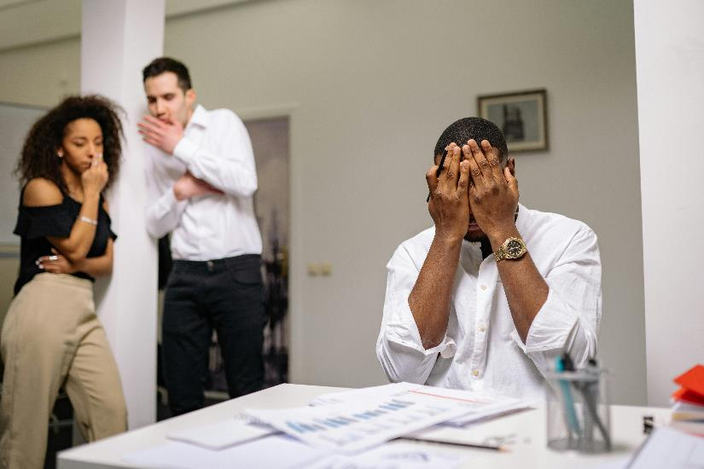
1.4 Does Unhealthy Conflict Exist?
Characteristics of an Unhealthy Conflict
The situation feels uncomfortable
There is a focus on the individual
You hear bickering
It may become loud
You hear unprofessional language
It involves blame
Photo by Yan Krukau Pexels License

Slide 10

1.4 The Business Case for Resolving Unhealthy Conflict
Business reasons to ensure unhealthy conflict is resolved:
Increasing productivity
Supporting healthy relationships
Developing a workplace culture to be proud of
Building inclusivity and belonging
Encouraging employee engagement
Making informed decisions
Welcoming brainstorming
Encouraging innovation and creativity
Setting your organization apart from the competition

Slide 11
1.5 HR: a Conflict Resolution Coach
As a Human Resources professional, there are two approaches to conflicts at work. One is to resolve the conflict yourself. The other approach is to coach people leaders to resolve workplace conflicts.
Exercise:
You work as the Human Resources Manager for a medium-sized manufacturing facility that employees 55 office staff. In addition, there are 80 employees on the day shift in the manufacturing facility, 70 on the afternoon shift, 50 on the night shift and 12 on the weekend shift. In total, there are 267 employees in this organization. 12 of these employees are people leaders.
Discussion:
Option 1. You can choose to coach 12 people leaders to address conflicts in their departments as they arise.
Option 2. You can address any conflicts that arise among the 267 employees. Remember, none of these employees report to you.
Which approach would you take and why?

Slide 12
1.6 Running Relay Ltd.
Throughout this text, you will be introduced to workplace conflict scenarios at Running Relay Ltd. It is essential to introduce you to the staff at Running Relay. Please familiarize yourself with the employee names, job titles, and biographies as it will help you understand the role plays and scripts throughout this text.
The Company: Runners Relay Ltd.
Industry: Running Shoes
Company Description: Runners Relay Ltd. was founded in 2015 by owner Frances Trembley (She/Her). Runners Relay is a small manufacturer of specialty running shoes, with a focus on environmentally friendly materials.

Slide 13
1.6 Meet the Staff at Running Relay Ltd: Office Staff
Anna Suarez (She/Her)
Human Resources Manager
Anna has attained her Certified Human Resources Professional (CHRP) designation from the HRPA and hopes to apply for her CHRL designation in the next year.
Andres Casso (He/Him)
Office Manager
Andres is the Office Manager at Runners Relay. Andres has been the Office Manager at Runners Relay for 5 years.
Penn Livington (They/Them)
Administrative Assistant
Penn hopes to become the Office Manager at Runners Relay someday.
Sunni Li (He/Him)
IT Technician
Sunni is a recent graduate excited to work full-time in his field of study.

Slide 14
1.6 Meet the Staff at Running Relay Ltd: Office Staff Continued
Chantal Russo (She/Her)
Marketing Coordinator
Chantal is taking a course on social media and hopes to apply what she learns at work.
Roman Stanski (They/Them)
Sales Associate
Roman wants to grow his sales and take a course in public speaking to improve his sales skills.
Harmon Patel (He/Him)
Safety and Environment Representative
Harmon is passionate about safety and is excited to introduce new training programs to the team at Runners Relay.

Slide 15
1.6 Meet the Staff at Running Relay Ltd: Manufacturing Staff
Leonard Swartz (He/Him)
Operations Manager
Leonard has been hired to lead the manufacturing operation and introduce cost-saving opportunities.
Helga Dietz (She/Her)
Day Shift Supervisor
Helga worked as a Production Associate for two years before being promoted to Supervisor.
Svetlana Antonov (She/Her)
Day Shift Production Associate
Svetlana is new to Runners Relay and is job shadowing to learn the processes and equipment.
Mikael Carlson (They/Them)
Day Shift Production Associate
Mikael is training to drive the new forklift at Runners Relay.
Sam Sellers (He/Him)
Day Shift Production Associate
Sam was working on the afternoon shift and recently transferred to the day shift at Runners Relay.

Slide 16
1.6 Meet the Staff at Running Relay Ltd: Manufacturing Staff Continued
Alejandro Rodriguez (He/Him)
Afternoon Shift Supervisor
Alejandro is being mentored by Leonard Swartz.
Aldona Jablonski (They/Them)
Afternoon Production Associate
Aldona is in a job rotation focused on learning additional jobs at Runners Relay.
Jamal Greene (He/Him)
Afternoon Production Associate
Jamal hopes to move to the day shift based on his family’s needs.
Steven Thomas (He/Him)
Afternoon Production Associate
Steven is taking IT courses on the weekends and hopes to transition to an IT position at Runners Relay in the future.

Slide 17
1.7 Key Takeaways
There will always be a certain amount of conflict within a workplace, the goal is to ensure it is healthy conflict.
A positive workplace culture includes a workplace that is free of unhealthy conflict.
Addressing unhealthy conflict in the workplace is part of a safe work environment.
Human Resources professionals address workplace conflict by coaching people leaders to address conflict within their departments.

