Slide 1
Recruitment and Selection
Chapter 1: Introduction to Recruitment and Selection
Unless otherwise noted, this work is licensed under a Creative Commons Attribution-NonCommercial-ShareAlike 4.0 International (CC BY-NC-SA 4.0) license. Feel free to use, modify, reuse or redistribute any portion of this presentation.

Slide 2
1.0 Learning Outcomes
By the end of this chapter, you will be able to:
Explain the significance of effective recruitment and selection in gaining a competitive advantage for your organization.
List the potential risks and consequences of poor hiring decisions.
Analyze the factors that contribute to successful recruitment strategies, including a company’s unique qualities and the specific skills required for the job.
Outline the steps involved in the selection process and the criteria used to assess candidates.
Identify and assess the external factors such as globalization, technology, and employment laws that impact recruitment and selection.
Discuss the ethical responsibilities of HR professionals in managing confidential information and ensuring fairness during the recruitment and selection processes.

Slide 3
1.1 Introduction
Human Resources (HR) is a very broad field. Recruitment and selection are but one component of the HR system.
Why does recruitment and selection matter?
Recruiting and selecting new employees can make or break a company. An employee represents, in the financial sense, a very high-risk investment. A company’s personnel costs may be a business’ single largest expense.
Choose well, and your employees can be a source of competitive advantage. On the other hand, a poor choice can represent a critical liability.

Slide 4
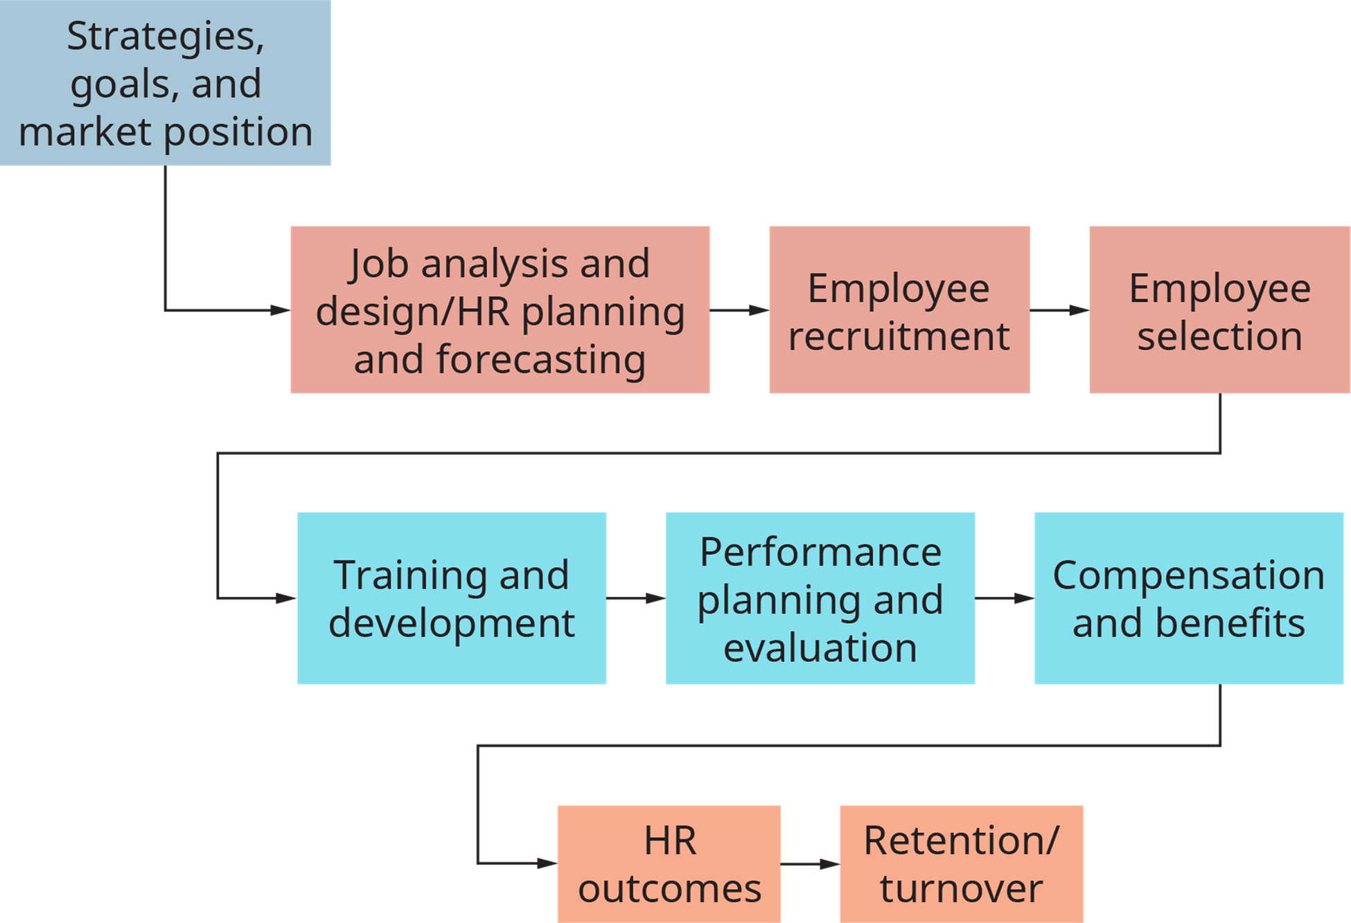
1.1 Introduction II
HR includes a broad range of functions and responsibilities that focus on managing and supporting the employees in an organization. HR ensures that the organization operates smoothly by handling everything related to employee management, from hiring to retirement. Talent management includes processes that help attract, develop, and retain high-performing employees, a key element of gaining competitive advantage.
We will examine only the recruitment and selection functions of talent management.
“Human Resource Management” by Rice University, CC BY 4.0

Slide 5
1.1 Introduction III
Recruitment
The goal of the recruitment process is to generate a pool of qualified candidates. It is the first step in the hiring process. Recruitment is the art of attraction, a process that requires a clear understanding of what makes the company unique as well as what type of person a company wants to attract.
Selection
Once a pool of candidates is assembled an HR manager must select the most qualified applicants from it. To find the best fit, criteria composed of critical skills, behaviours, and attitudes must be evaluated during interviews. Selective hiring is critical because it reduces turnover while increasing morale and productivity.

Slide 6
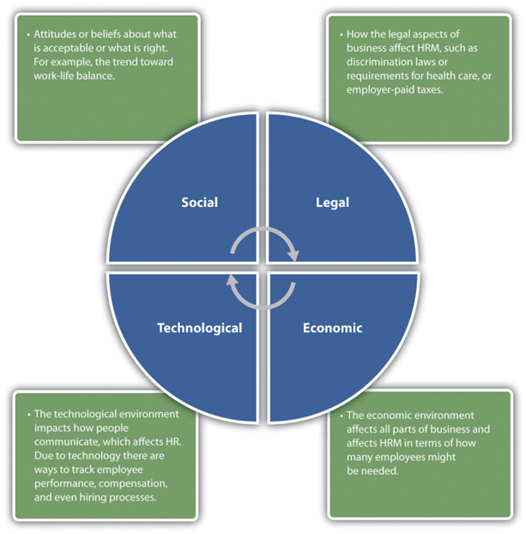
1.2 Awareness of External Factors
In addition to managing internal factors, an HR manager needs to consider the outside forces at play that may affect their organization. While you cannot control these external factors, you must be aware of them as they will impact your business and its employees. External factors can include:
Globalization
Changes to Employment Law
Employee Expectations
Diversity of the Workforce
Changing Workplace Demographics
Technological Developments
Changes In Social Networking Practices
Layoffs and Downsizing
Image by Ontario Tech University, CC BY-NC-SA 4.0

Slide 7
1.2 Awareness of External Factors II
Changes to Employment Law
HR managers must be aware of all laws that affect their workplace, ensuring the processes in place abide by them. In Canada both federal and provincial legislation plays a role in shaping recruitment practices. An HR manger will work withing the following legal frameworks
Discrimination Laws
Health and Safety Requirements
Compensation and Benefits Requirements (e.g., minimum wage and holidays)
Labour Laws

Slide 8
1.2 Awareness of External Factors III
Technology
Technology has greatly impacted HR and will continue to do so as new technology is developed. Using technology, workplaces now have virtual workforces that perform tasks from nearly all corners of the world.
Development in technology has allowed for telework from remote locations, and more flexible work scheduling. The use of smartphones, and the prevalence of social networking has impacted how HR departments are expected to disseminate information to employees and candidates. Databases and Human Resources Information Systems (HRIS) capture vast amounts of information about employees to serve as single sources of information to identify trends and inform business decisions. HR analytics tools will assist you in using this data to improve your workforce’s performance.

Slide 9
1.2 Awareness of External Factors IV
The Changing and Diverse Workforce
The retirement of the baby boomer generation will result in a loss of a major part of the working population, and there are not enough people to fill those jobs left vacant. This will create a unique staffing obstacle for Human Resources and mangers alike.
Challenges include the multigeneration workforce - employees between the ages of seventeen and sixty-eight having different values and job expectations, and a growing diversity of the workforce – greater variations in race, sex, ethnicity, age, and religion among employees and candidates. Different groups will have different goals, wants, and needs that must be acknowledges by an HR professional. An HR manager must also ensure that their business does not engage in discrimination by incorporating biases into their recruitment and selection process.

Slide 10
1.3 Skills Needed in HRM
A successful HR manager has an array of skills to deal with a variety of situations. However, it simply isn’t enough to have knowledge of the technical requirements of HR, it takes multiple ancillary skills to manage people.
The need for organization makes sense given that you are managing people’s pay, benefits, and careers. People skills are important in any type of management role and perhaps might be the most important skill for achieving success at any job. The ability to communicate goes along with people skills. Being able to communicate good news (hiring a new employee), bad news (layoffs), and everything in between, makes for an excellent HR professional.

Slide 11
1.3 Skills Needed in HRM II
Ethics
Ethics and a sense of fairness are also necessary for Human Resources. Ethics is the concept that examines the moral rights and wrongs of a certain situation. Ethical dilemmas often occur during the selection process as job applicants are tested with various selection tools. Hiring decisions can create ethical dilemmas that test the HR professional’s code of ethics.
HR managers are required to work with highly confidential information, such as personal data and salary information, so a sense of ethics when managing this information is essential. Some HR managers also negotiate employee and union contracts and manage workplace conflicts. Similarly, a sense of ethics while managing these situations is essential

Slide 12
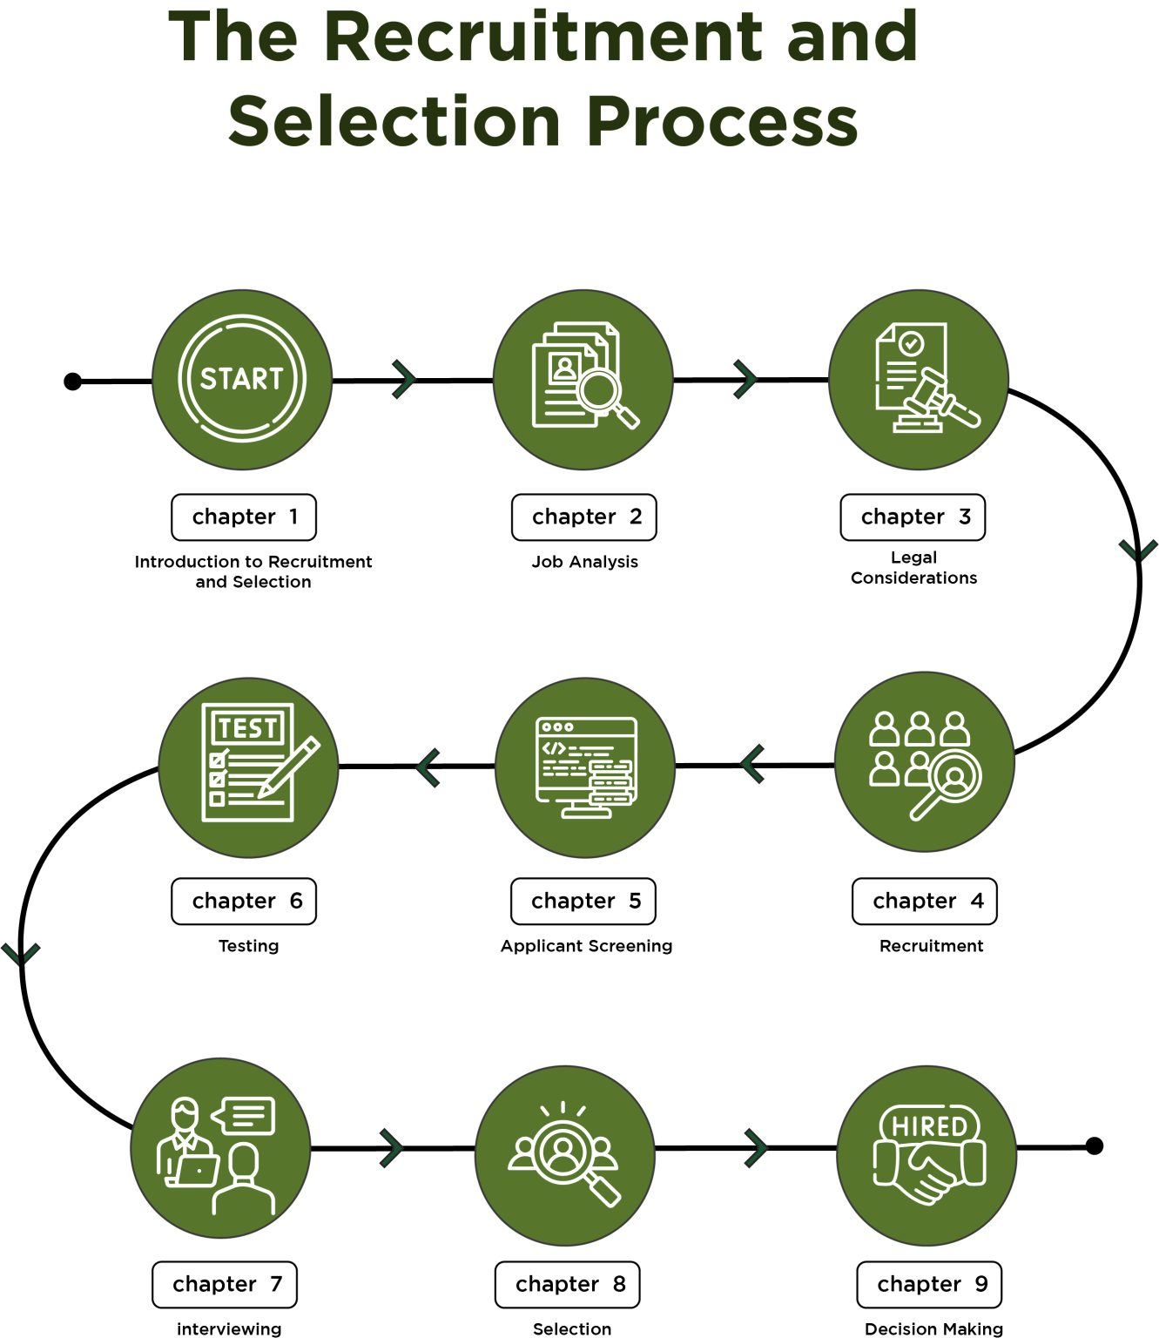
1.3 Skills Needed in HRM III
Effective Recruitment and Selection
Recruitment and selection should not be about luck of the draw. Decisions about somebody’s suitability for the job needs to be based on evidence rather than solely upon a ‘gut feeling’ or instinct.
A thoroughly planned recruitment process will result in qualified candidates. The selection of the best of these candidates will lead to better workplace performance, and a positive work environment.

Slide 13
Key Takeways:
Effective Recruitment: Requires the attraction of a competent and diverse applicant pool. To accomplish this, a company must highlight its unique qualities, and the specific skills applicable candidates must have.
Effective Selection: A business must select candidates who possess the necessary technical skills and match the company’s culture. Failing these criteria, the hiring of a candidate that doesn’t meet these criteria can result in turnover, reduced employee morale, and reduced productivity.
External Factors: Changes in society, technology, law, the economy and other structures external to a business can impact the recruitment and selection process. An HR manager needs to be aware of these issues to meet both the needs of their company, but also their employees.
HRM skills: An HR manager must have strong interpersonal and communication skills to facilitate their work. Their decisions must be informed by a strong sense of business ethics.

Slide 14
Key Terms II
Human Resources (HR): A department whose responsibilities include a broad range of functions that focus on managing and supporting the employees within their organization.
Talent Management: An HR responsibility which includes recruitment, selection, retention, and development of superior employees.
Recruitment: The process of attracting a pool of potential candidates for a job opening.
Selection: Assessing and choosing the best-fit candidates from the pool.
Telework: Working from home, or a remote location, using virtual tools.
Flexible Work Schedules: Scheduling which allows for irregularities in shift times, days off, and other time-related considerations.

Slide 15
Key Terms III
Social Networking: The communication of job posting in public spaces such as job boards, and social media platforms.
Human Resources Information Systems (HRIS): Software intended to assist HR in the organization and management of their personnel.
HR Analytics: Software intended to assist HR in understanding trends within, and improving the performance of, their organization’s workforce.
Diversity of the Workforce: The growing trends towards workforces being comprised of more disparate groups based on factors of age, race, sex, disability status, and religious belief.
Organization: The sorting of information to allow the management of responsibilities to be swift and accurate.

Slide 16
Key Terms IV
People Skills: Interpersonal skills such as dealing with large personalities, handling conflict, and coaching others in these skills.
Ability to Communicate: The skill of delivering news (good or bad) in such a way as to not disturb the comfort of those the news is being delivered to.
Ethics: The moral rights and wrongs of business.

