Slide 1
Recruitment and Selection
Chapter 7: Applicant Screening
Unless otherwise noted, this work is licensed under a Creative Commons Attribution-NonCommercial-ShareAlike 4.0 International (CC BY-NC-SA 4.0) license. Feel free to use, modify, reuse or redistribute any portion of this presentation.

Slide 2
Learning Outcomes
Explain the Purpose and Importance of Applicant Screening
Differentiate Between the Stages of Recruitment, Screening, and Selection
Apply Various Screening Methods Effectively
Implementing and Evaluating Screening Criteria
Creating ATS-Friendly Resumes
Utilizing Social Media and Reference Checks in the Screening Process

Slide 3
7.0 Applicant Screening
Applicant screening is how employers or recruiters assess job applications to determine which candidates are suitable for a position.
Includes: reviewing resumes, cover letters, and other application materials and conducting initial phone/video interviews. ​
Photo by windows Unsplash License

Slide 4
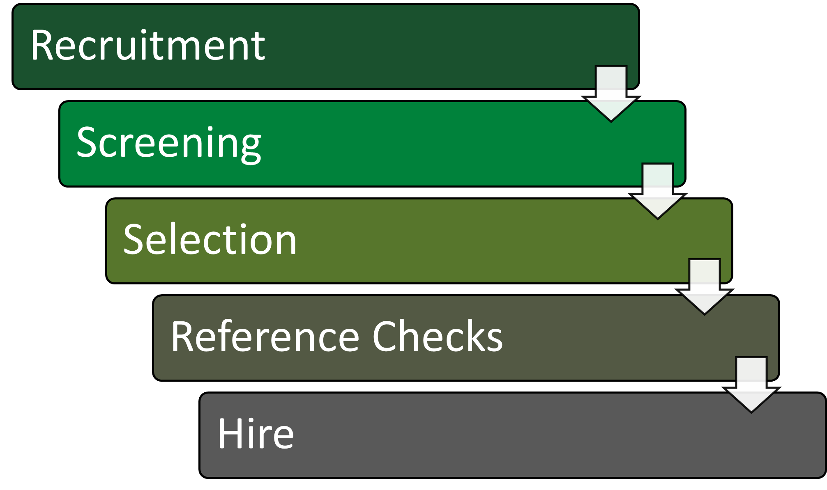
7.1 Recruitment, Screening, and Selection
Notes:
Recruitment, screening, and selection are interrelated stages in the hiring process, each playing a role in ensuring that the right candidates are hired for the right positions. At the recruitment stage, consider whether there are candidates for the job. At the screening stage, examine whether the applicants have the minimum requirements for the role based on their applications, resumes and screening interviews. At the selection stage, consider whether the applicants are the most qualified through employment testing and interview. Next, reference checks are completed before hiring the candidate.

Slide 5
7.2 Screening Methods
Application
Screening Interview
External Verification
Reference Checks
Notes:
Application: Conduct an initial assessment based on a review of a candidate’s cover letter, resume and application. This may also include a review of a candidate’s business (i.e., LinkedIn) and/or social networking (i.e., Facebook or Twitter) profiles. Screening application forms, cover letters or resumes involves reviewing the information candidates provide to assess their qualifications, skills, and suitability for a particular job or position. In this phase, the objective is to eliminate candidates who don’t meet the basic requirements for the position based on fundamental factors, including minimum experience and education.
Screening Interview: An initial telephone or online interview is a second level of active screening used to assess the candidate’s objective and motivation, relevant education and experience and to get a sense of the candidate as a person. In the course of approximately twenty to thirty minutes, an interviewer can confirm application and resume details and assess a range of soft skills—for example, active listening and communication—as well as engagement and overall level of poise and professionalism. Both phone and online screening interviews have their unique advantages and drawbacks. The choice should be guided by the hiring strategy of the organization. Once again, the objective is to eliminate candidates who don’t warrant the time and cost of an in-person interview or in-depth skills assessment.
External Verification: Verify stated educational qualifications and check references.
Reference checks are collected only for applicants who make it through earlier screening stages, so they tend to be done near the end of the screening process. Screening references involves the process of contacting individuals provided by a job applicant to verify their qualifications, experience, and character.

Slide 6
7.2 Resume Red Flags
Cookie-cutter resume
Lack of attention to detail
Unexplained employment gaps
Vague job descriptions
Regressed or plateaued careers
Multiple career changes
Notes:
Recruitment, Screening, and Selection

Slide 7
7.3 Application Tracking Systems (ATS)
ATS is software used to automate the initial review of job applications based on predefined criteria.
The ATS extracts relevant information from resumes, such as contact details, work experience, education, skills, and certifications, and stores it in a structured format for easy analysis.
Keyword Matching: The ATS searches for specific keywords related to the job requirements.
Customized Criteria: Employers can define customized criteria based on the job description, such as required skills, experience levels, education, and certifications.

Slide 8
7.3 Make Resumes ATS Friendly
Simple formatting
Tailor resume to job
Label sections
Avoid headers and footers
Save in different formats

Slide 9
7.4 Reference Checking
Phone References
Involves direct communication between the employer and the reference.
Online Reference Checking
Online reference checking involves sending requests by email or through specialized AI platforms.
Allows for real-time conversations, allowing the employer to gauge the tone and sincerity of the reference’s responses.
Employers can ask follow-up questions and probe for specific examples.
However, scheduling calls can be a time-consuming process of calling and playing phone tag with references.
References are asked to complete a questionnaire or provide feedback electronically.
References can respond conveniently from any device, potentially resulting in faster turnaround times.
Lack of the personal touch of a phone conversation, and may result in more generic responses from references.
Notes:
This involves using software to automate the initial review of job applications based on predefined criteria.

Slide 10
7.5 Social Media
In Canada, employers are leveraging social media platforms to review suitability of potential candidates and remove them from the hiring pool. A poll conducted by The Harris Poll “found that more than 60% of Canadian companies (65%) say they screen a candidate’s social media. Among this group, 41% said they have found content on a job candidate’s social media that caused them to not offer them the job” (Robitaille, 2023).
Photo by Alexander Shatov Unsplash License
Notes:
Involves direct communication between the employer and the reference.
Allows for real-time conversations, allowing the employer to gauge the tone and sincerity of the reference’s responses.
Employers can ask follow-up questions and probe for specific examples.
However, scheduling calls can be a time-consuming process of calling and playing phone tag with references.
Involves direct communication between the employer and the reference.
Allows for real-time conversations, allowing the employer to gauge the tone and sincerity of the reference’s responses.
Employers can ask follow-up questions and probe for specific examples.
However, scheduling calls can be a time-consuming process of calling and playing phone tag with references.

Slide 11
Key Takeaways
Screening as a Critical Process: Screening is essential for assessing job applications. It involves reviewing resumes and cover letters and conducting initial interviews to filter out unqualified candidates early on.
Application Review: The first step in screening involves evaluating application materials such as resumes, cover letters, and application forms to ensure candidates meet the minimum requirements.
Initial Screening Interviews: These are typically conducted over the phone or online to assess candidates’ qualifications and soft skills further, ensuring they meet the basic job criteria.
Early Elimination: Candidates who do not meet the minimum standards are eliminated early in the screening process to streamline the selection of potential hires.

Slide 12
Key Takeaways Cont.
External Verification: Near the end of the screening process, it’s important to verify candidates’ qualifications, experience, and character through reference checks and educational qualification verifications to confirm the accuracy of the information provided.
Applicant Tracking Systems (ATS): These systems automate the initial review of resumes using predefined criteria, helping to identify suitable candidates efficiently.
Identifying Common Issues: During the screening process, look for issues such as generic resumes, lack of detail, employment gaps, vague job descriptions, career regression, and multiple career changes.
Social Media Insights: Reviewing candidates’ social media profiles can provide additional insights into their professionalism and cultural fit for the organization.

Slide 13
Key Terms I
Applicant Screening​: The process of assessing job applications to determine suitable candidates before in-depth interviews or testing.​
Applicant Tracking Systems (ATS)​: Software used to automate the initial review of job applications based on predefined criteria such as keywords and customized filters.​
External Verification​: The process of verifying stated educational qualifications and checking references provided by the candidate.​
Initial Assessment​: Reviewing cover letters, resumes, and applications to eliminate unqualified candidates.​
Keyword Matching​: A method ATS uses to search for specific keywords related to job requirements in resumes.​

Slide 14
Key Terms II
Minimum Requirements (MQs)​: The baseline criteria established by employers or hiring managers that applicants must meet to be considered for a position.​
Online Reference Checking​: A method of reference checking involving sending reference check requests by email or through specialized AI platforms.​
Phone References​: A method of reference checking involving direct communication between the employer and the reference via phone.​
Recruitment: The hiring process aims to create a pool of qualified candidates from which the organization can select the best fit for the job.
Reference Check: Contacting individuals provided by a job applicant to verify their qualifications, experience, and character.

Slide 15
Key Terms III
Screening Criteria: Baseline criteria such as education, experience, certifications, and technical skills are used to evaluate candidates.
Screening Interview: An initial telephone or video interview to assess a candidate’s objectives, motivation, relevant education and experience, and personal attributes.
Selection: Identifying and hiring candidates that fit the job requirements and organizational culture best.
Social Media Screening: The practice of checking job applicants’ social media profiles to gather additional information about them beyond their resumes and cover letters.

