Slide 1
Recruitment and Selection
Chapter 4: Recruitment
Unless otherwise noted, this work is licensed under a Creative Commons Attribution-NonCommercial-ShareAlike 4.0 International (CC BY-NC-SA 4.0) license. Feel free to use, modify, reuse or redistribute any portion of this presentation.

Slide 2
4.0 Learning Outcomes
Discuss the importance of recruitment as the first step in the selection process.
Analyze the process of forecasting future hiring needs.
Outline the steps of an HR plan.
Identify the key components of a recruitment plan.
Compare and contrast internal and external recruitment methods, including their advantages and disadvantages.
Discuss how to attract job applicants.
Explain the importance of person-organization fit.

Slide 3
4.1 Recruitment
Recruitment is the first step in the selection process, which identifies, attracts, interviews, selects, hires, and onboards employees.
Recruitment is a process that provides an organization with a pool of qualified job candidates (an applicant pool).
Photo by Jon Tyson Unsplash License

Slide 4
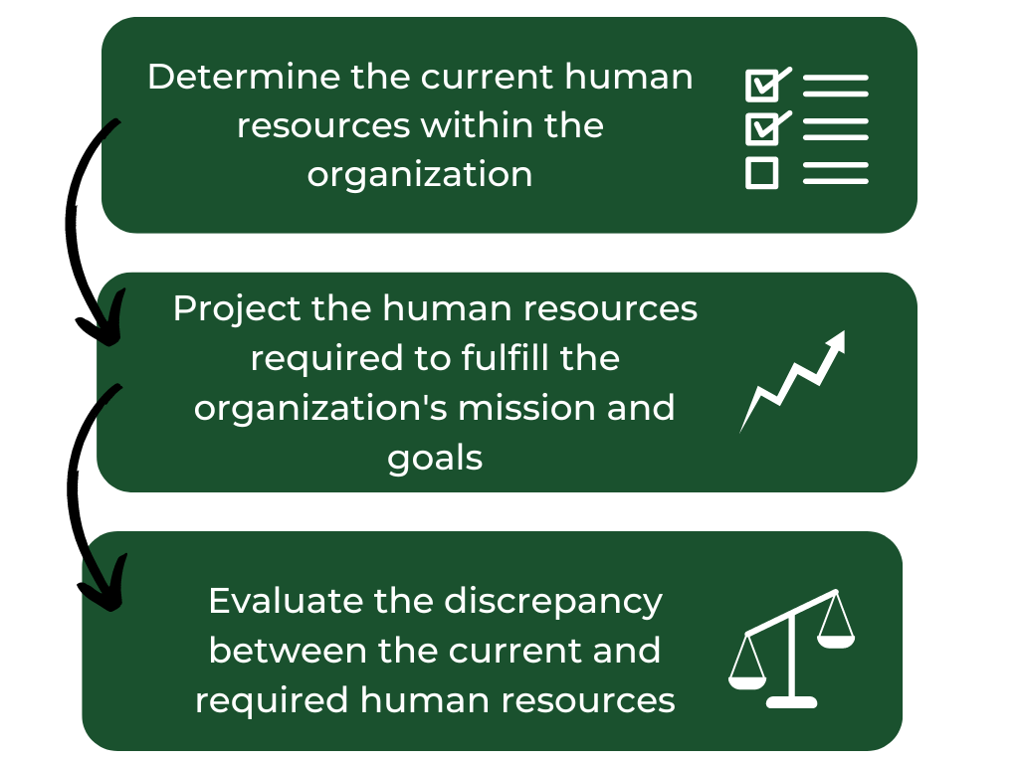
4.1 Forecasting HR Supply And Demand
Notes:
Recruitment, screening, and selection are interrelated stages in the hiring process, each playing a role in ensuring that the right candidates are hired for the right positions. At the recruitment stage, consider whether there are candidates for the job. At the screening stage, examine whether the applicants have the minimum requirements for the role based on their applications, resumes and screening interviews. At the selection stage, consider whether the applicants are the most qualified through employment testing and interview. Next, reference checks are completed before hiring the candidate.

Slide 5
4.2 Human Resource Planning
Human resource planning is developing a plan for satisfying an organization’s staffing needs.
A strategic HR plan lays out the steps that your organization will take to ensure that it has the right number of employees with the right skills your organization needs to accomplish its goals.
Photo by Jason Goodman Unsplash License
Notes:
Application: Conduct an initial assessment based on a review of a candidate’s cover letter, resume and application. This may also include a review of a candidate’s business (i.e., LinkedIn) and/or social networking (i.e., Facebook or Twitter) profiles. Screening application forms, cover letters or resumes involves reviewing the information candidates provide to assess their qualifications, skills, and suitability for a particular job or position. In this phase, the objective is to eliminate candidates who don’t meet the basic requirements for the position based on fundamental factors, including minimum experience and education.
Screening Interview: An initial telephone or online interview is a second level of active screening used to assess the candidate’s objective and motivation, relevant education and experience and to get a sense of the candidate as a person. In the course of approximately twenty to thirty minutes, an interviewer can confirm application and resume details and assess a range of soft skills—for example, active listening and communication—as well as engagement and overall level of poise and professionalism. Both phone and online screening interviews have their unique advantages and drawbacks. The choice should be guided by the hiring strategy of the organization. Once again, the objective is to eliminate candidates who don’t warrant the time and cost of an in-person interview or in-depth skills assessment.
External Verification: Verify stated educational qualifications and check references.
Reference checks are collected only for applicants who make it through earlier screening stages, so they tend to be done near the end of the screening process. Screening references involves the process of contacting individuals provided by a job applicant to verify their qualifications, experience, and character.

Slide 6
4.3 Trend Analysis
Trend analysis examines past employment levels against selected business variables to predict future staffing requirements.
Trend analysis uses historical data (i.e., experience to inform future needs, to perform this analysis, an HR manager will select the factor(s) influencing labour levels the most and chart them for four to five years.
Photo by Towfiqu barbhuiya Unsplash License
Notes:
Recruitment, Screening, and Selection

Slide 7
4.4 Development of a Recruitment Plan
A recruitment plan includes information to guide each step of the recruitment process. It should focus on the most important elements of connecting with and hiring the applicant who best matches the organization’s needs.
A recruitment plan guides the hiring process. Establishing timelines for each step in the recruitment process can be helpful to ensure that jobs are filled at the correct times.
Photo by Volodymyr Hryshchenko Unsplash License

Slide 8
4.5 Recruitment Pipeline
A recruitment pipeline is a continuous process of attracting, screening, and nurturing potential job candidates to ensure a steady supply of qualified applicants.
Tracking recruiting pipelines using analytical tools helps create a more efficient recruitment process.
Photo by Victor Unsplash License

Slide 9
4.5 Yield Ratio
Yield ratio is a performance indicator that pertains to the percentage of candidates from a specific source that made it from one stage to the next.
An HR manager could compare the yield of different recruitment sources to determine which one should be invested in for the future.
Photo by Jason Goodman Unsplash License
Notes:
This involves using software to automate the initial review of job applications based on predefined criteria.

Slide 10
4.6 Internal Recruitment
If an internal candidate meets the qualifications, this person might be encouraged to apply, and the job opening may not be published.
HR managers prepare an inventory of all current employees, knowing the skills and abilities of employees can help guide internal recruitment and development opportunities.
Photo by Cytonn Photography Unsplash License
Notes:
Involves direct communication between the employer and the reference.
Allows for real-time conversations, allowing the employer to gauge the tone and sincerity of the reference’s responses.
Employers can ask follow-up questions and probe for specific examples.
However, scheduling calls can be a time-consuming process of calling and playing phone tag with references.
Involves direct communication between the employer and the reference.
Allows for real-time conversations, allowing the employer to gauge the tone and sincerity of the reference’s responses.
Employers can ask follow-up questions and probe for specific examples.
However, scheduling calls can be a time-consuming process of calling and playing phone tag with references.

Slide 11
4.6 Internal Recruitment (cont.)
Succession planning ensures that the organization has capable and ready employees to step into leadership positions and other critical roles.
Replacement Charts are the visual tools used to map out current employees who are ready or have the potential to fill key positions.
Photo by Olivier Collet Unsplash License
Notes:
Involves direct communication between the employer and the reference.
Allows for real-time conversations, allowing the employer to gauge the tone and sincerity of the reference’s responses.
Employers can ask follow-up questions and probe for specific examples.
However, scheduling calls can be a time-consuming process of calling and playing phone tag with references.
Involves direct communication between the employer and the reference.
Allows for real-time conversations, allowing the employer to gauge the tone and sincerity of the reference’s responses.
Employers can ask follow-up questions and probe for specific examples.
However, scheduling calls can be a time-consuming process of calling and playing phone tag with references.

Slide 12
4.7 External Recruitment
The alternative to internal recruitment is external recruitment; an understanding of the labour market is essential when recruiting externally.
Professional Recruiters
Most organizations have employees who focus solely on the HR recruiting function.
Campus Recruiting
Colleges and universities are excellent sources of entry-level candidates with specialized or formal training.
Professional Associations
Professional associations are usually nonprofit organizations aiming to further a particular profession.
Job Websites
The internet offers numerous affordable job posting websites accessible to any company looking to advertise job openings.
Social Media
Social media is an excellent tool for attracting employees by creating buzz, sharing success stories, and showcasing company culture.
Referrals
Most recruiting plans include asking current employees, “Who do you know?”
Notes:
Involves direct communication between the employer and the reference.
Allows for real-time conversations, allowing the employer to gauge the tone and sincerity of the reference’s responses.
Employers can ask follow-up questions and probe for specific examples.
However, scheduling calls can be a time-consuming process of calling and playing phone tag with references.
Involves direct communication between the employer and the reference.
Allows for real-time conversations, allowing the employer to gauge the tone and sincerity of the reference’s responses.
Employers can ask follow-up questions and probe for specific examples.
However, scheduling calls can be a time-consuming process of calling and playing phone tag with references.

Slide 13
4.8 Internal vs. External Recruitment
Type of Recruitment | Advantages | Disadvantages
Internal recruitment | Rewards contributions of current staff It can be more cost-effective, as opposed to using a traditional recruitment strategy Can improve morale Knowing the past performance of the candidate can assist in knowing if they meet the criteria | This can produce “employee inbreeding,” which may reduce diversity and different perspectives May influence office politics as employees compete for promotions or opportunities It can create bad feelings if an internal candidate applies for a job and doesn’t get it
External recruitment | Brings new talent into the company Can help an organization obtain diversity goals New ideas and insights brought into the company | Implementation of a recruitment strategy can be expensive Can cause morale problems for internal candidates It can take longer for training and orientation
Notes:
Involves direct communication between the employer and the reference.
Allows for real-time conversations, allowing the employer to gauge the tone and sincerity of the reference’s responses.
Employers can ask follow-up questions and probe for specific examples.
However, scheduling calls can be a time-consuming process of calling and playing phone tag with references.
Involves direct communication between the employer and the reference.
Allows for real-time conversations, allowing the employer to gauge the tone and sincerity of the reference’s responses.
Employers can ask follow-up questions and probe for specific examples.
However, scheduling calls can be a time-consuming process of calling and playing phone tag with references.

Slide 14
4.9 Attracting Job Applicants
As a process, recruitment somewhat resembles marketing, as its objective is to raise the level of interest of customers in what the company has to offer.
We can sell the job with the employer brand clarified and the job defined. To make a job advertisement compelling, you must make an emotional connection.
Photo by Alex Kotliarskyi Unsplash License

Slide 15
4.10 Recruitment Importance
In today’s workplace, recruitment impacts an organization’s competitive success. Hiring the wrong person for a job can be costly to organizations. Therefore, highly talented and motivated employees offer a competitive advantage
Companies’ success is at risk when poorly hired employees have the wrong skills and/or experience.
Photo by krakenimages Unsplash License

Slide 16
Key Takeaways
Recruitment Process: Recruitment involves identifying, attracting, interviewing, selecting, hiring, and onboarding employees, creating a pool of qualified candidates.
Forecasting HR Needs: Companies must forecast future hiring needs and labour market trends by assessing current and required human resources and addressing discrepancies.
Examples of Forecasting: Companies like Starbucks and Canada’s Wonderland use forecasting to determine staffing needs for new stores or anticipated visitor surges.
HR Plans: A strategic HR plan outlines the steps to ensure the organization has the right employees with the necessary skills. It includes evaluating organizational goals, assessing current talent, forecasting future needs, conducting a gap analysis, and developing a recruitment plan.

Slide 17
Key Takeaways Cont.
Recruitment Strategies: Internal and external recruitment strategies have advantages and disadvantages. Internal recruitment rewards current staff and can improve morale, while external recruitment brings new talent and diversity.
Campus Recruiting: Colleges and universities are valuable sources of entry-level candidates with specialized or formal training. Campus recruiting programs help onboard new talent for future managerial roles.
Professional Associations and Job Websites: Professional associations and job websites like Indeed and Monster are effective for targeted recruitment, though they can result in an overwhelming number of applications.
Social Media: Social media platforms like LinkedIn, Facebook, and Twitter are excellent for building a media presence and attracting employees by sharing success stories and promoting company culture.

Slide 18
Key Takeaways Cont. II
Referrals: Employee referral programs are effective for high-quality hires, though they may impact workplace diversity and lead to nepotism.
Recruitment Plan: A recruitment plan should include job descriptions, recruiting budgets, timelines, candidate profiles, recruitment methods, and applicant review processes.
Yield Ratio: The yield ratio measures the efficiency of recruitment methods by comparing the number of candidates at each stage of the selection process.
Company Branding: A strong employment brand attracts top candidates and differentiates the company in the competitive job market. This includes clear corporate culture, market position, and performance expectations

Slide 19
Key Terms I
Applicant Pool: A group of individuals who have applied for a particular job opening and are considered for selection.
Campus Recruiting: The process of recruiting recent graduates or students from colleges and universities for entry-level positions.
Competitive Advantage: An organization's unique advantage over its competitors, often through a highly talented and motivated workforce. Corporate Recruiter: An in-house recruiter who focuses on filling positions within their company, often through networking and social media.
Employee Referrals: A recruitment strategy where current employees recommend qualified candidates from their network for open positions.
Employment Equity: Programs and policies aimed at promoting equal opportunities and diversity in the workplace by addressing imbalances in employment.

Slide 20
Key Terms II
Executive Search Firm: A specialized recruitment agency focused on filling high-level executive positions, often charging a percentage of the first-year salary.
Forecasting: Predicting future hiring needs and labour market trends to align recruitment efforts with organizational goals.
Gap Analysis: The process of comparing the current workforce with future needs to identify gaps in skills, experience, or number of employees.
Human Resource Planning: The process of systematically forecasting an organization’s future demand for and supply of employees and ensuring the right number of employees with the right skills are available when needed.
Internal Candidates are people who are already working for the company.
Person-Organization Fit: The degree to which an individual’s values, personality, and goals align with the culture and values of the organization.

Slide 21
Key Terms III
Professional Associations: Organizations that represent the interests of professionals in a specific industry, often providing job boards and career resources.
Realistic Job Preview: Providing potential candidates with a balanced view of both a job’s positive aspects and challenges to help them make informed decisions.
Recruitment: Identifying, attracting, interviewing, selecting, hiring, and onboarding employees.
Recruitment Methods: Various strategies and techniques are used to attract and select job candidates, such as job postings, social media, campus recruiting, etc.
Recruitment Pipeline: A continuous process of attracting, screening, and nurturing potential job candidates to ensure a steady supply of qualified applicants.

Slide 22
Key Terms
Recruitment Plan: A detailed strategy outlining how an organization will attract and hire the best candidates for open positions.
Strategic HR Plan: A plan that outlines the steps an organization will take to ensure it has the necessary human resources to achieve its strategic goals.
Supply and Demand: The balance between the number of available job candidates (supply) and the number of job openings (demand).
Temporary Recruitment: (staffing firm) is a business that supplies you with qualified candidates who will work on short-term contracts.
Trend Analysis: A method of predicting future staffing needs by examining historical employment data and business variables.
Yield Ratio: A performance metric that indicates the percentage of candidates from a specific recruitment source that proceed to the next stage of the selection process.

