Slide 1
Globalization in our Community: Keeping Score
Michael Quartermain
W2024 GDE/PME 852-001 International Education – Assignment #2
February 11, 2024
Professor Natalie Pitre, Ed.D.

Slide 2
Agenda
Introduction
The questions to be asked
Introducing the Balanced Score Card (BSC)
A Balanced Scorecard Educational Framework
Summary
References
Appendix

Slide 3
Introduction
The success or failure of international schools is often linked to standardized testing and evaluations that devote attention to limited aspects of student achievement. (Shalberg, 2012).
The idea of international schools advocates for a global civil society, yet this is not necessarily achieved (Wylie, 2008).
Some argue that today, the term 'international school' is used loosely to refer to what has been described as a "conglomeration of individual institutions which may or may not share an underlying educational philosophy" (Hayden & Thompson, 1998).
To manage a changing global and local environment, international schools are looking beyond their borders to other frameworks (Wylie, 2008)
Designing a global education scorecard requires considering various dimensions that reflect an institution’s commitment to internationalization, the quality of education provided, and the outcomes achieved.

Slide 4
Introduction
Outcomes-based education reform became popular in the 1980s with a focus on standardization and standards-based education policies in the 1990s while trying to be culturally sensitive (Sahlberg, 2012).
There can be differences in the importance placed on pragmatic versus ideological aspects between teachers and graduates (Hayden & Thompson, 1998).
The migration of overseas educators to new countries for professional growth has created concerns over culture, socializing, and varied teaching practices, which can contribute to standardization challenges largely made up of Anglo-Saxon backgrounds (Ospina and Medina, 2020; Poole and Bunnell, 2020).
International schools number over 11,000 schools and 500,000 teachers (Poole and Bunnell, 2020).

Slide 5
The questions:
If international schools generally share common intents and interests with overlapping ideological approaches, then why is it so hard to find a common measurement?
The question is, what should a standardized framework or strategy map look like for a global education assessment and scorecard include as performance measurements?
“Traditional models are limited in their ability to link individual performance objectives with institutional performance.” (Brown, 2012)

Slide 6
Balanced Scorecard (BSC) as a standard strategy framework
Figure 1: The Balanced Scorecard (Kaplan & Norton, 1992)
Taking a page from the business world, the idea of a balanced scorecard (BSC) may allow leaders in international education to look at the business of education from four important perspectives using four key questions. (Kaplan & Norton, 1992)
The BSC approach enhances communication with internal and external stakeholders and provides a means for standards to identify what matters to stakeholders. (Brown, 2012)

Slide 7
Balanced Scorecard and performance links for international education
Figure 2: Balanced Scorecard Strategy Map (Brown, 2012)
The BSC approach enhances communication with internal and external stakeholders and provides a means for standards to identify what matters to stakeholders. (Brown, 2012).
The transition to a BSC approach may remove built-in bias formed over the years as international schools attempt to adjust to changing environments.

Slide 8
Advantages & Disadvantages of the Balanced Scorecard
Advantages
Links strategic vision to responsible parties.
Translates strategy into measurable goals in operations.
Supports business processes and effective leadership.
Implements feedback and organizational learning.
Identifies change necessary through a continuous process
Brings transparency.
(Adapted from Lassoued, 2018; Kaplan & Norton, 1992)
Disadvantages
Focus on implementation and may lose cultural nuances.
Sets categories but does not set metrics (can also be an advantage)
Does not identify how to deal with areas that get off track.
Lack of moral and ethical guidance.
(Adapted from Kaplan & Norton, 1992)
Watch a short video on the Balanced Scorecard: A lecture from Robert S. Kaplan, Professor Emeritus, Harvard.
Link: https://www.youtube.com/watch?v=biyGxEix5Zs&t=87s
Notes:
Implementing a balanced scorecard allowed FMC’s managers to align their different perspectives to create a more focused corporation overall. General managers now review progress along the chosen metrics every month, and corporate executives do so on a quarterly basis. Implementing a balanced-scorecard approach is not a onetime effort. It requires continuous tracking of metrics and updating of strategic objectives, if needed. It is a continuous process, feeding performance back into the strategy process to assess its effectiveness.

Slide 9
“The BSC’s cascading process results in a consistent focus at all levels of the organization.” Cindy Brown
(Brown, 2012).

Slide 10
Future considerations and implications
Pedagogical Practices
Pedagogical practices, encouraging student engagement and critical thinking
Development of global competency frameworks that support changes in pedagogical practices.
Global Partnerships and Collaboration
The development of collaborations with international universities, organizations, and industries.
Technology and Innovation:
The use of technology to facilitate global learning, online collaborations, and virtual exchange programs.
Diversity and inclusivity among students and faculty foster a supportive environment.
Integration of technology in teaching.
Diverse teaching approaches and global perspectives that can foster an inclusive learning environment.
Global Competency Framework
This framework could include intercultural communication, cultural sensitivity, critical thinking, resilience and adaptability.
Have a diversity partnerships that supports globalization.
Diversity and Inclusion
Training for teachers in enhancing their ability to collaborate effectively in diverse settings.
Sustainability
A commitment to environmental sustainability in curriculum and initiatives promoting eco-friendly behaviours.

Slide 11
"Education is the most powerful weapon which you can use to change the world.“ Nelson Mandela
(World Bicycle Relief, nd).

Slide 12
Summary
International education has to confront developments brought about by globalization and the competing priorities of a changing worldview.
This can result in a varied landscape in adapting to and measuring institutions’ performance as the requirement for new capabilities evolves to meet stakeholder needs.
It is vital for institutions to create future value through investments in customers, employees, processes, technology and innovation (Kaplan and Norton, 1998).
The Balanced Scorecard can be a strategic tool to evaluate and standardize performance measurements at institutions.

Slide 13
References
Brown, C. (2012). Application of the Balanced Scorecard in Higher Education: Opportunities and Challenges: An Evaluation of Balance Scorecard Implementation at the College of St. Scholastica. Planning for higher education, 40, 40. Retrieved from https://www.semanticscholar.org/paper/Application-of-the-Balanced-Scorecard-in- Higher-and-Brown/491341f480e839cb5c65bc661091eb21a1d62fe1
Hayden, M. C.; Thompson, J. J., (1998). International Education: Perceptions of Teachers in International Schools.
International Review of Education44(5/6)1998-01-01549 – 568. Retrieved from course resources.
Kaplan, R. S., and Norton, D. P., (1992). The Balanced Scorecard—Measures that Drive Performance. Retrieved from https://hbr.org/1992/01/the-balanced-scorecard-measures-that-drive-performance-2
Retrieved from https://hbr.org/1992/01/the-balanced-scorecard-measures-that-drive-performance-2
Lassoued, K. (2018). BALANCED SCORECARD IMPLEMENTATION IN HIGHER EDUCATION: AN EMIRATI PERSPECTIVE. Corporate Ownership and Control, 15, 205-216. Retrieved from https://www.semanticscholar.org/paper/BALANCED-SCORECARD-IMPLEMENTATION-IN-HIGHER-AN- Lassoued/717c407c3570eb16cac0c5dc8419842373858738

Slide 14
References
Ospina, N. S., & Medina, S. L. (2020). Living and Teaching Internationally: Teachers Talk about Personal Experiences, Benefits, and Challenges. Journal of Research in International Education, 19(1), 38-53. https://doi.org/10.1177/1475240920915013
Poole, A., Bunnell, T., (2021). Developing the notion of teaching in 'International Schools' as precarious: towards a more nuanced approach based upon 'transition capital’. Globalisation, Societies and Education19(3)2021-05- 27287 – 297 Retrieved from course resources
Sahlberg, P. (2012). Global Educational Reform Movement is here!. Retrieved from https://pasisahlberg.com/global- educational-reform-movement-is-here/. Retrieved from course resources.
World Bicycle Relief (nd). 5 OF THE MOST INSPIRATIONAL NELSON MANDELA QUOTES. Retrieved from https://worldbicyclerelief.org/5-of-the-most-inspirational-nelson-mandela-quotes/
Wylie, M. (2008). Internationalizing curriculum: Framing theory and practice in international schools. Journal of Research in International Education, 7(1), 5-19. Retrieved from course resources.

Slide 15
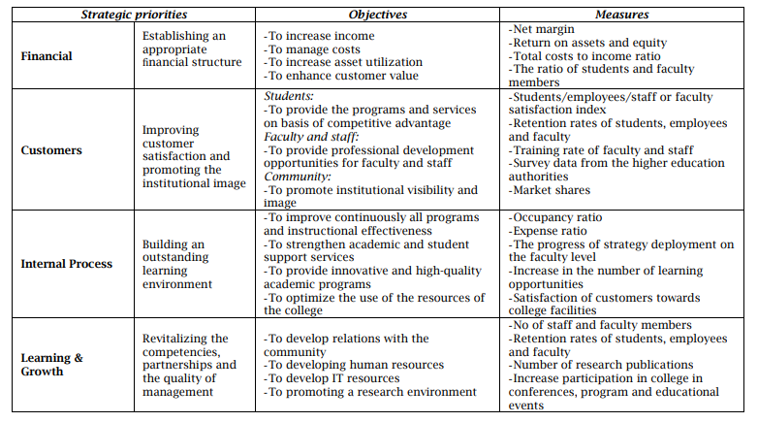
Appendix
Emirates College of Business (ECB) Balanced Scorecard Example (Lassoued, 2018).

