Slide 1
Education in a Globalized World: Let’s Start a Conversation
In our interconnected world, education plays a role in shaping competent and responsible global citizens.
Let’s start with what we mean by globalization, citizenship and education – how do you define these terms?
Let’s explore the current landscape of education……what are your views on the state of global education today?
"Education is the most powerful weapon which you can use to change the world.“
Nelson Mandela

Slide 2
Education in a Globalized World: Nurturing Global Citizens - Definitions
Globalization is essentially concerned with the increasing interdependence of people around the world. (Sant et al., 2018)
Citizenship is a matter of one’s formal legal and political status and a sense of belonging. It also entails the right and responsibility to make rights claims regarding those issues that impact one’s well-being. (Sant et al., 2018)
Education is the means by which we learn. (Sant et al., 2018)
International schools number over 11,000 schools and 500,000 teachers (Poole and Bunnell, 2020).

Slide 3
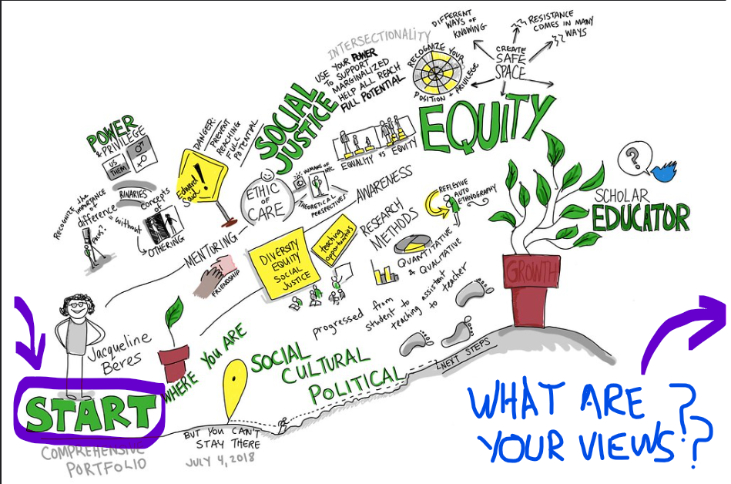
Global Citizenship and Education: The Current Landscape – you start here………..
Beres and Forsythe, 2018)
But you cannot stay here…

Slide 4
The Future Landscape – you can go here………..
Let’s explore the potential future of global education through actions educators can take.
Convergence: around global educational policies, practices, and values sharing common standards and elements.
Global Competencies: Educators emphasize skills such as critical thinking, cultural awareness, and empathy to prepare students to thrive in a globalized workforce.
Accessibility to Quality Education for all, both locally and globally, for economic advancement, social justice, equality, personal growth, and peace.
Sustainable Development Goals (SDGs) and the key role
education plays a role in achieving the SDGs.
Digital Learning evolution, blending online resources and personalized learning experiences.
Nexus of Global Education and Citizenship Education as a nurturer of informed, equipped, empowered and engaged global students

Slide 5
Global Citizenship and Education: Inspiring Conversations and Action
IMPACT | YOUR ACTIONS
Political impact
Sustainability impact
Economic impact
Cultural impact
Technological impact
Diversity aspects
Access aspects
One’s destination is never a place, but a new way of seeing things.” ― Henry Miller.

Slide 6
References
Forsythe, G., Beres, J., (2018).
Comprehensive Portfolio #viznotes
Retrieved from https://www.flickr.com/photos/gforsythe/42487409674/in/photostream/
Poole, A., Bunnell, T., (2021). Developing the notion of teaching in 'International Schools' as precarious: towards a more nuanced approach based upon 'transition capital’. Globalisation, Societies and Education19(3)2021-05-27287 – 297 Retrieved from course resources.
Sant, E., Davies, I., Pashby, K. & Shultz, L. (2018) Global citizenship education: A critical introduction to key concepts and debates. Bloomsbury Academic.

