Slide 1
Risk Management - Supply Chain and Operations Perspective
Chapter 7: Risk Monitoring
Unless otherwise noted, this work is licensed under a Creative Commons Attribution-NonCommercial-ShareAlike 4.0 International (CC BY-NC-SA 4.0) license. Feel free to use, modify, reuse or redistribute any portion of this presentation.

Slide 2
7.0 Learning Objectives
In this chapter, we will:
Identify and explain three key responsibilities of the board in risk management, including setting the risk appetite, overseeing risk policies, and fostering a risk-aware culture.
Describe the primary functions of a Board Risk Committee and outline the processes for monitoring key and emerging risks within an organization.
Evaluate the role of a Chief Risk Officer by listing at least five key responsibilities, such as leading risk management efforts and overseeing technology and cybersecurity risks.
Assess the contribution of internal audit to risk management by explaining how it provides independent assurance on the effectiveness of risk processes and controls.
Analyze the COSO Internal Control Framework by detailing its five components and explaining their relevance to risk management.
Discuss the role of internal audit in risk monitoring by identifying at least three ways it supports risk management activities, such as providing independent assurance and evaluating control activities.
Create an effective risk report by outlining the key components, including risk identification, assessment, and the use of visual elements like dashboards and heat maps.

Slide 3
7.1 Role of the Board in Risk Management
Oversight and Governance
Regularly review the risk profile and management strategies. Challenge management’s risk assumptions and ensure integration with strategic planning. Allocate resources effectively for risk management.
Policy Development
Set guidelines for risk identification, assessment, and mitigation. Define risk appetite and tolerance levels; adapt policies to changes. Regularly update policies to reflect new risks and best practices.
Risk Culture
Lead by example in prioritizing risk management. Encourage open communication about risks and integrate risk considerations into evaluations and incentives. Promote risk management training and education.

Slide 4
7.1 Risk Management Oversight and Reporting
Monitoring and Reporting
Committee Involvement
Strategic Risk Management
Cyber Risks
Accountability and Transparency
Implement systematic risk assessment and review effectiveness of strategies. Identify and monitor Key Risk Indicators (KRIs) aligned with strategic objectives. Establish a clear reporting structure and ensure comprehensive risk reporting.
Audit and Risk Committees should review risk areas, internal controls, and audit plans. Coordinate among committees with clear charters and regular updates to the full board.
Discuss strategic risks in board meetings and challenge management’s assumptions. Engage in scenario planning and stress testing; ensure alignment with strategic planning.
Oversee cybersecurity posture, investments, and incident response plans. Stay informed about cyber threats and regulatory requirements.
Define risk management responsibilities and include them in performance evaluations. Promote transparency in risk disclosures and communication with stakeholders.

Slide 5
7.2 Board Risk Committee
The Board Risk Committee is a specialized group within the board of directors focused on overseeing an organization’s risk management practices.
Composition: Typically 3-5 members with risk management expertise, enhancing risk oversight capabilities.
Responsibilities: Oversees the enterprise risk management framework, approves risk policies, monitors key and emerging risks, and ensures adequate reporting to the full board.
Meetings: Regularly meets (often quarterly) and holds additional sessions as needed, including private meetings with key executives like the Chief Risk Officer.
Scope: Covers a wide range of risks, including strategic, financial, operational, and emerging threats like cybersecurity.
Value: Facilitates in-depth risk discussions, demonstrates strong risk governance, and supports the full board’s ultimate responsibility for risk oversight.
Operations: Functions under a clear charter, regularly reviews its effectiveness, and engages in ongoing risk management education.

Slide 6
7.3 Role of Chief Risk Officer
The Chief Risk Officer (CRO) is a senior executive responsible for overseeing an organization’s enterprise-wide risk management.
Leadership: Leads enterprise-wide risk management efforts and integrates risk considerations into strategic planning.
Policy Development: Develops and implements risk policies and procedures, ensuring compliance with laws and regulations.
Culture: Fosters a risk-aware culture throughout the organization.
Reporting: Provides regular risk assessments to the board and executive management.
Crisis Management: Manages crises and mitigates their impact, including overseeing technology and cybersecurity risks.
Collaboration: Collaborates with other executives for comprehensive risk management and stays informed about emerging risks and best practices.

Slide 7
7.4 Role of Internal Audit
Independent Assurance: Provides objective assurance on the effectiveness of risk management processes.
Evaluation: Assesses the design and implementation of the risk management framework and identifies emerging risks and control issues.
Recommendations: Offers recommendations for improving risk management and control processes.
Risk Awareness: Promotes risk management principles and educates staff to foster a risk-aware culture.
Coordination: Coordinates with other risk and control functions to ensure comprehensive coverage and avoid duplication.
Reporting: Regularly reports to the Audit Committee and board on significant risk exposures and control issues and offers advisory services to management.

Slide 8
7.5 Internal Controls from a Risk Management Perspective
Internal controls are processes and measures an organization implements to provide reasonable assurance regarding achieving operations, reporting, and compliance objectives.
From a Risk management perspective, these are processes and measures implemented by an organization to:
Provide reasonable assurance that the organization’s objectives will be achieved
Mitigate risks to acceptable levels
Ensure effectiveness and efficiency of operations
Promote reliability of financial reporting
Ensure compliance with applicable laws and regulations

Slide 9
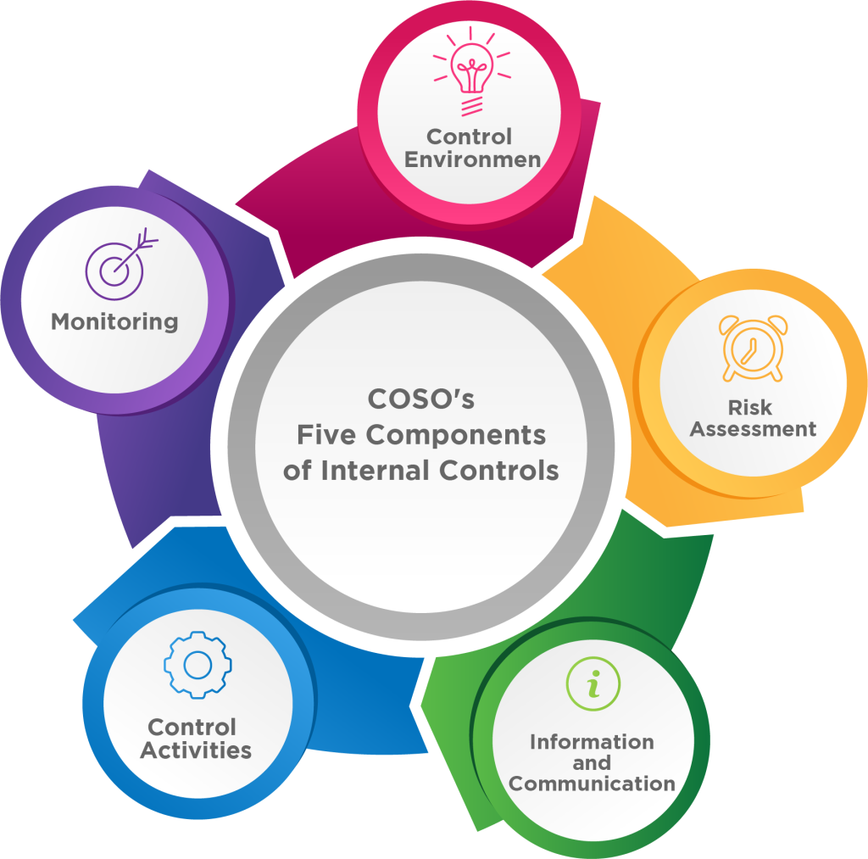
7.5 COSOS’s Internal Control Framework
Control Environment
Influences control through ethics, values, and structure.
Provides the basis for all internal control components.
Risk Assessment
Assesses risks and management strategies.
Includes internal and external risks and potential fraud.
Control Activities
Implements policies and procedures across the organization.
Includes approvals, reconciliations, and technology controls.
Information and Communication
Captures and communicates necessary information.
Ensures clarity of roles and internal relations.
Monitoring
Assesses quality through ongoing and separate evaluations.
Communicates issues and corrective actions to management and the board.
Figure 7.5.1: “COSO’s five components of Internal Control” by Sanaz Habibi, CC BY-NC-SA 4.0

Slide 10
7.6 Role of Internal Audit in Risk Monitoring
Internal audit is an activity that evaluates a company’s internal controls, including corporate governance and accounting processes, as well as risk monitoring.
Independent Assurance: Provides objective evaluation of risk management and internal controls.
Risk Assessment: Identifies and analyzes risks affecting organizational objectives.
Evaluation of Control Activities: Reviews and ensures effectiveness of control measures.
Monitoring of Risk Management Processes: Assesses the ongoing quality of risk management processes.
Reporting on Risk Issues: Delivers periodic updates on significant risks and control issues.
Recommendations for Improvement: Suggests enhancements to risk management and controls.
Advisory Role: Offers expert advice on risk-related matters.
Promoting Risk Awareness: Fosters a risk-aware culture throughout the organization.
Compliance Assurance: Assesses adherence to laws, regulations, and policies.
Continuous Monitoring Support: Helps implement and assess continuous monitoring processes.

Slide 11
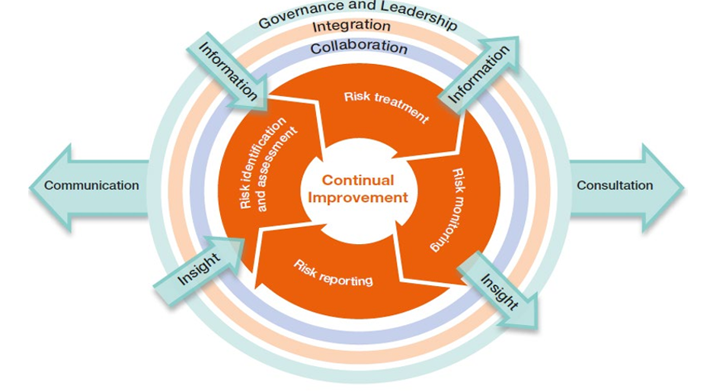
7.7 Risk Reporting
Purpose and Content: Communicates significant risks, their impacts, and mitigation status to senior management and the board.
Format and Frequency: Uses visual aids and narrative reports, typically every quarter, with additional reports for significant changes.
Internal Audit Role: Provides independent assurance and insights, enhancing the credibility and effectiveness of risk reporting.
Figure 7.7.1: Risk Reporting as a key component of Risk Management. Orange Book: Management of risk – Principles and Concepts, UK Government, Open Government License.

Slide 12
7.8 Chapter Summary
Chapter 7 emphasizes the critical role of risk monitoring within an organization and the board of directors’ responsibilities.
The board sets the risk appetite, oversees the implementation of risk policies, and fosters a risk-aware culture.
Regular reviews of risk profiles, challenging management’s risk assumptions, and integrating risk management into strategic planning are key board activities.
Clear guidelines for risk identification and mitigation, open communication, and training programs are essential for a robust risk culture.
Continuous risk assessment and using Key Risk Indicators (KRIs) to monitor significant risks are crucial.
The roles of specialized committees, such as the Board Risk Committee, Chief Risk Officer (CRO), and Internal Audit, and the COSO Internal Control Framework’s five components ensure effective internal controls and compliance with risk management processes.

