Slide 1
Risk Management - Supply Chain and Operations Perspective
Chapter 5: Risk Analysis
Unless otherwise noted, this work is licensed under a Creative Commons Attribution-NonCommercial-ShareAlike 4.0 International (CC BY-NC-SA 4.0) license. Feel free to use, modify, reuse or redistribute any portion of this presentation.

Slide 2
5.0 Learning Objectives
In this chapter, we will:
Describe the importance of risk assessment
Summarize the most common risk analysis techniques
Identify quantitative and qualitative risk analysis techniques
List traditional risk analysis techniques
Explain root cause analysis

Slide 3
5.1 What is Risk Assessment
Risk Assessment:
Process of identifying, analyzing, and evaluating risks. Systematic, iterative, and collaborative approach using stakeholders' knowledge. Based on the most recent information and supported by further research.
Risk Identification:
Finding, recognizing, and describing potential risks that affect project objectives. Utilizes a wide range of techniques to identify risks impacting one or more objectives.
Risk Analysis:
Comprehensive examination of risks based on characteristics. Considers sources, consequences, likelihood, triggers, contingencies, and controls. Key focus on risk exposure, likelihood, and consequence levels.
Risk Evaluation:
Supports decision-making by comparing risk analysis results to predefined criteria. Leads to decisions to transfer, avoid, treat/mitigate, approve, or reject risks.
Importance of Risk Assessment:
Foundation of a strong Enterprise Risk Management (ERM) program. Identifies threats, supports decisions, and enables a proactive approach. Essential for regulatory compliance and achieving organizational goals.

Slide 4
5.1 Risk Assessment Approaches
Top-Down Approach:
Starts with senior management.
Focuses on high-level, enterprise-wide risks (strategic, financial, operational, reputational).
Aligns risk management with strategic direction and priorities.
Provides a comprehensive view of significant risks.
Bottom-Up Approach:
Involves operational or functional levels (projects, processes, departments).
Relies on input from employees closest to day-to-day operations.
Focuses on project, process, compliance, and health and safety risks.
Captures risks not visible at higher levels.
Combining Approaches:
Provides strategic and granular views.
Encourages collaboration and information sharing.
Enhances ability to achieve strategic objectives and mitigate risks.

Slide 5
5.2 Risk Analysis
Objective of Risk Analysis:
Equip decision-makers with information to prioritize and manage identified risks.
Risk Analysis:
Evaluates likelihood and impact (consequence) of risks.
Prioritizes risks based on the formula: Risk = Likelihood × Consequence.
Uses qualitative and quantitative methods to assess risk levels.
Quantitative Risk Analysis:
Uses mathematical models and simulations.
Assigns numerical values to risks with statistical methods.
Qualitative Risk Analysis:
Relies on subjective judgment and theoretical models.
Evaluate risks based on predicted likelihood and impact.

Slide 6
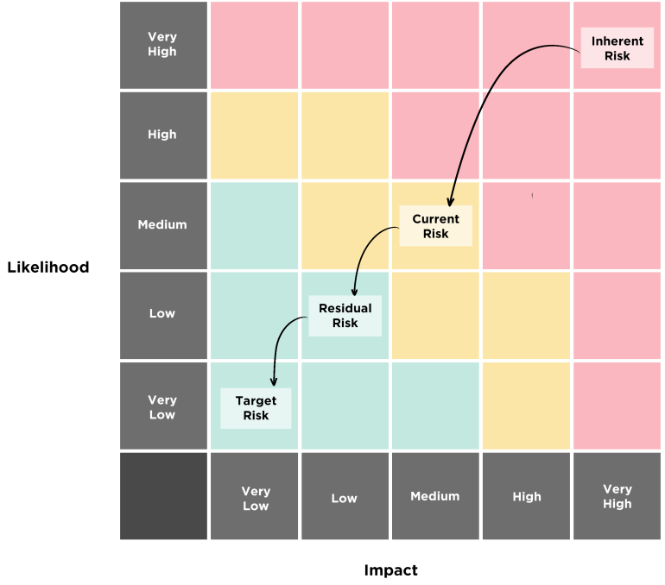
5.2 Level of Risks and Assessing Controls
Level of Risks and Assessing Controls: Risks are evaluated using a Risk Matrix, considering inherent risk, current/residual risk, and target risk to manage them effectively.
Inherent Risk: Represents the level of risk before any controls or mitigating actions are implemented.
Current/Residual Risk: The level of risk that remains after existing controls and mitigation measures are considered.
Target Risk: The desired or acceptable level of risk that aligns with the organization’s risk appetite and tolerance levels.
Figure 5.2.1: “Risk Matrix” by Sanaz Habibi, CC BY-NC-SA 4.0

Slide 7
5.3 Risk Analysis Techniques - Net Present Value (NPV)
Present Value
Is the current worth of a sum of money that will be received or paid in the future.
Net Present Value
Is the difference between the present value of all future cash inflows including the salvage value of assets and the present value of cash outflows over a period.
An investment should not be made when the Net Present Value (NPV) is negative. In contrast, a positive NPV would be indicative of an investment that should be made.

Slide 8
5.3 Risk Analysis Techniques - Probability Analysis
Involves quantifying uncertainties associated with various events or scenarios.
Regression Analysis
Is a statistical technique employed in risk assessment to identify relationships between variables and ultimately predict the potential severity of loss events.
There are two main ways to do this: the empirical approach and the theoretical approach.
The Empirical Approach uses real-world data and past experiences.
The Theoretical approach uses math and models to calculate probabilities.
Probability Analysis
Benefits include quantifying multiple risk factors' influence, identifying significant risk drivers, and developing predictive models.

Slide 9
5.3 Risk Analysis Techniques
Loss Exposures
Refer to situations or circumstances that may lead to financial losses for an individual, organization, or entity
Approaches for Jointly Analyzing Loss Frequency and Severity
The Prouty Approach is a qualitative technique used in risk assessment to determine how to treat different risks based on their potential frequency (likelihood) and severity (impact) of loss.
When analyzing loss exposures, risk management professionals consider four key dimensions: loss frequency, loss severity, total dollar losses, and timing

Slide 10
5.3 Events Consequences Analysis
Provides a graphical framework for depicting a decision-maker’s available choices (actions), potential outcomes (events), and interdependencies between these.
Explores the potential consequences of a single initiating event, branching out to depict various sequences of successes and failures that can culminate in different accident scenarios.
Decision Tree Analysis
Event Tree Analysis
Involves listing alternatives, identifying outcomes, determining payoffs, selecting a decision theory model, and applying it to make decisions.
Advantages include comprehensive coverage, probabilistic assessment, and identification of critical pathways.

Slide 11
5.3 Business Impact & Strategic Analysis
A deductive approach to system reliability, decomposing an undesired event into its constituent causes.
Involves identifying potential threats, analyzing risks, performing business impact analysis, developing mitigation strategies, and creating a comprehensive plan.
Fault Tree Analysis – FTA
Business Continuity Planning
SWOT Analysis
Categorizes risks into Strengths, Weaknesses, Opportunities, and Threats, helping develop tailored risk management strategies.
Helps identify combinations of failures leading to undesired outcomes and guides system reliability improvements.
Steps include identifying risks, categorizing them, analyzing interactions, developing strategies, and monitoring and reviewing.

Slide 12
5.3 Cause and Effect Analysis
Also known as the Fishbone Diagram or Ishikawa Diagram, is a structured technique used to identify potential causes of a problem or risk event.
Is a structured problem-solving technique used to identify the root causes of potential risks or undesirable events.
Fishbone Diagram
It involves repeatedly asking the question “Why?” to peel back layers of symptoms and uncover the underlying root causes.
It provides a systematic way to explore and visualize the root causes contributing to a specific effect or undesirable outcome.
A critical component of the Fishbone Diagram is the 5-Whys Analysis

Slide 13
5.3 Future State Analysis
Is a technique used to evaluate and quantify the potential impacts of uncertainties and risks on desired outcomes or objectives.
Is a technique used to quantify the potential impact of uncertainty on a project or decision.
Scenario Analysis
Monte-Carlo Analysis
It simulates various possible scenarios by considering the randomness or variability of different factors.
It involves creating and analyzing multiple plausible scenarios or future states of the world, each defined by a unique set of assumptions, trends, and events.

Slide 14
5.3 Human Reliability Analysis
Human Reliability and Error Analysis
Key steps include:
Analyzes human reliability in complex systems to identify potential errors and their impacts.
Evaluating necessary information
Identifying pre- and post-task states
Understanding information transmission
Classifying tasks adequately
Recognizing interconnections among staff and actions
Screening critical actions

Slide 15
5.3 Failure Modes and Effects Analysis
Failure Modes and Effects Analysis (FMEA) is a foundational technique for quantifying potential risks associated with a system’s design.
FMEA Procedure
Construct a detailed flow chart of the process.
Determine how each step could possibly fail.
Determine the “effects” of each possible failure.
Assign a Severity Rating for each effect.
Assign an Occurrence Rating for each failure.
Calculate and prioritize a Risk Priority Number (RPN) for each failure.
Review the process and conduct a root cause analysis.
Take action to eliminate or reduce the Risk Priority Number.
Recalculate the resulting RPN as the failure modes are reduced or eliminated.

Slide 16
5.4 Chapter Summary
Chapter 5 highlights the systematic process of identifying, analyzing, and evaluating risks in risk analysis.
Emphasizes the importance of risk assessment as the cornerstone of Enterprise Risk Management (ERM).
Discusses how risk assessment involves identifying threats, prioritizing them, and making informed decisions to mitigate risks, aiding in regulatory compliance and asset protection.
Explores two primary approaches for risk assessment: top-down (strategic risks) and bottom-up (operational risks), advocating for a combined approach for comprehensive risk understanding.
Covers various risk analysis techniques: quantitative methods (mathematical models, statistical methods) and qualitative methods (subjective judgment), along with tools like the Risk Matrix.
Discusses advanced techniques such as NPV, probability analysis, regression analysis, scenario analysis, human reliability and error analysis, and FMEA for thorough risk identification and mitigation.

