Slide 1
Risk Management - Supply Chain and Operations Perspective
Chapter 4: Identifying Risks
Unless otherwise noted, this work is licensed under a Creative Commons Attribution-NonCommercial-ShareAlike 4.0 International (CC BY-NC-SA 4.0) license. Feel free to use, modify, reuse or redistribute any portion of this presentation.

Slide 2
4.0 Learning Objectives
In this chapter, we will:
Identify and describe the types of risks that can positively and negatively affect an organization.
Describe the features of established risk identification strategies that can be used by organizations.
Create a Risk Register and connect it to a Risk Map.

Slide 3
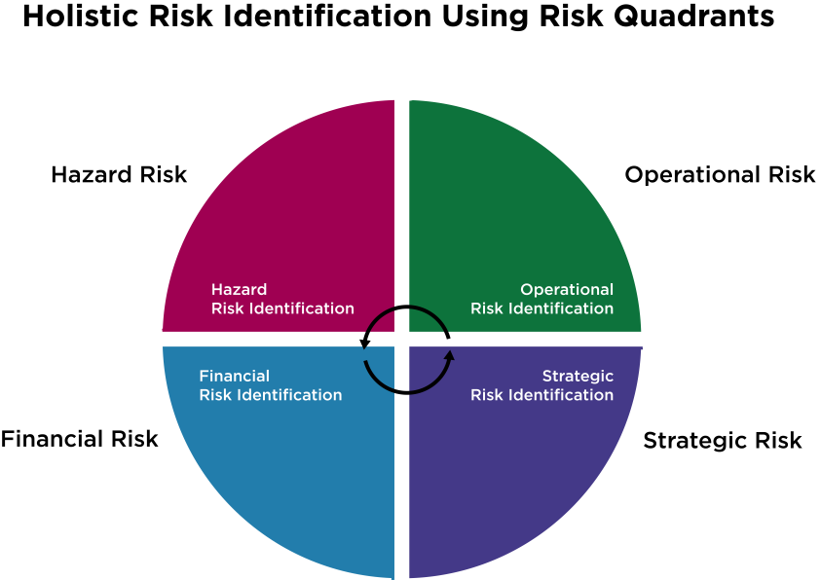
4.1 Risk Identification
Risk Identification Process: The second step in risk management involves finding, recognizing, and describing potential risks that could impact an organization’s objectives.
Internal and External Risks: Risks can originate within or outside the organization.
Traditional Silo Approach: Organizations often isolate risks within departments, lacking inter-departmental communication.
Enterprise Risk Management (ERM): Enables holistic management of all key risks and opportunities across the organization.
Holistic Risk Identification: A broad, integrated approach to managing risks, recognizing how different risks influence each other.
Example of Interconnected Risks: A fire at a distribution center (hazard risk) can disrupt IT systems, affecting overall operations (operational risk) and highlighting the importance of communication.
Figure 4.1.1: “Holistic Risk Identification Using Risk Quadrants” by Sanaz Habibi, CC BY-NC-SA 4.0. Click to enlarge

Slide 4
4.1 Types of Risks
When an organization conducts a risk assessment, it should identify all its risks before analyzing and responding to them using risk treatment techniques. The types of risks that should be identified are:
Known risks
risks that the organization knows about or that have previously affected the organization.
Emerging risks
risks that are not known to the organization.
Inherent risks
risks that have not been managed or treated.
Residual risks
the risk that remains after the risk has been managed or treated.

Slide 5
4.1 Approaches to Risk Identification
Top-Down Approach:
Bottom-Up Approach:
Senior management makes decisions on risks. Advantage: High-level access to all relevant risk information. Disadvantage: May lack detailed understanding of all organizational activities and depend on accurate internal information.
Personnel throughout the organization provide risk information. Advantage: Rich, detailed information from various levels of the organization. Disadvantage: Limited access to all relevant information and challenges in compiling a comprehensive risk perspective.
Best Practice: Combining both top-down and bottom-up approaches for a more comprehensive risk identification.

Slide 6
4.2 Risk Identification Approaches
There are many approaches and strategies that an organization can use to identify the potential adverse effects and opportunities that its risks present. When identifying risks, the best approach is an integrated approach, which is consistent with holistic risk management. A holistic approach to risk identification would involve individuals from senior management, middle management, risk management and personnel from all departments and sectors of the organization. In other words, it is a team approach to risk identification.
The following risk identification strategies should be performed by teams or groups that are familiar with the organization.

Slide 7
4.2 Risk Identification Strategies
Brainstorming:
An informal discussion where all suggestions are considered.
Risks are identified through the knowledge and experience of attendees.
Identified risks are analyzed and evaluated after the session.
Workshops:
Formal setting for risk identification through collaboration.
Includes internal and external stakeholders.
Facilitated by someone experienced in risk management to guide discussion and manage time.
SWOT:
Identifies risks by analyzing Strengths, Weaknesses, Opportunities, and Threats.
Commonly used during workshops or brainstorming sessions for decision-making.
Documents:
Risks are identified by examining relevant documents.
Includes surveys, compliance reviews, insurance policies, financial statements, contracts, and projects.

Slide 8
4.2 Risk Identification Strategies (cont.)
Root Cause Analysis:
Identifies risks by understanding the factors that caused past adverse events.
Focuses on implementing controls or strategies to prevent recurrence.
Physical Risk Inspections:
Involves skilled risk inspectors visiting sites to identify physical hazards.
Inspectors consult with front-line employees and managers to gather additional information.
Experts:
Risks are identified using the opinions of subject experts.
The Delphi technique involves anonymous responses from a panel of experts, with iterative rounds of questioning and feedback.

Slide 9
4.2 Risk Register
Overview:
Tool for identifying and managing risks across scenarios, processes, sectors, and locations.
Assesses and prioritizes risks by categorizing them into hazard, operational, financial, and strategic risks.
Components of a Risk Register:
Risk Event/Description: Lists risks under each category; typically focuses on negative outcomes.
Risk Owner: Entity responsible for decision-making and reporting on the risk.
Likelihood: Rated from 1 (unlikely) to 5 (likely), indicating the frequency of the event.
Impact: Rated from 1 (minimal) to 5 (significant), indicating the severity or consequences of the event.
Score: Calculated by multiplying likelihood and impact scores to quantify risk level.
Improvement Action: Actions or plans in place or proposed to address and improve risk.
Due Date/By When: Dates for implementing risk plans or noting when actions were taken.

Slide 10
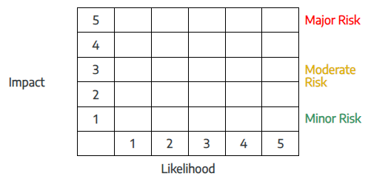
4.2 Risk Map
Risk Map:
Graphically represents risks from the risk register on a heat map.
Plots likelihood (x-axis) against impact/consequences (y-axis).
Scoring and Visualization:
Risks are scored by adding likelihood and impact scores.
Heat map color-coded into green (tolerated risks), yellow (moderate risks), and red (high-risk areas).
Risk Placement:
Risks with high scores (e.g., likelihood 5, impact 5) are in the red sector, indicating unacceptable risk levels.
Risks with low scores (e.g., likelihood 1, impact 1) are in the green sector, typically acceptable without further action.
Risk Management:
High-risk areas should be addressed by reducing the likelihood or impact.
Variation of the risk map can show inherent risks (red sector) and residual risks (yellow sector) after responses.
Further actions may be needed to reduce residual risks to the green sector, aligning with the organization's risk appetite.
Table 4.2.2: Basic Risk Map

Slide 11
4.3 Chapter Summary
Risk Identification Process: Identifying potential risks that could impact an organization positively or negatively is critical, following environmental scanning.
Holistic Approach: Enterprise Risk Management (ERM) integrates hazard, operational, financial, and strategic risks, managing them across the organization.
Types of Risks: Includes known, emerging, inherent, and residual risks.
Risk Identification Approaches: Top-down and bottom-up approaches, each with unique advantages and disadvantages.
Identification Strategies: Utilize brainstorming, workshops, SWOT analysis, document reviews, root cause analysis, physical inspections, and expert opinions.
Tools for Risk Management: Risk register and risk map to organize, visualize, assess, prioritize, and respond to risks based on their likelihood and impact.

