Slide 1
Risk Management - Supply Chain and Operations Perspective
Chapter 2: Risk Classification and Categories
Unless otherwise noted, this work is licensed under a Creative Commons Attribution-NonCommercial-ShareAlike 4.0 International (CC BY-NC-SA 4.0) license. Feel free to use, modify, reuse or redistribute any portion of this presentation.

Slide 2
2.0 Learning Objectives
In this chapter, we will:
Explain the different types of risk, including pure and speculative risk, subjective and objective risk, and diversifiable and non-diversifiable risk.
Identify the characteristics of the four main types of risk from the risk quadrants: hazard, operations, strategic, and financial risks.
Discuss the upside (potential gain) and downside (potential loss) associated with each type of risk.
Measure hazard risks using frequency and severity and implement strategies to prevent and reduce losses.
Assess financial risks like market and credit risks and strategic risks influenced by economic, demographic, and political factors using appropriate risk indicators.

Slide 3
2.1 Risk Classification and Its Significance
Understanding and Managing Risks: Classifying risks helps organizations better understand their nature, potential impact, and likelihood, enabling effective resource allocation and targeted risk management strategies.
Alignment with Objectives and Goals: Risk classification ensures that risk mitigation efforts are aligned with specific organizational objectives, such as financial, operational, and strategic goals.
Efficient Risk Assessment: Grouping similar risks into classifications allows for consistent evaluation and prioritization, making risk assessment more efficient.
Tailored Risk Management Techniques: Different risk types require distinct management approaches; classification enables the application of appropriate techniques for each category, such as technical solutions for technical risks and financial hedging for financial risks.
Streamlined Administrative Processes: Risk classification ensures that risks within the same category receive consistent attention, reducing the likelihood of overlooking critical risks and making reporting and monitoring more efficient.
Foundation for Effective Risk Management: Overall, risk classification enhances understanding, aligns with goals, facilitates assessment, enables targeted mitigation, and ensures administrative efficiency, contributing to successful project execution and organizational resilience.

Slide 4
2.2 Risk Classification
Risk can be classified in several ways, but the following classification has been used for clarity (Elliott, 2018):
Speculative and pure risk
Objective and subjective risk
Diversifiable and non-diversifiable risk
Quadrants of risk (Strategic, Financial, Operational, and Hazard)
Figure 2.2.1. “Classification of Risk” by Sanaz Habibi, CC BY-NC-SA 4.0.

Slide 5
2.2 Risk Classifications Breakdown
Speculative and Pure Risk
Subjective and Objective Risk
Diversifiable and Non-Diversifiable Risk
Pure Risk: Involves unavoidable risks with outcomes of either complete loss or no loss, with no potential for gain, such as natural disasters, death, theft, and liability risks, which can be mitigated through insurance.
Objective Risk: Quantifiable and measurable, based on concrete data and facts, independent of personal opinions or biases.
Diversifiable Risk: Firm-specific risks that impact individual stock prices, such as business risk, financial risk, and management risk, which can be mitigated through diversification.
Speculative Risk: Involves risks with uncertain outcomes that can result in either gains or losses, such as investing in stocks, real estate, starting a new business, and sports betting, often influenced by conscious choices.
Subjective Risk: Influenced by personal beliefs, perceptions, and experiences, making it individualized and variable from person to person.
Non-Diversifiable Risk: Systemic risks that affect an entire class of assets or liabilities, such as market risk, interest rate risk, and economic factors, which cannot be eliminated through diversification.

Slide 6
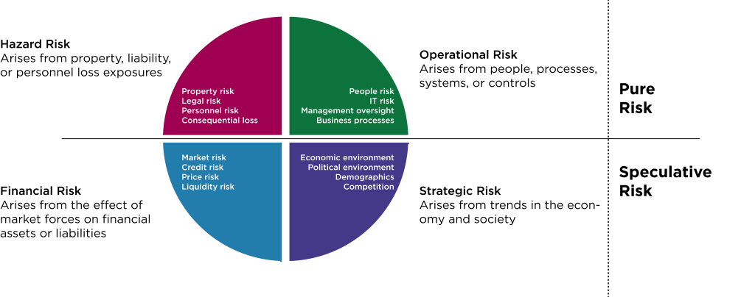
2.2 Risk Quadrants
Risks have been categorized differently in different regions and organizations. However, in North America, risks are normally placed into the following four quadrants (IRM’s Risk Management Standard, 2002).
Figure 2.2.2: “Risk Quadrants” by Sanaz Habibi, CC BY-NC-SA 4.0.

Slide 7
2.3 Hazard Risks
Definition and Impact: Hazard risks are unpredictable events arising from natural disasters, accidents, or other external factors that can significantly disrupt supply chains. These risks are generally insurable.
Examples: Hazard risks include theft/crime, fire or property damage, business interruptions, disease, personal injuries, disability, and liability.
Measurement: Hazard risks are measured by frequency (how often an event occurs) and severity (the seriousness of potential harm).
Management Techniques: Strategies include avoidance, separation, duplication, diversification, and prevention/reduction. Each technique focuses on either preventing losses or reducing their frequency and severity.
Insurance: Transferring the financial impact of risks with high severity and low frequency to an insurer, such as auto insurance for vehicle and property damage.
Categories of Hazard Risk:
Personnel Risk: Related to employee-related losses such as death, injury, health issues, and disability.
Property Risk: Involves loss or damage to property, affecting productivity (e.g., earthquake damage to a manufacturing facility).
Liability Risk: Financial responsibility for causing injury or loss, such as a faulty product harming a consumer.

Slide 8
2.3 Loss Exposure
Loss Exposure is the potential for loss faced by an individual or organization due to the frequency or severity of an event.
Circumstances:
Asset Exposed to Loss: Tangible (e.g., cash, property) and intangible assets (e.g., patents, copyrights).
Cause of Loss: Events like fire, thunderstorms, explosions, and accidents.
Financial Consequences: Direct loss (e.g., damaged property) and indirect loss (e.g., business interruption).
Types of Loss Exposures:
Property: Financial loss due to damage, theft, or loss of use of property (tangible and intangible).
Liability: Legal and financial responsibility for injury or damage to another party.
Personnel: Risks associated with employee injury, disability, death, or departure.
Net Income: Financial loss from increased expenses or decreased revenue due to events like loss of major customers, supply chain disruptions, or natural disasters.

Slide 9
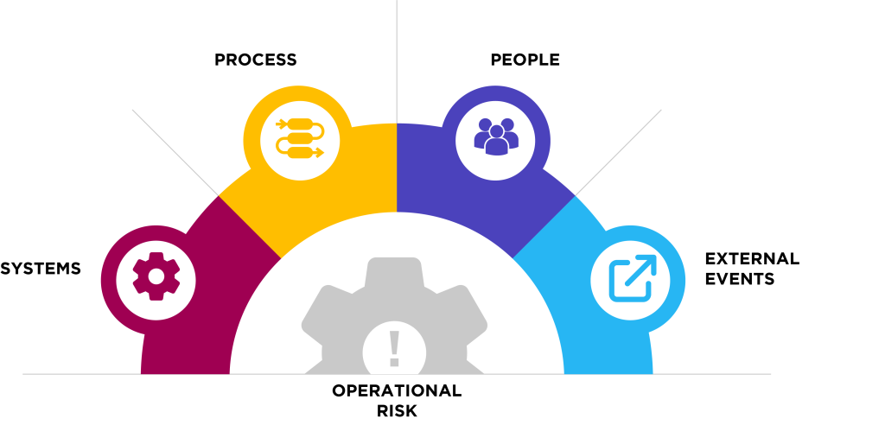
2.4 Operational Risks
People: Risk of financial loss or negative consequences from human error, misconduct, or lack of skills (e.g., employee fraud, negligence, turnover, skills gaps).
Process: Risk of loss from poorly designed or implemented business processes (e.g., data entry errors, order fulfillment issues, product development errors).
Systems: Risk of loss from failures or weaknesses in IT systems and infrastructure (e.g., hardware/software failures, cyberattacks, power outages).
External Events: Risk of loss from uncontrollable events (e.g., natural disasters, political unrest, economic downturns).
Figure 2.4.1: “Categories of Operational Risk” by Sanaz Habibi, CC BY-NC-SA 4.0

Slide 10
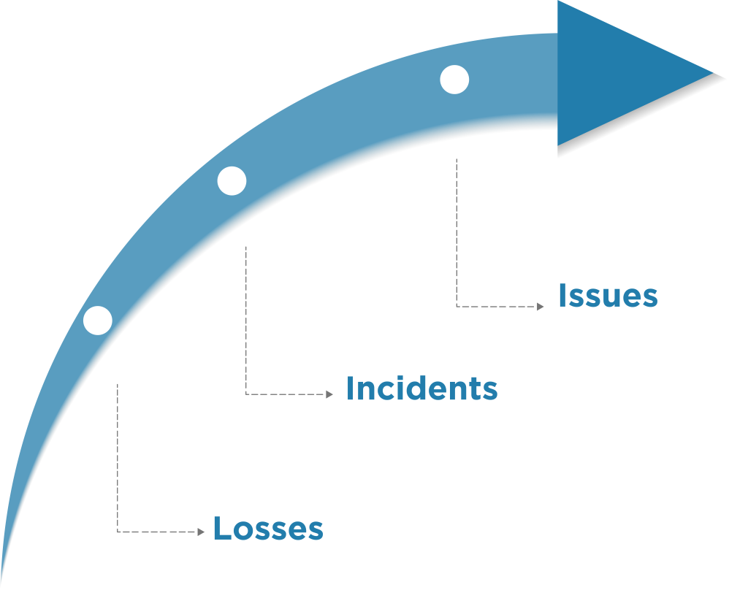
2.4 Operations Risk Indicators
Operational risk indicators (Key Risk Indicators) are the metrics used to measure and define the potential loss.
Examples:
Customer complaints: Indicates dissatisfaction levels.
Incomplete/inaccurate transactions: Measures internal process quality.
Employee turnover rates: Reflects workforce stability.
System downtime incidents: Highlights technology risks.
Compliance violations: Indicates regulatory adherence.
KRIs help organizations take preemptive action to prevent issues from becoming incidents, thereby avoiding potential losses.
Figure 2.4.2: “Progression of Issues to Losses” by Sanaz Habibi, CC BY-NC-SA 4.0

Slide 11
2.5 Financial Risks
Financial risks relate to changes in exchange rates, market risks, liquidity risks, or difficulties accessing capital. These risks can impact a company’s ability to procure raw materials or pay suppliers on time.
There are three major types of financial risks:
Market Risk: Uncertainty about the future value of an investment due to overall market changes.
Credit Risk: Risk of loss for lenders when borrowers fail to meet repayment obligations.
Price Risk: Changes in revenue or costs due to price fluctuations of consumed products.
Categories:
Currency price risk
Interest rate risk
Commodity price risk
Equity price risk
Liquidity risk
Types:
Firm-specific: Risk tied to a particular borrower.
Systemic: Broad market events like the 2008 financial crisis.
Example:
Currency devaluation increases the costs of imported raw materials, impacting financial stability.

Slide 12
2.6 Strategic Risks
Strategic risks are from events like a recession, a financial crisis, or a pandemic like COVID-19 can threaten or provide opportunities to organizations.
Economic Environment
Under this strategic risk, several Key Risk Indicators may help to identify the risk and take action: Gross Domestic Product (GDP), inflation, financial crisis, and international trade flows and restrictions.
Demographics
This refers to the characteristics of human populations. For example, the aging population and their expenses on health care, immigration, and younger populations in any specific area.
Political Environment
An action by one government to stop imports protecting local manufacturing or increase or decrease tariffs due to the political environment.

Slide 13
2.7 Chapter Summary
Emphasizes the importance of categorizing risks for better management and alignment with organizational objectives.
Classifies risks into pure and speculative risks, subjective and objective risks, and diversifiable and non-diversifiable risks.
Highlights the four main risk quadrants: hazard, operational, strategic, and financial risks.
Explains pure risks involve only the possibility of loss, while speculative risks involve potential gains or losses.
Differentiates subjective risks, influenced by personal beliefs and perceptions, from objective risks, based on measurable data.
Stresses the need for tailored risk management approaches to enhance organizational resilience and efficiency, including avoidance, separation, duplication, diversification, and insurance.

