Slide 1
Risk Management – Supply Chain and Operations Perspective
Chapter 10: Risk Management from a Sustainability Perspective
Unless otherwise noted, this work is licensed under a Creative Commons Attribution-NonCommercial-ShareAlike 4.0 International (CC BY-NC-SA 4.0) license. Feel free to use, modify, reuse or redistribute any portion of this presentation.

Slide 2
10.0 Learning Objectives
In this chapter, we will:
Analyze the paradigm shift from traditional risk management to sustainable risk management, highlighting the key differences and implications for organizations in the 21st century.
Evaluate the interconnectivity between sustainability challenges and organizational risks, providing examples of how sustainability issues can impact various aspects of an organization’s operations.
Identify and classify the different types of ESG risks, explaining their potential impacts on an organization’s value, operations, and long-term viability.
Apply various sustainability risk management frameworks, such as the UN SDGs, TCFD recommendations, and GRI Standards, to develop strategies for assessing and mitigating ESG-related risks.
Assess how integrating sustainability into risk management can create opportunities for competitive advantage, innovation, improved decision-making, and enhanced stakeholder trust and reputation.

Slide 3
10.1 Introduction
Integrating sustainability into risk management is essential for organizations in today's global landscape.
This approach represents a paradigm shift, offering a comprehensive method to address 21st-century challenges.
It involves identifying, assessing, and responding to threats and opportunities related to environmental, social, and governance (ESG) factors.
Traditional risk management is insufficient for interconnected challenges like climate change and resource scarcity.
Incorporating sustainability allows organizations to anticipate challenges and identify innovation opportunities.
Requires a shift from short-term, quantifiable risks to long-term, qualitative considerations.
Demands new tools, metrics, and ways of thinking about risk and value creation.

Slide 4
10.2 Sustainability and Risk
Sustainability issues and organizational risks are deeply interconnected in today’s business environment.
This interconnectivity manifests in several key ways:
Sustainability challenges can pose significant risks to organizations
Organizational decisions and risk management practices can influence sustainability outcomes
Sustainability risks often have ripple effects across an organization's operations and the broader economy
Climate change can impact supply chains, asset values, and market demand simultaneously
These risks arise from complex ESG systems, affecting multiple organizational aspects at once
Sustainability risks typically unfold over longer timeframes than traditional business risks

Slide 5
10.2 How to Effectively Manage Interconnected Risks
Adopt a holistic approach to risk assessment and mitigation
Integrate ESG factors into traditional risk management frameworks
Develop new metrics and tools for measuring sustainability-related risks
Enhance transparency around sustainability risks and opportunities
Align business strategies with sustainability goals

Slide 6
10.3 Types of Sustainability Risks: Environmental, Social, and Governance (ESG)
Sustainability risks are environmental, social, or governance events or conditions that, if they occur, could cause a negative material impact on an organization’s value, operations, and long-term viability. It’s important to note that these risk categories are often interconnected.
Environmental Risks
Stem from an organization’s impact on and dependence on the natural environment. Key environmental risks include climate change, natural resources, waste management & pollution, and environmental opportunities (COSO, 2018)
Social Risks
Relate to an organization’s impact on and relationship with society, including its workforce, customers, and communities. Key social risks include human rights, labour standards problems, social inequality, and community relations (COSO, 2018)
Governance Risks
How an organization is managed, overseen, and held accountable. Key governance risks include corporate governance, regulatory compliance, business ethics, executive compensation/board pay (COSO, 2018)

Slide 7
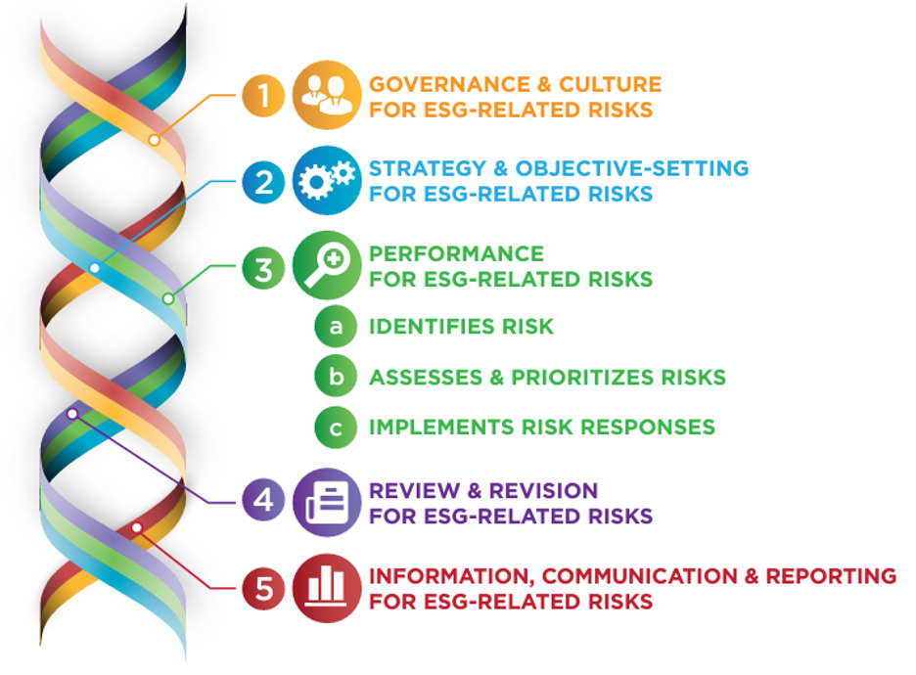
10.3 Managing ESG Risks
Effective management of ESG risks requires:
Integration of ESG factors into overall risk management frameworks
Development of new metrics and tools to measure and monitor sustainability-related risks
Enhanced disclosure and transparency around sustainability risks and opportunities
Alignment of business strategies with sustainability goals
Figure 10.3.1: “COSO ERM – ESG Integration” in Enterprise Risk Management: enterprise risk management to environmental, social and governance-related risks, © 2018 Committee of Sponsoring Organizations of the Treadway Commission (COSO) and World Business Council for Sustainable Development (WBCSD). All rights reserved. Used with permission. (See Acceptable Use of COSO Materials [PDF] for permission details).

Slide 8
10.3 How Sustainability Risks Can Impact
Sustainability risks are environmental, social, and governance (ESG) factors that can significantly impact an organization’s operations, financial performance, and long-term viability. The following are some of the most critical sustainability risks facing businesses today:
Climate Change and Extreme Weather Events
Resource Scarcity and Biodiversity Loss
Social Inequality and Human Rights Issues
Regulatory Changes and Compliance Challenges
Technological Disruptions and Transitions

Slide 9
10.4 Frameworks for Sustainable Risk Management
In response to growing demands for transparency and accountability on environmental, social, and governance (ESG) issues, many voluntary frameworks have emerged.
These frameworks provide companies with standardized structures to report on their ESG performance, catering to the information needs of external stakeholders.
Voluntary ESG reporting frameworks offer several advantages for businesses:
Standardization
Transparency
Improved Management
Enhanced Credibility

Slide 10
10.4 UN Sustainable Development Goals (SDGs) as a Risk Management Tool
The 17 SDGs, adopted by all UN Member States in 2015, provide a shared blueprint for peace and prosperity.
SDGs can serve as a risk management tool, helping identify sustainability risks and opportunities.
They offer a common language for communicating sustainability efforts to stakeholders.
Aligning business strategies with SDGs can help mitigate risks related to resource scarcity, climate change, and social inequality.

Slide 11
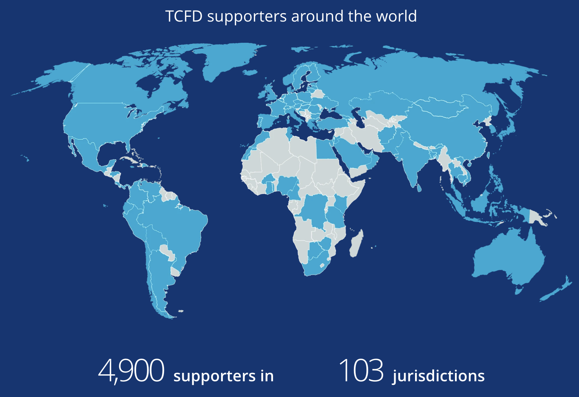
10.4 Task Force on Climate-Related Financial Disclosures (TCFD) Recommendations
TCFD, established by the Financial Stability Board, provides recommendations for climate-related disclosures.
The framework focuses on governance, strategy, risk management, and metrics related to climate risks.
It encourages scenario analysis to assess climate-related risks and opportunities on business strategy.
Figure 10.4.1: “TCFD supporters around the world” by TCFD. Used under Fair Dealing for Educational Purposes (Canada).

Slide 12
10.4 Global Reporting Initiative (GRI) Standards
GRI is an independent organization providing a global common language for sustainability impact communication.
GRI Standards are widely adopted for sustainability reporting on economic, environmental, and social impacts.
They help identify material sustainability topics, promoting transparency and accountability.

Slide 13
10.4 Risk Assessment Techniques for ESG-Related Risks
A good risk assessment isn’t just about listing potential problems. It’s about understanding how those problems could impact a company’s ability to achieve its goals.
Organizations achieve this by identifying the consequences and choosing the right tools (COSO, 2018).
These steps help guide discussions about which risks are most important to address. This prioritization considers two key factors:
Severity: How badly could this risk hurt the company’s ability to achieve its goals?
Risk Appetite: How much risk is the company comfortable taking on?

Slide 14
10.4 Assessment Approaches
Beyond this core set, additional tools can support a data-driven approach:
Competitor Analysis
Stakeholder Assessments
Peer Benchmarking
Data-Driven Approaches with Technology
There are several approaches to measuring ESG risk severity, both qualitative and quantitative.
Expert Input
Forecasting and Valuation Techniques
Scenario Analysis
ESG-Specific Tools

Slide 15
10.4 Strategies for Responding to Sustainability Risks
The COSO ERM Framework provides a structure for selecting appropriate responses to identified ESG risks. These responses fall into five main categories:
Accept
Avoid
Pursue
Reduce
Share

Slide 16
10.5 Opportunities in Sustainable Risk Management
Enhanced Stakeholder Trust and Reputation
Competitive Advantage and Innovation
Improved Decision-Making and Performance
Access to Capital and Investment Opportunities
Regulatory Compliance
Collaboration and Partnerships

Slide 17
10.6 Chapter Summary
Stresses the importance of integrating sustainability into risk management to tackle challenges like climate change, resource scarcity, and societal expectations.
Introduces Environmental, Social, and Governance (ESG) risk management as a holistic approach to addressing interconnected sustainability risks.
Highlights the limitations of traditional risk management in dealing with complex, long-term sustainability challenges.
Advocates for a comprehensive approach that includes new tools, metrics, and frameworks to assess and mitigate sustainability risks.
Details various sustainability risks—environmental, social, and governance—and their potential cascading effects on organizations and the economy.
Emphasizes the integration of ESG factors into traditional risk management frameworks to enhance transparency and align with sustainability goals.
Discusses key frameworks for assessing and responding to ESG risks, including the UN SDGs, TCFD recommendations, and GRI Standards.
Encourages adopting these frameworks and proactive strategies to mitigate threats, build stakeholder trust, and gain a competitive edge in a dynamic global environment.

