Slide 1
Risk Management - Supply Chain and Operations Perspective
Chapter 1: Introduction to Risk Management
Unless otherwise noted, this work is licensed under a Creative Commons Attribution-NonCommercial-ShareAlike 4.0 International (CC BY-NC-SA 4.0) license. Feel free to use, modify, reuse or redistribute any portion of this presentation.

Slide 2
1.0 Learning Objectives
In this chapter, we will:
Define traditional and modern risk as they apply to the study of Risk Management.
Outline the progression of Risk Management from Traditional to Enterprise Risk Management.
Describe the benefits provided by Risk Management for an organization and the economy.
Explain the importance of Basic Risk Measures on organizations.

Slide 3
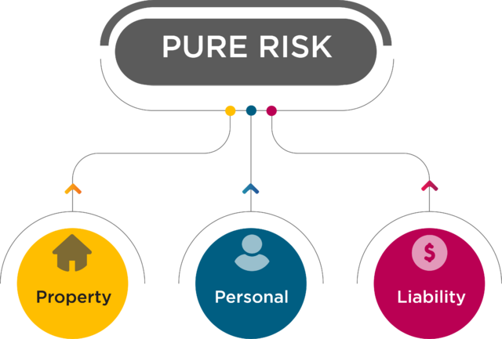
1.1 What is Risk?
Risk is often perceived negatively, such as being late for work, but can also involve positive aspects.
Risk is the chance of loss, with insurance focusing on insurable risks like property, liability, and personnel.
ISO 31000 defines risk as “the effect of uncertainty on objectives,” encompassing both positive and negative outcomes.
Risk can have upsides (benefits) and downsides (disadvantages), such as international students experiencing both the benefits and challenges of studying abroad.
Figure 1.1.1. “Pure Risk” by Sanaz Habibi, CC BY-NC-SA 4.0
Types of insurable risks include:
Property Risk: Losses from damage or destruction of property.
Liability Risk: Losses from legal obligations due to negligence.
Personnel Risk: Losses from bodily injury, death, or disability.

Slide 4
1.2 The Practice of Risk Management
Risk management is the process of assessing, treating and monitoring all of an organization’s risks in order to minimize their adverse effects on the organization.
Risk management has evolved from traditional risk management, which focused solely on hazard risks and was prevalent post-WWII, to enterprise risk management (ERM), which was introduced in the 1990s.
Traditional Risk Management, associated with hazard risks (pure risks covered by insurance), concentrated on accidental losses with no potential gains.
ERM emerged to address all organizational risks, including hazard, operational, financial, and strategic risks, recognizing their interrelated nature.
Unlike Traditional Risk Management, which aims to restore pre-loss conditions, ERM aims to maximize organizational potential and manage all risks comprehensively.
ERM balances both upside and downside risks and is applicable across various types of organizations, while Traditional Risk Management focuses on minimizing the downside of insurable risks.

Slide 5
1.2 Roles in Risk Management
Larger organizations will very likely have dedicated risk management departments consisting of risk officers, risk managers, loss control specialists, legal teams, and an insurance team.
Risk officer:
An individual with direct authority over the risk management team and reports to senior management.
Risk manager:
An individual who oversees the risk management process in the organization to protect its assets.
Loss control specialist:
An expert who inspects risks within an organization and recommends ways to reduce their frequency or severity.
Legal team:
An individual who performs legal functions as lawyers, legal experts, or legal specialists in the organization.
Insurance team:
An individual with an insurance background who has the expertise to negotiate insurance contracts and manage claim settlements.
In a smaller organization, the responsibilities for risk management are often placed on top of the daily activities of individuals associated with operating the business.

Slide 6
1.3 Benefits of Risk Management: Organizations
Managing Cost of Risk:
Covers total costs of accidental losses, including prevention, reduction, and administration.
Reducing Uncertainty:
Risk management reduces uncertainty, enhancing profitability and attractiveness to investors.
Informed Risk Taking:
Balances opportunity risks against potential rewards according to the organization’s risk appetite.
Profitability:
Helps evaluate risks and returns while aligning with organizational objectives and risk appetite.
Integrated Risk Management:
Provides a holistic view of risks and their interdependencies, improving decision-making.
Regulatory Compliance:
Ensures adherence to laws and reporting requirements, supporting audit and compliance processes.

Slide 7
1.3 Benefits of Risk Management: The Economy
Minimizing Systemic Risks:
The inability to implement effective risk management by an organization can result in a failure not only for the organization but for the economy itself, as described in the opening paragraph of this section.
Retaining Resources:
An accidental loss such as a natural disaster or a fire could adversely affect quantities of available resources and, subsequently, an organization’s ability to manufacture products. Allocating resources to risk management is a cost that could minimize the effects on or loss of productive resources.
Reducing Economic Resources:
The implementation of effective risk management will relieve the burden of uncertainty placed on an organization and the effects of its failures on the economy caused by the downside of risk. This will allow the organization to freely pursue activities intended to maximize profits, wages and return on investments.

Slide 8
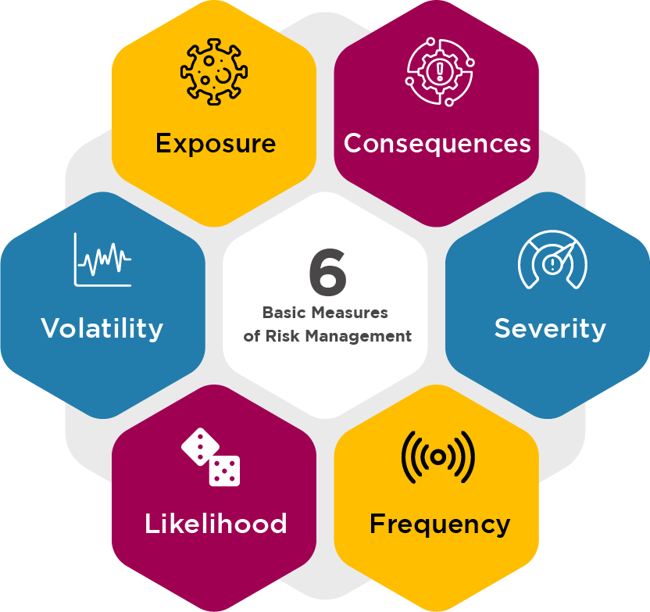
1.4 Basic Risk Measures
Risk Assessment: Involves identifying and analyzing risks to measure and improve them.
Risk Measurement Techniques: Includes benchmarking against industry averages and scoring based on criteria.Basic
Risk Measures: Includes exposure, volatility, likelihood, frequency, and severity.
Figure 1.4.1: “Six Basic Measures of Risk Management” by Sanaz Habib, CC BY-NC-SA 4.0

Slide 9
1.4 Key Metrics for Assessing Risk
Exposure
Volatility
Likelihood
Refers to the level of risk an organization faces, quantifiable by potential damage and calculated as probability of loss times the total amount of loss.
Measures the frequency of fluctuations in asset prices, with increased volatility leading to higher risk.
Assesses the probability of an event occurring, crucial for risk management and loss prevention.
Consequences
Frequency and Severity Relationship
Time Horizon and Correlation
Describes the impact or severity of an event, addressed by measures to reduce or mitigate losses.
Risk responses vary based on the frequency and severity of losses, affecting how hazard risks are managed.
Longer time horizons and correlated risks increase overall risk, as seen in cases like supply chains dependent on geopolitical factors.

Slide 10
1.5 Chapter Summary
Concept of Risk: Risk includes both potential negative and positive outcomes, not just chances of loss.
Traditional vs. Modern Risk Management: Traditional focus on negative, insurable hazards; modern definitions like ISO 31000 view risk as affecting objectives with both upsides and downsides.
Enterprise Risk Management (ERM): Emerged in the 1990s, covering all risk types (hazard, operational, financial, strategic) and viewing them as interconnected.
Benefits of ERM: Enhances decision-making, reduces costs and deterrents from hazard risks, manages downsides, and optimizes performance.
Compliance and Efficiency: Ensures adherence to legal requirements, reduces resource wastage, and improves resource allocation.
Fundamental Risk Measures: Exposure, volatility, likelihood, and consequences are essential for identifying and analyzing risks effectively.

