Slide 1
Organizational Business Communication
Chapter 8: Business Reports and Revising Your Work
Unless otherwise noted, this work is licensed under a Creative Commons Attribution-NonCommercial-ShareAlike 4.0 International (CC BY-NC-SA 4.0) license. Feel free to use, modify, reuse or redistribute any portion of this presentation.

Slide 2
Learning Outcomes
In this chapter, we will:
Examine how audience analysis impacts reports.
Recognize different types of reports.
Differentiate features of formal reports.
Demonstrate strategies for revising your work.
Recognize what remixing is and examine how you can use it to produce new insights.

Slide 3
Questions For Reflection
Have you ever written a report in the workplace? (Incident report, progress report, etc.?) How did you compose the report? Did you encounter any challenges? If so, what were they?
Have you ever written a report as part of a course? What was the purpose of the report? How did you write it? Did you encounter any challenges? If so, what were they?
Select one or more concepts that we’ve studied so far this semester. How do you think it will be useful when writing reports?
How do you think a report differs from an essay?
Have you ever applied skills you've learned in one class to another class? What new insights did you come up with?

Slide 4
Audience Analysis in Reports
As with any type of writing, when writing reports, it is necessary to know your audience.
Here are some questions to consider about your audience as you write:
What does your audience expect to learn from your report?
Do you have only one audience or multiple audiences? Do they have different levels of knowledge about the topic?
How much research does your audience expect you to have done?
How current does your research need to be?
What types of sources does your audience expect you to have?
What is the educational level of your audience?
How much background information does your audience need?
What technical terms will your audience need defined? What terms will they already be familiar with?
Is there a template or style guide that you should use for your report?
What is the cultural background of your audience?

Slide 5
Types of Reports
Progress report
Is used to give management an update on the status of a project.
It is generated at timed intervals or on completion of key stages.
Recommendation report
Is used to help management make decisions.
The goal is to identify a solution to a problem or suggest a course of action.
Summary Report
Is used to give management information.
It focuses on the facts, leaving it to management to decide on a course of action.
It records accomplishments to date and identifies any challenges or concerns.
It is usually written by the project lead and is one to two pages long.
The intention of a recommendation report is not to assign blame or be overly critical, but to suggest improvements in a positive manner.

Slide 6
Organizing Reports
Reports are typically organized around six key elements:
Who the report is about and/or prepared for
What was done, what problems were addressed, and the results, including conclusions and/or recommendations
Where the subject studied occurred
When the subject studied occurred
Why the report was written (function), including under what authority, for what reason, or by whose request
How the subject operated, functioned, or was used
While there is no universal format for a report, there is a common order to the information: title page; table of contents; executive summary; introduction; body; conclusion and/or recommendations; References; Appendix or appendices.

Slide 7
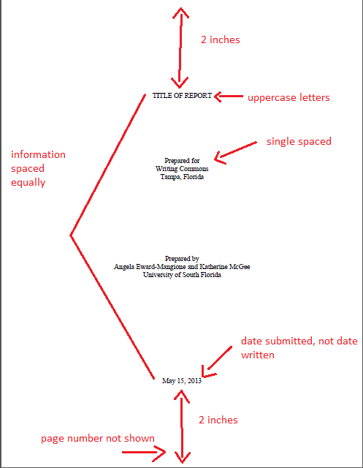
Writing Formal Reports – Title Page
The title page provides the audience with the:
Name of the report.
Name, title, and organization of the individual receiving the report.
Name of the author and any necessary identifying information.
Date of submission.
The items on the title page should be equally spaced apart from each other
Figure 11.1 Report Title Page Components

Slide 8
Writing Formal Reports – Letter of Transmittal
A letter of transmittal announces the report topic to the recipient(s).
If applicable, the first paragraph should identify who authorized the report and why the report is significant.
Provide the purpose of the report in the first paragraph as well.
The next paragraph should briefly identify, categorize, and describe the primary and secondary research of the report.
Use the concluding paragraph to offer to discuss the report; it is also customary to conclude by thanking the reader for their time and consideration.
The letter of transmittal should be formatted as a business letter. Some report writers prefer to send a memo of transmittal instead.

Slide 9
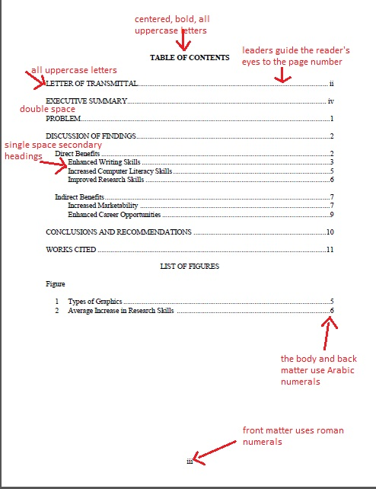
Writing Formal Reports – Table of Contents
The table of contents page features the headings and secondary headings of the report and their page numbers, enabling audience members to quickly locate specific parts of the report.
Leaders are used to guide the reader’s eye from the headings to their page numbers.
The words “TABLE OF CONTENTS” should appear at the top of the page in all uppercase and bolded letters.
Type the titles of major report parts in all uppercase letters as well, double spacing between them.
Secondary headings should be indented and single spaced, using a combination of upper- and lowercase letters.
Figure 11.2 Table of Contents and List of Figures components

Slide 10
Writing Formal Reports – Executive Summary
An executive summary presents an overview of the report that can be used as a time-saving device by recipients who do not have time to read the entire report.
The executive summary should include a:
Summary of purpose
Overview of key findings
Identification of conclusions
Overview of recommendations
Type “EXECUTIVE SUMMARY” in all uppercase letters and centered.
Follow with paragraphs that include the above information, but do not use first-level headings to separate each item.
Each paragraph of information should be single-spaced with double spacing between paragraphs. Everything except for the title should be left-aligned.
An executive summary is usually ten percent of the length of the report.
The executive summary should be written last.

Slide 11
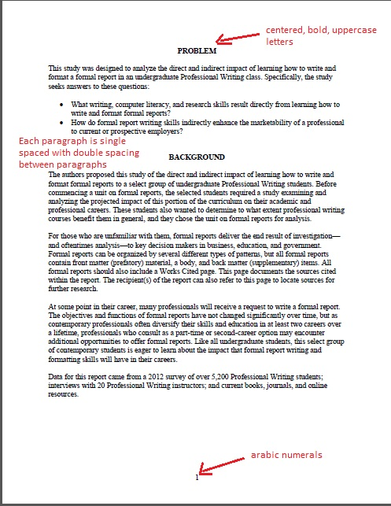
Writing Formal Reports – Introduction
The introduction sets the stage for the report, clarifies what need(s) motivated it, and helps the reader understand what structure the report will follow.
Most report introductions address the following elements: background information, problem or purpose, significance, scope, methods, organization, and sources.
To begin this section, type “BACKGROUND” or “INTRODUCTION” in all uppercase letters.
You do not need to utilize any first-level headings in this section.
Figure 11.3 Introduction Page

Slide 12
Writing Formal Reports – Discussion of Findings
This section presents the evidence for your conclusions.
This key section should be carefully organized to enhance readability.
Useful organizational patterns for report findings include but are not limited to:
Best Case/Worst Case
Compare/Contrast
Chronology
Geography
Importance
Journalism Pattern
Follow the first paragraph with a first-level heading.
Use first-level headings for all other major parts of this section.
First-level headings should appear in bold, uppercase letters.
Center first-level headings, but align any second-level headings with the left margin.
Type any second-level headings in bold, upper- and lowercase letters.

Slide 13
Writing Formal Reports – Integrating Graphics
Formal report authors use graphics to present data in different forms.
Paragraphs of text and complex or numerical data tend to bog readers down, making graphics a beneficial enhancement.
Graphics also make data easier to understand, so they sometimes make a stronger impact on the audience.
Keep the audience in mind.

Slide 14
Writing Formal Reports – Conclusions and Recommendations; Works Cited
Conclusions and Recommendations
This section conveys the key results from the analysis in the discussion of findings section.
Type “CONCLUSIONS AND RECOMMENDATIONS” in all uppercase letters.
Follow this functional head with the conclusions of the report.
The conclusions should answer any research questions that were posed earlier in the report.
Present the conclusions in an enumerated or bulleted list to enhance readability.
Works Cited
All formal reports should include a works cited page.
It is acceptable to follow MLA (Modern Language Association), CMS (Chicago Manual of Style), or APA (American Psychological Association) documentation style for entries on this page.
Arrange all sources alphabetically.

Slide 15
Revising, Editing, Proofreading
Think of revision as one more way to meet the audience’s needs.
To revise a piece of writing, it may help you to consider three approaches: look at the big picture, check your organization, and proofread your final draft.
Revising for higher order concerns means working on the organization of your ideas.
A way to edit for higher order concerns is to prepare a reverse outline using your draft.
Another technique is to imagine that you’re having a conversation with a friend.
Lower order concerns focus on editing and proofreading.
Strategies for editing and proofreading your work:
Take a break between writing and editing
Read your work aloud.
Work through your document slowly, moving word by word.
Start at the end of your document and work towards the beginning.
Don’t rely exclusively on spelling- or grammar-checking software.
Review through your document several times.

Slide 16
What is Remixing?
In the workplace, you will often remix the writing of your coworkers. (This is sometimes called “patchwriting.”)
In the workplace, remixing saves time and helps use the talents of many different people.
Remixing can also teach us a lot about how the creative process works. Chances are strong that you already practice the basics of remixing when you learn a new skill.
Experimenting with remixing can help you in many ways in the workplace. Many people’s careers have been launched by the skills they learned while remixing for fun.
Recently, many marketing and communications professionals have learned that embracing remixing can be a great way to promote their brand.

Slide 17
Key Takeaways
Reports have a wide variety of purposes and styles. The three major types are progress reports, recommendation reports and summary reports.
Formal reports usually have an executive summary, an introduction, a body (which might be separated into background, methods, results, and analysis), a conclusions/recommendations section, references, and an appendix.
The amount of revision you'll do will depend on the importance of the document.
Many students see revision as just checking spelling and grammar, but revision is about re-thinking the piece. The first draft is for you, so that you can get your thought down, and the second is for your audience. When you revise, think about your audience.

Slide 18
Key Takeaways II
When you revise, start with higher-order concerns. Don't be afraid to reorganize or even cut pieces and start over.
After you've revised the big picture pieces, focus on editing (looking for punctuation, spelling and grammar mistakes), and then proofreading (taking one last look at your almost-finished document to make sure all the changes were made).
Remixing involves taking a source and turning it into something new. In the workplace, you'll often remix the work of your coworkers.

