Slide 1
Organizational Business Communication
Chapter 7: The Research Process and Proper Source Citation
Unless otherwise noted, this work is licensed under a Creative Commons Attribution-NonCommercial-ShareAlike 4.0 International (CC BY-NC-SA 4.0) license. Feel free to use, modify, reuse or redistribute any portion of this presentation.

Slide 2
Learning Outcomes
By the end of this chapter you will:
Critique the role that sources play in persuasion.
Construct a research focus and question.
Differentiate the types of sources you can use and determine where to find them.
Design effective survey and interview questions.
Evaluate sources for trustworthiness.
Differentiate workplace and academic citation.
Define academic integrity.
Identify strategies for citing, including in-text citation and references.

Slide 3
Questions For Reflection
What is your definition of "academic integrity"?
Do you find it easier to create an argument in writing or in person? Why?
Think about the last time that you did research. What kind of research did you do? Were you able to find all the sources you needed? If not, what kind of sources did you struggle to find?
How do you determine what sources to trust online?
Why do you think the rules that we have around source use exist? Why do we cite sources?

Slide 4
What is Academic Integrity?
Citation is an area where the stakes are high during your university career.
You must take full responsibility for your work, acknowledge your own efforts, and acknowledge the contributions of others’ efforts.
Working/ writing with integrity requires accurately representing what you contributed as well as acknowledging how others have influenced your work.
Plagiarism can be:
Intentional: knowingly using someone else’s work and presenting it as your own
Unintentional: inaccurately or inadequately citing ideas and words from a source
Scholarship involves learning from others while developing one's insights.
To meet academic integrity standards, you must acknowledge the part of your work that develops from others’ efforts.

Slide 5
Why Use Sources
Your research task become easier when you understand why you are using sources.
Sometimes, academic and workplace research is difficult because we know we have to use sources, but we don’t always understand why.
Research can:
Provide a deep look into a narrow topic.
Provide a broad overview of something you’re just learning about.
Show you up-to-date information on a topic that changes quickly.
Save you time by allowing you to build off of someone else’s work.
Offer a perspective you haven’t considered yet.
Test your ideas to see if they’re sound.
Help you solve a problem by showing how someone else solved it.
Bring together different perspectives so you can consider a problem from all sides.
Allow you to analyze the opinions of many different people, so you can find trends.
Show how someone in a different industry, company or location solved a problem.

Slide 6
Karan’s Story
Karan's transition from studying in India to Canada revealed differences in citation expectations and assignment lengths.
He is unfamiliar with source use.
Karan copied text into his assignment, resulting in plagiarism concerns.
Karan's teacher opted to help rather than report him for plagiarism.
Karan learned the importance of distinguishing what words and ideas are his and what words and ideas come from the source.
Karan learned to use quotation marks to show what words came from the source, and to paraphrase by never looking directly at the source.

Slide 7
Asking Research Questions
Whether you’re writing a paper for a university class or doing workplace research, you’ll be more efficient if you begin with a clear research question.
Research questions are essential to the research process.
Research questions aid in making informed decisions, ensuring that the gathered information is based on conscious thought rather than luck.
Research questions are different from most of the questions for which we seek information.
Research questions cannot be answered by a quick web search; they require critical thinking, multiple information sources, and more often than regular questions, start with "How" or "Why.”
Research questions are crucial in workplace research because if answers were readily available, there would be no need to conduct research.

Slide 8
Workplace vs. Academic Citation
In the workplace, you may often find yourself using your colleague’s words without crediting them.
In the workplace, your employer usually owns the writing you produce, so workplace writing often doesn’t cite individual authors.
Citation is not only an ethical practice, but it is also a great persuasive strategy.
In North American schools, students are expected to demonstrate research integration, citing, quoting, and paraphrasing skills. Unless specified, instructors assume students wrote the entire assignment, unless you use quotation marks.
Image by u_zscsfn7pja , Pixabay License

Slide 9
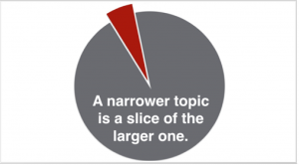
Narrowing Your Focus
Once you have a need for research, you may need to prowl around a bit online to explore the topic and figure out what you actually want to find out and write about.
Use background reading to familiarize yourself with the terminology used by experts in your narrower topic.
In the workplace, your research question may become more focused as you gain industry knowledge.
Stay open to fueling your inspiration through reading, scanning, looking at, and listening to information resources; this is very useful during any step of the process to develop research questions.
Figure 9.1

Slide 10
Types of Sources
Once you have your research question, you’ll need information sources to answer it. Anything that contains information can be considered a source, for example: books, websites, articles, reports, interviews, art, TV/radio programs, and more.
To choose the right sources, consider aspects such as why the source was created, how you'll use it, the intended audience, and its format.
The purpose of the source: Authors typically want to inform and educate, persuade, sell services/products or entertain.
Another way to categorize information is by the role it will play in your argument. Primary sources contain original information, while secondary sources provide analysis or interpretation of primary information. Tertiary sources summarize or index information.
We can also categorize information by the expertise of its intended audience, such as popular, professional, or scholarly.

Slide 11
Fantastic Sources and Where to Find Them
Most scholarly articles are housed in specialized databases. KPU Libraries provide access to several databases available free to people affiliated with the University.
Google Scholar is a free general scholarly database available to all who have access to the Internet.
When Are News Sources Helpful?
You need breaking news or historical perspectives on a topic.
You need to learn more about a culture, place, or time period from its own sources.
You want to keep up with what is going in the world today.
When Are News Sources of Limited Use?
You need very detailed analysis by experts.
You need sources that must be scholarly or modern views on a historical topic.
Depending on your topic, however, you might seek sources such as: Social media posts, Blog posts, Archives.

Slide 12
Conducting Interviews and Surveys
If you conduct scholarly research, such as research that will be published in a peer-reviewed journal, you’ll first have to get approval from a Research Ethics Board.
To conduct research ethically, you should consider the risk you’re placing your participants under. Specifically, you can consider:
How might my research cause harm?
How can I limit this harm?
Interviews give you qualitative data. That’s data that can’t be measured and is often descriptive. Surveys give you quantitative data: data that can be measured.
When you design your questions, you should:
Have a clear purpose.
Research in advance.
Keep it simple.
Word your questions neutrally.

Slide 13
What If You Can't Find Sources For Your Topic?
“Divide and conquer” Instead of searching for the "answer," divide the question into parts.
Research each part independently.
Example:
Research question: How can virtual teams be implemented at Pixar Animation Studios?
You should divide the question into two parts, in order to conquer it:
First research virtual teams (their challenges, best practices, etc.).
Next research Pixar (its mission, corporate culture, etc.)
Database searches might look like this:
“Virtual teams” AND (challenges OR "best practices")
Pixar AND "corporate culture"
By orchestrating an interplay between your two sources, putting them in dialogue with each other and with your own ideas, you can offer an original analysis

Slide 14
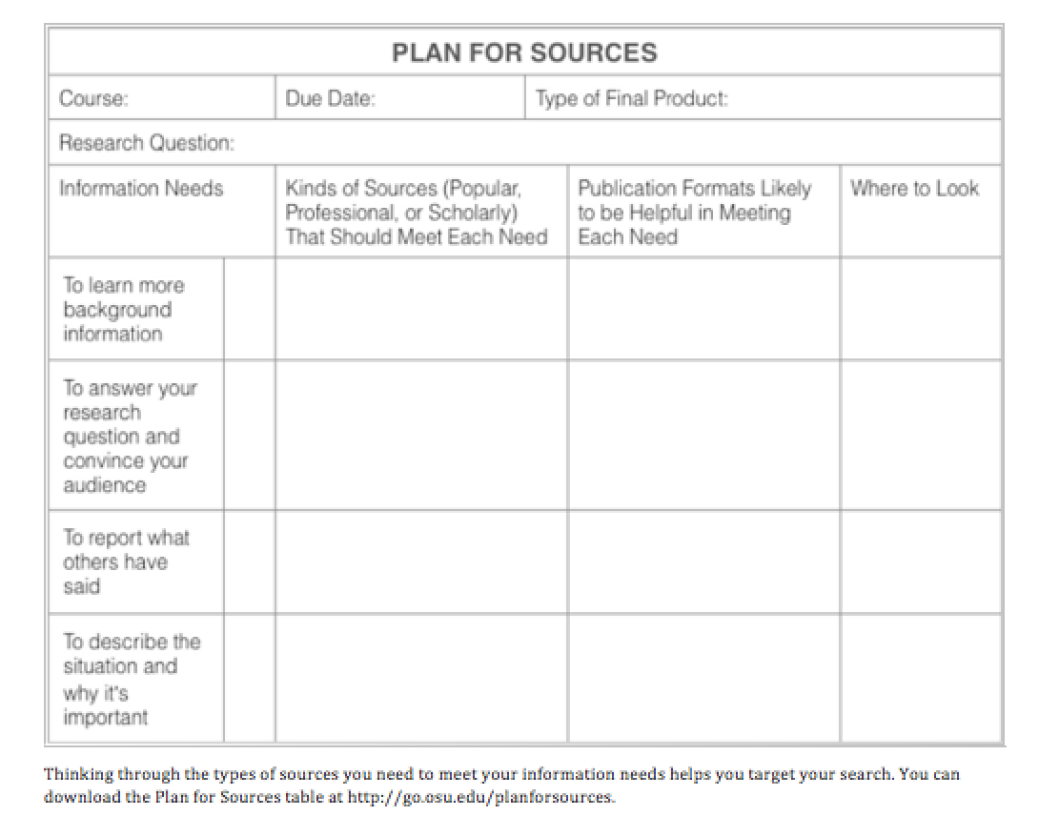
Making a Source Plan
Making a plan first will ensure that you don’t just grab any resource you come across.
This plan for sources allows students to identify their information needs, the kind of sources they’ll need, the publication formats and where to look. This will make a source plan.

Slide 15
Evaluating Sources
Once you’ve located your sources, you have to determine whether or not you can trust them.
The CRAAP Test
There are five parts to the CRAAP Test:
ACCURACY
The SIFT Test
It gives you some practical steps you can take to figure out if you can trust a source.
Stop
CURRENCY
RELEVANCE
AUTHORITY
PURPOSE
Investigate the source
Find trusted coverage
Trace claims, quotes, and media back to the original context
It’s about Recontextualizing

Slide 16
Making an Argument
Making an argument means trying to convince others that you are correct or persuade them to take a particular action.
Components of an argument: The claim, or thesis; The reservations, alternatives, and objections; reasons and evidence.
The order in which the components should appear in your persuasive reports, presentations and other assignments may vary, but a common structure begins with an introduction that explains why the situation is important.
The research question isn't explicit, but the thesis or claim typically appears at the end of the introduction.
The body of your paper follows and consists of:
Your reasons supporting the thesis.
Evidence that reinforces each reason.
Acknowledgment of potential objections, reservations, counterarguments, or alternative solutions.
A response to each objection to demonstrate its incorrectness or insignificance. Sometimes you might need to concede a point if it's not refutable.

Slide 17
Synthesizing Sources
If you're asked to research something in the workplace, it means it's not only about summarizing sources but also about providing your own analysis.
It’s wise to not only analyze the sources, but also to try to combine your own ideas with ideas and experience.
To practice synthesis, you should look for connections and patterns.
One way to synthesize when writing an argument essay, paper, or other project is to look for themes among your sources. (Categorize ideas by topic)
Synthesis gets easier with experience and becomes increasingly important as you advance in your career.

Slide 18
What is Citing?
Citing is basically giving credit. If your source is well-cited, you’ve told the audience whose ideas/words belong to whom and exactly where to go to find those words.
There are many good reasons to cite sources:
To avoid plagiarism & maintain academic integrity.
To acknowledge the work of others.
To provide credibility to your work & to place your work in context.
To help your future researching self & other researchers easily locate sources
Citation is also a time to think about what kind of sources you value and who you cite.
There are challenges that might make knowing when and how to cite difficult for you:
You learned how to write in A different school system.
Not really understanding the material you’re using.
Running out of time.
Shifting cultural expectations of citation.

Slide 19
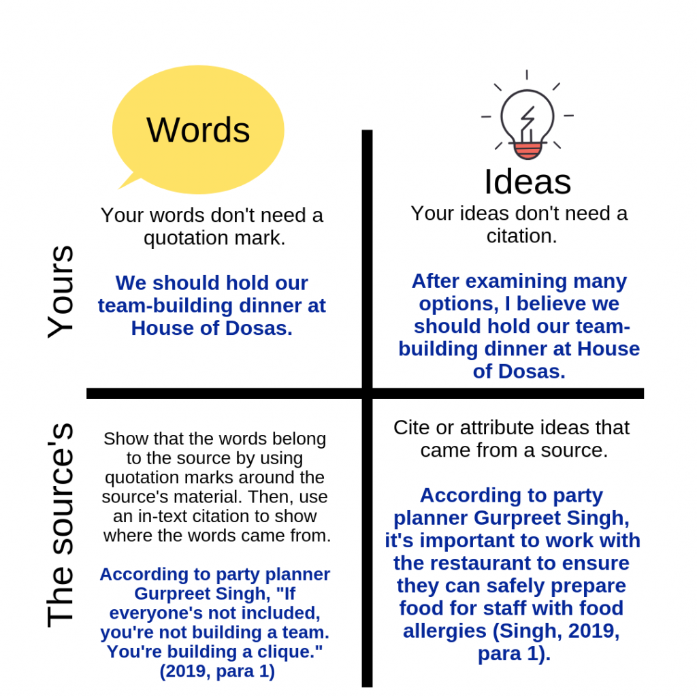
How to Cite Sources
To cite sources, you should make two things clear:
The difference between your words and the source’s words.
The difference between your ideas and the source’s ideas.
When you use the source’s words, put quotation marks around them.
When the source’s ideas are important, you’ll want to paraphrase or summarize.
When you paraphrase, you take a single point within a source and restate it.
When you summarize, you are simply trying to capture the main points of a larger source in a short way.
Figure 10a.2 The distinction between your own words and a sources.

Slide 20
How to Cite Sources - What Information Do I Cite?
Cite when you are directly quoting.
Cite when you are summarizing and paraphrasing.
Cite when you are citing something that is highly debatable.
When Don’t You Cite?
Don’t cite when what you are saying is your own insight.
Don’t cite when you are stating common knowledge.
Examples of information that would not need to be cited include:
Partition in India happened on August 15th, 1947.
Vancouver is the 8th biggest city in Canada.

Slide 21
Creating In-Text Citations and References
An in-text citation tells the reader where the information in a particular sentence came from.
In MLA citation, the in-text citation consists of the author’s last name and the page number (or paragraph number for sources with no page numbers).
If you’ve already used the author’s name in the sentence, you don’t have to repeat it in the in-text citation.
If you’re using APA citation, you add the date that the work was created. As with MLA, you don’t have to repeat the name of the author if you’ve already said it in the sentence.
If you don’t know the name of the author, simply put the first few words of the title.
If you don’t know the date, write “n.d.” for No Date.
If you don’t know the page number, put in the paragraph number.
The purpose of a reference, however, is to give enough information for the reader to find the original source.

Slide 22
Key Takeaways
Having a clear research question will save you time. You may have to do some background research before you find your actual research question.
If you can't find sources on your topic, try the divide and conquer approach.
To determine how useful a source is, you can evaluate it according to the CRAAP test. When evaluating online sources, it's especially important to determine whether the person has the authority to speak on the topic and whether the ideas have been supported with evidence.
When you research, you'll need to build on the ideas of others. Citation is a way to give credit to the people whose ideas influenced you.
When it comes to citation, you have two tools: in-text citation (which go at the end of the sentence where the source was referenced) and references (a longer citation at the end of the work that helps the reader locate the source). In the workplace, you may also use footnotes and links.

Slide 23
Key Takeaways II
If the ideas of the sources are important, you will quote and either paraphrase or summarize the source. This involves changing the language of the source so that it matches your document. Don't simply swap out a few words, but restate the author's point so that it matches the tone of your document. Put an in-text citation at the end of the sentence.
Citation practices can be tricky in the age of the Internet, so you can use citation generators as long as you check to make sure they're correct.
Sources add to the ethos of your argument by providing knowledge and perspectives that you don't have.
An argument usually has a thesis (what you're claiming), evidence, reasoning (how the evidence connects to the claim), acknowledgement (what someone who doesn't agree with you would say) and response (how you'd refute that).
When you summarize sources, you restate their point. When you synthesize, you combine multiple ideas to turn them into something new.

