Slide 1
Organizational Business Communication
Chapter 11: Intercultural Communication
Unless otherwise noted, this work is licensed under a Creative Commons Attribution-NonCommercial-ShareAlike 4.0 International (CC BY-NC-SA 4.0) license. Feel free to use, modify, reuse or redistribute any portion of this presentation.

Slide 2
Learning Outcomes
In this chapter, we will:
Discuss intrapersonal, interpersonal and intercultural communication.
Identify and solve conflict in the workplace.
Interpret team dynamics.

Slide 3
Questions For Reflection
How much experience do you have communicating with people of different cultures? How have these experiences impacted you?
When you enter into a new workplace, community or culture, how do you learn how to communicate effectively in that space?
What are your fears about intercultural communication?
Have you ever worked in a group before? How did the experience go? Did you experience any miscommunications?
How did you learn how to communicate with others? Do you feel that all the communication skills you learned were helpful? Why or why not?

Slide 4
Intrapersonal Communication – Communication with one's self
Self-concept is “what we perceive ourselves to be” and involves aspects of image and esteem.
How we see ourselves and how we feel about ourselves influences how we communicate with others.
Developing a sense of self as a communicator involves balance between constructive feedback from others and constructive self-affirmation.
Self-reflection is a trait that allows us to adapt and change to our context or environment, to accept or reject messages, to examine our concept of ourselves and choose to improve.
Internal monologue refers to the self-talk of intrapersonal communication.
Self-concept can be informed by engaging in dialogue with one or more people, and through reading or listening to spoken works.
Attending to what others communicate can add value to your self-concept.

Slide 5
Interpersonal Communication – Communication with others
Exchanging messages between two people whose lives mutually influence one another in unique ways in relation to social and cultural norms
Social Penetration Theory Progression from superficial to intimate levels of communication in social penetration theory (sometimes referred to as the Onion Theory (Altman & Taylor, 1973)
Self disclosure refers to what you communicate about yourself by the clothing you wear, the tattos you display, etc.
Interpersonal communication is necessary in the business environment. We want to know our role and place within the organization, accurately predict those within our proximity, and create a sense of safety and belonging.

Slide 6
Conflict in the Work Environment
Conflict is the physical or psychological struggle associated with the perception of opposing or incompatible goals, desires, demands, wants, or needs.
Conflict is unavoidable and can be opportunity for clarification, growth, and even reinforcement of the relationship.
Joseph DeVito offers several conflict management strategies that you might adapt and expand for your use:
Avoidance
Defensiveness versus Supportiveness
Face-Detracting and Face-Saving
Empathy
Managing Your Emotions
Evaluations and Criticism in the Workplace

Slide 7
Rituals of Conversation
Steven Beebe, Susan Beebe, and Mark Redmond offer us five stages of conversation:
Initiation
Preview
Talking Point(s)
Feedback
Closing

Slide 8
Intercultural Communication – communicating with people from other cultures
Culture involves beliefs, attitudes, values, and traditions that are shared by a group of people.
All aspects of communication are influenced by culture.
Intercultural communication is communication between people with differing cultural identities.
Ethnocentrism makes you far less likely to be able to bridge the gap with others and often increases intolerance of difference.
Ethnocentric tendencies, stereotyping, and assumptions of similarity can make it difficult to learn about cultural differences.
All cultures have characteristics such as initiations, traditions, history, values and principles, purpose, symbols, and boundaries.
Cultures have distinct orientations when it comes to rules, uncertainty, time and time horizon, masculinity, directness, materialism, and power distance

Slide 9
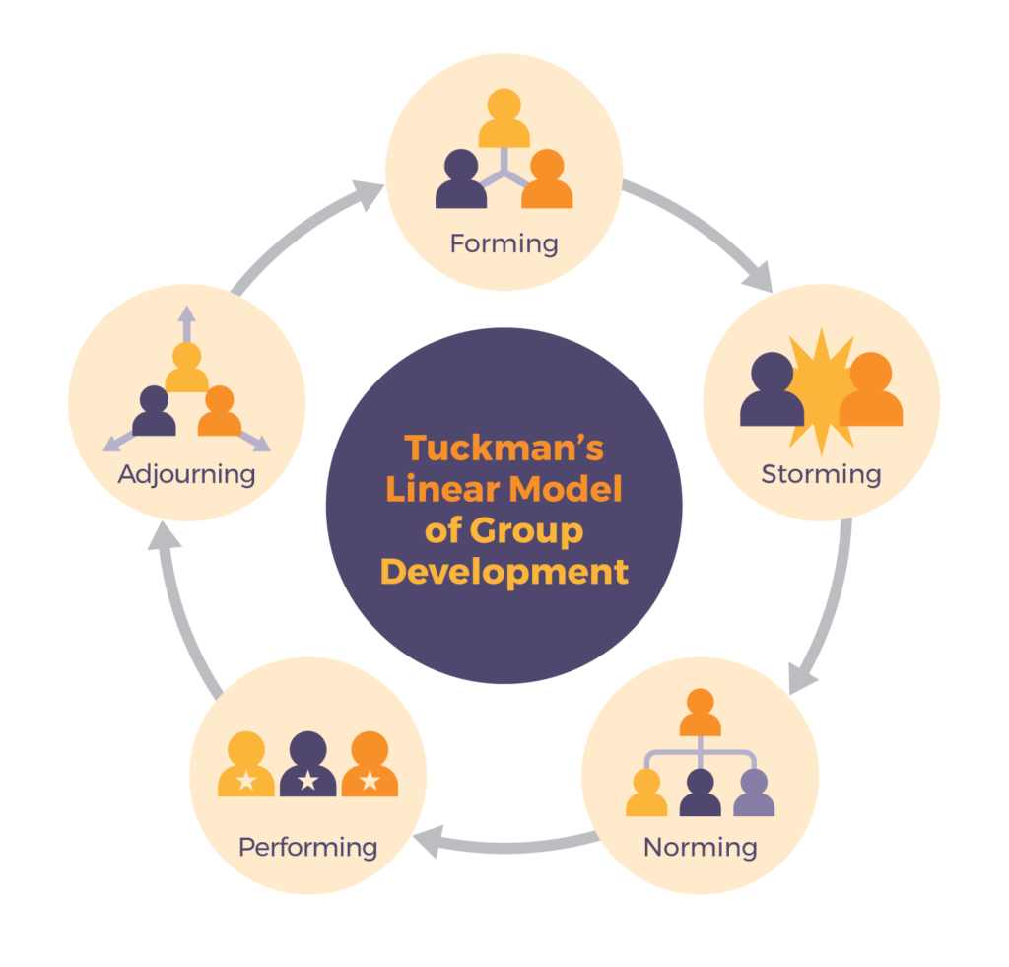
Understanding Team Dynamics - The Tuckman Team Model
“Tuckman’s Stages of Group Development,” proposed by psychologist Bruce Tuckman in 1965, is one of the most famous theories of team development.
It describes four stages that teams may progress through: forming, storming, norming, and performing (a 5th stage was added later: adjourning).
Note that at each stage, communication is a critical component of successfully moving to the next stage.
Figure 18.9 The Stages of the Tuckman Model.

Slide 10
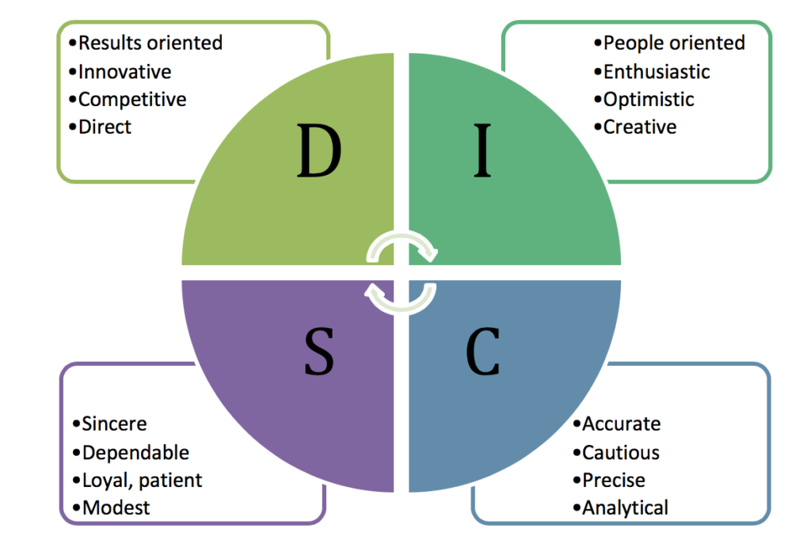
Understanding Team Dynamics - DISC Model
DISC theory, developed in 1928 by Dr. William Moulton Marston.
Is a model for conflict management as it predicts behaviours based on four key personality traits he originally described as Dominance, Inducement, Submission, and Compliance.
You might find different terms used in different contexts. The four general traits are now often described as (1) Dominance, (2) Influence/Inspiring (3) Steadiness/Supportive, and (4) Compliance/Conscientiousness.
Figure 18.11 DISC Profile

Slide 11
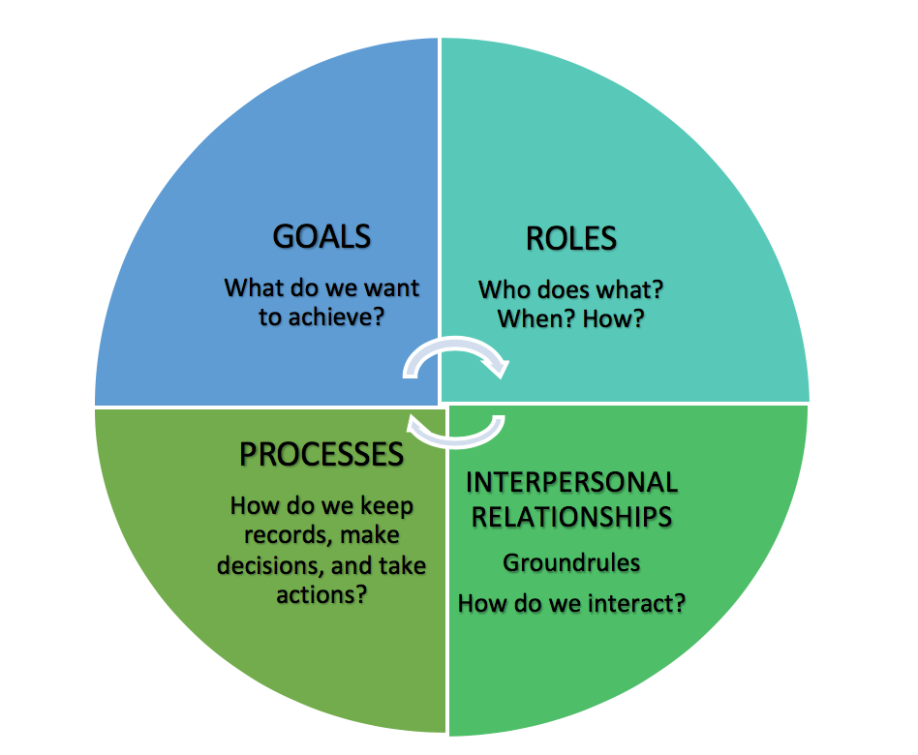
Understanding Team Dynamics - GRIP Model
Richard Beckhard’s GRPI model, originally developed in 1972, has been widely adapted in sports contexts as the GRIP model.
It outlines four interrelated components of highly effective teamwork:
Goals
Roles
Interpersonal
Processes
Figure 18.12 GRIP Model of teamwork dynamics.

Slide 12
Understanding Team Dynamics - Thomas-Kilmann Conflict Mode Model
Thomas and Kilmann’s model for handling team conflict outlines five main approaches to managing team conflict, placed in a matrix of two scales: Assertiveness and Cooperativeness.
Competing
Highly assertive, but uncooperative behavior.
Accommodating
Highly cooperative, but unassertive behavior
Can lead to avoiding conflict and self-silencing of good ideas to appease others, resulting in resentment.
Compromising
A moderate approach in both assertiveness and cooperativeness
Can lead to dissatisfaction and mediocre progress or results.
Avoiding
Collaborating
Can lead to animosity or constructive competition and innovation if managed well.
Unassertive and uncooperative, generally the least effective approach.
Avoids the problem without seeking a solution.
Can be useful in situations where a feasible solution seems impossible.
Highly assertive and cooperative approach.
Best for finding solutions benefiting the whole team and building respect.
Characterized by a desire to "win at all costs" and dominate.

Slide 13
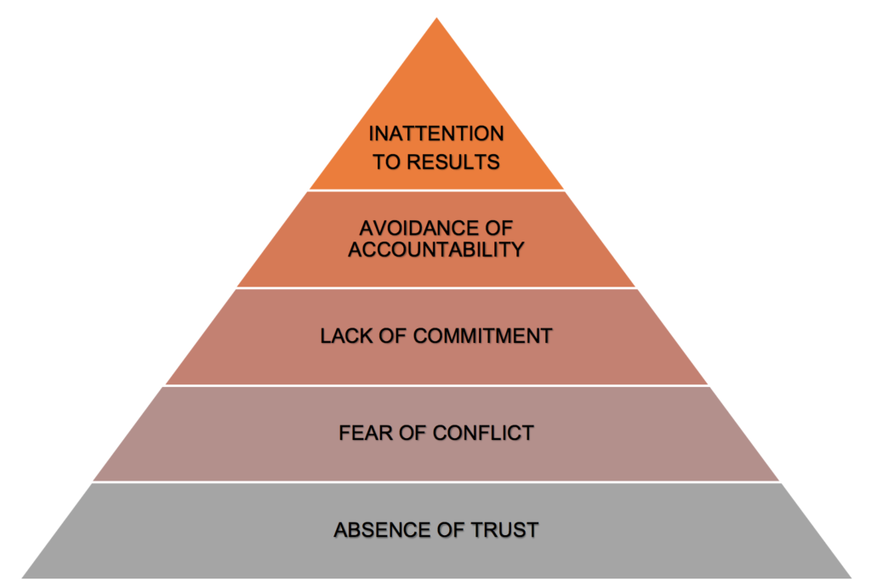
Understanding Team Dynamics - Lencioni Model
Lencioni outlines five common problems teams experience that impact their effectiveness:
Lack of trust
Fear of conflict
Lack of commitment
Avoidance of accountability
Inattention to results
Lencioni advises tackling each dysfunction, displayed in the pyramid, from the bottom up. Establishing trust is a crucial first step to being able to manage conflict, achieve commitment, create accountability and focus on results.
Figure 18.13 Lencioni Model: Five Dysfunctions of a Team

