Slide 1
Human Resources Management: Competencies for HR Professionals​
Chapter 6: Training and Development
Unless otherwise noted, this work is licensed under a Creative Commons Attribution-NonCommercial-ShareAlike 4.0 International (CC BY-NC-SA 4.0) license. Feel free to use, modify, reuse or redistribute any portion of this presentation.

Slide 2
Learning Outcomes
Define a learning culture related to individuals, teams and the organization
Explain various training programs and methods of delivery offered to employees, including web-based learning
Describe the training framework and training development steps
Define the principles and steps of employee and career development
Justify training and development budgets through various evaluation models
Demonstrate competencies to enhance individuals, teams and the organization to acquire and use new skills in their jobs as an HR Professional

Slide 3
6.1 Learning Culture
A learning culture is an entire organization committed to learning for the benefit of individual employees, teams and the organization.
A Learning Culture is created by Human Resources by following the steps:
Assessment
Provide learning opportunities
Reward learning
Instil knowledge sharing and cooperation
Provide support and role modelling
Monitor and assess
Notes:
Assessment: Assess the training opportunities that exist.
Provide learning opportunities: HR designs innovative, diverse programs for employees.
Reward learning: HR needs to recognize and reward the learning efforts of its employees.
Instil knowledge sharing and cooperation: HR can create opportunities for employees to share knowledge, communicate and exchange ideas and insights, and provide feedback on products and services with each other.
Provide support and role modelling: HR can provide training and coaching on “what makes a successful learning culture” with the company leaders.
Monitor and assess: HR can collect and analyze data through employee surveys and questionnaires on satisfaction of their learning.

Slide 4
6.1 Learning Culture Competency
Identify opportunities for learning that occur as part of everyday work activities.
Encourage employees to seek out learning opportunities beyond formalized instruction.
Encourage learning that enhances individual, team, and organizational effectiveness.
Identify potential strategies to embed learning and development into the culture of the organization.
Assess the merits of alternative strategies to create an organizational learning culture.
Implement initiatives to develop a learning culture to enhance the organization’s effectiveness.

Slide 5
6.2 Employee Training and Development I
Training refers to formal and planned efforts to help employees acquire knowledge, skills, and abilities to improve performance in their current job.
Development on the other hand refers to formal and planned efforts to help employees acquire the knowledge, skills, and abilities required to perform future job responsibilities and for the long-term achievement of individual goals and/or organizational objectives.
Notes:
Training can also be described as an endeavour aimed to improve or develop additional competency or skills in an employee on the job one currently holds in order to increase performance or productivity. Training involves a change in attitude, skills, or knowledge of a person with the result being an improvement in behaviour. For training to be effective it has to be a planned activity conducted after a thorough needs analysis and targeted at certain competencies.

Slide 6
6.2 Employee Training and Development II
Training & Education, Is There a Difference?
The terms education and training are often used interchangeably. However, education is the process of acquiring knowledge and information, usually in a formal manner while training is the mastery of a skill or skill set.
This Photo by Unknown Author is licensed under CC BY-SA-NC

Slide 7
6.2 Employee Orientation or Onboarding
Employee orientation is the process used for welcoming a new employee into the organization. The objectives of employee orientation are as follows:
To reduce start-up costs
To reduce anxiety
To reduce employee turnover
To save time for the supervisor and coworkers
To set expectations and attitudes
Notes:
Employee orientation is the process used for welcoming a new employee into the organization. The objectives of employee orientation are as follows:
To reduce start-up costs. If an orientation is done right, it can help get the employee up to speed on various policies and procedures, so the employee can start working right away. It can also be a way to ensure all hiring paperwork is filled out correctly, so the employee is paid on time.
To reduce anxiety. Starting a new job can be stressful. One goal of an orientation is to reduce the stress and anxiety people feel when going into an unknown situation.
To reduce employee turnover. Employee turnover tends to be higher when employees don’t feel valued or are not given the tools to perform. Employee orientation can show that the organization values the employee and provides the tools necessary for a successful entry.
To save time for the supervisor and coworkers. A well-done orientation makes for a better prepared employee, which means less time having to teach the employee.
To set expectations and attitudes. If employees know from the start what the expectations are, they tend to perform better. Likewise, if employees learn the values and attitudes of the organization from the beginning, there is a higher chance of a successful tenure at the company (Dessavre, 2023).

Slide 8
6.2 Employee Training and Development
In-house training programs are learning opportunities developed by the organization in which they are used.
External training includes any type of training that is not performed internally by the organization. It can include sending an employee to a seminar to help further develop leadership skills or helping pay tuition for an employee who wants to take a marketing class.
Notes:
In house - This is usually the second step in the training process and often is ongoing. In-house training programs can be training related to a specific job, such as how to use a particular kind of software. In a manufacturing setting, in-house training might include an employee learning how to use a particular kind of machinery.

Slide 9
6.3 Onboarding Steps for New Employees
Tour
Have clear goals and expectations
Be realistic about goals
Create a schedule
Use digital documents
Match new employees with a coach or mentor
After onboarding training
This Photo by Unknown Author is licensed under CC BY-NC-ND

Slide 10
6.4 Training Framework
The framework for developing a training program are as follows:
Needs assessment and learning objectives
Learning Strategies
Delivery mode
Budget
Content
Timelines
Notes:
The framework for developing a training program are as follows:
Needs assessment and learning objectives. Articulating specific and measurable learning objectives will in turn guide you in determining the learnings required – and specific areas for training.
Learning Strategies. Determine the right learning strategies best suited to the learning styles of your employee audience to ensure the training is successful.
Delivery mode. What is the best way to get your message across? Is web-based training more appropriate, or should mentoring be used? Can simulation training be used for a portion of the training while job shadowing be used for another part of the training? Most training programs will include a variety of delivery methods.
Budget. How much money do you have to spend on this training?
Content. What needs to be taught? How will you organize and sequence the information and course materials?
Timelines. How much time is required for the training – is it one-time only, are there multiple segments, is it repeated annually (eg. safety training)? Is there a deadline for training to be complete

Slide 11
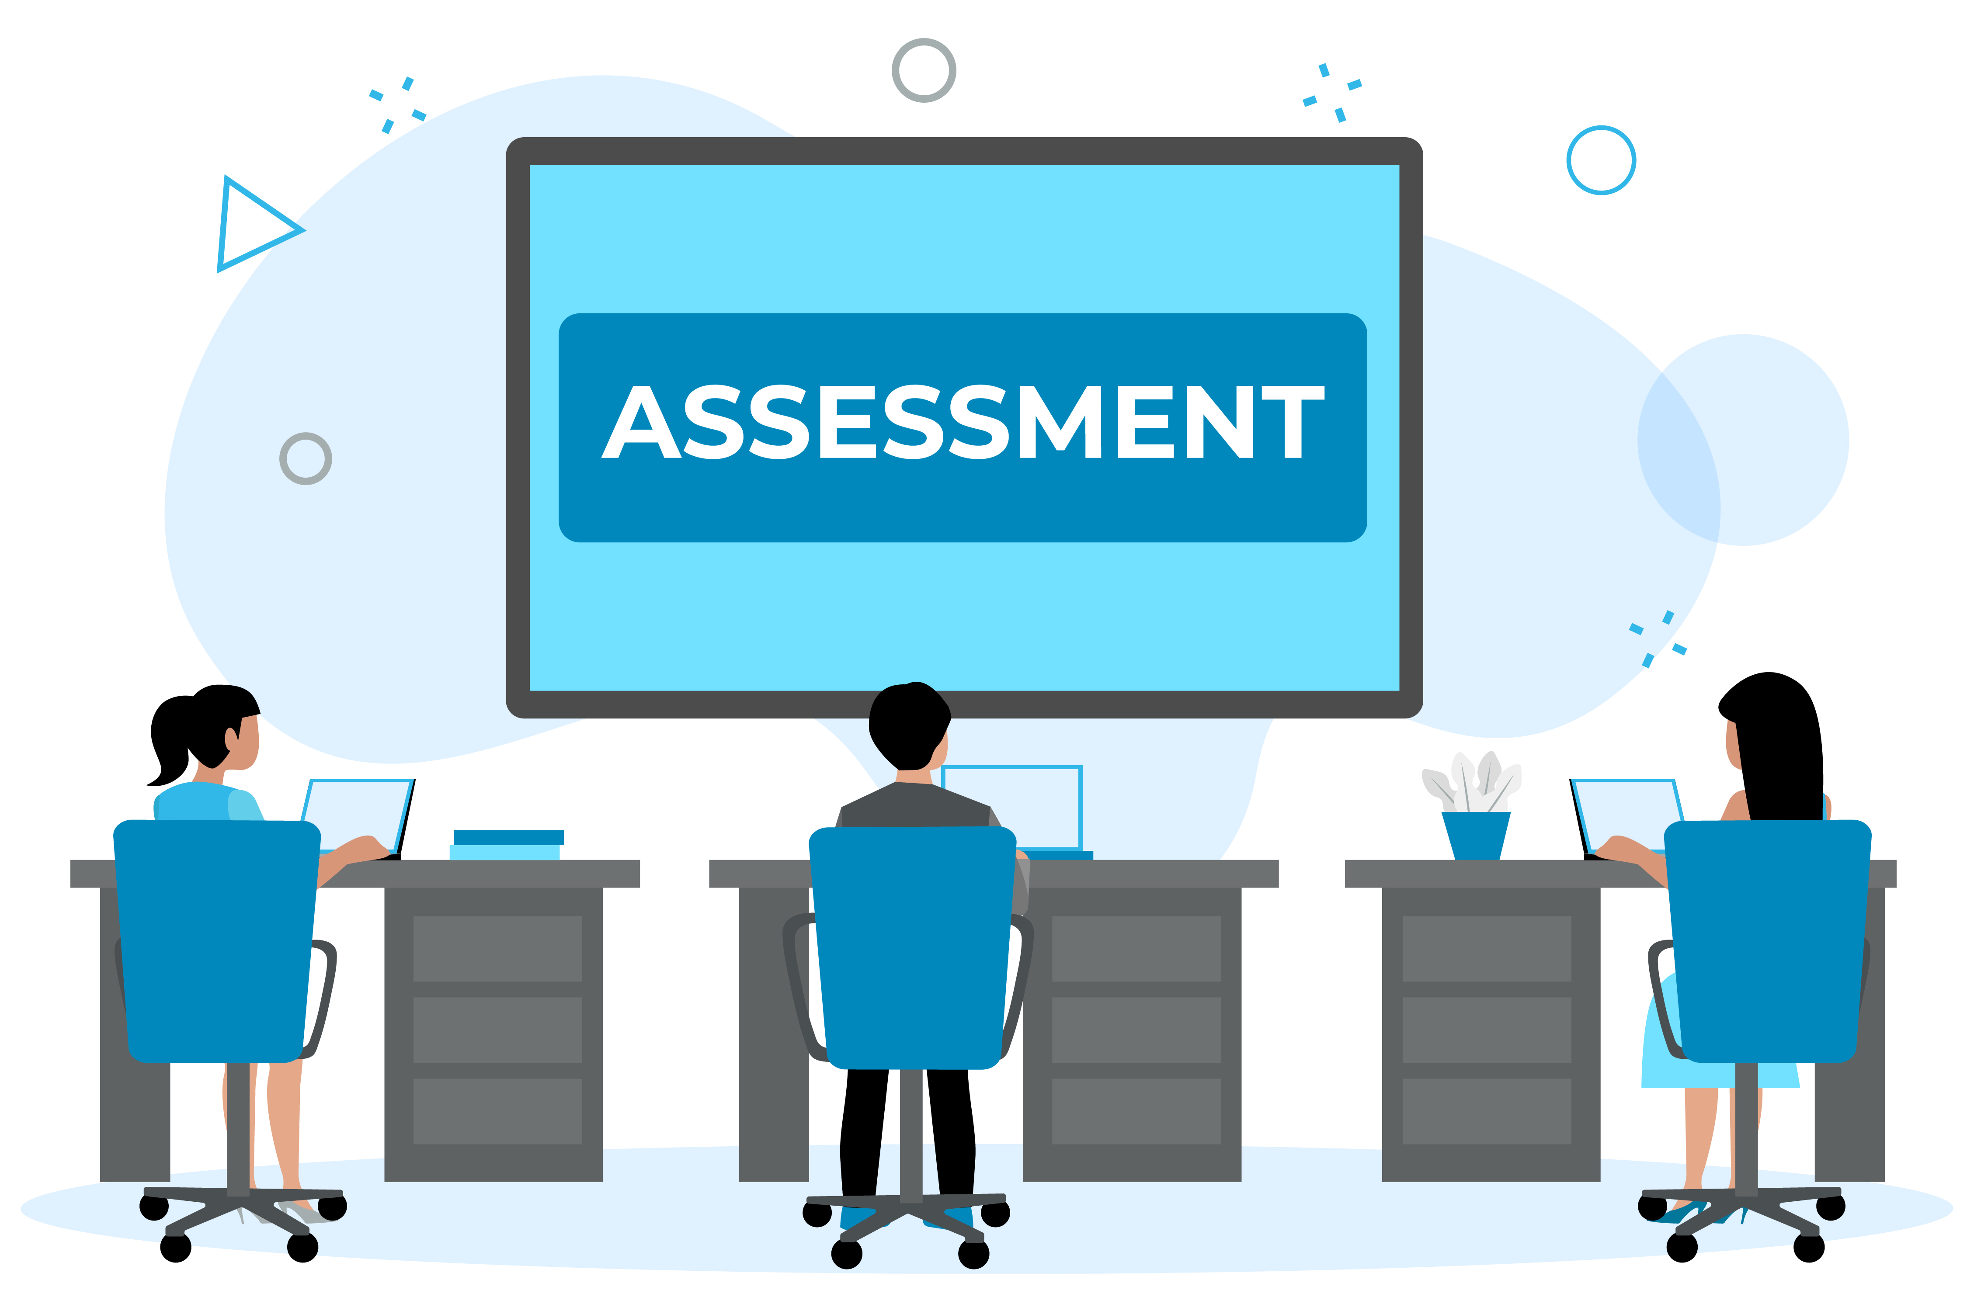
6.4 Needs Assessment
There are three levels of training needs assessment:
Organizational assessment,
Occupational (task) assessment
Individual assessment.
“Online Employee Assessment” by Digits.co.uk Images CC-BY 2.0
Notes:
Organizational assessment. In this type of needs assessment, we can determine the skills, knowledge, and abilities a company needs to meet its strategic objectives. This type of assessment considers things such as changing demographics and technological trends, and is forward-looking. To perform an organizational assessment, one can look at future trends and the overall company’s strategic plan. HR managers can also see how jobs and industries are changing. For example, the COVID-19 pandemic has made the use of technology much more important for educational institutions. It is likely that many of the technological tools that schools now rely on will remain, and as a whole, schools must take a closer look at exactly how technology will affect teaching in the future. Overall, this type of assessment looks at the types of KSA’s that will be needed for the success of the organizations and whether training can help in developing them.
Occupational (task) assessment. This type of assessment looks at the specific tasks, skills knowledge, and abilities required to do the different jobs within the organization. Data for this step can come from a review of performance evaluations that can uncover a pattern where employees in specific jobs are not meeting expectations. As a result, this may provide data as to where your training is lacking. In the example of schools and teaching, the impact of new technology may be the greatest for the teaching staff and less so for the support staff.
Individual assessment. An individual assessment looks at the performance of an individual employee and determines what training should be provided for that individual. Continuing with the example of teaching, the analysis would focus on the individual teachers and their level of comfort with the new technology. As a result of this analysis, it may be decided that only teachers with technological fluency below a certain level need to be trained.

Slide 12
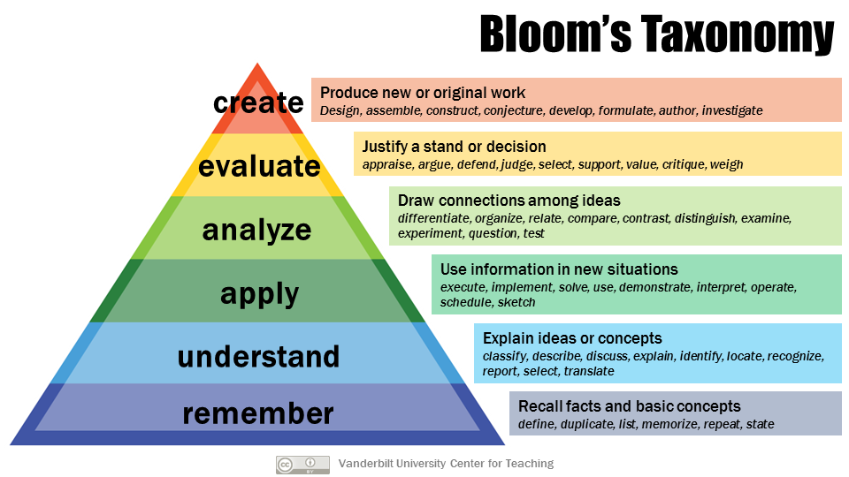
6.4 Learning Objectives
Notes:
A learning objective is what you want the learner to be able to do, explain, or demonstrate at the end of the training period. Good learning objectives are performance-based and clear, and the result of the learning objective can be observable or measured in some way.
Bloom’s Taxonomy is a framework for developing action verbs to skills and knowledge that trainers want their trainees to be “able to do” upon completion of the training program. Within the framework there are a six categories: Knowledge, Comprehension, Application, Synthesis and Evaluation. Within each category are sub-categories that are similar (simple to complex) expectations of the trainee. Most trainers use Bloom’s Taxonomy to design Learning Objectives, or sometimes called Outcomes (Armstrong, 2010).

Slide 13
6.4 Learning Principles
Learning Principles are a guideline for trainers to follow to ensure their learners are learning effectively. These include ensuring the training is designed to include:
Repetition
Relevance
Participation
Feedback
Transfer of Learning
Notes:
Learning Principles are a guideline for trainers to follow to ensure their learners are learning effectively. These include ensuring the training is designed to include:
Repetition: Learners repeat information and possible memorize it, and practice it in sequences until they can recall the information. Example: Addition tables in primary school
Relevance: Learners will learn best when the information is relevant to their own lives and gives them some type of meaning. Example: Teaching international students about traffic rules in Canada by showing videos of traffic, or going on a driving field trip in traffic.
Participation: Learners learn quickly when they actively participate in the learning. Example: A trainer can show you how to bake a pizza; however, you will learn quicker if you bake your own pizza.
Feedback: Learners like to get feedback on “how well they are doing.” If they make mistakes, they can correct them with feedback. Positive feedback to learners also provides motivation and builds confidence. Example: “You completed the presentation with ease and professionalism. Well done.”
Transfer of Learning: Learners will learn more quickly after they learn the theory if they can apply the skills to the job immediately. As well, they will become more productive, and there are fewer errors in their work. Example: Teach learners how to use a digital cash register. Following the training, the learner is placed at the counter, with a seasoned employee, and waits on customers using the digital cash register.

Slide 14
6.4 Other Training Development Considerations
Content Development
Learning Strategies
Budget
Timelines
Communication of opportunities

Slide 15
6.4 Learning Priorities Competencies
Consult key stakeholders in the development of organizational learning priorities.
Identify potential organizational learning priorities that are aligned with organizational strategy.
Analyze the return on investment of alternative organizational learning priorities.
Select organizational learning priorities to maximize return on investment and alignment with the business strategy.

Slide 16
6.5 On-the-Job Training
On-the-job training is training that is performed on the job to teach the employee their job.
On-the-job coaching
Job shadowing
Job rotation
Apprenticeships
Internships
Mentoring

Slide 17
6.5 Mentoring and Coaching Competencies
Maintain knowledge of current mentoring and coaching principles.
Educate leaders on the merits of mentoring and coaching employees.
Keep leaders informed about the learning and development priorities of employees.
Develop learning programs to build mentoring and coaching skills in leaders.
Deliver mentoring and coaching training to leaders.

Slide 18
6.5 Off-the-Job Training
Off-the-job training is another way of saying classroom training. The training may be in a physical classroom, online classroom, or self-directed training (online).
Lectures
Videos
Simulations
Role Plays
Case Studies
Self-Study

Slide 19
6.6 Web Based Learning
Web-based training involves the use of technology to facilitate training. There are two types of web-based learning.
Synchronous learning uses instructor-led facilitation. The participants are in the same place at the same time.
Asynchronous learning is self-directed and no instructor facilitating the course. The participant learns at their own place and on their own time
“Web based learning” by Fanshawe College CC BY

Slide 20
6.7 Provision of Continuing Development Opportunities Competencies
Assess the potential of employees to develop competencies aligned with organizational strategy.
Develop learning opportunities for employees that enable them to contribute effectively to organizational objectives.
Develop learning objectives that maximize the growth potential of employees.

Slide 21
6.7 Employee Development
An employee development program is a process developed to help people manage their careers, learn new things, and take steps to improve personally and professionally.
This Photo by Unknown Author is licensed under CC BY-SA

Slide 22
6.7 Learning and Development Program Implementation Competencies
Maintain knowledge of current literature in the field of adult learning.
Apply established theories of adult learning to the development of learning and development programs.
Implement learning and development programs that are relevant and effective.
Develop the competence of employees using evidence-based methods.

Slide 23
6.7 High Potential Programs (Leadership Development)
High potential (hi-po) programs are concerned with the early identification and the development of employees who have the potential to assume leadership positions in the future.
This photo by Unknown Author is licensed under CC BY-SA

Slide 24
6.7 Leadership Development Competency
Develop an effective succession planning process.
Implement a succession planning process.
Develop an effective program for the early identification and tracking of leadership talent.
Implement a program for the early identification and tracking of leadership talent.
Develop a developmental planning process for high-potential individuals.
Implement a developmental planning process for high-potential individuals.

Slide 25
6.8 Career Development
A career development plan usually includes a list of short- and long-term goals that employees have pertaining to their current and future jobs, and a planned sequence of formal and informal training and experiences needed to help them reach their goals.

Slide 26
6.9 Learning and Development Priorities Evaluation Competencies
Establish outcome measures for learning and development programs that are aligned with organizational objectives.
Maintain knowledge of sound measurement principles accepted in the HR field.
Assess progress towards learning and development goals using sound measurement principles.
Document progress towards learning and development goals.
Evaluate the effectiveness of learning and development programs.
Evaluate the likelihood that learning and development priorities will aiign with progress towards organizational objectives.

Slide 27
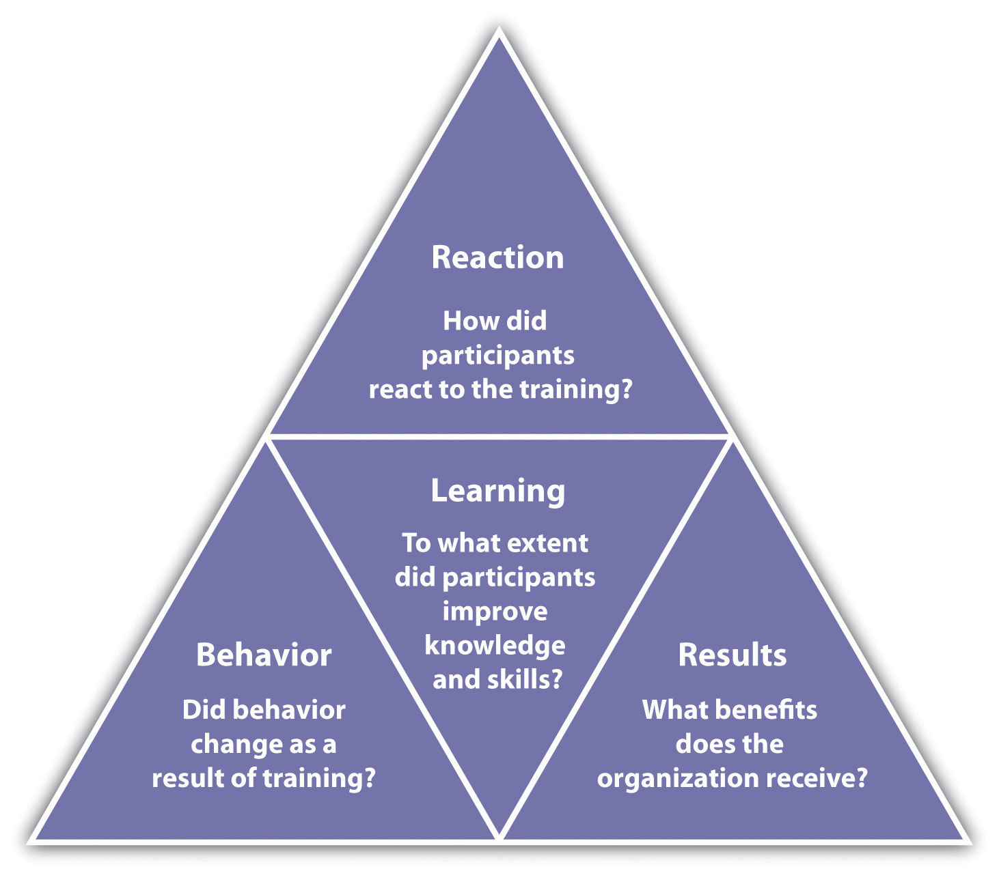
6.9 Measuring Training Effectiveness
Kirkpatrick model for measuring training effectiveness:
Reaction
Learning
Behaviour
Results
ROI
Notes:
The classic model to measure the effectiveness of training is the Kirkpatrick model (Kirkpatrick, 2006). His model has four levels:
Reaction: How did the participants react to the training program?
Learning: To what extent did participants improve knowledge and skills?
Behaviour: Did behaviour change as a result of the training?
Results: What benefits to the organization resulted from the training?
Return on Investment: What cost benefits/profit increases have resulted from the training?
Each of Kirkpatrick’s levels can be assessed using a variety of methods. We will discuss those next.

Slide 28
6.9 Learning Priorities Competencies
Consult key stakeholders in the development of organizational learning priorities.
Identify potential organizational learning priorities that are aligned with organizational strategy.
Analyze the return on investment of alternative organizational learning priorities.
Select organizational learning priorities to maximize return on investment and alignment with business strategy.

Slide 29
Summary
Define a learning culture related to individuals, teams and the organization
Explain various training programs and methods of delivery offered to employees, including web-based learning
Describe the training framework and training development steps
Define the principles and steps of employee and career development
Justify training and development budgets through various evaluation models
Demonstrate competencies to enhance individuals, teams and the organization to acquire and use new skills in their jobs as an HR Professional

Slide 30
End Chapter Review
What is the difference between training and development?
Describe the process of onboarding a new employee.
What are principles of learning?
What are the different types of training?
How is training effectiveness measured?

