Slide 1
Human Resources Management: Competencies for HR Professionals​​
Chapter 4: Analyzing and Designing Work
Unless otherwise noted, this work is licensed under a Creative Commons Attribution-NonCommercial-ShareAlike 4.0 International (CC BY-NC-SA 4.0) license. Feel free to use, modify, reuse or redistribute any portion of this presentation.

Slide 2
Learning Outcomes
Explain the strategic value and impact of job analysis to an organization
Describe uses of job analysis information for HRM
Explain the categories of task-based and skill-based analysis
Describe the content of job descriptions and job specifications
Discuss examples of various factors considered in job design

Slide 3
4.1 Strategy and Job Analysis
A job is a position that involves completing a task or work.
Tasks in a job are typically related or similar in nature.
Each job requires its own set of skills, knowledge, and experiences.
Companies may have similar jobs that many people complete.
A position is a role that involves a specific set of responsibilities assigned to one person.
Each person in a position has specific duties to fulfill.
Similar positions may be grouped together, forming a job family.
Notes:
A job is a paid position that involves completing a task or work.
The tasks in a job are typically related or similar in nature.
Different jobs require different skills, knowledge, and experiences.
Companies may have several similar jobs that many people complete.
A position is a paid role that involves a specific set of responsibilities assigned to one person.
Each person in a position has specific duties to fulfill.
Some positions may be similar and grouped together, forming a job family.

Slide 4
4.1 Strategic Impact of Job Analysis
Job analysis is a vital tool for HR managers to make informed decisions on employee hiring, motivation, and compensation, ultimately distinguishing innovative and progressive companies from their competitors.
Select jobs to study
Determine information needed
Identify sources of data
Determine methods of data collection
Evaluate and verify data
Use data to begin the process of writing the analysis, then the job description
Notes:
Job analysis is crucial in various HR activities, including recruitment, selection, training and development, performance appraisals, compensation, and compliance with laws and legislation.
It outlines the skills, knowledge, and abilities required for a job, helping HR managers make informed decisions on employee hiring, motivation, and compensation.
Companies that prioritize job analysis distinguish themselves as innovative and progressive in the competitive job market.

Slide 5
4.2 Job Analysis
Job Analysis is a systematic process used to identify and determine, in detail, the particular job duties and requirements and the relative importance of these duties for a given job
Job analysis aims to answer the following questions:
The specific elements of the job
Physical and mental activities
When is the job performed
How is the job performed
Under what conditions
Notes:
Here are some examples of how the results of job analysis can be used in HRM:
Production of accurate job postings to attract strong candidates;
Identification of critical knowledge, skills, and abilities required for success to include as hiring criteria;
Identification of risks associated with the job responsibilities to prevent accidents;
Design of performance appraisal systems that measure actual job elements;
Development of equitable compensation plans;
Design training programs that address specific and relevant knowledge, skills, and abilities.

Slide 6
4.2 Job Analysis Competencies
Conduct a job analysis using an objective methodology that is appropriate for the purpose for which the job analysis is conducted.
Implement job enrichment, job enlargement, and job re-design initiatives when deemed appropriate.

Slide 7
4.2 Information Needed: Task- & Competency-based Analysis
Task-based Analysis:
Most common: uses task statements to identify job elements.
Answers 4 questions: action, object, expected output, and tools/processes.
Clear terms, start with a verb, and avoid abbreviations in task statements.
Competency-based Analysis:
Focuses on specific knowledge and abilities for high-level positions.
Sources of data for job analysis include human and non-human sources.
Possible non-human sources include job analysis reports, job descriptions, and equipment records.
Possible human sources include job incumbents, supervisors, and job experts.
Notes:
Task-based Analysis
Task-based job analysis is the most common and uses task statements to identify elements of jobs.
Task statements should answer four questions: Performs what action? To whom or what? To produce what or why is it necessary? Using what tools, equipment, work aids, processes?
Task statements should use clear, easily understood terms and start with a verb to show the action being taken.
Competency-based Analysis
Competency-based analysis identifies specific knowledge and abilities for the job, and is subjective and used for high-level positions.
Non-human data sources for job analysis include job analysis reports, equipment records, and design blueprints, among others.
Human sources for job analysis include job incumbents, supervisors, job experts, and professional associations and governing bodies.

Slide 8
4.2 Sources of Data
Non- Human Sources
Human Sources
Photo by fas Pixabay License
Photo by Mohammad Yusuf Pexels License
Notes:
Non Human Sources
Previous job analysis reports
Existing job descriptions and specifications
Equipment maintenance records
Equipment design blueprints
Architectural blueprints of work area
Recordings of employee working
Training manuals and materials
Magazines, newspapers, other literature
Human Sources
Job Incumbents
Supervisors
Job Experts
Professional Associations & Governing Bodies

Slide 9
4.2 Evidence-Based Approach Competencies
Consult the literature for solutions to HR challenges.
Promote the use of data and quantitative and qualitative research in the decision-making process.
Document the rationale for HR decisions.

Slide 10
4.2 Methods of Data Collection
The following describes the most common job analysis methods.:
Open-ended questionnaire
Structured questionnaire
Interview
Observation
Work diary or log

Slide 11
4.3 Job Description
Job descriptions should include the following components:
1. Job Title
2. Department/Reports to
3. NOC code
4. Job Functions
5. Knowledge, Skill, and Abilities
6. Education and experience required
7. Physical requirement of the job

Slide 12
4.4 Job Design
Job design involves specifying job contents, methods, and relationships to satisfy various requirements.
Job design can enhance employee productivity and satisfaction.
Human resource professionals must consider job redesign when adapting to changes in workflow and organizational demands.
Notes:
Job design involves the specification of job contents, methods, and relationships to meet organizational and personal needs, and is essential for raising productivity and job satisfaction. It may involve job redesign or business process re-engineering to adapt to changing organizational demands, and requires a thorough understanding of job tasks and work flow processes.

Slide 13
4.4 Productivity Competencies
Develop potential initiatives that align culture and values with organizational strategy.
Measure employee productivity.
Measure employee engagement and morale.

Slide 14
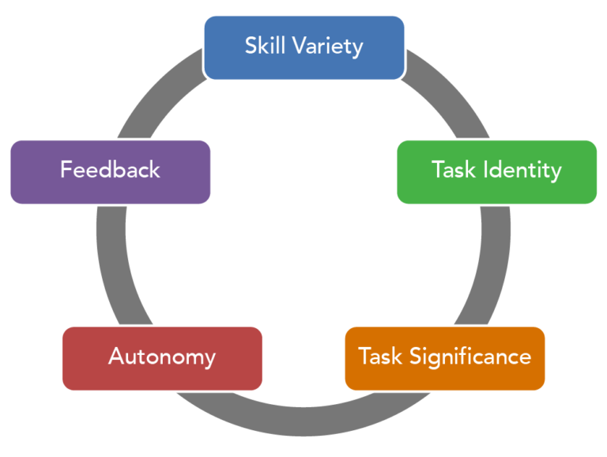
4.4 Designing Efficient Jobs: Job Characteristics Model
The job characteristics model describes five core job characteristics leading to critical psychological states, resulting in work-related outcomes:
Skill Variety
Task Identity
Task Significance
Autonomy
Feedback
“Job Design Model” by Freedom Learning Group. Provided by: Lumen Learning. CC BY
Notes:
Skill Variety: the extent to which the job requires a person to utilize multiple skills.
Task Identity: the degree to which a person is in charge of completing an identifiable piece of work from start to finish.
Task Significance: whether a person’s job substantially affects other people’s work, health, or well-being.
Autonomy: the degree to which a person has the freedom to decide how to perform his or her tasks.
Feedback: the degree to which people learn how effective they are being at work.
The presence of these five core job dimensions leads to:
Meaningful work
Responsibility for outcomes
Knowledge of results

Slide 15
4.5 Approaches to Job Design
Job Enlargement:
Design approach in which the scope of the job is increased through extending and enhancing the range of its duties and responsibilities.
Job Enrichment:
Design approach aimed at making work more interesting and challenging for employees. May consist of giving more responsibility and opportunities for impact.
Ergonomics:
the science of matching the job to the worker and the product to the user
Notes:
Job Enlargement:
Job enlargement is a horizontal expansion of job activities that can be beneficial for employee satisfaction and higher quality customer services.
The effects of job enlargement may depend on the type of tasks added to the job, with more positive effects seen when employees are given tasks that require them to be knowledgeable in different areas.
Job Enrichment:
Job enrichment involves giving employees more responsibility and opportunities for impact than originally required by their job, creating opportunities for professional growth and recognition.
Companies using job enrichment may experience positive outcomes, such as reduced turnover, increased productivity, and reduced absences, because employees who have the authority and responsibility over their work can be more efficient and increase their overall performance.
However, job enrichment may cause dissatisfaction among certain employees who may expect greater levels of pay or other types of compensation, and it is not suitable for everyone as not all employees desire to have control over how they work.

Slide 16
4.5 Job Analysis Competencies
Conduct a job analysis using an objective methodology that is appropriate for the purpose for which the job analysis is conducted.
Implement job enrichment, job enlargement, and job re-design initiatives when deemed appropriate.

Slide 17
4.6 Contemporary Issues in Job Design
Trends have emerged in the design of jobs in organizations.
Telecommuting
Team-based work
Flexible working hours
Alternative work patterns
Artificial intelligence
“working from bed” by Microbiz Mag, CC BY
Notes:
Telecommuting:
Telecommuting has become a normal way of working due to the COVID-19 pandemic, which will have enormous effects on organizations and society in general.
Team-Based Work:
Effective teams share five characteristics: shared values, mutual trust, inspiring vision, skill/talent, and rewards.
Flex Time:
Flex time allows employees to choose when they start and end their work day, which provides a better work-life balance and increases company production.
Compressed Work Week:
A compressed work week shortens an employee's work week by the number of days worked, which allows for a better work-life balance.
Artificial Intelligence (AI):
AI is having major implications in how work is performed, as it can be used to support or even replace mental tasks.

Slide 18
Summary
Explain the strategic value and impact of job analysis to an organization
Describe uses of job analysis information for HRM
Explain the categories of task-based and skill-based analysis
Describe the content of job descriptions and job specifications
Discuss examples of various factors considered in job design

Slide 19
End Chapter Review
What is job analysis and why is it important for HR managers?
How can job design impact employee satisfaction and productivity?
What is the job characteristics model and how does it aim to design motivating jobs?
In what ways can the evolution of jobs, including the rise of AI, impact HR processes and job design?

