Slide 1
Gerry Adams
And the Good Friday Agreement

Slide 2
To Be Discussed...
01
02
03
04
Early Life and Politics
His Affect on GFA
Life after GFA
Conclusions and Questions

Slide 3
01
Early Life and Politics
Overview of his life and politics

Slide 4
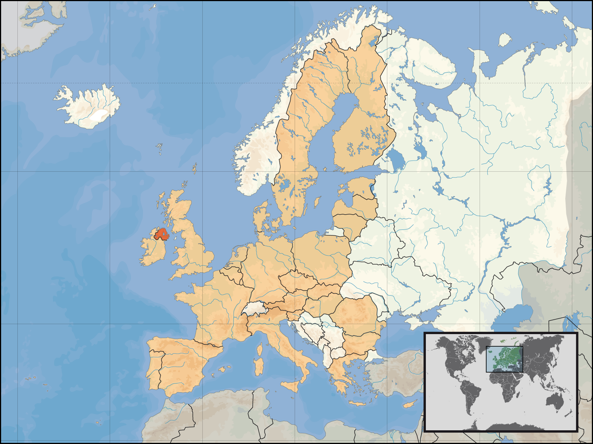
Who Is He?
Northern Irish Politician
Born in Belfast, NI, 1948
Leader of Sinn Fein from 1983-2018
Repeatedly accused of being in the IRA but not convicted

Slide 5
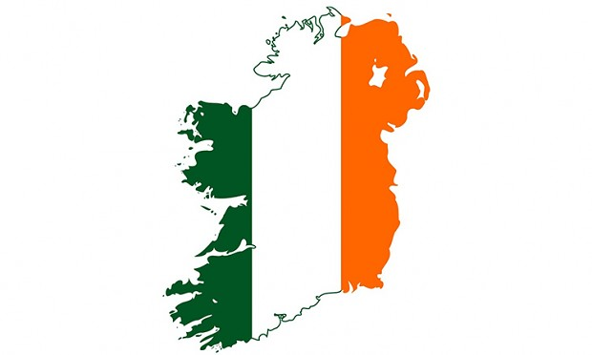
Republicanism and Nationalism
United Ireland
British Rule as foreign and colonialist
Typically tied to Catholicism
MP’s and Westminster

Slide 6
IRA Connections
Imprisoned without charge in 1972
IRA leaders demanded his release prior to ceasefire talks
1977 was aquitted of IRA membership
Denied he was a member, refused to disassociate with the organization

Slide 7
02
His Affect on GFA
Overview of the agreement and what he did to make it the way it is

Slide 8
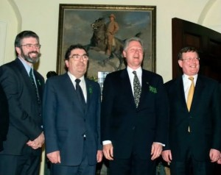
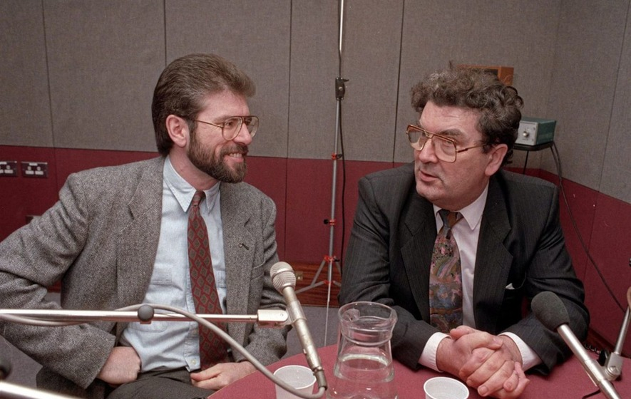
What is the GFA?
The Good Friday Agreement
Agreement signed between British and Irish governments negotiated between the main parties
Adams and Hume (SDLP leader) worked with Reynolds (Irish Taoiseach) to start the peace process
Involved Bill Clinton and Irish-American Lobby

Slide 9
Policies Created
Executive headed by joint First and Deputy First Minister’s office ruled by the leaders of the two largest parties
Established the right of Northern Irish born people to take both Irish, and British citizenship and identify as such
Established the right of the Northern Irish people to vote on their nationality
Assembly measures identify as nationalist, unionist or other for purposes of cross community representation
Members of committees are elected using proportional representation
Development of a council between Northern Ireland and the Republic

Slide 10
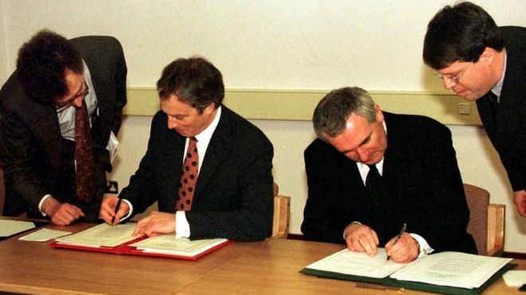
Agreement Signing
April 10th 1998
Agreement was supported by Sinn Fein, SDLP (Social Democratic and Labour Party) and 87% of Catholics
Felt that the agreement should be supported by both Northern Irish and Republic of Ireland citizens

Slide 11
Sinn Fein and GFA
Were once a strong supporter of no British Rule
Became supporters of the GFA
Adams saw it not as a peace deal, but as part of the peace process
Saw it as a transitional period for Irish reunification
His goal was to weaken British link and strengthen national self determination

Slide 12
Goals of the Talks
Constitutional and political change
Release of political prisoners
Implementation of equality agenda

Slide 13
03
Life after GFA
1998-2018

Slide 14
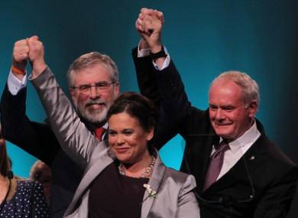
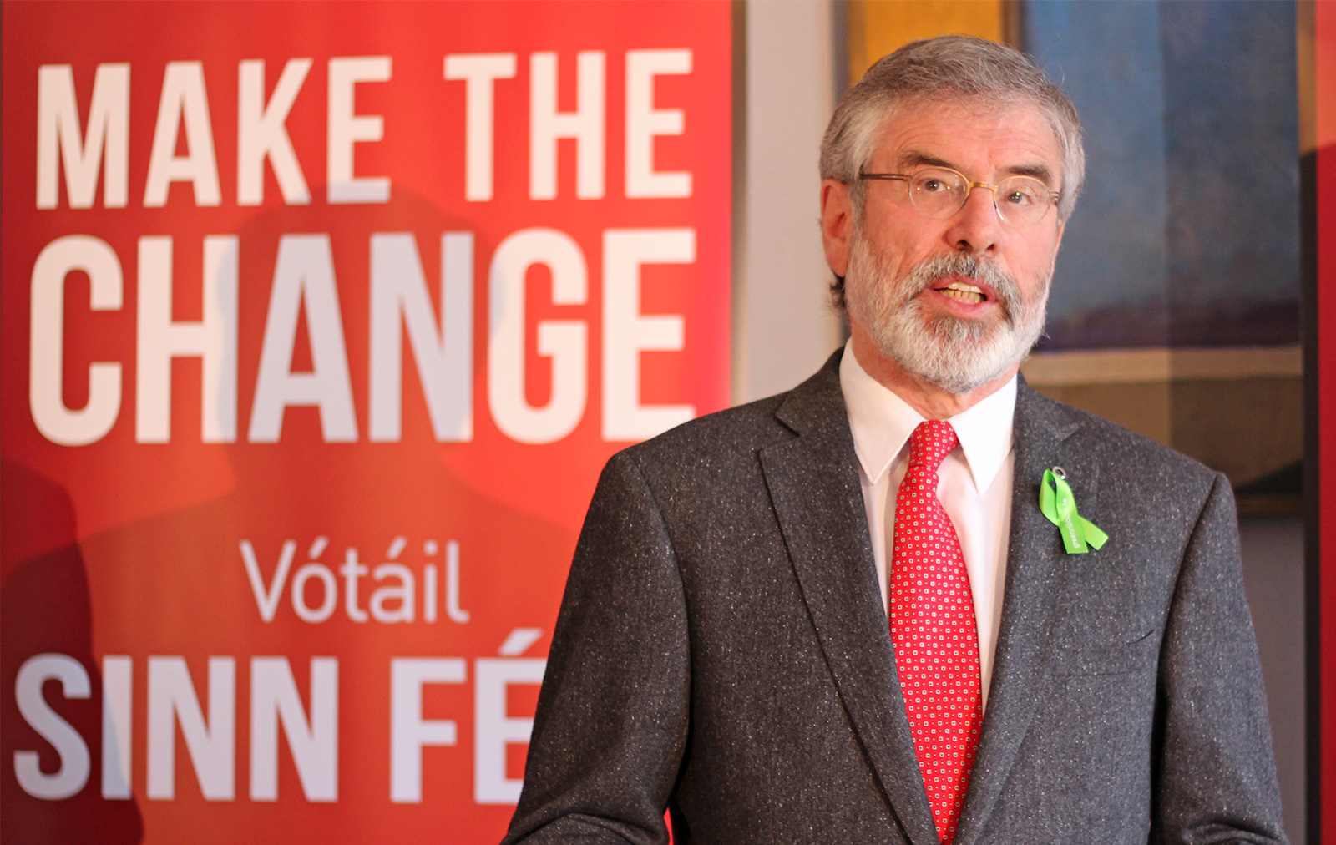
Life in Politics
Represented Belfast West in NI assembly from 1998-2010
Represented Louth and East Meath in Irish Dail from 2010-2020
Stepped down from politics to bring in a new generation that was not tarnished with IRA affiliation accusations

Slide 15
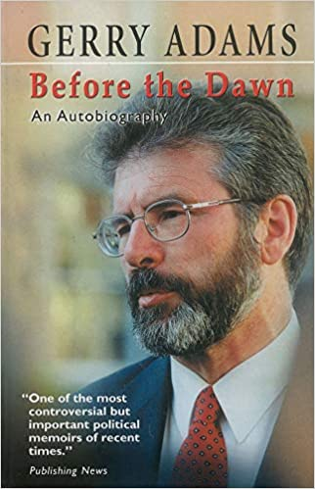
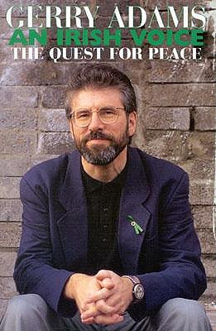
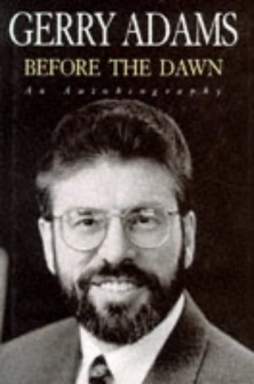
Writings and Public Appearances
Written 4 books about his life and the peace process
Writes in newspapers, recently focusing on Brexit, it negotiations and impacts
Involved in many interviews

Slide 16
04
Conclusions and Questions

Slide 17
Conclusions
Adams was very influential in the peace process
The GFA, while not providing everything desired was a good compromise
His appearances since have been less radical, but have helped to keep the world aware of the nationalist agenda

Slide 18
Questions?

Slide 19
The End
Thank you for listening

Slide 20
Citations
Adams, Gerry. “Gerry Adams on the Role of Sinn Fein Post-Good Friday (1998).” Alpha History. https://alphahistory.com/northernireland/gerry-adams-sinn-fein-1998/.
Adams, Gerry. “To cherish a just and lasting peace.” Fordham international law journal, 22(4), 1179–. Fordham University, School of Law.
Adams, Gerry and Barry McCarron. “Lessons from the Irish Peace Process: An Interview with Gerry Adams.” Georgetown Journal of International Affairs 16, no. 1 (2015): 218–23. http://www.jstor.org/stable/43773684
“The Belfast Agreement (Good Friday Agreement) Policy Paper” Northern Ireland Office. April 10th 1998. https://www.gov.uk/government/publications/the-belfast-agreement.
“Books by Gerry Adams and Complete Book Reviews.” Publishers Weekly. https://www.publishersweekly.com/pw/authorpage/gerry-adams.html.
Brewer, John D. “The Sociology of the Northern Irish Peace Process.” The Legacy of the Good Friday Agreement. Edited by Armstrong, Charles I., David Herbert and Jan Erik. 271-289. Cham, Switzerland: Palgrave Macmillan, 2018.
Cowell-Meyers, K. and Arthur, Paul. "Gerry Adams." Encyclopedia Britannica. https://www.britannica.com/biography/Gerry-Adams.
“Gerry Adams: Profile of Sinn Féin leader” BBC News. https://www.bbc.com/news/uk-northern-ireland-27238602.
Hopkins, Stephen. “The Life History of an Exemplary Provisional Republican: Gerry Adams and the Politics of Biography.” Irish Political Studies 33, no. 2 (2018): 259–77. https://doi.org/10.1080/07907184.2018.1454666.
McCann, David. “Managing Orderly Decline? Nationalism in Northern Ireland Since the Good Friday Agreement (1998).” The Political Quarterly (London. 1930) 88, no. 2 (2017): 241–47. https://doi.org/10.1111/1467-923X.12350.

