Slide 1
ACC TRAINING PEER VISITOR TRAINERS
Notes:
Do introduction of teachers and learners
You might want to do an icebreaker, for example:
UNIQUE AND SHARED: Create groups of 4-5 people and let them discover what they have in common, along with interesting characteristics that are unique to each person in the group
One of the main pillars of the Amputee Coalition of Canada (ACC) is its peer visitor program and this is one of the ways the ACC fulfills its Mission “ To empower our Canadian limb loss community through connections, resources, education and peer support”.
Train the trainer programs teach participants everything they need to become trainers, in this case peer visitor trainers
Trainers, for the most part, will be persons with amputation who have been previously certified as amputee peer visitors
There are two peer visitor training manuals, which are very slightly different in that one is focused on teaching in person and the other for teaching remotely
There are also two different sets of slides to be used in training and these are embedded in the online books and easilty downloadable to your computer

Slide 2
Learning Outcomes
At the end of the day you will understand:
Principles of adult learning.
As well as how to:
Create a positive learning environment.
Overcome barriers to learning.
Deliver a Peer Visitor training session.
Assess skills, knowledge and readiness to teach new peer visitors.
Evaluate the success of training.

Slide 3
Section 1: Organizing a Training Day

Slide 4
Section 1: Organizing a Training Day
Define the specific learning objectives and outcomes of the training day.
Determine what knowledge, skills, or behaviours participants should acquire or improve upon by the end of the session.
Understand the characteristics and needs of the participants.
Notes:
Organizing a training day involves careful planning and preparation to ensure a smooth and effective learning experience for participants.
Define the specific learning objectives and outcomes of the training day
Determine what knowledge, skills, or behaviours participants should acquire or improve upon by the end of the session
*Clear objectives provide focus and direction for planning and delivering the training.
Understand the characteristics and needs of the participants
*Consider their existing knowledge, experience, and learning styles to help tailor the content, activities, and materials.
Ask learners who they might learn more about the characteristics and needs of learners in a peer visitor training class

Slide 5
Section 1: Organizing a Training Day
Develop an agenda
Plan content and materials
Choose effective training methods
Create a welcoming environment
Incorporate assessment and feedback
Consider logistics and resources
Notes:
Develop an agenda — Create a detailed agenda that outlines the schedule and topics to be covered throughout the training day. Allocate sufficient time for each activity or session, considering breaks and transitions. Ensure a balance between presentation, interactive exercises, discussions, and practical application of concepts.
Plan content and materials — Prepare the content, materials, and resources required for the training day. Develop engaging presentations, handouts, visual aids, or multimedia materials that support the learning objectives. Ensure that all materials are well-organized, accessible, and aligned with the intended outcomes.
Choose effective training methods — Select appropriate training methods that align with the objectives and cater to diverse learning styles. Incorporate a variety of strategies such as lectures, group discussions, case studies, role plays, demonstrations, and interactive exercises. Interactive and participatory approaches encourage engagement and knowledge retention.
Create a welcoming environment — Set up the training venue or virtual platform in a way that promotes a positive and comfortable learning environment. Arrange seating, lighting, and audiovisual equipment to ensure clarity and visibility. Create opportunities for participants to network and interact with each other.
Incorporate assessment and feedback — Include assessments or knowledge checks throughout the training day to evaluate participants' understanding and progress. This could be in the form of quizzes, group activities, or practical demonstrations. Provide opportunities for participants to give feedback on the training content, delivery, and overall experience.
Consider logistics and resources — Take care of logistical aspects such as venue bookings, technology requirements, catering, transportation, and any necessary permissions or permits. Ensure that all required resources, including training materials, audiovisual equipment, and stationery, are readily available.
Keep an open mind, adapt, and refine your training approach based on participant feedback and observations. Reflect on the effectiveness of the training day, identify areas for improvement, and incorporate those learnings into future sessions

Slide 6
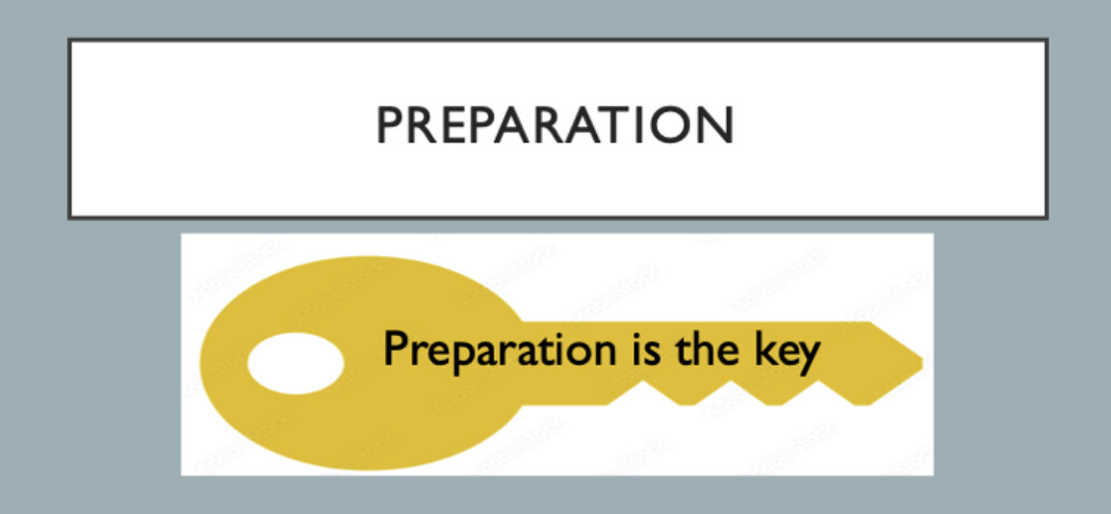
Preparation
Notes:
As a trainer, you will be provided with the curriculum and a set of PowerPoint slides providing the content for the training day
Your role will involve being knowledgeable about the content of the training and facilitating the training, based on this information
Bring your enthusiasm, experience, skills and knowledge to the session
It is important to engage with the participants as well as facilitate participant’s engagement with each other

Slide 7
Preparation
Your role as a trainer involves being knowledgeable about the content of the training and facilitating the training.
Bring your enthusiasm, experience, skills, and knowledge to the session!
Be prepared, organized, and diligent to ensure the training session will go as smoothly as possible.
Notes:
Be sure to always be prepared, organized, and diligent to ensure that the training session will go as smoothly as possible
If food is being provided for attendees, be sure to ask about allergies and dietary restrictions prior to starting the session
Inform learners about important landmarks such as washrooms, water fountains, automated external defrillator (AED), fire exits and exits
SLIDES
A link to the slides for the training session can be found in bed and each of the PV training manuals
It is recommended that you review them in advance of the session, and ensure that you have some method available for sharing them during the session. This might be a computer, projector, and slides during during a video conference of your teaching remotely.
They are speaker notes on most of the slides that you can also open them download them and add your own notes as you prefer. I usually save a Notes file as a PDF which can be printed or can be put on your iPad to refer to as you’re teaching.
Slides can be printed as handouts, for instance three to a page and made available to impersonal learners if you choose to do so

Slide 8
Starting a Session
Notes:
Starting a teaching session effectively sets the tone for the entire session and helps establish a positive and engaging learning environment

Slide 9
Starting a Session – In Person
Ensure that the physical space is arranged appropriately.
Set up necessary equipment, materials, and visual aids.
Arrange seating to facilitate interaction and engagement.
Notes:
When beginning a teaching session…read bullets on slide

Slide 10
Starting a Session - Virtual
Ensure everyone has access to the Zoom* meeting in advance.
Stable internet connection.
Cameras ON
* or whatever videoconferencing platform you are using
Notes:
Encourage (require?) learners to keep the cameras on. This creates an environment, which is much more conducive to sharing and feeling safe.

Slide 11
Starting a Session
In-person and Virtual sessions:
A training session requires engagement.
As the trainer, it is your role to find a way to engage the participants.
Introduce yourself and provide a brief outline for the day.
Ask the participants to introduce themselves and set guidelines for the introduction.
Use Ice Breakers.
Notes:
*The goal is to keep it brief and move on to a longer introductory activity with the group. *As the trainer, make note of the participant’s expectations and remember to address them.
*At the end of the day, ask the participants if their expectations have been met.
You might want to consider having more than one trainer present. This provides variety for the participants, potentially increased engagement, and less fatigue for a solo trainer.

Slide 12
Starting a Session
Welcome participants as they enter the classroom or join the virtual session.
Clearly communicate the learning objectives or goals for the session.
If the current session builds upon previous lessons…
Set the stage for the lesson by providing a relevant context or hook.
Smoothly transition to the main content.
Notes:
Welcome participants as they enter the classroom or join the virtual session
*Greet them warmly and establish a positive rapport
*Take a moment to connect with them individually
Clearly communicate the learning objectives or goals for the session
*What will participants achieve or understand by the end of the session?
*Provide a clear focus and sense of purpose for future peer visitors, and set expectations
If the current session builds upon previous lessons…
*Briefly review the key concepts or topics previously covered
*Help participants recall prior knowledge and establish continuity
Set the stage for the lesson by providing a relevant context or hook
*Capture participants’ attention and generate curiosity
*Describe a real-life scenario, ask a thought-provoking question, recount a captivating story, or state a surprising fact
Smoothly transition to the main content of the session
*Begin delivering the lesson material, providing explanations, and examples, and guiding students through activities or discussions as planned.

Slide 13
Technical Skills
Notes:
You will all be at different levels of comfort with using technology
The amount of technology that you’ll be using very much depends on the context
In a very small group, you may be using very little technology to teach
As a group gets larger, you may want to, for instance, you slides as we are doing today
Naturally, if you’re teaching remotely, there’s a fair bit of technology involved
You need to think about the technology you’re going to use in advance and make sure you’re comfortable with it while at the same time having a back up plan in case it fails

Slide 14
Technical Skills
Are you comfortable presenting and engaging with others virtually, via Zoom or Teams?
Practice a few times before your first training session.
How will you manage if the internet goes out?
Share your technical plan with the participants in your opening remarks and/or an earlier communication before the course.
Notes:
As trainers, you will be expected to effectively navigate and utilize technology in the modern educational landscape.
It is challenging today to go through the use of June zooms, or other programs such as teams; we recommend that if you’re going to teach your peer visitors remotely and you’re worried about technology that you contact us and we can set up a meeting to assist you in running a remote session.
ACC is planning to develop a short, two-hour, training for people who take the train the trainers course, but would still like to become more comfortable with teaching online.
No, but if you’re teaching your visitors remotely, we are suggesting that you also use Kahoot, which is already been pre-set up for you with questions; this information appears in the peer visitor training guide; slides that are included in the remote training manual include links, and pass code for Kahoot

Slide 15
Technical Skills – In person
Use appropriate language.
Pace lessons effectively.
Use visual aids.
Include breaks in the schedule.
Ask thought-provoking questions.
Provide clear explanations.
Vary your instructional strategies.
Notes:
Trainers should vary their instructional strategies to cater to diverse learning styles and engage all participants.
*This concept will be covered in an upcoming section called Teaching Adult Learners.

Slide 16
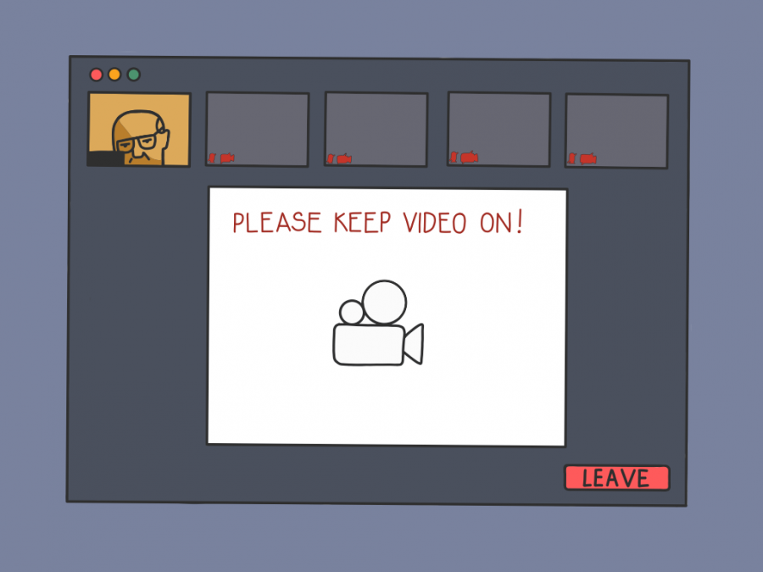
Technical Skills - Virtual
Make your own personalized notes in PowerPoint.
Urge participants to keep their cameras on during virtual sessions.
Run breakout rooms.

Slide 17
Section 2: Managing the Training Day

Slide 18
Group Dynamics

Slide 19
Group Dynamics
Group Dynamics
Change over time
Connection and experience
Group size
Working in pairs
Discussions
Engagement
Participation
Trust and cooperation
Notes:
Group dynamics refers to the patterns of interactions, relationships, and behaviors that occur within a group of individuals.
It involves the study of how people in a group influence and are influenced by each other, and how their collective interactions shape the overall functioning and development of the group.
Group dynamics can be observed in various contexts, such as classrooms, work teams, social clubs, and community organizations.

Slide 20
Group Dynamics
Group dynamics change over the length of time the group is together.
Establish connections and common experiences.
Provide opportunities to connect with one another.
Structure learning activities in pairs or small groups
Regroup to complete activities.
Notes:
Group dynamics change over the length of time the group is together.
Establishing connection and common experience helps the group move from initial discomfort at the beginning to shared experience at the end.
The first step is providing the opportunity to connect with one another.
Suggestions for initial introductions were included earlier in this document.
If you have a large group, 4 or more, structure learning activities in pairs or small groups to complete the initial part of the activity in break-out rooms and then regroup to complete the activities.
This will provide an opportunity for individuals to work together, and members of the group have the opportunity to get to know one another.

Slide 21
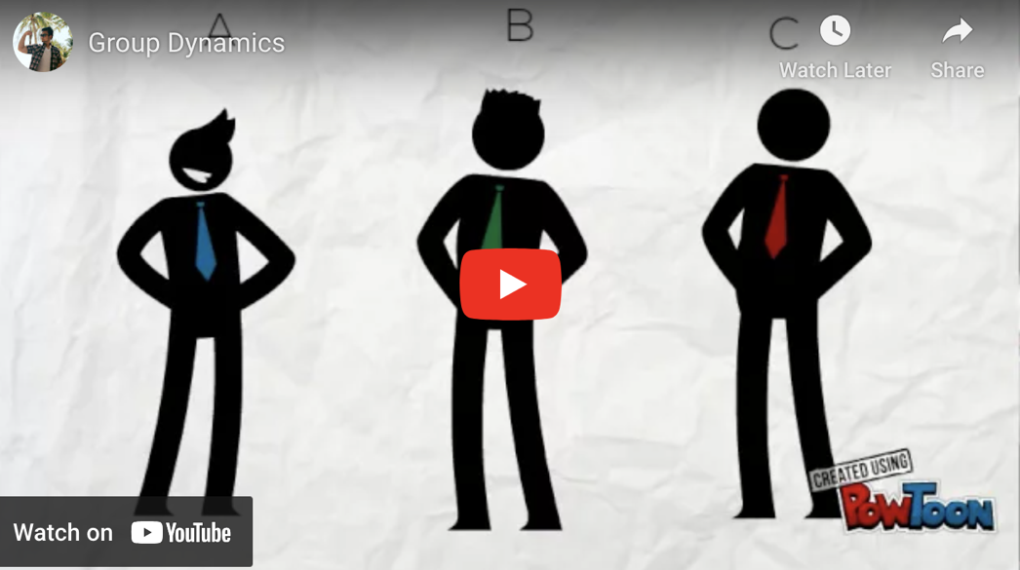
Group Dynamics
Notes:
Take a few moments and watch this short animation describing the concept of group dynamics (4 min).
Before displaying the next slide, ask participants to brainstorm the signs and challenges of poor group dynamics.

Slide 22
Group Dynamics
When group dynamics are not good, several signs and challenges may arise within the group:
Lack of communication.
Conflict and tension.
Low participation and engagement.
Lack of trust and cooperation.
Decision-making challenges.
Notes:
Group dynamics change over the length of time the group is together.
Establishing connection and common experience helps the group move from initial discomfort at the beginning to shared experience at the end.
The first step is providing the opportunity to connect with one another.
Suggestions for initial introductions were included earlier in this document.
If you have a large group, 4 or more, structure learning activities in pairs or small groups to complete the initial part of the activity in break-out rooms and then regroup to complete the activities.
This will provide an opportunity for individuals to work together and members of the group have the opportunity to get to know one another

Slide 23
Interpersonal Skills

Slide 24
Use a clear and understandable style to:
Explain
Explain concepts.
Present
Present ideas.
Provide
Provide instructions.
Notes:
Effective communication enables trainers to deliver information and knowledge to the learners. It involves explaining concepts, presenting ideas, and providing instructions in a clear and understandable manner. Without effective communication, learners may struggle to grasp the content being taught. Everyone has unique learning needs, and effective communication allows trainers to understand their students’ individual strengths, weaknesses, and learning styles. By actively listening to peer visitors and engaging in meaningful conversations, trainers can tailor their instructional methods, adapt their teaching strategies, and provide the necessary support to help students succeed.

Slide 25
Interpersonal Skills
Use effective communication to understand participants’ individual strengths, weaknesses, learning styles:
Actively listen to participants and engage in meaningful conversations.
Tailor your instructional methods and adapt your teaching strategies.
Provide the necessary support to help participants succeed.
Notes:
Effective communication enables trainers to deliver information and knowledge to the learners. It involves explaining concepts, presenting ideas, and providing instructions in a clear and understandable manner. Without effective communication, learners may struggle to grasp the content being taught. Everyone has unique learning needs, and effective communication allows trainers to understand their students’ individual strengths, weaknesses, and learning styles. By actively listening to peer visitors and engaging in meaningful conversations, trainers can tailor their instructional methods, adapt their teaching strategies, and provide the necessary support to help students succeed.

Slide 26
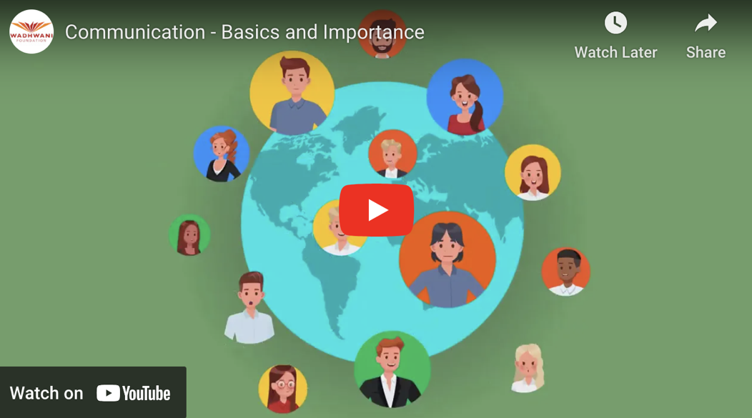
Interpersonal Skills
Notes:
Take a few moments to show the video highlighting the importance of effective communication – six minutes

Slide 27
Intentional vs. Unintentional Communication.
Understanding and Listening.
Paraphrase and Summarize.
Ask for Feedback to ensure participants are receiving the intended message.
Check Non-Verbal Communication.
Take a Step Back or Take a Break
Notes:
An example of intentional communication, is verbal communication: i.e. What would you like to do today?
An unintentional communication could be a person rolling their eyes, or shrugging their shoulders in response to the question, while directly saying, anything you want.
One obstacle in communication is understanding and listening.
As a trainer, you will want to clarify with the participants, that they have understood the material.
As a trainer, you want to be intentional in your communication.
Be clear when sharing information, and asking for feedback, to ensure the participants are receiving the message, you intended, in your communication.
Check-in with the participants, to see if they understand the material, by paraphrasing, summarizing, and asking questions of the participants.
Also, checking the non-verbal communication being shared by the participants. I.e.,
Have they disengaged?
Are they no longer responding to your questions?
If so, take a moment, to re-engage. Maybe a break is needed, maybe the information has been too intense, and need to take a step back, and ask the participants what they need.

Slide 28
Communication Effectiveness
Methodically guiding a conversation enhances communication effectiveness:
Promotes active participation.
Allows for sharing of personal experiences.
Facilitates learning and problem-solving.
Helps achieve desired outcomes.
Keeps session on track while being respectful of participants needs.
Notes:
Communication skills, used by the trainer during the session, could include paraphrasing, summarizing, questions, and verbal and non-verbal communication. Additionally, guiding a conversation enhances communication effectiveness, promotes active participation, facilitates learning and problem-solving, and helps achieve desired outcomes. It is a valuable skill that can lead to productive and meaningful discussions in various settings.
Lastly, an important topic to discuss would be time and classroom management. What do you do in a situation where someone asks questions all the time, to the point where things get off schedule? Given that we are an organization focusing on people who have experienced amputations, it is natural that when people meet, they will want to talk about their own experiences and associated traumas. Having the ability to methodically guide a conversation to stay on track while being respectful of a person is an asset.

Slide 29
Managing Conflict

Slide 30
Potential sources or causes of conflict:
Different perspectives and opinions.
Opposing styles and approaches.
Limited resources.
Power struggles.
Unmet needs.
…on personal, organizational, and societal levels.
Notes:
Conflict refers to a disagreement, clash, or struggle between two or more parties with incompatible goals, interests, values, or beliefs. It often involves a sense of opposition and can occur at various levels, such as interpersonal, organizational, or societal. Conflict can arise due to different perspectives, limited resources, power struggles, or unmet needs, among other factors.
Imagine a scenario where two colleagues, John and Jane, are working on a project together. They have different approaches and ideas on how to accomplish the tasks. John believes in taking a methodical and detailed approach, while Jane prefers a more creative and flexible approach. As they work together, conflicts start to arise. John becomes frustrated with Jane’s perceived lack of structure and feels that she is not putting in enough effort. On the other hand, Jane feels stifled by John’s rigidity and thinks that he is resistant to change. The conflicting styles and differences in opinion hinder their progress and create tension between them.

Slide 31
Methods of conflict mitigation:
Proactive Conflict Prevention.
Active Listening.
Learn Conflict Resolution Skills.
Follow Up.
Self-Reflection.
…be as unbiased as possible, avoid tunnel vision, and listen to the parties involved.
Notes:
Managing conflict is an important skill for trainers to cultivate, as conflicts can arise among trainers, between future peer visitors, and between future peer visitor trainers and the person(s) teaching the training session.
Conflict management allows individuals or groups to address and resolve underlying issues or disagreements. By engaging in constructive communication and finding common ground, conflicts can be resolved, and problems can be addressed. This leads to improved relationships and increased productivity. If left unaddressed or mismanaged, can escalate and strain relationships. By managing conflict in a respectful and constructive manner, individuals can better understand each other’s perspectives, build empathy, and find mutually agreeable solutions.This promotes healthier relationships, fosters trust and strengthens teamwork.
Proactive Conflict Prevention
- Establish clear expectations for behaviour and promote a culture of inclusivity, understanding, and mutual respect.
Active Listening
- Provide individuals with the opportunity to express their concerns, perspectives, and emotions without interruption. Show empathy, seek to understand their point of view, and acknowledge their feelings.
Learn Conflict Resolution Skills
- Provide explicit instruction on strategies such as active listening, effective communication, problem-solving, and negotiation. Encourage individuals to find common ground, seek win-win solutions, and collaborate to peacefully resolve conflicts.
Follow up
- Follow up with people involved in conflicts to ensure that the resolution is satisfactory and that any lingering issues are addressed.
Self-Reflection
- Engage in self-reflection and seek feedback from colleagues, mentors, or professional development opportunities to enhance your conflict management skills.

Slide 32
Teaching Adult Learners

Slide 33
Teaching Adult Learners
Keep training on schedule.
Recognize participants’ different styles of learning.
Check that participants are following along and engaging with the material.
Create opportunities to share individual experiences and knowledge.
Incorporate time for reflection.
Assess progress as a group.
Notes:
There are several theories that guide adult education, including. self-directed learning, experiential learning, and transformational learning.
Adults have multiple responsibilities and demands therefore it is important to keep the training on schedule.
Adults have different learning styles therefore it will be key, to check in with the participants that they are following along and able to engage with the material.
Assess as a group, if an additional short break is needed, or if material needs to be readdressed, if there is a lag in progressing through the material.
Adult learners bring a wealth of life experiences and prior knowledge to the learning process.
Acknowledge and value their experiences and create opportunities for them to share and reflect on their knowledge and insights.
It is also important to recall that people learn differently. For instance, John learns faster and retains information more easily by reading, on the other hand, Jane learns best by doing things hands on.

Slide 34
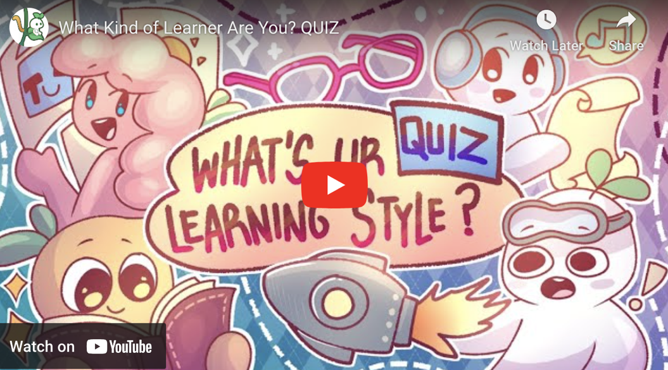
Teaching Adult Learners
Notes:
This quiz helps people determine their preferred learning style. There are four types of learning styles: auditory, visual, kinesthetic, and reading and writing. This is not a test of knowledge. The intention is to help people understand that they will be working with people with arrange of learning styles.

Slide 35
Teaching Adult Learners
Motivate participants by connecting content to real-life situations.
Demonstrate the relevance and benefits of what they are learning.
Incorporate a variety of teaching methods.
Offer options for individual learning methods.
Encourage participants to develop their self-directed learning skills.
Offer specific timely and constructive feedback.
Notes:
It should also be noted that people tend to be more motivated to learn when they can see the practical applications of the knowledge and skills being taught. Connect the content to real-life situations, work scenarios, or personal goals. Demonstrate the relevance and benefits of what they are learning.
It is also important to recognize that adult learners have diverse needs and preferences.
Provide flexibility in learning formats, delivery methods, and pace.
Offer options for self-directed learning, individualized projects, or alternative assessments.
Encourage adult learners to take responsibility for their own learning.
Facilitate their ability to set goals, self-assess, and seek resources independently.
Provide guidance and support as they develop their self-directed learning skills.
Adult learners benefit from timely and constructive feedback that helps them gauge their progress and make improvements.
Offer specific feedback that focuses on their strengths and areas for growth.

Slide 36
Section 2: How to Teach Each Section of the Guide
Notes:
If you planned this in advance (ie notified the learners what they will have to present), this is a great section in which to have the learners demonstrate some of the teaching of each of the sections.

Slide 37
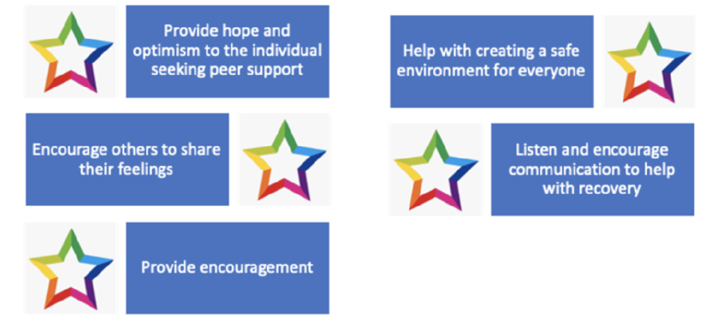
How to Teach - Peer Support
Notes:
General
Begin by asking learners if they have taken time to read the sections on peer support in both peer visitor training manuals, in-person and remote.
Define what peer support is or asking the learners what they think peer support is before teaching.
Inform trainers of ways or activities that will ensure that the learners will understand the content, asking open-ended questions mixed in with other questions that require more thinking.
Ensure the trainers are aware of the slides for peer support which they can use to teach learners.
Note the differences in adult learning and give the trainers activities that can help the learners take in the information based on their style of learning and also based on the content you are trying to teach.

Slide 38
How to Teach - Peer Support - In person
Instruct the trainers to encourage learners to share their understanding of what peer support is:
Provide suggestions on how to keep learners engaged.
Use visual aids such as PowerPoint or video.
Cover key concepts of Peer Support.
Refer to the prepared slides and Peer Visitor Training Manuals for clarification.

Slide 39
How to Teach - Peer Support - In person
Provide suggestions for a variety of learning styles:
Reading/Writing Learners.
Visual/Auditory Learners.
Kinaesthetic Learners.
Facilitate active group discussions.
Promote the importance of Peer Support.
Provide a list of Tips to review key concepts

Slide 40
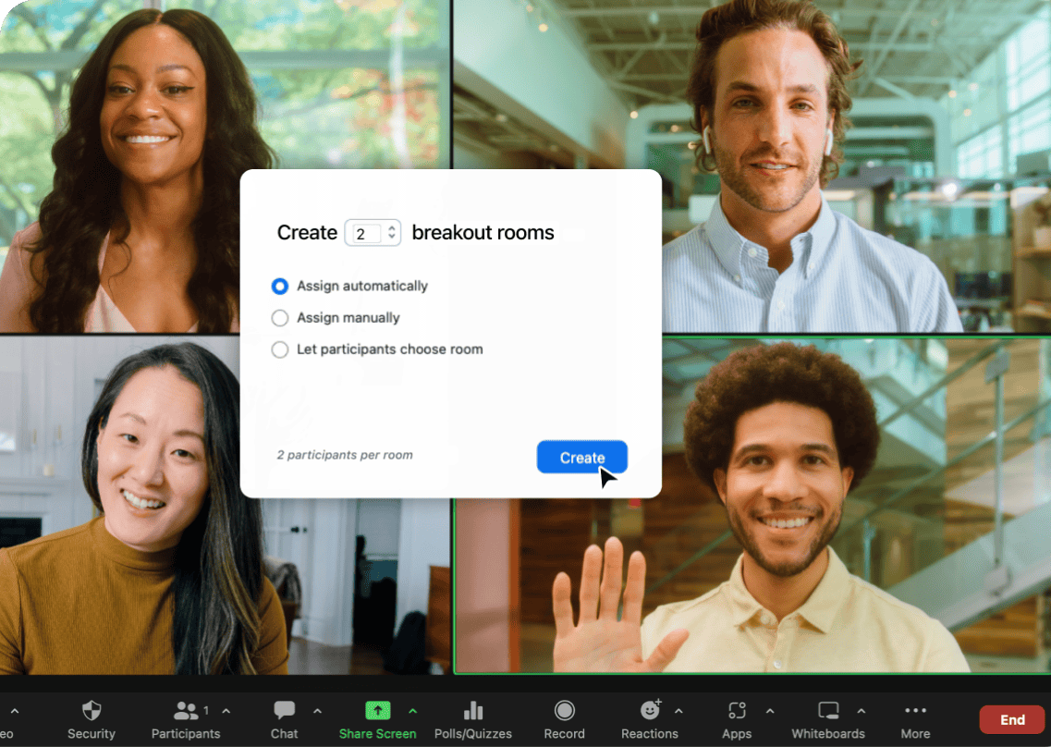
How to Teach - Peer Support - Virtual
Set guidelines to ensure participants are comfortable to ask questions.
Make sure cameras and microphones are on.
Keep the group engaged with more activities.
Include role playing and reflection into presentations.
Create breakout rooms to engage in group discussions.
Notes:
Note – we are planning to offer a two hour session online to help prepare people to teach virtually

Slide 41
How to Teach - Peer Support
Notes:
After the teaching show a video about what peer support is from a professional. (40s)
Consider not using or changing video – it may be difficult for some to follow the accent.

Slide 42
How to Teach - Roles and Responsibilities
Review the roles and responsibilities of Peer Visitors.
Discuss challenges and obstacles that can occur.
Suggest methods of effectively engaging hesitant Learners.
Transition from discussion to learning activities to encourage participation.
Incorporate reflective exercises to teach characteristics and competencies.

Slide 43
How to Teach - Roles and Responsibilities
Review what Peer Support Visitors are not and what they should not do.
Facilitate multiple role playing/scenario based exercises.
Prepare follow up questions for discussion of key concepts.

Slide 44
How to Teach - Roles and Responsibilities
To teach Ethics, trainers should:
Prepare a reflective exercise for learners.
Develop a way to check the understanding of learners and promote participation.
Discuss other effective methods to teach learners about ethics.

Slide 45
How to Teach - Roles and Responsibilities - Virtual
Engage Learners in discussion and activities.
Prepare role-playing exercises to teach characteristics and competencies.
Lead discussion and encourage participation to teach ethics.
Use breakout rooms.
Keep this section clear, concise, repeat key concepts.
Provide take-away resources.
Check understanding.
Notes:
Learning activities in the section of the pier visitor training include:
Pair and share: learners partner up and discuss an important role appear. Visitor should have based on their experiences.
Quiz: general knowledge, and telling the roles and responsibilities of peer visitors
Reflection: ask individuals to tasks appear visitor has based on their experience

Slide 46
How to Teach - Communication
Provide scenario-based group practice to demonstrate the importance of communication:
Verbal communication.
Non-verbal communication, body language.
Supportive communication, emotion.
Empathy vs. Sympathy.

Slide 47
How to Teach - Communication
Notes:
*To the train the trainer teacher - You may decide not to show the next FEW videos depending on the amount of time available. If each learner has been given an opportunity to practice teach, it will be unlikely to have the time to show these videos, and they are available in the peer visitor, guide, and in the manuals.

Slide 48
How to Teach – Communication
Suggest prompts for further discussion:
Facilitate sharing of personal experiences.
Make time for personal reflection.
Discuss barriers to communication.
Create awareness of “off limits” topics.
Silence as a communication skill.

Slide 49
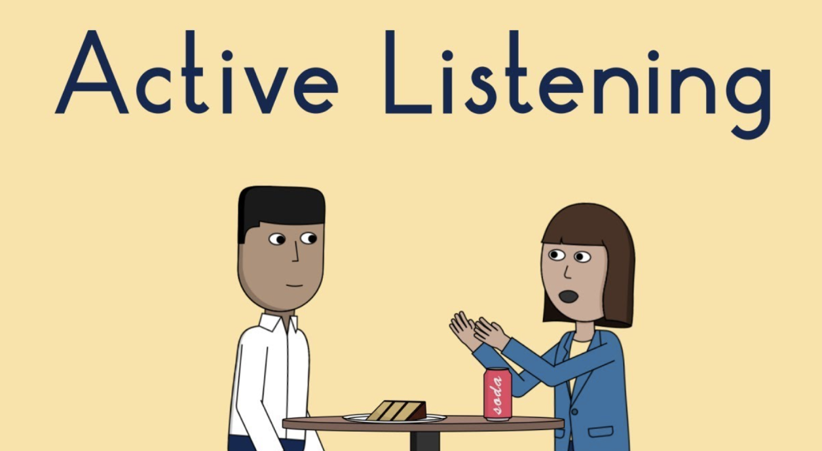
How to Teach - Communication

Slide 50
How to Teach - Communication

Slide 51
How to Teach - Communication Tips for effective remote teaching
Guide group discussion and use break out rooms.
Use questioning techniques that stimulate critical thinking.
Paraphrase, summarize, and ask clarifying questions.
Engage learners in role-playing scenarios.
Provide opportunities for feedback

Slide 52
How to Teach - Recovery
Content areas and activities
Guide discussion about the 6 phases of recovery.
Facilitate peer learning activities.
Share lived experiences.
Review the role of the Peer Visitor during each stage of recovery.
Discuss coping strategies and how amputees can utilize them.

Slide 53
How to Teach - The Visit
Content area(s)
Advantages of Peer Support Visits:
Promotes professional growth.
Sharing best practices.
Fosters a collaborative culture.
Provides opportunities for self-reflection and continuous improvement.

Slide 54
How to Teach - The Visit Setting up the Visit
Content areas:
Receiving referrals.
Prepare for potential challenges.
Strategies for providing feedback on sensitive topics, managing resistance, handling disagreements.
Setting goals, identifying areas of focus, specific needs or preferences.
Notes:
Discuss flow and strategies for training both in-person and virtual

Slide 55
How to Teach - The Visit During the Visit
Keep sessions interactive and engaging.
Combine presentations, group discussions, role plays, demonstrations.
Participate and share insights and experiences.
Active observation.
What you don’t want to happen during visits…
Notes:
Discuss methods for training both in-person and virtual
Learning Activities:
Simulation/Role playing/Group Activities to facilitate what a visit would be like. Remember to ask the proper questions, severity of amputation, conditions, or other relevant information to plan for a visit.
Conducting another simulation/role playing can be effective and also builds on planning for a visit
Can split into 2 groups of DOs and DONTs in different settings. For example, DO and DONTs in a hospital, persons home, or online

Slide 56
How to Teach - The Visit After the Visit
Content areas:
Follow up
Evaluation
Reporting
Notes:
Discuss methods for training both in-person and virtual
Provide access to additional resources, workshops, or conferences related to post-visit peer support.
Encourage trainers to stay updated with the latest research, best practices, and emerging trends in the field

Slide 57
How to Teach - Mental Health Support Content areas
Mental health conditions and their symptoms.
Impact on individuals’ lives.
Common mental health disorders and their prevalence.
De-stigmatizing mental health.
“Any support that people receive to protect or promote their mental health and psychosocial well-being.”

Slide 58
How to Teach - Mental Health Support Content areas
Grief, Depression, Anxiety.
Quality of Life.
Post Traumatic Stress Disorder.
Body Image Disturbance.
Self-care and Self-esteem Building.
Notes:
Remind trainers the role of peer visitors, and the importance of peer visitors roles when dealing with mental health issues.
Active listening skills and empathy
Importance of creating a safe, supportive, and non-judgmental space
Recognize and respect diverse cultural backgrounds, beliefs, and values
Provide inclusive and equitable support to individuals from different communities
Facilitate discussions and opportunities for reflection and learning from each other’s insights and expertise
Comfortable talking about grief, depression and suicide
Need to know the signals of depression/suicidal; Responsibilities of the peer visitor

Slide 59
How to Teach - Difficult Issues Content areas
Role of Peer Support and limitations.
How to spot difficult situations and deal with them.
Recognize the signs of suicidal thoughts.
Available resources and referral processes for professional intervention.
Sexuality and sexual health.
Notes:
Issues such as suicide and sexuality can be hard to talk about as a peer visitor; some persons might also find it difficult to teach this content to future peer visitors.
You might want to take a few moments, at the start of the section, to allow learners to share their thoughts about teaching the sections on difficult issues, which include suicide and sexuality.

Slide 60
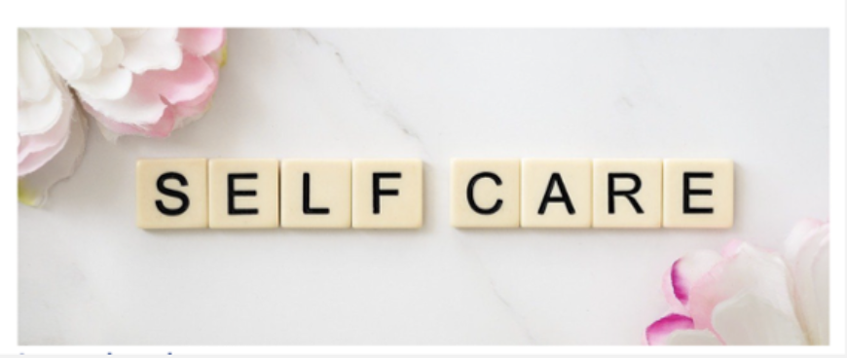
How to Teach - Self Care Content areas
What is Self Care?
Emotional
Practical
Physical
Mental
Social
Spiritual
Notes:
PV trainers will encourage learners wo:
Reflect on own self-care practices, boundaries, and well-being; seek support and self-care when needed.
Address common challenges individuals may face when engaging in self-care, such as time constraints, guilt, or feeling undeserving.
Teach strategies for overcoming these challenges and fostering a positive self-care mindset.
Exercise
Assess clients’ fitness levels, screen for any health risks, and adapt exercises accordingly.
Goal setting and action planning in the context of exercise.
SMART GOALS (Specific, Measurable, Achievable, Relevant, Time-bound)
Motivation
Nature
Shared experiences in connecting with nature.
Consider diverse needs, abilities, and cultural backgrounds when planning nature-based activities and to promote equal access to nature for all. Possible obstacles that may limit a person to use nature as self-care.
Offer other resources that can simulate nature or environment.
Mindfulness

Slide 61
Section 4: Ending the Training Day

Slide 62
Ending the Training Day
Recap main takeaways of the session.
Revisit original Learning Outcomes.
Provide contact information for follow up.
Evaluation of the session and trainer.
Notes:
In the last section of the train, the trainers manual, there is a section for FAQs; we hope that this will grow as each of you encounter, teaching challenges, and possible solutions, and share them with us
Because the manual is online and live, we can constantly update as we learn more
You will need to ensure, either on paper or electronically, that all the future. Visitors complete a pretest and post test. We are using this to gauge the effectiveness of the training program. You might find it helpful to send the survey out in advance of the session to assist you in planning the days teaching. In addition, there’s a post session evaluation that you need to ask learners to complete.
What do you do if someone should not be a peer visitor? I have the learners discuss this and strategize about how they would deal with it

Slide 63
Questions
Notes:
Remind the learners to let us know when they offer PD training in their region
This includes dates, how many were trained, as well as a list of trainees were eligible for certification with their contact information

Slide 64
Don’t forget to complete
the post-assessment and evaluation
THANK YOU!

