Slide 1
Holistic Care and Wellness in Early Years Settings
Chapter 6: Safety Promotion in Early Years Setting
Unless otherwise noted, this work is licensed under a Creative Commons Attribution-NonCommercial-ShareAlike 4.0 International (CC BY-NC-SA 4.0) license. Feel free to use, modify, reuse or redistribute any portion of this presentation.

Slide 2
Learning Outcomes
In this chapter, we will:
Understand policies and procedures related to the roles and responsibilities in the supervision of children and adults, including prohibited practices.
Identify the nature of childhood injuries, factors that increase the risk of occurrence and preventive strategies.
Awareness of emergency preparedness, evacuation routines, and serious occurrence reporting.

Slide 3
6.1 Ratios
Regulation:
Educators must comply with mandated ratios when working with children.
The ratio of adults to children decreases as the age of children increases.
Reduced Ratios:
Ratios in licensed childcare settings may be reduced during specific times such as the first 1.5 hours, last operational hour, and rest periods.
Infant programs and outdoor play must never be reduced.
Photo by Ron Lach, Pexels License.

Slide 4
6.2 Mixed Age & Family Age Groupings
Mixed Age Groupings:
Some licenses allow a small percentage of children to move to the next age group before reaching the designated age, with specific capacities defined.
These mixed age groupings help with smoother transitions when a child is ready to move up; details of such groupings must be outlined in the license before implementation.
Family Age Groupings
Family age groupings may take place in areas with smaller populations such as rural and remote locations.
Family age groupings support children in learning more about one another through mixed ages learning alongside one another.
Family age groupings must not exceed a group size of 15 children.

Slide 5
6.3 Supervision of Children I
Educators handle various tasks while supervising children and learn to ensure their safe supervision in busy settings.
Head counting is a crucial practice to track children's attendance and movement, preventing any child from being left behind during transitions.
Educators position themselves strategically for supervision during free play, especially in areas with larger groups or more risk-taking activities.
When working with younger children, educators closely monitor equipment usage for safety, never leaving children unattended on elevated surfaces. They develop the skill of stepping back or intervening appropriately to ensure safety, confidence, and self-esteem building.

Slide 6
6.3 Supervision of Children II
Field trips require enhanced supervision due to safety hazards.
Proper planning, permission forms, insurance coverage, and vulnerable sector checks for parent volunteers are crucial before field trips.
School vehicles for transport need to meet car seat regulations.
Consider a budget for fees and possible subsidies.
A field trip bag provides educators with a tool to carry important resources such as emergency cards, attendance sheets, medical plans, medications, etc.
“Kids at Kubota Garden, 2003 ” by Seattle Municipal Archives, from Flickr, CC BY 2.0.

Slide 7
6.4 Supervision of Adults
Student & Volunteers:
Students and volunteers must always be supervised by an employee or home childcare provider and can never be alone with children in licensed childcare centers or homes.
Once a student becomes an employee and completes orientation and training, they can interact with children like regular employees.
Supervision policies for students and volunteers are introduced during orientations to clarify interaction expectations with children in early years settings.
Prohibited Practices:
Licensed early years settings require policies to prevent prohibited practices, providing training and consequences for violations in orientations and ongoing training.
Prohibited practices are detailed in parent handbooks, essential for family comfort; these handbooks cover various aspects including services, fees, program statements, supervision, anaphylactic policies, concerns, and emergency preparedness.

Slide 8
6.5 Emergency Preparedness I
Emergencies:
Emergency cards with guardians' info, special medical details, and emergency contacts are prepared for each child and classrooms have phone lists with key numbers like 911 and poison control.
Accessible phones or cell phones in classrooms, outdoor areas, and on field trips aid emergency communication, while a travel bag containing emergency medications, medical plans, first aid kits, and more ensures quick response during emergencies.
Medication Storage:
Medications are stored in locked containers, both in classrooms and refrigerators, with portable access during drills and emergencies; keys are safely kept nearby.
Life-saving emergency medications like asthma inhalers and Epi-Pens are kept out of reach for children but easily accessible for adults; school-age children may carry these medications with guardian permission and staff support.

Slide 9
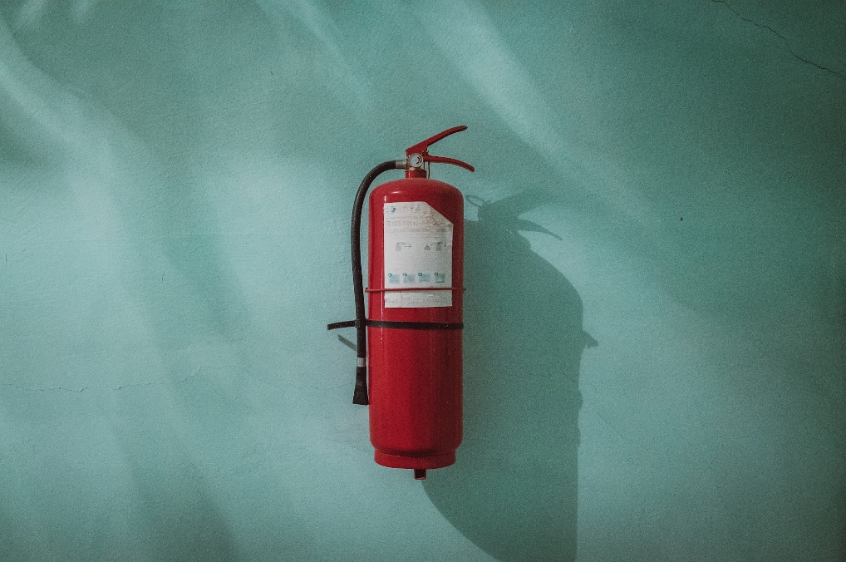
6.5 Emergency Preparedness II
Evacuation Procedures:
Evacuation plans with roles and responsibilities are created in consultation with local fire chiefs; monthly fire drills are conducted, documented, and filed for inspection.
Emergency locations are established and communicated to families, often with agreements in place; educators carry medications and medical plans during drills and evacuations.
Monthly fire drills involve children evacuating to safe outdoor spaces or emergency locations, led by a Director/Designate.
Photo by Piotr Chrobot, Unsplash License.
Notes:
The Director/Designate verifies attendance and completes a fire drill report after each drill.

Slide 10
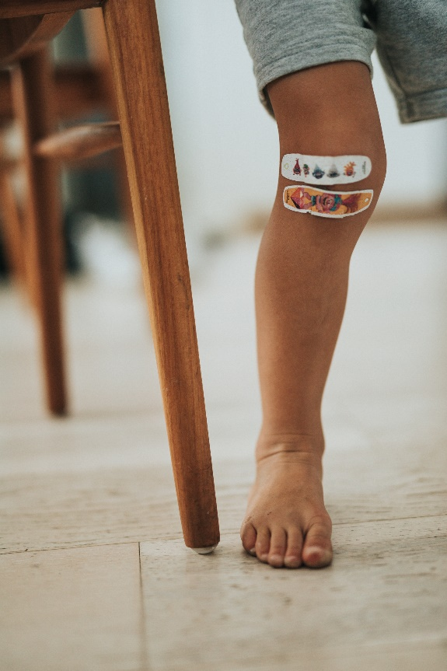
6.6 Incident Reports
RECEs understand accidents are normal in child development and help children learn from manageable risks while providing first aid when necessary.
Educators complete incident reports, and share them with families after accidents, including minor scrapes to more serious injuries.
Incident reports are kept in children's files for tracking patterns or future references, ensuring families are informed about distressing situations or injuries.
Incident reports are also used for other situations like biting or peer conflicts.
Photo by Nathan Dumlao, Unsplash License.

Slide 11
6.6 Biting
Biting is common among young children and can cause stress for both families involved; reasons for biting vary from expressing intense feelings to lack of language skills.
Incident reports must be completed for the child who was bitten, and communication with both families is crucial to provide reassurance and information.
If biting continues, temporary measures such as shadowing the child may be necessary; maintaining consistent routines and communication with families is important.
Skin-breaking bites need to be reported to public health; public health will follow up with both families to ensure safety and verify immunization records.
Photo by Nathan Dumlao, Unsplash License.

Slide 12
6.7 Outdoor Play & Playground Safety
Licensed early years settings in Ontario are required to incorporate outdoor play into their daily schedules, with a minimum of 2 hours of outdoor play per day for programs operating over 6 hours (OME, 2014). This outdoor play time can be divided into multiple periods to accommodate routines and weather conditions. Outdoor play is not only vital for children's physical health but also their learning and well-being. Nature-based experiences engage children's senses and positively impact mental health (Tillmann et al., 2018). Educators play a crucial role in promoting outdoor engagement and sharing its benefits with families, fostering a connection with nature beyond the child care setting.
Photo by Rashid Sadykov, Unsplash License.

Slide 13
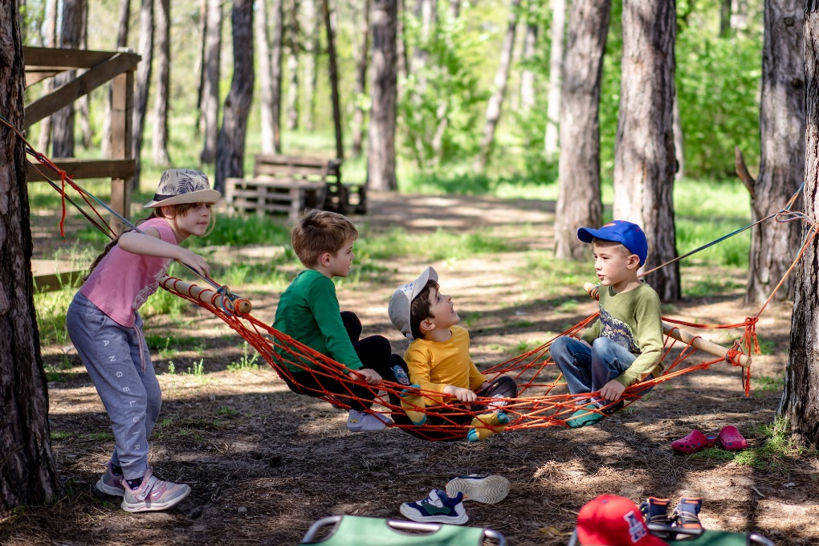
6.7 Playgrounds in Early Years Settings
Naturalizing outdoor play areas involves complying with playground safety standards; working with specialized companies and certified inspectors ensures safety while fostering a connection to nature.
Playground policies are developed with certified inspectors and advisors, guiding strategic educator placement for supervision, and addressing ratios, weather, inspections, and maintenance.
Outdoor play spaces have capacity limits set by program advisors.
Infant programs use strollers for nature walks, while toddlers utilize wagons; walking through neighborhoods enhances community connections.
Photo by Alexandr Podvalny, Unsplash License.

Slide 14
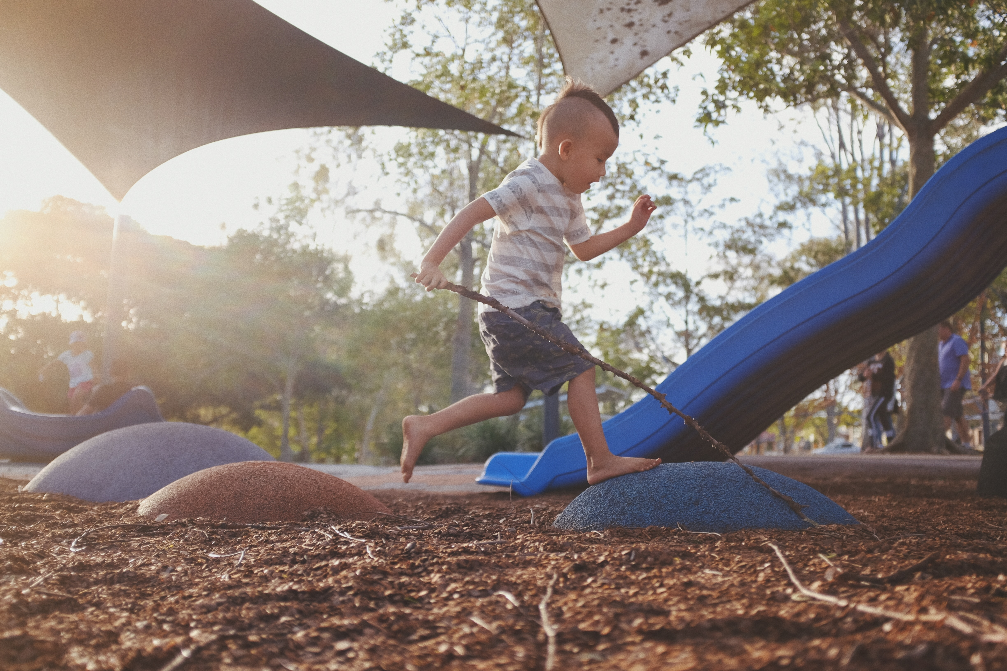
6.7 Playground Inspections
Daily inspections by educators are essential, involving sand area maintenance, equipment checks, and closure of unsafe areas.
Monthly inspections, performed by supervisors or licensees, are more thorough, closing unsafe areas and conducting repairs, with logs of repairs maintained.
Annual inspections by certified playground inspectors test impact surfaces, generate detailed reports, and require action plans for noncompliance, reviewed by program advisors and updated as needed.
Recommendations in annual reports may contribute to action plans for ongoing playground safety improvements.
Photo by Bambi Corro, Unsplash License.

Slide 15
6.8 Weather Safety
Early years settings in Southwestern Ontario face extreme weather conditions in both summer and winter.
Educators use resources and guidelines provided by early years organizations to ensure safe outdoor learning experiences, including sunscreen and appropriate clothing measures.
Environment Canada's data on UV Index, air quality, and temperatures help educators determine outdoor play durations and implement safety measures like water breaks or additional clothing layers.
Collaboration among educators helps schedule outdoor play during safer times, avoiding peak UV index or extreme cold hours, with local public health units also providing extreme weather alerts and safety information.
Educators tailor decisions based on the age group; infants may stay indoors while older children might have shorter outdoor play sessions during alerts, and recognizing signs of distress in children is crucial.

Slide 16
6.9 Safe Sleep Practices
Infant programs in early years settings promote safe sleep practices by encouraging infants to sleep in cribs, resulting in reduced Sudden Infant Death Syndrome (SIDS) rates.
The transition of infants into these settings may involve adjusting sleep habits, with some infants initially needing methods like swings or rocking to sleep.
Educators must transition sleeping infants to designated cribs, even though this may take time due to potential disturbances.
Infants often adapt to crib sleeping faster in early years settings than at home.
Photo by Helena Lopes, Unsplash License.

Slide 17
6.9 Sleep Supervision
Toddler and preschool programs provide designated cots for naps and quiet time, ensuring children's rest and comfort.
Each child should have an assigned cot, with sheets changed and cots sanitized between uses.
Children find comfort in the consistency of having their cot placed in the same spot daily.
Infants older than 12 months, who don't sleep in cribs at home, may have a child-sized cot in the infant playroom, supervised for safety.
Nap and rest periods must not exceed two hours, with exceptions based on family consultation and observed child needs.
Organizational policies dictate regular educator visual checks.
As children approach kindergarten, they may transition away from daily naps, with plans discussed with parents and quiet activities introduced; cots should still be available.
Older preschool programs may offer non-nap learning spaces, which must adhere to proper staffing ratios and cannot operate with reduced ratios.

Slide 18
6.10 Serious Occurrences
Serious occurrences in licensed early years settings necessitate investigations, reporting, and documentation according to Ministry of Education guidelines.
Licensed settings establish serious occurrence reporting policies and train employees, students, and volunteers during orientation.
Employees must recognize and report incidents that become serious occurrences, after administering necessary safety measures.
Investigations involve supervisors or licensees, relevant authorities like Children’s Aid Society and the Ministry of Education, contacting affected families promptly, and filing reports on CCLS.
Public notification form for serious occurrences is posted by the license, updated and displayed for 10 business days.
Licensees create an annual report to identify patterns, reviewed by program advisors during licensing visits.

Slide 19
6.11 Choking Prevention in Young Children
Preventative measures to reduce the potential for choking in young children are present in early years settings. This may include the elimination of certain types of foods, the reduction of small pieces, and the enhanced supervision of materials that may cause choking. With the use of loose parts in early years settings it is important that educators know the children well and understand their capabilities when engaging with loose parts. Close supervision must always take place when children are exploring small items.

Slide 20
6.12 Safe Drinking Water
Annual lead testing in early years settings' water supply ensures safe drinking water for children.
Lead's harmful effects on child development are well-known.
Early years settings minimize lead-containing products.
Lead flushing protocols are taught in orientation, ensuring regular water supply flushing by employees.
Flushing procedures must be documented and annual sampling is tested by a lab with results sent to the Ministry of Environment to ensure compliance.
Testing typically covers drinking sources like kitchen sinks and water fountains.
Photo by Daniel Hooper, Unsplash License.

