Slide 1
Holistic Care and Wellness in Early Years Settings
Chapter 3: Illness Prevention and Management
Unless otherwise noted, this work is licensed under a Creative Commons Attribution-NonCommercial-ShareAlike 4.0 International (CC BY-NC-SA 4.0) license. Feel free to use, modify, reuse or redistribute any portion of this presentation.

Slide 2
Learning Outcomes
In this chapter, we will:
Explain the policies and procedures for reducing the spread of infection and maintaining children’s health and well-being.
Ability to connect legislative and administrative policies to procedures necessary for effectively managing illness in self and in the early years setting.

Slide 3
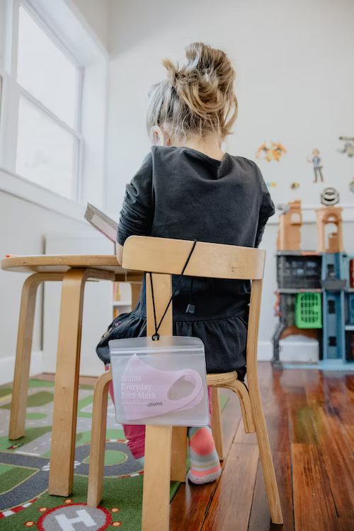
3.1 Illness Prevention in Early Years Settings
Enrollment in licensed child care programs in Ontario ensures children follow the provincial immunization schedule, protecting them and the community from preventable diseases.
Early years settings prioritize safe and healthy environments, implementing measures like hand hygiene, health checks, and disinfection routines to prevent the spread of illness. Mental health in these settings gained importance during the Covid-19 pandemic, with resources provided to support children and caregivers.
Photo by Kelly Sikkema, Unsplash License.

Slide 4
3.2 Immunizations
Vaccination has been a longstanding practice to prevent illness and protect families in Canada and globally. During the COVID-19 pandemic, misinformation about vaccines became widespread, requiring public health to provide additional support to help families understand the value of vaccinations. Educators play a role in assisting families by providing reliable resources and understanding immunization legislation and exemptions.
Vaccines prevent illness and protect families.
Immunization records must be kept up to date for enrollment in licensed child care.
Ontario's vaccine schedule guides timing and required vaccines.
Exemptions allowed for medical, philosophical, or religious reasons with proper documentation.

Slide 5
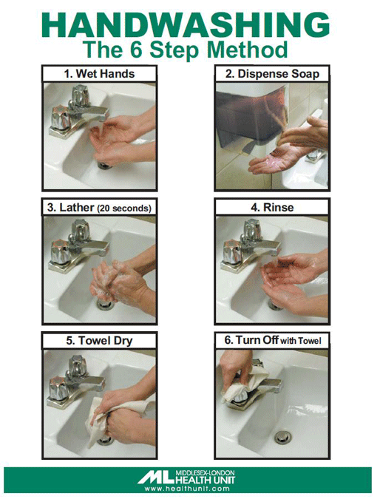
3.3 Hand Hygiene
Handwashing is vital to prevent illness in educational settings, and hand sanitizer is not a substitute for proper handwashing. Educators should teach and model handwashing techniques, using songs to make it enjoyable for children. Hand sanitizer can be used by educators in certain situations when handwashing is not immediately accessible. However, it should not be used after diapering or helping with toilet use, and handwashing remains the preferred method of hand hygiene for young children.
Photo reproduced with the permission of the Middlesex-London Health Unit.

Slide 6
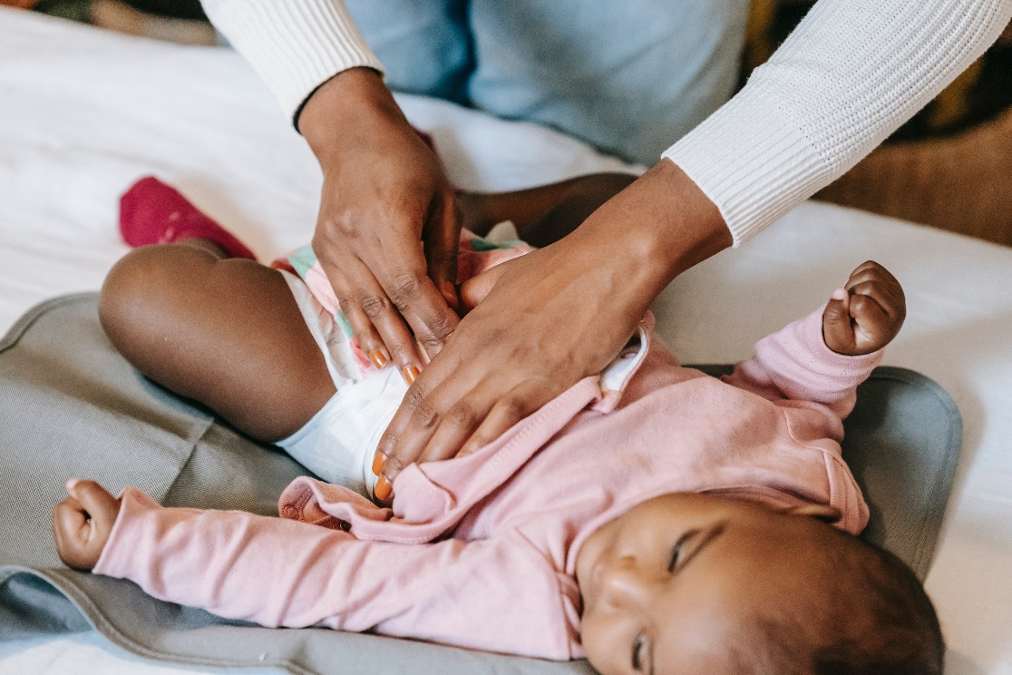
3.4 Diapering and Toileting
Diapering and toilet training are significant routines in early years settings that promote autonomy and control for young children. Educators and caregivers should collaborate to establish a consistent plan for toilet training. Creating a trusting and supportive environment is crucial for success. During diaper changes, educators can engage with children, explain the process, and involve them in certain tasks. Respect for children's autonomy is essential, and choices should be provided. Safe and hygienic practices must be followed during diapering and toileting to ensure the physical well-being of children.
Photo by William Fortuanto, Pexels License.

Slide 7
3.5 Cleaning and Disinfecting
Cleaning and Disinfecting Tasks:
Wiping down tables and chairs, sweeping and mopping floors, maintaining surface cleanliness and tidiness.
Cleaning and Disinfecting Solutions:
Bleach and water solutions for disinfection, prepared daily for efficacy and using low to intermediate level chlorine (bleach) solutions.
Proper Handling of Cleaning Products:
Specific training for storage, handling, and use of disinfection products, following protocols to ensure safety when working with chemicals or cleaning products.

Slide 8
3.6 Mental Health in the Early Years
Covid-19 impacts on early years settings:
Physical health and safety measures
Licensed child care remained open for essential workers
Challenges and ongoing mental health support
Ministry support for educators:
Shifting focus to social and emotional well-being
Pedagogical approaches in re-opening programs
Changes in practices and communication:
Limited interactions and virtual tours
Utilization of digital platforms for communication and documentation
Photo by Pavel Danilyuk, Pexels License.

Slide 9
3.7 Illness Management
Educators in early years settings prioritize the health and wellness of children by following public health protocols and policies. Families need to be aware of illness exclusion policies before enrolling their children, and educators collaborate with them to support the well-being of all children. Daily health checks, connection to community resources, and adherence to public health guides contribute to a safe learning environment.
Educators follow health protocols and policies to prioritize children's health and wellness.
Families should know illness exclusion policies before enrolling their children.
Educators collaborate with families to support the well-being of all children.
Daily health checks, community resource connections, and public health guides enhanced safety.

Slide 10
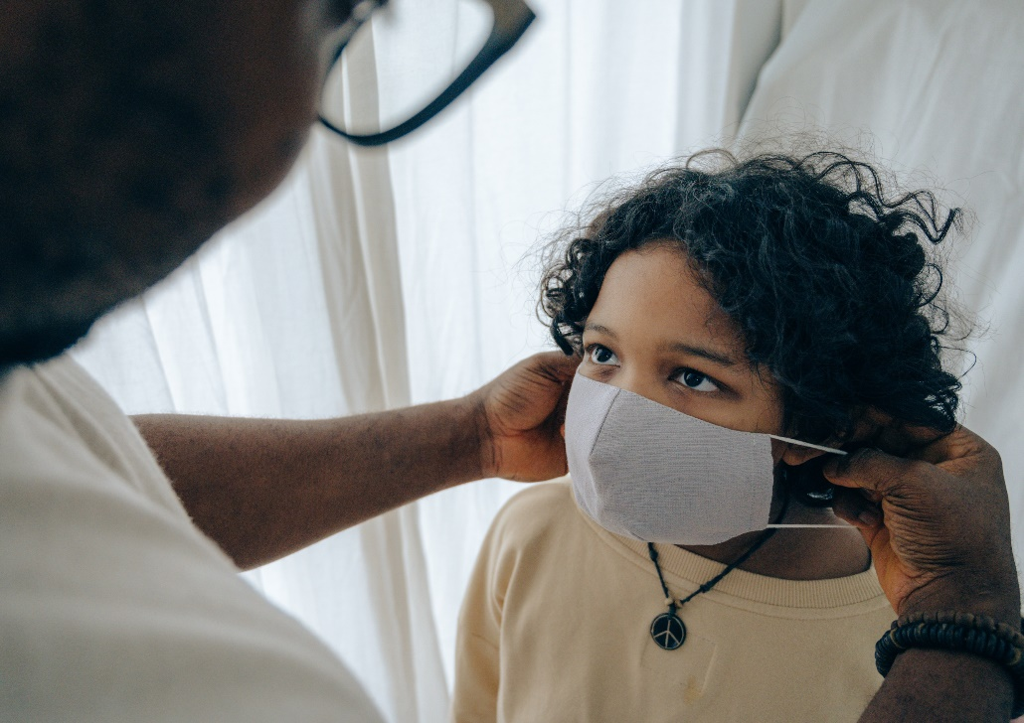
3.8 Managing Outbreaks in Early Years Settings
During an outbreak in a child care setting, public health may declare the outbreak when multiple individuals exhibit similar symptoms within a short time frame. Enhanced infection control measures are implemented, and child care operators must track and report cases to the local public health unit.
Outbreaks declared when multiple individuals show similar symptoms in child care.
Enhanced infection control measures implemented.
Child care operators track and report cases to public health unit.
Photo by Ketut Subiyanto, Pexels License.

Slide 11
3.9 Asthma and Allergies
Children attending early years settings may have asthma or anaphylactic allergies, which require proper planning and protocols to ensure their safety. Licensed child care programs must collaborate with families and medical professionals to develop and implement individualized plans for children with asthma or life-threatening allergies.
Life-threatening conditions: asthma and anaphylactic allergies
Licensed child care require policies, training, and individualized plans
Policies include exposure reduction and communication strategies
Care plans developed alongside families and medical professionals
Photo by Luci, Pexels License.

Slide 12
3.10 Medical Plans
Individualized Medical Plans: Developed for children with conditions/devices, guiding symptom recognition, medication administration, and emergencies.
Medication Administration Policies: Reviewed by educators/staff/students/volunteers. Posted in classrooms, accessible during activities/trips, with locked medicine box.
Prescription Medication: Must be in original container with label. Educators verify permission form matches label. Administered as prescribed, documented to avoid double dosing.
Non-Prescription Medication: Administered cautiously, doctor's letter required. Original container labeled with child's name. Administration documented each time.
Topical Ointments: Families provide lotions/ointments. Educators ensure allergen-free options. Labeled with child's name, expired ones returned. Children may apply when capable.

