Slide 1
Holistic Care and Wellness in Early Years Settings
Chapter 2: Health Promotion
Unless otherwise noted, this work is licensed under a Creative Commons Attribution-NonCommercial-ShareAlike 4.0 International (CC BY-NC-SA 4.0) license. Feel free to use, modify, reuse or redistribute any portion of this presentation.

Slide 2
Learning Outcomes
In this chapter, we will:
Articulate the legislation and recommendations of Canadian and local health care systems for children birth to 12 years;
Analyze, evaluate and apply relevant information from a variety of sources;
Collaborate with children, families, colleagues, agencies, and community partners to create, maintain, evaluate and promote safe and healthy early learning environments to support independence, reasonable risk-taking and healthy development and well-being.

Slide 3
2.1 Public Health in Canada
Health Definition
“The World Health Organization (W.H.O.) offers a simple definition of health as “a state of complete physical, mental, and social well-being, and not merely the absence of disease or infirmity”. “Social well-being” is an important aspect of this definition that may not always occur to us in thinking about our health” (Government of Canada, 2008).
Source: World Health Organization. (2023). Constitution.
Canada upholds children's rights based on the UNCRC, and public health agencies support health promotion efforts. Local health units played a crucial role in guiding the early years sector during the COVID-19 pandemic
Children's rights upheld based on the UNCRC.
Health promotion includes social and environmental interventions.
Public health agencies collaborate with local units.
Local health units oversee various settings.
Public health units guided the early years sector during COVID-19.

Slide 4
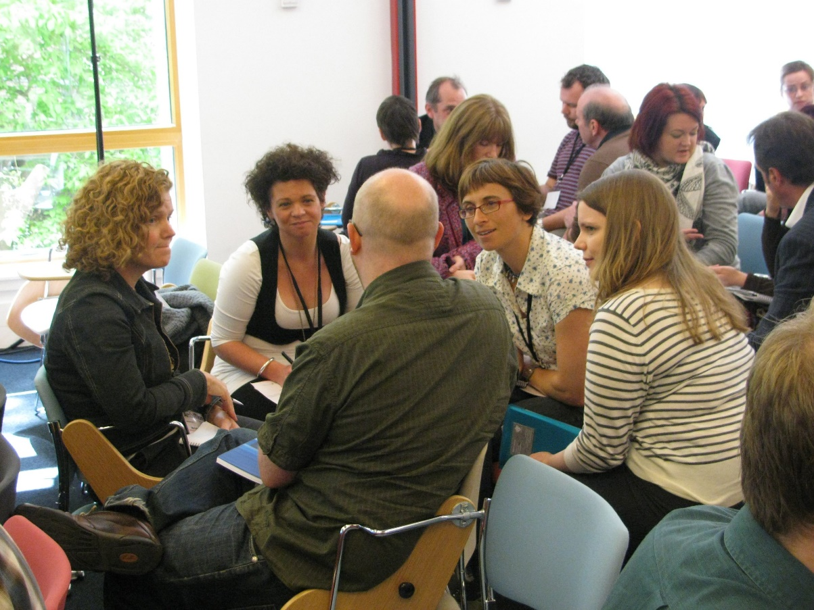
2.1 Interprofessional Collaboration
Welcoming and belongingness for all individuals in early years' settings with diverse worldviews.
Collaboration among community agencies to promote healthy living and well-being.
Child and Youth Network (CYN) supports children and youth through collaboration with over 170 agencies in London and Middlesex.
Photo by Culture Republic, CC-BY-ND.

Slide 5
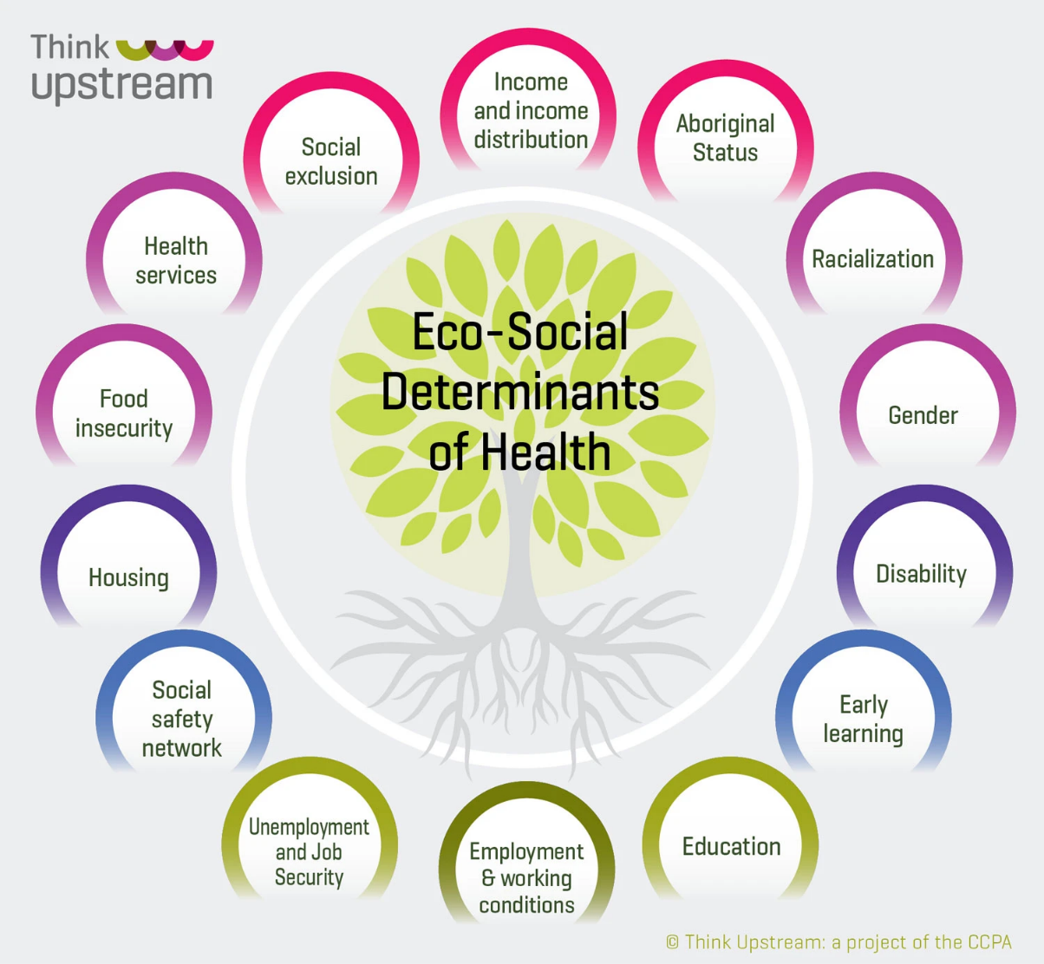
2.3 Social Determinants of Health
Social determinants of health impact children, families, educators, and communities. Early years' settings promote diversity, equity, and inclusion. Educators advocate and disrupt dominant discourses. Think Upstream project provides additional considerations.
Social determinants: income, education, discrimination.
Early years' settings promote diversity, equity.
Educators advocate, disrupt discourses.
Think Upstream project for additional considerations.
Eco-Social Determinants of Health by Think Upstream.

Slide 6
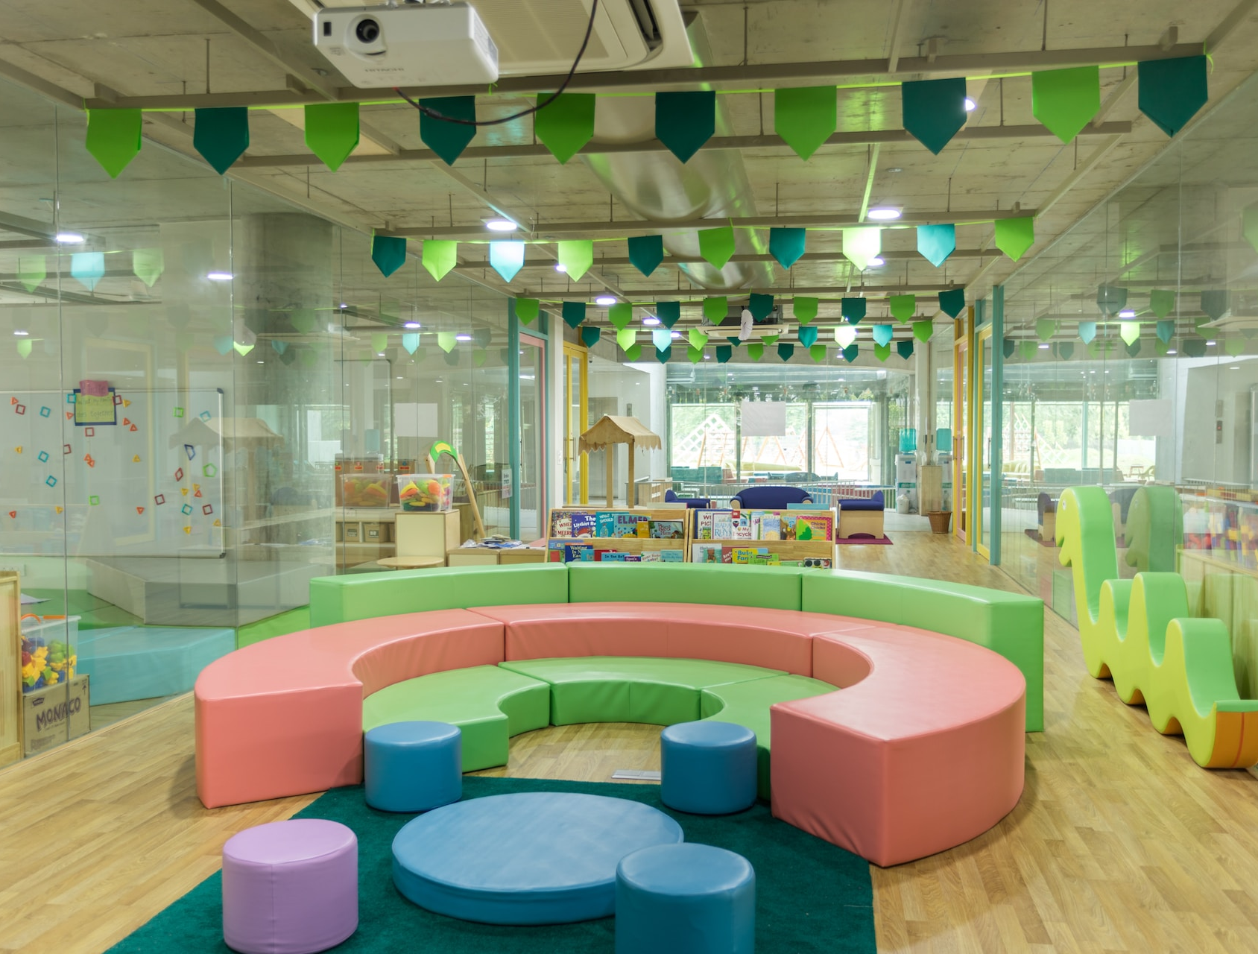
2.4 Safe Spaces, Accountable Spaces
Safe spaces play a crucial role in promoting health for young children. Compliance with regulations and the implementation of accountable spaces are essential for protecting the well-being of children in early learning programs.
Safe space regulations:
Building codes, fire codes, and safe drinking water mandates
Inspections and potential citations by regulatory bodies
Accountability in early learning:
Child Care and Early Years Act, 2014 (CCEYA)
Licensees responsible for addressing inspector concerns
Social well-being importance:
How Does Learning Happen and The Kindergarten Program frameworks
Four foundations: belonging, perspective, safety, and well-being
Photo by Gautam Arora, Unsplash Licence
Notes:
Safe spaces support health promotion
Regulated by codes and mandates
Noncompliances may result in citations
Child Care and Early Years Act, 2014 (CCEYA)
Licensees accountable for safe spaces
Consideration of social well-being
Importance of social well-being
Learning frameworks: How Does Learning Happen (2014) and The Kindergarten Program (2016)
Four foundations: belonging, unique perspective, safe environment, well-being
Creating inclusive and diverse learning spaces
Reflecting children, families, and educators
Learning from diverse abilities, traditions, beliefs
Communication with families for support
Co-construction of knowledge
Welcoming and accountable spaces
Encouraging diverse perspectives
Communicating needs
Setting up social and physical environments

Slide 7
2.5 Inequities in Health Promotion
Awareness of inequities:
Educators need to be aware of inequities to provide support.
Children, families, and educators face various adversities.
Unequal access to resources and support:
Not all children have equal access to financial security, responsive relationships, etc.
Barriers to resources and protection from discrimination exist.
Environmental racism:
Systemic issue impacting children and families in Canada.
Contradicts the promotion of health in Canada's political system.

Slide 8
2.6 Environmental Racism
Environmental racism persists as a significant issue embedded within Canadian society, particularly affecting marginalized children and their families. The colonial structure present in various systems necessitates awareness of these inequities and a commitment to advocate for change. Promoting healthy living for all children requires addressing environmental racism and its impact on their well-being.
Advocacy and awareness are crucial in promoting healthy living for all children and addressing the inequities caused by environmental racism.
Statistics indicate that Black and Indigenous communities in Canada disproportionately face discrimination and environmental racism.
Educators play a vital role in supporting children and families affected by environmental racism, advocating for change, and accessing resources to promote well-being.

Slide 9
2.7 Child Maltreatment
CECE Standard VI: Confidentiality, Release of Information and Duty to Report
Registered early childhood educators (RECEs) respect the confidentiality of information related to children and families and obey all laws pertaining to privacy and the sharing of information. RECEs disclose such information only when required or allowed by law to do so or when necessary consent has been obtained for the disclosure of information. They understand that as a result of their professional knowledge and role, they are in a unique position to recognize possible signs of child abuse, neglect and family violence, and have a particular duty to report their suspicions (CECE, 2017).
Child maltreatment adversely affects children's health and well-being, with potential long-term physical and mental health consequences. Early years educators conduct regular health checks and foster responsive relationships to promote positive growth and development. They also have a responsibility to report suspected abuse or neglect.

