Slide 1
Pre-Health Science: Pathways to Success
Chapter 7: Learning & Knowing Yourself

Slide 2
7.0 Learning Objectives
After reading this chapter, you should be able to do the following:
Discover the different types of learning and what is currently influencing your learning
Make informed and effective learning choices in regards to personal attitude and motivation
Evaluate and make informed decisions about your learning styles and learning skills
Identify resources to help you take responsibility for your own learning journey
Identify resources to assist you with special learning needs
Recognize how academic success connects to career success

Slide 3
7.1 Learning & Knowing Yourself
Learning is a Process:
It is important to recognize that learning is work. Sometimes it is easy and sometimes it is difficult, but there is always work involved.
Video: Study LESS Study SMART

Slide 4
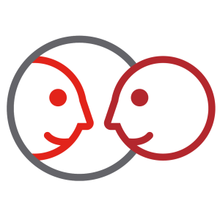
7.2 Self- Assessment
How do you feel about your learning abilities? Take this quick survey to figure it out.
Learning for me is easy. I don’t even have to think about it.
I feel like I learn better when information is presented in one specific way.
If I can’t learn something right away, I have difficulty staying with it.
I think my teachers are the most significant aspect of my learning.

Slide 5
7.3 What is Learning?
Putting info “in”
Perceiving information through 5 senses
Memory
Brain encodes and stores in short-term memory
Brain stores in long-term memory
Recalling stored info
Taking info “out”

Slide 6
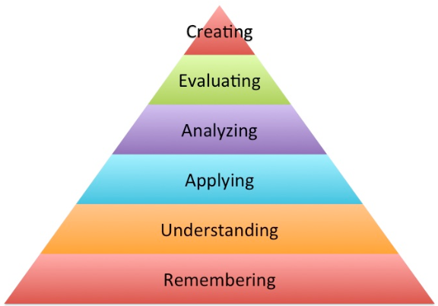
7.3 What is Learning?
Learning is cumulative
Bloom’s Taxonomy categorizes levels of learning
Create – Produce new ideas
Evaluate – Justify or support an idea
Analyze – Draw connections
Apply – Use info in new ways
Understand/Comprehend – Explain ideas or concepts
Remember – Recall facts and basic concepts
"Bloom's Taxonomy" by Andrea Hernandez, CC BY-SA 2.0

Slide 7
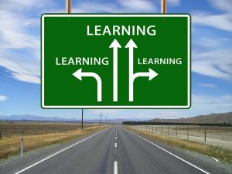
7.4 What Influences Your Ability to Learn?
Traits of Successful Learners
Your Attitude Toward Learning
Your Motivation
Performing AND Learning?
Your Mindset – Fixed vs. Growth Mindset
Photo by Gerd Altmann, Pixabay License

Slide 8
7.4 What Influences Your Ability to Learn?
Are you motivated by performance or learning?
Fixed Mindset
Performance goal-oriented student
Growth Mindset
Learning goal-oriented student
Wants good grades
Wants to understand concepts

Slide 9
7.5 How Might Preferences, Culture and Personality Impact My Learning?
Learning Preferences
Cultural Preferences
Personality Types
Myers-Briggs: Identifying Personality Traits and Styles
Taking Responsibility for Your Learning
Exercise: Learning Preferences

Slide 10
7.6 Learning Challenges
Challenges may include: circumstantial, environmental, self-inflicted, disabilities, etc.
Identifying your personal challenges is crucial for success
Systemic barriers – harassment, racism, violence, etc.
Accessibility – mobility impairments, learning disabilities, etc.
Accommodations – financial support and assistance, priority access to housing
©Fanshawe College
Notes:
Colleges offer support for those with permanent disabilities (and some temporary disabilities). Those with documented disabilities have special legal rights to certain accommodations. Even those whose disabilities are not diagnosed can receive some accommodations.

Slide 11
7.7 Learning Online
Reflective Practice
How is online learning different from in-person learning?
What skills will I need to develop that are specific to online learning?
What is “blended” learning?
Try This: Online Learning Readiness Indicator

Slide 12
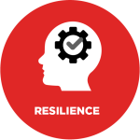
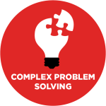
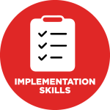
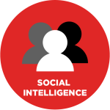
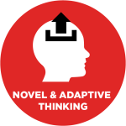
7.8 Take Action – Take Charge of Your Learning Experience
Making Decisions About Your Own Learning
Make Mistakes Safe
Make Everything Problem Centred
Make It Occupation Related
Make the Most of Your Time
Make Fanshawe Faculty Your Partners in Learning

Slide 13
7.9 Reflective Activities
Do you know your learning style and learning Preference? Watch the TEDx Video and complete the reflective activities to help you understand your own learning preferences, the results may surprise you!

Slide 14
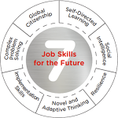
7.10 Career Connections
Developing your self-directed learning skills will help you develop your novel and adaptive thinking skills, and implement solutions to solve complex problems.
View these tips on how understanding learning styles will help you in your career.
“Silex Job Skills For the Future” © Fanshawe College
Notes:
comment./reflect and refer to text

Slide 15
7.11 Fanshawe Resources
Fanshawe College Learning Supports
The Library Learning Commons
The Prepare to Learn Series
Accessibility & Accommodations
Indigenous Learning Centre
Peer Tutoring
Notes:
Same as above –statement

Slide 16
7.12 Knowledge Check
Reflective Practice
Do you keep a journal? One way to combat negative bias is to keep a “gratitude and accomplishment” journal. What accomplishments could you list in that journal? What are you grateful for?
Are you a self-directed learner? What can you do to take control of your own learning?
Preference, culture, and personality impacts our learning. How might they also impact your career in healthcare?

