Slide 1
Pre-Health Science: Pathways to Success
Chapter 3: Job Skills for the Future

Slide 2
3.0 Learning Objectives
After reading this chapter, you should be able to do the following:
Define the 7 Job Skills for the Future
Identify personal skills and knowledge as it pertains to Job Skills for the Future
Relate the 3 Job Skills emphasized in the Pre-Health Science program to knowledge and skills gained while in the program

Slide 3
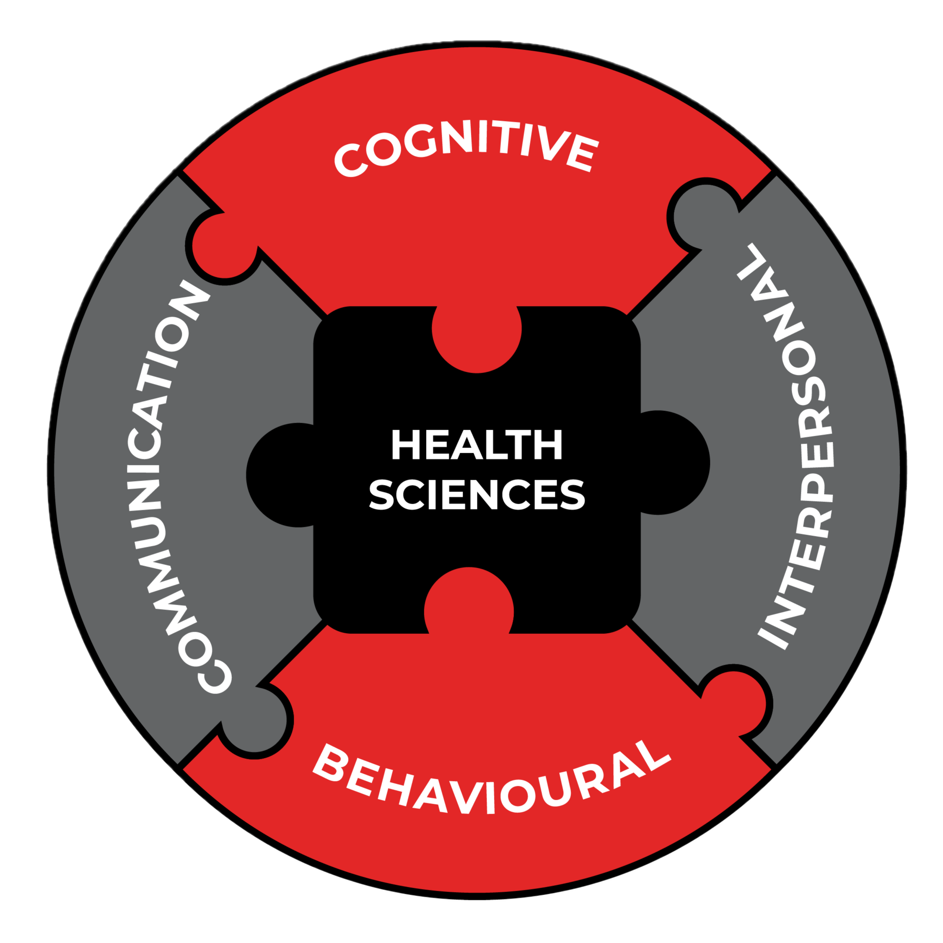
3.1 Health Perspective
“Don’t give up. You might have to take a different route than other people, but that will make you stronger than you know. It will give you more life experiences and skills that will help you in the nursing field later.”
Melanie Mitchell Sparkes, Pre-Health Science Graduate and BScN Year 4 Student

Slide 4
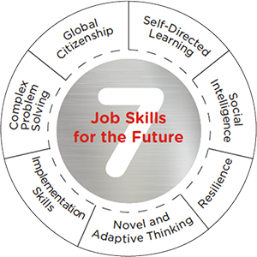
3.2 Seven Job Skills
Going Forward
Fanshawe College has identified 7 Job Skills for the Future that all programs in the college embed into their curriculum.
Pre-Health Science will cover each job skill listed with specific focus on self-directed learning, resilience, and complex problem solving.

Slide 5
3.3 Global Citizenship
Create an awareness of the wider world and your place in it.
Global citizenship is having a worldview grounded in civic responsibility and ethics. Global citizens think both on a structural level and an individual level.
A global citizen:
learn from and with others who are different from themselves
examine ideas such as privilege and relative positions of power
are committed to social justice and to breaking down global inequities

Slide 6
3.4 Self-Directed Learning
Being a self-directed learner is being autonomous, organized, and self-disciplined.
Excelling in Self-directed Learning as a Job Skill means:
You can:
Take initiative to learn
Work towards solving real-world problems trying to find efficient solutions
Adapt and learn as needed
Not fear change
Be accountable
Be punctual

Slide 7
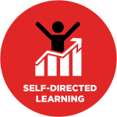
3.4 Self-Directed Learning
Excelling in Self-directed Learning as a Job Skill means:
Others see you as:
Acting without being told to
Assessing your own abilities – strengths and weaknesses
Adapting to new technology
A motivated/driven person

Slide 8
3.5 Social Intelligence
Social Intelligence is being able to interact positively with others, building strong healthy relationships, and thriving in social environments.
Excelling in Social Intelligence as a Job Skill means:
You:
Have a passion for working with others towards positive outcomes
Are curious about the world and the people in it
Care about others
Have good emotional control (Emotional Intelligence)
Listen with intent and exhibit strong conversational skills

Slide 9
3.5 Social Intelligence
Excelling in Social Intelligence as a Job Skill means:
Others see you as:
Having respect for diverse opinions, values, belief systems and the contributions of others
Having a constantly renewed sense of curiosity and wonder
Having a willingness towards helping others
A good listener and communicator

Slide 10
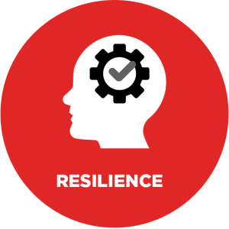
3.6 Resilience
Resilience is the ability to thrive while overcoming obstacles.
Resilience and Pre-Health Science
In PHS you will have many opportunities to develop the Job Skill of Resilience.
Due to the rigour of the program, time-management skills required to be successful.
Level one courses are all pre-requisites for level two. Students must recognize areas for improvement and not give up, but use the many resources in the program, as well as the college facilities.

Slide 11
3.7 Novel And Adaptive Thinking
Being a Novel and Adaptive Thinker means being creative in analysis and solutions.
Excelling in Novel and Adaptive Thinking as a Job Skill means:
You are good at:
Synthesizing data and information
Analyzing
Evaluating
Making sound, ethical decisions
Thinking innovatively and creatively
Not getting too attached to outcomes

Slide 12
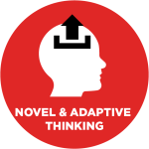
3.7 Novel And Adaptive Thinking
Excelling in Novel and Adaptive Thinking as a Job Skill means:
Others see you that have the ability to:
Apply a logical, systematic approach to solving problems
Create solutions that balance facts and feelings
Inspire increased trust from others

Slide 13
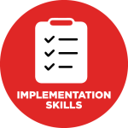
3.8 Implementation Skills
Manage projects to achieve key milestones and outcomes
Excelling in Implementation skills means an individual has a “get ‘er done” attitude.
They can design, manage, and execute projects, initiatives or plans in an organized, timely fashion.
They can guide a project from idea to completion while managing themselves and others effectively.
They are action orientated and enjoy a ‘hands-on approach’.

Slide 14
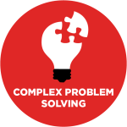
3.9 Complex Problem Solving
Complex Problem Solving is the skill of applying a method to a problem, often not seen before, to obtain a satisfactory solution.
Complex Problem Solving and Pre-Health Science
In PHS you will have many opportunities to develop the Job Skill of Complex Problem Solving:
The cocurricular delivery of the program means the concepts in learned in one class will be used and applied in other courses.
Biomedical applications are used throughout the program using ‘systems-based’ problems and/or ‘clinical problems’ from different perspectives in different courses.

Slide 15
3.10 Key Terms
Complex Problem Solving
Global Citizenship
Implementation Skills
Job Skills for the Future
Novel and Adaptive Thinker
Resilience
Self-Directed Learner
Social Intelligence

