Slide 1
Pre-Health Science: Pathways to Success
Chapter 2: Pre-Health Science

Slide 2
2.0 Learning Objectives
After reading this chapter, you should be able to do the following:
Define the goals of the Pre-Health Sciences Pathway to Advanced Diplomas and Degrees (PHS or Pre-Health Science) program
Identify program fit for health-related programs
Differentiate between PHS and other foundational science programs

Slide 3
2.1 Pre-Health Science
“As a respiratory therapist, you have to be adaptable, quick thinking, and develop excellent critical thinking and troubleshooting abilities. You also need the technical skills to perform lifesaving tasks such as endotracheal intubation. Lastly, effective communication with patients, family members, and the health care team is essential.”
Greg Donde, RRT, BHSc, MSc, FCSRT

Slide 4
2.2 What Is The Pre-Health Sciences Pathway To Advanced Diplomas And Degrees Program
What is the Pre-Health Program?
The Pre-Health Sciences Pathway to Advanced Diplomas and Degrees (PHS or Pre-Health Science) program provides students with the opportunity to study subject areas relevant to health career programs at Fanshawe College and to instill an appreciation of the professional roles, responsibilities and academic requirements of health care disciplines.

Slide 5
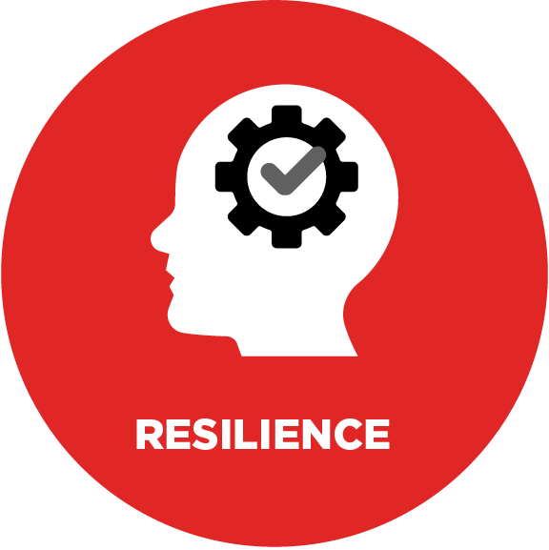
2.2 What Is The Pre-Health Sciences Pathway To Advanced Diplomas And Degrees Program
Vocational Learning Outcomes
Vocational Learning Outcomes (VLOs) describe the learning being done at the program level and follow the credentialing framework outlined by the ministry. Each course will outline Course Learning Objectives (CLOs) that will be achieved by the end of the course and will relate back to the Vocational Learning Outcomes at varying levels as a program.

Slide 6
2.2 What Is The Pre-Health Sciences Pathway To Advanced Diplomas And Degrees Program
Evaluating Vocational Learning Outcomes
To measure the success of each student in meeting the vocational learning outcomes, each college will define expected learning outcomes, but the general guidelines for each can be found here: Pre-Health Sciences Pathway to Advanced Diplomas and Degrees Program Standard, July 2016

Slide 7
2.3 Program Fit
Pre-Health Science Program Fit
Pre-Health Science is a two-semester (1 year) Ontario College Certificate program designed to provide students with the core knowledge, skills, and abilities fundamental to academic success in health sciences programs, as well as other science-related programs at the advanced diploma or degree level.
Refer to the Fanshawe Career Guide for more information on program fit for the PHS program.

Slide 8
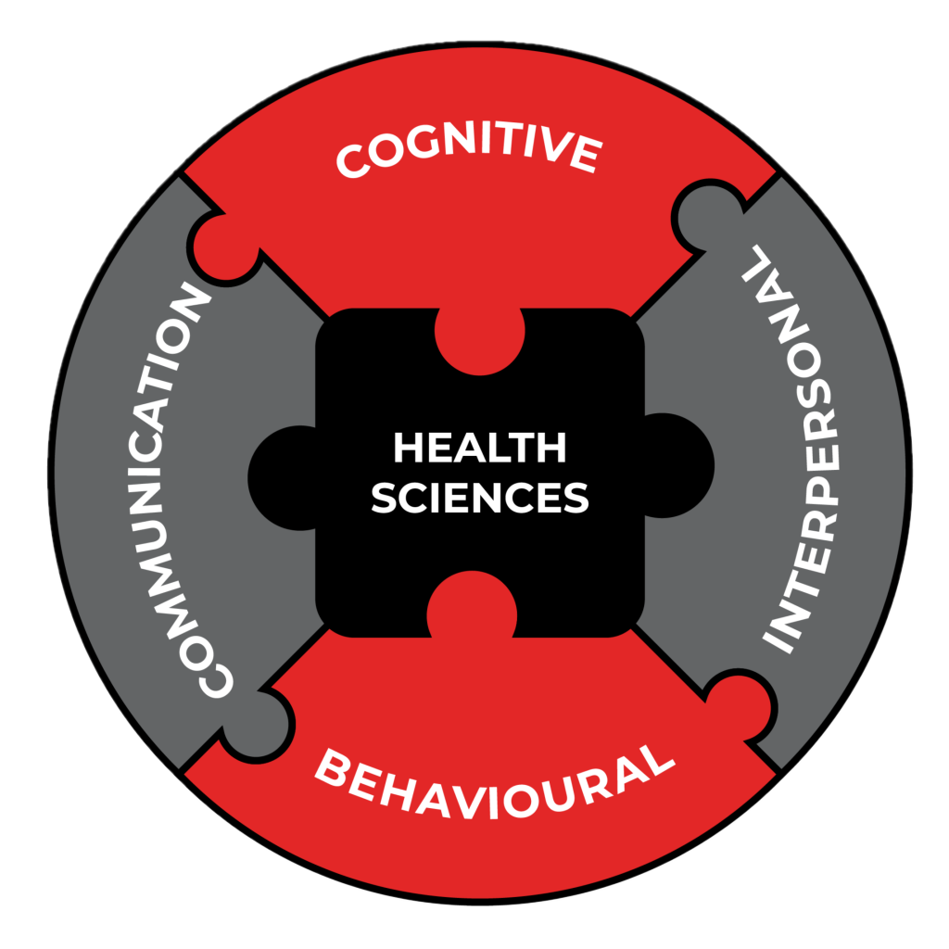
2.3 Program Fit
Healthcare Perspective
Skills Required for Success in Healthcare Professions
Communication
Cognitive
Interpersonal
Behavioural

Slide 9
2.4 Why Pre-Health Science
Skills Development
The program has been designed with a focus on the: core knowledge, skills, abilities, and success in Health Science and other science related programs and the workplace.
The program helps to develop foundational skills (also called soft skills) such as goal setting, planning and organizing, self – leadership, and critical thinking, with a correlation of biomedical concepts between different scientific disciplines.

Slide 10
2.5 Knowledge Check
Reflective Practice
What are your top 2 health career program goals and why?
What 3 skills do you feel you need to develop to better prepare for that program?
How will the Pre-Health Science (PHS) program help you with your career goals?

Slide 11
2.5 Knowledge Check
Key Terms
Co-curricular
Course Learning Objectives (CLOs)
Foundational Skills
Pre-Health Sciences Pathway to Advanced Diplomas and Degrees
Program Advisory Committee (PAC)
Vocational Learning Outcomes (VLOs)

