Slide 1
Pre-Health Science: Pathways to Success
Chapter 16: Communication Skills – Collaborating with Others

Slide 2
16.0 Learning Objectives
By the end of this chapter you will be able to :
Identify the communication process and what can get in the way
Define the forms and purpose of communication
Articulate the variables to communication
Evaluate and make informed decisions about your strengths and challenges when communicating with others
Define a strategy to manage conflict with others to further develop your complex problem solving, novel and adaptive thinking, and social intelligence
Define the forms and purpose of communication
Understand how technology has changed communication
Identify resources that can help you take responsibility for your own learning journey
Recognize how academic success connects to career success

Slide 3
16.1 Communication Skills
Collaborating with Others
Communication is a complex skill that involves conveying and understanding information
Well-honed communication skills can improve all aspects of your life.
One way you can develop your communication skills is to connect with your Fanshawe Student Union and become a class representative.

Slide 4
16.2 Self-Assessment
How do you feel about your communication skills? Take the self-assessment quiz in Section 16.2.

Slide 5
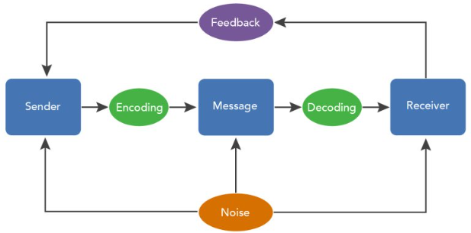
16.3 The Communication Process
Communication is crucial to any relationship

Slide 6
6.2 The Communication Process
Communication skills can be improved!
Become an “active” listener
Become an “effective” speaker
Photo by Akson, Unsplash Licensesh

Slide 7
16.4 Opportunities for Effective Speaking
Effective Speaking
Honest, but not critical
Look for common ground
Avoid sarcasm/irony unless you know the person
Don’t try to “talk” like the other person
Relate to the person
Be assertive; not aggressive or passive

Slide 8
16.5 Opportunities for Active Listening
Active Listening
Talk less, listen more
Ask questions
Watch and respond to body language
Show that you are listening and care
Give the person feedback

Slide 9
16.6 Online Discussion Forums
Discussion boards are an important tool for
Building collaborative relationships
Express developing ideas
Get feedback for you learning

Slide 10
16.6 Online Discussion Forums
What makes a good post?
Check the rubric!
Review “Level 1, Level 2, Level 3” diagram in Section 16.6
Quality of your post is important
Review “Tips for Participating in Forums” in Section 16.6
Photo by Christina @ wocintechchat.com, on Unsplash License

Slide 11
16.7 Team and Group Work in Action
Working in groups is an important skill
Common in the workplace and in school
What are the pros and cons?
Effective groupwork (more in section 16.8)
Common goals
Use each other as resources
Clear, open, honest communication

Slide 12
16.7 Team and Group Work in Action
Conflict Resolution
Conflict is natural, but an opportunity
Be respectful
No assumptions
Be open-minded
Take a step back
Recognize the value of compromise
Use tools

Slide 13
16.8 Connecting and Communicating in Action
What is the purpose of communication?
Improve your social connections by:
Recognize value in connecting
Make new friends
Join organized groups and activities

Slide 14
16.9 Career Connection
Now that you understand the concept of communication, and its importance, visit Section 16.9 Career Connection in your text, and reflect on the interview questions asked.
In addition, follow instructions in section 16.9 for taking a True Colours online assessment.

Slide 15
16.10 Fanshawe Resources
As a full-time student, you have access to a full catalogue of LinkedIn Learning Modules (for free)!
Section 16.10 expands on where to find them, and provides additional Fanshawe Resources for this topic.

Slide 16
16.11 Knowledge Check
Now that you understand the importance of effective communication, reflect and assess your communication skills by completing the exercises in Section 16.11.

