Slide 1
Pre-Health Science: Pathways to Success
Chapter 14: Writing and Presenting

Slide 2
14.0 Learning Objectives
After reading this chapter, you should be able to do the following:
Develop interpersonal skills by practicing techniques for physical presence and speaking skills.
Plan effective presentations by understanding key communication format factors, identifying the essential elements of an introduction, body and conclusion.
Learn about presentation aids and how the can improve a presentation, including understanding their benefits, differentiating between types, and creating visually impactful aids meeting quality standards.
Gain skills in delivering presentations, including understanding the preparation process, strategies for handling mistakes and surprises, considering crucial audience factors, and providing constructive feedback through critiquing professional presentations

Slide 3
14.1 Introduction to Writing and Presenting
The ability to communicate effectively and with confidence is a core skill
Presentations need to be planned and well-structured
Anxiety is a common barrier many presenters experience
Interpersonal skills are perhaps the most important for a successful presentation
The next phase of the process is about planning
The final phase focuses on delivering a presentation

Slide 4
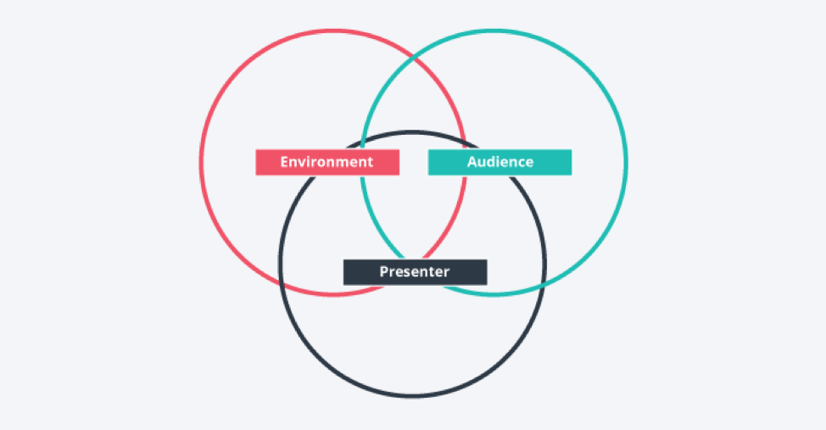
14.2 Interpersonal Presentation Skills
What Makes a Successful Speech or Presentation?

Slide 5
14.2 Interpersonal Presentation Skills
The Speaker
The Audience
The audience is as involved as you are
The Environment
Sometimes you have no control over your environment
Room temperature
Body Language
Coherent Structure
Enthusiasm
Expertise
Practice
Key elements:
Voice
Awareness of yourself and awareness of the audience is key
If you’re not interested, they’re not interested
Things to check out:
Distracting noises
The lay of the land

Slide 6
14.2 Interpersonal Presentation Skills
The Presenter: Your Strengths and Weaknesses
Are you aware of your strengths and weaknesses as a presenter?
You can convert perceived weaknesses into potential strengths
Your first step in helping define what makes you yourself is to look at what you’re good at and what you enjoy doing

Slide 7
14.2 Interpersonal Presentation Skills
What Are My Verbal Communication Techniques?
Pitch
Volume
Emphasis
Pronunciation
Fillers
Rate

Slide 8
14.2 Interpersonal Presentation Skills
What Non-Verbal Cues Do I Use?
Gestures
Facial Expression
Posture
Silence
Movement

Slide 9
14.2 Interpersonal Presentation Skills
Consider the factors presented in this section.
Visit Section 14.2 in your text, and reflect on the questions asked.

Slide 10
14.3 Planning the Presentation
Planning
Think about a strategy for your presentation. How will you engage with the world outside of you?
Preparing a Presentation Strategy
You can use the acronym FAST to develop your message according to the elements of format, audience, style, and tone
Visit Section 14.3 to find the FAST and AUDIENCE tools that will help you to lay out a strategy

Slide 11
14.3 Planning the Presentation
Presentation Purpose
Your presentation will have a general and specific purpose
Timing
To assess the timing of your speech as you prepare, you can:
Set a timer while you do a few practice runs, and take an average.
Run your speech text through an online speech timer.
Estimate based on the number of words
Incorporating Backchannels
Technology has given speakers new ways to engage with an audience in real time
Using publicly accessible social networks, such as a Facebook Page or Twitter feed, can also help to spread your message to a wider audience
Your general purpose may be to inform, persuade, or entertain
Your specific purpose addresses what you are going to inform, persuade, or entertain your audience with

Slide 12
14.3 Planning the Presentation
Developing the Content
Creating an Outline
Introduction
Body
Conclusion
Visit Section 14.3 for tips on how to do it

Slide 13
14.4 Presentation Aids
Presentations can be enhanced by the effective use of visual aids
Visuals can provide a reference, illustration, or image to help the audience to understand and remember your point
Emphasis, Support, and Clarity
The purpose for each visual aid should be clear and speak for itself
Using visuals to support your presentation can help the audience learn about your topic
Clarity is key in the use of visual aids

Slide 14
14.4 Presentation Aids
Methods and Materials
Slide Decks
Flip Charts, Whiteboards, and Large Prints
Handouts
Demonstrations and Tactile Aids

Slide 15
14.4 Presentation Aids
Using Visual Aids
Designing Slide Decks
Font
Colour
Big
Clear
Simple
Consistent
Legible
Use common fonts
Size (large)
Contrast
Background color and images complement each other
Repeat Colours (two or three)
Avoid blue-green, red-green

Slide 16
14.5 Delivering the Presentation
Preparing to Present
Practise by rehearsing your presentation
Your appearance is an important part of your audience’s first impression
Depending on the circumstances, you may have some choices to make about the environment.
Ask yourself, What could go wrong?

Slide 17
14.5 Delivering the Presentation
During the Presentation
Manage your anxiety
If you are using a microphone, there are a few cautions to be aware of
Mistakes or surprises can happen
Read your audience to recognize their mood
It’s a good idea to invite questions from the audience
To effectively critique a presentation, it’s good to balance self-analysis with constructive feedback from others

Slide 18
14.6 Knowledge Check
Now that you know how to prepare for and deliver well-executed presentations, visit Section 14.6 to review some good presentation tips and complete the exercises.

Slide 19
14.6 Knowledge Check
Key Terms
Asynchronous Delivery Backchannels
FAST
Gesture
Non-verbal Cues
Slide Decks
Visual Aids

