Slide 1
Pre-Health Science: Pathways to Success
Chapter 10: Remembering What You Read

Slide 2
10.0 Learning Objectives
After reading this chapter, you should be able to do the following:
Describe strategies for deciding which course content to learn and retain.
Differentiate between short-term and long-term memory, and describe the role of each in effective studying.
Identify memory-strengthening strategies.
Discuss the way reading differs in college and how to successfully adapt to that change.
Describe how to allocate enough time for reading by determining your reading speed and pacing and scheduling set times for active reading.
Explain recursive reading strategies.

Slide 3
10.1 Improving Your Memory
Memory is the process of storing and retrieving information
The process of remembering ideas or images:
Visit Section 10.1 to take a quick reflection

Slide 4
10.1 Improving Your Memory
Short-term memory is made up of the information we are processing at any given time
Working memory is a type of short-term memory, but we use it when we are actively performing a task
Long-term memory is made up the information you know.
Visit Section 10.1 for tips on moving information from short-term to long-term memory.
Reflect on how can you decide what to study and complete the exercise

Slide 5
10.2 The Nature and Types of Reading
Reading enhances thinking, vocabulary, and connects disparate parts for critical thinking proficiency
The reasons why we read longer pieces (outside of reading for pleasure) are categorized into:
Introducing new content
Comprehending familiar content
Visit Section 10.2 and try the experiment in the Reflective Practice!

Slide 6
10.3 How Do You Read to Learn?
Active Reading
Strategies to engage with text to increase knowledge
4 step process
Preparing
Reading
Capturing Key Ideas
Reviewing

Slide 7
10.4 Effective Reading Strategies
Allowing Adequate Time for Reading
Ways to make time for reading:
Determining reading speed and pacing
Scheduling active reading sessions
Practising recursive reading strategies

Slide 8
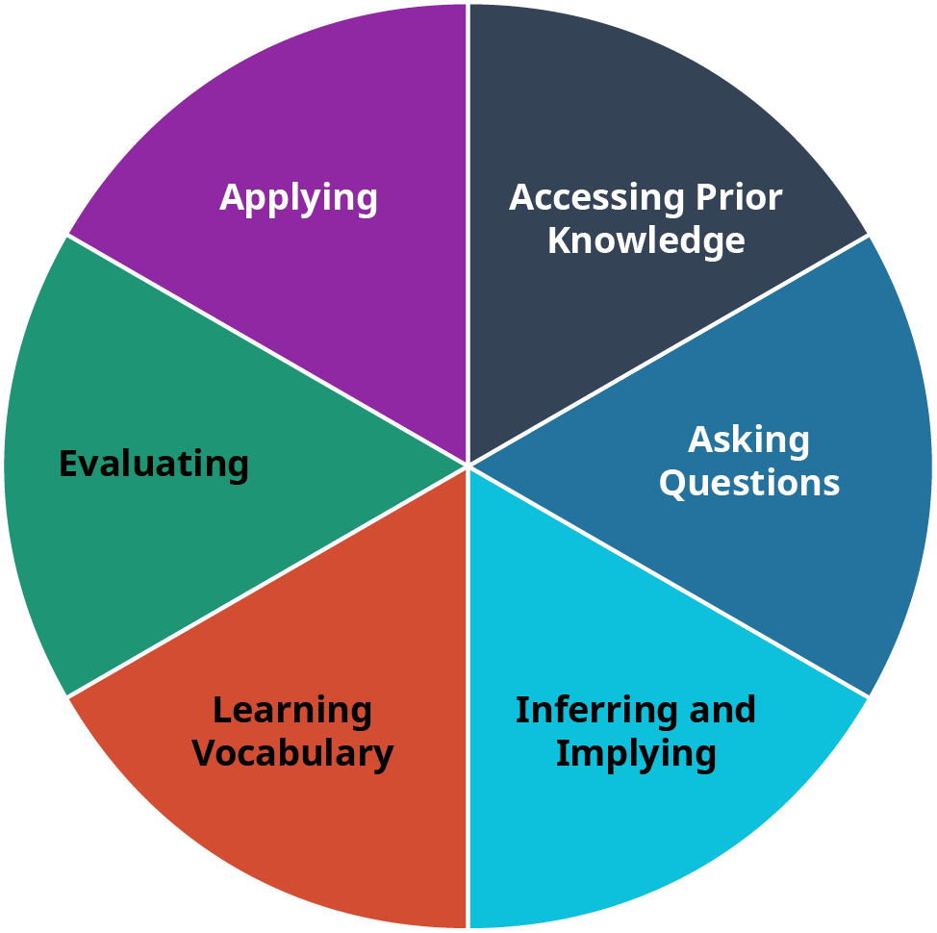
10.4 Effective Reading Strategies
The six elements of recursive reading should be considered as a circular, not linear, process.

Slide 9
10.4 Effective Reading Strategies
Preparing to Read for Specific Disciplines in College
Reading for college isn’t the same as reading for pleasure
Strategies for reading in College Disciplines:
Skimming
Active Reading
Extracting key points and main ideas from the reading
The SQ3R reading strategy: Survey, Question, Read, Recite, Review

Slide 10
10.4 Effective Reading Strategies
Primary sources offer original information. Secondary sources provide interpretations; readers should consider biases in both
Gather information about the reading material and author from various sources, including book features, author biographies, internet searches, and library databases
Learning new information can be very difficult if you balk at ideas that are different from what you’ve always thought
Approach reading with an open mind and challenge personal biases for a comprehensive understanding

Slide 11
10.5 Knowledge Check
Visit Section 10.5 to answer the reflection questions and complete the exercises.

