Slide 1
Sales Leadership Management
Chapter 4: The Power of Effective Communication
Unless otherwise noted, this work is licensed under a Creative Commons Attribution-NonCommercial-ShareAlike 4.0 International (CC BY-NC-SA 4.0) license. Feel free to use, modify, reuse or redistribute any portion of this presentation.

Slide 2
4.0 Learning Outcomes
In this chapter, we will:
Describe the elements of effective business communication.
Examine the implications of different types of verbal and nonverbal communication.
Summarize appropriate etiquette for business communication.

Slide 3
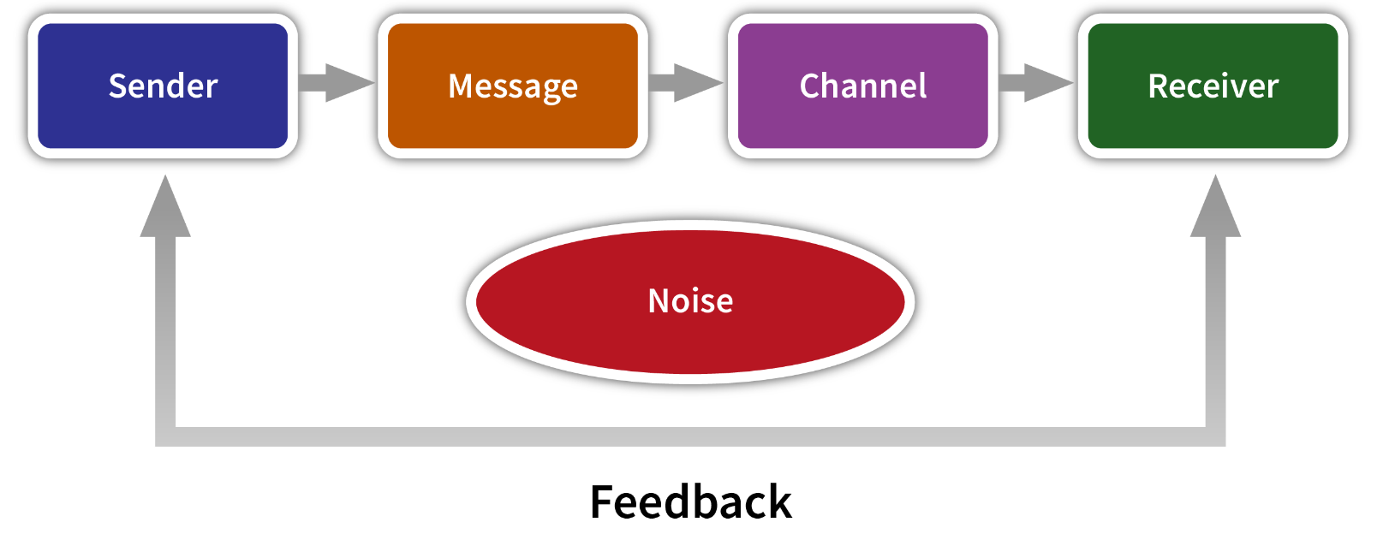
4.1 Ready, Set, Communicate
Communication, the exchange of information or ideas between sender and receiver, is a challenging aspect in your personal life, at school, and especially in selling.
The standard model of communication has evolved based on two parties—the sender and the receiver— exchanging information or ideas.
Figure 4.1.1: “Traditional Communication Process”

Slide 4
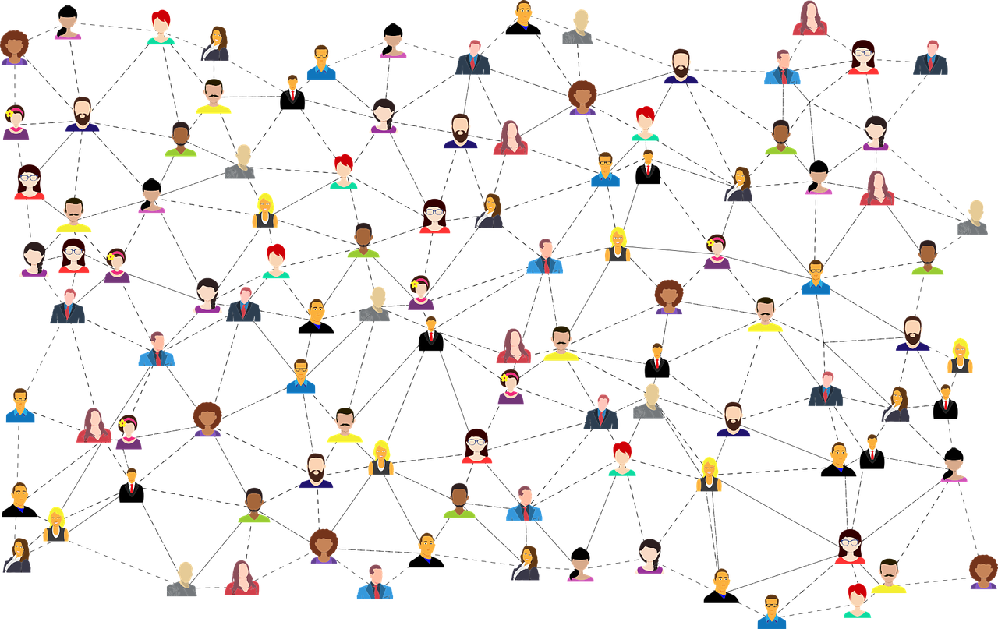
4.1 Ready, Set, Communicate
Tips for Effective Communication
Tip 1: Empathy Is Essential
Empathy is about demonstrating that you care about the other person’s situation.
Tip 2: Think Before You Communicate
Tip 3: Be Clear
Tip 4: Be Brief
Tip 5: Be Specific
Tip 6: Be Timely
Photo by Gordon Johnson, Pixabay

Slide 5
4.1 Ready, Set, Communicate
Listen Up
Use active listening
Ask questions
Focus
Take notes
There’s more to Communication than Meets the Eye…or Ear
People comprehend information in four distinct ways:
Why: They want to know the reasons for doing something.
What: They want to know the facts about it.
How: They want to know only the information they need to get it done.
What if: They want to know the consequences of doing it.

Slide 6
4.2 Types Of Communication
There are three types of communication: verbal, which involves speaking to one or many people to convey a message; nonverbal, which includes body language and other observations about people; and written, which includes a message that is read in hard copy, e-mail, text message, instant message, social media, blog, or other Internet-based written communication.
Verbal communication is powerful, fast, and natural and includes voice inflections that help senders and receivers understand the message more clearly.
Sentence | Meaning
I borrowed your book. | I was the one who took your book.
I borrowed your book. | I didn’t take your book; I only borrowed it.
I borrowed your book. | Your book was the one I borrowed.
I borrowed your book. | I borrowed your book, not your laptop.
Source: Kiely, 1993
Table 4.2.1: The Impact of Intonation
Notes:
Consider the following situations:
A cardiac surgeon with a high-risk patient is wondering what to do. The physician calls Ted Schulte at Guidant to get his input on how to handle the situation. Schulte recommends the appropriate pacemaker and offers to drive one hundred miles early in the morning in order to be able to answer any questions that might arise during the surgery.
A food wholesaler is working overtime to prepare invoices. Unfortunately, one out of five has a mistake. The result is that customers don’t get their invoices in a timely fashion, so they don’t pay quickly and don’t pay the correct amounts. Consequently, the company has to borrow money fulfill its payroll obligations. Jay King, a salesperson from DG Vault, recommends the wholesaler purchase an electronic invoicing system. The wholesaler does. Subsequently, it takes the wholesaler just days to get invoices ready, instead of weeks. And instead of the invoices being only 80 percent accurate, they are close to being 100 percent accurate. The wholesaler no longer has trouble meeting its payroll because customers are paying more quickly.
Sanderson Farms, a chicken processor, wants to build a new plant near Waco, Texas. The chambers of commerce for several towns in the area vie for the project. The chamber representative from Waco, though, locates an enterprise zone that reduces the company’s taxes for a period of time, and then works with a local banker to get the company better financing. In addition, the rep gets a local technical college involved so Sanderson will have enough trained employees. These factors create a unique package that sells the company on setting up shop in Waco.

Slide 7
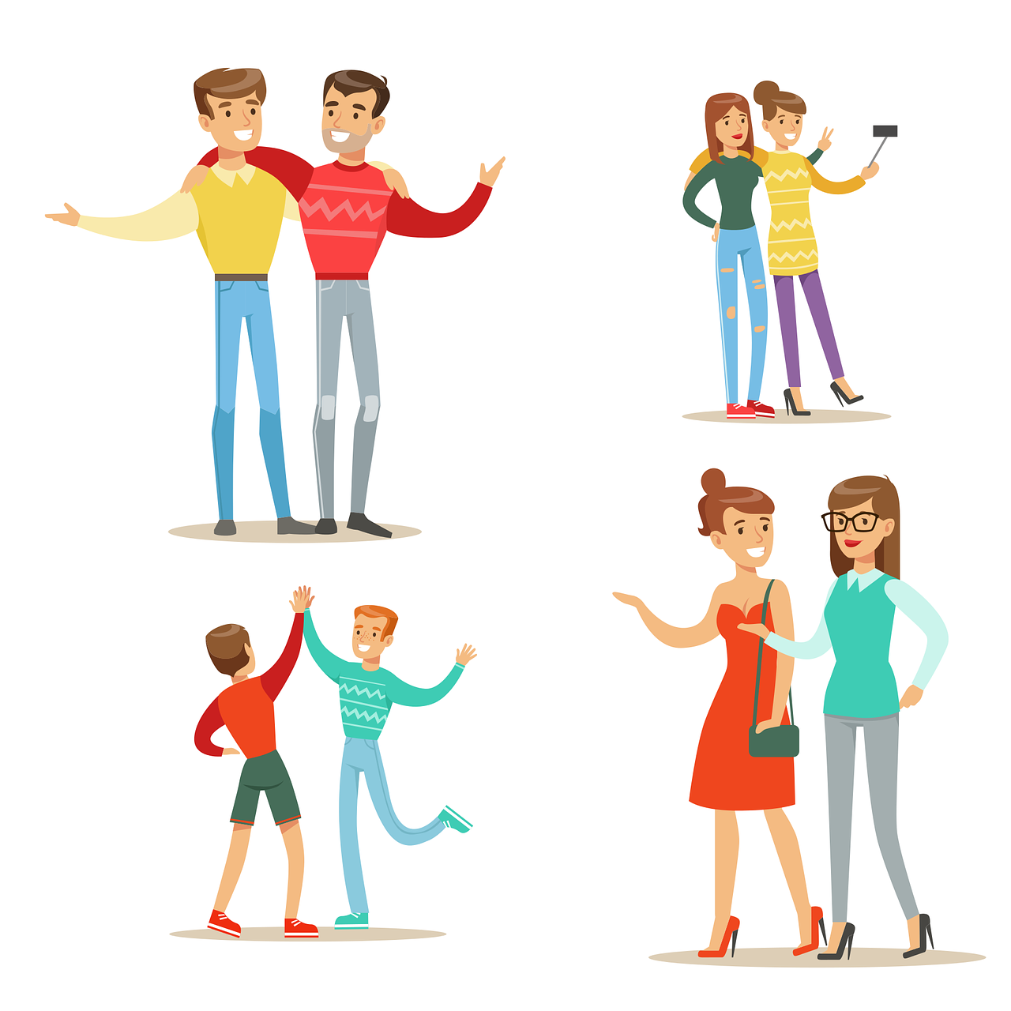
4.2 Types Of Communication
Types of Nonverbal Communication
Handshake
Body language
Gestures
Nodding or shaking your head
Eye contact (or lack of eye contact)
Eye roll
Facial expressions
Touch
Space or proximity
Dress
Multitasking
Photo by Bansi Patel, Pixabay

Slide 8
4.2 Types Of Communication
Written Communication Tips
Be short and sweet: Shorter is always better when it comes to business correspondence.
Grammar, please: Sentences should be structured correctly and use proper grammar, including a subject and a verb in each sentence.
Check spelling: Use the spell-check tool on your computer.
Read before you send: Reread your document or electronic communication before it goes out.
Just the facts: Stick to the facts to maximize the impact of your written communications; leave the emotional topics for verbal dialogue.

Slide 9
4.3 Your Best Behaviour
Etiquette Tips for Conversations, Meetings, and Presentations
Be prepared; don’t waste anyone’s time or focus.
Prepare a written agenda and hand it out at the start of the meeting to keep the group focused on the desired topics.
Speak clearly and at a volume that is easy to hear, but not too loud so as to be distracting.
Be professional and respectful; don’t interrupt when others are speaking.
Use eye contact.
At the end, recap your key points and identify next steps.
“People Having a Meeting” by Edmond Dantès, CC0
Notes:
Example: B2B
Epson sells printers to Staples and makes them to the specifications determined by Staples or Levis sells to the Bay or other big box stores certain types of their jeans specific to that big box store (you can only get those product lines in those stores). Other examples of B2B selling include parts or ingredients, such as when Intel sells computer chips to Toshiba to manufacture laptop computers or when a fabric company sells cotton fabric to Gap to make their T-shirts. Many B2B companies, such as Intel, have branded their products so that consumers quickly identify these products even though the products are only sold to businesses.
Example: B2C
In the example above, when Staples sell the Epson printers to consumers, it is B2C personal selling. Other examples of B2C selling include a waiter taking your order at a restaurant, a salesperson helping you find jeans in your size at American Eagle Outfitters, or a real estate agent showing you a house. Some companies engage in both B2B and B2C selling, such as Staples, FedEx, Microsoft, Costco and Geek Squad, since they serve business customers as well as the ultimate consumer. Many manufacturers such as Dove, Coke, and Oscar Meyer do not actually participate in B2C personal selling, but these brands use B2C marketing to make consumers aware of their brands. Meanwhile, their B2B personal selling organizations focus on selling these products to retailers such as Safeway, CVS, and Sam’s Club (i.e., their customers), which in turn, sell their products in B2C channels to consumers like you.

Slide 10
4.3 Your Best Behaviour
Etiquette for Requesting and Giving Business Cards
Carry your business cards in a case so they don’t wear out or tear as a crumpled business card makes a poor first impression (Ramsey, 2019).
Never leave home without them. It is unprofessional to have to say “I didn’t bring any with me” (Ramsey, 2019).
Present your card with the print facing the person receiving it (Tanzon-Corre, 2017).
Never force anyone to take your card (Bergstrom, 2009).
When receiving a business card, take a minute to review the information to make sure you remember who gave you the card. Make any notes or comments on it later (Bergstrom, 2009).
Notes:
Example: Strategic Alliance
Before introducing the iPhone, Apple contracted AT&T to be the exclusive service provider. Each company had something to contribute to the relationship, and each one had something to gain. In this case, AT&T pays Apple for each new customer it receives. Apple increases its revenues, and AT&T gains new customers. Both companies had to invest in research and development to make the relationship happen. Both companies “had skin in the game,” so both worked hard to ensure success through public relations, advertising, personal selling, and follow-up customer service. As a result, the relationship has been extremely successful for both parties, as a strategic alliance should be (Cauley, 2008).

Slide 11
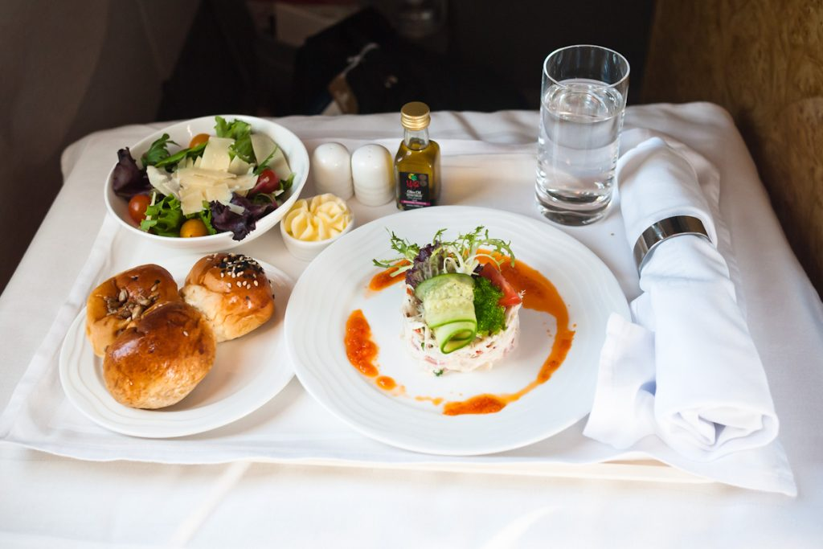
4.3 Your Best Behaviour
Etiquette for Business Meals
Remember which dishes and utensils to use
As a general rule of thumb, the person who invites pays
Order simply and take note of what our host orders
Silence your cell phone
Be courteous to the wait staff
Etiquette for Thank-You Notes
Start with a clear introduction
Be specific
Make it personal and make it special by including your own sentiments
“Emirates Business Class Dinner (Appetizer)” by Kenneth Lu, CC BY 2.0

Slide 12
4.3 Your Best Behaviour
Do’s and Don’ts of Telephone Etiquette
Do find the perfect volume for your voice and use it
Do, conduct the call in an enclosed or isolated area
Do, speak slowly and spell your name when leaving a voice message
Don’t make or take another call or text during a meeting
Don’t discuss confidential issues in public areas—you never know who might be listening
Don’t eat, drink, or chew gum when leaving a voice mail or talking on the phone
Don’t leave a long, rambling voice mail message
Do practice beforehand

Slide 13
4.4 Key Takeaways & Terms
Business cards
Channel
Communication
Communication model
Decoding
Empathy
Encoding
Mehrabian formula
Nonverbal communication
Standard model of communication
Verbal communication
Written communication

Slide 14
4.5 Test Your Knowledge
Link: Questions
Photo by Gerd Altmann via Pixabay

