Slide 1
Sales Leadership Management
Chapter 3: Introduction to the Selling Process: Prospecting and Qualifying
Unless otherwise noted, this work is licensed under a Creative Commons Attribution-NonCommercial-ShareAlike 4.0 International (CC BY-NC-SA 4.0) license. Feel free to use, modify, reuse or redistribute any portion of this presentation.

Slide 2
3.0 Learning Outcomes
In this chapter, we will:
Explain the role of the seven steps of the selling process.
Identify needs and opportunities.
Discuss the role prospecting plays in the selling process.
Identify resources to use when prospecting.
Explain how to research a qualified prospect and list resources to conduct prospect research.
List the questions to ask to meet qualifying objectives.

Slide 3
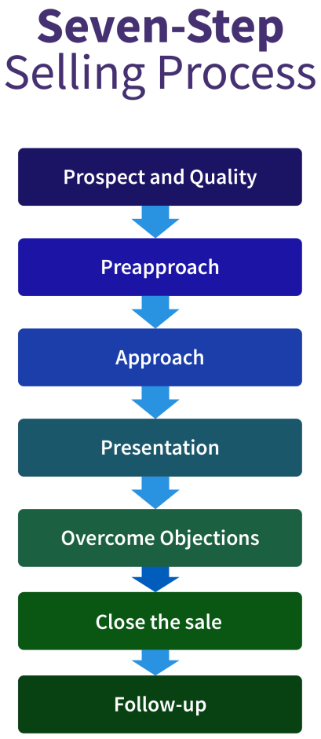
3.1 It’s A Process: Seven Steps To Successful Selling
Seven-Step Selling Process (Solomon et al., 2008)
Prospect and qualify
Preapproach
Approach
Presentation
Overcome objections
Close the sale
Follow-up
Examples: The Seven-Step Selling Process in the B2C & B2B Market
“Selling Steps” by Freddy Vale, CC BY-NC-SA 4.0

Slide 4
3.2 Solving, Not Selling
Step 1: Complete a Needs and Opportunity Analysis
Step 2: Brainstorm Solutions and Generate Ideas
Know your problem or opportunity.
Generate; don’t evaluate.
Push beyond the wall.
Seek strategic stimuli.
Step 3: Identify General and Specific Benefit Statements
General benefit statements, as opposed to specific benefit statements, are broad enough that they would be important to most people.
The specific benefit statement identifies the way a solution addresses a prospect’s particular situation and needs, on the other hand, comes once you’ve grabbed your prospect’s attention.

Slide 5
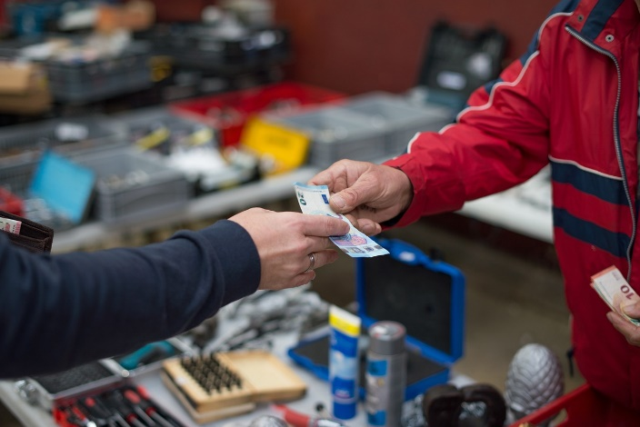
3.3 The Seven Steps Of Selling
Step 1: Prospecting and Qualifying
A prospect is a lead that is qualified or determined to be ready, willing, and able to buy.
It’s much more fruitful to invest your time with a qualified prospect, one who has the desire or ability to buy the product or service.
Step 2: Pre-approach – Chapter 5
A good salesperson researches their prospect, the market, familiarizing themselves with the customer’s needs, and learning all the relevant information regarding the product and service.
Step 3: Approach – Chapter 5
This usually involves introductions, making some small talk, asking a few warm-up questions, and generally explaining who you are and whom you represent.
Photo by Rudy and Peter Skitterians, Pixabay

Slide 6
3.3 The Seven Steps Of Selling
Step 4: Presentation – Chapter 6
The presentation should be tailored to the customer, explaining how the product meets that person or company’s needs.
Step 5: Handling Objections – Chapter 6
After you’ve made your sales presentation, it’s natural for your customer to have some hesitations or concerns called objections.
Step 6: Closing the Sale – Chapter 7
Eventually, if your customer is convinced your product will meet their needs, you close by agreeing on the terms of the sale and finishing up the transaction.
Step 7: Following Up – Chapter 7
The follow-up is an important part of assuring customer satisfaction, retaining customers, and prospecting for new customers.
Notes:
Consider the following situations:
A cardiac surgeon with a high-risk patient is wondering what to do. The physician calls Ted Schulte at Guidant to get his input on how to handle the situation. Schulte recommends the appropriate pacemaker and offers to drive one hundred miles early in the morning in order to be able to answer any questions that might arise during the surgery.
A food wholesaler is working overtime to prepare invoices. Unfortunately, one out of five has a mistake. The result is that customers don’t get their invoices in a timely fashion, so they don’t pay quickly and don’t pay the correct amounts. Consequently, the company has to borrow money fulfill its payroll obligations. Jay King, a salesperson from DG Vault, recommends the wholesaler purchase an electronic invoicing system. The wholesaler does. Subsequently, it takes the wholesaler just days to get invoices ready, instead of weeks. And instead of the invoices being only 80 percent accurate, they are close to being 100 percent accurate. The wholesaler no longer has trouble meeting its payroll because customers are paying more quickly.
Sanderson Farms, a chicken processor, wants to build a new plant near Waco, Texas. The chambers of commerce for several towns in the area vie for the project. The chamber representative from Waco, though, locates an enterprise zone that reduces the company’s taxes for a period of time, and then works with a local banker to get the company better financing. In addition, the rep gets a local technical college involved so Sanderson will have enough trained employees. These factors create a unique package that sells the company on setting up shop in Waco.

Slide 7
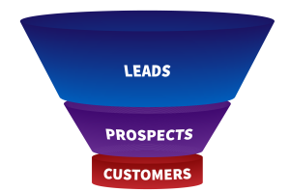
3.4 Prospecting: A Vital Role In The Selling Process
Finding leads (or people who might be prospects) is the most vital part of the selling process—you can’t make a sale without identifying the people to whom you’ll be selling.
The Value of a Lead
The Sales Funnel
An illustration of the sales funnel the sales process begins with a large pool of prospects and ends with a more focused number of buyers. It is a helpful way to visualize the process of finding and qualifying your customers and effectively illustrates the value of identifying a large pool of potential prospects.
Prioritizing Leads
Understand how to use the sales funnel to maximize leads
Figure 3.4.2 “Traditional Sales Funnel” by Freddy Vale CC BY-NC-SA 4.0

Slide 8
3.5 Go Fish: Resources To Help You Find Your Prospects
Tips for Identifying New Customers
Where to Find Prospects
Existing customers
It costs anywhere from five to 25 times more to attract a new customer than to keep an existing customer.
Referrals
There’s nothing more powerful than getting information about a product or service from a friend or people you trust before you buy.
Networking and social networking
Networking is the art of building alliances or mutually beneficial relationships.

Slide 9
3.5 Go Fish: Resources To Help You Find Your Prospects
Business directories in print
Online databases and directories
Newspapers, trade publications, and business journals
Trade shows and events
Advertising and direct mail
Cold calling
Being a subject matter expert
Photo by Pexels via Pixabay
Notes:
Example: B2B
Epson sells printers to Staples and makes them to the specifications determined by Staples or Levis sells to the Bay or other big box stores certain types of their jeans specific to that big box store (you can only get those product lines in those stores). Other examples of B2B selling include parts or ingredients, such as when Intel sells computer chips to Toshiba to manufacture laptop computers or when a fabric company sells cotton fabric to Gap to make their T-shirts. Many B2B companies, such as Intel, have branded their products so that consumers quickly identify these products even though the products are only sold to businesses.
Example: B2C
In the example above, when Staples sell the Epson printers to consumers, it is B2C personal selling. Other examples of B2C selling include a waiter taking your order at a restaurant, a salesperson helping you find jeans in your size at American Eagle Outfitters, or a real estate agent showing you a house. Some companies engage in both B2B and B2C selling, such as Staples, FedEx, Microsoft, Costco and Geek Squad, since they serve business customers as well as the ultimate consumer. Many manufacturers such as Dove, Coke, and Oscar Meyer do not actually participate in B2C personal selling, but these brands use B2C marketing to make consumers aware of their brands. Meanwhile, their B2B personal selling organizations focus on selling these products to retailers such as Safeway, CVS, and Sam’s Club (i.e., their customers), which in turn, sell their products in B2C channels to consumers like you.

Slide 10
3.6 Researching Your Prospect: Going Deeper
About the Company
Demographics/ Company news/ Financial performance
About the Company’s Customers
Customer demographics/ Size of customer base/ What customers are saying about your prospect
About the Current Buying Situation
Type of Purchase/ Competitor/Current Provider/ Current Pricing
About the Contact Person
Title and Role in the Company/ Professional Background/ Personal Information/ Essential Problem(s) Your Contact Needs to Solve/ Motivation for Buying
About Your Existing Customers
Opportunities to Expand the Relationship/ Opportunities for Synergy/ Sources of Information
Notes:
Example: Strategic Alliance
Before introducing the iPhone, Apple contracted AT&T to be the exclusive service provider. Each company had something to contribute to the relationship, and each one had something to gain. In this case, AT&T pays Apple for each new customer it receives. Apple increases its revenues, and AT&T gains new customers. Both companies had to invest in research and development to make the relationship happen. Both companies “had skin in the game,” so both worked hard to ensure success through public relations, advertising, personal selling, and follow-up customer service. As a result, the relationship has been extremely successful for both parties, as a strategic alliance should be (Cauley, 2008).

Slide 11
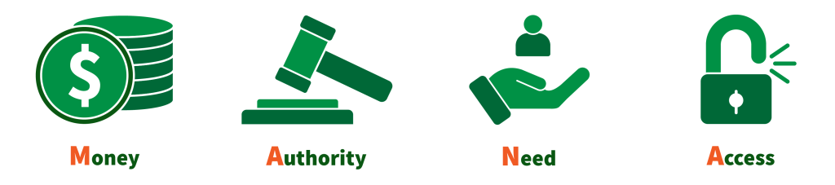
3.7 Qualifying Your Prospects
This qualifying technique is called MANA (money, authority, need, and access).
Does he or she have money to purchase the product or service?
Does he or she have the authority to make the buying decision?
Does your prospect have a need?
Do you have access to the influencer or decision makers?
“MANA” by Freddy Vale CC BY-NC-SA 4.0

Slide 12
3.8 Key Takeaways & Terms
Approach
Closing
Follow-up
General benefit statement
Lead
MANA
Networking
Objections
Prospecting
Prospect
Qualifying
Precall planning worksheet
Preapproach
Right questions
Sales funnel
Service-level agreement (SLA)
Specific benefit statement
Synergy

Slide 13
3.9 Test Your Knowledge
Link: Questions
Photo by Gerd Altmann via Pixabay

