Slide 1
Sales Leadership Management
Chapter 2: Why And How People And Organizations Buy
Unless otherwise noted, this work is licensed under a Creative Commons Attribution-NonCommercial-ShareAlike 4.0 International (CC BY-NC-SA 4.0) license. Feel free to use, modify, reuse or redistribute any portion of this presentation.

Slide 2
2.0 Learning Outcomes
In this chapter, we will:
Describe the different types of customers and their needs.
Discuss the implications of Maslow’s hierarchy of needs for selling.
Differentiate the types of buyers and buying situations in the business-to-business (B2B) environment.
List the steps in the buying process.
Identify how to use FAB for effective selling.

Slide 3
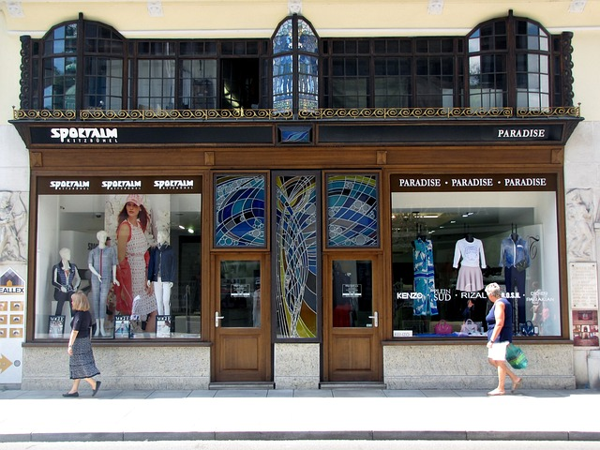
2.1 Buying 101
Inside Consumer Behaviour
The science of consumer behaviour describes and even defines how you shop and, more importantly, why you buy.
Understanding how and why customers buy can make a significant difference in how you sell.
Understanding the customer and the buying process can make your selling efforts successful.
Photo by (Joenomias) Menno de Jong via Pixabay

Slide 4
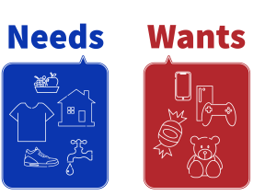
2.1 Buying 101
Do You Need It or Want It?
There is a significant difference in what motivates you to buy products and services you need, compared to those you want.
Why This Matters
It will be more likely that your customer will end up purchasing your product if it meets a core need, but more importantly, satisfies their wants .
Needs versus Wants
Needs are essentials, those products and services you literally cannot live without.
Wants are products, services, and activities that can improve your quality of life; you desire to have them because you think they will make you happy.
“Needs and Wants” by Freddy Vale, CC BY-NC-SA 4.0

Slide 5
2.2 Maslow’s Hierarchy Of Needs
Maslow (1954) in his popular “Hierarchy of Needs” theory suggested that needs could be categorized into two sets. The first set comprising of the four levels can be called the deficiency needs and the top level can be referred to ask growth or being needs.
Deficiency needs, as the name suggest generally come into force in case of some deficiency of any kind.
Growth needs are more concerned with the concepts of realization of one’s potential and “self actualization.”

Slide 6
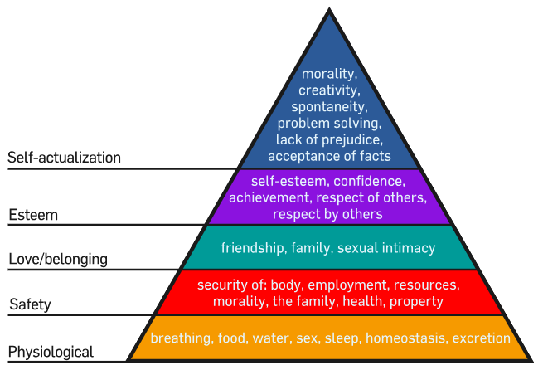
2.2 Maslow’s Hierarchy Of Needs
Whether you are selling in business-to-consumer (B2C) or business-to-business (B2B) environments. When you understand the motivation of your customer, you can customize your solution and your message to meet their needs, emotions, and motivations.
Figure 2.2.1: “Maslow’s hierarchy of needs” by User:Factoryjoe CC BY-SA 3.0 demonstrates that humans fill higher needs only after lower needs are met.
Notes:
Consider the following situations:
A cardiac surgeon with a high-risk patient is wondering what to do. The physician calls Ted Schulte at Guidant to get his input on how to handle the situation. Schulte recommends the appropriate pacemaker and offers to drive one hundred miles early in the morning in order to be able to answer any questions that might arise during the surgery.
A food wholesaler is working overtime to prepare invoices. Unfortunately, one out of five has a mistake. The result is that customers don’t get their invoices in a timely fashion, so they don’t pay quickly and don’t pay the correct amounts. Consequently, the company has to borrow money fulfill its payroll obligations. Jay King, a salesperson from DG Vault, recommends the wholesaler purchase an electronic invoicing system. The wholesaler does. Subsequently, it takes the wholesaler just days to get invoices ready, instead of weeks. And instead of the invoices being only 80 percent accurate, they are close to being 100 percent accurate. The wholesaler no longer has trouble meeting its payroll because customers are paying more quickly.
Sanderson Farms, a chicken processor, wants to build a new plant near Waco, Texas. The chambers of commerce for several towns in the area vie for the project. The chamber representative from Waco, though, locates an enterprise zone that reduces the company’s taxes for a period of time, and then works with a local banker to get the company better financing. In addition, the rep gets a local technical college involved so Sanderson will have enough trained employees. These factors create a unique package that sells the company on setting up shop in Waco.

Slide 7
2.3 Business-To-Business (B2B) Buying
With B2B customers, sometimes referred to as organizational (or institutional) markets, there are several different types of situations that define needs and purchasing behaviour.
Business buyers can be divided into Producers, Resellers, and Organizations.
Figure 2.3.1: Types of B2B Buyers

Slide 8
2.3 Business-To-Business (B2B) Buying
B2C and B2B purchasers are different for several reasons. The most important differentiator is that consumers purchase for their own consumption (or the consumption of their household or friends), whereas B2B customers purchase to produce or resell the product to a company or the ultimate consumer.
B2C Buying Decision | B2B Buying Decision
Emotions and aspirations | Rational
Buy same day to weeks | Can take months or years
Simple | Complex – usually evaluating at least three different suppliers
May or may not be budgeted | Budgeted
Low risk | High risk
Individual decision | Purchasing manager or senior manager usually
May or may not include some research | Analytical including cost-benefit analysis
Source: Nussbaum, 2017; Scotter, 2020

Slide 9
2.3 Business-To-Business (B2B) Buying
Types of B2B Buying Situations
New-Task Buy
When a company purchases a good or service for the first time, this could be considered as a new-task buy.
Straight Rebuy
The buyer routinely repurchases a product or service.
Modified Rebuy
Sometimes, your customer may already be purchasing the product but wants to change the terms, prices, suppliers, or product specifications.
Strategic Alliance
Some relationships go to the next level and actually create a partnership that puts both parties at risk and provides opportunities for all parties to gain.
Notes:
Example: B2B
Epson sells printers to Staples and makes them to the specifications determined by Staples or Levis sells to the Bay or other big box stores certain types of their jeans specific to that big box store (you can only get those product lines in those stores). Other examples of B2B selling include parts or ingredients, such as when Intel sells computer chips to Toshiba to manufacture laptop computers or when a fabric company sells cotton fabric to Gap to make their T-shirts. Many B2B companies, such as Intel, have branded their products so that consumers quickly identify these products even though the products are only sold to businesses.
Example: B2C
In the example above, when Staples sell the Epson printers to consumers, it is B2C personal selling. Other examples of B2C selling include a waiter taking your order at a restaurant, a salesperson helping you find jeans in your size at American Eagle Outfitters, or a real estate agent showing you a house. Some companies engage in both B2B and B2C selling, such as Staples, FedEx, Microsoft, Costco and Geek Squad, since they serve business customers as well as the ultimate consumer. Many manufacturers such as Dove, Coke, and Oscar Meyer do not actually participate in B2C personal selling, but these brands use B2C marketing to make consumers aware of their brands. Meanwhile, their B2B personal selling organizations focus on selling these products to retailers such as Safeway, CVS, and Sam’s Club (i.e., their customers), which in turn, sell their products in B2C channels to consumers like you.

Slide 10
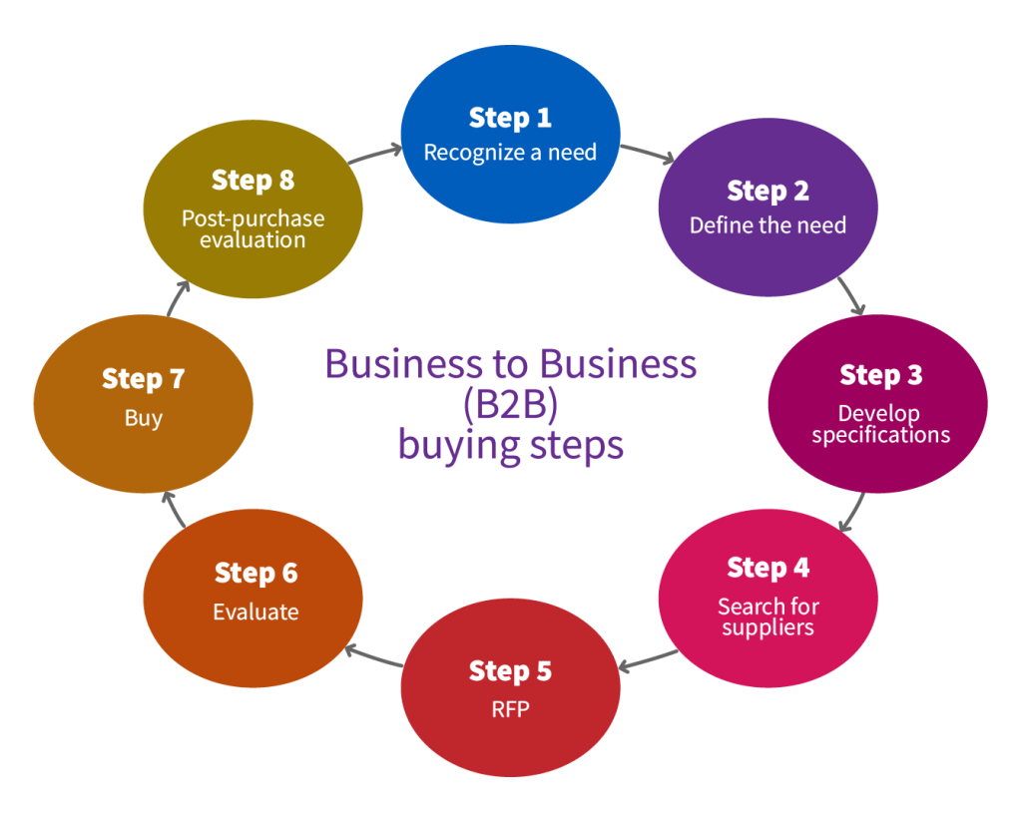
2.4 How The Buying Process Works
The Traditional View of the Seven Steps of the B2B Buying Process
Recognizing the need
Defining the need
Developing the specifications
Searching for appropriate suppliers
Requesting proposals
Evaluating proposals
Making the buying decision
Post-purchase evaluation
Figure 2.4.1 “B2B Buying Steps” by Freddy Vale CC BY-NC-SA 4.0
Notes:
Example: Strategic Alliance
Before introducing the iPhone, Apple contracted AT&T to be the exclusive service provider. Each company had something to contribute to the relationship, and each one had something to gain. In this case, AT&T pays Apple for each new customer it receives. Apple increases its revenues, and AT&T gains new customers. Both companies had to invest in research and development to make the relationship happen. Both companies “had skin in the game,” so both worked hard to ensure success through public relations, advertising, personal selling, and follow-up customer service. As a result, the relationship has been extremely successful for both parties, as a strategic alliance should be (Cauley, 2008).

Slide 11
2.4 How The Buying Process Works
Emotions Dominate B2B Buying
Business-to-business means person-to- person. That means that although a B2B buyer is making a decision on behalf of their company, they still behaves like a consumer and is subject to emotions and feelings.
Fear and Trust
People will not buy from someone they don’t trust, which is why some salespeople are more successful than others; they work to establish and develop trust with the customer.

Slide 12
2.5 Buying Process Meets Fab
Features, Advantages, and Benefits (FAB)
FAB is more than a way of selling; it’s a way of thinking like your customers.
Feature: what the product has
Advantage: what the features do
Benefit: what the features mean
Photo by gonghuimin468 via Pixabay

Slide 13
2.6 Key Takeaways & Terms
Advantage
B2B purchaser
Buying centre
Decision makers
Initiators
Power Level
Science of consumer behaviour
Strategic alliance
Users
Wants

Slide 14
2.7 Test Your Knowledge
Link: Questions
Photo by Gerd Altmann via Pixabay

