Slide 1
Sales Leadership Management
Chapter 12: Channel Sales Partners
Unless otherwise noted, this work is licensed under a Creative Commons Attribution-NonCommercial-ShareAlike 4.0 International (CC BY-NC-SA 4.0) license. Feel free to use, modify, reuse or redistribute any portion of this presentation.

Slide 2
12.0 Learning Outcomes
In this chapter, we will:
Explain why marketing channel decisions can result in the success or failure of products.
Describe the basic types of channels in business-to-consumer (B2C) and business-to-business (B2B) markets.
Explain the advantages and challenges companies face when using multiple channels and alternate channels.
Discuss how third party sales are different than direct sales.
Describe the factors that affect a firm’s channel decisions.
Outline the five steps in the channel management process.
Describe the types of conflicts that can occur in marketing channels.
Describe the ways in which channel members achieve cooperation with one another.

Slide 3
12.1 Marketing Channels and Channel Partners
Today, marketing channel decisions are as important as the decisions companies make about the features and prices of products.
Consumers have become more demanding.
How companies sell has become as important as what they sell.
The firms a company partners with to actively promote and sell a product as it travels through its marketing channel to users are referred to by the firm as its channel members (or partners).
The simplest marketing channel consists of just two parties—a producer and a consumer.
Products and services may pass through multiple organizations before they get to you. These organizations are called intermediaries (or middlemen or resellers).
The intermediaries can help companies sell the products better than they could working alone.
There are four forms of utility, or value, that channels offer. These are time, form, place, and ownership.

Slide 4
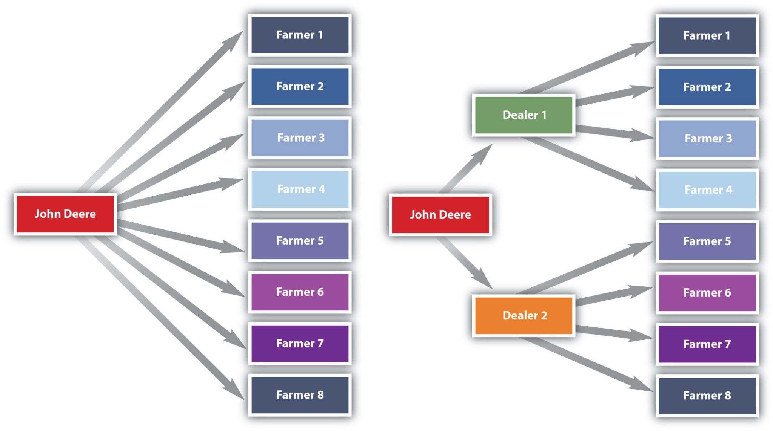
12.1 Marketing Channels and Channel Partners
Intermediaries also create efficiencies by streamlining the number of transactions an organization must make, each of which takes time and costs money to conduct.
The marketing environment is always changing, so what was a great channel or channel partner yesterday might not be a great channel partner today
Using Intermediaries to Streamline the Number of Transactions
Notes:
“Using Intermediaries to Streamline the Number of Transactions” shows, by selling the tractors it makes through local farm machinery dealers, the farm machinery manufacturer John Deere can streamline the number of transactions it makes from eight to just two.

Slide 5
12.1 Marketing Channels versus Supply Chains
All the organizations that figure into any part of the process of producing, promoting, and delivering an offering to its user are considered part of the offering’s supply chain.
These types of firms aren’t considered channel partners because it’s not their job to actively sell the products being produced. Nonetheless, they all contribute to a product’s success or failure.
Firms are constantly monitoring their supply chains and tinkering with them so they’re as efficient as possible. This process is called supply chain management.

Slide 6
12.1 Types of Channel Partners - Wholesalers
Wholesalers Obtain large quantities of products from producers, store them, and break them down into cases and other smaller units more convenient for retailers to buy, a process called “breaking bulk.”
There are many types of wholesalers:
Merchant Wholesalers are wholesalers that take title to the goods. They are also sometimes referred to as distributors, dealers, and jobbers.
Brokers, or agents, don’t purchase or take title to the products they sell. Their role is limited to negotiating sales contracts for producers.
Manufacturers’ Sales Offices or Branches are selling units that work directly for manufacturers. These are found in business-to-business settings.
Notes:
Example: The First Cell Phone Call Was an Epic Troll
Good thing you don’t have to use the cell phone shown in this YouTube video. You could forget about putting it in your purse or pocket. But in 1973, the phone was the latest and greatest of gadgets. Martin Cooper, who championed the development of the device, was a lead engineer at Motorola. To whom do you think Cooper made his first phone call on the device? To his rivals at AT&T, which at the time manufactured only “landline” phones. He wanted to let them know he and Motorola had changed the telephone game.

Slide 7
12.1 Types of Channel Partners - Retailers
Retailers buy products from wholesalers, agents, or distributors and then sell them to consumers.
Supermarkets or grocery stores, are self-service retailers that provide a full range of food products to consumers, as well as some household products.
Drugstores specialize in selling over-the-counter medications, prescriptions, and health and beauty products and offer services such as photo developing.
Convenience stores are miniature supermarkets. Many of them sell gasoline and are open twenty-four hours a day.
Specialty stores sell a certain type of product, but they usually carry a deep line of it.
Superstores are oversized department stores that carry a broad array of general merchandise as well as groceries.
Warehouse clubs are supercentres that sell products at a discount. They require people who shop with them to become members by paying an annual fee.

Slide 8
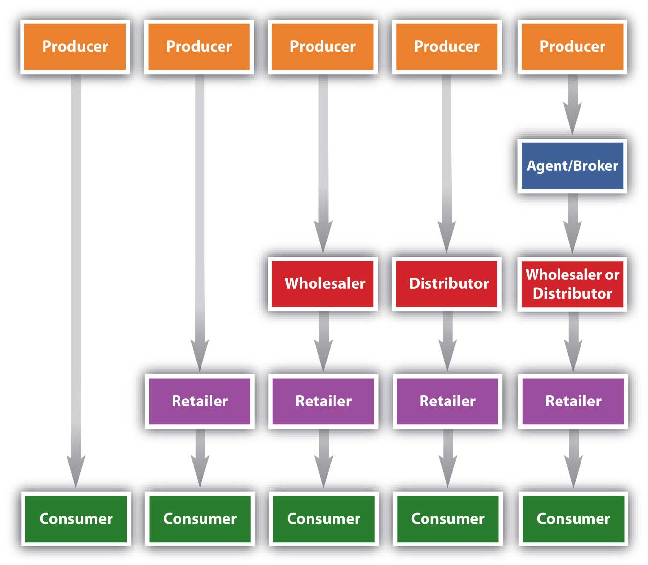
12.2 Typical Marketing Channels
The shortest marketing channel consists of just two parties—a producer and a consumer. A channel such as this is a direct channel. By contrast, a channel that includes one or more intermediaries—say, a wholesaler, distributor, or broker or agent—is an indirect channel. In an indirect channel, the product passes through one or more intermediaries. That doesn’t mean the producer will do no marketing directly to consumers.
Typical Channels in Business-to-Consumer (B2C) Markets

Slide 9
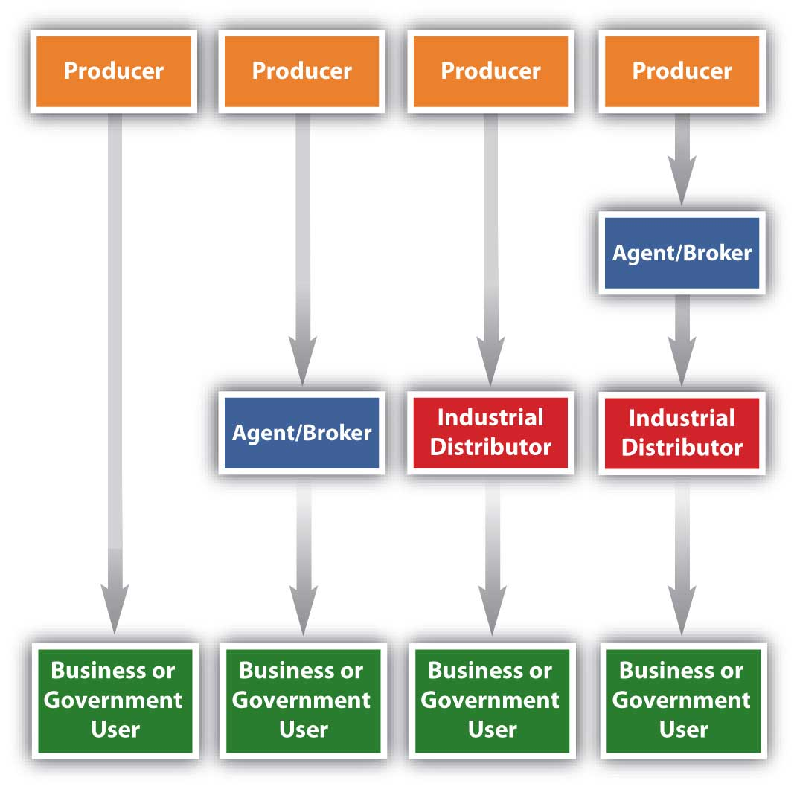
12.2 Typical Marketing Channels
Notice how the channels resemble those in B2C markets, except that the products are sold to businesses and governments instead of consumers like you. The industrial distributors shown in. the figure are firms that supply products that businesses or government departments and agencies use but don’t resell.
Typical Channels in Business-to-Business (B2B) Markets

Slide 10
12.2 Disinitermediation
Disintermediation is the process of cutting out the middlemen or intermediaries.
Sometimes cutting out the middleman is desirable but not always.
A wholesaler with buying power and excellent warehousing capabilities might be able to purchase, store, and deliver a product to a seller more cheaply than its producer could acting alone.
Hiring a distributor will cost a producer money.
The distributor can help the producer sell greater quantities of a product, increasing the producer’s profits.
You have to perform the functions the middlemen once did.
The Internet has facilitated a certain amount of disintermediation by making it easier for consumers and businesses to contact one another without going through any middlemen.
Sometimes it’s simply impossible to cut out middlemen. (Coca-Cola Company for example)

Slide 11
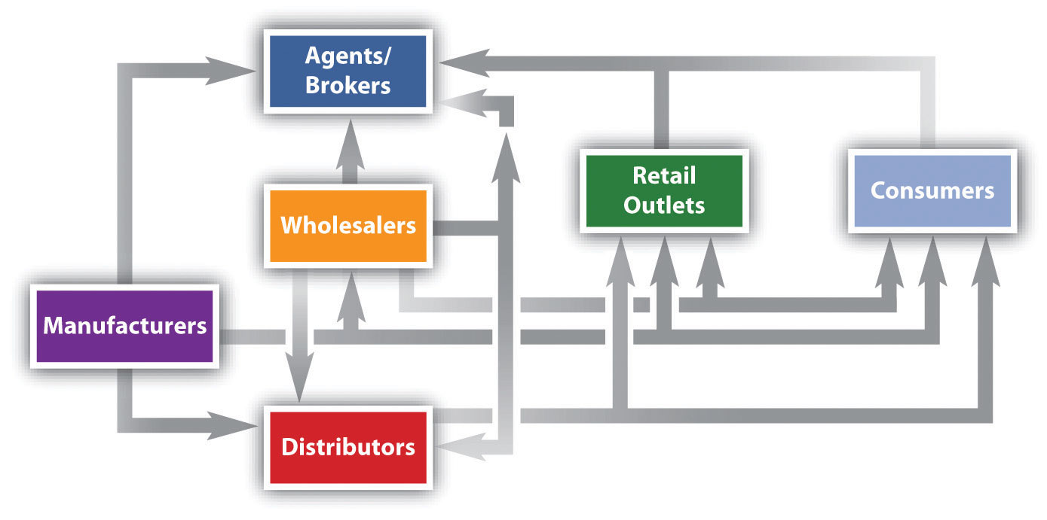
12.2 Multiple Channels and Alternate Channels
In some situations, a wholesaler will sell to brokers, who then sell to retailers and consumers. In other situations, a wholesaler will sell straight to retailers or straight to consumers. Manufacturers also sell straight to consumers, and, as we explained, sell straight to large retailers.
The key is understanding the different target markets for your product and designing the best channel to meet the needs of customers in each.
Using multiple channels can be effective.
Some companies find ways to increase their sales by forming strategic channel alliances with one another.
Alternate Channel Arrangements

Slide 12
12.2 International Marketing Channels
The question is how to enter these markets? Via what marketing channels?
Acquiring part or all of a foreign company is a common strategy for companies.
Corruption and unstable governments also make it difficult to do business in some countries.
Use intermediaries, like joint ventures. It is an entity created when two parties agree to share their profits, losses, and control with one another in an economic activity they jointly undertake.
Simply export your products.
Companies can sell their products directly to other firms abroad, or they can hire intermediaries such as brokers and agents that specialize in international exporting to help them find potential buyers for their products.
Franchising: this grants an independent operator the right to use a company’s business model, name, techniques, and trademarks for a fee.
Licensing is similar to franchising. For a fee, a firm can buy the right to use another firm’s manufacturing processes, trade secrets, patents, and trademarks for a certain period of time.

Slide 13
12.3 Third-Party Sales
Third-party sales are sales conducted by anyone other than the producer. Even when there are four or five parties involved, we refer to all of them as third parties.
Third-party sales are often vexing for marketers.
It is much more difficult to understand and influence the sales process.
Direct sales involve selling products directly to consumers through company-owned channels, offering more control over marketing, brand image, and pricing.
Third-party sales involve selling products through retailers, where the company has less control over marketing and sales strategies, and the focus is on maximizing sales regardless of the brand.
Approaches to Support Third-Party Sales Success:
Understand and align incentives.
Provide exceptional sales support.
Create demand for your product.

Slide 14
12.4 Channel Selection Factors
Selecting the best marketing channel is critical because it can mean the success or failure of your product.
how your customers want to buy products.
Type of Customer
Type of Product
Is perishable or valuable product?
Some have to be sold through shorter marketing channels than others.
Channel Partner Capabilities
Your ability versus the ability of other types of organizations that operate in marketing channels.
The Business Environment and Technology
Consider the general business environment, such as the economy or technological changes(internet).
Competing Products’ Marketing Channels
How your competitors sell their products.
You don’t always have to choose the channels your competitors rely on.
Notes:
Example: Domino’s Website
Some sites let customers tailor products to their liking. On the Domino’s website, you can pick your pizza ingredients and then watch them as they fall onto your virtual pizza. The site then lets you know who is baking your pizza, how long it’s taking to cook, and who’s delivering it. Even though interaction is digital, it somehow feels a lot more personal than a basic phone order. Developing customer relationships is what today’s marketing is about. The Internet is helping companies do this.

Slide 15
12.4 Factors That Affect a Product’s Intensity of Distribution
Intensive Distribution
Try to sell their products in as many outlets as possible.
Are often used for convenience offerings.
Selective Distribution
Involves selling products at select outlets in specific locations.
By selling different models with different features and price points at different outlets, a manufacturer can appeal to different target markets.
Exclusive Distribution
Involves selling products through one or very few outlets.
Exclusive simply means limiting distribution to only one outlet in any area and can be a strategic decision based on applying the scarcity principle to creating demand.

Slide 16
12.5 Channel Management Process
Analyze the Consumer.
Identify customers and their needs.
Understand buying behavior and preferences.
Establish the Channel Objectives.
Set goals based on customer requirements and company strategy.
Specify Distribution Tasks.
Define specific functions for the channel system.
Evaluate and Select Among Channel Alternatives.
Determining the specific channel tasks is a prerequisite of the evaluation and selection process.
There are four considerations for channel alternatives: number of levels, intensity at the various levels, types of intermediaries at each level, and application of selection criteria to channel alternatives.
Decide who will be in charge of the selected channels.
Evaluate Channel Member Performance.
Measure performance and make improvements if necessary.
Notes:
Example: Buying Characteristics
What might the buying characteristics of the purchaser of a high-quality curved TV be? After identifying the traits of the ultimate user you might the following characteristics:
purchased only from a well-established, reputable dealer
purchased only after considerable research to compare prices and merchandise characteristics
purchase may be postponed
purchased only from a dealer equipped to provide prompt and reasonable product service
Example: Specifying Distribution Tasks
An example of this is how a manufacturer might delineate the following tasks as necessary to profitably reach the target market:
Provide delivery within 48 hours after order placement
Offer adequate storage space
Provide credit to other intermediaries
Facilitate a product return network
Provide readily available inventory (quantity and type)

Slide 17
12.6 Managing Channel Conflicts
In a distribution channel, conflict usually arises in one of two forms: structural or behavioural.
Channel conflict is a dispute among channel members.
Vertical conflict is a conflict that occurs between two different types of members in a channel (a manufacturer, an agent, a wholesaler, or a retailer).
Horizontal conflict is a conflict that occurs between organizations of the same type (two manufacturers that each want a powerful wholesaler to carry only its products).
Companies aim to foster cooperation with channel partners to achieve common goals.
Strategies include providing sales incentives, creating marketing materials, and educating sales representatives.
Building relationships and emphasizing benefits of working together can strengthen cooperation.
Notes:
Example: Chinese Garlic Producers
Chinese garlic producers were accused of this practice in the early 2000s, and when garlic prices soared due to problems in China, other countries’ producers were unable to ramp back up to cover the demand. U.S. catfish farmers have recently accused China of the same strategy in that market. While there are global economic agreements that prohibit dumping and specify penalties when it occurs, the process can take so long to right the situation that producers have already left the business.
Example: Boar’s Head
Producing marketing and promotional materials their channel partners can use for sales purposes can also facilitate cooperation among companies. In-store displays, brochures, banners, photos for web sites, and advertisements the partners can customize with their own logos and company information are examples. Look at the banner in Figure 12.6.1. Although it looks like it was made by the grocery store displaying it, it wasn’t. It was produced by Boar’s Head, a meat supplier, for the grocer and others like it.

Slide 18
12.6 Channel Integration: Vertical and Horizontal Marketing Systems
Another way to foster cooperation in a channel is to establish a vertical marketing system.
In a vertical marketing system, channel members formally agree to closely cooperate with one another.
A vertical integration is when one channel member takes over the functions of another member.
Vertical integration can be forward, or downstream.
Backward integration occurs when a company moves upstream in the supply chain.
Franchises are another type of vertical marketing system.
In a conventional marketing system the channel members have no affiliation with one another. All the members operate independently.
Horizontal marketing system is one in which two companies at the same channel level agree to cooperate with another to sell their products or to make the most of their marketing opportunities, and is sometimes called horizontal integration.
Notes:
Example: P&G
Procter & Gamble (P&G) has traditionally been a manufacturer of household products, not a retailer of them. But the company’s long-term strategy is to compete in every personal-care channel, including salons, where the men’s business is underdeveloped. In 2009, P&G purchased The Art of Shaving, a seller of pricey men’s shaving products located in upscale shopping malls. P&G also runs retail boutiques around the globe that sell its prestigious SK-II skin-care line (Neff, 2009).

