Slide 1
Sales Leadership Management
Chapter 11: Sales Analytics
Unless otherwise noted, this work is licensed under a Creative Commons Attribution-NonCommercial-ShareAlike 4.0 International (CC BY-NC-SA 4.0) license. Feel free to use, modify, reuse or redistribute any portion of this presentation.

Slide 2
11.0 Learning Outcomes
In this chapter, we will:
Define sales analytics.
Discuss the different metrics that sales people and sales managers use.
Outline the steps in conducting a sales analysis.
Explain the different types of data analytics.
Discuss the different types of dashboards and their purpose.
List the five elements of a sales enablement strategy
Define customer relationship marketing.
Describe the importance of customer relationship marketing.

Slide 3
11.1 Sales Analytics and Sales Metrics
Sales analytics is the process of compiling and analyzing sales data in a way that compares sales expectations with actual sales results.
Sales analytics help to gain important customer insight!
Companies large and small use sales analytics tools to understand their businesses.
Sales analytics allow you to analyze your customers’ purchasing habits, your product performance, and your sales team’s performance.
Armed with sales analytics metrics, your company’s sales reps, marketers, and product managers can strategize future initiatives and improve their overall sales and marketing efforts.
Notes:
If your company reported its best-ever quarterly sales results, your first instinct would probably involve a good number of fist pumps. But then you’d pivot to an important question:
What happened to make the quarter so successful? The answer would be found in sales data analysis based on specific metrics. You’d take those key sales metrics, study them, and form actionable insights to steer future business decisions.

Slide 4
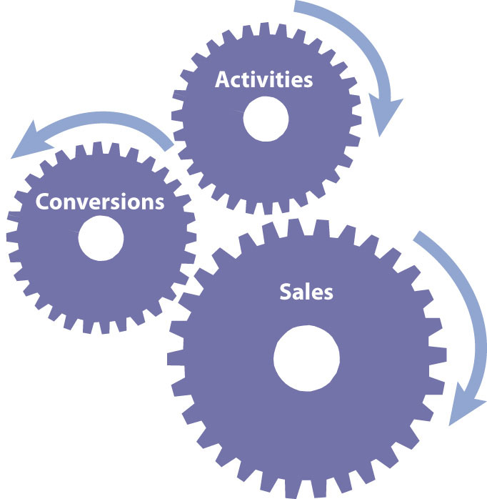
11.1 Metrics Used by Salespeople
The key metric, or measure, salespeople are evaluated on are the revenues they generate.
Conversion ratios measure how good a salesperson is at moving customers from one stage in the selling cycle to the next.
Salespeople can track their conversion ratios to identify which stages of the sales cycle they need to work on.
A win-loss analysis is an “after the battle” review of how well a salesperson performed given the opportunities he/she faced.
When the results are fed to managers, the analysis can help a company develop better products.
A marketing manager who listens carefully to what salespeople say during a win-loss analysis can develop better advertising and marketing campaigns.
How Activities and Conversions Drive Sales

Slide 5
11.1 Metrics Used by Sales Managers
The sales manager is interested in all the same metrics as the salesperson, plus others.
Sales managers also use sales cycle metrics to make broader decisions.
Sales managers also look at other measures such as market share, or how much of the market is buying from the firm versus its competitors; sales by product or by customer type; and sales per salesperson.
Time is yet another element that sales managers look at.
Sales executives don’t just focus on sales, though. They also focus on costs.
Customer satisfaction is another important metric. Salespeople and their bosses want satisfied customers.

Slide 6
11.2 Sales Metrics for Ecommerce
There are eight key metrics for assisting in forecasting future sales:
Sell-through rate
Sales funnel performance
Sales pipeline performance
Lead conversion rate
Average order value
Customer lifetime value (CLV)
Sales growth
Product performance

Slide 7
11.3 Sales Data Analysis
To conduct a sales analysis, a clear objective, collection tools, an analytical study, and the willingness to make changes is required. Here’s the process, broken into four steps:
Collect data using analytics tools
Analyze your results
Determine a sales metric to analyze
Apply your findings to future initiatives

Slide 8
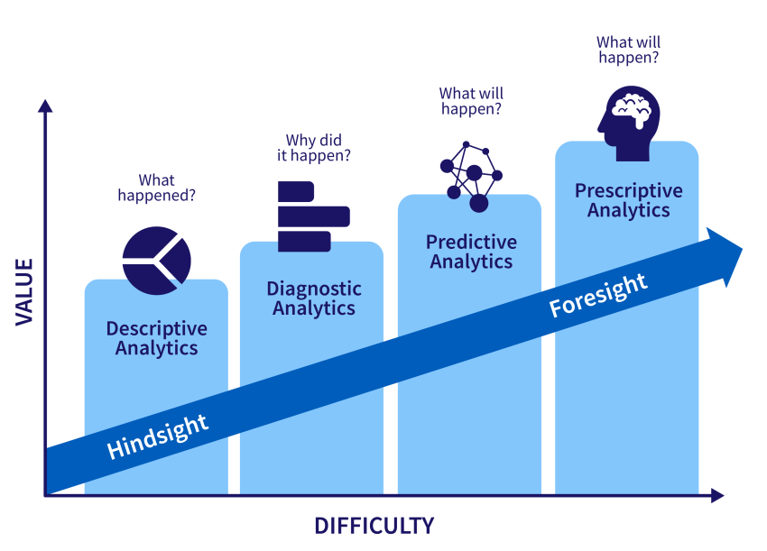
11.4 Types of Analytics
All analytics can be categorized in four ways: describe, diagnose, predict, and prescribe.
Calculating some summary statistics such as mean, median, mode and standard deviation is an example of descriptive analytics.
Similarly matching, or creating a scatter plot diagram are examples of diagnostic techniques.
Predictive techniques involve using regression analysis and attempts to find similarities between historical data sets to be able to forecast into the future.
Prescriptive analytics involve using decision support systems, machine learning and artificial intelligence to analyze the information and recommend a course of action.
“Analytics” by Freddy Vale CC BY-NC-SA 4.0

Slide 9
11.5 Data Visualization and Dashboards
Data visualization is the graphical representation of information and data (such as charts, graphs, and maps) that can quickly summarize data in a way that is more intuitive and can lead to new insights and understandings.
Dashboards are a type of data visualization that provide a heads-up display of critical indicators, letting managers get a graphical glance at key performance metrics.
Dashboard and reports are similar as well as different.
Both provide past data and bring different metrics together
Reports are more like a snap-shot, they are static while dashboards are more live and interactive.
There are three types of dashboards:
The operational dashboards give us a idea of what is happening now.
The strategic dashboards keep an eye on the Key Performance Indicators (KPI).
The analytical dashboards depend on data and help to identify the various trends.
Notes:
Importance of Dashboards
More value out of your Data: A properly designed dashboard is a fantastic tool to gather information and integrate cross-functional operations so as to better the core business metrics. Anyone on the team can use the dashboard and get meaningful insights so that the decisions are beneficial for the business.
Consolidate multiple data points: Dashboards bring the data from different metrics together on a single interface, so the reports can be compiled more easily, quickly and more meaningfully.
Align teams and departments: Dashboards provide a very clear and objective picture of what is currently happening and what is impacting the performance. They make the data very meaningful and understandable for all the teams to and departments, which would aid proper co-ordination between the overall organization.
Metrics you can track on an operational dashboard
Website performance metrics like new users, bounce rates etc.
Count of follower and activities like comments, likes etc. on social media channels.
Return on ad spending to evaluate the digital advertising expenditure (Hayward, 2023).
Metrics you can track on a strategic dashboard
Monthly, quarterly, or yearly performance (fiscal or non-fiscal)
Accounts and and new openings, growth rate.
Earnings before interest, tax, depreciation, and amortization (EBIDTA) (Hayward, 2023).
Metrics you can track on an analytical dashboard
Annual contract value to understand what an average customer contract is worth
Company spending habits (Hayward, 2023).

Slide 10
11.6 Sales Enablement
Sales enablement is the iterative process of providing your business’s sales team with the resources they need to close more deals (Hubspot, 2023).
Companies need to continuously update their salespeople about the advancements at each step of the journey, or they will be left behind.
It is crucial to choose the right training design and program. IDEA (Induct, Develop, Enable, and Assess) is an approach that encompasses the entire training process.
Training should focus on establishing sustainable practices that align with changing requirements and market trends and should include honing analytical abilities and soft skills.
Updating the education system with flexible and innovative curricula, vocational courses, and R&D centers will be crucial in generating future-ready salespeople.
Five important elements of a sales enablement strategy include creating content to support sales engagement, investing in sales training, building an effective sales tech stack, adopting a cross-functional approach, and documenting the sales enablement plan.
Notes:
Sales Enablement: Three Popular and Effective Formats
Sales enablement content can take many different forms, but here are three of the most popular and effective formats:
Case Studies
Naturally, your prospects want to understand if your solution is a good fit for them—if it does all the things they need it to and has a track record of delivering results for similar businesses. Case studies will help you to set their minds at ease. This type of content should set out the specific problems facing a client, then explain exactly how your product helped them, plus the specific results they achieved after teaming up with you.
Comparison Pages
Once they’ve progressed beyond the awareness stage of the sales funnel, your prospect will have a clear idea of the solution they need. Now, they’re going to compile a shortlist of solutions that fit the mould and compare them to one another.
Explainers
An explainer could be anything from a sales proposal, to a webinar, to an ebook. The format itself isn’t the most important thing—what matters is that it helps your prospects answer a question or resolve a problem they’re facing.
Assess Your Existing Training Materials
At this point, you need to understand three things:
Are your training materials consistent? Do they offer conflicting advice or recommend different processes? For your training to be effective, it’s important that all your collateral is on message.
Are they relevant to your team’s skill profile? If your team is predominantly made up of inexperienced, entry-level reps, don’t expect them to benefit from sales materials aimed at senior sales management who’ve been on the job for years.
Are they broad enough in scope? By which I mean, does your existing training content address all the challenges your sales team faces? Or are there key issues that aren’t covered by your current curriculum?

Slide 11
11.7 Customer Relationship Marketing
Customer relationship management (CRM) strategies have become increasingly important worldwide due to changes in expectations from customers as well as changes in the nature of markets.
CRM is a (strategy that combines) people, processes and technology that seeks to understand a company’s customers, focusing on customer retention and relationship development.
Successful CRM implementation requires cross-functional, customer-focused business process re-engineering, not just technology.

Slide 12
11.8 Importance of CRM
In today's highly competitive business environment, companies seek differentiation from competitors, and CRM is a powerful tool for achieving this.
Building strong customer relationships through CRM creates a competitive advantage that is difficult for competitors to replicate.
The rise of digital technologies has increased customer expectations, and CRM helps companies understand and meet these expectations.
The pillars of CRM have been defined through five major perspectives: process, strategy, philosophy, capability, and technological tool.
Understanding and implementing these CRM pillars lead to building profitable customer relationships and strengthening the company's position in the market.

