Slide 1
Fanshawe SOAR
Chapter 9: Reading and Notetaking

Slide 2
9.0 Learning Objectives
After reading this chapter, you should be able to do the following:
Identify the type of things you will need to read in college (LO1)
Define the active reading process (LO1, LO6))
Learn about various note taking styles to identify what might work for you (LO1, LO6)
Recognize that you may need to adapt how you read and take notes depending on the purpose and format (LO2)
Identify skills and strategies to create notes that are effective study tools (LO1,LO2)
Reflect on your own note taking and study skills to identify areas of improvement (LO1)
Identify resources that can help you take responsibility for developing your note taking and reading skills.(LO4)
Recognize how academic success connects to career success (LO1)

Slide 3
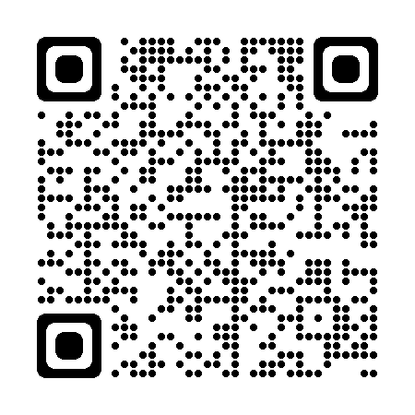
9.1 Self-Assessment
How do you feel about your reading abilities?
Reflect on the guiding questions in Section 9.1
Self-Assessment: Section 9.1 - Click the link or scan the QR code
Self-assessment

Slide 4
9.2 How Do You Read to Learn?
Active Reading
Strategies to engage with text to increase knowledge
4 step process
Preparing
Reading
Capturing Key Ideas
Reviewing

Slide 5
9.3 Notetaking
Styles of Note Taking
Lists
Outlines
Concept Maps
Short phrases
Not the best option
Important ideas
Supporting ideas underneath
Allows prioritization
organized
Cornell Method
Centre important idea
Create branches for additional points
2 column approach
Cue column and note column
Summary
Highly recommended
Opportunity

Slide 6
9.4 General Tips on Notetaking
Be prepared
Choose a tool
Label, number, and date
Don’t try to capture everything
Don’t just copy
Leave space between ideas
Use signals and abbreviations
Review your notes
Write a summary
Action

Slide 7
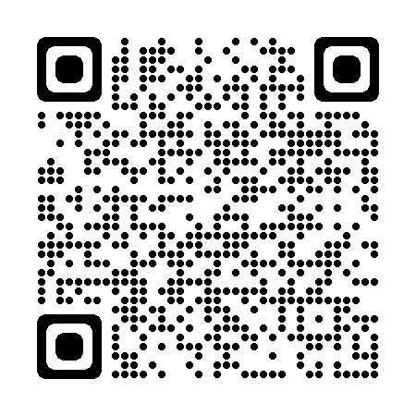
9.5 Reflection
Your note taking strategies will differ for each course. Do you feel equipped to take quality notes for all of your classes?
Answer the reflection questions in Section 9.6.
Reflect

Slide 8
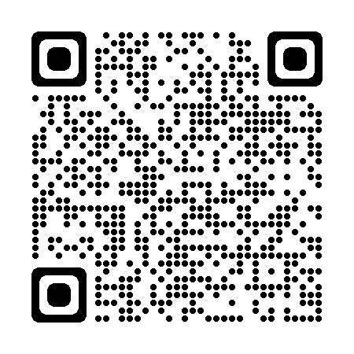
9.6 Career Connection
You will be expected to read and take notes throughout your working life and your job success will be dependent on your skills in this area.
Visit Section 9.6 for career connections.

Slide 9
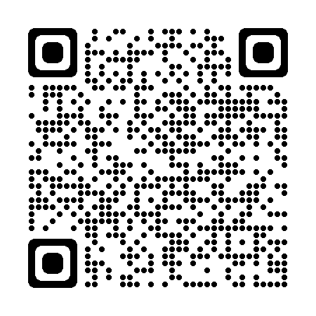
9.7 Fanshawe Resource
The Library Learning Commons offers workshops and individual assistance with reading, note taking, and other study strategies.
Visit Section 9.7 for helpful links.

Slide 10
9.8 Key Takeaways
Active reading is a skill
Taking notes is more than just a record of what your professor said
Strategically take notes for each subject
It is vital to return to your notes after class
Reading a taking notes require active listening

