Slide 1
Fanshawe SOAR
Chapter 6: Communicating and Connecting

Slide 2
6.0 Learning Objectives
After reading this chapter, you should be able to do the following:
Identify the communication process and what can get in the way (LO1, LO6)
Define the forms and purpose of communication (LO6)
Articulate the variables to communication (LO6)
Evaluate and make informed decisions about your strengths and challenges when communicating with others (LO1, LO6)
Define a strategy to manage conflict with others to further develop your complex problem solving, novel and adaptive thinking, and social intelligence (LO2, LO3, LO6)
Define the forms and purpose of communication (LO6)
Understand how technology has changed communication (LO3, LO6)
Identify resources that can help you take responsibility for your own learning journey (LO4)
Recognize how academic success connects to career success (LO1)

Slide 3
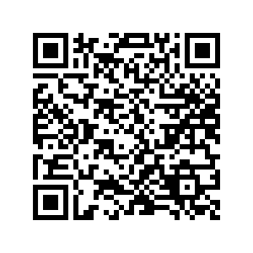
6.1 Self-Assessment
How do you feel about your communication skills? Take the self-assessment quiz in Section 6.1, or scan the QR code to take you there.
Self-Assessment: Section 6.1 - Click the link or scan the QR code
Self-assessment

Slide 4
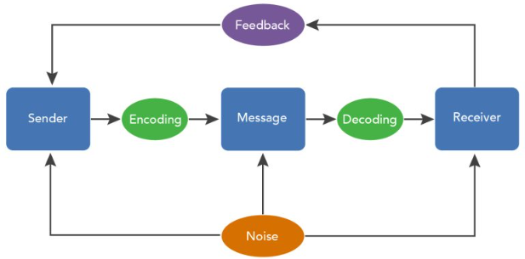
6.2 The Communication Process
Communication is crucial to any relationship
Opportunity

Slide 5
6.2 The Communication Process
Communication skills can be improved!
Become an “active” listener
Become an “effective” speaker
Photo by Akson on Unsplash

Slide 6
6.3 Opportunities for Effective Speaking
Effective Speaking
Honest, but not critical
Look for common ground
Avoid sarcasm/irony unless you know the person
Don’t try to “talk” like the other person
Relate to the person
Be assertive; not aggressive or passive
Opportunity

Slide 7
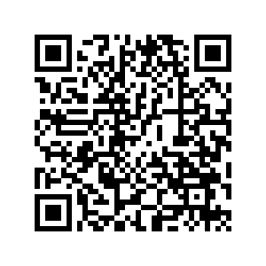
6.4 Opportunities for Active Listening
Active Listening
Talk less, listen more
Ask questions
Watch and respond to body language
Show that you are listening and care
Give the person feedback
Go to section 6.4 or scan the QR code to try the exercise
Opportunity

Slide 8
6.5 Online Discussion Forums
Discussion boards are an important tool for
Building collaborative relationships
Express developing ideas
Get feedback for you learning
Opportunity

Slide 9
6.5 Online Discussion Forums
What makes a good post?
Check the rubric!
Review “Level 1, Level 2, Level 3” diagram in Section 6.5
Quality of your post is important
Review “Tips for Participating in Forums” in Section 6.5
Photo by Christina @ wocintechchat.com on Unsplash

Slide 10
6.6 Team and Group Work
Working in groups is an important skill
Common in the workplace and in school
What are the pros and cons?
Effective groupwork (more in section 6.7)
Common goals
Use each other as resources
Clear, open, honest communication
Action

Slide 11
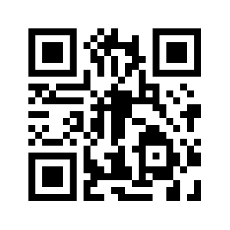
6.6 Team and Group Work
Conflict Resolution
Conflict is natural, but an opportunity
Be respectful
No assumptions
Be open-minded
Take a step back
Recognize the value of compromise
Use tools
Watch video in Section 6.6 or scan the QR code

Slide 12
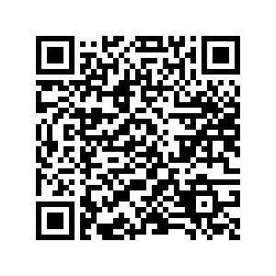
6.7 Connecting and Communicating in Action
What is the purpose of communication?
Improve your social connections by:
Recognize value in connecting
Make new friends
Join organized groups and activities
Scan the QR code or go to Section 6.7 to try the exercise
Action

Slide 13
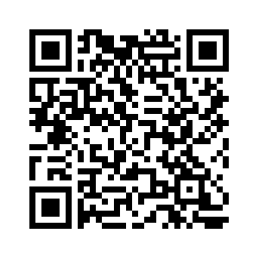
6.8 Reflection
Now that you understand the importance of effective communication, reflect and assess your communication skills by completing the exercises in Section 6.8.
Follow the link to Section 6.8 or scan the QR code.
Reflect

Slide 14
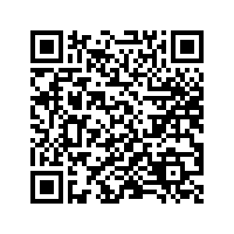
6.9 Career Connection
Now that you understand the concept of communication, and its importance, visit Section 6.9 Career Connection in your text, and reflect on the interview questions asked.
In addition, follow instructions in section 6.9 for taking a True Colours online assessment.

Slide 15
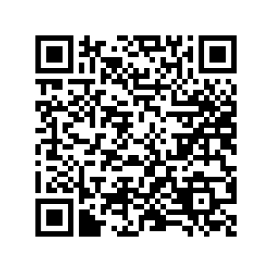
6.10 Fanshawe Resources
As a full-time student, you have access to a full catalogue of LinkedIn Learning Modules (for free)!
Section 6.10 expands on where to find them, and provides additional Fanshawe Resources for this topic.

Slide 16
6.11 Key Takeaways
Choose the appropriate communication tool
Check FOL email daily and use for all formal communication
Communication is complex; many variables to consider
Active listening is crucial
Online discussion boards are a great tool
Poor communication can lead to conflict
Practice your communication skills!

