Slide 1
Fanshawe SOAR
Chapter 3 : Values, Motivation, and Setting Goals

Slide 2
3.0 Learning Objectives
After reading this chapter, you should be able to do the following:
Identify some personal values that drive your short, mid, and long term goals (LO2)
Understand what S.M.A.R.T. goals are and how they work (LO2)
Recognize how having goals promotes focus and keeps you motivated to take steps to achieve your goal every day (LO2, LO3)
Recognize that personal, academic, and career goals are all connected and can be created the same way (LO2)
Identify resources to help you navigate your academic path toward your career goal (LO4)
Recognize how academic success connects to career success (LO1)

Slide 3
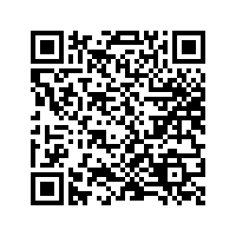
3.1 Self-Assessment
How do you feel about your readiness to create an academic plan that is aligned with your career plan and life plans? Let’s discuss.
Self-Assessment: 3.1 Self-Assessment Click the link or scan the QR code
Self-assessment

Slide 4
3.2 Goal Setting
Write down your:
Short-term goals; within the next few weeks
i.e. deadlines, meetings, exam
Midterm goals; this school year and perhaps during your college journey
i.e. getting the right education, getting involved in college opportunities
Long-term goals; beyond college
i.e. Graduating, getting a career job
Photo by Estée Janssens, Unsplash License

Slide 5
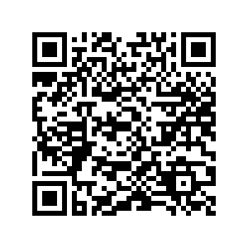
3.3 Creating S.M.A.R.T. Goals
A goal is a specific end result you desire
Set S.M.A.R.T. goals
Specific
Measurable
Attainable
Relevant
Time-bound
Check your learning
Try “Is it SMART?”
Opportunity

Slide 6
3.4 Staying Focused and Motivated
Plan ahead
Think about the results of your goals
Remember your successes
Break tasks into smaller (manageable) pieces
Reward yourself for completed significant tasks
What other strategies do you use?
Photo by Estée Janssens,
Unsplash License
Action

Slide 7
3.5 Reflective Activities
Now that you know how to plan and set goals:
Visit Section 3.5 Reflective Activities in your text
Complete Reflection tasks outlined
Reflect

Slide 8
3.6 Career Connection
Every workplace uses goal setting!
Whether work goals or academic goals or personal goals, the same process can be applied.
Identify a meaningful goal, create the plan, execute on the plan, regularly review and use feedback to revise your goals and plan.
Visit Section 3.6 and watch the linked videos

Slide 9
3.7 Fanshawe Resources
Fanshawe has various resources to help with your goals!
Visit Section 3.7 in your text for links to useful Fanshawe resources.

Slide 10
3.8 Key Takeaways
Write out short-term and long-term goals
Use the S.M.A.R.T. method for well planned goals
Goals help you set priorities and remain committed
Writing down goals in a visible place will help you stay motivated and focused
Fanshawe has various resources to identify goals and create an academic plan

