Slide 1
Fanshawe SOAR
Chapter 2: Learning & Knowing Yourself / Who Am I

Slide 2
2.0 Learning Objectives
After reading this chapter, you should be able to do the following:
Discover the different types of learning and what is currently influencing your learning (LO1,2,3)
Make informed and effective learning choices in regards to personal attitude and motivation.(LO1,2,3)
Evaluate and make informed decisions about your learning styles and learning skills. (LO1,2,4)
Identify resources to help you take responsibility for your own learning journey. (LO1, 2,4)
Identify resources to assist you with special learning needs.(LO1, LO4)
Recognize how academic success connects to career success (LO1)

Slide 3
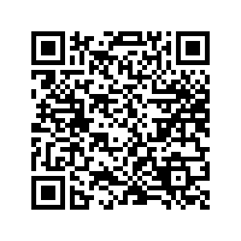
2.1 Self-Assessment
How do you feel about your learning abilities and challenges after completing the self assessment at the beginning of this chapter? Let’s discuss.
Self-Assessment: 2.1 Self-Assessment Click the link or scan the QR code
Self-assessment

Slide 4
2.2 What is Learning?
Putting info “in”
Perceiving information through 5 senses
Memory
Brain encodes and stores in short-term memory
Brain stores in long-term memory
Recalling stored info
Taking info “out”
Opportunity

Slide 5
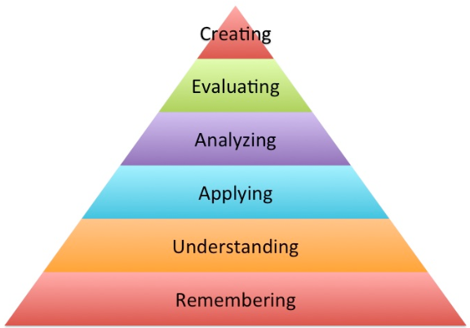
2.2 What is Learning?
Learning is cumulative
Bloom’s Taxonomy categorizes levels of learning
Create – Produce new ideas
Evaluate – Justify or support an idea
Analyze – Draw connections
Apply – Use info in new ways
Understand/Comprehend – Explain ideas or concepts
Remember – Recall facts and basic concepts
"Bloom's Taxonomy" by Andrea Hernandez

Slide 6
2.3 What Influences Your Ability to Learn?
Resilience – ability to keep going when things get tough
Are you motivated by performance or learning?
Fixed Mindset
Performance goal-oriented student
Growth Mindset
Learning goal-oriented student
Wants good grades
Wants to understand concepts

Slide 7
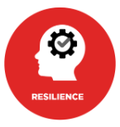
2.3 What Influences Your Ability to Learn?
You can improve your ability to learn
Negative bias thinking can be a roadblock to learning
Be aware of negative bias
Focus on the positive
Keep a gratitude and accomplishment journal

Slide 8
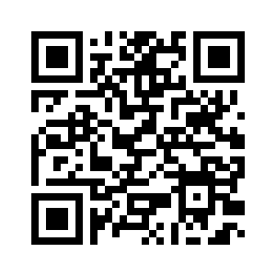
2.4 How Might Preferences, Culture and Personality Impact My Learning?
The mode or combination of modes that learners tend to prefer or respond well to:
aural (learn best by listening)
visual (learn best by seeing pictures, graphs, charts)
read/write (learn best by reading and taking notes)
kinesthetic (learn best by doing)
feeling (learn best by associating emotion to the learning)
Self-Assessment: The VARK Questionnaire – How do you learn best?
Opportunity

Slide 9
2.4 How Might Preferences, Culture and Personality Impact My Learning?
Cultural Preferences
Cultures and groups have specific ways of learning
i.e. Indigenous learning often uses story-telling to teach concepts
Personality Types
Personality styles may impact learning ability
Employers may use personality assessments in the hiring process
Self-Assessment: You can take a free version of a simple Myers-Briggs Personality Self-Assessment by going to Appendix C .

Slide 10
2.5 Learning Challenges
Challenges may include: circumstantial, environmental, self-inflicted, disabilities, etc.
Identifying your personal challenges is crucial for success
Systemic barriers – harassment, racism, violence, etc.
Accessibility barriers – colleges offer support in the form of:
Accommodations
Assistive technology
Opportunity
Notes:
Colleges offer support for those with permanent disabilities (and some temporary disabilities). Those with documented disabilities have special legal rights to certain accommodations. Even those whose disabilities are not diagnosed can receive some accommodations.

Slide 11
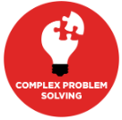
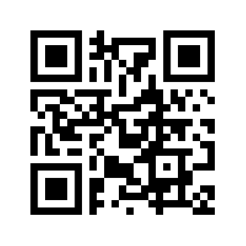
2.6 Learning Online
High level of self-directed learning required
Instructor is not the central figure in the learning environment
Social intelligence skill development
Online may feel harder; it requires more independency
Try This: Online Learning Readiness Indicator

Slide 12
2.7 Take Action – Take Charge of Your Learning Experience
Your experiences and needs will dictate your ideal learning process
Plan your own instruction; assess frequently
Create a safe environment for mistakes
Turn tasks into problems you have to solve/accomplish
Relate your learning activities to your goal occupation
Learn to manage time efficiently
Think of your instructors as partners in your education
Action

Slide 13
2.8 Reflective Activities
Do you know your learning style? Watch the TEDx Video in Section 2.8 and complete the reflective activities to help you understand your own learning preferences, the results may surprise you!
Reflect

Slide 14
2.9 Career Connections
Developing your self-directed learning skills will help you develop your novel and adaptive thinking skills, and implement solutions to solve complex problems.
Visit Section 2.9 for tips on how understanding learning styles will help you in your career.
Notes:
comment./reflect and refer to text

Slide 15
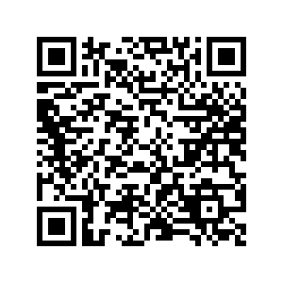
2.10 Fanshawe Resources
Visit Section 2.10 or scan the QR Code for links and resources to help you achieve academic success at Fanshawe.

Slide 16
2.11 Key Takeaways
You’re responsible for your learning
Learning goes well beyond memorization
Application and understanding of concepts are crucial
Reflecting on your learning will help identify relatable strategies
Supports exist for many challenges—seek them out!
Identify who your support network is

