Slide 1
Fanshawe SOAR
Chapter 1: Introduction

Slide 2
1.0 Learning Objectives
After reading this chapter, you should be able to do the following:
Reflect on why you are in college (LO2)
Understand the written and unwritten rules of being a Fanshawe College student (LO5)
Understand that this is your learning journey and you are responsible for your success (LO1, 2,3)
Identify key connections to help you with your success at Fanshawe College (LO4)
Identify how this resource is structured and how it can help you be a more successful student (LO4)
Recognize how academic success connects to career success (LO1)

Slide 3
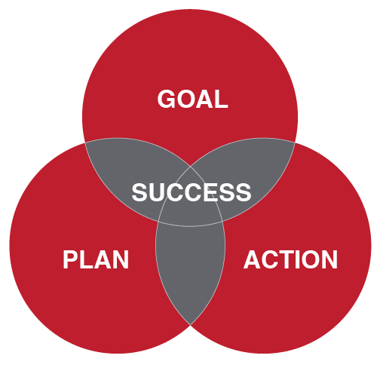
1.0 Introduction
This course is designed to help you
Identify what you want to get out of college (your GOAL).
Identify some strategies to help you reach your goal (your PLAN).
Identify what steps you need to take to execute this plan (your ACTION.)

Slide 4
1.2 Why College?
Develop technical skills along with “soft skills”.
Soft skills are in demand.
Fanshawe College has identified 7 Job Skills for the future.
Notes:
A 2022 survey of 1,000 Canadian businesses identified that in a tight or competitive job market, employers may not be able to hire externally. Instead, they are identifying those with the soft skills who could be trained on the hard skills and step quickly into a much needed position (Slater, 2022).
COVID impacted the way we do business and the current work from home, hybrid work models rely on being adaptable, resilient, learning on your own, and complex problems solving using your social intelligence by connecting and communicating through a screen.

Slide 5
1.3 SOAR
Each chapter in the book will follow the SOAR method:
Self-assess your strengths and weaknesses in relation to a particular topic.
Identify some strategies, that are really opportunities for you to improve.
Encourage you to take action and apply those opportunities.
Reflect on what comes next for you.

Slide 6
1.4 Key Contacts
Professor – questions about assignments, quizzes and the course site.
Academic Advisor – questions about schedules, programs etc.
Proper email etiquette is important.
Question: What are some of the things that should be included in an email?
Notes:
Fanshawe College has a diverse network of supports to help you during your time at Fanshawe and beyond. Sometimes identifying the right person or the right resource can be challenging and if you are under stress, it can be even harder.

Slide 7
1.5 The Written Rules
Accepting your offer to become part of the Fanshawe Falcon community means you have agreed to abide by all the policies that govern you while you are a student.
Policy information can be found on our Fanshawe website and is worth reviewing. In particular the Student Code of Conduct
Question: What training offered at the college will help you succeed as a student at Fanshawe?

Slide 8
1.6 The Unwritten Rules
The hidden curriculum can be thought of as a set of unwritten rules or expectations. What are the unwritten rules about:
what you should be doing before attending class?
arriving late to class?
what you should be doing in class?
what you should be doing after class?
if you are not able to attend that class?

Slide 9
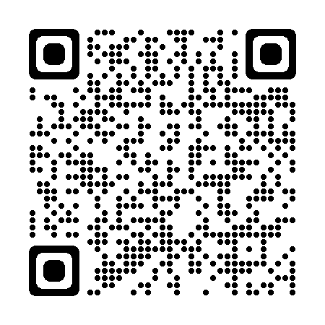
1.7 Reflective Activities
Visit Section 1.7 and complete the reflective questions. You may be asked to post/share them.
Reflect

Slide 10
1.8 Career Connections
Do you have a LinkedIn profile?
Is it up to date?
Why do you think this is important?
Do you know how to reflect back on lessons learned?
This is important in interviews!
Visit Section 1.8 for ways in which chapter 1 relates to your career.

Slide 11
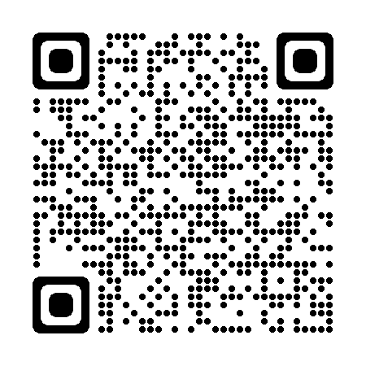
1.9 Fanshawe Resources
Here For You is a core principle that inspires Fanshawe’s relationship with you, our students.
Visit Section 1.9 or scan the QR Code for links and resources that will help you succeed.

Slide 12
1.10 Key Takeaways
College requires commitment, focus, and effort
Fanshawe’s 7 Job Skills for the Future
Seek support through Fanshawe
Academic integrity is important
Learn written and unwritten rules
Connect with your academic advisor and professors
Reflect back on strengths and weaknesses to help you plan

