Slide 1
Principles of Macroeconomics
CHAPTER 8: AGGREGATE EXPENDITURE
Unless otherwise noted, this work is licensed under a Creative Commons Attribution-NonCommercial-ShareAlike 4.0 International (CC BY-NC-SA 4.0) license. Feel free to use, modify, reuse or redistribute any portion of this presentation.

Slide 2
Learning Outcomes
At the end of this chapter, you will be able to:
Explain the Aggregate Expenditure Model
Determine the Level of Aggregate Expenditure in the Economy
Define Macroeconomic Equilibrium
Identify the Multiplier Effect

Slide 3
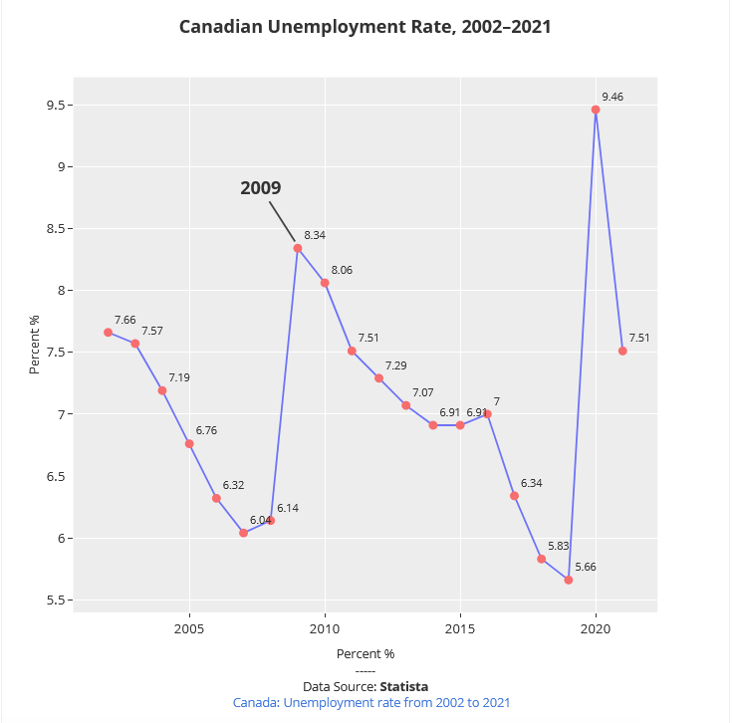
8.0 Introduction
The Great Recession of 2008-2009 affected the Canadian economy
The financial market meltdown called for action by the Federal Government
Question: What caused this recession and what prevented the economy from spiraling further into recession?

Slide 4
8.1 Defining Aggregate Expenditure
Aggregate expenditure is the current value of all the finished goods and services in the economy.
The aggregate expenditure equation is:
AE = C + I + G + NX
Consumption (C): The household consumption over a period of time.
Planned investment (I): Planned spending on capital goods.
Government expenditure (G): The amount of spending by federal, provincial, and local governments. Government expenditure can include infrastructure or transfers which increase the total expenditure in the economy.
Net exports (NX): Total exports minus the total imports.

Slide 5
8.1 Actual vs Planned Investment I
When a company decides on how much to spend on investment, we assume they are deciding about business fixed expenditures.
The difference between actual investment and planned investment will be caused by an unexpected change in inventories.
When actual investment spending exceeds planned investment spending, we see an unexpected increase in inventories.
When actual investment spending is less than planned investment spending, we see an unexpected decrease in inventories.

Slide 6
8.1 Actual vs Planned Investment II
Let us assume Toyota manufactures 20,000 pick-up trucks in 2023, so planned investment would be based on the number of trucks manufactured.
Suppose, Toyota was able to sell only 18,000 trucks by the end of the year, then actual investment would depend on the number of trucks sold.
Due to changing economic circumstances, planned investment and actual investments may differ.
Sometimes, businesses sell less due to falling consumer demand and therefore, actual investments would fall below planned. Whenever businesses can sell more due to growing demand, actual investments increase beyond planned.
When Toyota manufactures 20K trucks, but sells only 18K, inventories build up, production and real GDP decrease.
When Toyota manufactures 20K trucks, but sells 22K, inventories decrease, production and real GDP increase.

Slide 7
8.1 Equilibrium
A macroeconomy is in equilibrium when Aggregate Expenditure = GDP

Slide 8
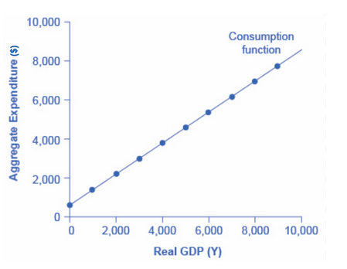
8.2 Components of AE: Consumption I
Income can be consumed or saved. The relationship between income and consumption is called the consumption function. Consumption has an Autonomous part and an Induced part. Autonomous consumption does not depend on disposable income, induced part varies with disposable income.

Slide 9
8.2 Components of AE: Consumption II
Because consumption heavily depends on income, we have a concept in the AE model called marginal propensity to consume (MPC).
MPC = Change in Consumption ÷ Change in Disposable Income
Marginal propensity to consume (MPC) is the share or percentage of additional income a person decides to consume (spend).
Marginal propensity to save (MPS) is the share of additional income a person decides to save.
MPC + MPS = 1 must always hold true since the only options are to consume or save income.

Slide 10
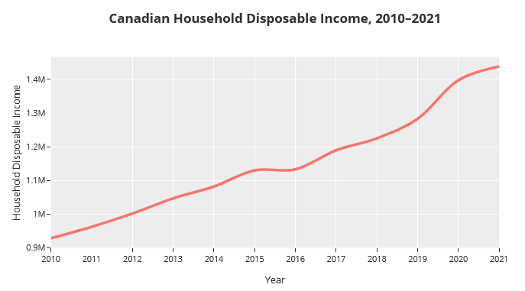
8.2 Components of AE: Consumption III
The relationship between income and consumption can be extended to the national economy as any increase in national income will lead to an increase in consumption. National Income = GDP = Disposable income + Net taxes

Slide 11
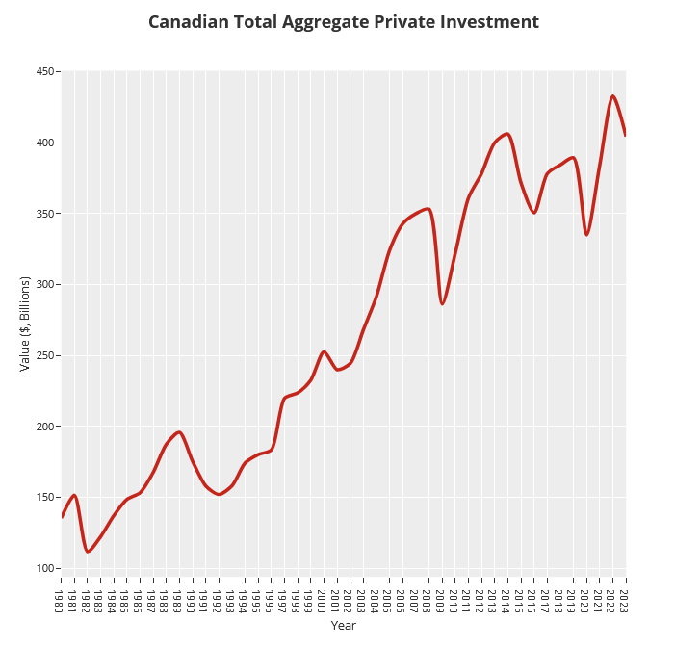
8.2 Components of AE: Planned Investment I
Planned investment is determined by:
Expectations of future profitability
The real interest rate
Taxes
Cash flow

Slide 12
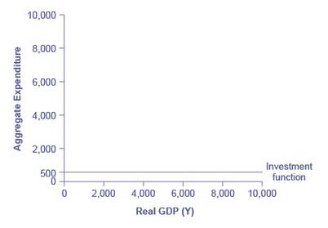
8.2 Components of AE: Planned Investment II
The investment function shows the relationship between real GDP and investment levels.
The investment function can be drawn as a horizontal line as investment decisions do not depend primarily on the level of GDP in the current year. Investment is called an Autonomous expenditure, that does not depend on real GDP.

Slide 13
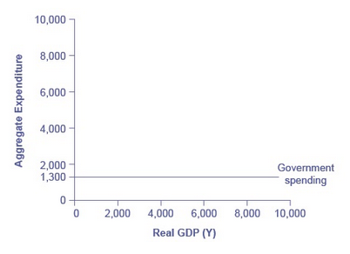
8.2 Components of AE: Government Purchases
Federal, provincial, and local governments determine the level of government spending.
Government spending is independent of GDP and so is shown as a horizontal line.
Government spending is called an Autonomous expenditure, that does not depend on real GDP.

Slide 14
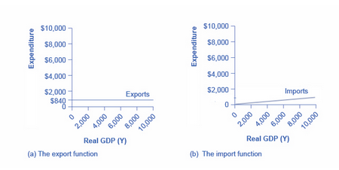
8.2 Components of AE: Net Exports
Exports do not depend on a country's national income (GDP), so exports are autonomous too.
The import function is connected to national income. As income grows, a country’s ability to import increases.
The slope of the function (line) = marginal propensity to import (MPI) where the percentage change in spending on imports when national income changes.

Slide 15
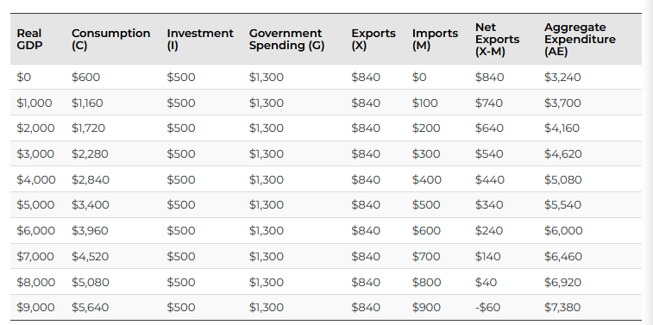
8.3 The Aggregate Expenditure Function I
The aggregate expenditure function shows the total expenditures in the economy for each level of real GDP.
To find the aggregate expenditure function sum the parts using the equation C + I + G + (X-M) = AE
The equilibrium level of AE is $6000 in the table below where AE = GDP

Slide 16
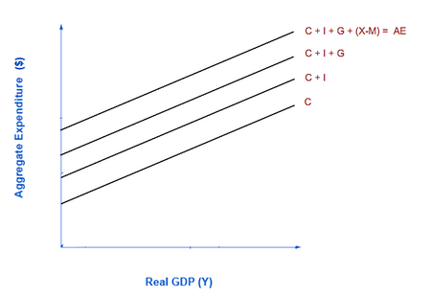
8.3 The Aggregate Expenditure Function II
Graphically, the aggregate expenditure function is formed by stacking:
the consumption function
the investment function
the government spending function
the net export function

Slide 17
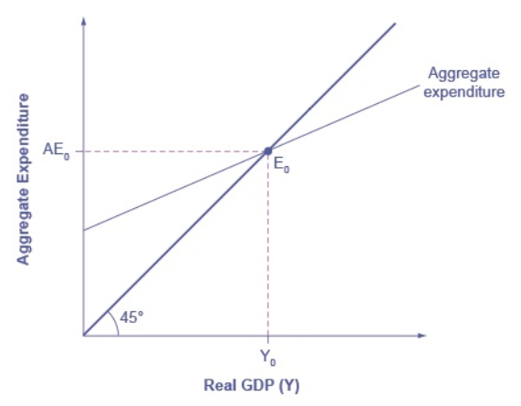
8.3 The Aggregate Expenditure Function III
Point E₀ is the equilibrium for the economy
This point is where total amount being spend equals the total level of production

Slide 18
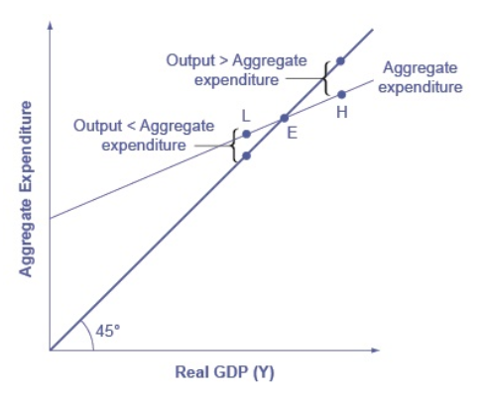
8.3 The Aggregate Expenditure Function IV
The point of intersection between the aggregate expenditure function and the 45° line is a macroeconomic equilibrium. No change in inventories.
To the right of equilibrium (i.e. at H) output is higher than AE, spending falls and unsold inventories pile up.
To the left of equilibrium (i.e. at L) output is lower than AE, spending increases and store shelves get empty, inventories decline.

Slide 19
8.4 The Multiplier I
Changes in any category of expenditure have a more than proportional impact on GDP.
The multiplier shows that the change in GDP is a multiple of the change in any autonomous expenditure (I, G or X)
Changes in autonomous variables cause the AE curve to shift vertically creating a new equilibrium.

Slide 20
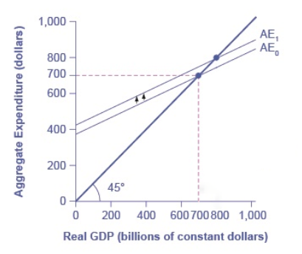
8.4 The Multiplier II
In this example there is an increase in Government expenditure
Original increase in aggregate expenditure from government purchase | 100
Second round of increase in AE from additional consumption... | 100+80 = 180
Third-round increase in AE due to induced consumption from additional income in second round | 180 + 60 = 240
Fourth round increase in AE due to further induced consumption from additional expenditure incurred in round 3 | 240 + 40 = 280

Slide 21
8.4 The Multiplier III
First formula for calculating the multiplier:
Multiplier = 1 ÷ (1- MPC)
When MPC = 0.8, multiplier = 1/(1 – 0.8) = 5 implying, a dollar increase in G, increases GDP by $5.
Second formula for calculating the multiplier:
Change in GDP ÷ change in any autonomous expenditure (I, G, or X)
When a G increase by $100M increases GDP by $500M, multiplier = $500M/$100M = 5
The multiplier applies when expenditure decreases as well as when it increases.

Slide 22
8.5 Key Terms
Aggregate expenditure
Autonomous consumption
Autonomous Expenditure
Consumption
Consumption function
Induced expenditure
Investment function
Macroeconomy equilibrium
Marginal propensity to consume (MPC)
Marginal propensity to import (MPI)
Marginal propensity to save (MPS)
Multiplier
Wealth

