Slide 1
Principles of Macroeconomics
CHAPTER 7: THE MARKET FOR LOANABLE FUNDS
Unless otherwise noted, this work is licensed under a Creative Commons Attribution-NonCommercial-ShareAlike 4.0 International (CC BY-NC-SA 4.0) license. Feel free to use, modify, reuse or redistribute any portion of this presentation.

Slide 2
Learning Outcomes
At the end of this chapter, you will be able to:
Explain Saving, Investment and the Financial System
Examine the Loanable Funds Market
Define the Crowding Out Effect

Slide 3
7.0 Introduction
Question: Where do households, businesses and governments find the money to finance their expenditures?
Financial markets are where savers put their savings to work, and borrowers find funding to borrow.
Notes:
Banks - which in turn loaned the money to individuals or businesses that wanted to borrow money. Some was invested in private companies or loaned to government agencies that wanted to borrow money to raise funds for purposes like building roads or mass transit. Some firms reinvested their savings in their own businesses.
In this chapter, we will provide an overview of financial markets to provide context for the subsequent discussion of money and the banking system.

Slide 4
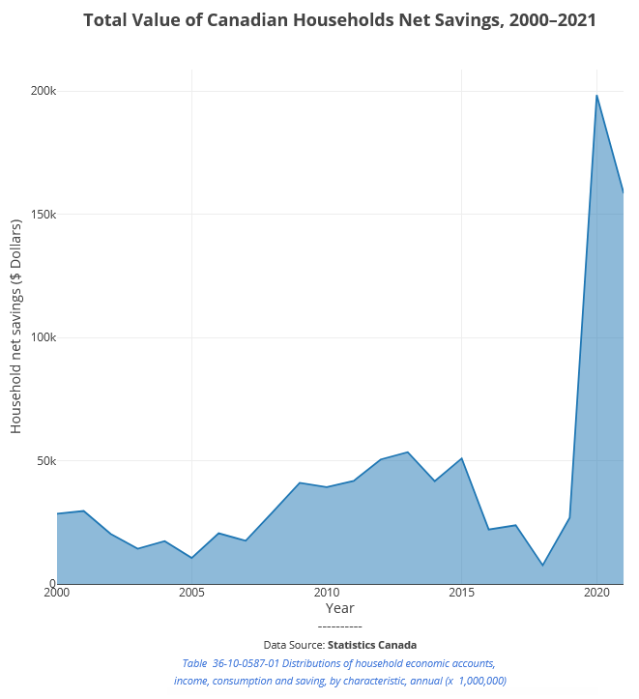
7.1 Financial Markets I
Question: Canadian households saved almost $159 billion in 2021.Where do these savings go?
Banks
Invested in private companies
Loaned to government agencies
Reinvested into businesses.
Notes:
Some of the savings ended up in banks, which in turn loaned the money to individuals or businesses that wanted to borrow money. Some was invested in private companies or loaned to government agencies that wanted to borrow money to raise funds for purposes like building roads or mass transit. Some firms reinvested their savings in their own businesses.

Slide 5
7.1 Financial Markets II
Financial markets include the banking system, equity markets like the Toronto Stock Exchange, bond markets, commodity markets and more
All financial assets are called securities.
Equities (i.e. stocks) give savers ownership in a company in return for dividends (a regular payment from the company) and/or capital gains (e.g. when you sell the stock at a profit).
Bonds are a type of debt, where a saver lends money to a borrower in return for an interest payment.

Slide 6
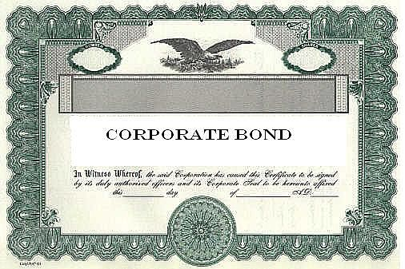
7.1 Bank Loan and Bond
A bank loan is when a firm borrows an amount of money and then promises to repay it, including some rate of interest, over a predetermined period of time.
A bond is a financial contract like a loan, typically, bond interest rates are lower than loan interest rates, and there are organized secondary markets for bonds, making them more liquid to bondholders than loans.
Photo by Wiktionary is licensed under CC BY-SA.
Notes:
A bank loan for a firm works in much the same way as a loan for an individual who is buying a car or a house. The firm borrows an amount of money and then promises to repay it, including some rate of interest, over a predetermined period of time. If the firm fails to make its loan payments, the bank (or banks) can take the firm to court and require it to sell its buildings or equipment to pay its debt.
A bond is a financial contract like a loan, typically, bond interest rates are lower than loan interest rates, and there are organized secondary markets for bonds, making them more liquid to bondholders than loans. Bonds are issued by major corporations and also by various levels of government. For example, cities borrow money by issuing municipal bonds, the federal government borrows money when the Canadian Department Finance issues Treasury bonds.

Slide 7
7.1 Corporation
A corporation is a business that “incorporates”
it is owned by shareholders that have limited liability for the company’s debt but share in its profits (and losses).
may be private or public,
may or may not have publicly traded stock.
They may raise funds to finance their operations or new investments by raising capital through selling stock or issuing bonds.

Slide 8
7.2 Savings and Investment
From Chapter 4, we recall that the GDP identity is Y = C + I + G + NX
Assume we have a closed economy NX = 0
In a closed economy, our new GDP identity is Y = C + I + G
Re-arrange the equation by solving for investment I = Y − C − G (eq 1)
S_{private} = Y + TR − C − T and
S_{public} = T − G − TR
S = S_{private} + S_{public}
= (Y + TR − C −T) + (T−G−TR)
= Y+ TR − TR + T − T− C − G
= Y − C − G (eq 2)
Therefore, S = I (from eq 1 and 2)
SAVING FINANCES INVESTMENT
Notes:
This tells us that investment is going to be an economy’s income minus consumption and government spending.
Now let us consider savings. We can split savings into two components: private savings that refers to households and public savings that refers to governments
In the private sector, households receive income by providing their factors of production, like labour, to firms (Y). They also receive money from the government which we called transfer payments in Chapter 4 (TR). But households also spend money. Money spent on goods and services is classified under consumption (C). Additionally, households must also pay taxes to the government (T). Therefore, the private savings function can be written as:

Slide 9
7.3 Government Budget
A budget surplus is when a government collects more than it spends
T > G + TR
A deficit is when a government has negative public savings, or when it spends more than it collects.
T < G + TR
This Photo by DENIS ESAULOV 1987 is licensed under CC BY-NC.
Notes:
When public savings is negative total savings will be smaller than it otherwise could have been. A reduction in total savings will lead to a reduction in total investment since savings equals investment. When savings falls so does investment.

Slide 10
7.4 The Loanable Funds Market
Loanable funds market includes loans, bonds, and stocks. The rate of return for loanable funds is based on demand and supply.
Demand is the willingness of firms to engage in large scale projects.
Supply is the willingness of households, and governments to save.
Photo by Gov.UK is licensed under CC BY-ND.
Notes:
In the market for loanable funds, the demand is measured by the willingness of firms to borrow to engage in large-scale construction projects. This could include the construction of a new manufacturing facility, research into a new product line, or upgrading existing capital.
On the other hand, the supply of loanable funds is determined by the willingness of households to save in addition to the savings, or dissavings, of the government.

Slide 11
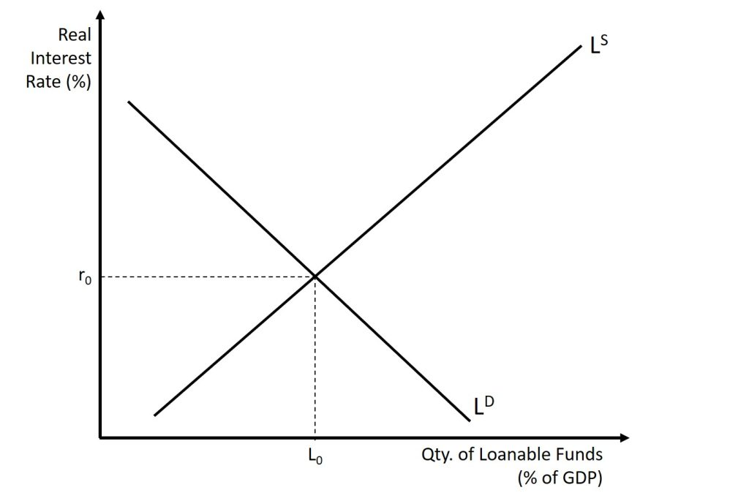
7.4 Demand and Supply in the Loanable Funds Market
The horizontal axis of the financial market shows the quantity of money that is loaned or borrowed in this market.
The vertical axis measures the real rate of interest.
Notes:
The simplest example of a rate of return is an interest rate. For example, when you put money into a savings account at a bank, you receive interest on your deposit. The interest payment expressed as a percent of your deposits is the interest rate. Similarly, if you demand a loan to buy a car or a computer, you will need to pay interest on the money you borrow.
Recall, the “real interest rate” in an economy is often considered to be the rate of return minus an index of inflation, such as the rate of change of the CPI or GDP deflator.
a higher rate of return (that is, a higher price) will decrease the quantity demanded. As the interest rate rises, consumers will reduce the quantity that they borrow.
According to the law of supply, a higher price increases the quantity supplied. Consequently, as the interest rate paid on borrowing rises, more firms will be eager to issue loans. Conversely, if the interest rate on loans fall, the quantity of financial capital supplied in the market for loanable funds will decrease and the quantity demanded will fall.

Slide 12
7.4 Demand and Supply in the Loanable Funds Market
A change in the interest rate, ceteris paribus, cause changes in the quantity of the loanable funds, represented by movement along the LD or LS curves.

Slide 13
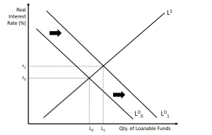
7.5 Increase in Demand for Loanable Funds
Demand for more loans resulting from stronger economic growth results in an outward shift of the demand curve. Businesses expect a stronger economy will increase expected profits and they demand more loans.
The interest rate will adjust until the market is in a new state of equilibrium. Compared to the initial equilibrium, both the real interest rate and quantity of loanable funds will increase.
Notes:
Suppose that some event causes households and business to demand more loans. This may be caused by increased consumer optimism which causes people to start to buy (and need to finance) more. It could be because of an uptick in business leading to increased confidence in investment projects sought by businesses

Slide 14
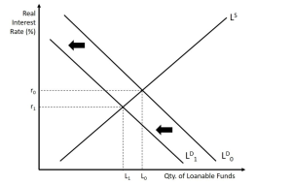
7.5 Decrease in Demand for Loanable Funds
A decrease in demand for loans due to lower consumer confidence results in an inward shift of the demand curve. As consumers buy less, sales decline, businesses cut down investments, so businesses demand less funds as well.
The interest rate will adjust until the market is in a new state of equilibrium. Compared to the initial equilibrium, both the real interest rate and quantity of loanable funds will decrease
Notes:
Suppose that some event causes households and business to demand less loans. This may be caused by increased consumer pessimism which causes people to start to buy (and need to finance) less. It could be because of and downturn in business leading to decreased confidence in investment projects sought by businesses.

Slide 15
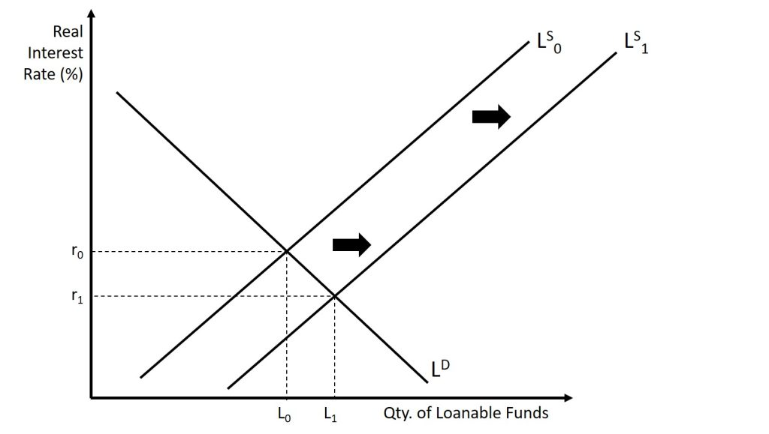
7.5 Increase in Supply of Loanable Funds
Increase in supply of funds due to economic slowdown results in an outward shift of the supply curve, as people save more and spend less. More savings increases supply of loanable funds.
The interest rate will adjust until the market is in a new state of equilibrium. Compared to the initial equilibrium, the real interest rate will now be lower even though the quantity of loanable funds is now greater
Notes:
Suppose that some event causes households to save more. This may be caused by a desire to be more fiscally responsible or it may be caused by a government policy. For example, suppose that the government offers some sort of tax incentive to save or perhaps they decrease or eliminate the tax that must be paid on interest earned.

Slide 16
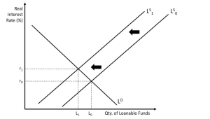
7.5 Decrease in Supply of Loanable Funds
Decrease in supply of funds results in an inward shift of the supply curve. This could happen when wealth goes up and people spend more and save less.
The interest rate will adjust until the market is in a new state of equilibrium. Compared to the initial equilibrium, both the real interest rate and quantity of loanable funds will increase.
Notes:
Suppose that some event causes households and business to save less. This may be caused by a desire to consumer more (and hence save less) or it may be caused by a government policy. For example, suppose that the government raises the tax that must be paid on interest earned

Slide 17
7.5 A Decrease in the Supply of Loanable Funds (Public Sector) – Crowding Out
As government budget deficit increases, the gap between G and (T + TR) increases, and government dissavings increases.
As aggregate savings fall, supply of loanable funds decreases, and interest rates rise. Investment decreases.
Crowding out is when private sector investment is crowded out due to rising interest rate.
Notes:
When the government needs more money for their operations than what they have collected in revenues, they must run a deficit. As we saw earlier, when the deficit increases, the gap between G+T and TR increases. Therefore, the level of dissavings increases. As this occurs, public savings decreases leading to a decrease in national savings. Graphically, the outcome is the same as when there is a decrease in the supply of loanable funds.
As the equilibrium interest rate rises due to a decrease in loanable funds, private investment could decrease as loans get more costly. When the government enacts policies that require borrowing, there is potentially less private investment which is a hindrance. This phenomenon is called crowding-out.

Slide 18
7.6 Key Terms
Bank Loan
Bond
Consumer Price Index (CPI)
Corporation
Crowding Out
Financial markets
GDP deflator
Interest rate
Investment
Loanable Funds Market
Securities
Stock

