Slide 1
Chapter 29
Introduction to Chromatography and Spectroscopy
Slides to accompany Organic and Biochemistry Supplement to Enhanced Introductory College Chemistry by Gregory Anderson, Jen Booth, Caryn Fahey, Adrienne Richards, Samantha Sullivan Sauer, and David Wegman
Slide design and template by Revathi Mahadevan
Except where otherwise noted, images, tables & diagrams are reused from Organic and Biochemistry Supplement to Enhanced Introductory College Chemistry
Slides are licensed under CC-BY 4.0, Except while otherwise noted

Slide 2
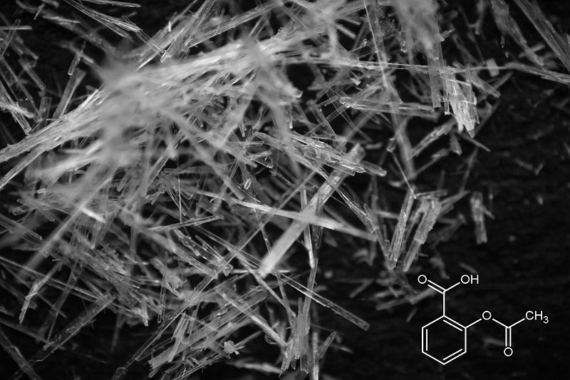
Figure 29.0a
Figure 29.0a. Acetylsalicylic acid crystals and their chemical structure. (Credit: Image by Steve Mike Neef, CC BY-SA 3.0)

Slide 3
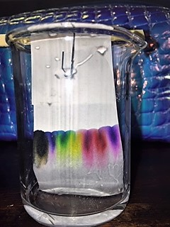
Figure 29.1a
Figure 29.1a. Picture of paper chromatography of various marker ink. (Credit: Photo by Amitchell125, CC BY-SA 4.0)

Slide 4
Figure 29.2a
Figure 29.2a. Setup of paper chromatography (credit: Chromatography , CC BY-NC 4.0).

Slide 5
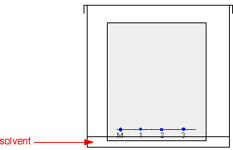
Figure 29.2b
Figure 29.2b. Placement of solvent in paper chromatography (credit: Chromatography , CC BY-NC 4.0).

Slide 6
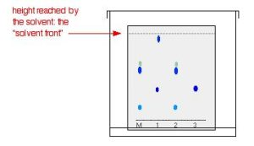
Figure 29.2c
Figure 29.2c. Paper chromatography result after solvent (mobile phase) moves (credit: Chromatography , CC BY-NC 4.0).

Slide 7
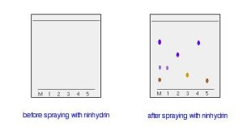
Figure 29.2d
Figure 29.2d. The left-hand diagram shows the paper after the solvent front has almost reached the top. The spots are still invisible. The second diagram shows what it might look like after spraying with ninhydrin (credit: Chromatography , CC BY-NC 4.0

Slide 8
Figure 29.2e
Figure 29.2e. Two-way paper chromatography. a) single dot of sample is placed at M and run with first solvent. b) after drying, the paper is rotated and run with second solvent. c) End result showing the separated sample (credit: Chromatography , CC BY-NC 4.0).

Slide 9
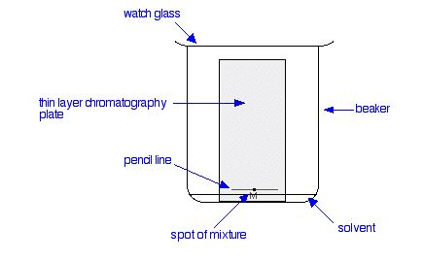
Figure 29.2f
Figure 29.2f. Setup of TLC (thin layer chromatography) (credit: Chromatography, CC BY-NC 4.0).

Slide 10
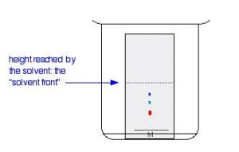
Figure 29.2g
Figure 29.2g. TLC experiment about halfway through mobile phase movement (credit: Chromatography, CC BY-NC 4.0).

Slide 11
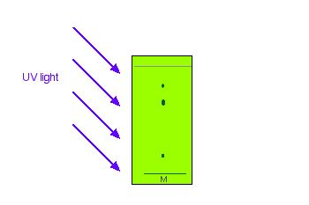
Figure 29.2h
Figure 29.2h. TLC plate glowing under UV light with the separate components as dull dots (credit: Chromatography, CC BY-NC 4.0).

Slide 12
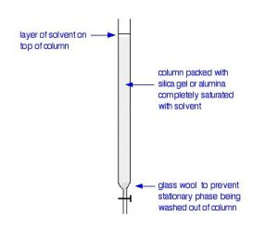
Figure 29.3a
Figure 29.3a. Chromatography column (credit: Chromatography, CC BY-NC 4.0).

Slide 13
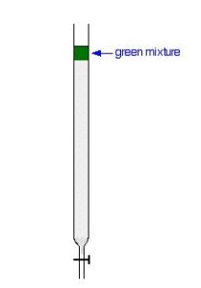
Figure 29.3b
Figure 29.3b. Start of a chromatography column with a green mixture (credit: Chromatography, CC BY-NC 4.0).

Slide 14
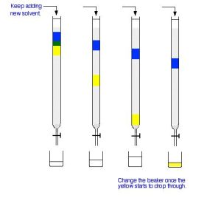
Figure 29.3c
Figure 29.3c. Evolution of green mixture separation over time of adding more solvent (credit: Chromatography, CC BY-NC 4.0).

Slide 15
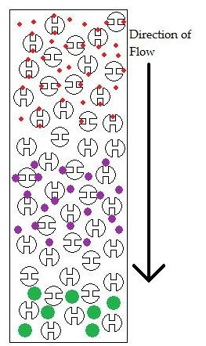
Figure 29.3d
Figure 29.3d. Schematic of a size exclusion column. The larger particles will elute first because they are too big to fit inside the pores. The smallest particles will elute last because they fit very well inside the pores (credit: Chromatography, CC BY-NC-SA 4.0).

Slide 16
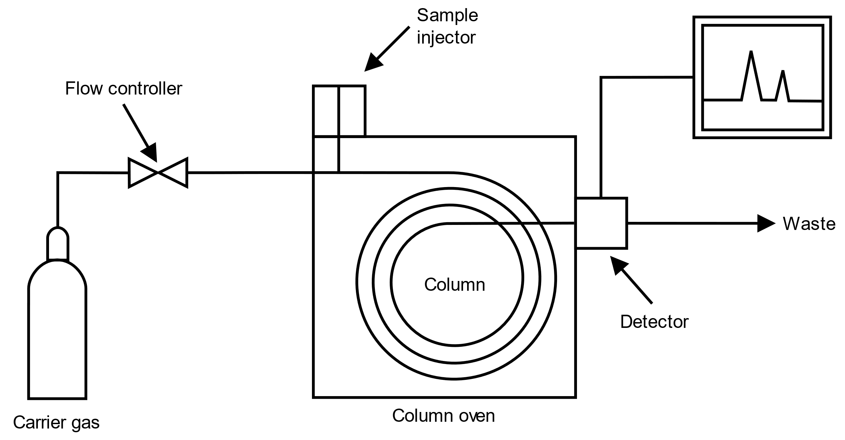
Figure 29.4a
Figure 29.4a. Schematic of gas chromatograph. (Credit: Image by Offnfopt, PD)

Slide 17
Figure 29.4b
Figure 29.4b. Simulation of separation of mixture using GC. (Credit: Gif by Dvstechnique, PDM)

Slide 18
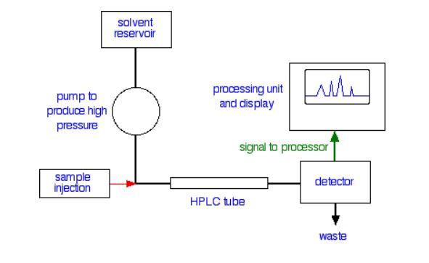
Figure 29.4c
Figure 29.4c. Schematic of HPLC (credit: Chromatography, CC BY-NC 4.0).

Slide 19
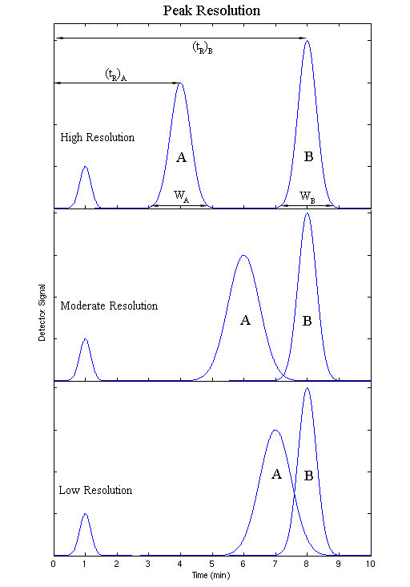
Figure 29.4d
Figure 29.4d. Output of HPLC showing high, moderate and low resolution between peaks A and B (credit: Chromatography, CC BY-NC-SA 4.0).

Slide 20
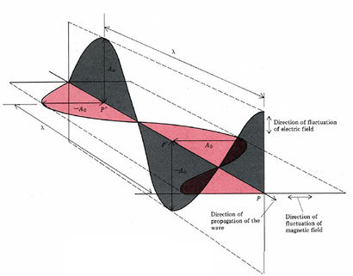
Figure 29.5a
Figure 29.5a. Cross section of electromagnetic wave. (Credit: ChemPRIME (Moore et al.), CC BY-NC-SA 4.0 )

Slide 21
Figure 29.5b
Figure 29.5b. Infrared spectrum of water. (Credit: ChemPRIME (Moore et al.), CC BY-NC-SA 4.0 )

Slide 22
Figure 29.5c
Figure 29.5c. Wavelength of a wave. (Credit: Map: Organic Chemistry (Wade), CC BY-NC-SA 4.0)

Slide 23
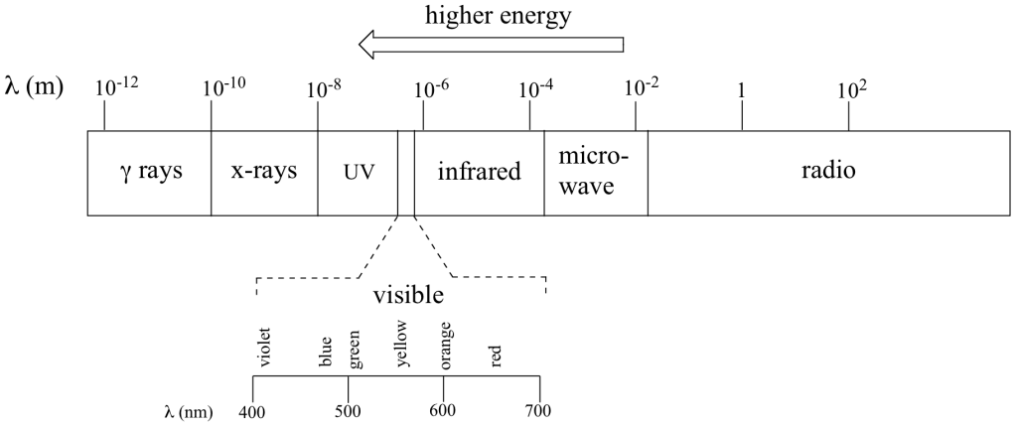
Figure 29.5d
Figure 29.5d. The electromagnetic spectrum. (Credit: Map: Organic Chemistry (Wade), CC BY-NC-SA 4.0 )

Slide 24
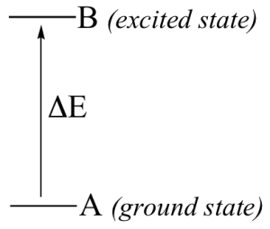
Figure 29.5e
Figure 29.5e. Change in energy required to move molecule from ground state (A) to excited state (B). (Credit: Map: Organic Chemistry (Wade), CC BY-NC-SA 4.0 )

Slide 25
Figure 29.6a
Figure 29.6a. Infrared wavelengths. (Credit: Map: Organic Chemistry (Wade) , CC BY-NC-SA 4.0)

Slide 26
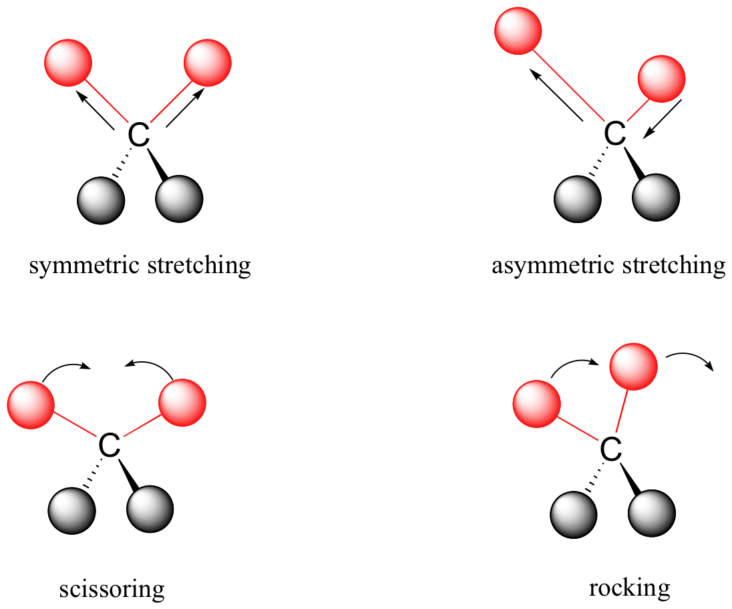
Figure 29.6b
Figure 29.6b. Vibrational modes of stretching, scissoring and rocking.(Credit: Map: Organic Chemistry (Wade) , CC BY-NC-SA 4.0)

Slide 27
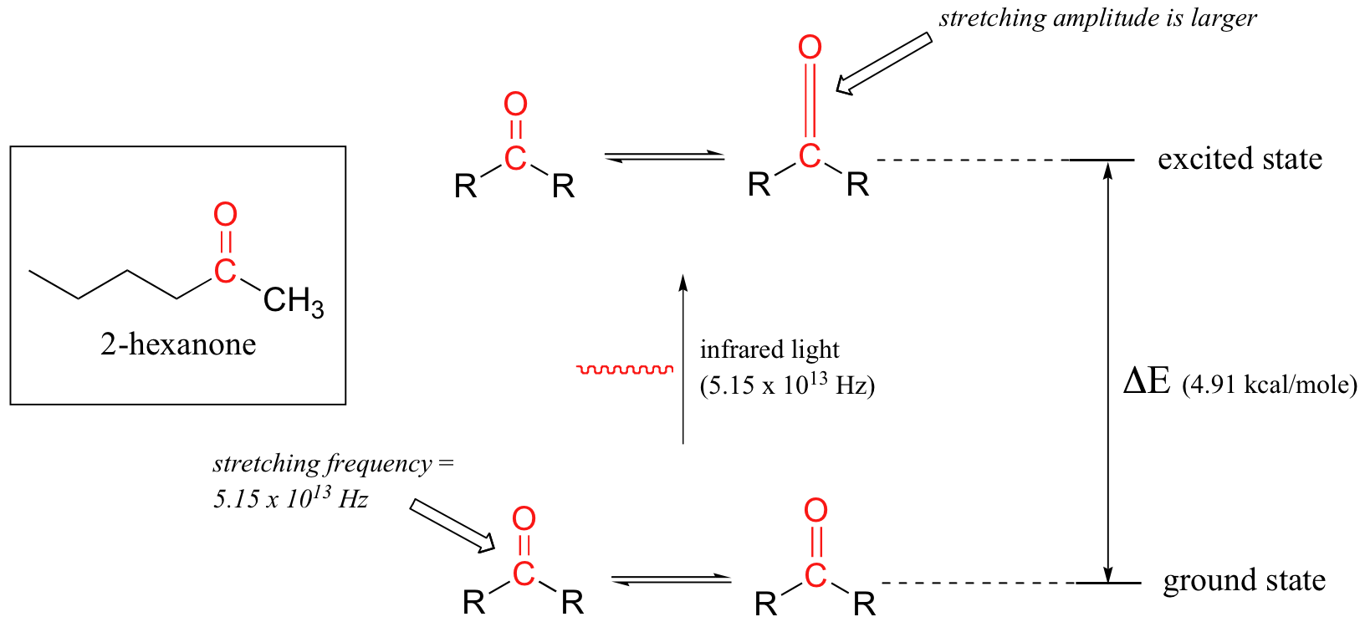
Figure 29.6c
Figure 29.6c. Excitation of carbonyl bond in 2-hexanone. (Credit: Map: Organic Chemistry (Wade) , CC BY-NC-SA 4.0)

Slide 28
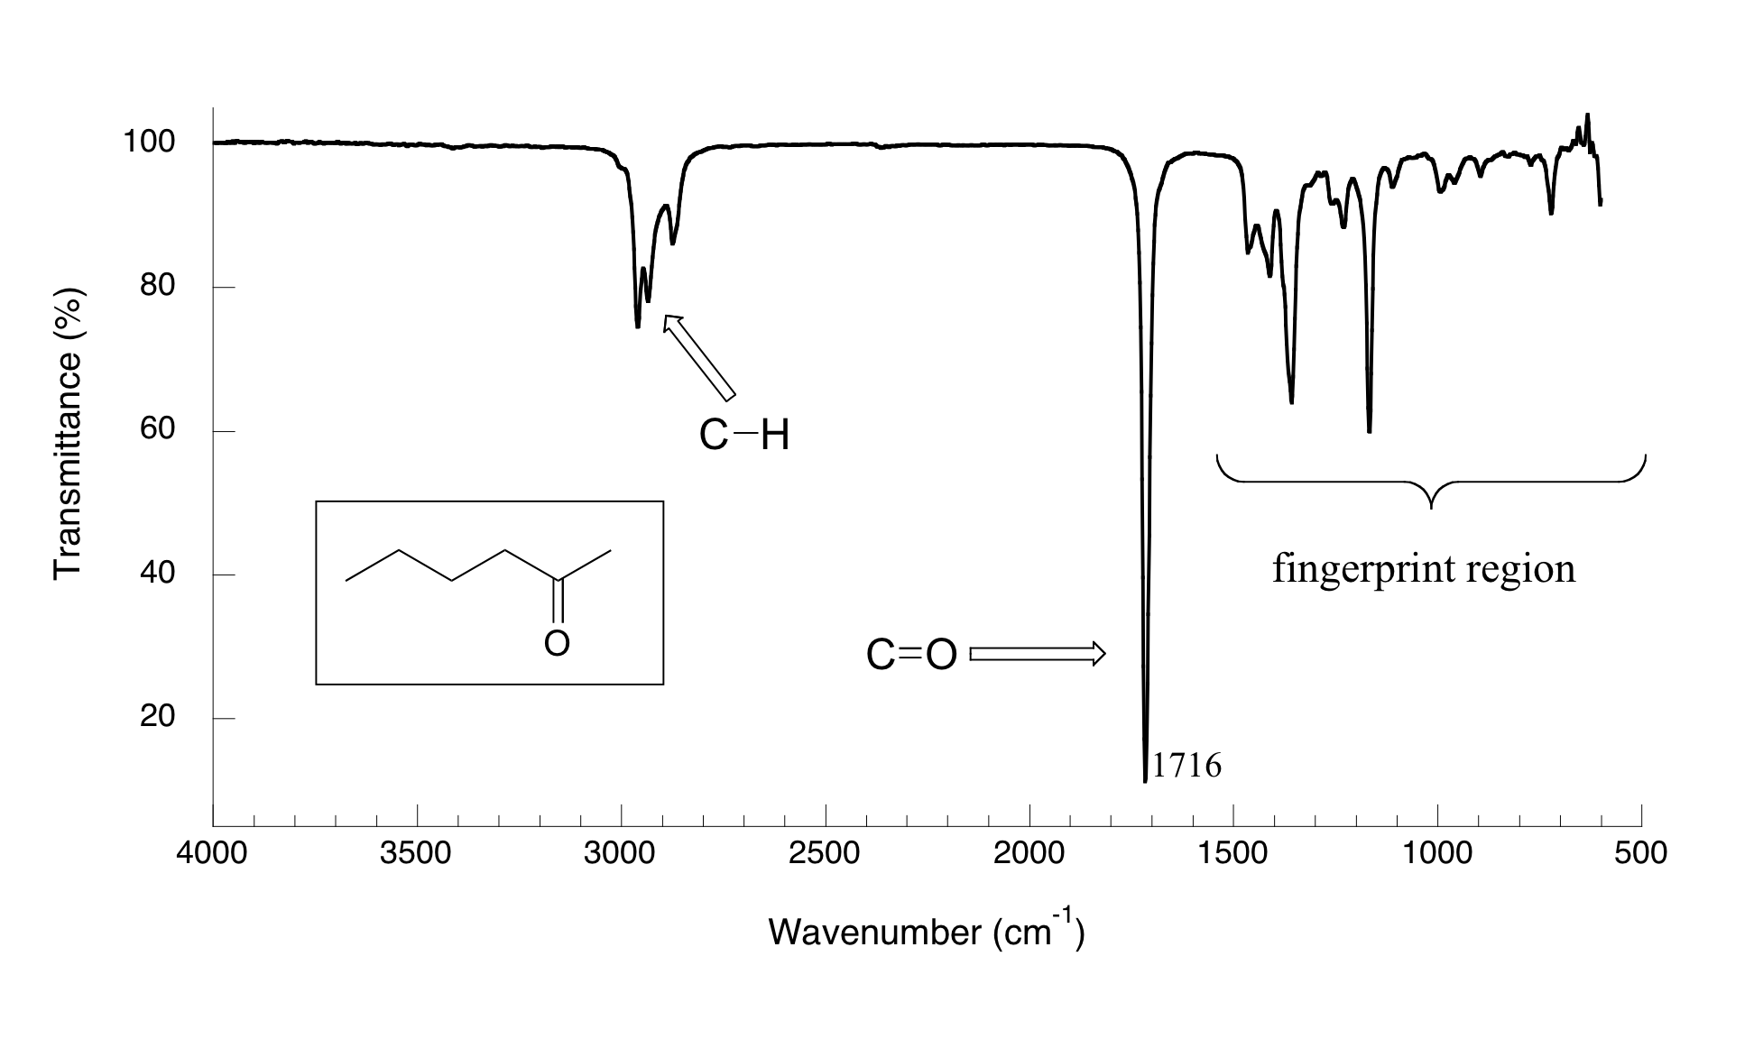
Figure 29.6d
Figure 29.6d. IR spectrum of 2-hexanone. (Credit: Map: Organic Chemistry (Wade) , CC BY-NC-SA 4.0)

Slide 29
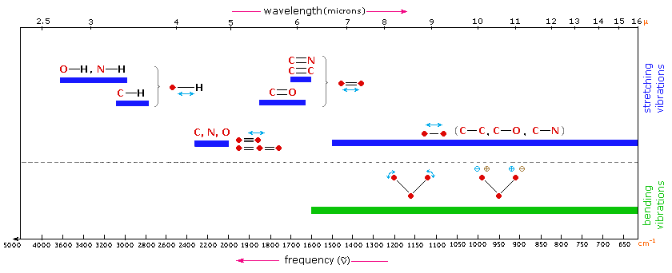
Figure 29.6e
Figure 29.6e. General regions for stretching and bending vibrations of various functional groups. (Credit: Map: Organic Chemistry (Wade) , CC BY-NC-SA 4.0)

Slide 30
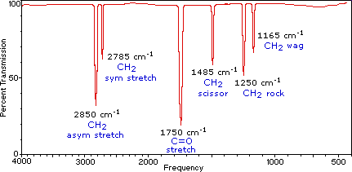
Figure 29.6f
Figure 29.6f. Infrared spectrum of methanal. (Credit: Map: Organic Chemistry (Wade) , CC BY-NC-SA 4.0)

Slide 31
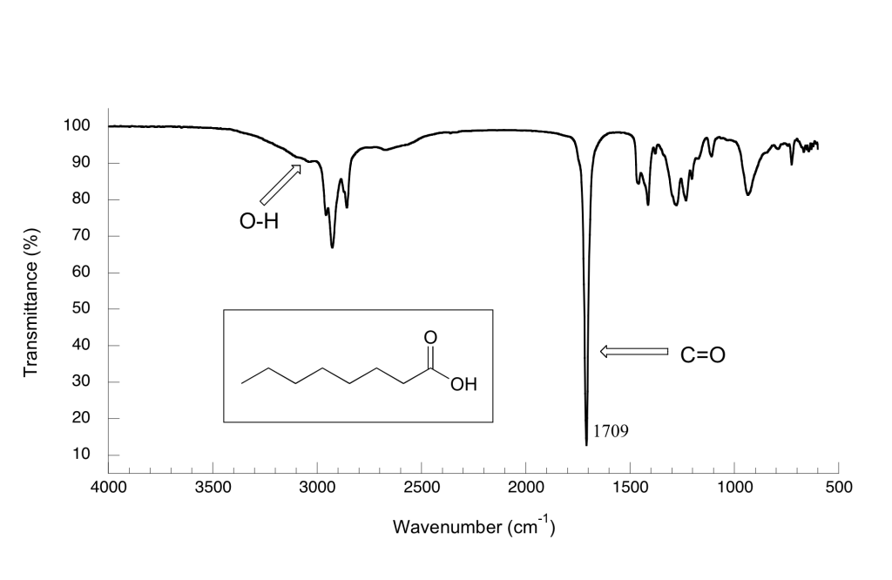
Figure 29.6g
Figure 29.6g. Infrared spectrum of octanoic acid. (Credit: Map: Organic Chemistry (Wade) , CC BY-NC-SA 4.0)

Slide 32
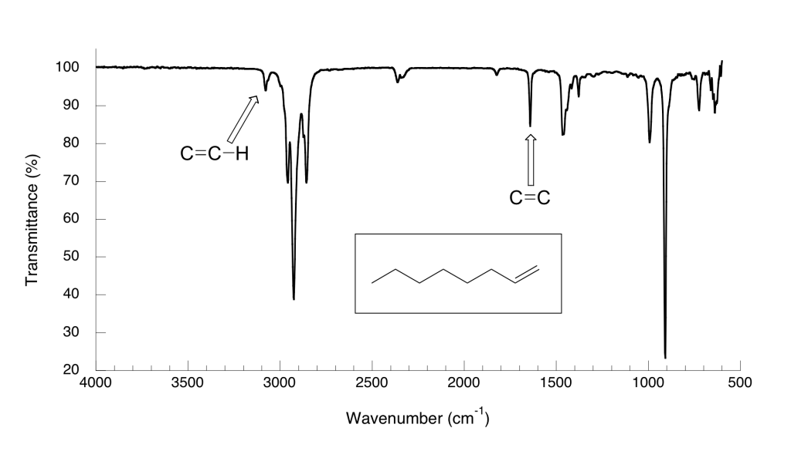
Figure 29.6h
Figure 29.6h. Infrared spectrum of 1-octene. (Credit: Map: Organic Chemistry (Wade) , CC BY-NC-SA 4.0)

Slide 33
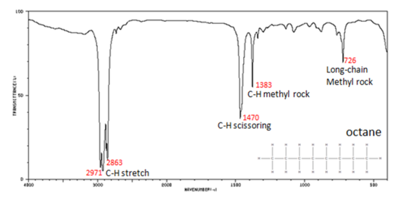
Figure 29.6i
Figure 29.6i. Infrared spectrum of octane (credit: Organic Chemistry (Wade) , CC BY-NC-SA 4.0).

Slide 34
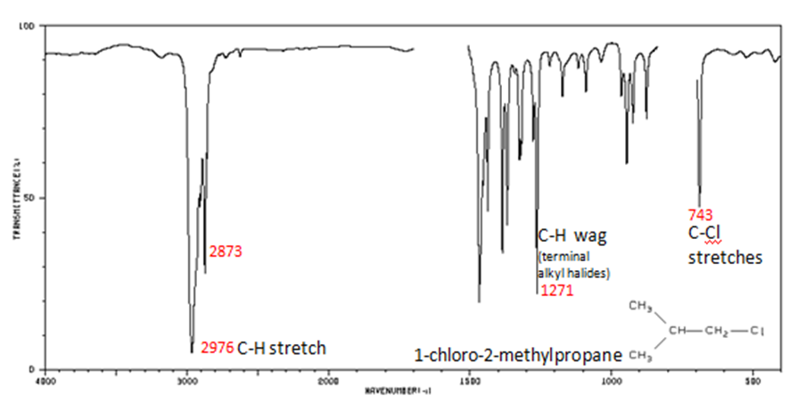
Figure 29.6j
Figure 29.6j. Infrared spectrum of 1-chloro-2-methylpropane (credit: Organic Chemistry (Wade) , CC BY-NC-SA 4.0).

Slide 35
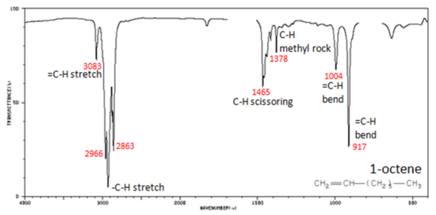
Figure 29.6k
Figure 29.6k. Infrared spectrum of 1-octene (credit: Organic Chemistry (Wade) , CC BY-NC-SA 4.0).

Slide 36
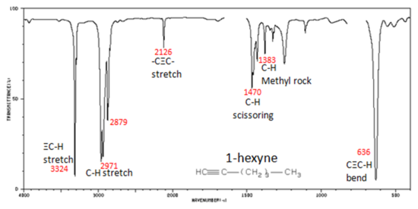
Figure 29.6l
Figure 29.6l. Infrared spectrum of 1-hexyne (credit: Organic Chemistry (Wade) , CC BY-NC-SA 4.0).

Slide 37
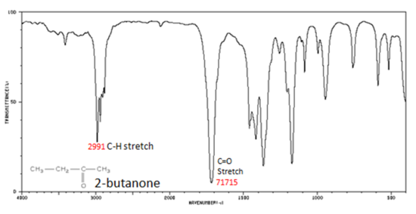
Figure 29.6m
Figure 29.6m. Infrared spectrum of 2-butanone (credit: Organic Chemistry (Wade) , CC BY-NC-SA 4.0).

Slide 38
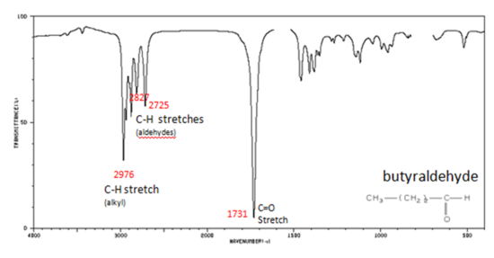
Figure 29.6n
Figure 29.6n. Infrared spectrum of butyraldehyde (credit: Organic Chemistry (Wade) , CC BY-NC-SA 4.0).

Slide 39
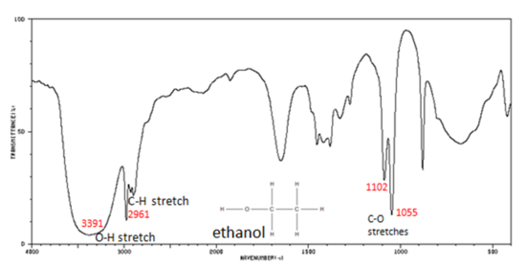
Figure 29.6o
Figure 29.6o. Infrared spectrum of ethanol (credit: Organic Chemistry (Wade) , CC BY-NC-SA 4.0).

Slide 40
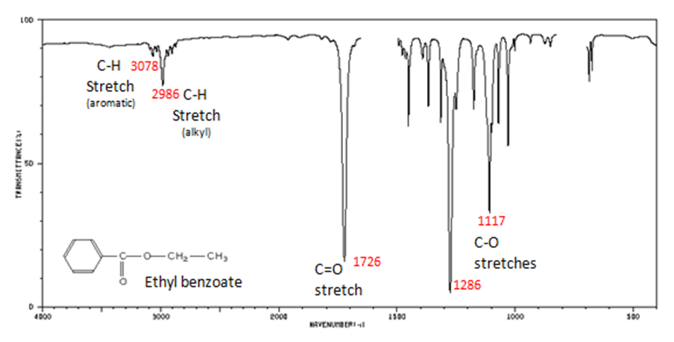
Figure 29.6p
Figure 29.6p. Infrared spectrum of ethyl benzoate (credit: Organic Chemistry (Wade) , CC BY-NC-SA 4.0).

Slide 41
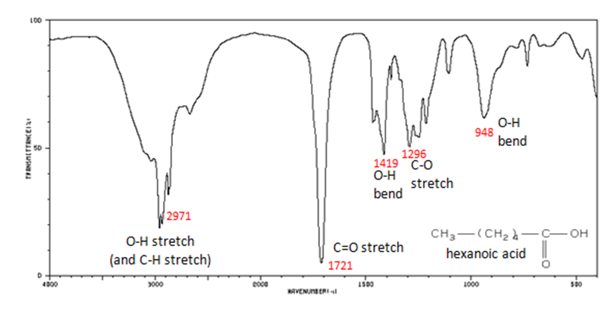
Figure 29.6q
Figure 29.6q. Infrared spectrum of hexanoic acid (credit: Organic Chemistry (Wade) , CC BY-NC-SA 4.0).

Slide 42
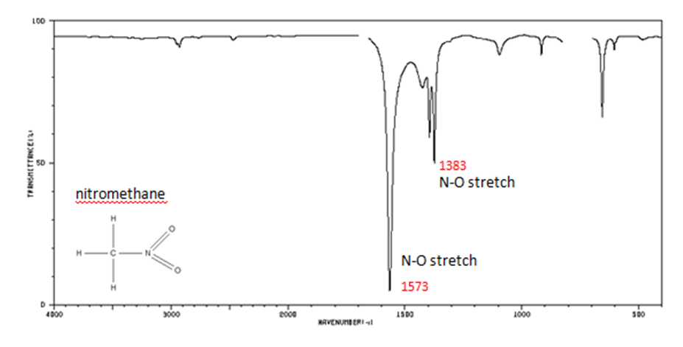
Figure 29.6r
Figure 29.6r. Infrared spectrum of nitromethane (credit: Organic Chemistry (Wade) , CC BY-NC-SA 4.0).

Slide 43
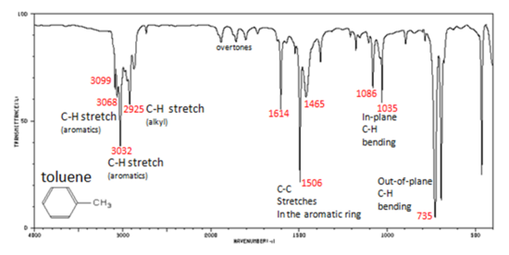
Figure 29.6s
Figure 29.6s. Infrared spectrum of toluene (credit: Organic Chemistry (Wade) , CC BY-NC-SA 4.0).

Slide 44
Figure 29.6t
Figure 29.6t. Structure of cyclobutanol, 2-butanone, ethyl vinyl ether, 2-methyl2-propen-1-ol, and 2-methylpropanal. (Credit: Map: Organic Chemistry (Wade) , CC BY-NC-SA 4.0)

Slide 45
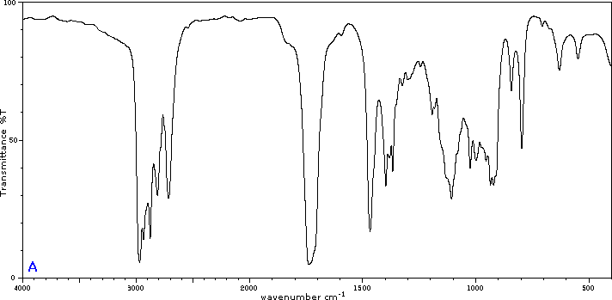
Figure 29.6u
Figure 29.6u. Infrared spectrum of unknown compound A. (Credit: Map: Organic Chemistry (Wade) , CC BY-NC-SA 4.0)

Slide 46
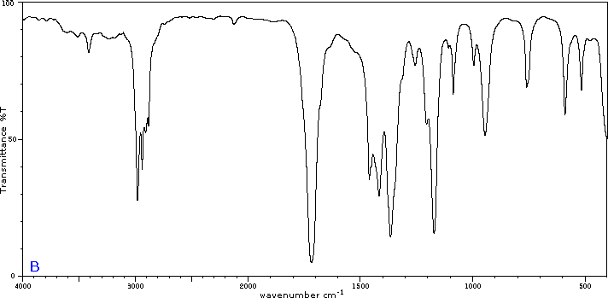
Figure 29.6v
Figure 29.6v. Infrared spectrum of unknown compound B. (Credit: Map: Organic Chemistry (Wade) , CC BY-NC-SA 4.0)

Slide 47
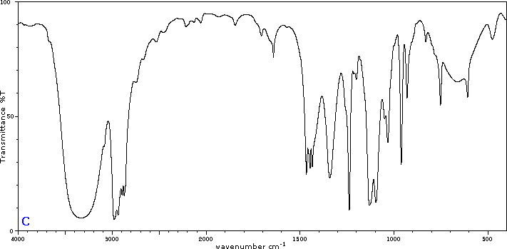
Figure 29.6w
Figure 29.6w. Infrared spectrum of unknown compound C. (Credit: Map: Organic Chemistry (Wade) , CC BY-NC-SA 4.0)

Slide 48
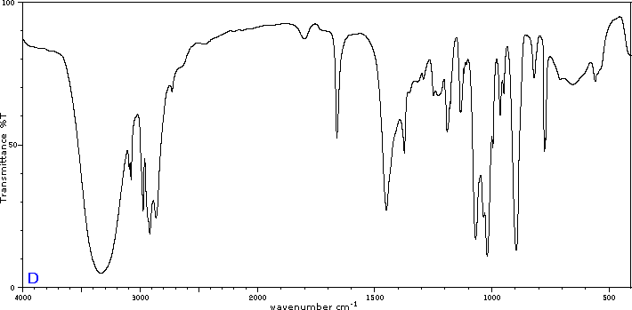
Figure 29.6x
Figure 29.6x. Infrared spectrum of unknown compound D. (Credit: Map: Organic Chemistry (Wade) , CC BY-NC-SA 4.0)

Slide 49
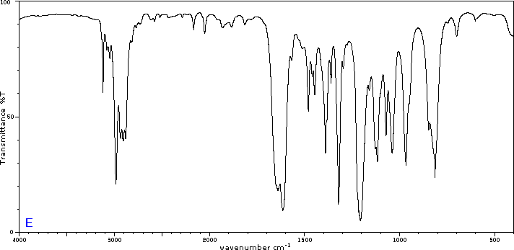
Figure 29.6y
Figure 29.6y. Infrared spectrum of unknown compound E. (Credit: Map: Organic Chemistry (Wade) , CC BY-NC-SA 4.0)

Slide 50
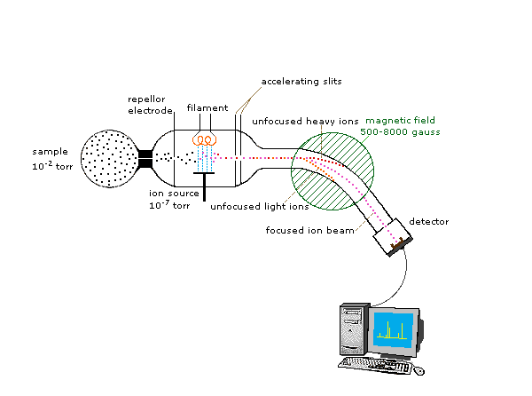
Figure 29.7a
Figure 29.7a. The schematic of a mass spectrometer. (credit: Map: Organic Chemistry (Wade), CC BY-NC-SA 4.0).

Slide 51
Figure 29.7b
Figure 29.7b. Formation of molecular ions and fragment ions (credit: Map: Organic Chemistry (Wade), CC BY-NC-SA 4.0).

Slide 52
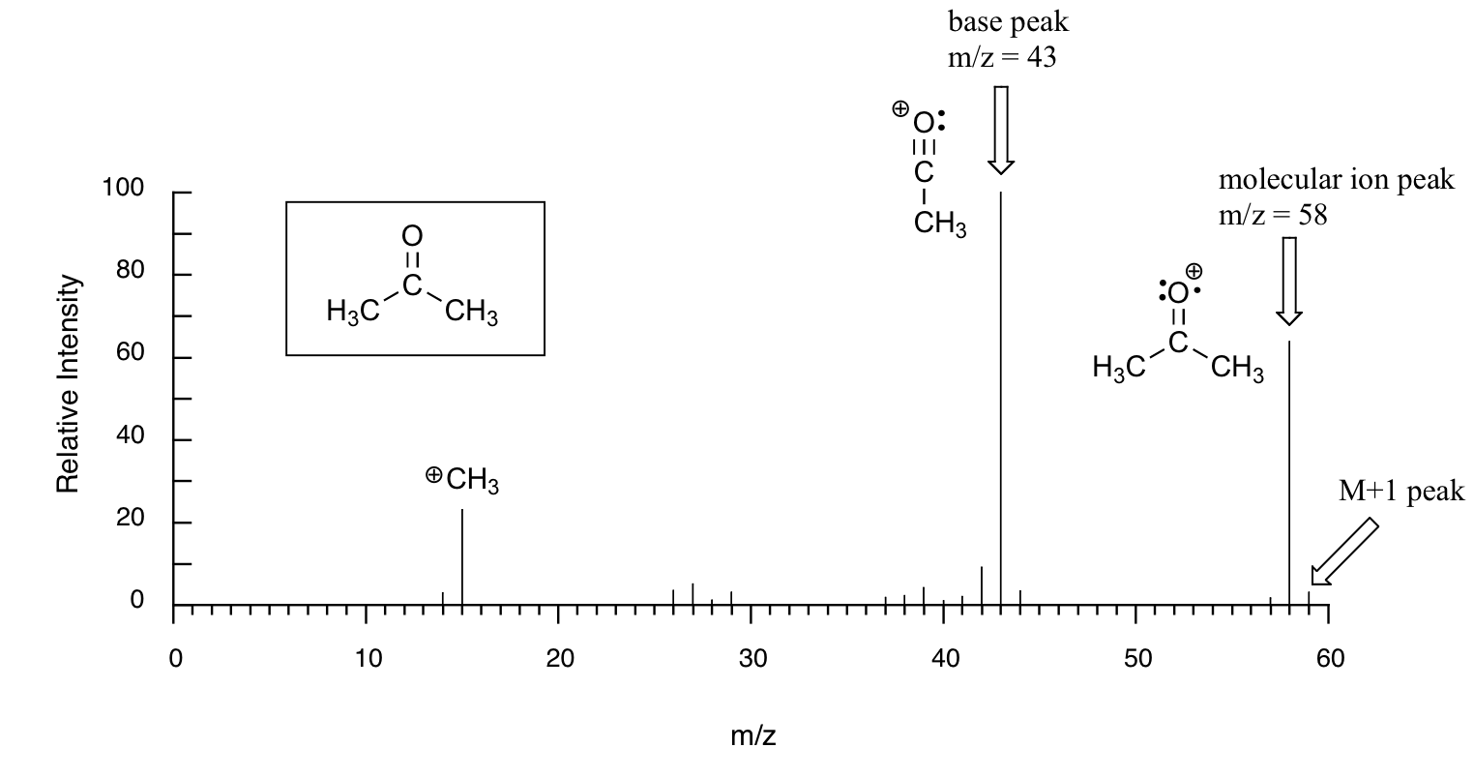
Figure 29.7c
Figure 29.7c. Typical output for an electron-ionization MS experiment examining propanone (or acetone) (MS data for Compound 319 by National Institute of Advanced Industrial Science and Technology via SDBSWeb, Dec. 2, 2016, modified in Map: Organic Chemistry (Wade), CC BY-NC-SA 4.0.).

Slide 53
Figure 29.7e
Figure 29.7e. a) Mass spectrum of pentan-2-one and b) Mass spectrum of pentan-3-one (credit: Map: Organic Chemistry (Wade), CC BY-NC-SA 4.0).

Slide 54
Figure 29.7g
Figure 29.7g. a) Mass spectrum of 2-methylbutane and b) Mass spectrum of pentane (credit: Map: Organic Chemistry (Wade), CC BY-NC-SA 4.0).

Slide 55
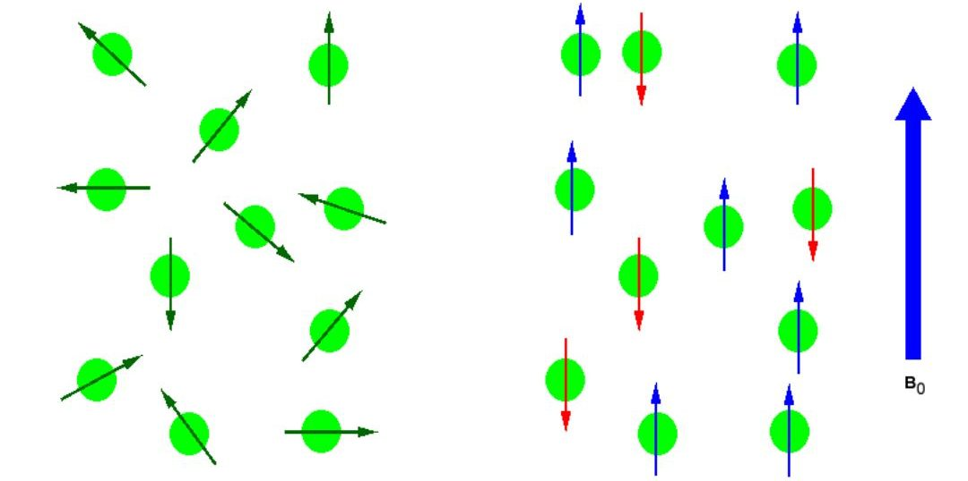
Figure 29.8a
Figure 29.8a. (Left) Random nuclear spin without an external magnetic field. (Right) Ordered nuclear spin in an external magnetic field (credit: Map: Organic Chemistry (Wade), BY-NC-SA 4.0. / Aligned horizontally).

Slide 56
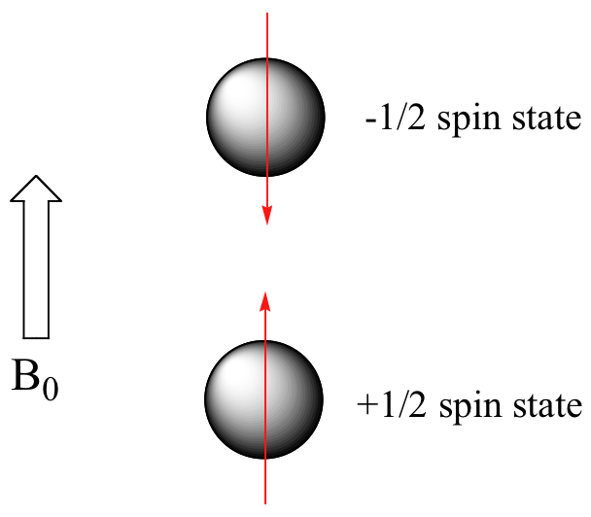
Figure 29.8b
Figure 29.8b. Hydrogen atom alignment within a magnetic field according to spin state (credit: Map: Organic Chemistry (Wade), BY-NC-SA 4.0.).

Slide 57
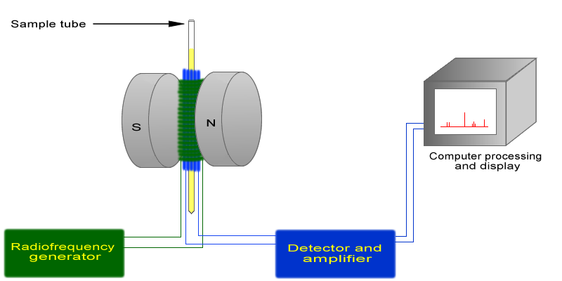
Figure 29.8c
Figure 29.8c. Schematic of NMR spectrometer (credit: Map: Organic Chemistry (Wade), BY-NC-SA 4.0.).

Slide 58
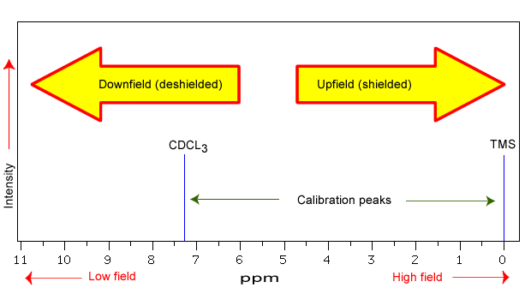
Figure 29.8d
Figure 29.8d. NMR spectrum produced by varying the applied radio frequency. (credit: Map: Organic Chemistry (Wade), BY-NC-SA 4.0.)

Slide 59
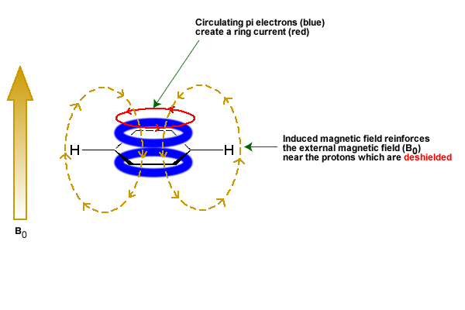
Figure 29.8e
Figure 29.8e. Magnetic anisotropy of π systems (credit: Map: Organic Chemistry (Wade), BY-NC-SA 4.0.)

Slide 60
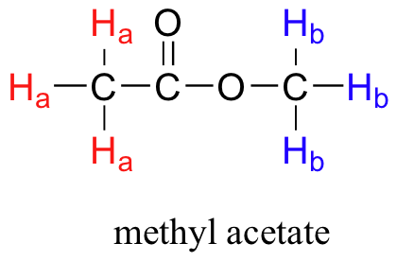
Figure 29.9a
Figure 29.9a. Structure of methyl acetate (methyl ethanoate) (credit: Organic Chem: Biological Emphasis vol. 1 (page 242), CC BY-NC-SA 4.0).

Slide 61
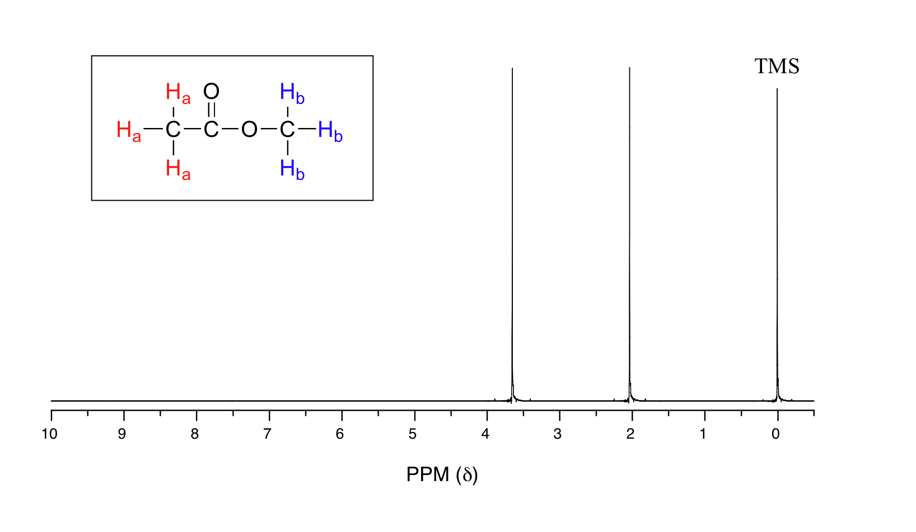
Figure 29.9b
Figure 29.9b. 1H NMR spectrum of methyl ethanoate (credit: Organic Chem: Biological Emphasis vol. 1 (page 244), CC BY-NC-SA 4.0).

Slide 62
Figure 29.9c
Figure 29.9c. Structure of TMS (credit: Organic Chem: Biological Emphasis vol. 1 (page 244), CC BY-NC-SA 4.0).

Slide 63
Figure 29.9d
Figure 29.9d. Chemical shift of various halomethanes. Increase in chemical shift seen with increase in electronegativity (F more electronegative Cl which is more than Br which is more than H) (credit: Organic Chem: Biological Emphasis vol. 1 (page 248), CC BY-NC-SA 4.0).

Slide 64
Figure 29.9e
Figure 29.9e. Identification of protons in methyl ethanoate (Credit: Organic Chemistry with a Biological Emphasis Volume I (page 249), CC BY-NC-SA 4.0, edited by Organic Chemistry (Wade), CC BY-NC-SA 4.0).

Slide 65
Figure 29.9f
Figure 29.9f. Equivalent protons in benzene, acetone (propanone), pyruvate, and cyclohexane (Credit: Organic Chemistry with a Biological Emphasis Volume I (page 239), CC BY-NC-SA 4.0, edited by Organic Chemistry (Wade), CC BY-NC-SA 4.0).

Slide 66
Figure 29.9g
Figure 29.9g. Equivalent protons in glycine, ethanal (acetaldehyde), and para-dimethylbenzene (xylene) (credit: Organic Chem: Biological Emphasis vol. 1 (page 239), CC BY-NC-SA 4.0).

Slide 67
Figure 29.9h
Figure 29.9h. Equivalent protons in alanine and adenine (credit: Organic Chem: Biological Emphasis vol. 1 (page 241), CC BY-NC-SA 4.0).

Slide 68
Figure 29.9i
Figure 29.9i. Equivalent protons in isopentyl diphosphate and seratonin (credit: Organic Chem: Biological Emphasis vol. 1 (page 241), CC BY-NC-SA 4.0).

Slide 69
Figure 29.9k
Figure 29.9j. Chemical shifts for proton NMR of functional groups (credit: Map: Organic Chemistry (Wade), CC BY-NC-SA 4.0).

Slide 70
Table 29.9a – Part 1
Table 29.9a – Part 1. ¹NMR Chemical Shifts of Functional Groups
Hydrogen type* | Chemical shift (ppm)
RCH₃ | 0.9 - 1.0
RCH₂R | 1.2 - 1.7
R₃CH | 1.5 – 2.0
 | 1.5 – 1.8
RNH₂ | 1 - 3
ArCH₃ | 2.2 – 2.4
 | 2.3 – 3.0
ROCH₃ | 3.7 – 3.9
 | 3.7 – 3.9
* R stands for any alkyl chain; Ar stands for any aryl group (benzene based); the underlined H is the one being measured
Source: "12.5: Functional Groups and Chemical Shifts in ¹H NMR Spectroscopy" In Map: Organic Chemistry (Wade), CC BY-NC-SA 4.0.

Slide 71
Table 29.9a – Part 2
Table 29.9a – Part 2. ¹NMR Chemical Shifts of Functional Groups
Hydrogen type* | Chemical shift (ppm)
ROH | 1 - 5
 | 3.7 – 6.5
 | 5 - 9
ArH | 6.0 – 8.7
 | 9.5 – 10.0
 | 10 -13
* R stands for any alkyl chain; Ar stands for any aryl group (benzene based); the underlined H is the one being measured
Source: "12.5: Functional Groups and Chemical Shifts in ¹H NMR Spectroscopy" In Map: Organic Chemistry (Wade), CC BY-NC-SA 4.0.

Slide 72
Figure 29.9l
Figure 29.9k. ¹H NMR spectra for 1-propanol, 2-propanol, propanal, and propanoic acid. The full spectrum are shown using the scale at the bottom of each figure. The insets show close-ups of the NMR spectra from 0 – 5 ppm. The original data used to construct these spectra are found here. (Credit: Instrumental Analysis, CC BY-NC-SA 4.0).

Slide 73
Figure 29.9m
Figure 29.9l. Structure of 1,3-dibromo-2,2-dimethylpropane (credit: Image by Samantha Sullivan Sauer using MolView, CC BY-NC 4.0)

Slide 74
Figure 29.9n
Figure 29.9m. NMR spectrum of para-xylene (IUPAC name 1,4-dimethylbenzene) (credit: Organic Chem: Biological Emphasis vol. 1 (page 246), CC BY-NC-SA 4.0).

Slide 75
Figure 29.9o
Figure 29.9n. 1H NMR spectrum of 1,1,2-trichloroethane showing spin-spin coupling (credit: Map: Organic Chemistry (Wade), CC BY-NC-SA 4.0).

Slide 76
Figure 29.9p
Figure 29.9o. The spin-spin coupling between Ha and Hb in 1,1,2-trichloroethane (credit: Map: Organic Chemistry (Wade), CC BY-NC-SA 4.0).

Slide 77
Figure 29.9q
Figure 29.9p. The spin-spin coupling between Hb and Ha in 1,1,2-trichloroethane (credit: Map: Organic Chemistry (Wade), CC BY-NC-SA 4.0).

Slide 78
Figure 29.9r
Figure 29.9q. NMR spectrum of ethyl ethanoate (credit: Map: Organic Chemistry (Wade), CC BY-NC-SA 4.0)..

Slide 79
Figure 29.9s
Figure 29.9r. The spin-spin coupling of two simple organic molecules (credit: Organic Chem: Biological Emphasis vol. 1 (page 258), CC BY-NC-SA 4.0).

Slide 80
Figure 29.9t
Figure 29.9s. The spin-spin coupling of two simple organic molecules (credit: Organic Chem: Biological Emphasis vol. 1 (page 258), CC BY-NC-SA 4.0).

Slide 81
Figure 29.9u
Figure 29.9t. Structure of triclosan (credit: Organic Chem: Biological Emphasis vol. 1 (page 258), CC BY-NC-SA 4.0).

Slide 82
Figure 29.10a
Figure 29.10a. 13C-NMR spectrum of ethyl ethanoate, showing the expected four signals, one for each of the carbons (credit: Organic Chem: Biological Emphasis Vol I (page 265), CC BY-NC-SA 4.0).

Slide 83
Figure 29.10b
Figure 29.10b. ¹³C NMR spectrum of pentane. (Credit: "Pentane- compound 2475" © National Institute of Advanced Industrial Science and Technology via SDBSWeb , accessed 11/21/2023.)

Slide 84
Figure 29.10c
Figure 29.10c. Two different views of the same molecule of pentane showing the molecule's symmetry. (credit: Image by Samanatha Sullivan Sauer, created with MolView, CC BY-NC 4.0)

Slide 85
Figure 29.10d
Figure 29.10d. X substituent on alpha carbon of alkane. Beta and gamma carbons are labelled (credit: Map: Organic Chemistry (Wade), CC BY-NC-SA 4.0).

Slide 86
Figure 29.10f
Figure 29.10f. Typical ¹³C chemical shift regions of the major chemical classes (credit: Map: Organic Chemistry (Wade), CC BY-NC-SA 4.0).

Slide 87
Figure 29.10g
Figure 29.10g. 13C NMR of methylbenzene (toluene) (credit: Organic Chem: Biological Emphasis Vol I (page 266), CC BY-NC-SA 4.0).

Slide 88
Figure 29.10h
Figure 29.10h. 13C NMR of methyl methacrylate (methyl 2-methylpro-2-penate) (credit: Organic Chem: Biological Emphasis Vol I (page 266), CC BY-NC-SA 4.0).

Slide 89
Figure 29.10i
Figure 29.10i. ¹³C NMR spectrum of ethanol. (Credit: "Ethyl Alcohol - compound 1300" © National Institute of Advanced Industrial Science and Technology via SDBSWeb, accessed 11/21/2023).

Slide 90
Figure 29.10k
Figure 29.10k. ¹³C NMR spectrum for 1-methylethyl propanoate. (Credit: "Isopropyl propionate - compound 2923" © National Institute of Advanced Industrial Science and Technology via SDBSWeb, accessed 11/21/2023)

Slide 91
Figure 29.10l
Figure 29.10l. Proton NMR spectrum of 1-heptanol (credit: Organic Chem: Biological Emphasis Vol I (page 257), CC BY-NC-SA 4.0).

Slide 92
Figure 29.10m
Figure 29.10m. Carbon NMR spectrum of 1-heptanol (credit: Organic Chem: Biological Emphasis Vol I (page 266), CC BY-NC-SA 4.0).

Slide 93
Figure 29.11a
Figure 29.11a. Isolated, conjugated and cumulated carbon-carbon double bonds. (Credit: Organic Chemistry (Wade), CC BY-NC-SA 4.0)

Slide 94
Figure 29.11b
Figure 29.11b. Visible portion of electromagnetic spectrum. (Credit: Virtual Textbook of Organic Chemistry, CC BY-NC-SA 4.0)

Slide 95
Figure 29.11c
Figure 29.11c. Colour wheel showing complementary colours opposite each other. (Credit: Virtual Textbook of Organic Chemistry, CC BY-NC-SA 4.0)

Slide 96
Figure 29.11d
Figure 29.11d. (a) Schematic diagram showing the attenuation of radiation passing through a sample; P₀ is the source’s radiant power and P_{T} is the radiant power transmitted by the sample. (b) Schematic diagram showing how we redefine P₀ as the radiant power transmitted by the blank. Redefining P₀ in this way corrects the transmittance in (a) for the loss of radiation due to scattering, reflection, absorption by the sample’s container, and absorption by the sample’s matrix. (Credit: Instrumental Analysis, CC BY-NC-SA 4.0 )

Slide 97
Figure 29.11e
Figure 29.11e. Possible molecular electron excitations in organic molecules to a higher energy orbital from visible or UV radiation. (Credit: Organic Chemistry (Wade), CC BY-NC-SA 4.0)

Slide 98
Figure 29.11f
Figure 29.11f. 1,3-butadiene showing the conjugated double (pi) bond pattern (credit: Organic Chem: Biological Emphasis Vol I (page 72), CC BY-NC-SA 4.0).

Slide 99
Figure 29.11g
Figure 29.11g. 1,3,6-heptatriene showing conjugated and isolated pi bond sections (credit: Organic Chem: Biological Emphasis Vol I (page 72), CC BY-NC-SA 4.0).

Slide 100
Figure 29.11h
Figure 29.11h. Structure of beta-carotene with 11 conjugated double bonds (credit: Organic Chem: Biological Emphasis Vol I (page 222), CC BY-NC-SA 4.0).

Slide 101
Figure 29.11i
Figure 29.11i. Structure of two compounds with multiple double bonds (credit: Organic Chem: Biological Emphasis Vol I (page 73), CC BY-NC-SA 4.0).

Slide 102
Figure 29.11j
Figure 29.11j. Isolated and conjugated pi bonds in two structures with multiple double bonds. (Credit: Map: Organic Chemistry (Wade), CC BY-NC-SA 4.0)

Slide 103
Figure 29.11k
Figure 29.11k. Structure of lycopene (credit: Organic Chem: Biological Emphasis Vol I (page 73), CC BY-NC-SA 4.0)

Slide 104
Figure 29.11m
Figure 29.11l. Absorbance spectrum of nicotinamide adenine dinucleotide (NAD+) (credit: Organic Chem: Biological Emphasis Vol I (page 224), CC BY-NC-SA 4.0).

Slide 105
Figure 29.11n
Figure 29.11m. Absorbance spectrum of the common food colouring Red #3. (credit: Organic Chem: Biological Emphasis Vol I (page 225), CC BY-NC-SA 4.0).

Slide 106
Figure 29.11o
Figure 29.11n. Absorbance spectrum of the common food colouring Blue #1 (credit: Organic Chem: Biological Emphasis Vol I (page 226), CC BY-NC-SA 4.0).

Slide 107
Figure 29.11p
Figure 29.11o. Two structures with multiple double bonds (A and B) (credit: Organic Chem: Biological Emphasis Vol I (page 223), CC BY-NC-SA 4.0).

Slide 108
Figure 29.11q
Figure 29.11p. Glass of water. (credit: Photo by Aman Sachan, CC BY-SA 4.0)

Slide 109
Figure 29.11r
Figure 29.11q. Graph of absorbance vs mg Fe/L for experimental data. (Credit: Instrumental Analysis, CC BY-NC-SA 4.0)

