Slide 1
Chapter 28
Introduction to Biochemistry
Slides to accompany Organic and Biochemistry Supplement to Enhanced Introductory College Chemistry by Gregory Anderson, Jen Booth, Caryn Fahey, Adrienne Richards, Samantha Sullivan Sauer, and David Wegman
Slide design and template by Revathi Mahadevan
Except where otherwise noted, images, tables & diagrams are reused from Organic and Biochemistry Supplement to Enhanced Introductory College Chemistry
Slides are licensed under CC-BY 4.0, Except while otherwise noted

Slide 2
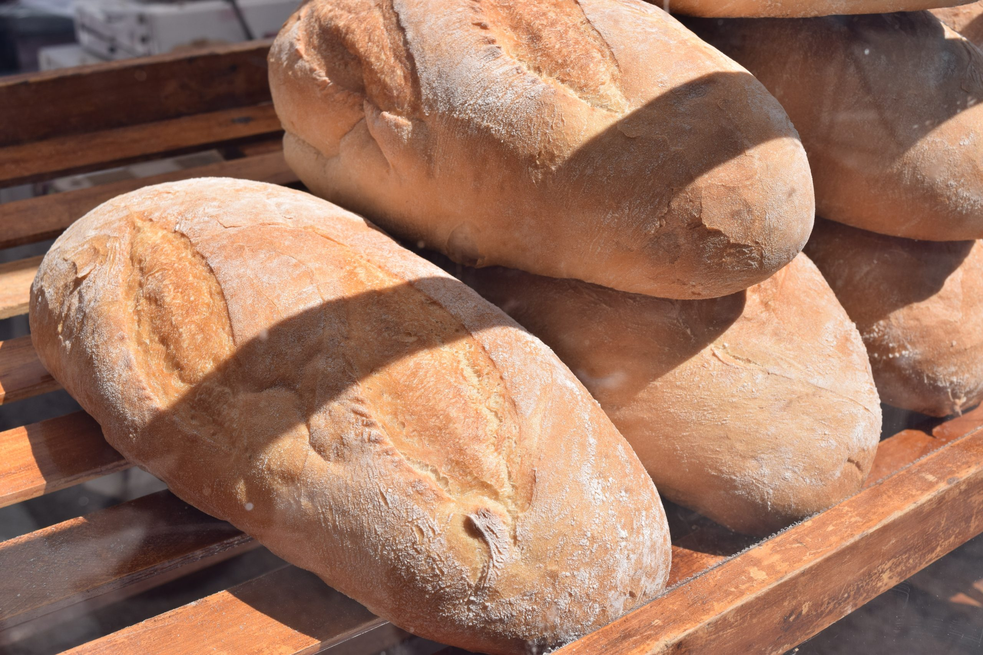
Figure 28.0a
Figure 28.0a. Bread, one of the most common foods in the human diet, is composed of carbohydrates, an important biomolecule. (credit: Photo by Tom Nora on Unsplash )

Slide 3
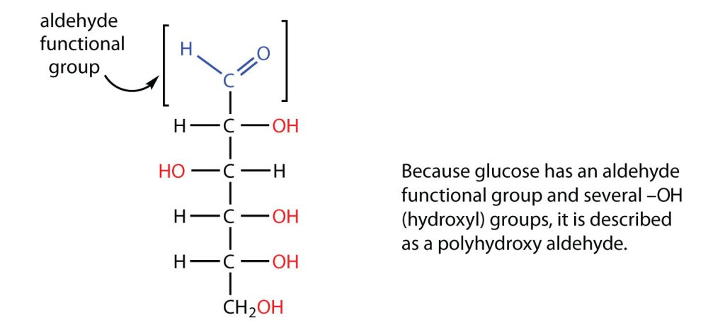
Figure 28.1a
Figure 28.1a. Structure of a common carbohydrate (credit: Intro Chem: GOB (V. 1.0)., CC BY-NC-SA 3.0).

Slide 4
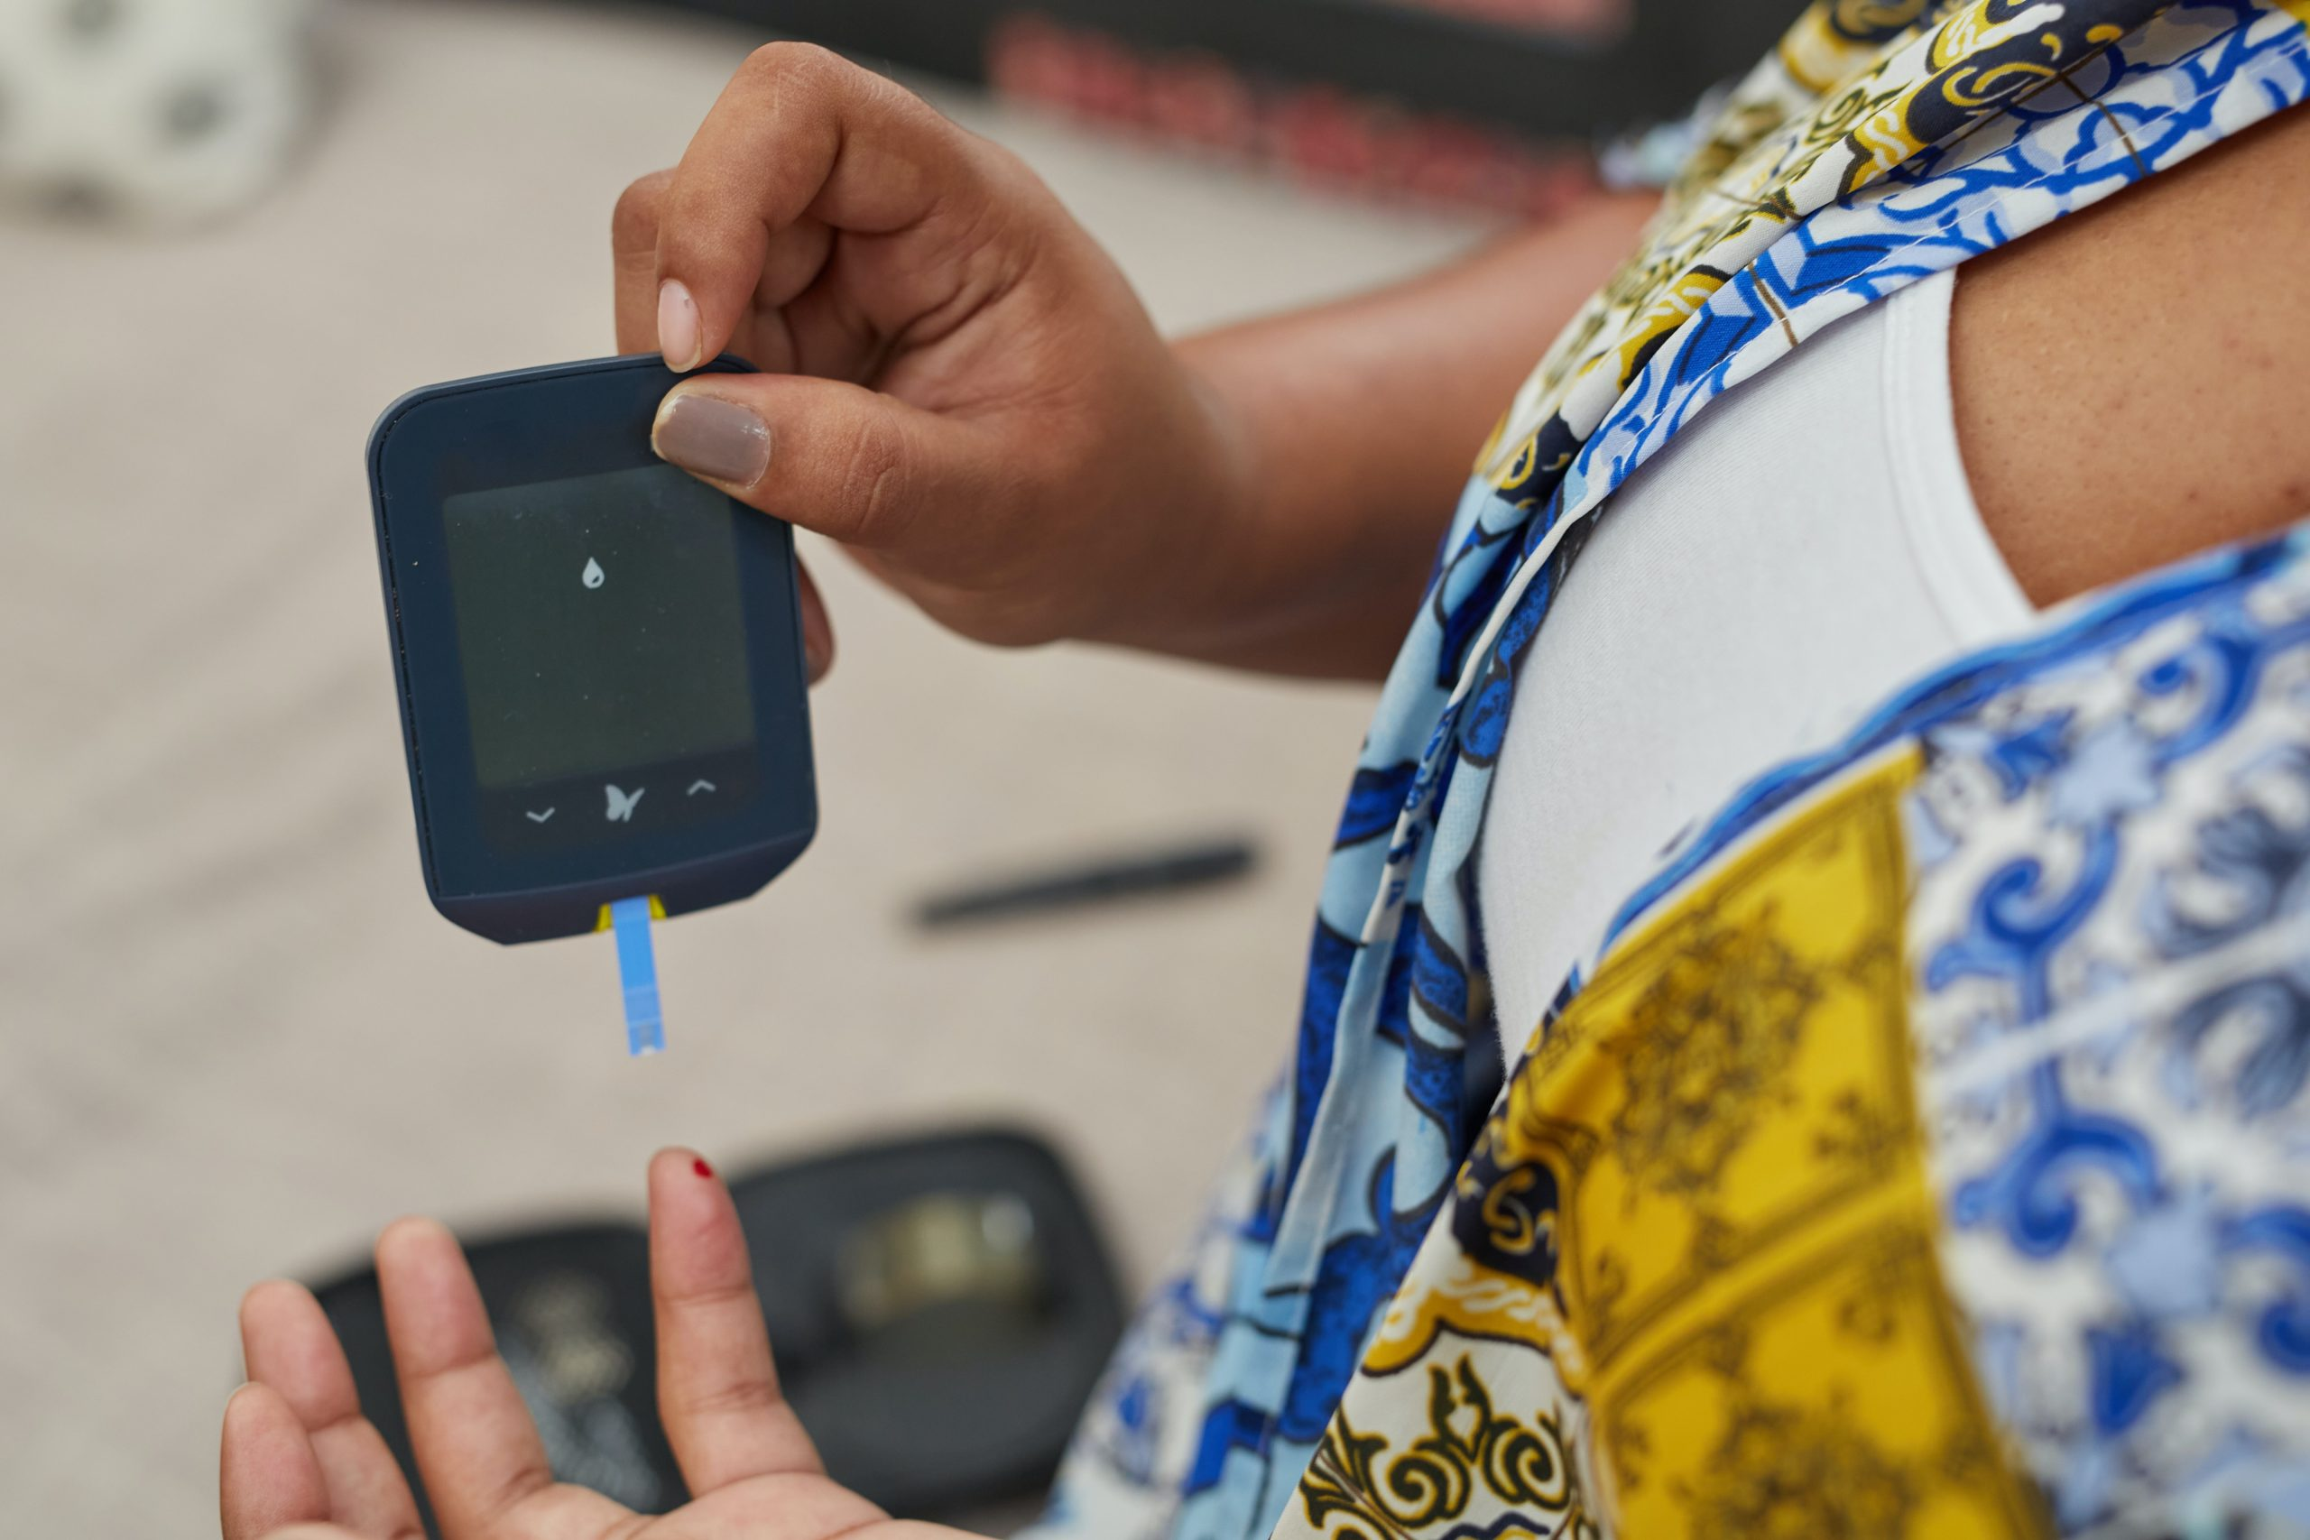
Figure 28.1b
Figure 28.1b. Using a Glucose Meter to Test Blood Glucose Level. (Credit: Photo by Sweet Life on Unsplash)

Slide 5
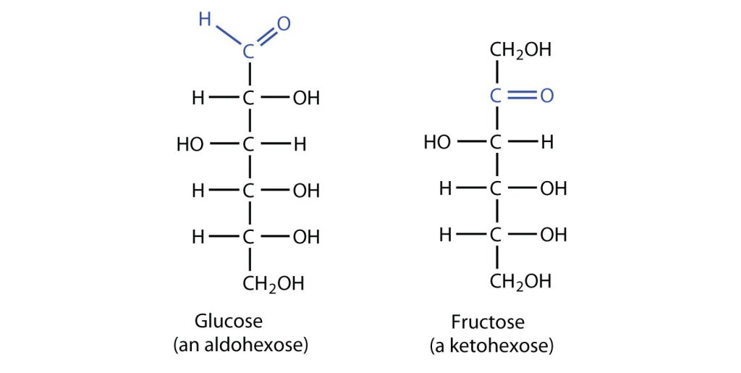
Figure 28.1c
Figure 28.1c. Glucose contains an aldehyde functional group and is six carbons long; thus it is classified as an aldohexose. Fructose, on the other hand, contains a ketone functional group and is also six carbons long; thus it is classified as a ketohexose (credit: Intro Chem: GOB (V. 1.0)., CC BY-NC-SA 3.0).

Slide 6
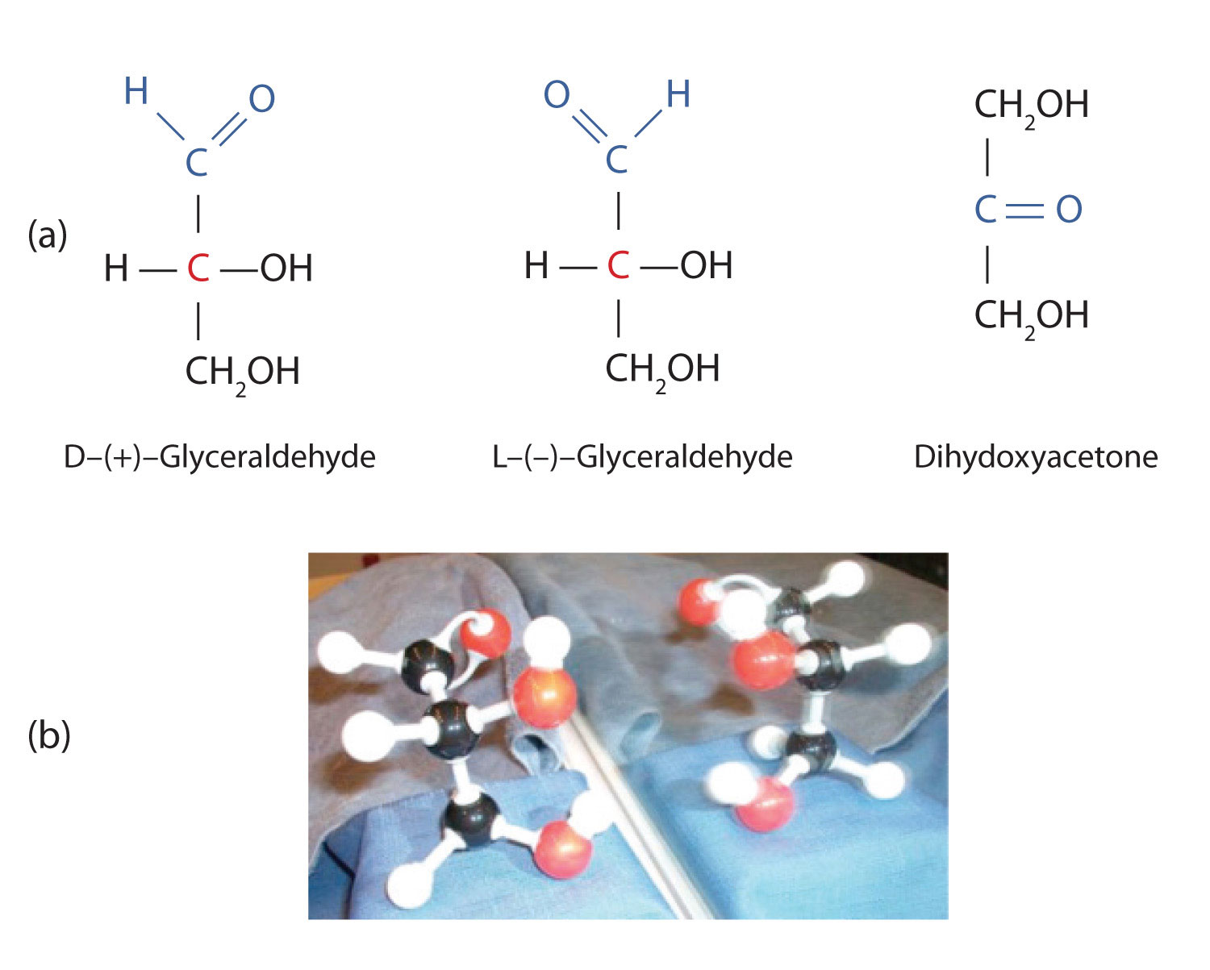
Figure 28.1d
Figure 28.1d. Structures of the Trioses. (a) D- and L-glyceraldehyde are mirror images of each other and represent a pair of enantiomers. (b) A ball-and-stick model of D-glyceraldehyde is reflected in a mirror. Note that the reflection has the same structure as L-glyceraldehyde (credit: Intro Chem: GOB (V. 1.0)., CC BY-NC-SA 3.0).

Slide 7
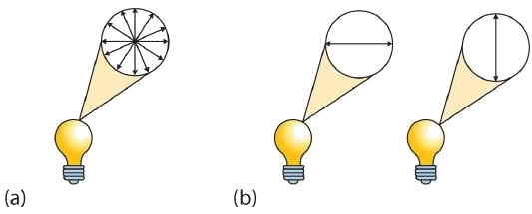
Figure 28.1e
Figure 28.1e. When ordinary light is not polarized, the waves vibrate in all conceivable angles (a). However, when light is polarized, the waves will vibrate in one single plane (b). (Credit: Introduction to Chemistry: GOB (V. 1.0)., CC BY-NC-SA 3.0., edited by Basics of GOB Chemistry (Ball et al.), CC BY-NC-SA 4.0.)

Slide 8
Figure 28.1f
Figure 28.1f. In the photo on the left, two Polaroid sheets are aligned in the same direction; plane-polarized light from the first Polaroid sheet can pass through the second sheet. In the photo on the right, the top Polaroid sheet has been rotated 90° and now blocks the plane-polarized light that comes through the first Polaroid sheet (credit: Intro Chem: GOB (V. 1.0)., CC BY-NC-SA 3.0).

Slide 9
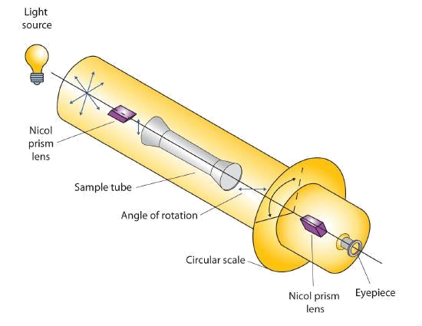
Figure 28.1g
Figure 28.1g. Diagram of a Polarimeter (Credit: Introduction to Chemistry: GOB (V. 1.0)., CC BY-NC-SA 3.0., edited by Basics of GOB Chemistry (Ball et al.), CC BY-NC-SA 4.0.)

Slide 10
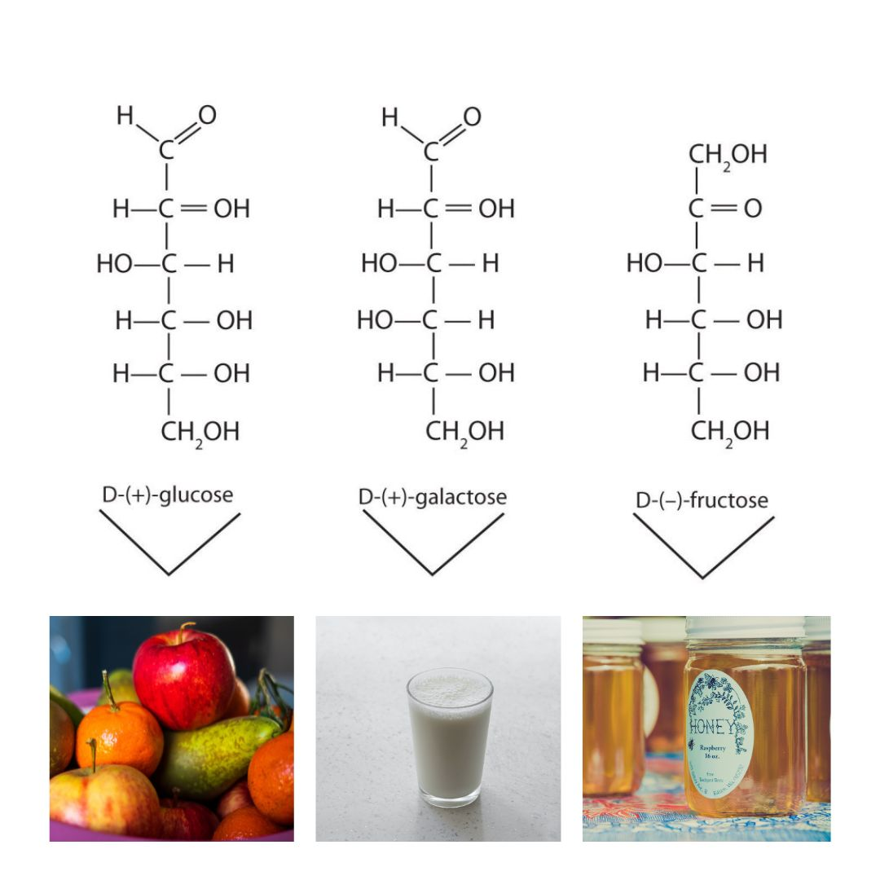
Figure 28.1h
Figure 28.1h. Structures of Three Important Hexoses. Each hexose is pictured with a food source in which it is commonly found. (credit: Introduction to Chemistry: GOB (v. 1.0) , CC BY-NC-SA 4.0; edited by Reva to include Photo by Nick Fewings, Photo by engin akyurt and Photo by Amelia Bartlett all under Unsplash license)

Slide 11
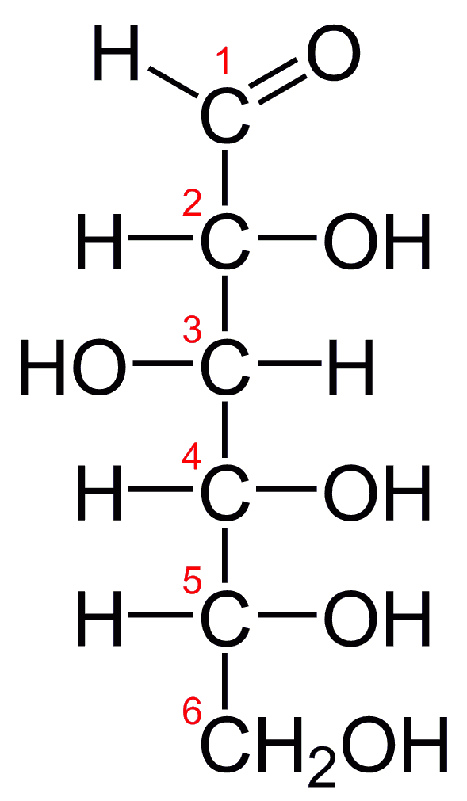
Figure 28.1i
Figure 28.1i. Fischer projection of D-glucose. (Credit: Photo by Benjah-bmm27 edited by Yikrazuul , Public Domain)

Slide 12
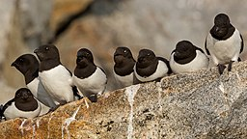
Figure 28.1j
Figure 28.1j. Little auks sitting on a rock (Image by AWeith, CC BY-SA 4.0).

Slide 13
Table 28.1a
Table 28.1a. The Relative Sweetness of Some Compounds
Compound | Relative Sweetness
lactose | 16
maltose | 32
glucose | 74
sucrose | 100
fructose | 173
aspartame | 18,000
acesulfame K | 20,000
saccharin | 30,000
sucralose | 60,000
Source: "16.3: Important Hexoses" In Basics of GOB Chemistry (Ball et al.), CC BY-NC-SA 4.0.

Slide 14
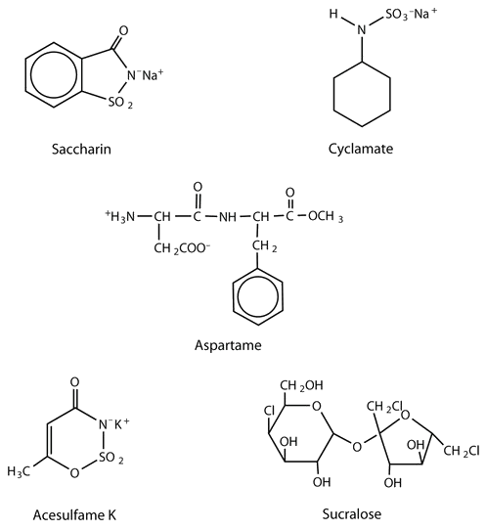
Figure 28.1k
Figure 28.1k. The structures of five artificial sweeteners that are approved for consumption: saccharin, cyclamate, aspartame, acesulfame K, and sucralose (Credit: Introduction to Chemistry: GOB (v. 1.0) ., edited by Basics of GOB Chemistry (Ball et al.), CC BY-NC-SA 4.0.)

Slide 15
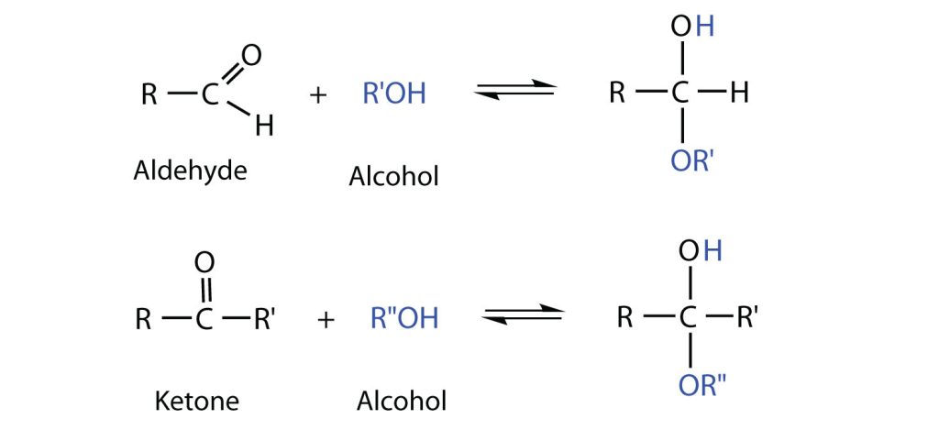
Figure 28.1l
Figure 28.1l. Reaction schemes for an aldehyde reacting with an alcohol, and a ketone reacting with an alcohol. R stands in for any alkyl group (credit: Intro Chem: GOB (v. 1.0), CC BY-NC-SA 3.0).

Slide 16
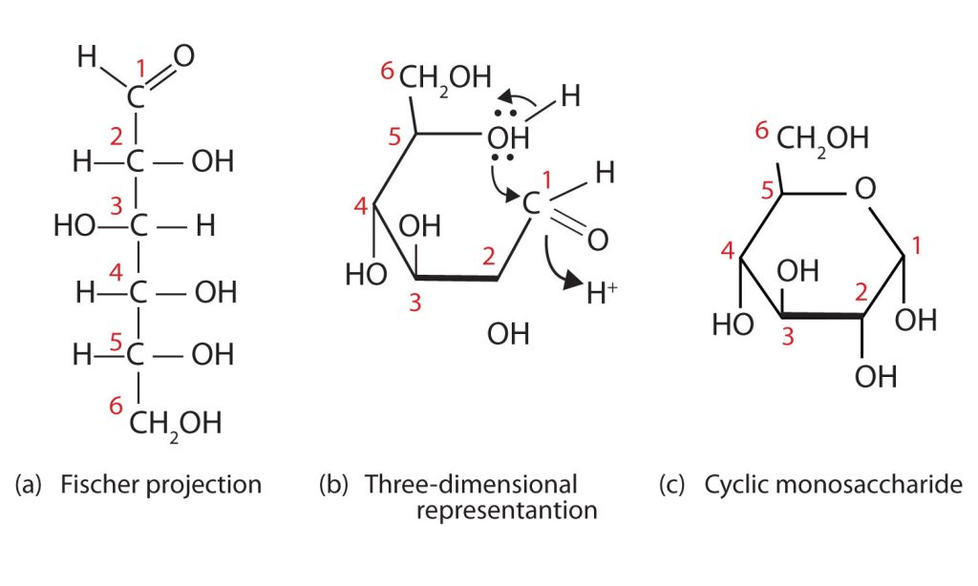
Figure 28.1m
Figure 28.1m. Cyclization of D-Glucose. D-Glucose can be represented with a Fischer projection (a) or three dimensionally (b). By reacting the OH group on the fifth carbon atom with the aldehyde group, the cyclic monosaccharide (c) is produced (credit: Intro Chem: GOB (v. 1.0), CC BY-NC-SA 3.0).

Slide 17
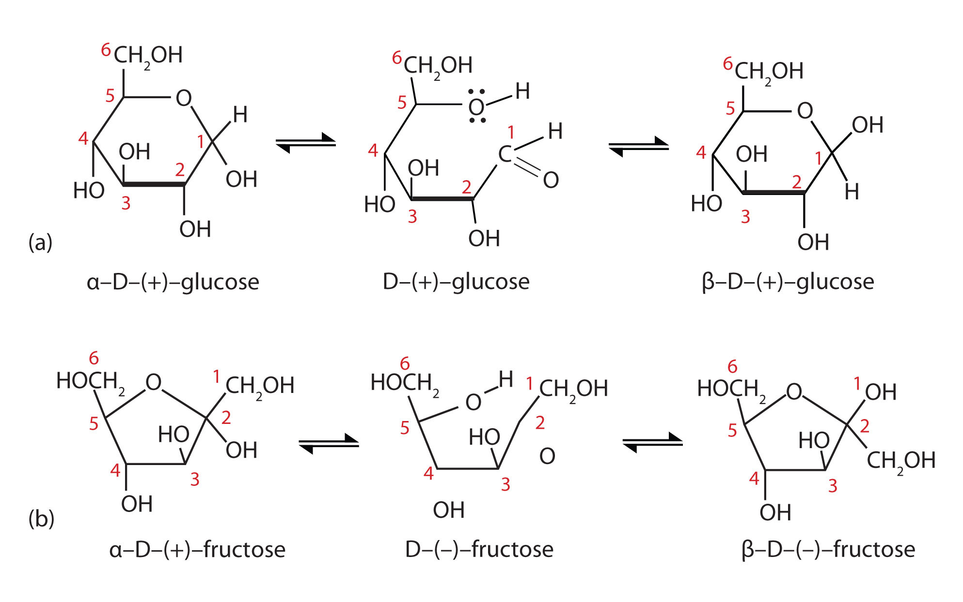
Figure 28.1n
Figure 28.1n. Monosaccharides. In an aqueous solution, monosaccharides exist as an equilibrium mixture of three forms. The interconversion between the forms is known as mutarotation, which is shown for D-glucose (a) and D-fructose (b). (credit: Intro Chem: GOB (v. 1.0), CC BY-NC-SA 3.0).

Slide 18
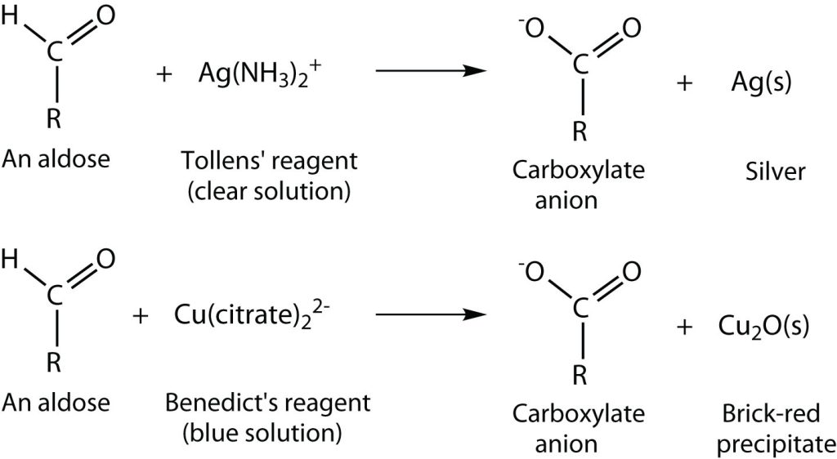
Figure 28.1o
Figure 28.1o. Oxidation reactions of monosaccharides using either Tollens' reagent or Benedict's reagent (credit: Intro Chem: GOB (v. 1.0), CC BY-NC-SA 3.0).

Slide 19
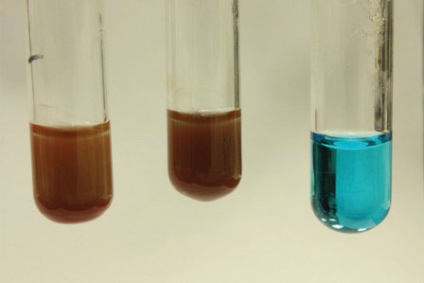
Figure 28.1p
Figure 28.1p. Benedict’s Test. Benedict’s test was performed on three carbohydrates, depicted from left to right: fructose, glucose, and sucrose. The solution containing sucrose remains blue because sucrose is a nonreducing sugar (credit: Intro Chem: GOB (v. 1.0), CC BY-NC-SA 3.0).

Slide 20
Figure 28.1q
Figure 28.1q. Reaction mechanism depicting how two monosaccharides can link to form a disaccharide. (Credit: Introduction to Chemistry: GOB(v. 1.0), edited by (Ball et al.) , CC BY-NC-SA 4.0)

Slide 21
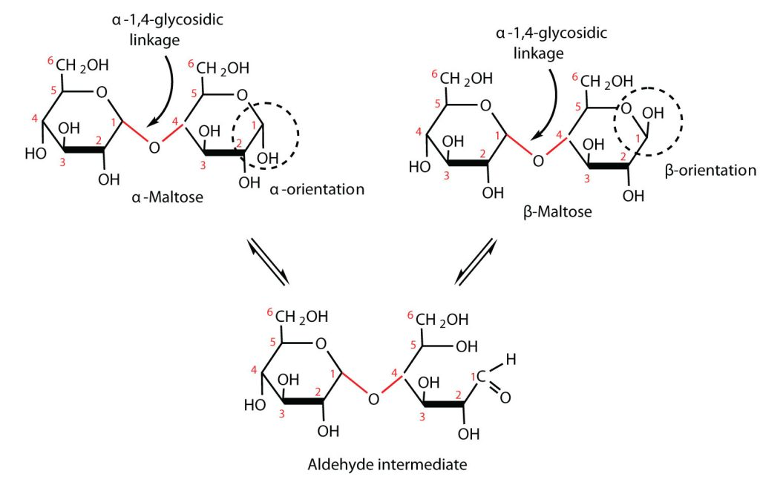
Figure 28.1r
Figure 28.1r. An Equilibrium Mixture of Maltose Isomers (credit: Intro Chem: GOB (v. 1.0), CC BY-NC-SA 3.0).

Slide 22
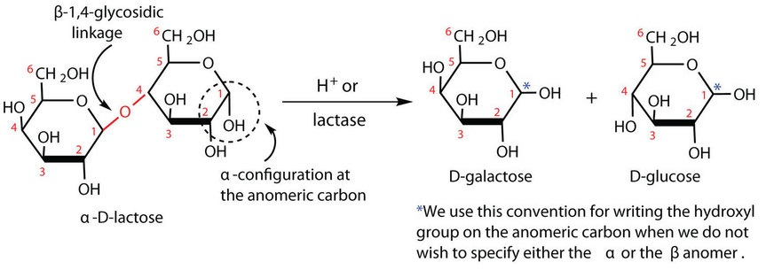
Figure 28.1s
Figure 28.1s. Reaction mechanism of the acid hydrolysis of lactose into its constituent monosaccharides by the enzyme lactase. (Credit: Introduction to Chemistry: GOB (v. 1.0), edited by (Ball et al.) , CC BY-NC-SA 4.0)

Slide 23
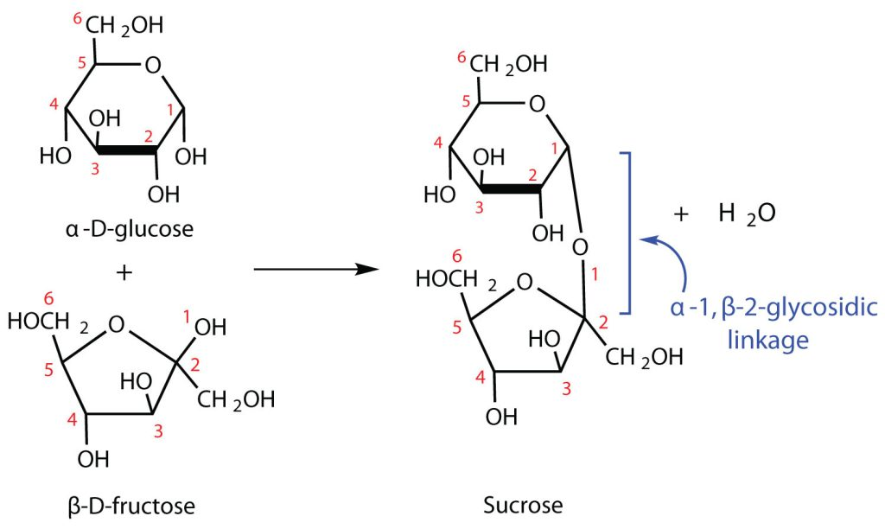
Figure 28.1t
Figure 28.1t. Reaction mechanism of the formation of sucrose from the starting monosaccharides glucose and fructose (credit: Intro Chem: GOB (v. 1.0), CC BY-NC-SA 3.0).

Slide 24
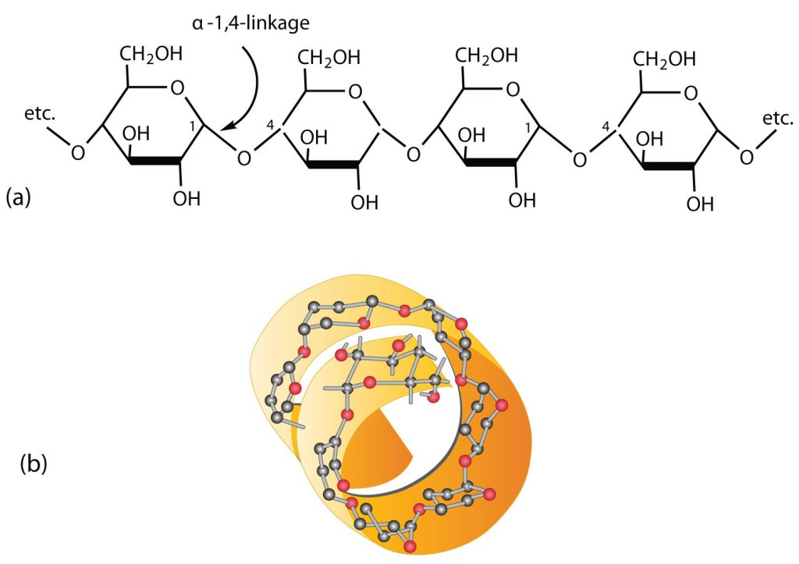
Figure 28.1u
Figure 28.1u. Amylose. (a) Amylose is a linear chain of α-D-glucose units joined together by α-1,4-glycosidic bonds. (b) Because of hydrogen bonding, amylose acquires a spiral structure that contains six glucose units per turn (credit: Intro Chem: GOB (v. 1.0), CC BY-NC-SA 3.0).

Slide 25
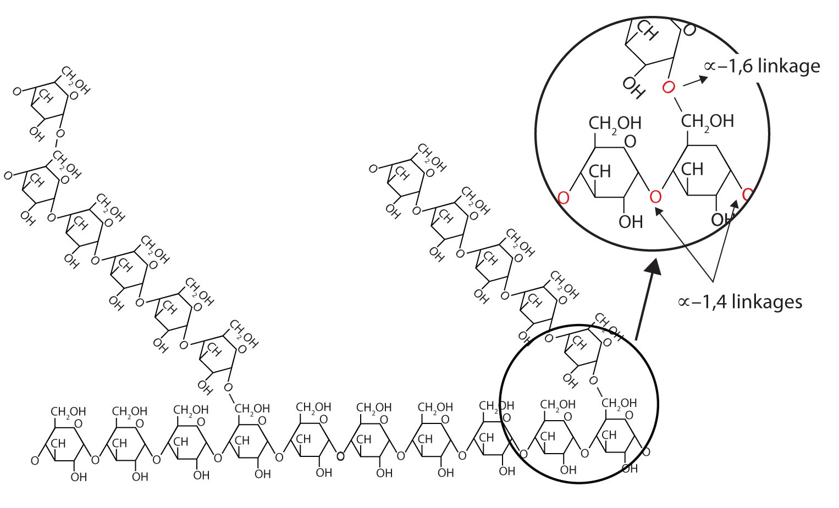
Figure 28.1v
Figure 28.1v. Representation of the Branching in Amylopectin and Glycogen. Both amylopectin and glycogen contain branch points that are linked through α-1,6-linkages. These branch points occur more often in glycogen (credit: Intro Chem: GOB (v. 1.0), CC BY-NC-SA 3.0).

Slide 26
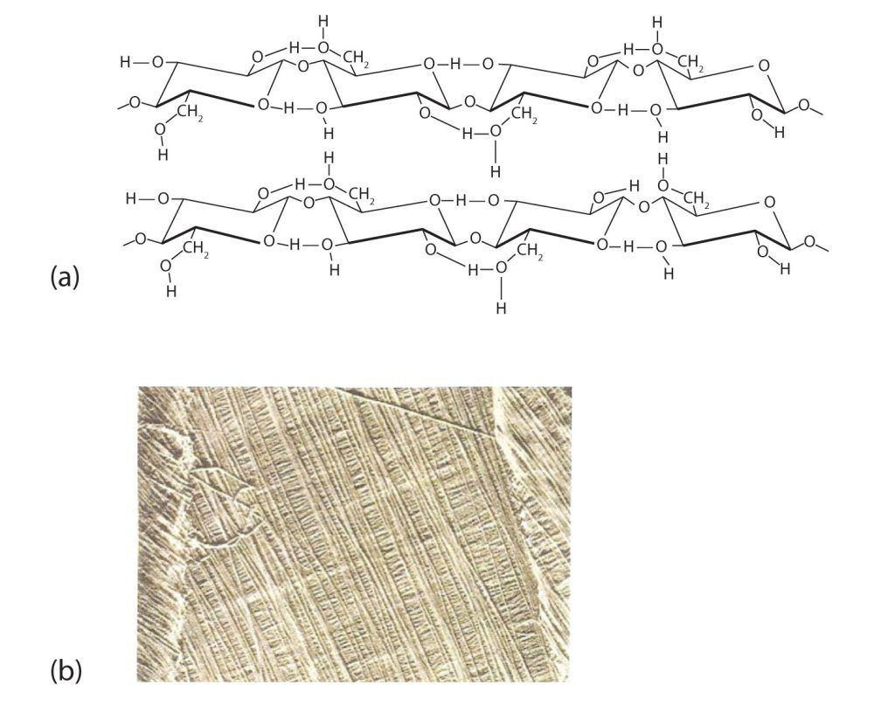
Figure 28.1w
Figure 28.1w. Cellulose. (a) There is extensive hydrogen bonding in the structure of cellulose. (b) In this electron micrograph of the cell wall of an alga, the wall consists of successive layers of cellulose fibers in parallel arrangement (credit: Intro Chem: GOB (v. 1.0), CC BY-NC-SA 3.0).

Slide 27
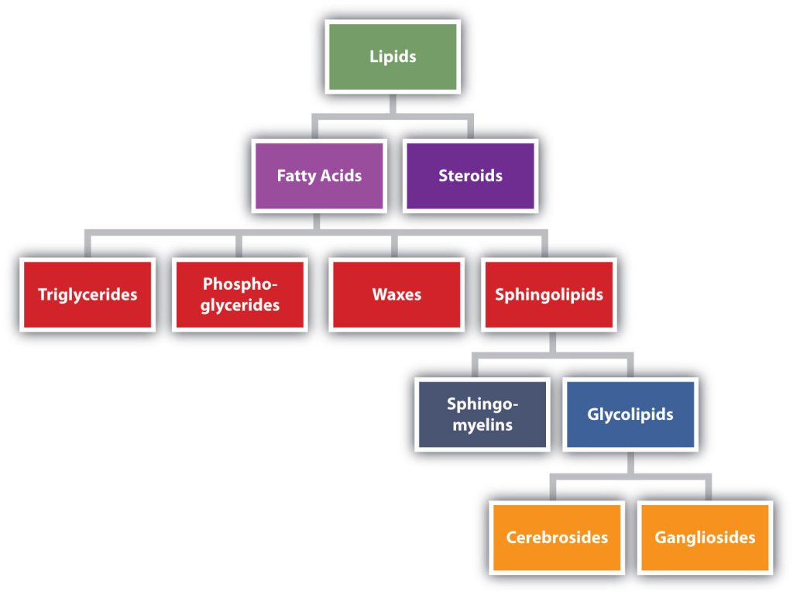
Figure 28.2a
Figure 28.2a. Lipid Organization Based on Structural Relationships. Lipid categorized into fatty acids and steroids. Fatty acids are further separated into triglycerides, phospho-glycerides, waxes, and sphingolipids. Sphingolipids are separated into sphingo-myelins and glycolipids. Glycolipids are separated into cerebrosides and gangliosides (credit: Intro Chem: GOB (v. 1.0), CC BY-NC-SA 3.0).

Slide 28
Figure 28.2b
Figure 28.2b. Cis fatty acids have two H atoms on the same side of the plane of the fatty acid while trans fatty acids have the two H atoms on opposite sides (credit: Intro Chem: GOB (v. 1.0), CC BY-NC-SA 3.0).

Slide 29
Table 28.2a
Table 28.2a. Some Common Fatty Acids Found in Natural Fats
Name | Abbreviated Structural Formula | Condensed Structural Formula | Melting Point (°C) | Source
lauric acid | C₁₁H₂₃COOH | CH₃(CH₂)₁₀COOH | 44 | palm kernel oil
myristic acid | C₁₃H₂₇COOH | CH₃(CH₂)₁₂COOH | 58 | oil of nutmeg
palmitic acid | C₁₅H₃₁COOH | CH₃(CH₂)₁₄COOH | 63 | palm oil
palmitoleic acid | C₁₅H₂₉COOH | CH₃(CH₂)₅CH=CH(CH₂)₇COOH | 0.5 | macadamia oil
stearic acid | C₁₇H₃₅COOH | CH₃(CH₂)₁₆COOH | 70 | cocoa butter
oleic acid | C₁₇H₃₃COOH | CH₃(CH₂)₇CH=CH(CH₂)₇COOH | 16 | olive oil
linoleic acid | C₁₇H₃₁COOH | CH₃(CH₂)₃(CH₂CH=CH)₂(CH₂)₇COOH | −5 | canola oil
α-linolenic acid | C₁₇H₂₉COOH | CH₃(CH₂CH=CH)₃(CH₂)₇COOH | −11 | flaxseed
arachidonic acid | C₁₉H₃₁COOH | CH₃(CH₂)₄(CH₂CH=CH)₄(CH₂)₂COOH | −50 | liver
Source: "17.1: Fatty Acids" In Basics of GOB Chemistry (Ball et al.), CC BY-NC-SA 4.0.

Slide 30
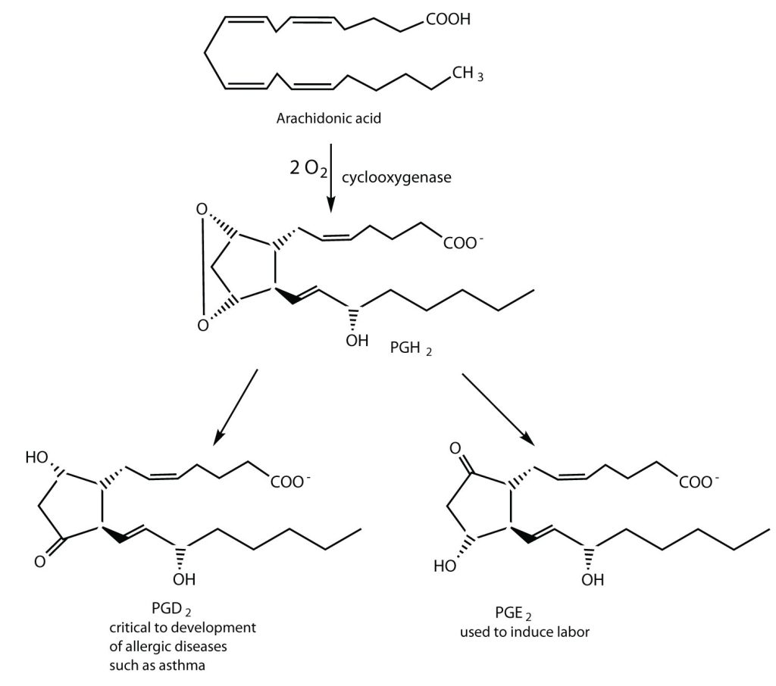
Figure 28.2c
Figure 28.2c. Arachidonic acid can be converted into a prostaglandin by the enzyme cyclooxygenase, which is the enzyme that several drugs including Ibuprofen inhibit. Prostaglandins can then be used as starting materials to to produce other products, such as PGD₂ and PGE₂ (credit: Intro Chem: GOB (v. 1.0), CC BY-NC-SA 3.0).

Slide 31
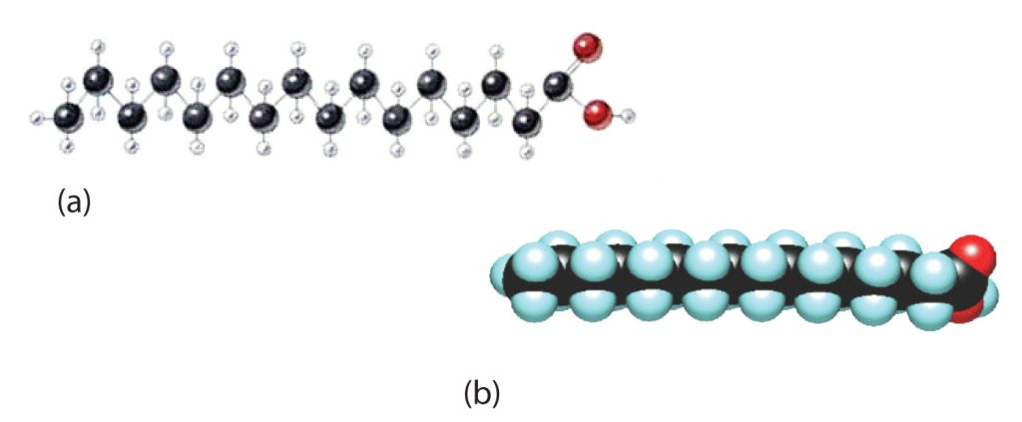
Figure 28.2d
Figure 28.2d. The Structure of Saturated Fatty Acids. (a) There is a zigzag pattern formed by the carbon-to-carbon single bonds in the ball-and-stick model of a palmitic acid molecule. (b) A space-filling model of palmitic acid shows the overall straightness of a saturated fatty acid molecule (credit: Intro Chem: GOB (v. 1.0), CC BY-NC-SA 3.0).

Slide 32
Figure 28.2e
Figure 28.2e. Myricyl cerotate, the main component of carnauba wax, is an ester derived from a fatty acid and a long-chain alcohol. This is an important wax that is found in furniture, automobile, and floor waxes (credit: Intro Chem: GOB (v. 1.0), CC BY-NC-SA 3.0).

Slide 33
Figure 28.2f
Figure 28.2f. Triglycerides are formed from the addition of fatty acid molecules with the glycerol backbone (credit: Intro Chem: GOB (v. 1.0), CC BY-NC-SA 3.0).

Slide 34
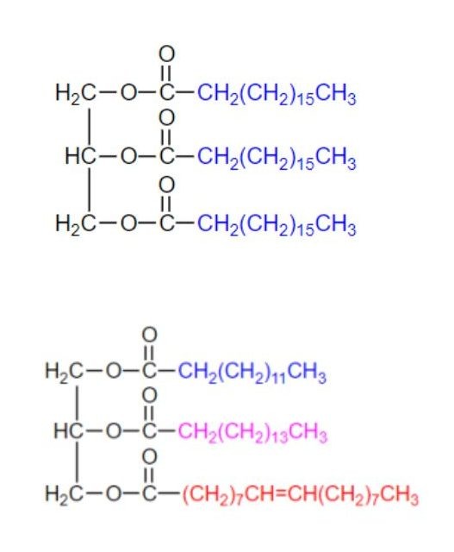
Figure 28.2g
Figure 28.2g. Tristearin, a simple triglyceride is shown at the top. Most naturally occurring triglycerides are mixed triglycerides, such as the one shown on the bottom (Credit: Basics of GOB (Ball et al.), CC BY-NC-SA 4.0)

Slide 35
Table 28.2b.
Table 28.2b. Average Fatty Acid Composition of Some Common Fats and Oils (%)*
Fat/Oil | Lauric | Myristic | Palmitic | Stearic | Oleic | Linoleic | Linolenic
Fat - butter (cow) | 3 | 11 | 27 | 12 | 29 | 2 | 1
Fat - tallow |  | 3 | 24 | 19 | 43 | 3 | 1
Fat - lard |  | 2 | 26 | 14 | 44 | 10
canola oil |  |  | 4 | 2 | 62 | 22 | 10
coconut oil† | 47 | 18 | 9 | 3 | 6 | 2
corn oil |  |  | 11 | 2 | 28 | 58 | 1
olive oil |  |  | 13 | 3 | 71 | 10 | 1
peanut oil |  |  | 11 | 2 | 48 | 32
soybean oil |  |  | 11 | 4 | 24 | 54 | 7
*Totals less than 100% indicate the presence of fatty acids with fewer than 12 carbon atoms or more than 18 carbon atoms.
†Coconut oil is highly saturated. It contains an unusually high percentage of the low-melting C₈, C₁₀, and C₁₂ saturated fatty acids.
Source: "17.2: Fats and Oils" In Basics of GOB Chemistry (Ball et al.), CC BY-NC-SA 4.0.

Slide 36
Figure 28.2h
Figure 28.2h. Bacteria produce the molecules diacetyl and 3-hydroxy-2-butanone during the ripening process of cream used to make butter. These molecules, and not the fat, are what give butter its characteristic flavour (credit: Intro Chem: GOB (v. 1.0), CC BY-NC-SA 3.0).

Slide 37
Figure 28.2i
Figure 28.2i. The formation of soaps, a process called saponification, starts with the hydrolysis of triglyceride molecules (which are esters) to produce fatty acids. These fatty acids are then reacted with a base, such as sodium hydroxide, to form soap molecules (credit: Intro Chem: GOB (v. 1.0), CC BY-NC-SA 3.0).

Slide 38
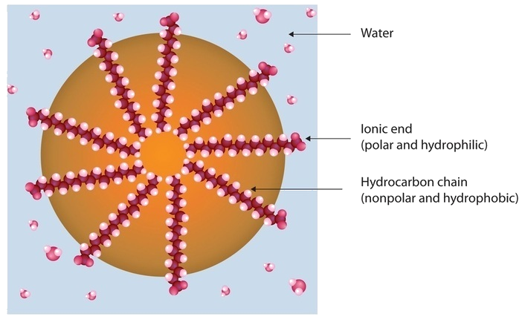
Figure 28.2j
Figure 28.2j. Typical structure of a soap molecule (credit: Intro Chem: GOB (v. 1.0), CC BY-NC-SA 3.0).

Slide 39
Figure 28.2k
Figure 28.2k. Hydrogenation of an alkene produce an alkane. This same reaction occurs in vegetable oils to produce fats (credit: Intro Chem: GOB (v. 1.0), CC BY-NC-SA 3.0).

Slide 40
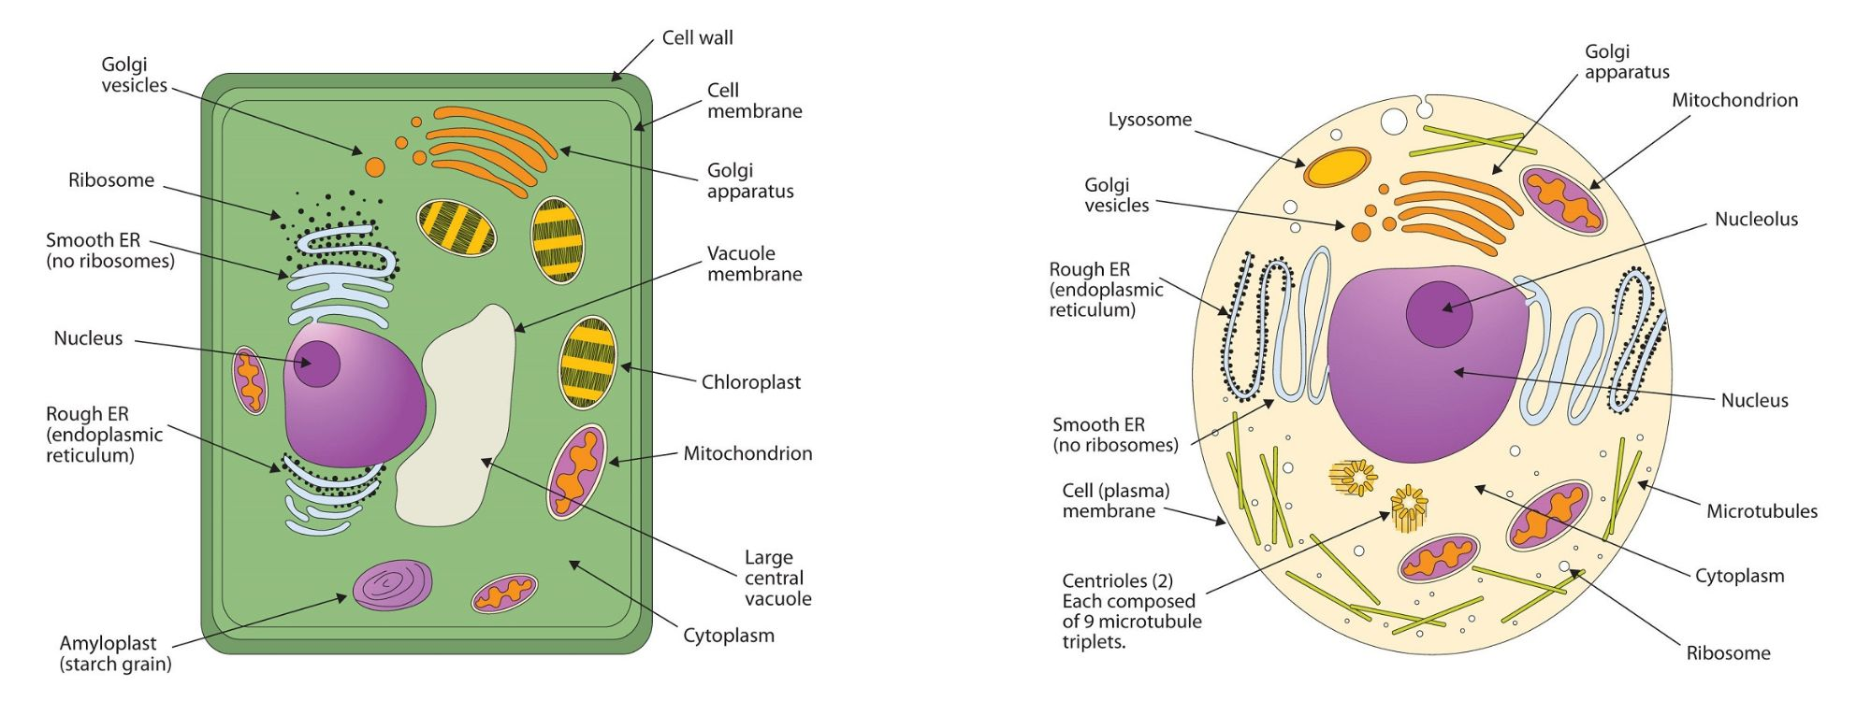
Figure 28.2l
Figure 28.2l. (A) An Idealized Plant Cell. Not all the structures shown here occur in every type of plant cell. (B) An Idealized Animal Cell. The structures shown here will seldom all be found in a single animal cell (credit: Intro Chem: GOB (v. 1.0), CC BY-NC-SA 3.0).

Slide 41
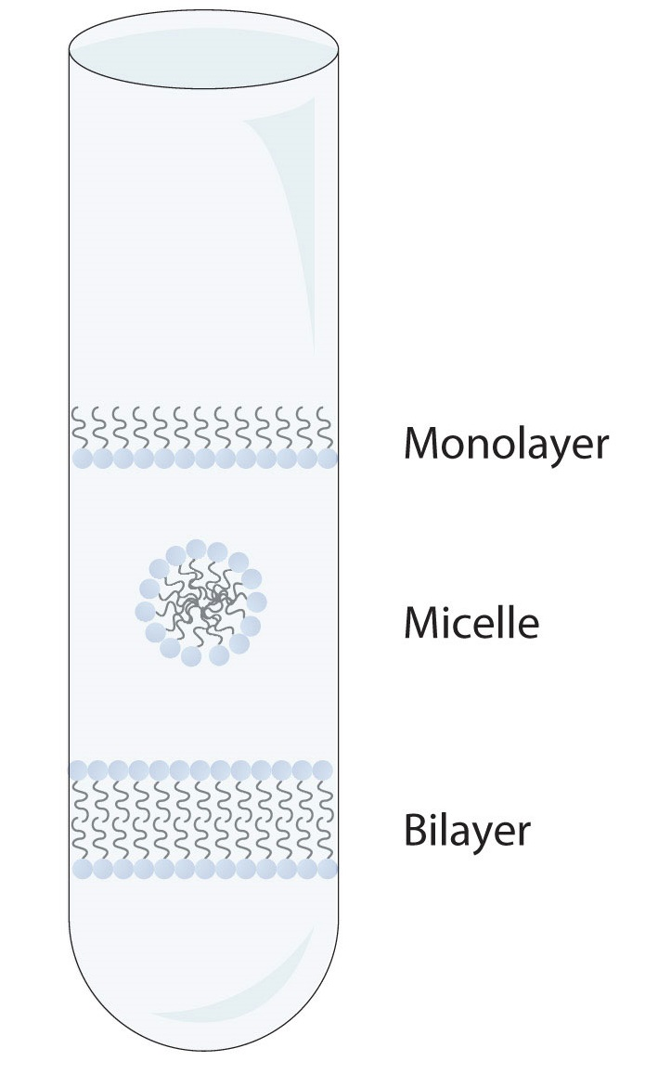
Figure 28.2m
Figure 28.2m. Spontaneously Formed Polar Lipid Structures in Water: Monolayer, Micelle, and Bilayer. (Credit: Introduction to Chemistry: GOB (v. 1.0), edited by (Ball et al.), CC BY-NC-SA 4.0)

Slide 42
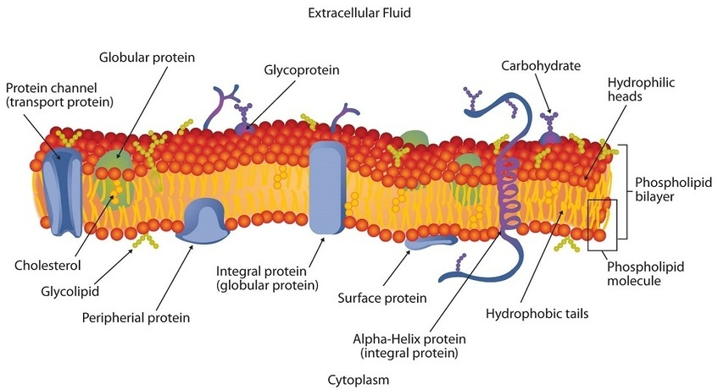
Figure 28.2n
Figure 28.2n. Schematic Diagram of a Cell Membrane. The membrane enclosing a typical animal cell is a phospholipid bilayer with embedded cholesterol and protein molecules. Short oligosaccharide chains are attached to the outer surface. (Credit: Introduction to Chemistry: GOB (v. 1.0), edited by (Ball et al.), CC BY-NC-SA 4.0)

Slide 43
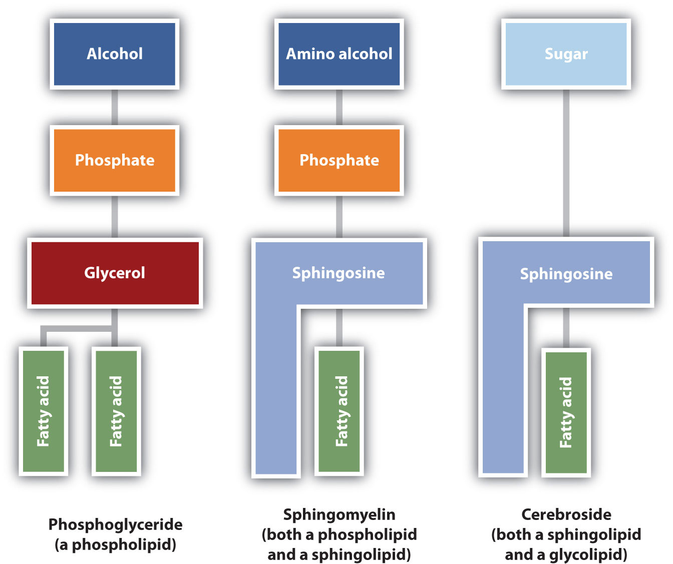
Figure 28.2o
Figure 28.2o. Component Structures of Some Important Membrane Lipids. Phosphoglyceride are composed of alcohol, phosphate, glycerol and 2 fatty acids. A sphingomyelin contains phosphate, sphingosine, and a fatty acid. A cerbroside contains sugar, sphingosine and a fatty acid (credit: Intro Chem: GOB (v. 1.0), CC BY-NC-SA 3.0).

Slide 44
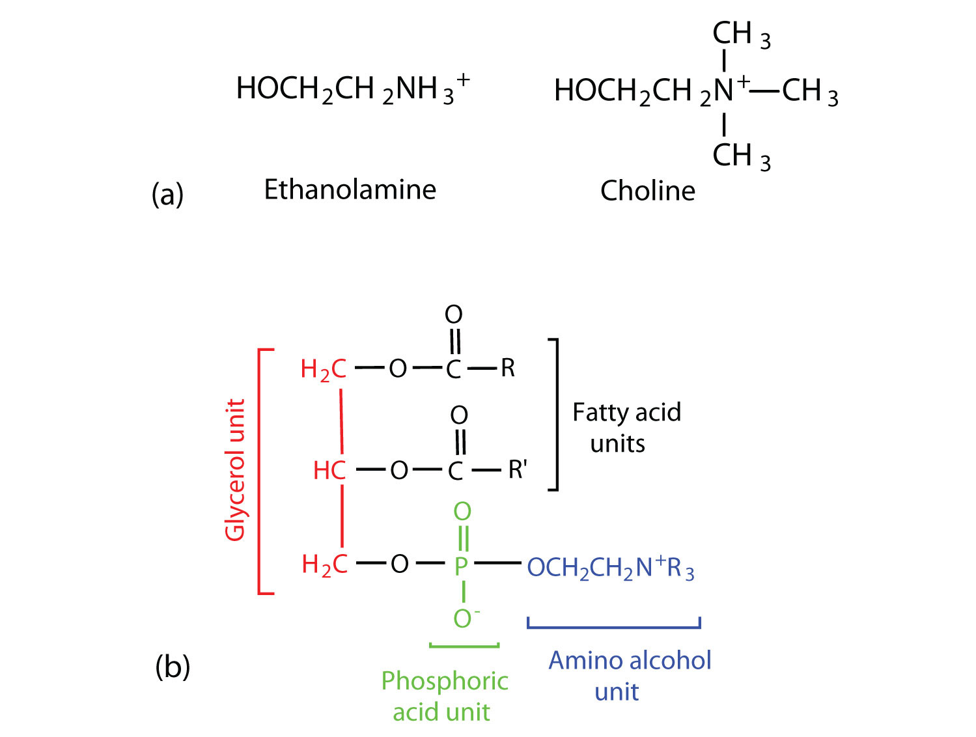
Figure 28.2p
Figure 28.2p. Phosphoglycerides. (a) Amino alcohols are commonly found in phosphoglycerides, which are evident in its structural formula (b). Structural formula of ethanolamine and choline are shown. The structural formula of a phosphoglyceride is shown with the glycerol unit, phosphoric unit, and amino alcohol unit highlighted in different colours (credit: Intro Chem: GOB (v. 1.0), CC BY-NC-SA 3.0).

Slide 45
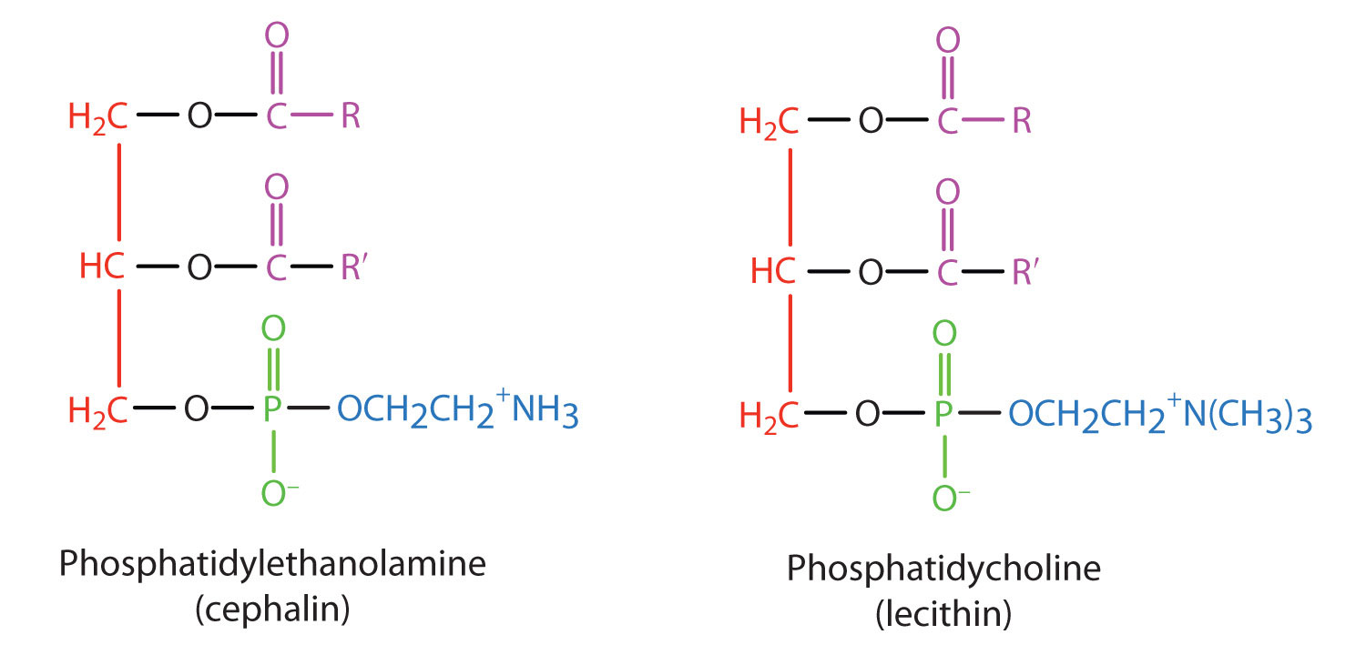
Figure 28.2q
Figure 28.2q. Structures of cephalin and lecithin, two common phosphoglycerides (credit: Intro Chem: GOB (v. 1.0), CC BY-NC-SA 3.0).

Slide 46
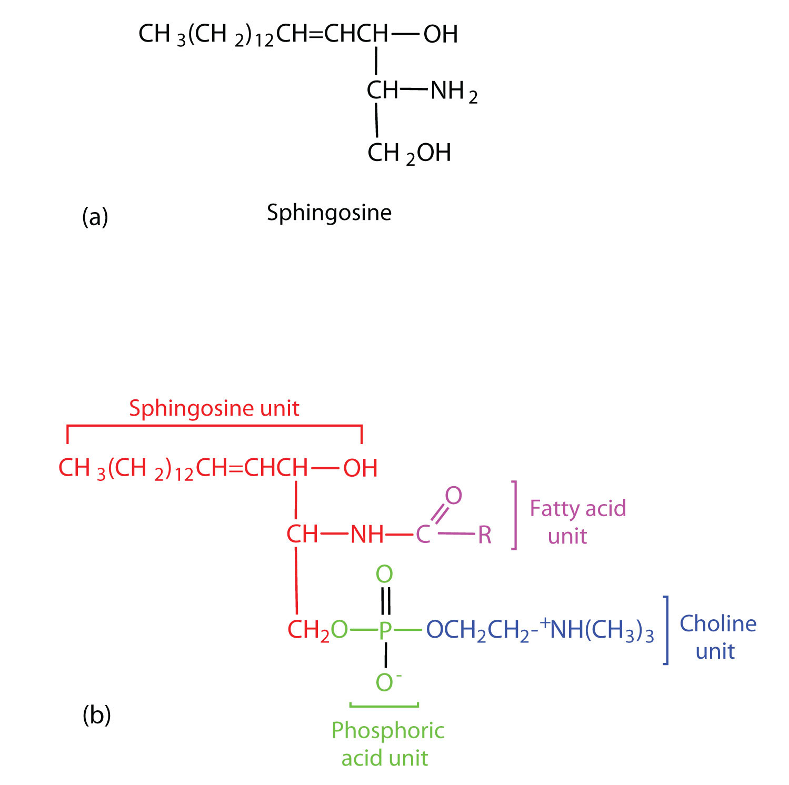
Figure 28.2r
Figure 28.2r. Sphingolipids. (a) Sphingosine, an amino alcohol, is found in all sphingolipids. (b) A sphingomyelin is also known as a phospholipid, as evidenced by the phosphoric acid unit in its structure. Structural formula of sphingosine is shown. The general structure of a sphingolipid is shown with the sphingosine unit, fatty acid unit, phosphoric acid unit, and choline unit highlighted in different colours (credit: Intro Chem: GOB (v. 1.0), CC BY-NC-SA 3.0).

Slide 47
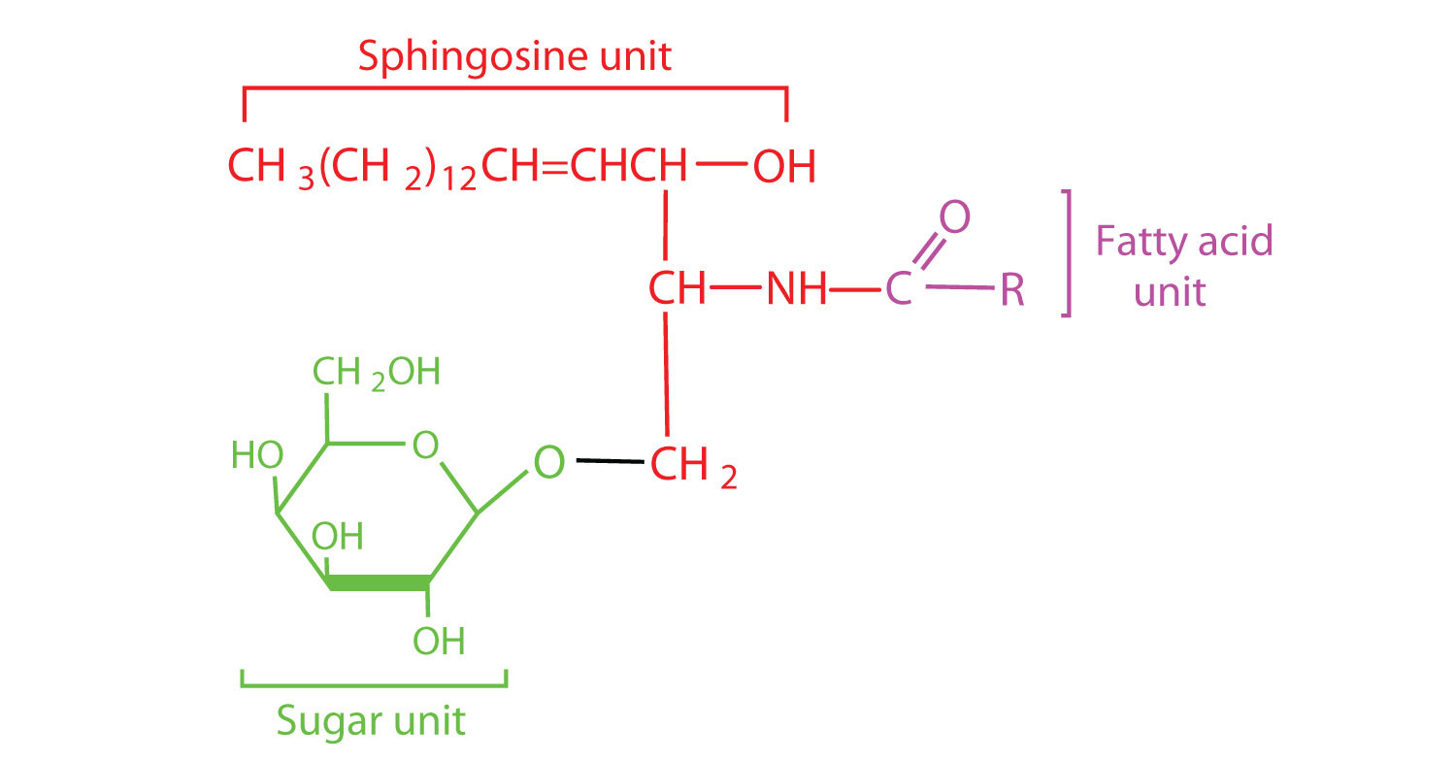
Figure 28.2s
Figure 28.2s. Cerebrosides. Cerebrosides are sphingolipids that contain a sugar unit. General structure of a cerebroside with its sugar unit, sphingosine unit, and fatty acid unit highlighted in different colours (credit: Intro Chem: GOB (v. 1.0), CC BY-NC-SA 3.0).

Slide 48
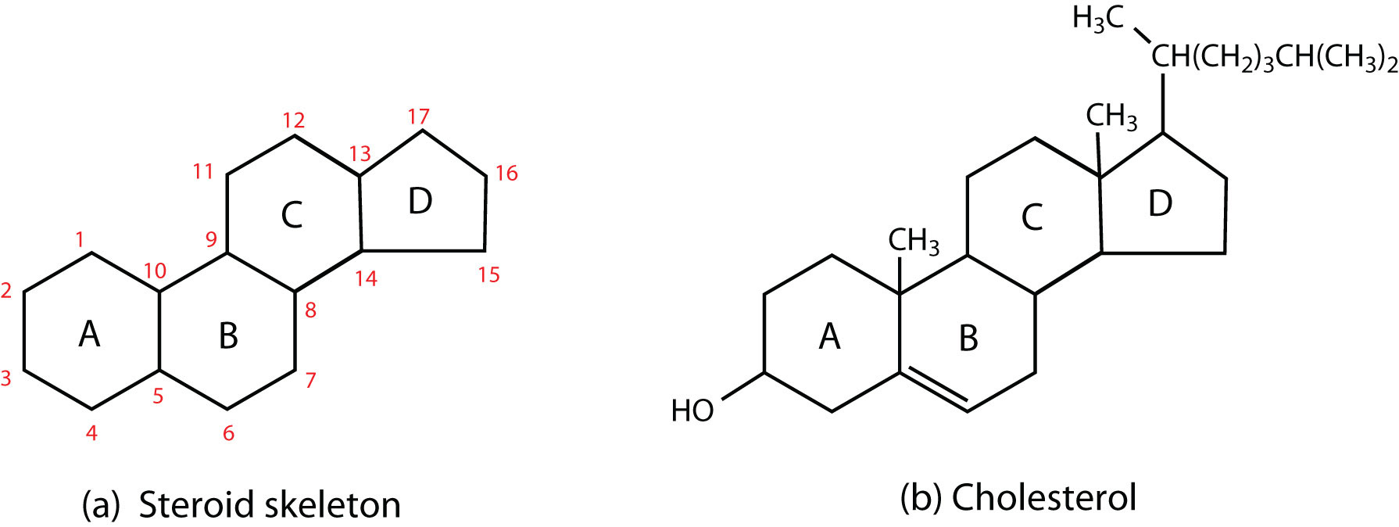
Figure 28.2t
Figure 28.2t. Steroids. (a) The four-fused-ring steroid skeleton uses letter designations for each ring and the numbering of the carbon atoms. (b) The cholesterol molecule follows this pattern (credit: Intro Chem: GOB (v. 1.0), CC BY-NC-SA 3.0).

Slide 49
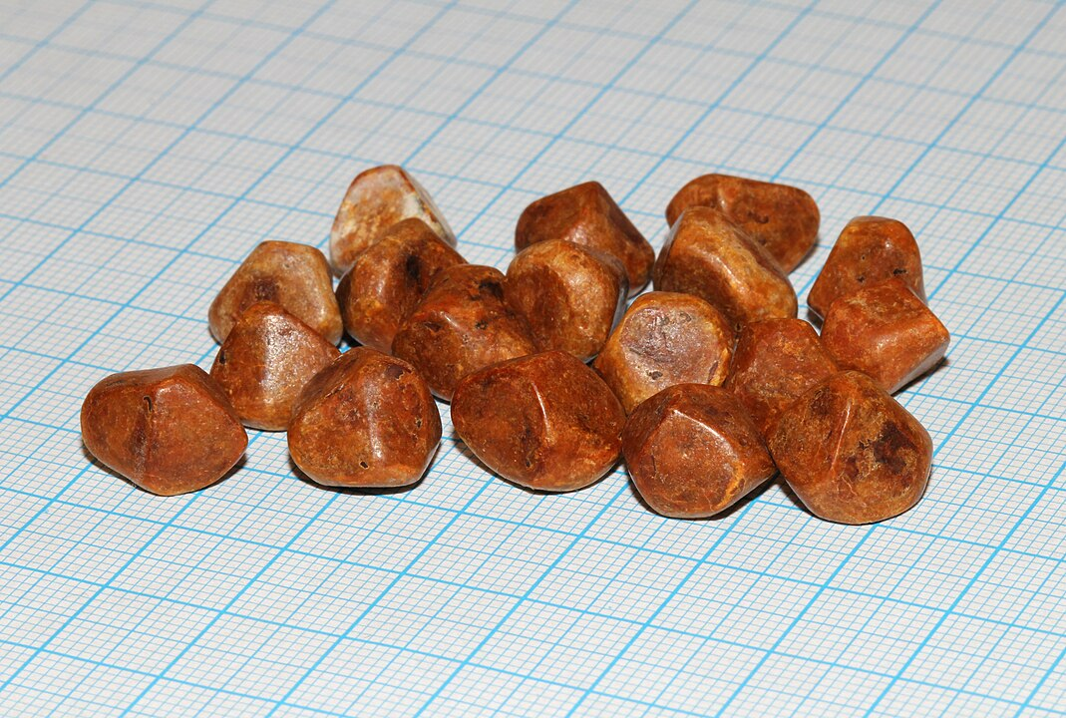
Figure 28.2u
Figure 28.2u. Numerous small gallstones made up largely of cholesterol, all removed from one patient. Grid scale = 1 mm. (Credit: Photo by George Chernilevsky, CC BY-SA 4.0)

Slide 50
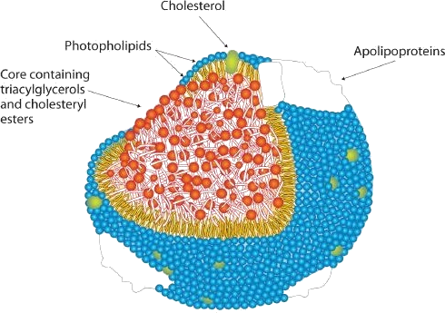
Figure 28.2v
Figure 28.2v. Artist rendition of a typical lipoprotein molecule. (Credit: Introduction to Chemistry: GOB (v. 1.0), edited by (Ball et al.), CC BY-NC-SA 4.0)

Slide 51
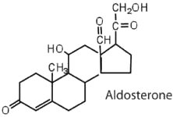
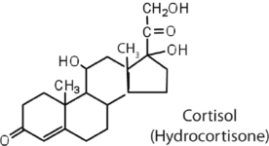
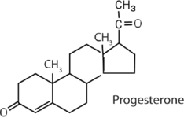
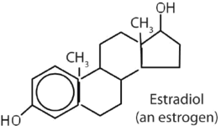
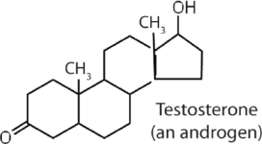
Table 28.2c
Table 28.2c. Representative Steroid Hormones and Their Physiological Effects
Hormone | Effect
 | regulates salt metabolism; stimulates kidneys to retain sodium and excrete potassium
 | stimulates the conversion of proteins to carbohydrates
 | regulates the menstrual cycle; maintains pregnancy
 | stimulates female sex characteristics; regulates changes during the menstrual cycle
 | stimulates and maintains male sex characteristics
Image Credits: Introduction to Chemistry: GOB (v. 1.0), edited by (Ball et al.), CC BY-NC-SA 4.0)

Slide 52
Figure 28.2w
Figure 28.2w. Bile Acids. (a) Cholic acid is an example of a bile acid. (b) Sodium glycocholate is a bile salt synthesized from cholic acid and glycine. (Credit: Introduction to Chemistry: GOB (v. 1.0), edited by (Ball et al.), CC BY-NC-SA 4.0)

Slide 53
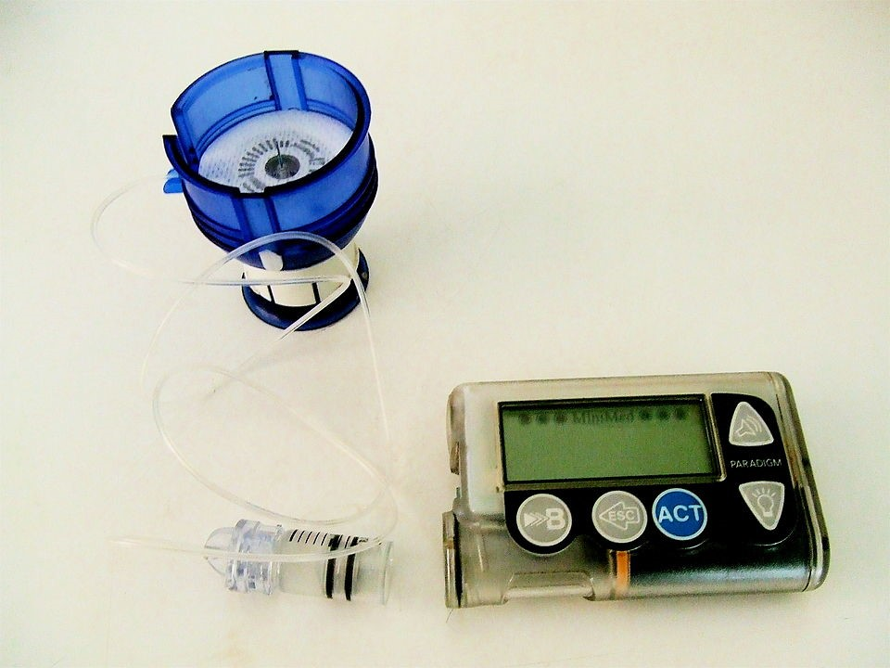
Figure 28.3
Figure 28.3a. Insulin pump, showing an infusion set loaded into spring-loaded insertion device. A reservoir is attached to the infusion set (shown here removed from the pump). (Photo by David-i98, PDM).

Slide 54
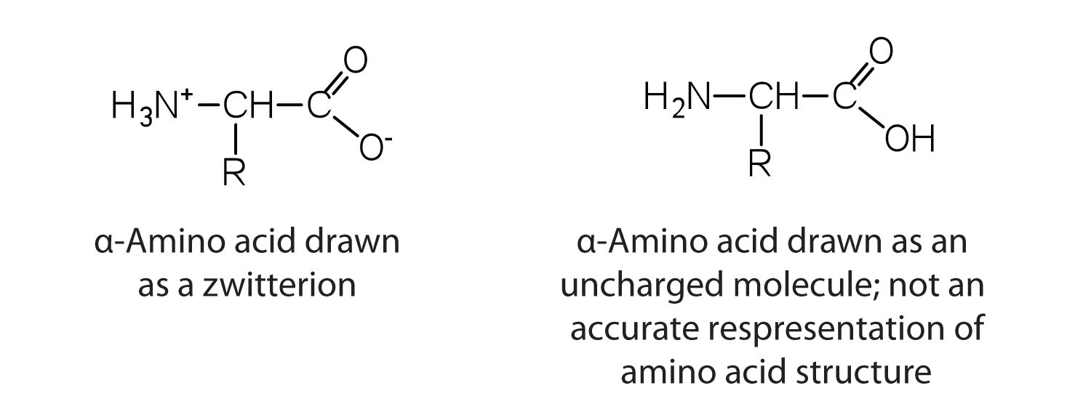
Figure 28.3b
Figure 28.3b. Structural representations of an amino acid in zwitterion form (the more "realistic" state) and as an uncharged molecule (credit: Intro Chem: GOB (v. 1.0), CC BY-NC-SA 3.0).

Slide 55
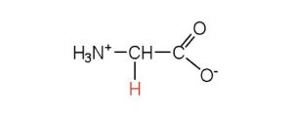
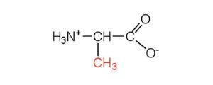
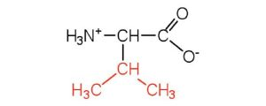
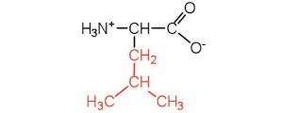
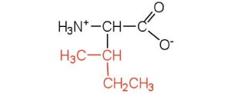
Table 28.3a.
Table 28.3a. Common Amino Acids Found in Proteins – Nonpolar R Groups
Common Name | Abbreviation | Structural Formula (at pH 6) | Molar Mass | Distinctive Feature
glycine | gly (G) |  | 75 | the only amino acid lacking a chiral carbon
alanine | ala (A) |  | 89 | —
valine | val (V) |  | 117 | a branched-chain amino acid
leucine | leu (L) |  | 131 | a branched-chain amino acid
isoleucine | ile (I) |  | 131 | an essential amino acid because most animals cannot synthesize branched-chain amino acids
phenylalanine | phe (F) |  | 165 | also classified as an aromatic amino acid
tryptophan | trp (W) |  | 204 | also classified as an aromatic amino acid
methionine | met (M) |  | 149 | side chain functions as a methyl group donor
proline | pro (P) |  | 115 | contains a secondary amine group; referred to as an α-imino acid
Credit: Introduction to Chemistry: GOB (v. 1.0), edited by (Ball et al.), CC BY-NC-SA 4.0)

Slide 56
Table 28.3b.
Table 28.3b. Common Amino Acids Found in Proteins – Polar but Neutral R Groups
Common Name | Abbreviation | Structural Formula (at pH 6) | Molar Mass | Distinctive Feature
serine | ser (S) |  | 105 | found at the active site of many enzymes
threonine | thr (T) |  | 119 | named for its similarity to the sugar threose
cysteine | cys (C) |  | 121 | oxidation of two cysteine molecules yields cystine
tyrosine | tyr (Y) |  | 181 | also classified as an aromatic amino acid
asparagine | asn (N) |  | 132 | the amide of aspartic acid
glutamine | gln (Q) |  | 146 | the amide of glutamic acid
Credit: Introduction to Chemistry: GOB (v. 1.0), edited by (Ball et al.), CC BY-NC-SA 4.0

Slide 57
Table 28.3c.
Table 28.3c. Common Amino Acids Found in Proteins – Negatively Charged R Groups
Common Name | Abbreviation | Structural Formula (at pH 6) | Molar Mass | Distinctive Feature
aspartic acid | asp (D) |  | 132 | carboxyl groups are ionized at physiological pH; also known as aspartate
glutamic acid | glu (E) |  | 146 | carboxyl groups are ionized at physiological pH; also known as glutamate
Credit: Introduction to Chemistry: GOB (v. 1.0), edited by (Ball et al.), CC BY-NC-SA 4.0)

Slide 58
Table 28.3d.
Table 28.3d. Common Amino Acids Found in Proteins – Positively Charged R Groups
Common Name | Abbreviation | Structural Formula (at pH 6) | Molar Mass | Distinctive Feature
histidine | his (H) |  | 155 | the only amino acid whose R group has a pK_{a} (6.0) near physiological pH
lysine | lys (K) |  | 147 | —
arginine | arg (R) |  | 175 | almost as strong a base as sodium hydroxide
Credit: Introduction to Chemistry: GOB (v. 1.0), edited by (Ball et al.), CC BY-NC-SA 4.0)

Slide 59
Figure 28.3c
Figure 28.3c. Proline is one of the 20 common amino acids. When modified with the addition of a hydroxyl group, it becomes hydroxyproline. This modification step occurs after the amino acid has been assembled into a protein (credit: Intro Chem: GOB (v. 1.0), CC BY-NC-SA 3.0).

Slide 60
Figure 28.3d
Figure 28.3d. L-glyceraldehyde is the reference compound for the assignment of absolute configuration of amino acids. An example of an L-amino acid and a D-amino acid are given (credit: Intro Chem: GOB (v. 1.0), CC BY-NC-SA 3.0).

Slide 61
Figure 28.3e
Figure 28.3e. Amino acids naturally exist as zwitterions. As a result, the addition of either an acid or a base allows the amino acid to itself act as a base or an acid, respectively (credit: Intro Chem: GOB (v. 1.0), CC BY-NC-SA 3.0).

Slide 62
Table 28.3e.
Table 28.3e. Examples of Some Representative Amino Acids
Amino Acid | Classification | pI
alanine | nonpolar | 6.0
valine | nonpolar | 6.0
serine | polar, uncharged | 5.7
threonine | polar, uncharged | 6.5
arginine | positively charged (basic) | 10.8
histidine | positively charged (basic) | 7.6
lysine | positively charged (basic) | 9.8
aspartic acid | negatively charged (acidic) | 3.0
glutamic acid | negatively charged (acidic) | 3.2
Source: "18.2: Reactions of Amino Acids" In Basics of GOB Chemistry (Ball et al.), CC BY-NC-SA 4.0.

Slide 63
Figure 28.3f
Figure 28.3f. The ninhydrin test is used to detect fingerprints on samples. Ninhydrin reacts with the amine functional group present in a amino acids in the proteins of skin cells to form a purple-coloured compound (credit: Intro Chem: GOB (v. 1.0), CC BY-NC-SA 3.0).

Slide 64
Figure 28.3g
Figure 28.3g. When two amino acids react to form a peptide bond, this linkage occurs between the amino group of one amino acid and the carboxyl group of another, forming an amide linkage with the release of a molecule of water (credit: Intro Chem: GOB (v. 1.0), CC BY-NC-SA 3.0).

Slide 65
Figure 28.3h
Figure 28.3h. The continued reaction between the carboxyl group of a growing chain of amino acids with the amino group of additional amino acids leads to many amino acids becoming linked, forming a peptide (credit: Intro Chem: GOB (v. 1.0), CC BY-NC-SA 3.0).

Slide 66
Figure 28.3i
Figure 28.3i. A typical protein structure, in which the free amino group (N-terminal end) is depicted as being on the left and the free carboxyl group (C-terminal end) is depicted as being on the right (credit: Intro Chem: GOB (v. 1.0), CC BY-NC-SA 3.0).

Slide 67
Figure 28.3j
Figure 28.3j. Space-filling model of bradykinin. (Photo by Fvasconcellos, PDM)

Slide 68
Figure 28.3k
Figure 28.3k. Primary Structure of Human Insulin. Human insulin, whose amino acid sequence is shown here, is a hormone that is required for the proper metabolism of glucose (credit: Intro Chem: GOB (v. 1.0), CC BY-NC-SA 3.0).

Slide 69
Figure 28.3l
Figure 28.3l. A Ball-and-Stick Model of an α-Helix. This ball-and-stick model shows the intrachain hydrogen bonding between carbonyl oxygen atoms and amide hydrogen atoms. Each turn of the helix spans 3.6 amino acids. Note that the side chains (represented as green spheres) point out from the helix. (Credit: Introduction to Chemistry: GOB (v. 1.0), edited by (Ball et al.)CC BY-NC-SA 4.0)

Slide 70
Figure 28.3m
Figure 28.3m. A Ball-and-Stick Model of the β-Pleated Sheet Structure in Proteins. The side chains extend above or below the sheet and alternate along the chain. The protein chains are held together by interchain hydrogen bonding. (Credit: Introduction to Chemistry: GOB (v. 1.0), edited by (Ball et al.), CC BY-NC-SA 4.0)

Slide 71
Figure 28.3n
Figure 28.3n. A Ribbon Model of the Three-Dimensional Structure of Insulin. The spiral regions represent sections of the polypeptide chain that have an α-helical structure, while the broad arrows represent β-pleated sheet structures. (Credit: Introduction to Chemistry: GOB (v. 1.0), edited by (Ball et al.), CC BY-NC-SA 4.0)

Slide 72
Figure 28.3o
Figure 28.3o. Tertiary Protein Structure Interactions. Four interactions stabilize the tertiary structure of a protein: (a) ionic bonding, (b) hydrogen bonding, (c) disulfide linkages, and (d) dispersion forces (credit: Intro Chem: GOB (v. 1.0), CC BY-NC-SA 3.0).

Slide 73
Figure 28.3p
Figure 28.3p. Formation of disulfide linkages between two cystine amino acid units (credit: Intro Chem: GOB (v. 1.0), CC BY-NC-SA 3.0).

Slide 74
Figure 28.3q
Figure 28.3q. The Quaternary Structure of Hemoglobin. Hemoglobin is a protein that transports oxygen throughout the body. (Image by Theislikerice, CC BY-SA 4.0)

Slide 75
Figure 28.3r
Figure 28.3r. Levels of Structure in Proteins.(Credit: Introduction to Chemistry: General, Organic, and Biological (v. 1.0), edited by (Ball et al.), CC BY-NC-SA 4.0)

Slide 76
Table 28.3f.
Table 28.3f. Protein Denaturation Methods
Method | Effect on Protein Structure
Heat above 50°C or ultraviolet (UV) radiation | Heat or UV radiation supplies kinetic energy to protein molecules, causing their atoms to vibrate more rapidly and disrupting relatively weak hydrogen bonding and dispersion forces.
Use of organic compounds, such as ethyl alcohol | These compounds are capable of engaging in intermolecular hydrogen bonding with protein molecules, disrupting intramolecular hydrogen bonding within the protein.
Salts of heavy metal ions, such as mercury, silver, and lead | These ions form strong bonds with the carboxylate anions of the acidic amino acids or SH groups of cysteine, disrupting ionic bonds and disulfide linkages.
Alkaloid reagents, such as tannic acid (used in tanning leather) | These reagents combine with positively charged amino groups in proteins to disrupt ionic bonds.
Source: "18.4: Proteins" In Basics of GOB Chemistry (Ball et al.), CC BY-NC-SA 4.0.

Slide 77
Figure 28.3s
Figure 28.3s. Denaturation and Renaturation of a Protein. The denaturation (unfolding) and renaturation (refolding) of a protein is depicted. The red boxes represent stabilizing interactions, such as disulfide linkages, hydrogen bonding, and/or ionic bonds (credit: Intro Chem: GOB (v. 1.0), CC BY-NC-SA 3.0).

Slide 78
Table 28.3g.
Table 28.3g. Classes of Enzymes
Class | Type of Reaction Catalyzed | Examples
oxidoreductases | oxidation-reduction reactions | Dehydrogenases catalyze oxidation-reduction reactions involving hydrogen and reductases catalyze reactions in which a substrate is reduced.
transferases | transfer reactions of groups, such as methyl, amino, and acetyl | Transaminases catalyze the transfer of amino group, and kinases catalyze the transfer of a phosphate group.
hydrolases | hydrolysis reactions | Lipases catalyze the hydrolysis of lipids, and proteases catalyze the hydrolysis of proteins
lyases | reactions in which groups are removed without hydrolysis or addition of groups to a double bond | Decarboxylases catalyze the removal of carboxyl groups.
isomerases | reactions in which a compound is converted to its isomer | Isomerases may catalyze the conversion of an aldose to a ketose, and mutases catalyze reactions in which a functional group is transferred from one atom in a substrate to another.
ligases | reactions in which new bonds are formed between carbon and another atom; energy is required | Synthetases catalyze reactions in which two smaller molecules are linked to form a larger one.
Source: "18.5: Enzymes" In Basics of GOB Chemistry (Ball et al.), CC BY-NC-SA 4.0.

Slide 79
Figure 28.3t
Figure 28.3t. Substrate Binding to the Active Site of an Enzyme. The enzyme dihydrofolate reductase is shown with one of its substrates: NADP+ (a) unbound and (b) bound. The NADP+ (shown in red) binds to a pocket that is complementary to it in shape and ionic properties (credit: Intro Chem: GOB (v. 1.0), CC BY-NC-SA 3.0).

Slide 80
Figure 28.3u
Figure 28.3u. The Lock-and-Key Model of Enzyme Action. (a) Because the substrate and the active site of the enzyme have complementary structures and bonding groups, they fit together as a key fits a lock. (b) The catalytic reaction occurs while the two are bonded together in the enzyme-substrate complex (credit: Intro Chem: GOB (v. 1.0), CC BY-NC-SA 3.0).

Slide 81
Figure 28.3v
Figure 28.3v. The Induced-Fit Model of Enzyme Action. (a) The enzyme hexokinase without its substrate (glucose, shown in red) is bound to the active site. (b) The enzyme conformation changes dramatically when the substrate binds to it, resulting in additional interactions between hexokinase and glucose (credit: Intro Chem: GOB (v. 1.0), CC BY-NC-SA 3.0).

Slide 82
Figure 28.3w
Figure 28.3w. Urease catalyzes the hydrolysis of urea into carbon dioxide and ammonia. Urease is specific to urea; it will not catalyze the hydrolysis of closely-related molecules such as methylurea, thiourea, nor biuret (credit: Intro Chem: GOB (v. 1.0), CC BY-NC-SA 3.0).

Slide 83
Figure 28.4a
Figure 28.4a. A vial of insulin. It has been given a trade name, Actrapid, by the manufacturer. (Photo by Mr Hyde, PDM)

Slide 84
Figure 28.4b
Figure 28.4b. Backbone structure of both ribose and deoxyribose (credit: Intro Chem: GOB (v. 1.0), CC BY-NC-SA 3.0).

Slide 85
Figure 28.4c
Figure 28.4c. The nitrogenous bases found in DNA and RNA (credit: Intro Chem: GOB (v. 1.0), CC BY-NC-SA 3.0).

Slide 86
Table 28.4a.
Table 28.4a. Composition of Nucleotides in DNA and RNA
Composition | DNA | RNA
purine bases | adenine and guanine | adenine and guanine
pyrimidine bases | cytosine and thymine | cytosine and uracil
pentose sugar | 2-deoxyribose | ribose
inorganic acid | phosphoric acid (H₃PO₄) | H₃PO₄
Source: "19.1: Nucleotides" In Basics of GOB Chemistry (Ball et al.), CC BY-NC-SA 4.0.

Slide 87
Figure 28.4d
Figure 28.4d. The Pyrimidine and Purine Nucleotides (credit: Intro Chem: GOB (v. 1.0), CC BY-NC-SA 3.0).

Slide 88
Figure 28.4e
Figure 28.4e. Structures of Two Important Adenine-Containing Nucleotides (credit: Intro Chem: GOB (v. 1.0), CC BY-NC-SA 3.0).

Slide 89
Figure 28.4f
Figure 28.4f. Structure of a Segment of DNA. A similar segment of RNA would have OH groups on each C2′, and uracil would replace thymine (credit: Intro Chem: GOB (v. 1.0), CC BY-NC-SA 3.0).

Slide 90
Figure 28.4g
Figure 28.4g. DNA Double Helix. (a) This represents a computer-generated model of the DNA double helix. (b) This represents a schematic representation of the double helix, showing the complementary bases. (Credit: Introduction to Chemistry: GOB (v. 1.0), edited by (Ball et al.), CC BY-NC-SA 4.0)

Slide 91
Figure 28.4h
Figure 28.4h. Complementary Base Pairing. Complementary bases engage in hydrogen bonding with one another: (a) thymine and adenine; (b) cytosine and guanine (credit: Intro Chem: GOB (v. 1.0), CC BY-NC-SA 3.0).

Slide 92
Figure 28.4i
Figure 28.4i. Difference in Widths of Possible Base Pairs (credit: Intro Chem: GOB (v. 1.0), CC BY-NC-SA 3.0).

Slide 93
Figure 28.4j
Figure 28.4j. A Schematic Diagram of DNA Replication. DNA replication occurs by the sequential unzipping of segments of the double helix. Each new nucleotide is brought into position by DNA polymerase and is added to the growing strand by the formation of a phosphate ester bond. Thus, two double helixes form from one, and each consists of one old strand and one new strand, an outcome called semiconservative replications. (This representation is simplified; many more proteins are involved in replication (credit: Intro Chem: GOB (v. 1.0), CC BY-NC-SA 3.0).

Slide 94
Figure 28.4k
Figure 28.4k. A Schematic Diagram of RNA Transcription from a DNA Template. The representation of RNA polymerase is proportionately much smaller than the actual molecule, which encompasses about 50 nucleotides at a time (credit: Intro Chem: GOB (v. 1.0), CC BY-NC-SA 3.0).

Slide 95
Table 28.4b.
Table 28.4b. Properties of Cellular RNA in Escherichia coli
Type | Function | Approximate Number of Nucleotides | Percentage of Total Cell RNA
mRNA | codes for proteins | 100–6,000 | ~3
rRNA | component of ribosomes | 120–2900 | 83
tRNA | adapter molecule that brings the amino acid to the ribosome | 75–90 | 14
Source: "19.3: Replication and Expression of Genetic Information" In Basics of GOB Chemistry (Ball et al.), CC BY-NC-SA 4.0.

Slide 96
Figure 28.4l
Figure 28.4l. Transfer RNA. (a) In the two-dimensional structure of a yeast tRNA molecule for phenylalanine, the amino acid binds to the acceptor stem located at the 3′ end of the tRNA primary sequence. (The nucleotides that are not specifically identified here are slightly altered analogs of the four common ribonucleotides A, U, C, and G.) (b) In the three-dimensional structure of yeast phenylalanine tRNA, note that the anticodon loop is at the bottom and the acceptor stem is at the top right. (c) This shows a space-filling model of the tRNA (credit: Intro Chem: GOB (v. 1.0), CC BY-NC-SA 3.0).

Slide 97
Figure 28.4n
Figure 28.4n. The Elongation Steps in Protein Synthesis - Protein synthesis is already in progress at the ribosome. The growing polypeptide chain is attached to the tRNA that brought in the previous amino acid (in this illustration, Cys) (Credit: Introduction to Chemistry: General, Organic, and Biological (v. 1.0), edited by (Ball et al.) CC BY-NC-SA 4.0).

Slide 98
Figure 28.4o
Figure 28.4o. The Elongation Steps in Protein Synthesis - An activated tRNA, which has the anticodon AAA, binds to the ribosome next to the previous bound tRNA and interacts with the mRNA molecule though base pairing of the codon and anticodon. The amino acid Phe is being incorporated into the polypeptide chain by the formation of a peptide linkage between the carboxyl group of Cys and the amino acid group of the Phe. This reaction is catalyzed by the enzyme peptidyl transferase, a component of the ribosome. (Credit: Introduction to Chemistry: General, Organic, and Biological (v. 1.0), edited by (Ball et al.) CC BY-NC-SA 4.0)

Slide 99
Figure 28.4p
Figure 28.4p. The Elongation Steps in Protein Synthesis - The Cys-Phe linkage is now complete, and the growing polypeptide chain remains attached to the tRNA for Phe. (Credit: Introduction to Chemistry: General, Organic, and Biological (v. 1.0), edited by (Ball et al.) CC BY-NC-SA 4.0)

Slide 100
Figure 28.4q
Figure 28.4q. The Elongation Steps in Protein Synthesis - The ribosome moves to the right along the mRNA strand. This shift brings the next codon, GUC, into its correct position on the surface of the ribosome. Note that an activated tRNA molecule, containing the next amino acid to be attached to the chain is moving to the ribosome. Steps (b)-(d) will be repeated until the ribosome reaches a stop codon. (Credit: Introduction to Chemistry: General, Organic, and Biological (v. 1.0), edited by (Ball et al.) CC BY-NC-SA 4.0)

Slide 101
Figure 28.4r
Figure 28.4r. The Genetic Code (Credit: Introduction to Chemistry: General, Organic, and Biological (v. 1.0), edited by (Ball et al.) CC BY-NC-SA 4.0)

Slide 102
Figure 28.4s
Figure 28.4s. Three Types of Point Mutations (credit: Intro Chem: GOB (v. 1.0), CC BY-NC-SA 3.0).

Slide 103
Figure 28.4t
Figure 28.4t. An Example of Radiation Damage to DNA. (a) The thymine dimer is formed by the action of UV light. (b) When a defect in the double strand is produced by the thymine dimer, this defect temporarily stops DNA replication, but the dimer can be removed, and the region can be repaired by an enzyme repair system (credit: Intro Chem: GOB (v. 1.0), CC BY-NC-SA 3.0).

Slide 104
Table 28.4c.
Table 28.4c. Some Representative Genetic Diseases in Humans and the Protein or Enzyme Responsible
Disease | Responsible Protein or Enzyme
alkaptonuria | homogentisic acid oxidase
galactosemia | galactose 1-phosphate uridyl transferase, galactokinase, or UDP galactose epimerase
Gaucher disease | glucocerebrosidase
gout and Lesch-Nyhan syndrome | hypoxanthine-guanine phosphoribosyl transferase
hemophilia | antihemophilic factor (factor VIII) or Christmas factor (factor IX)
homocystinuria | cystathionine synthetase
maple syrup urine disease | branched chain α-keto acid dehydrogenase complex
McArdle syndrome | muscle phosphorylase
Niemann-Pick disease | sphingomyelinase
phenylketonuria (PKU) | phenylalanine hydroxylase
sickle cell anemia | hemoglobin
Tay-Sachs disease | hexosaminidase A
tyrosinemia | fumarylacetoacetate hydrolase or tyrosine aminotransferase
von Gierke disease | glucose 6-phosphatase
Wilson disease | Wilson disease protein
Source: "19.5: Mutations and Genetic Diseases" In Basics of GOB Chemistry (Ball et al.), CC BY-NC-SA 4.0.

Slide 105
Figure 28.4u
Figure 28.4u. Normally, phenylalanine is converted to tyrosine by the enzyme phenylalanine hydroxylase. People with PKU lack this enzyme, and thus cannot process phenylalanine, which is necessary for the production of neurotransmitters such as dopamine and norepenephrine and the pigment melanin (credit: Intro Chem: GOB (v. 1.0), CC BY-NC-SA 3.0).

Slide 106
Figure 28.4v
Figure 28.4v. A buildup of phenylalanine in those with PKU results in the accumulation of phenylpyruvate, which inhibits normal brain development (credit: Intro Chem: GOB (v. 1.0), CC BY-NC-SA 3.0).

Slide 107
Figure 28.4w
Figure 28.4w. EcoRI is a restriction endonuclease that always cuts DNA at a specific genetic sequence, as shown here (credit: Intro Chem: GOB (v. 1.0), CC BY-NC-SA 3.0).

Slide 108
Figure 28.4x
Figure 28.4x. Flow chart diagram outlining the process of cloning (credit: Intro Chem: GOB (v. 1.0), CC BY-NC-SA 3.0).

Slide 109
Figure 28.5a
Figure 28.5a. Jack Drummond’s single-paragraph article in 1920 which provided structure and nomenclature used today for vitamins (credit: Chemistry for Changing Times (Hill & McCreary), CC BY-NC-SA 4.0).

Slide 110
Figure 28.5b
Figure 28.5b. The Vitamins (credit: Image by Allison Calabrese, CC BY 4.0).

Slide 111
Figure 28.5c
Figure 28.5c. Lipid soluble vitamins of vitamin A, E, D₂ and K₁ (credit: Chemistry for Changing Times (Hill & McCreary), CC BY-NC-SA 4.0).

Slide 112
Table 28.5a.
Table 28.5a. Fat Soluble Vitamins and Their Function
Vitamin and alternative name | Sources | Recommended daily allowance | Function | Problems associated with deficiency
A retinal or β-carotene | Yellow and orange fruits and vegetables, dark green leafy vegetables, eggs, milk, liver | 700–900 µg | Eye and bone development, immune function | Night blindness, epithelial changes, immune system deficiency
D cholecalciferol | Dairy products, egg yolks; also synthesized in the skin from exposure to sunlight | 5–15 µg | Aids in calcium absorption, promoting bone growth | Rickets, bone pain, muscle weakness, increased risk of death from cardiovascular disease, cognitive impairment, asthma in children, cancer
E tocopherols | Seeds, nuts, vegetable oils, avocados, wheat germ | 15 mg | Antioxidant | Anemia
K phylloquinone | Dark green leafy vegetables, broccoli, Brussels sprouts, cabbage | 90–120 µg | Blood clotting, bone health | Hemorrhagic disease of newborn in infants; uncommon in adults
Source credit: Chemistry for Changing Times (Hill & McCreary), CC BY-NC-SA 4.0).

Slide 113
Table 28.5b.
Table 28.5b. Water Soluble Vitamins and Their Function
Vitamin and alternative name | Sources | Recommended daily allowance | Function | Problems associated with deficiency
B₁ thiamine | Whole grains, enriched bread and cereals, milk, meat | 1.1–1.2 mg | Carbohydrate metabolism | Beriberi, Wernicke-Korsikoff syndrome
B₂ riboflavin | Brewer’s yeast, almonds, milk, organ meats, legumes, enriched breads and cereals, broccoli, asparagus | 1.1–1.3 mg | Synthesis of FAD for metabolism, production of red blood cells | Fatigue, slowed growth, digestive problems, light sensitivity, epithelial problems like cracks in the corners of the mouth
B₃ niacin | Meat, fish, poultry, enriched breads and cereals, peanuts | 14–16 mg | Synthesis of NAD, nerve function, cholesterol production | Cracked, scaly skin; dementia; diarrhea; also known as pellagra
B₅ pantothenic acid | Meat, poultry, potatoes, oats, enriched breads and cereals, tomatoes | 5 mg | Synthesis of coenzyme A in fatty acid metabolism | Rare: symptoms may include fatigue, insomnia, depression, irritability
B₆ pyridoxine | Potatoes, bananas, beans, seeds, nuts, meat, poultry, fish, eggs, dark green leafy vegetables, soy, organ meats | 1.3–1.5 mg | Sodium and potassium balance, red blood cell synthesis, protein metabolism | Confusion, irritability, depression, mouth and tongue sores
B₇ biotin | Liver, fruits, meats | 30 µg | Cell growth, metabolism of fatty acids, production of blood cells | Rare in developed countries; symptoms include dermatitis, hair loss, loss of muscular coordination
B₉ folic acid | Liver, legumes, dark green leafy vegetables, enriched breads and cereals, citrus fruits | 400 µg | DNA/protein synthesis | Poor growth, gingivitis, appetite loss, shortness of breath, gastrointestinal problems, mental deficits
B₁₂ cyanocobalamin | Fish, meat, poultry, dairy products, eggs | 2.4 µg | Fatty acid oxidation, nerve cell function, red blood cell production | Pernicious anemia, leading to nerve cell damage
C ascorbic acid | Citrus fruits, red berries, peppers, tomatoes, broccoli, dark green leafy vegetables | 75–90 mg | Necessary to produce collagen for formation of connective tissue and teeth, and for wound healing | Dry hair, gingivitis, bleeding gums, dry and scaly skin, slow wound healing, easy bruising, compromised immunity; can lead to scurvy
Source credit: Chemistry for Changing Times (Hill & McCreary), CC BY-NC-SA 4.0).

Slide 114
Figure 28.5d
Figure 28.5d. Polar bear (credit: Image by Alan Wilson, CC BY-SA 3.0).

Slide 115
Figure 28.5e
Figure 28.5e. Antioxidants Role (credit: Image by Allison Calabrese, CC BY 4.0).

Slide 116
Table 28.5c.
Table 28.5c. Some Antioxidants Obtained from Diet and Their Related Functions
Antioxidant | Functions Attributed to Antioxidant Capacity
Vitamin A | Protects cellular membranes, prevents glutathione depletion, maintains free radical detoxifying enzyme systems, reduces inflammation
Vitamin E | Protects cellular membranes, prevents glutathione depletion
Vitamin C | Protects DNA, RNA, proteins, and lipids, aids in regenerating vitamin E
Carotenoids | Free radical scavengers
Lipoic acid | Free radical scavenger, aids in regeneration of vitamins C and E
Phenolic acids | Free radical scavengers, protect cellular membranes
Table source: Wikipedia, Chemistry for Changing Times (Hill & McCreary), CC BY-NC-SA 4.0.

Slide 117
Table 28.5d.
Table 28.5d. Vitamin Stability Upon Air, Light and Heat Exposure
Vitamin | Soluble in Water | Stable to Air Exposure | Stable to Light Exposure | Stable to Heat Exposure
Vitamin A | no | partially | partially | relatively stable
Vitamin C | very unstable | yes | no | no
Vitamin D | no | no | no | no
Vitamin E | no | yes | yes | no
Vitamin K | no | no | yes | no
Thiamine (B₁) | highly | no | ? | > 100 °C
Riboflavin (B₂) | slightly | no | in solution | no
Niacin (B₃) | yes | no | no | no
Pantothenic Acid (B₅) | quite stable | no | no | yes
Vitamin B₆ | yes | ? | yes | ?
Biotin (B₇) | somewhat | ? | ? | no
Folic Acid (B₉) | yes | ? | when dry | at high temp
Cobalamin (B₁₂) | yes | ? | yes | no
Table source: Wikipedia, Chemistry for Changing Times (Hill & McCreary), CC BY-NC-SA 4.0.

