Slide 1
Chapter 27
Polymers
Slides to accompany Organic And Biochemistry Supplement To Enhanced Introductory College Chemistry by Gregory Anderson, Caryn Fahey, Jen Booth, Adrienne Richards, Samantha Sullivan Sauer, and David Wegman
Slide design and template by Revathi Mahadevan
Except where otherwise noted, images, tables & diagrams are reused from Organic and Biochemistry Supplement to Enhanced Introductory College Chemistry
Slides are licensed under CC-BY 4.0, Except while otherwise noted

Slide 2
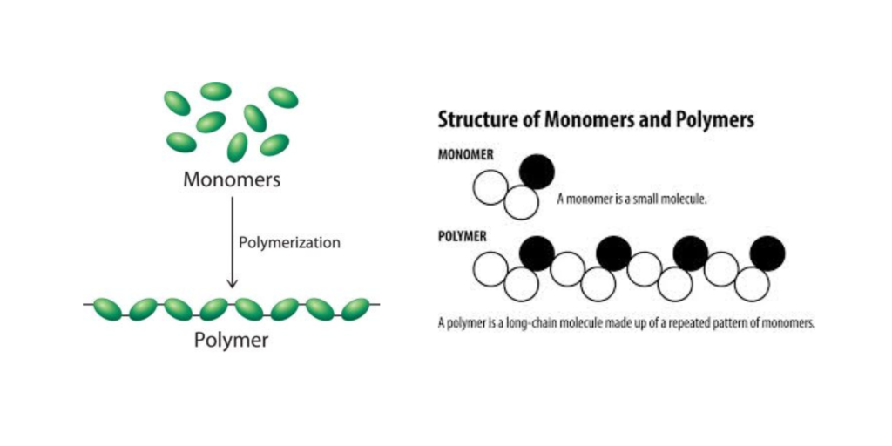
Figure 27.1a
Figure 27.1a. Polymer formation during a polymerization reaction, a large number of monomers become connected by covalent bonds to form a single long molecule, a polymer. (Credit left: General Chemistry, CC BY-NC-SA 3.0, right: Image by K.R Roshith, CC BY-SA 4.0)

Slide 3
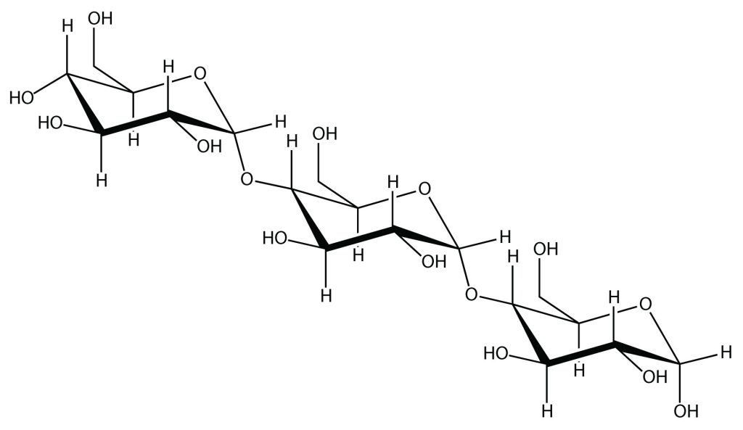
Figure 27.1b
Figure 27.1b. Polymer structure of starch with repeating glucose units. (Credit: Introductory Chemistry, CC BY-NC-SA 3.0)

Slide 4
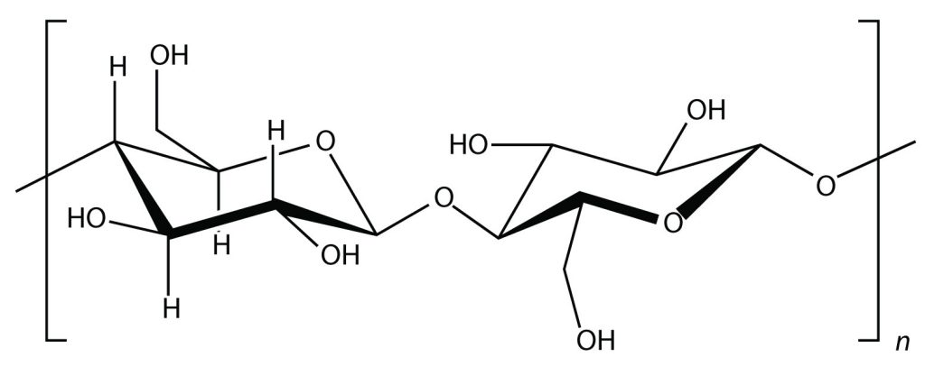
Figure 27.1c
Figure 27.1c. Polymer structure of cellulose with repeating glucose units. (Credit: Introductory Chemistry, CC BY-NC-SA 3.0)

Slide 5
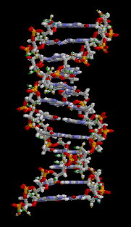
Figure 27.1d
Figure 27.1d. Nucleotides in DNA double helix (credit: animation by brian0918, PDM).

Slide 6
Figure 27.1e
Figure 27.1e. Billard balls representing the Bicentennial. (Credit right: work by MaChe, PDM; left: modification of work courtesy of the Gerald R. Ford Presidential Museum, PDM)

Slide 7
Figure 27.1f
Figure 27.1f. Examples of products made from Bakelite (credit a: "Set of Phenol formaldehyde resin buttons" by Gregory Tobias, CC BY-SA 3.0; b: work by William Warby, CC BY 2.0; c: work by Tangerineduel, CC BY-SA 4.0).

Slide 8
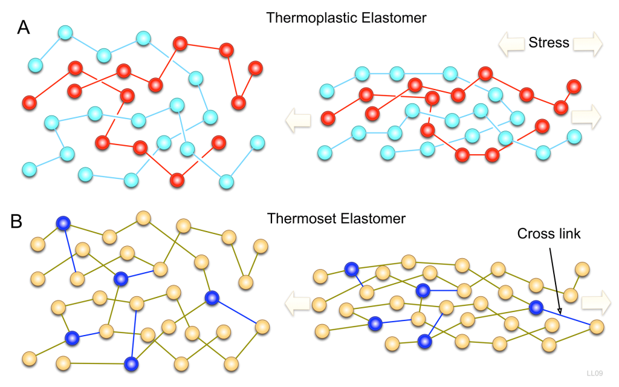
Figure 27.2a
Figure 27.2a. Arrangement of polymer chains in a thermoplastic and thermosetting polymer. (Credit: Photo by LaurensvanLieshout, CC BY-SA 3.0)

Slide 9
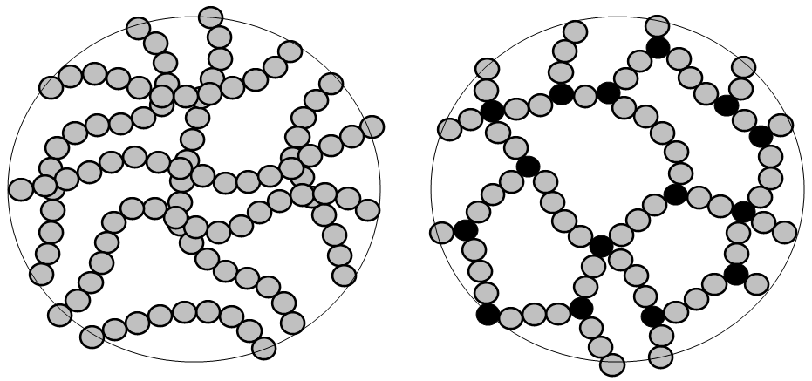
Figure 27.2b
Figure 27.2b. Schematic views: left, linear chains of macromolecules (case of a thermoplastic polymer); right, a three-dimensional macromolecule (case of a thermosetting polymer). The tri- and tetravalent cross-linking nodes are represented in black. Such a network is insoluble and does not melt. Dimension of a circle (monomer unit): approximately one ångström (Å). (Credit: Photo by Cjp24, CC BY-SA 3.0)

Slide 10
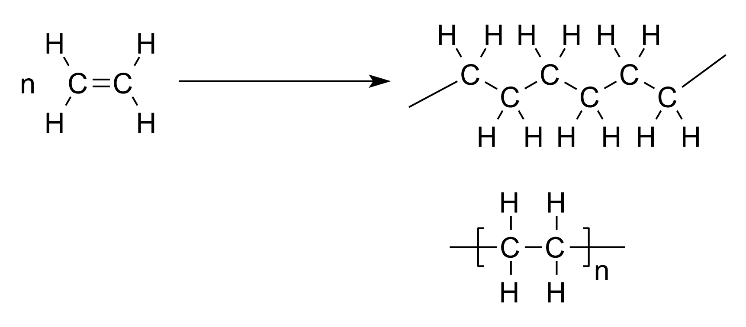
Figure 27.2c
Figure 27.2c. Addition polymerization of ethene (ethylene) to form polyethene (polyethylene). (Credit: Photo by V8rik, CC BY-SA 3.0).

Slide 11
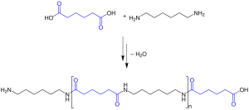
Figure 27.2d
Figure 27.2d. Structure of the Condensation Polymerization of Adipic acid and Hexamethylendiamine to Nylon 6,6. (Credit: Photo by MaChe, PDM)

Slide 12
Figure 27.3a
Figure 27.3a. Structure and formation of polyethylene. (Credit: Chemistry for Changing Times (Hill and McCreary), CC BY-SA )

Slide 13
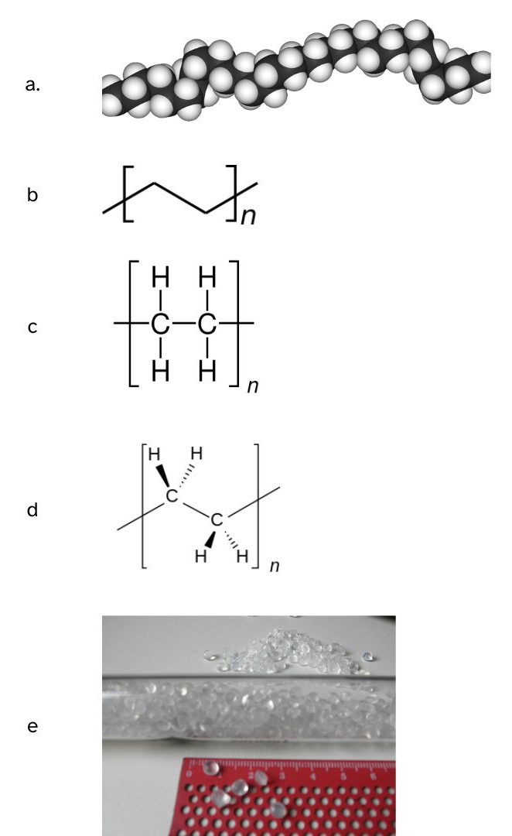
Figure 27.3b
Figure 27.3b. a) 3D representation of polyethylene, b) line structure representation of polyethylene, c) structural formula representation of polyethylene, d) 2D representation of polyethylene, e) photo of polyethylene beads. (credit a: "Polyethylene-3D" by Benjah-bmm27, PDM; b. "Polyethylene repeat unit" by Av wiki, PDM; c. "Chemical structural formula (repeat unit) of polyethylene" by Chem Sim 2001, PDM; d: "Polyethylene-repeat-2D" by Benjah-bmm27, PDM; e: "Polyethylene balls10" by Lluis tgn, CC BY-SA 3.0)

Slide 14
Figure 27.4a
Figure 27.4a. Two monomers are covalently bonded together to form a dimer. (Credit: Map: Chemistry for Changing Times (Hill and McCreary) , CC BY-NC-SA 4.0)

Slide 15
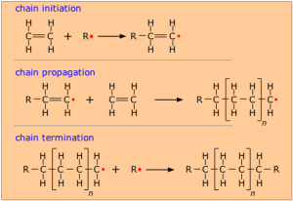
Figure 27.4b
Figure 27.4b. Free-radical mechanism for the formation of polyethylene. (Credit: Map: Chemistry for Changing Times (Hill and McCreary) , CC BY-NC-SA 4.0)

Slide 16
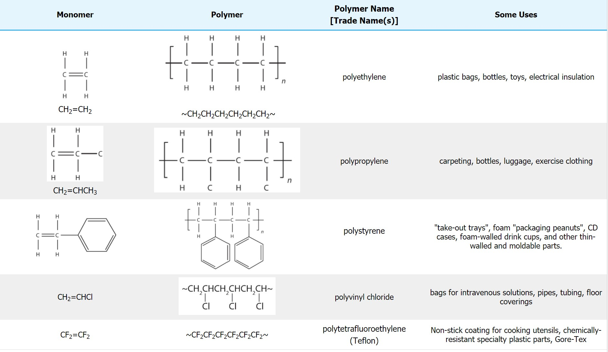
Figure 27.4c
Figure 27.4c. Some common addition polymers made from ethylene monomer derivatives. (Credit: Map: Chemistry for Changing Times (Hill and McCreary) , CC BY-NC-SA 4.0)

Slide 17
Table 27.4a
Table 27.4a. More Common Addition Polymers Made from Ethylene Monomer Derivatives
Monomer | Polymer Name | Trade Name(s) | Uses
H₂C=CCl₂ | polyvinylidene dichloride | Saran | Clinging food wrap
H₂C=CH(CN) | polyacrylonitrile | Orlon, Acrilan, Creslan | Fibers for textiles, carpets, upholstery
H₂C=CH(OCOCH₃) | polyvinyl acetate |  | Elmer's glue - Silly Putty Demo
H₂C=CH(OH) | polyvinyl alcohol |  | Ghostbusters Demo
H₂C=C(CH₃)COOCH₃ | polymethyl methacrylate | Plexiglass, Lucite | Stiff, clear, plastic sheets, blocks, tubing, and other shapes
H₂C=CH-C(CH₃)=CH₂ | polyisoprene | natural or some synthetic rubber | applications similar to natural rubber
H₂C=CH-CH=CH₂ | polybutadiene | polybutadiene synthetic rubber | select synthetic rubber applications
H₂C=CH-CCl=CH₂ | polychloroprene | Neoprene | chemically-resistant rubber
Source: "10.3: Addition Polymerization - One + One + One + ... Gives One!" In Map: Chemistry for Changing Times (Hill and McCreary), CC BY-NC-SA 4.0

Slide 18
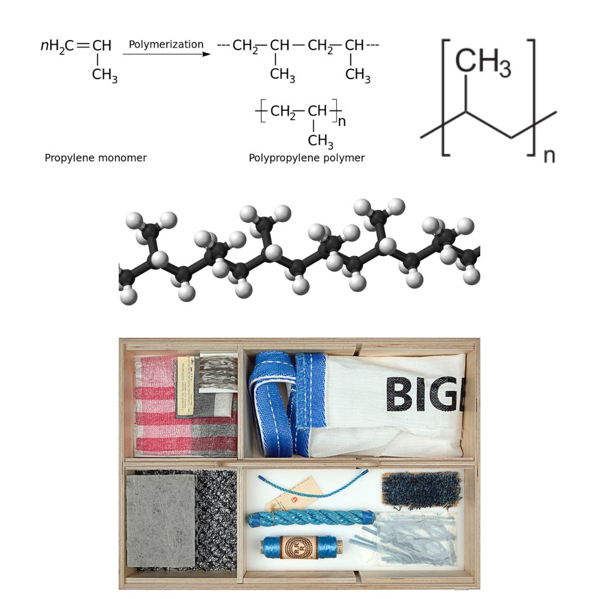
Figure 27.4d
Figure 27.4d. a) the polymerization of polypropylene, b) the line structure of polypropylene, c) a 3D rendering of polypropylene and d) examples of materials made from polypropylene. (credit a: Image by Cjp24 translated by Vis M, PDM; b: Image by NEUROtiker, PDM; c: Image by Benjah-bmm27, PDM; d: Image by Joep Vogels, Textielmuseum Tilburg, CC BY-SA 4.0).

Slide 19
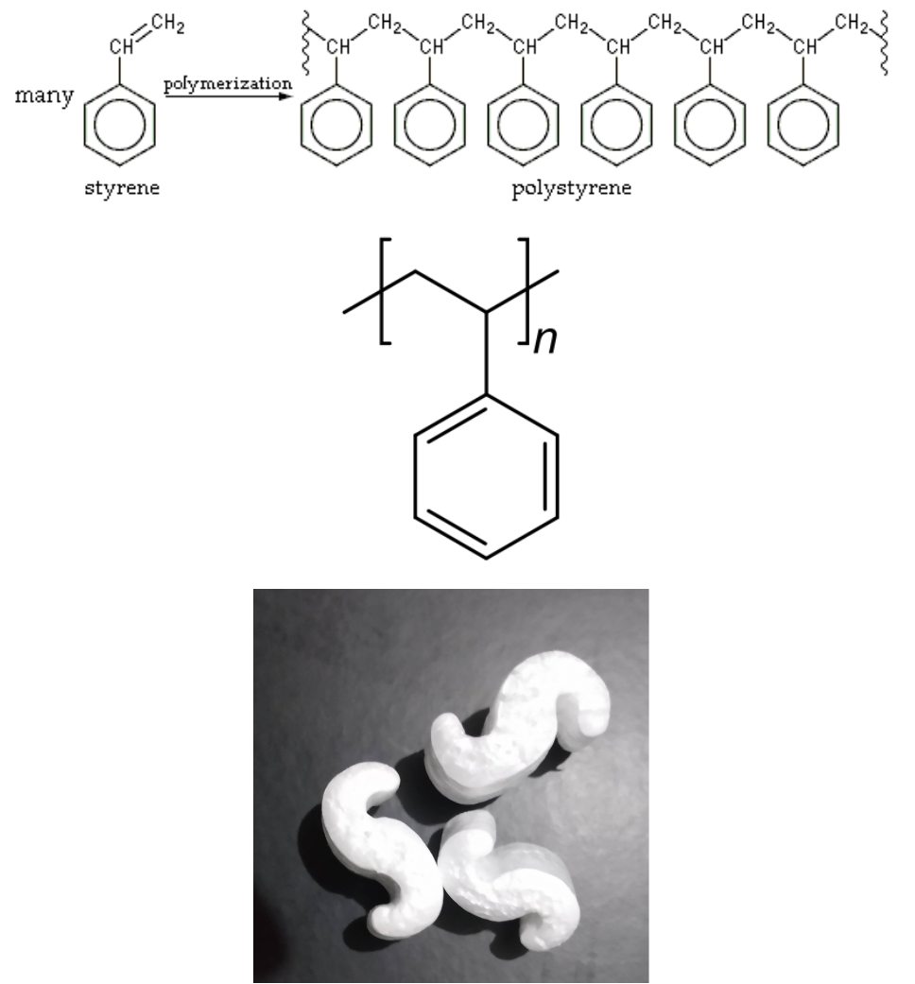
Figure 27.4e
Figure 27.4e. a) the polymerization of polystyrene b) the line structure of polystyrene and c) an example of materials made from polystyrene. (credit a: Image by H Padleckas, PDM; b: Image by LordOider, PDM; c: Image by John Cross, CC BY-SA 4.0)

Slide 20
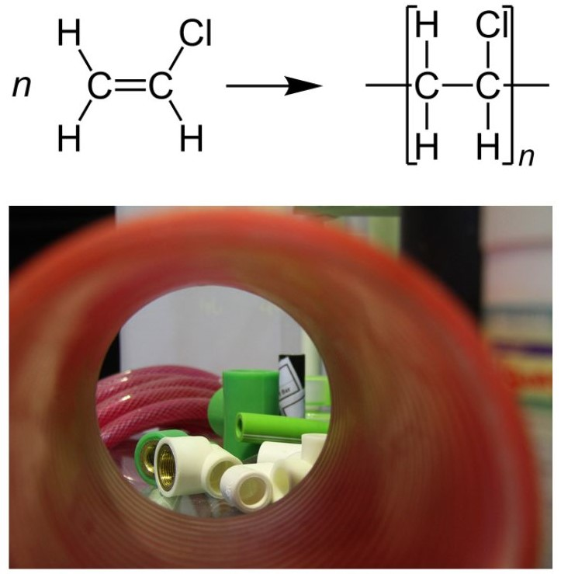
Figure 27.4f
Figure 27.4f. The polymerization of vinyl chloride to form PVC and examples of PVC piping. (credit a: Image by Jü, PDM; b: Image by Nikat, CC BY-SA 3.0)

Slide 21
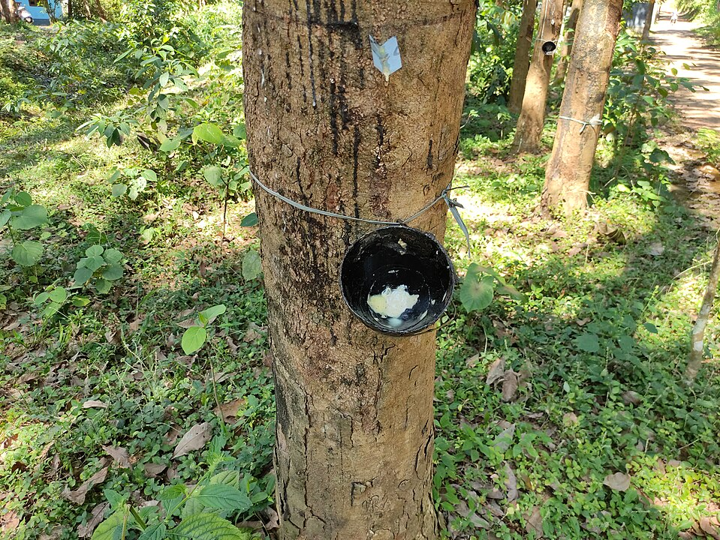
Figure 27.5a
Figure 27.5a. Rubber (latex) collection from a rubber tree. (Credit: Photo by Vis M, CC BY-SA 4.0)

Slide 22
Figure 27.5b
Figure 27.5b. Structure of isoprene (2-methyl-1,3-butadiene) and the formation of cis-polyisoprene (rubber) (credit left: Image by Alhadis, PDM; middle Image by Nevetsjc using Inkscape, PDM; right: Image by Alhadis, Public Domain)

Slide 23
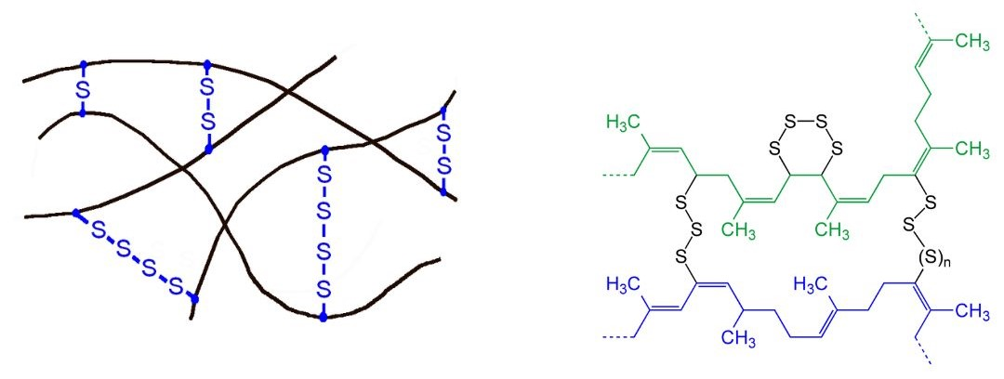
Figure 27.5c
Figure 27.5c. Sketch of the impact of sulfur cross-links in polymers and general representation of the chemical structure of vulcanized natural rubber showing the crosslinking of two polymer chains (blue and green) with sulfur (n = 0, 1, 2, 3 …). (credit left: Image by Cjp24, CC0; right: photo by Jü , CC0)

Slide 24
Figure 27.5d
Figure 27.5d. Trans (left) and cis (right) -1,4-polybutadiene (credit Images a & b by Jü; CC0)

Slide 25
Figure 27.5e
Figure 27.4e. Free radical synthesis of neoprene from 2-chloro-1,3-butadiene. (Credit: Photo by Rifleman 82, PDM)

Slide 26
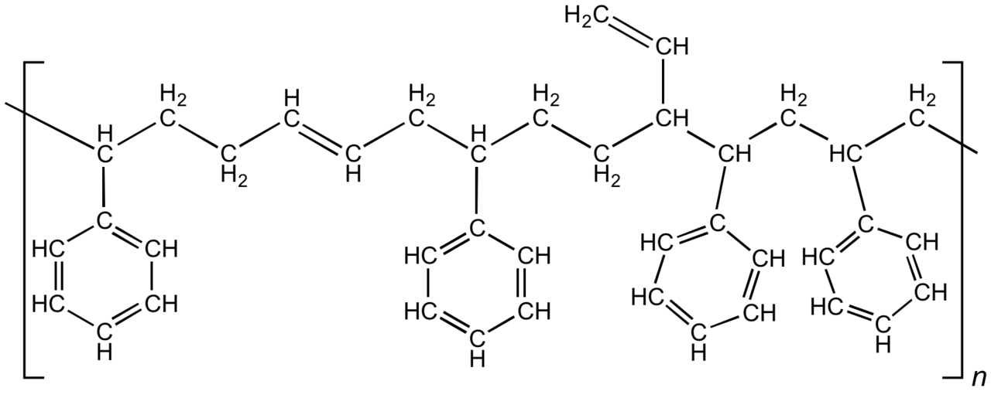
Figure 27.5f
Figure 27.4f. Structure of styrene-butadiene polymer showing repeating styrene (aromatic ring) and butadiene (carbon-carbon double bond) units. (Credit: Photo by Smokefoot, CC BY-SA 3.0).

Slide 27
Figure 27.6a
Figure 27.6a. Condensation polymerization reaction. (Credit: chem1, CC BY-SA 3.0).

Slide 28
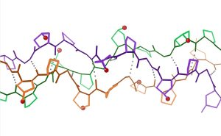
Figure 27.6b
Figure 27.6b. Detail of collagen Gly-Pro-hPro triple helix, with backbone hydrogen bonds (credit: Image by Dcrjsr, CC BY 3.0).

Slide 29
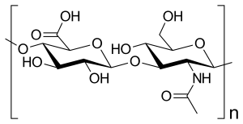
Figure 27.6c
Figure 27.6c. Skeletal formula of muco-polysaccharide chain (credit: Image by Vaccinationist, PDM).

Slide 30
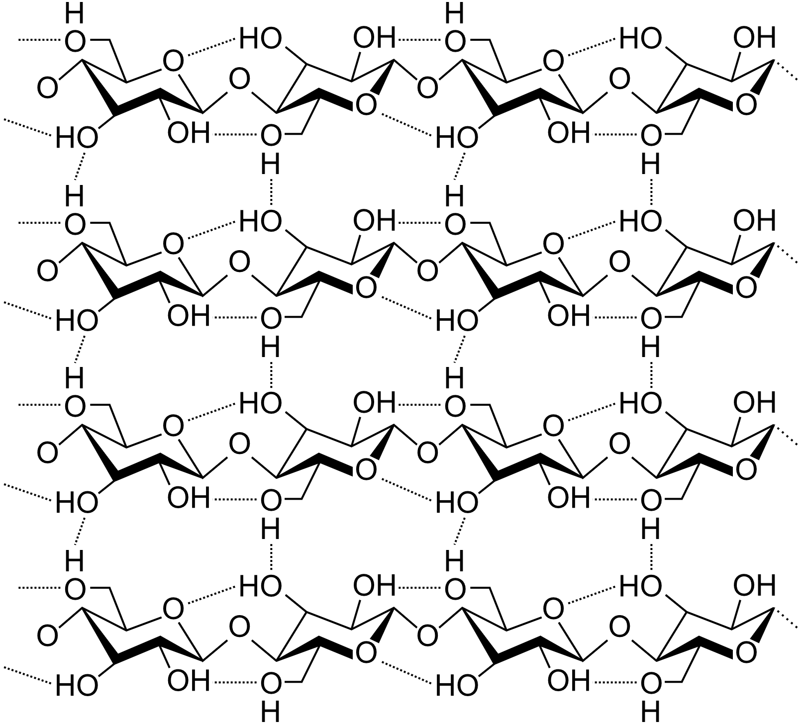
Figure 27.6d
Figure 27.6d. Interconnected structure of cellulose based on repeating sugar units. This is another condensation polymer (credit: Image by Laghi.l, CC BY-SA 3.0).

Slide 31
Figure 27.6e
Figure 27.6e. Synthesis of Nylon 66 from adipic acid and hexamethylene diamine. (Credit Virtual Textbook of Organic Chemistry, edited by Chemistry for Changing Times (Hill and McCreary) , CC BY-NC-SA 4.0)

Slide 32
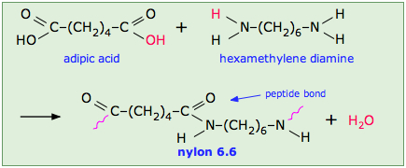
Figure 27.6f
Figure 27.6f. Synthesis of nylon highlighting the peptide bond (amide link) (credit Chemistry for Changing Times (Hill and McCreary), CC BY-NC-SA 4.0).

Slide 33
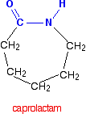
Figure 27.6g
Figure 27.6g. Structure of caprolactam. (Credit: Supplemental Modules (Organic Chemistry), CC BY-NC 4.0)

Slide 34
Figure 27.6h
Figure 27.6h. Monomers of Kevlar (Credit: Supplemental Modules (Organic Chemistry), CC BY-NC 4.0)

Slide 35
Figure 27.6i
Figure 27.6i. Structure of Kevlar (Credit: Supplemental Modules (Organic Chemistry), CC BY-NC 4.0)

Slide 36
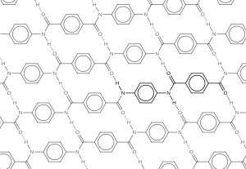
Figure 27.6j
Figure 27.6j. The diagram shows the polymer structure of Kevlar, with hydrogen bonds between polymer chains represented by dotted lines (Credit: Chemistry (OpenStax), CC BY 4.0).

Slide 37
Figure 27.6k
Figure 27.6k. (a) These soldiers are sorting through pieces of a Kevlar helmet that helped absorb a grenade blast. Kevlar is also used to make (b) canoes and (c) marine mooring lines. (credit a: modification of work by Michael T. Gams, USMC, PDM; credit b: Photo by OakleyOriginals, CC BY 2.0; credit c: modification of work by Casey H. Kyhl, PDM)

Slide 38
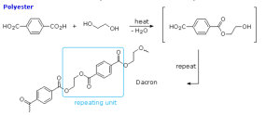
Figure 27.6l
Figure 27.6l. The synthesis of Dacron/PETE (a polyester). (Credit: Virtual Textbook of Organic Chemistry, edited by Chemistry for Changing Times (Hill and McCreary) , CC BY-NC-SA 4.0)

Slide 39
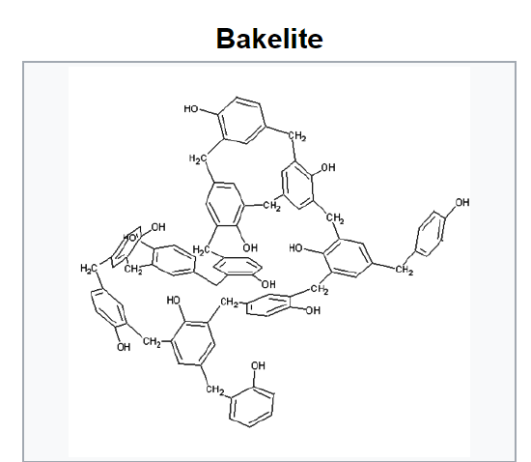
Figure 27.6m
Figure 27.6m. 3D structure of Bakelite (phenol-formaldehyde polymer). (Credit: Photo by JohnSRoberts99, GNU License, edited by Chemistry for Changing Times (Hill and McCreary) , CC BY-NC-SA 4.0).

Slide 40
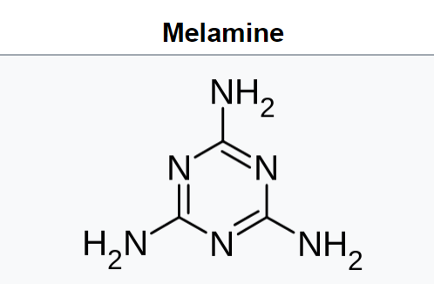
Figure 27.6n
Figure 27.6n. Structure of Melamine.(Credit: Photo by User:Edgar181, PDM, edited by Chemistry for Changing Times (Hill and McCreary) , CC BY-NC-SA 4.0).

Slide 41
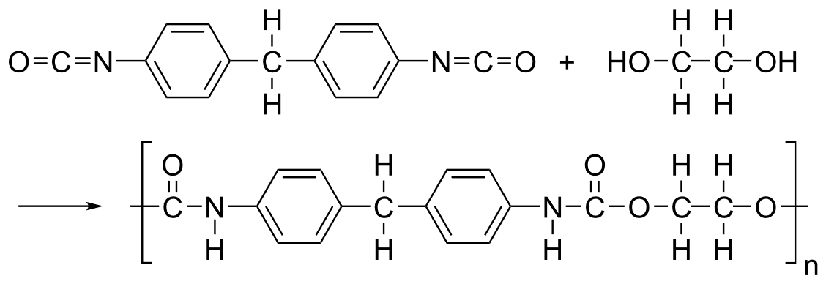
Figure 27.6o
Figure 27.6o. Synthesis of polyurethane. (Credit: Photo by Hbf878. CC BY-SA 3.0)

Slide 42
Figure 27.6p
Figure 27.6p. Formation of polycarbonate from bisphenol A and phosgene. (Credit: Photo by Akane700, PDM)

Slide 43
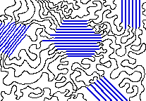
Figure 27.7a
Figure 27.7a. The crystalline parts of this polymer are shown in blue. (Credit: Virtual Textbook of Organic Chemistry, CC BY-NC-SA 4.0)

Slide 44
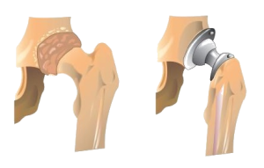
Figure 27.7b
Figure 27.7b. Hip Joint Replacement. Synthetic polymers are an important part of a hip joint replacement. The hip is much like a ball-and-socket joint, and total hip replacements mimic this with a metal ball that fits in a plastic cup. (Credits: Introduction to Chemistry: GOB (V. 1.0)., CC BY-NC-SA 3.0), edited by (Ball et al.)), CC BY-NC-SA 4.0.).

Slide 45
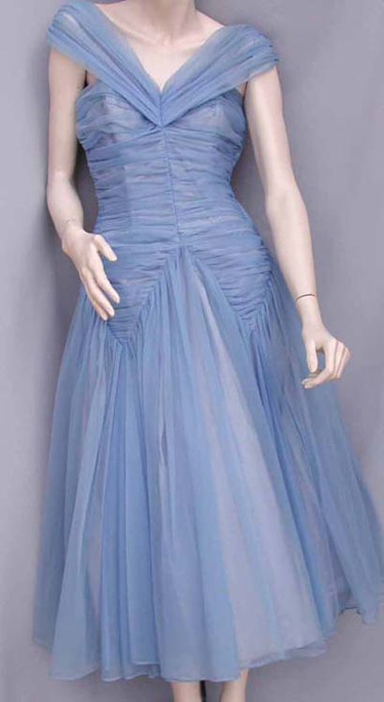
Figure 27.7c
Figure 27.7c. Blue nylon fabric ball gown. (Credit: Photo by Science History Institute, CC BY-SA 3.0)

Slide 46
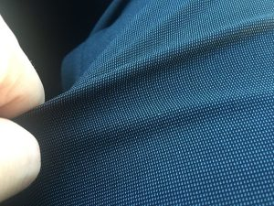
Figure 27.7d
Figure 27.7d. Stretching polyester fabric.. (Credit: Photo by Bearas, CC BY-SA 4.0)

Slide 47
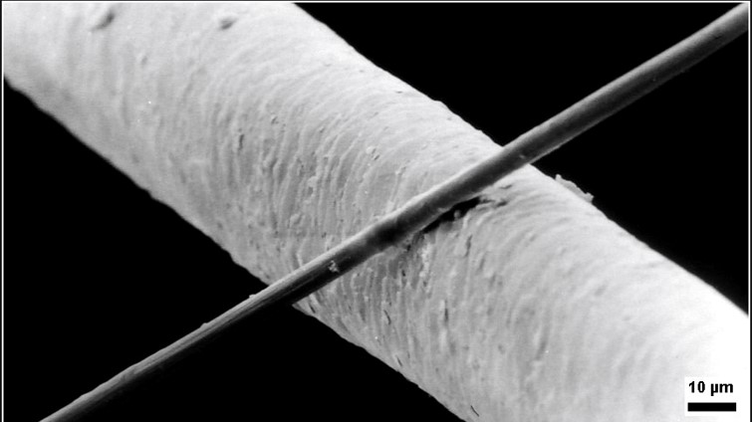
Figure 27.7e
Figure 27.7e. Close-up view of microfiber compared to a human hair. (Credit: Photo by EvSOP HGUM, CC BY-SA 4.0)

Slide 48
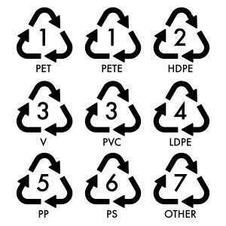
Figure 27.8a
Figure 27.8a. Plastic identification codes (PIC) and types of plastic (Credit: Image by juicy_fish on Freepik).

Slide 49
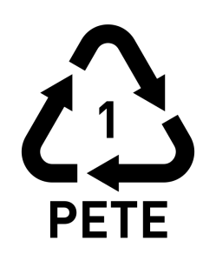
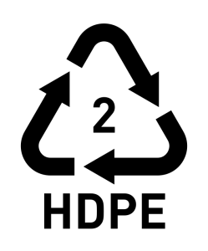
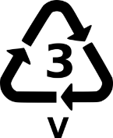
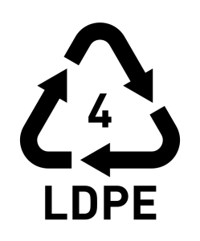
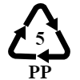
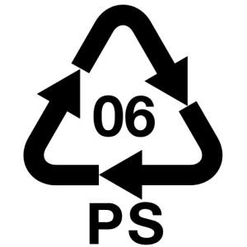
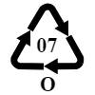
Table 27.8a
Table 27.8a. The Major Groups of Plastic Polymers
Plastic identification code | Type of plastic polymer | Monomer | Properties | Common packaging applications | Melting temperatures (°C)
 | Polyethylene terephthalate (PET, PETE) | terephthalic acid (Benzene-1,4-dicarboxylic acid) and ethylene glycol (etheane-1,2-diol) | Clarity, strength, toughness, barrier to gas and moisture. | Soft drink, water and salad dressing bottles; peanut butter and jam jars; ice cream cone lids; small consumer electronics | 250
 | High-density polyethylene (HDPE) | ethylene (ethene). | Stiffness, strength, toughness, resistance to moisture, permeability to gas | Water pipes, Gas & Fire Pipelines, Electrical & Communications conduit, hula hoop rings, five-gallon buckets, milk, juice and water bottles; grocery bags, some shampoo/toiletry bottles | 130
 | Polyvinyl chloride (PVC) | vinyl chloride (chloroethene) | Versatility, ease of blending, strength, toughness. | Blister packaging for non-food items; cling films for non-food use. May be used for food packaging with the addition of the plasticizers needed to make natively rigid PVC flexible. Non-packaging uses are electrical cable insulation; rigid piping; vinyl records. | 240
 | Low-density polyethylene (LDPE) | ethylene (ethene). | Ease of processing, strength, toughness, flexibility, ease of sealing, barrier to moisture | Frozen food bags; squeezable bottles, e.g., honey, mustard; cling films; flexible container lids | 120
 | Polypropylene (PP) | propylene (propene) | Strength, toughness, resistance to heat, chemicals, grease and oil, versatile, barrier to moisture. | Reusable microwaveable ware; kitchenware; yogurt containers; margarine tubs; microwaveable disposable take-away containers; disposable cups; soft drink bottle caps; plates. | 173
 | Polystyrene (PS) | styrene (Ethenylbenzene) styrene (Ethenylbenzene) | Versatility, clarity, easily formed | Egg cartons; packing peanuts; disposable cups, plates, trays and cutlery; disposable take-away containers | 240
 | Other (often polycarbonate or ABS) | various | Dependent on polymers or combination of polymers | Beverage bottles, baby milk bottles. Non-packaging uses for polycarbonate, compact discs, "unbreakable" glazing, electronic apparatus housing, lenses (including sunglasses), prescription glasses, automotive headlamps, riot shields, instrument panels. | n/a
Source: Except where otherwise noted, this table is adapted from "Plastic recycling" and "Resin identification code" on Wikipedia, licensed under CC BY-SA 4.0; edited by Samantha Sullivan Sauer with reference to Hein et al (2014). Except where otherwise noted, all images are in the Public Domain. Image credits for plastic identification code in column 1: 06-PS Image by Anton Poliakov, CC BY-SA 4.0; 07-O Image by Tomia, CC BY 2.5.

Slide 50
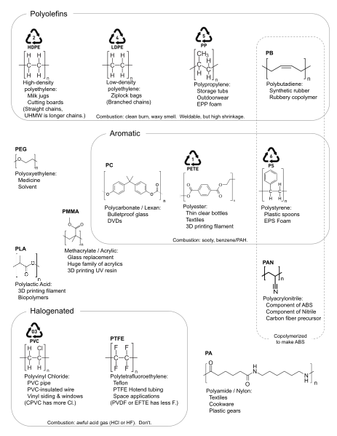
Figure 27.8b
Figure 27.8b. Summary of plastics and those that are recyclable. (Credit: Image by Orion Lawlor, CC0)

Slide 51
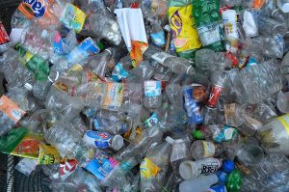
Figure 27.8c
Figure 27.8c. Plastic water bottles present a special recycling problem because of their widespread use in away-from-home locations. (Credit: Image by Celinebj, CC BY-SA 4.0)

Slide 52
Figure 27.9a
Figure 27.9a. A plastic bag (probably mistaken for a jellyfish, the sea turtle's only food) cannot be regurgitated and leads to intestinal blockage and slow death (left) remains of an albatross that mistook bits of plastic junk for food (right) (credit modifications of left: work by Coordinador copy, CC BY-SA 4.0; work by USFWS - Pacific Region, CC BY-NC 2.0)

Slide 53
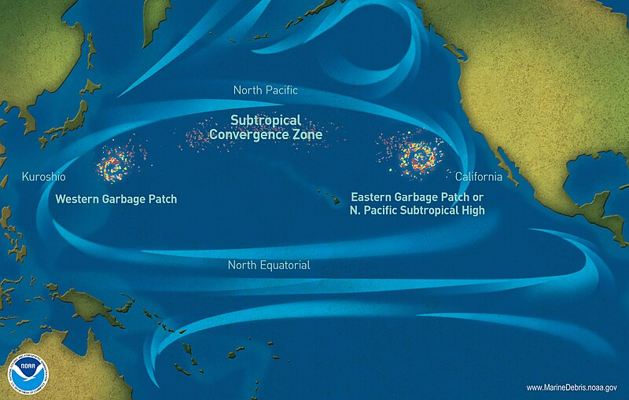
Figure 27.9b
Figure 27.9b. Marine debris accumulation locations in the North Pacific Ocean (Credit: work by NOAA, PD)

Slide 54
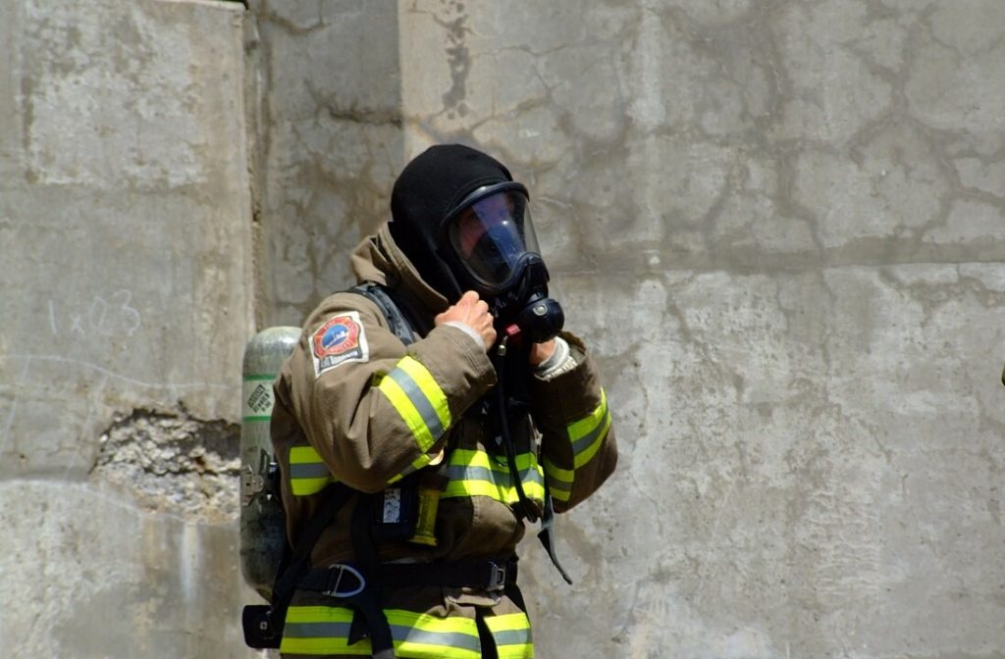
Figure 27.9d
Figure 27.9d. A firefighter in Toronto, Canada wears a Nomex hood in 2007. (Credit: Image by Sherurcij, ©)

Slide 55
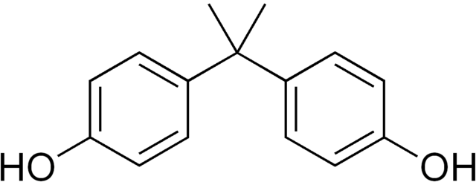
Figure 27.9e
Figure 27.9e. Structure of bisphenol-A (BPA). (Credit: Image by Edgar181, PDM)

