Slide 1
Chapter 26
Amides and Amines
Slides to accompany Organic and Biochemistry Supplement to Enhanced Introductory College Chemistry by Gregory Anderson, Jen Booth, Caryn Fahey, Adrienne Richards, Samantha Sullivan Sauer, and David Wegman
Slide design and template by Revathi Mahadevan
Except where otherwise noted, images, tables & diagrams are reused from Organic and Biochemistry Supplement to Enhanced Introductory College Chemistry
Slides are licensed under CC-BY 4.0, Except while otherwise noted

Slide 2
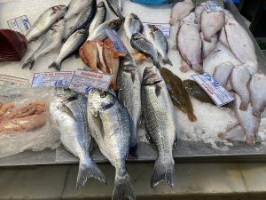
Figure 26.0a
Figure 26.0a. The characteristic and unmistakable odour of fish is due to a mixture of simple alkylamines. (credit: Photo by Dudva, CC BY-SA 4.0)

Slide 3
Figure 26.0b
Figure 26.0b. A nucleophilic acyl substitution reaction of carboxylic acid derivative. (credit: Organic Chemistry (OpenStax), CC BY-NC-SA 4.0)

Slide 4
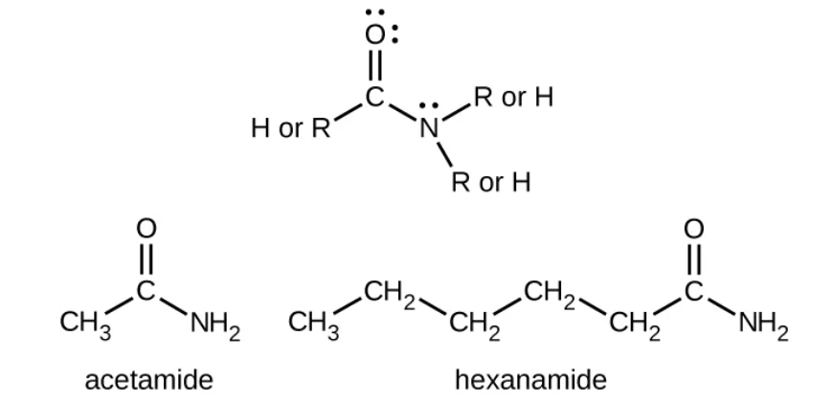
Figure 26.0c
Figure 26.0c. The image represents the functional groups for amides. It also shows two specific examples of amides. (credit: Chemistry 2e (OpenStax), CC BY 4.0)

Slide 5
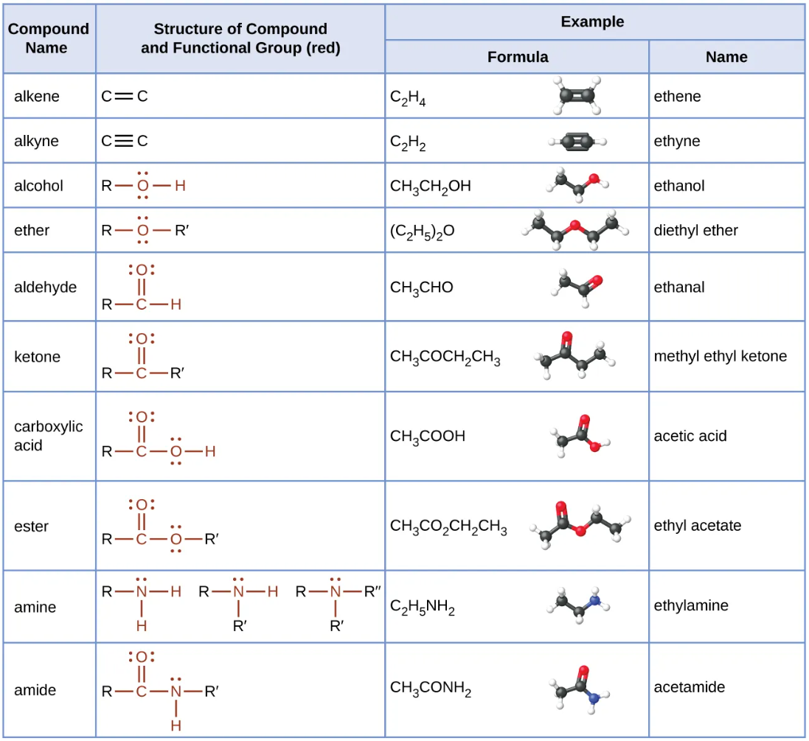
Figure 26.0d
Figure 26.0d. Summary of Organic Compounds (credit: Chemistry 2e (OpenStax), CC BY 4.0)

Slide 6
Figure 26.1a
Figure 26.1a. Examples of amines. (Credit: Chemistry 2e, OpenStax, CC BY 4.0)

Slide 7
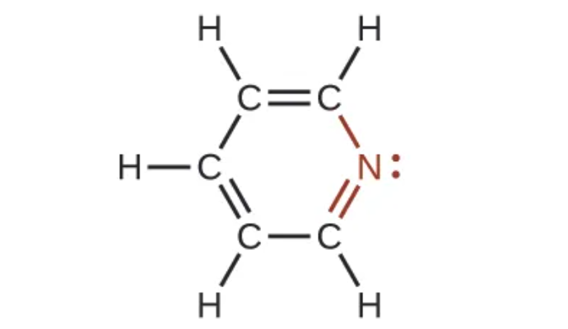
Figure 26.1b
Figure 26.1b. The illustration shows one of the resonance structures of pyridine. (Credit: Chemistry 2e, OpenStax, CC BY 4.0)

Slide 8
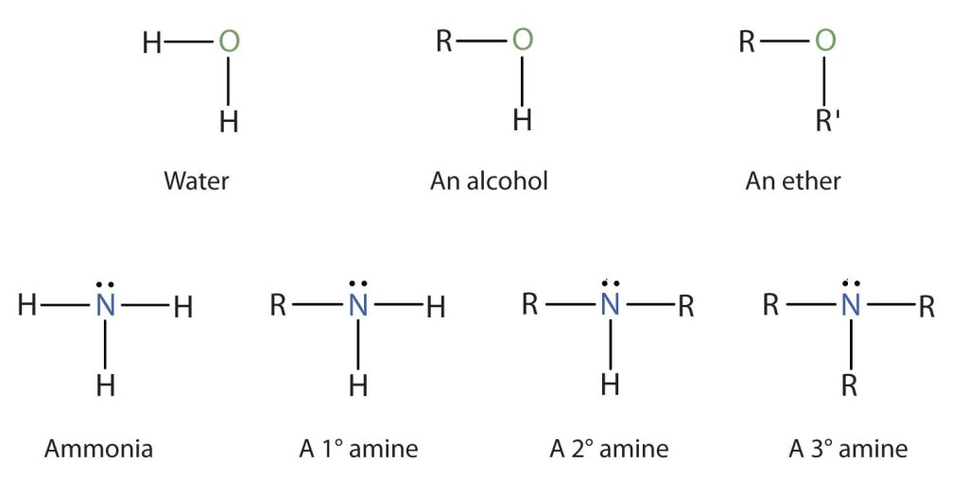
Figure 26.1c
Figure 26.1c. The Structure of Amines Compared to Water, an Alcohol, and an Ether. (Credit: Intro Chem: GOB (V. 1.0)., CC BY-NC-SA 3.0.)

Slide 9
Figure 26.1d
Figure 26.1d. Comparison of tertiary alcohol and tertiary amine. (Credit: Organic Chemistry, OpenStax, CC BY-NC-SA 4.0)

Slide 10
Figure 26.1e
Figure 26.1e. Comparison of an amine and an alcohol. (Credit: Intro Chem: GOB (V. 1.0)., CC BY-NC-SA 3.0.)

Slide 11
Figure 26.1f
Figure 26.1f. Example of a quaternary salt. (Credit: Organic Chemistry, OpenStax, CC BY-NC-SA 4.0)

Slide 12
Figure 26.1g
Figure 26.1g. Linear and ring structure examples of amines. (Credit: Organic Chemistry, OpenStax, CC BY-NC-SA 4.0)

Slide 13
Figure 26.1h
Figure 26.1h. Examples of naming amines. (Credit: Organic Chemistry, OpenStax, CC BY-NC-SA 4.0)

Slide 14
Figure 26.1i
Figure 26.1i. Examples of naming amines with more than one functional group. (Credit: Organic Chemistry, OpenStax, CC BY-NC-SA 4.0)

Slide 15
Figure 26.1j
Figure 26.1j. Examples of symmetrical secondary and tertiary amines. (Credit: Organic Chemistry, OpenStax, CC BY-NC-SA 4.0)

Slide 16
Figure 26.1k
Figure 26.1k. Examples of unsymmetrical secondary and tertiary amines. (Credit: Organic Chemistry, OpenStax, CC BY-NC-SA 4.0)

Slide 17
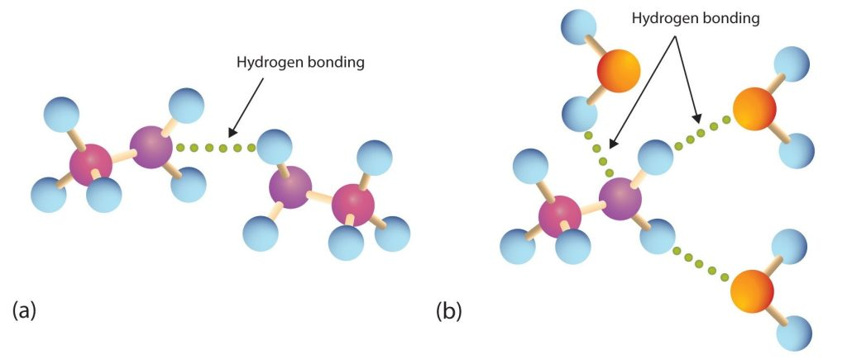
Figure 26.2a
Figure 26.2a. Hydrogen Bonding. (a) Amine molecules are associated through hydrogen bonding. (b) An amine molecule can form a hydrogen bond with water molecules (credit: Intro Chem: GOB (V. 1.0)., CC BY-NC-SA 3.0).

Slide 18
Table 26.2a.
Table 26.2a. Physical Properties of Some Amines and Comparable Oxygen-Containing Compounds
Name | Condensed Structural Formula | Class | Molar Mass | Boiling Point (°C) | Solubility at 25°C (g/100 g Water)
butylamine | CH₃CH₂CH₂CH₂NH₂ | 1° | 73 | 78 | miscible
diethylamine | (CH₃CH₂)₂NH | 2° | 73 | 55 | miscible
butyl alcohol | CH₃CH₂CH₂CH₂OH | — | 74 | 118 | 8
dipropylamine | (CH₃CH₂CH₂)₂NH | 2° | 101 | 111 | 4
triethylamine | (CH₃CH₂)₃N | 3° | 101 | 90 | 14
dipropyl ether | (CH₃CH₂CH₂)₂O | — | 102 | 91 | 0.25
Source: "15.11: Physical Properties of Amines" In Basics of GOB Chemistry (Ball et al.), CC BY-NC-SA 4.0.

Slide 19
Figure 26.2b
Figure 26.2b. Structure of beta-naphthylamine. (Credit: Intro Chem: GOB (V. 1.0)., CC BY-NC-SA 3.0)

Slide 20
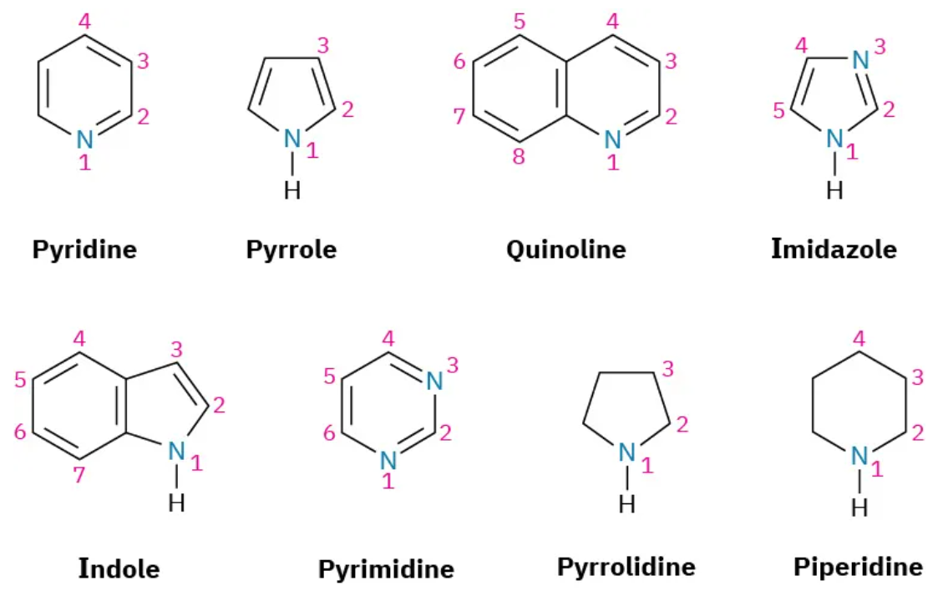
Figure 26.3a
Figure 26.3a. Examples of heterocyclic amines. (Credit: Organic Chemistry, OpenStax, CC BY-NC-SA 4.0)

Slide 21
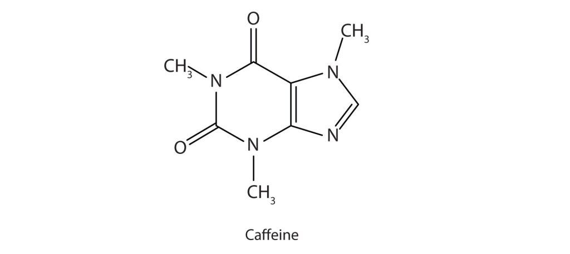
Figure 26.3b
Figure 26.3b. Structural diagram for Caffeine (credit: Intro Chem: GOB (V. 1.0)., CC BY-NC-SA 3.0).

Slide 22
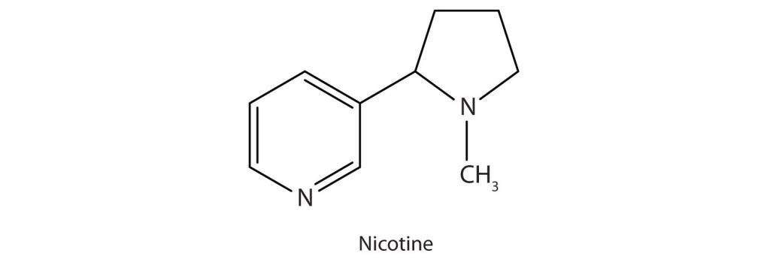
Figure 26.3c
Figure 26.3c. Structural diagram for Nicotine (credit: Intro Chem: GOB (V. 1.0)., CC BY-NC-SA 3.0).

Slide 23
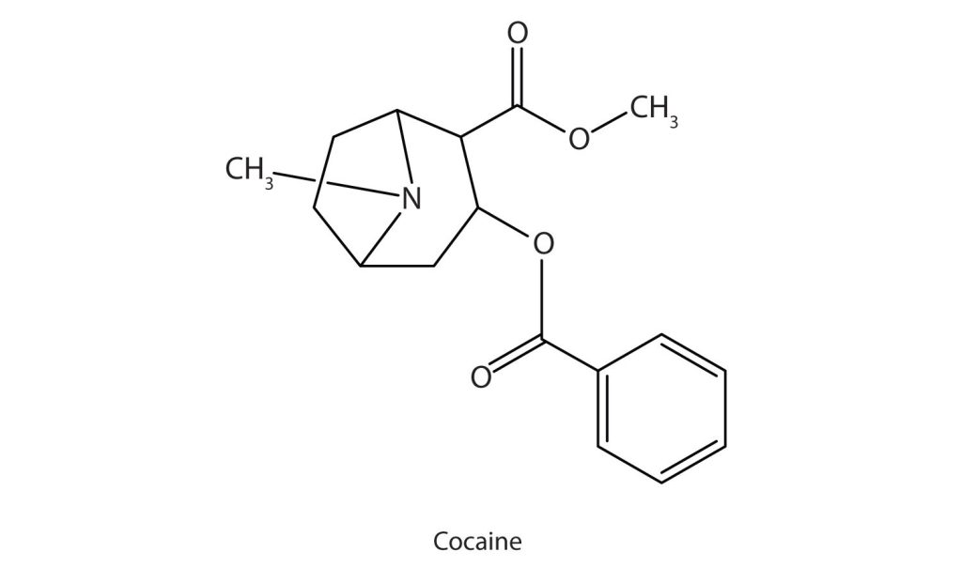
Figure 26.3d
Figure 26.3d. Structural diagram for Cocaine (credit: Intro Chem: GOB (V. 1.0)., CC BY-NC-SA 3.0).

Slide 24
Figure 26.3e
Figure 26.3e. Chemical reaction of Cocaine with Hydrochloric acid. (credit: Intro Chem: GOB (V. 1.0)., CC BY-NC-SA 3.0).

Slide 25
Figure 26.4a
Figure 26.4a. Amines accepting protons from water to form ions (credit: Intro Chem: GOB (V. 1.0)., CC BY-NC-SA 3.0).

Slide 26
Figure 26.4b
Figure 26.4b. Specific reaction of methylamine with water (credit: Intro Chem: GOB (V. 1.0)., CC BY-NC-SA 3.0).

Slide 27
Figure 26.4c
Figure 26.4c. An insoluble amine reacting with an acid to form a soluble salt (credit: Intro Chem: GOB (V. 1.0)., CC BY-NC-SA 3.0).

Slide 28
Figure 26.5a
Figure 26.5a. Amide groups (Credit: Introduction to Chemistry: GOB (V. 1.0)., CC BY-NC-SA 3.0).

Slide 29
Figure 26.5b
Figure 26.5b. Comparison of Formic acid and Formamide (Credit: Introduction to Chemistry: GOB (V. 1.0)., CC BY-NC-SA 3.0).

Slide 30
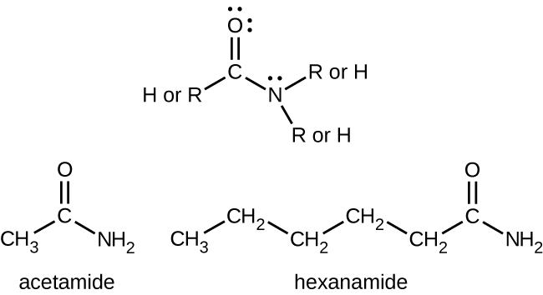
Figure 26.5c
Figure 26.5c. Basic structure of an amide showcasing functional groups (credit: General Chemistry 1 & 2 , CC BY 4.0).

Slide 31
Figure 26.5d
Figure 26.5d. Chemical reaction for formation of an amide (credit: General Chemistry 1 & 2 , CC BY 4.0).

Slide 32
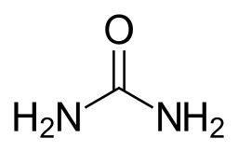
Figure 26.5e
Figure 26.5e. The molecular structure of urea (credit: Image by NEUROtiker, PDM).

Slide 33
Table 26.5a.
Table 26.5a. Physical Constants of Some Unsubstituted Amides
Condensed Structural Formula | Name | Melting Point (°C) | Boiling Point (°C) | Solubility in Water
HCONH₂ | formamide | 2 | 193 | soluble
CH₃CONH₂ | acetamide | 82 | 222 | soluble
CH₃CH₂CONH₂ | propionamide | 81 | 213 | soluble
CH₃CH₂CH₂CONH₂ | butyramide | 115 | 216 | soluble
C₆H₅CONH₂ | benzamide | 132 | 290 | Slightly soluble
Source: "15.14: Physical Properties of Amides" In Basics of GOB Chemistry (Ball et al.), CC BY-NC-SA 4.0.

Slide 34
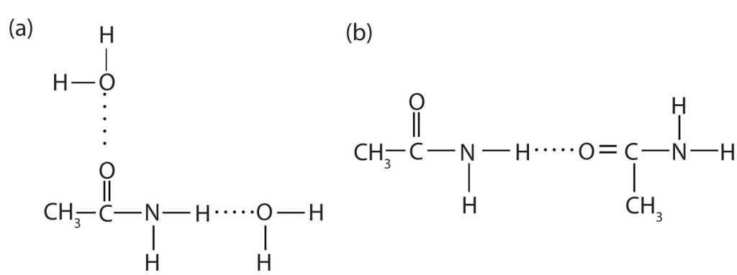
Figure 26.5f
Figure 26.5f. Hydrogen Bonding in Amides. Amide molecules can engage in hydrogen bonding with water molecules (a). Those amides with a hydrogen atom on the nitrogen atom can also engage in hydrogen bonding (b). Both hydrogen bonding networks extend in all directions. (Credit: Intro Chem: GOB (V. 1.0)., CC BY-NC-SA 3.0, edited by (Ball et al.), CC BY-NC-SA 4.0)

Slide 35
Figure 26.5g
Figure 26.5g. The molecular structure of urea. (credit: Image by NEUROtiker, PDM).

Slide 36
Figure 26.6a
Figure 26.6a. Hydrolysis of an amide in acid solution actually gives a carboxylic acid and the salt of ammonia or an amine (the ammonia or amine initially formed is neutralized by the acid). Basic hydrolysis gives a salt of the carboxylic acid and ammonia or an amine. (Credit: Intro Chem: GOB (V. 1.0)., CC BY-NC-SA 3.0)

Slide 37
Figure 26.6b
Figure 26.6b. Solution for reaction of butyramide and water. (credit: Intro Chem: GOB (V. 1.0)., CC BY-NC-SA 3.0)

Slide 38
Figure 26.6c
Figure 26.6c. Reaction of benzamide and water. (credit: Intro Chem: GOB (V. 1.0)., CC BY-NC-SA 3.0)

Slide 39
Figure 26.6d
Figure 26.6d. Reaction of acetic acid with ammonia. (Credit: Intro Chem: GOB (V. 1.0)., CC BY-NC-SA 3.0)

Slide 40
Figure 26.6e
Figure 26.6e. Reaction of a carboxylic aid and amine produce an amide and water. (Credit: Chemistry (OpenStax), CC BY 4.0)

Slide 41
Figure 26.6f
Figure 26.6f. Formation of an ester. (Credit: Intro Chem: GOB (V. 1.0)., CC BY-NC-SA 3.0)

Slide 42
Figure 26.6g
Figure 26.6g. Formation of an amide. (Credit: Intro Chem: GOB (V. 1.0)., CC BY-NC-SA 3.0)

Slide 43
Figure 26.6h
Figure 26.6h. Reaction of an amide with lithium aluminum hydride and hydrolysis to form an amine (Credit: Organic Chemistry (OpenStax), CC BY-NC-SA 4.0).

Slide 44
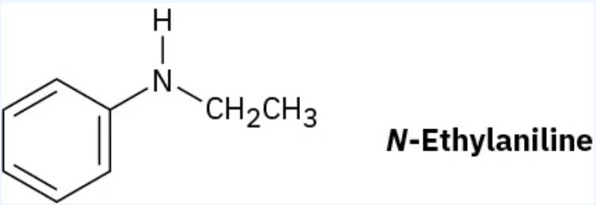
Figure 26.6i
Figure 26.6i. Reduction of an amide with lithium aluminum hydride to produce N-ethylaniline (Credit: Organic Chemistry (OpenStax), CC BY-NC-SA 4.0).

Slide 45
Figure 26.6j
Figure 26.6j. Reduction of an amide with lithium aluminum hydride and hydrolysis to form an N-Ethylaniline. (Credit: Organic Chemistry (OpenStax), CC BY-NC-SA 4.0).

Slide 46
Figure 26.6k
Figure 26.6k. Reduction of a nitrile to form a primary amine. (credit: Organic Chemistry (Morsch et al.), CC BY-SA 4.0. )

Slide 47
Figure 26.6l
Figure 26.6l. Prediction of product of nitrile reduction (credit: Organic Chemistry (Morsch et al.), CC BY-SA 4.0).

Slide 48
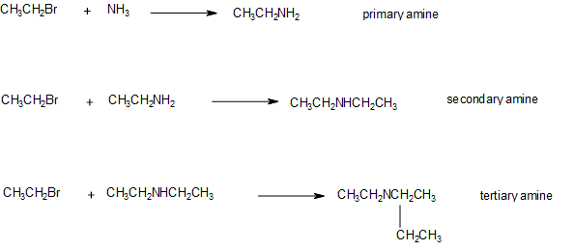
Figure 26.6m
Figure 26.6m. Formation of primary amine from ammonia, secondary amine from primary amine, and tertiary amine from secondary amine through alkylation (credit: Supplemental Modules, CC BY-NC 4.0 / Adapted by Samantha Sullivan Sauer / Biovia Draw)

