Slide 1
Chapter 25
Carboxylic Acids and Esters
Slides to accompany Organic and Biochemistry Supplement to Enhanced Introductory College Chemistry by Gregory Anderson, Jen Booth, Caryn Fahey, Adrienne Richards, Samantha Sullivan Sauer, and David Wegman
Slide design and template by Revathi Mahadevan
Except where otherwise noted, images, tables & diagrams are reused from Organic and Biochemistry Supplement to Enhanced Introductory College Chemistry
Slides are licensed under CC-BY 4.0, Except while otherwise noted

Slide 2
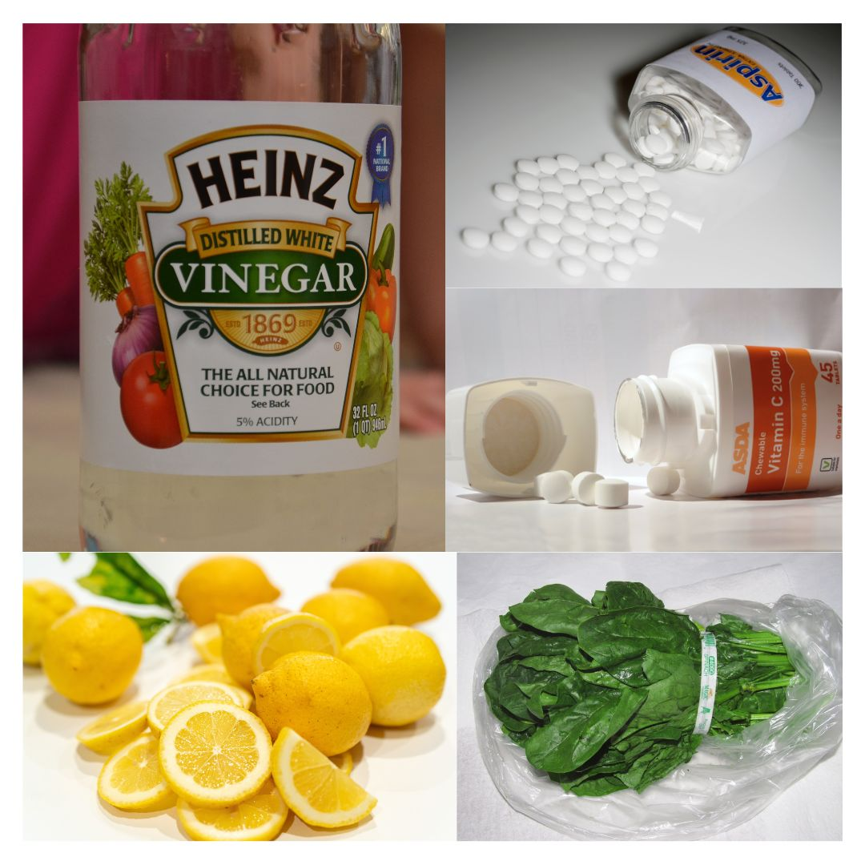
Figure 25.1a
Figure 25.1a. Carboxylic Acids in the Home. Carboxylic acids occur in many common household items. (a) Vinegar contains acetic acid, (b) aspirin is acetylsalicylic acid, (c) vitamin C is ascorbic acid, (d) lemons contain citric acid, and (e) spinach contains oxalic acid. (credit a: Photo by Joe Shlabotnik, CC BY-NC-SA 2.0; b: Photo by U.S. Food and Drug Administration, CC BY-SA 2.0; c: Photo by Pete, PD; d: Photo by eggbank, Unsplash; e: Photo by Willis Lam, CC BY-SA 2.0)

Slide 3
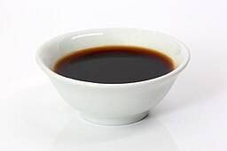
Figure 25.1b
Figure 25.1b. Cup of soy sauce (credit: Image by Tim Reckmann, CC BY 2.0).

Slide 4
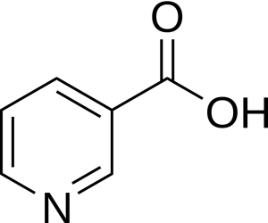
Figure 25.1c
Figure 25.1c. Molecular structure of Niacin (credit: Image by Mysid, PDM)

Slide 5
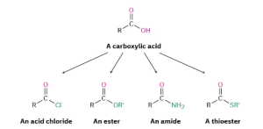
Figure 25.1d
Figure 25.1d. Carboxylic acids, the starting point for formation of several acid derivatives; acid chlorides, esters, amides and thioesters. (credit: Organic Chemistry (OpenStax), CC BY-NC-SA 4.0.)

Slide 6
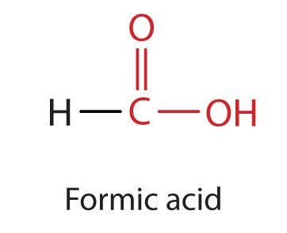
Figure 25.1e
Figure 25.1e. Functional group for carboxylic acids representing formic acid (credit: Intro Chem: GOB (v. 1.0), CC BY-NC-SA 3.0).

Slide 7
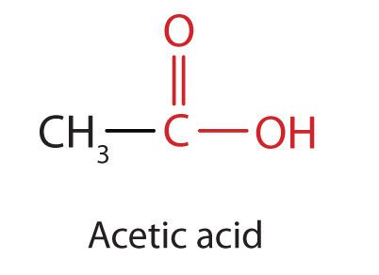
Figure 25.1f
Figure 25.1f. Functional group for carboxylic acids representing acetic acid (credit: Intro Chem: GOB (v. 1.0), CC BY-NC-SA 3.0).

Slide 8
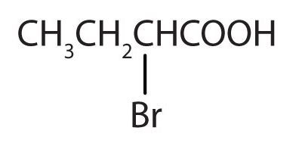
Figure 25.1g
Figure 25.1g. The structural diagram here represents 2-bromo-propanoic acid (credit: Intro Chem: GOB (v. 1.0), CC BY-NC-SA 3.0).

Slide 9
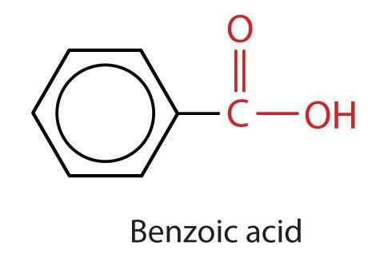
Figure 25.1h
Figure 25.1h. Image represents a ring structure containing the functional groups for carboxylic acids (credit: Intro Chem: GOB (v. 1.0), CC BY-NC-SA 3.0).

Slide 10
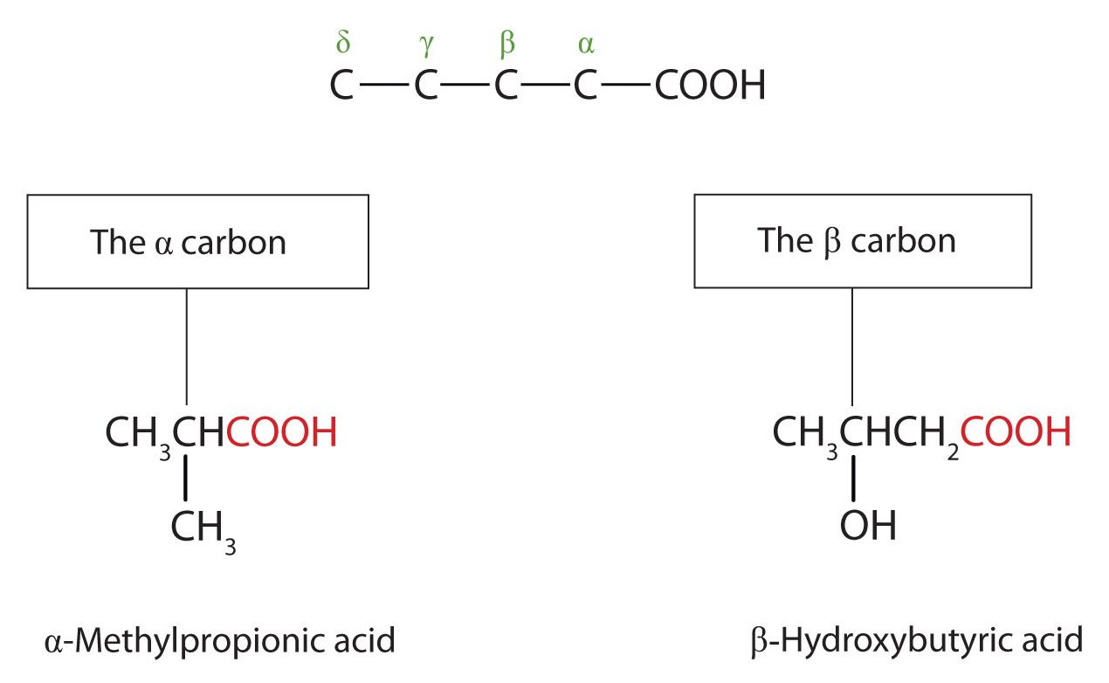
Figure 25.1i
Figure 25.1i. Use of Greek letters to represent the position of substituent groups (credit: Intro Chem: GOB (v. 1.0), CC BY-NC-SA 3.0).

Slide 11
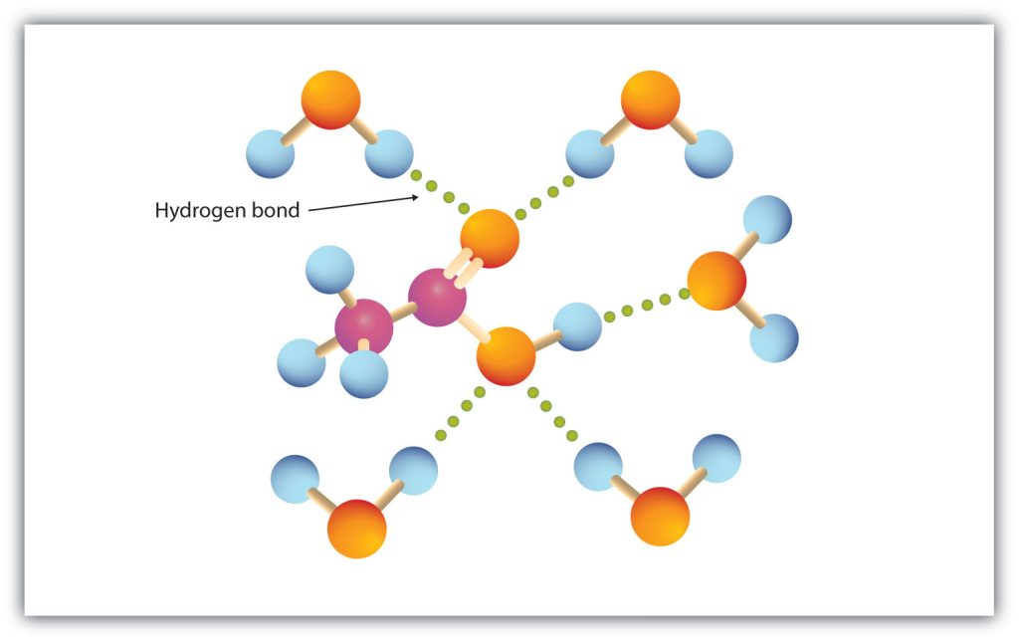
Figure 25.2a
Figure 25.2a. Hydrogen Bonding between an Acetic Acid Molecule and Water Molecules. Carboxylic acids of low molar mass are quite soluble in water (credit: Intro Chem: GOB (v. 1.0), CC BY-NC-SA 3.0).

Slide 12
Table 25.2a.
Table 25.2a. Physical Constants of Carboxylic Acids
Condensed Structural Formula | Name of Acid | Melting Point (°C) | Boiling Point (°C) | Solubility (g/100 g of Water)
HCOOH | formic acid | 8 | 100 | miscible
CH₃COOH | acetic acid | 17 | 118 | miscible
CH₃CH₂COOH | propionic acid | –22 | 141 | miscible
CH₃(CH₂)2COOH | butyric acid | –5 | 163 | miscible
CH₃(CH₂)₃COOH | valeric acid | –35 | 187 | 5
CH₃(CH₂)₄COOH | caproic acid | –3 | 205 | 1.1
C₆H₅COOH | benzoic acid | 122 | 249 | 0.29
Source: "15.3: Physical Properties of Carboxylic Acids" In Basics of GOB Chemistry (Ball et al.), CC BY-NC-SA 4.0.

Slide 13
Figure 25.3a
Figure 25.3a. Diagram representing the addition of a double bond to oxygen and then a hydroxyl group to an alcohol to create a carboxylic acid. (credit: Chemistry (OpenStax), CC BY).

Slide 14
Figure 25.3b
Figure 25.3b. Similar to figure 25.2a. we now see specific examples of an alcohol, aldehyde and carboxylic acid represented. (credit: Intro to Chem: GOB (v. 1.0), CC BY-NC-SA 3.0).

Slide 15
Figure 25.3c
Figure 25.3c. Formation of nitrile through substitution reaction of alkyl bromide with sodium cyanide. (credit: Organic Chem (Morsch et al.), CC BY-SA 4.0).

Slide 16
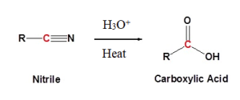
Figure 25.3d
Figure 25.3d. Hydrolysis reaction of a nitrile with an acidic catalyst forming a carboxylic acid (credit: Organic Chem (Morsch et al.), CC BY-SA 4.0).

Slide 17
Figure 25.3e
Figure 25.3e. Hydrolysis reaction of a cyclopentanecarbonitrile with an acidic catalyst forming a cyclopentanecarboxylic acid (credit: Organic Chem (Morsch et al.), CC BY-SA 4.0).

Slide 18
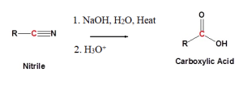
Figure 25.3f
Figure 25.3f. Hydrolysis reaction of a nitrile with a basic catalyst forming a carboxylic acid (credit: Organic Chem (Morsch et al.), CC BY-SA 4.0).

Slide 19
Figure 25.3g
Figure 25.3g. Hydrolysis reaction of butane nitrile with a basic catalyst forming a butanoic acid (credit: Organic Chem (Morsch et al.), CC BY-SA 4.0).

Slide 20
Figure 25.3h
CH₃COOH + H₂O --> CH₃COO⁻ + H₃O⁺
Carboxylic Acid + water --> Carboxylate Ion + Hydronium Ion
Figure 25.3h. Reaction of a carboxylic acid with water to produce a carboxylate ion and hydronium ion.

Slide 21
Figure 25.3i
Figure 25.3i. Reaction of a carboxylic acid with a strong base (sodium hydroxide) forming a carboxylate ion, a sodium ion and water. (credit: Chemistry (OpenStax), CC BY).

Slide 22
Figure 25.3j
RCO₂H + AgOH → RCO₂^{δ(-)} Ag^{δ(+)} + H₂O
Figure 25.3j. Reaction of a heavy metal base with a carboxylic acid.

Slide 23
Figure 25.3k
Figure 25.3k. General esterification reaction with carboxylic acid and alcohol combining to form ester with byproduct of water. (credit: Organic Chemistry (OpenStax), CC BY-NC-SA 4.0).

Slide 24
Figure 25.3l
Figure 25.3l. Reaction of acetic acid and an alcohol to produce an ester and water. (credit: Chemistry (OpenStax), CC BY).

Slide 25
Figure 25.3m
Figure 25.3m. Esterification of acetic acid and 1-butanol forming butyl acetate and water (credit: Organic Chemistry (OpenStax), CC BY-NC-SA 4.0).

Slide 26
Figure 25.3n
Figure 25.3n. Primary amide formation from reaction of carboxylic acid with ammonia. (credit: Organic Chemistry (OpenStax), CC BY-NC-SA 4.0).

Slide 27
Figure 25.3o
Figure 25.3o. Formation of secondary amide from reaction of carboxylic acid with primary amine. (credit: Organic Chemistry (OpenStax), CC BY-NC-SA 4.0).

Slide 28
Figure 25.3p
Figure 25.3p. General reaction of carboxylic acid with thionyl chloride to produce acid chloride (credit: Supplemental Modules (Organic Chemistry, CC BY-NC-SA 4.0).

Slide 29
Figure 25.3q
Figure 25.3q. Formation of an acid anhydride from substitution of an acid chloride with a carboxylic acid (credit: UIS: CHE 269 (Morsch and Andrews) , CC BY-NC-SA 4.0).

Slide 30
Figure 25.3r
Figure 25.3r. Formation of a carboxylic acid from substitution of an acid chloride with water (credit: UIS: CHE 269 (Morsch and Andrews) , CC BY-NC-SA 4.0).

Slide 31
Figure 25.3s
Figure 25.3s. Formation of an ester from substitution of an acid chloride with an alcohol (credit: UIS: CHE 269 (Morsch and Andrews) , CC BY-NC-SA 4.0).

Slide 32
Figure 25.3t
Figure 25.3t. Formation of an amide from substitution of an acid chloride with an amine or ammonia (credit: UIS: CHE 269 (Morsch and Andrews) , CC BY-NC-SA 4.0).

Slide 33
Figure 25.4a
Figure 25.4a. Reaction of acetic acid and water produce hydronium ions and carboxylate ions. (Credit: Chem 114: Human Chemistry II (Muíño), CC BY-NC-SA 4.0).

Slide 34
Figure 25.4b
Figure 25.4b. Reaction of pyruvic acid and water produce pyruvate ions and hydronium ions. (Credit: Chem 114: Human Chemistry II (Muíño),CC BY-NC-SA 4.0).

Slide 35
Figure 25.4c
Figure 25.4c. Dissociation of carboxylic acids and their K_{a} equation. (Credit: Chem 114: Human Chemistry II (Muíño),CC BY-NC-SA 4.0).

Slide 36
Table 25.4a.
Table 25.4a. Comparisons of Carboxylic Acid K_{a} and pK_{a} Values
Name | Compound | K_{a} | pK_{a}
formic acid | HCOOH | 1.8 X 10^{–4} | 3.74
acetic acid | CH₃COOH | 1.8 X 10^{–5} | 4.74
propanoic acid | CH₃CH₂COOH | 1.3 X 10^{–5} | 4.89
butanoic acid | CH₃CH₂CH₂COOH | 1.5 X 10^{–5} | 4.82
chloroacetic acid | ClCH₂COOH | 1.4 X 10^{–3} | 2.85
trichloroacetic acid | Cl₃CCOOH | 2.3 X 10^{–1} | 0.64
hexanoic acid | CH₃(CH₂)₄COOH | 1.3 X 10^{–5} | 4.89
benzoic acid | C₆H₅COOH | 6.5 X 10^{–5} | 4.19
oxalic acid | HOOCCOOH | 5.4 X 10^{–2} | 1.27
 | –OOCCOOH | 5.2 X 10^{–5} | 4.28
glutaric acid | HOOC(CH₂)₃COOH | 4.5 X 10^{–5} | 4.35
 | –OOC(CH₂)₃COOH | 3.8 X 10^{–6} | 5.42
Source: Comparison of Carboxylic acids. (Credit: Chem 114: Human Chemistry II (Muíño),CC BY-NC-SA 4.0).

Slide 37
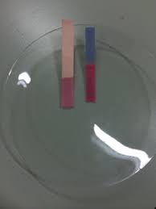
Figure 25.4d
Figure. 25.4d. Litmus paper has been exposed to an acidic solution. (Credit: Photo by Kanesskong, CC BY-SA 4.0)

Slide 38
Figure 25.4e
Figure 25.4e. Examples of carboxylate anions - positively charged ions.(Credit: Intro to Chem: GOB (V. 1.0)., CC BY-NC-SA 3.0.)

Slide 39
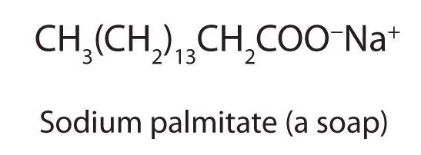
Figure 25.4f
Figure 25.4f. Condensed structural formula for sodium palmitate. (Credit: Intro to Chem: GOB (V. 1.0)., CC BY-NC-SA 3.0.)

Slide 40
Figure 25.4g
Figure 25.4g. Examples of carboxylate anions - calcium propionate and potassium sorbate. (Credits: Intro to Chem: GOB (V. 1.0)., CC BY-NC-SA 3.0.)

Slide 41
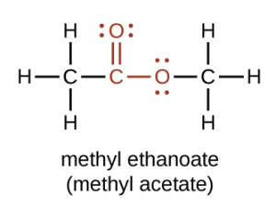
Figure 25.5a
Figure 25.5a. Condensed structural formula for an ester highlighting the carbonyl group and a single oxygen bonded to another carbon (credit: Chemistry (OpenStax), CC BY).

Slide 42
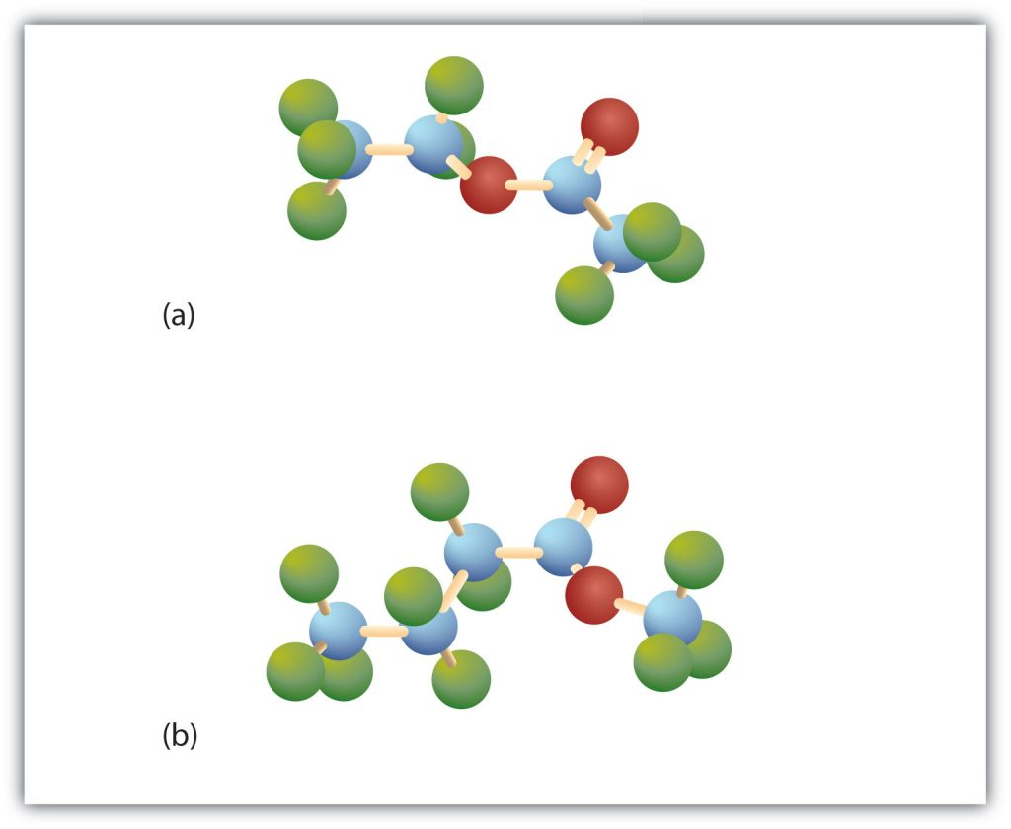
Figure 25.5b
Figure 25.5b. The Structure of Esters. Esters feature a carbon-to-oxygen double bond that is also singly bonded to a second oxygen atom, which is then joined to an alkyl or an aryl group. The esters shown here are ethyl acetate (a) and methyl butyrate (b). (credit: Intro Chem: GOB (V. 1.0)., CC BY-NC-SA 3.0.)

Slide 43
Figure 25.5c
Figure 25.5c. Chemical reaction of acetic acid and ethanol to produce an ester: ethyl acetate (credit: Chemistry (OpenStax), CC BY 4.0).

Slide 44
Table 25.5a.
Table 25.5a. Physical Properties of Some Esters
Condensed Structural Formula | Name | Molar Mass | Melting Point (°C) | Boiling Point (°C) | Aroma
HCOOCH₃ | methyl formate | 60 | −99 | 32
HCOOCH₂CH₃ | ethyl formate | 74 | −80 | 54 | rum
CH₃COOCH₃ | methyl acetate | 74 | −98 | 57
CH₃COOCH₂CH₃ | ethyl acetate | 88 | −84 | 77
CH₃CH₂CH₂COOCH₃ | methyl butyrate | 102 | −85 | 102 | apple
CH₃CH₂CH₂COOCH₂CH₃ | ethyl butyrate | 116 | −101 | 121 | pineapple
CH₃COO(CH₂)₄CH₃ | pentyl acetate | 130 | −71 | 148 | pear
CH₃COOCH₂CH₂CH(CH₃)₂ | isopentyl acetate | 130 | −79 | 142 | banana
CH₃COOCH₂C₆H₅ | benzyl acetate | 150 | −51 | 215 | jasmine
CH₃CH₂CH₂COO(CH₂)₄CH₃ | pentyl butyrate | 158 | −73 | 185 | apricot
CH₃COO(CH₂)₇CH₃ | octyl acetate | 172 | −39 | 210 | orange
Source: "15.6: Physical Properties of Esters" In Basics of GOB Chemistry (Ball et al.), CC BY-NC-SA 4.0.

Slide 45
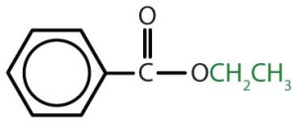
Table 25.5b.
Table 25.5b. Nomenclature of Esters
Condensed Structural Formula | Common Name | IUPAC Name
HCOOCH₃ | methyl formate | methyl methanoate
CH₃COOCH₃ | methyl acetate | methyl ethanoate
CH₃COOCH₂CH₃ | ethyl acetate | ethyl ethanoate
CH₃CH₂COOCH₂CH₃ | ethyl propionate | ethyl propanoate
CH₃CH₂CH₂COOCH(CH₃)₂ | isopropyl butyrate | isopropyl butanoate
 | ethyl benzoate | ethyl benzoate
Table and image credit: Intro Chem: GOB (V. 1.0)., CC BY-NC-SA 3.0.

Slide 46
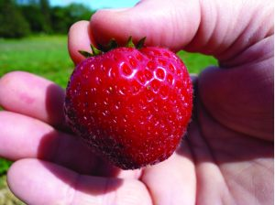
Figure 25.5d
Figure 25.5d. Over 350 different volatile molecules (many members of the ester family) have been identified in strawberries. (credit: Photo by Rebecca Siegel, Chemistry (OpenStax), CC BY 4.0).

Slide 47
Figure 25.6a
Figure 25.6a. Chemical reaction of an alcohol and a carboxylic acid forming an ester and water (credit: Intro Chem: GOB (V. 1.0)., CC BY-NC-SA 3.0).

Slide 48
Figure 25.6b
Figure 25.6b. Chemical reaction of an alcohol and a carboxylic acid forming an ester and water (credit: Intro Chem: GOB (V. 1.0)., CC BY-NC-SA 3.0).

Slide 49
Figure 25.6c
Figure 25.6c.A chemical reaction of an ester with water is the reverse of the production of an ester (esterification) (credit: Intro Chem: GOB (V. 1.0)., CC BY-NC-SA 3.0).

Slide 50
Figure 25.6d
Figure 25.6d. An example of acidic hydrolysis of butyl acetate (credit: Intro Chem: GOB (V. 1.0)., CC BY-NC-SA 3.0).

Slide 51
Figure 25.6e
Figure 25.6e. Chemical reaction for the acidic hydrolysis of ethyl butyrate (credit: Intro Chem: GOB (V. 1.0)., CC BY-NC-SA 3.0).

Slide 52
Figure 25.6f
Figure 25.6f. Reaction of an ester with a base (credit: Intro Chem: GOB (V. 1.0)., CC BY-NC-SA 3.0).

Slide 53
Figure 25.6g
Figure 25.6g. Chemical reaction of ethyl acetate with sodium hydroxide (credit: Intro Chem: GOB (V. 1.0)., CC BY-NC-SA 3.0).

Slide 54
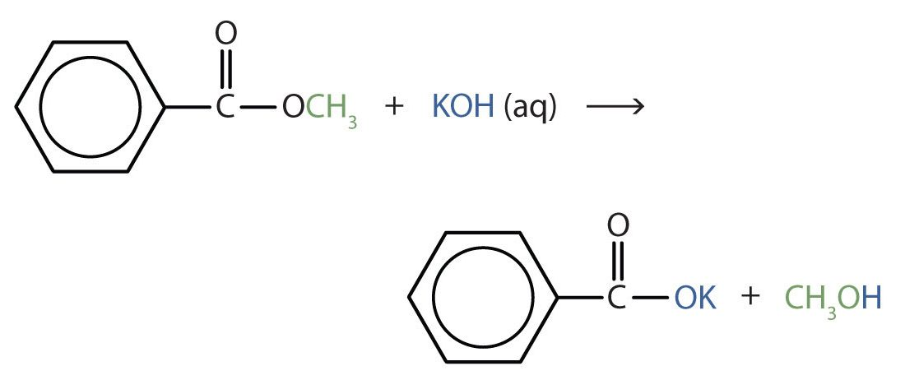
Figure 25.6h
Figure 25.6h. Hydrolysis of methyl benzoate in potassium hydroxide (credit: Intro Chem: GOB (V. 1.0)., CC BY-NC-SA 3.0).

Slide 55
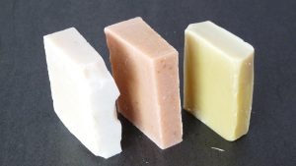
Figure 25.6i
Figure 25.6i. Various bars of soap (credit: Image by Baba79, CC BY-SA 4.0).

