Slide 1
Chapter 24
Aldehydes and Ketones
Slides to accompany Organic and Biochemistry Supplement to Enhanced Introductory College Chemistry by Gregory Anderson, Jen Booth, Caryn Fahey, Adrienne Richards, Samantha Sullivan Sauer, and David Wegman
Slide design and template by Revathi Mahadevan
Except where otherwise noted, images, tables & diagrams are reused from Organic and Biochemistry Supplement to Enhanced Introductory College Chemistry
Slides are licensed under CC-BY 4.0, Except while otherwise noted

Slide 2
Figure 24.0a
Figure 24.0a. Wooden beams gain strength and stability when laminated with aldehyde-based adhesives. (credit: Photo by Hudson Hintze, Unsplash license)

Slide 3
Figure 24.1a
Figure 24.1a. The carbonyl group is polar, and the geometry of the bonds around the central carbon is trigonal planar. (Credit: Beginning Chemistry (v. 1.0), CC BY-NC-SA 3.0.)

Slide 4
Figure 24.1b
Figure 24.1b. An alcohol group can be oxidized into a carbonyl group. (credit: Chemistry (OpenStax), CC BY).

Slide 5
Figure 24.1c
Figure 24.1c. Examples of aldehydes. They carbonyl group must be on a terminal carbon in a chain (credit: Intro Chem: GOB (v. 1.0), CC BY-NC-SA 3.0).

Slide 6
Figure 24.1d
Figure 24.1d. Examples of ketones. They carbonyl group must be on an internal carbon in a chain (credit: Intro Chem: GOB (v. 1.0), CC BY-NC-SA 3.0).

Slide 7
Figure 24.1e
Figure 24.1e. Condensed formulas for aldehydes and ketones (credit: Intro Chem: GOB (v. 1.0), CC BY-NC-SA 3.0).

Slide 8
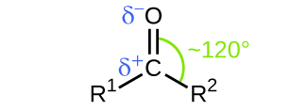
Figure 24.1f
Figure 24.1f. Bond angles and dipole moments in a carbonyl group (credit: Chemistry (OpenStax), CC BY).

Slide 9
Figure 24.1g
Figure 24.1g. The first three simplest aldehyde molecules. (credit: Beginning Chemistry (v. 10), CC BY-NC-SA 3.0.)

Slide 10
Figure 24.1h
Figure 24.1h. The simplest ketone molecule. (Credit:Beginning Chemistry (v. 1.0), CC BY-NC-SA 3.0.)

Slide 11
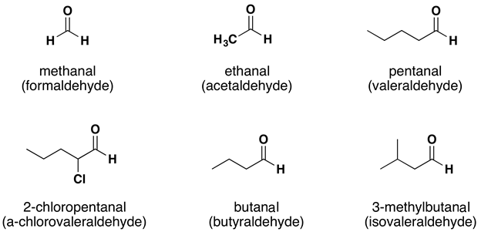
Figure 24.2a
Figure 24.2a. IUPAC names for some aldehydes. Common names are given in brackets below (credit: Supplemental Modules (Organic Chemistry), CC BY-NC-SA 4.0).

Slide 12
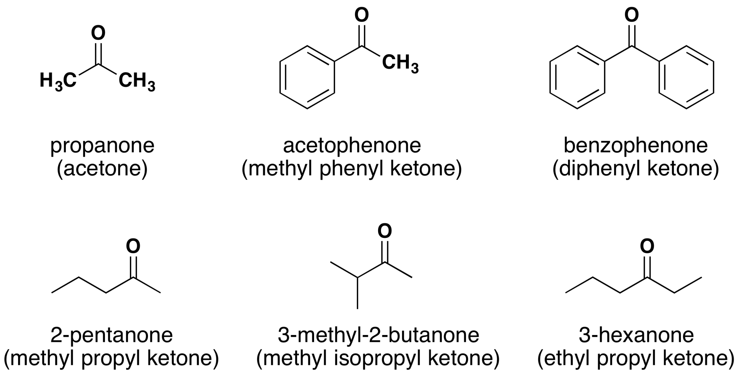
Figure 24.2b
Figure 24.2b. IUPAC names for some ketones. Common names are given in brackets below (credit: Supplemental Modules (Organic Chemistry), CC BY-NC-SA 4.0).

Slide 13
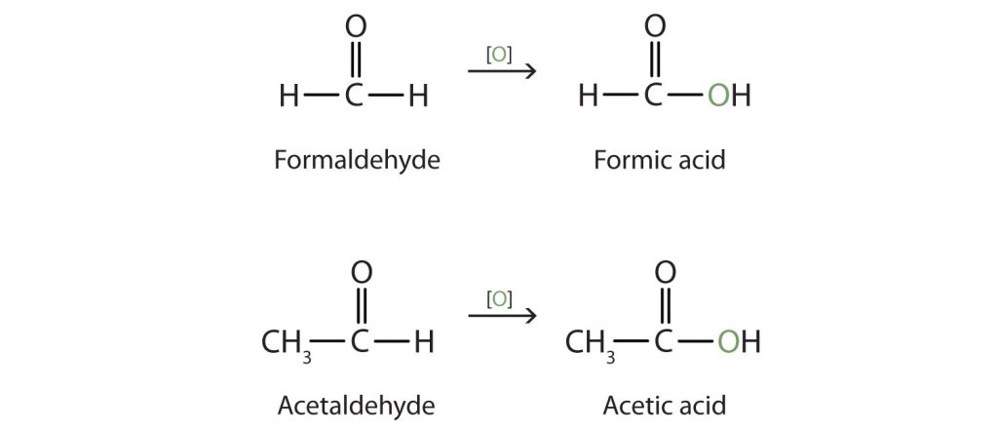
Figure 24.2c
Figure 24.2c. Historical common names of aldehydes stem from the common names of the carboxylic acids that they can be converted into via a process called oxidation (covered in chapter 24.3). (Credits: Intro Chem: GOB (V. 1.0)., CC BY-NC-SA 3.0.)

Slide 14
Figure 24.2d
Figure 24.2d. The simplest ketone, commonly known as acetone, contains three carbons, with the carbonyl group located on the central carbon. (Credits: Intro to Chem: GOB (V. 1.0)., CC BY-NC-SA 3.0.)

Slide 15
Figure 24.2e
Figure 24.2e. Historical common names for ketones are derived by naming the two side chains attached to the carbonyl group, and adding the word "ketone" at the end. (Credits: Intro Chem: GOB (V. 1.0)., CC BY-NC-SA 3.0.)

Slide 16
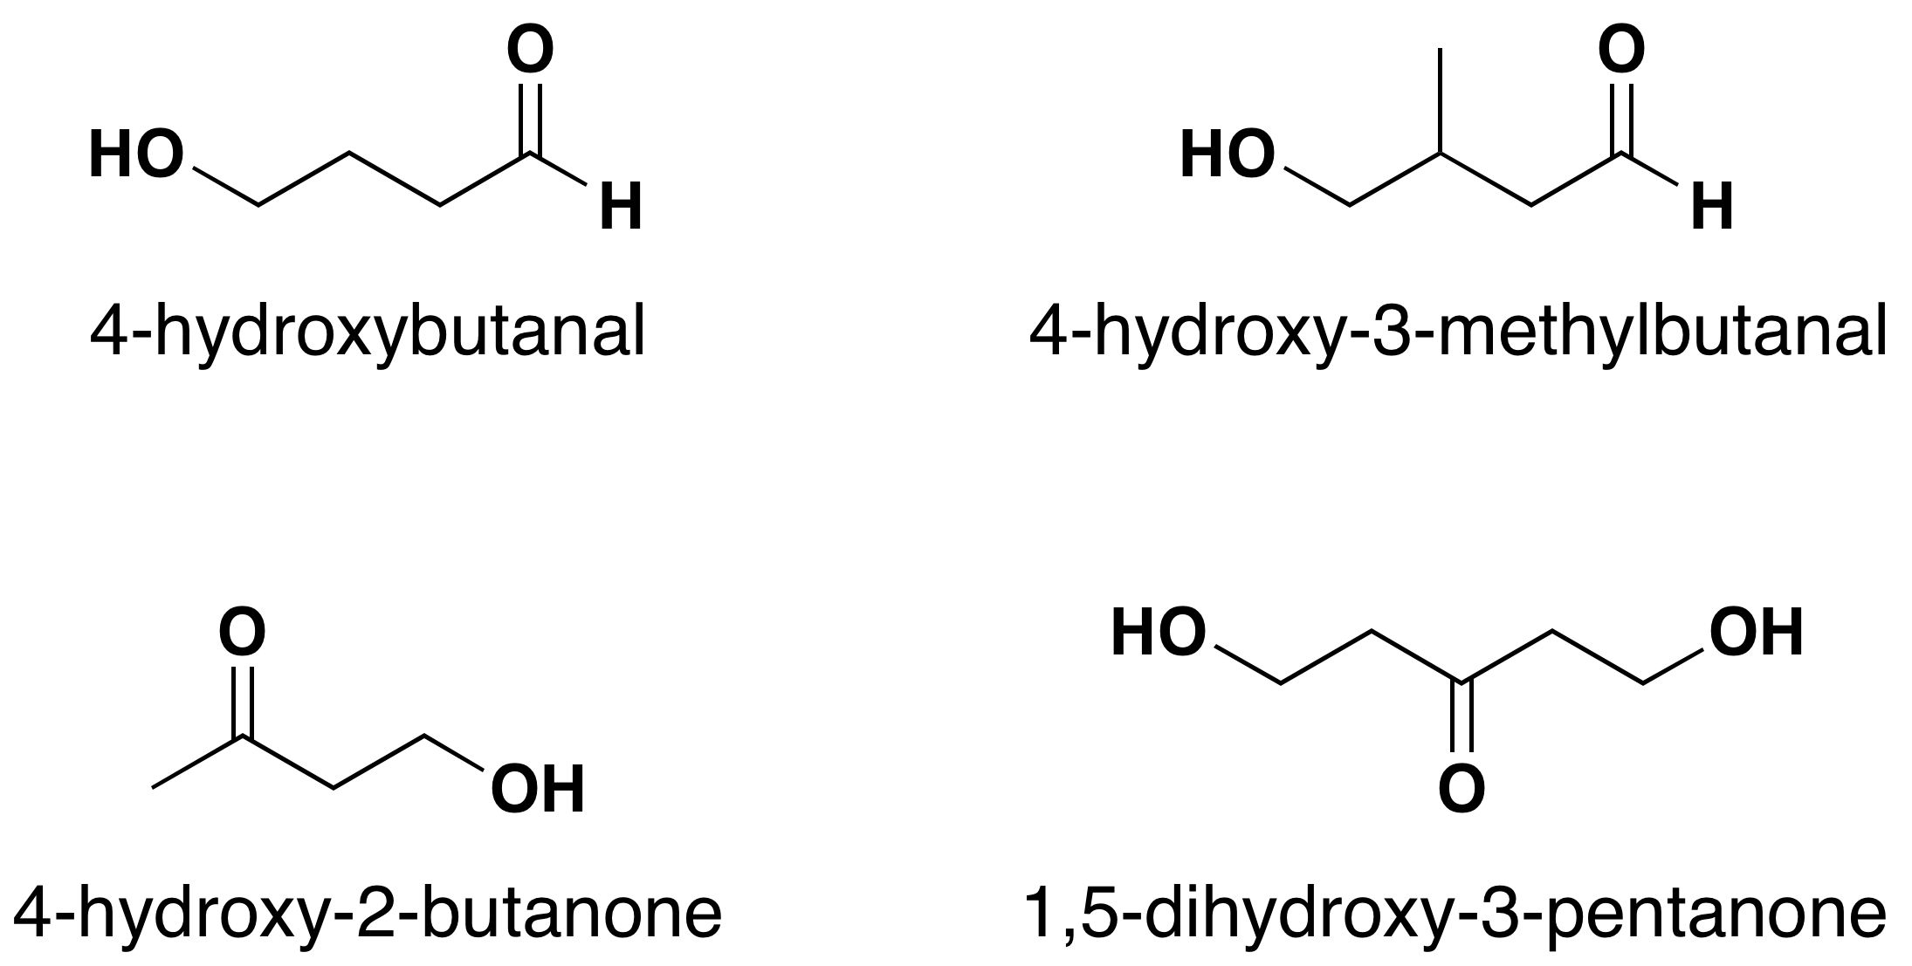
Figure 24.2f
Figure 24.2f. Molecules with two or more functional groups (credit: Supplemental Modules (Organic Chemistry), CC BY-NC-SA 4.0).

Slide 17
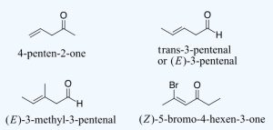
Figure 24.2g
Figure 24.2g. Examples of ketones and aldehydes with alkene functional groups (credit: Supplemental Modules (Organic Chemistry), CC BY-NC-SA 4.0).

Slide 18
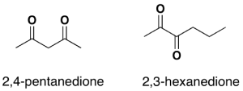
Figure 24.2i
Figure 24.2i. Examples of diones (credit: Supplemental Modules (Organic Chemistry), CC BY-NC-SA 4.0).

Slide 19
Figure 24.3a
Figure 24.3a. Dipole moments are found in carbonyl groups, with the carbon having a positive dipole and the highly electronegative oxygen having a negative dipole. (Credits: Intro Chem: GOB (V. 1.0)., CC BY-NC-SA 3.0.)

Slide 20
Table 24.3a.
Table 24.3a. Boiling Points of Compounds Having Similar Molar Masses but Different Types of Intermolecular Forces
Compound | Family | Molar Mass | Type of Intermolecular Forces | Boiling Point (°C)
CH₃CH₂CH₂CH₃ | alkane | 58 | dispersion only | –1
CH₃OCH₂CH₃ | ether | 60 | weak dipole | 6
CH₃CH₂CHO | aldehyde | 58 | strong dipole | 49
CH₃CH₂CH₂OH | alcohol | 60 | hydrogen bonding | 97
Source: "14.10: Properties of Aldehydes and Ketones" In Basics of GOB Chemistry (Ball et al.), CC BY-NC-SA 4.0.

Slide 21
Figure 24.3b
Figure 24.3b. Hydrogen bonding occurs between the oxygen in the carbonyl group of either aldehydes or ketones and the hydrogen of water molecules. (Credits: Intro Chem: GOB (V. 1.0)., CC BY-NC-SA 3.0.)

Slide 22
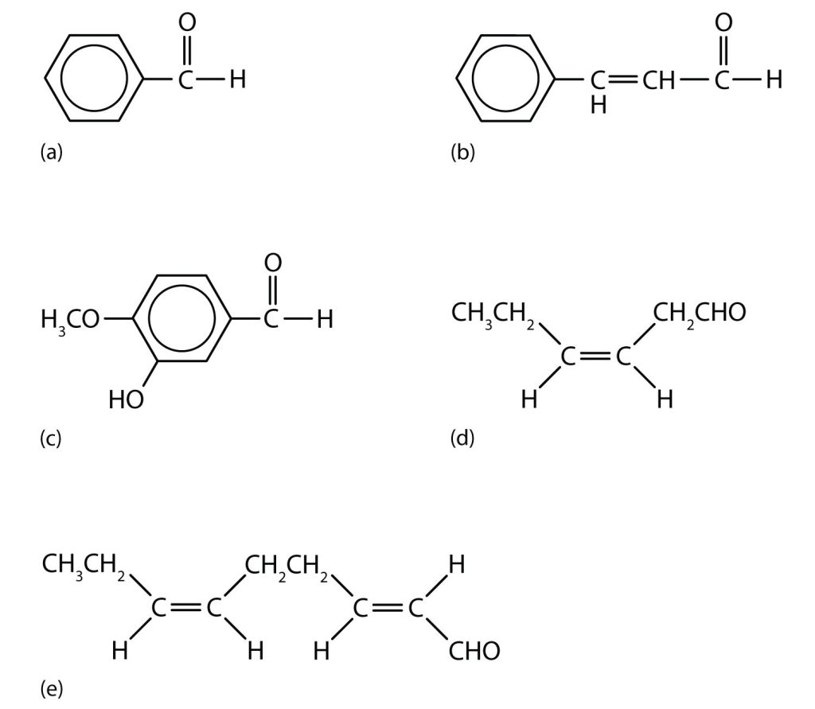
Figure 24.3c
Figure 24.3c. Some interesting aldehydes. (a) Benzaldehyde is an oil found in almonds; (b) cinnamaldehyde is oil of cinnamon; (c) vanillin gives vanilla its flavour; (d) cis-3-hexenal provides an herbal odour; and (e) trans-2-cis-6-nonadienal gives a cucumber odour. (Credits: Intro Chem:GOB (V. 1.0)., CC BY-NC-SA 3.0.)

Slide 23
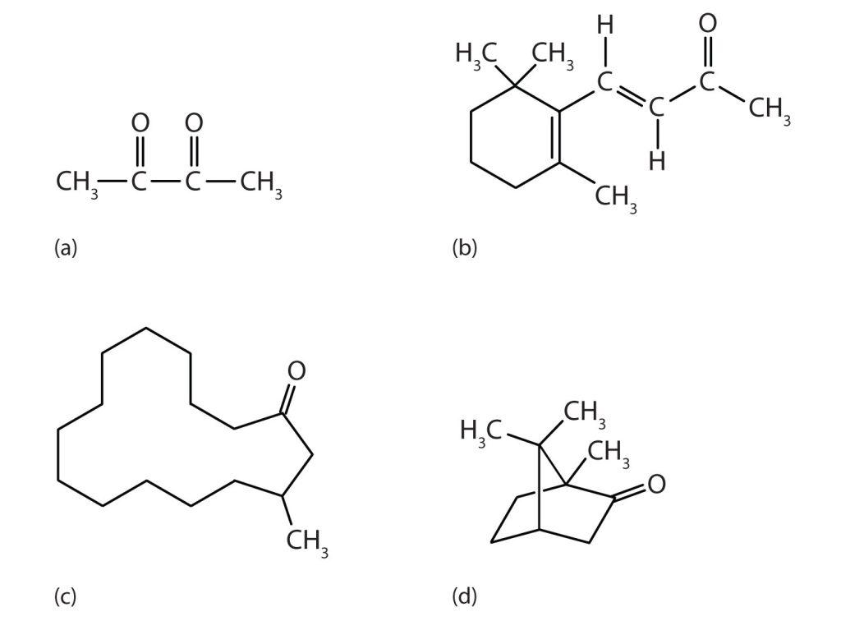
Figure 24.3d
Figure 24.3d. Some interesting ketones. (a) Butter flavouring comes from 2,3-butanedione; (b) β-ionone is responsible for the odour of violets; (c) muscone is musk oil, an ingredient in perfumes; and (d) camphor is used in some insect repellents. (Credits: Intro Chem: GOB (V. 1.0)., CC BY-NC-SA 3.0.)

Slide 24
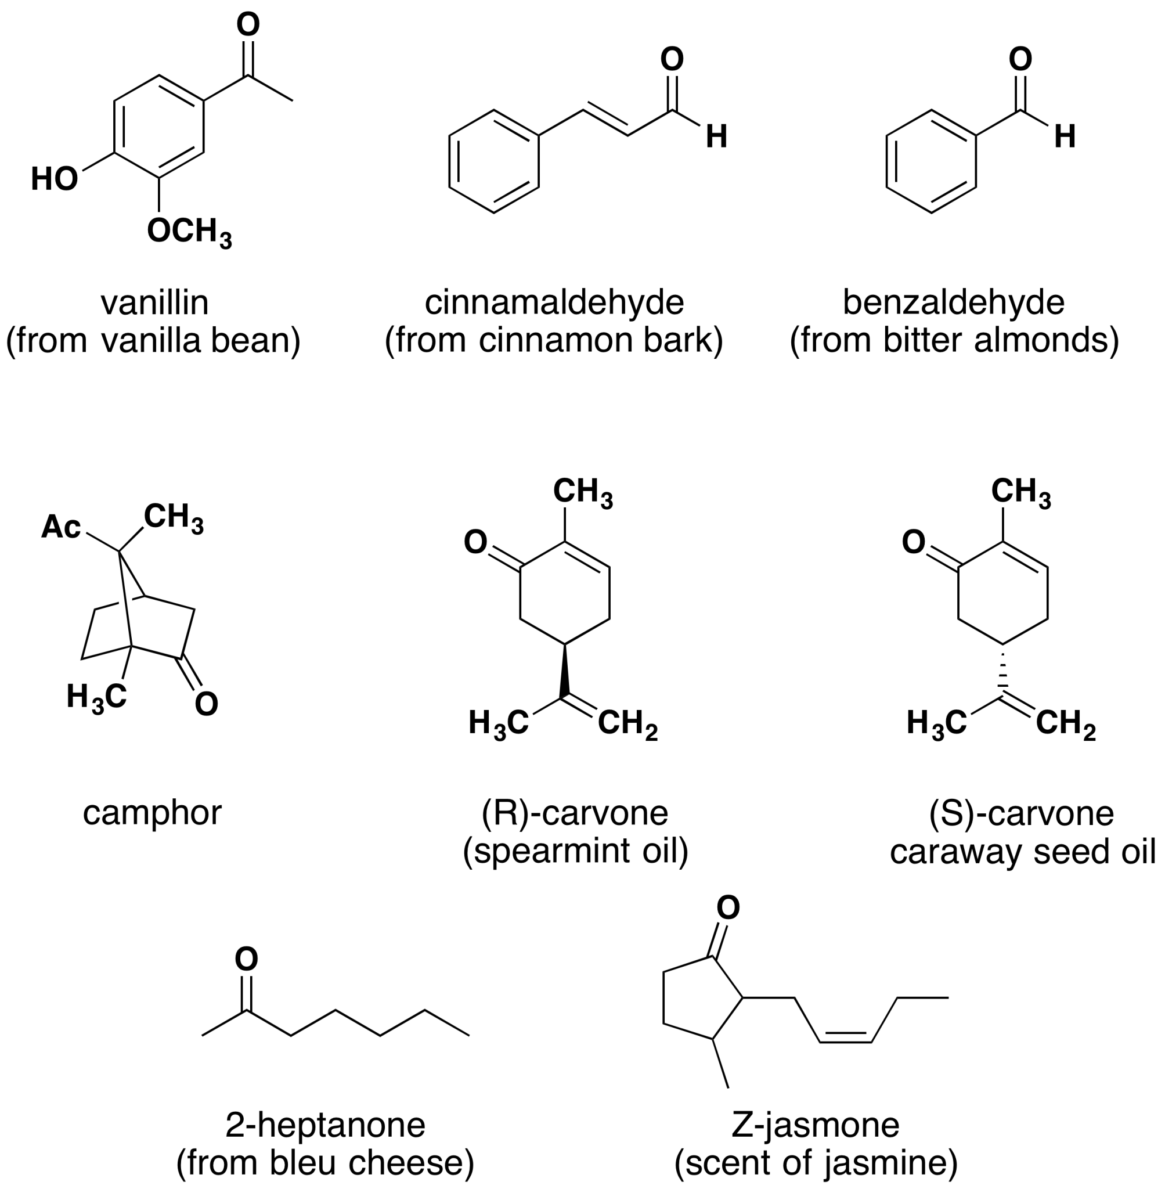
Figure 24.3e
Figure 24.3e. Aldehyde and ketone containing molecules isolated from plant sources (credit: Supplemental Modules (Organic Chemistry), CC BY-NC-SA 4.0).

Slide 25
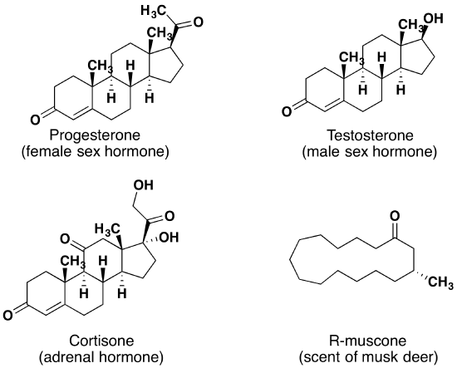
Figure 24.3f
Figure 24.3f. Aldehyde and ketone containing molecules isolated from animal sources (credit: Supplemental Modules (Organic Chemistry), CC BY-NC-SA 4.0).

Slide 26
Figure 24.4a
Figure 24.4a. Primary alcohols can be oxidized to produce aldehydes (credit: Chemistry 2e (OpenStax), CC BY )

Slide 27
Figure 24.4b
Figure 24.4b. Secondary alcohols can be oxidized to produce ketones (credit: Chemistry 2e (OpenStax), CC BY).

Slide 28
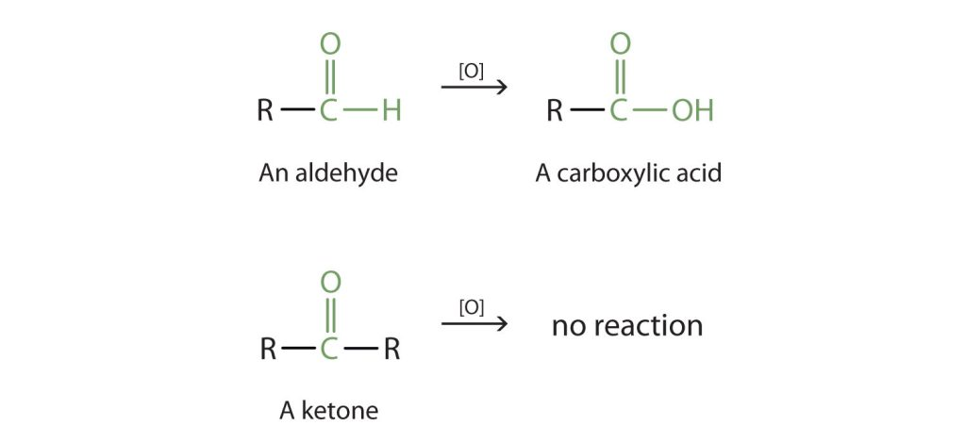
Figure 24.4c
Figure 24.4c. Oxidation is a chemical reaction that can be achieved using permanganate (in the presence of sulfuric acid), dichromate, oxygen, or by mild oxidizing agents such as Cu2+ or Ag+. Aldehydes are readily oxidized in this process to carboxylic acids, whereas ketone will resist this reaction. (credit: Intro Chem: GOB (V. 1.0)., CC BY-NC-SA 3.0.)

Slide 29
Figure 24.4d
Figure 24.4d. Reaction scheme of a typical aldehyde in the Tollens' test, often referred to as the "silver mirror test." This simple test allows chemists to differentiate aldehydes from ketones and alcohols. (Credits: Intro Chem: GOB (V. 1.0)., CC BY-NC-SA 3.0.)

Slide 30
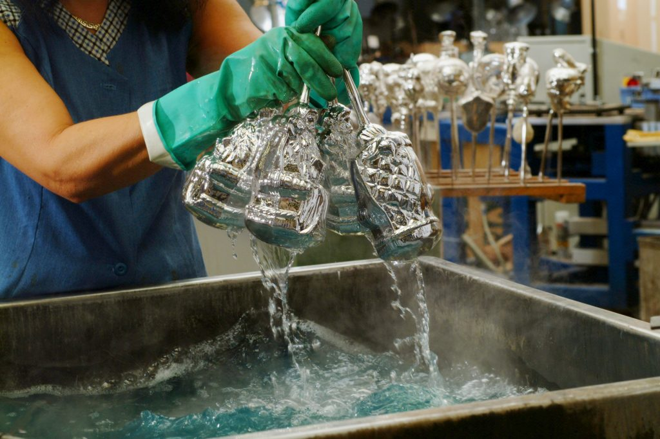
Figure 24.4e
Figure 24.4e. A reaction related to the Tollens’ reaction is often used to silver mirrors. These ornaments were silvered by such a reaction. Glucose, a simple sugar with an aldehyde functional group, is used as the reducing agent. (Credit: Photo by Krebs Glas Lauscha, CC BY 3.0)

Slide 31
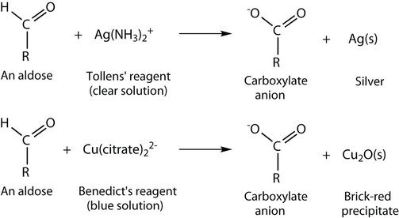
Figure 24.4f
Figure 24.4f. Oxidation of an aldehyde-based compound using the Tollens' reagent and the Benedict's reagent. Notice the change in colour of each reaction (credit: Intro Chem: GOB (V. 1.0)., CC BY-NC-SA 3.0.).

Slide 32
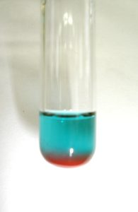
Figure 24.4g
Figure 24.4g. Oxidation of aldehyde with Benedict's reagent. Original blue reagent on top and resulting red precipitate on bottom. This is a positive result (credit: Image by Kala Nag, CC BY-SA 4.0).

Slide 33
Figure 24.4h
Figure 24.4h. Reduction of a carbonyl group to an alcohol (credit: Organic Chemistry (OpenStax), CC BY-NC-SA 4.0).

Slide 34
Figure 24.4i
Figure 24.4i. An aldehyde is reduced to a primary alcohol. A ketone is reduced to a secondary alcohol (credit: Organic Chemistry (OpenStax), CC BY-NC-SA 4.0).

Slide 35
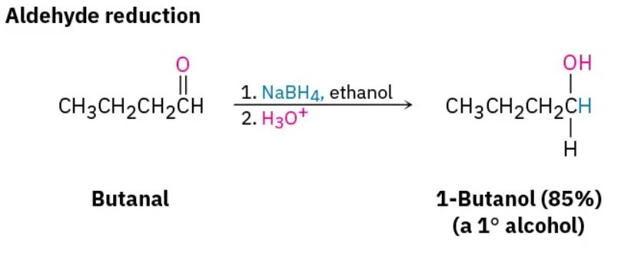
Figure 24.4j
Figure 24.4j. Reduction of butanal forming 1-butanol (credit: Organic Chemistry (OpenStax), CC BY-NC-SA 4.0).

Slide 36
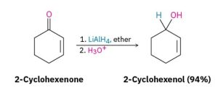
Figure 24.4k
Figure 24.4k. Reduction of 2-cyclohexenone forming 2-cyclohexenol (credit: Organic Chemistry (OpenStax), CC BY-NC-SA 4.0)

Slide 37
Figure 24.4l
Figure 24.4l. Oxidation states of methane, methanol, methanal, methanoic acid and carbon dioxide. Left to right increase in oxidation state (more oxidized). Right to left decrease in oxidation state (more reduced) (credit: Org Chem Bio Emphasis, CC BY-NC-SA 4.0).

Slide 38
Figure 24.4m
Figure 24.4m. Oxidation states of functional groups. Left to right increase in oxidation state (more oxidized). Right to left decrease in oxidation state (more reduced) (credit: Org Chem Bio Emphasis, CC BY-NC-SA 4.0).

Slide 39
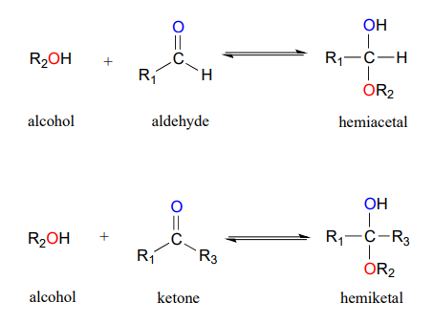
Figure 24.4n
Figure 24.4n. Addition of an alcohol to an aldehyde and a ketone forming a hemiacetal and a hemiketal. (credit: Org Chem Bio Focus (Vol 2), CC BY-NC-SA)

Slide 40
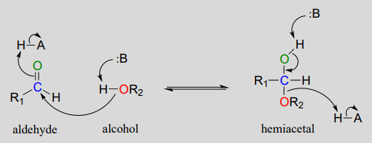
Figure 24.4o
Figure 24.4o Biochemical mechanism of hemiacetal formation. (credit: Organic Chemistry with a Biological Focus (Vol 2), CC BY-NC-SA)

Slide 41
Figure 24.4p
Figure 24.4p. Addition of an aldehyde with water to form a hydrate. (credit: Organic Chemistry with a Biological Focus (Vol 2), CC BY-NC-SA)

Slide 42
Figure 24.4q
Figure 24.4q. Addition of HCN to ethanal.(credit: Addition Reactions, CC BY-NC)

Slide 43
Figure 24.4r
Figure 24.4r. Addition of HCN to propanone.(credit: Addition Reactions, CC BY-NC)

Slide 44
Figure 24.4s
Figure 24.4s. CN ion attacking the carbonyl group. (credit: Addition Reactions, CC BY-NC)

Slide 45
Figure 24.4t
Figure 24.4t. Formation of mandelonitrile from benzaldehyde and hydrogen cyanide. (credit: Image by Samantha Sullivan Sauer using Biovia Draw, CC BY-NC-SA 4.0)

Slide 46
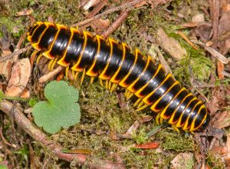
Figure 24.4u
Figure 24.4u. Millepede - Apheloria Viginiensis Corrugata (credit: Image by Marshal Hedin, CC BY 2.0)

