Slide 1
Chapter 23
Alcohols, Ethers and Related Groups
Slides to accompany Organic and Biochemistry Supplement to Enhanced Introductory College Chemistry by Gregory Anderson, Jen Booth, Caryn Fahey, Adrienne Richards, Samantha Sullivan Sauer, and David Wegman
Slide design and template by Revathi Mahadevan
Except where otherwise noted, images, tables & diagrams are reused from Organic and Biochemistry Supplement to Enhanced Introductory College Chemistry
Slides are licensed under CC-BY 4.0, Except while otherwise noted

Slide 2
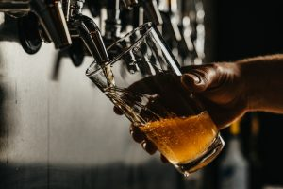
Figure 23.0a
Figure 23.0a. A glass of beer. Photo by Josh Olalde on Unsplash

Slide 3
Figure 23.1a
Figure 23.1a. Structure of ethanol a) structural formula, b) ball and stick model, c) space-filling model. (credit a: Image by Ju, PDM; b: Image by Benjah-bmm27, PDM; c: Image by Benjah-bmm27, PDM).

Slide 4
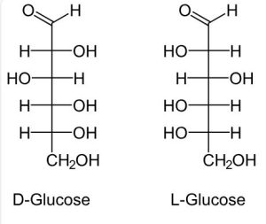
Figure 23.1b
Figure 23.1b. Structure of D-glucose and L-glucose showing multiple -OH groups per molecule (credit: Image by NEUROtiker, PDM).

Slide 5
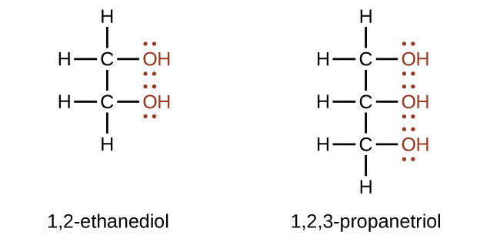
Figure 23.1c
Figure 23.1c. Structure of 1,2-ethanediol and 1,2,3-propanetriol (credit: General Chemistry 1 & 2, CC BY 4.0).

Slide 6
Figure 23.1d
Figure 23.1d. Structure of methyl alcohol (methanol), ethyl alcohol (ethanol), Propyl alcohol (propan-1-ol), and Isopropyl alcohol (propan-2-ol) (credit: Intro Chem: GOB (V. 1.0)., CC BY-NC-SA 3.0).

Slide 7
Figure 23.1e
Figure 23.1e. Structure of primary (1º) alcohol (credit: Intro Chem: GOB (V. 1.0)., CC BY-NC-SA 3.0).

Slide 8
Figure 23.1f
Figure 23.1f. Structure of secondary (2º) alcohol (credit: Intro Chem: GOB (V. 1.0)., CC BY-NC-SA 3.0).

Slide 9
Figure 23.1g
Figure 23.1g. Structure of tertiary (3º) alcohol (credit: Intro Chem: GOB (V. 1.0)., CC BY-NC-SA 3.0).

Slide 10
Figure 23.1h
Figure 23.1h. Structure of isobutyl, sec-butyl and tert-butyl groups (credit: Intro Chem: GOB (V. 1.0)., CC BY-NC-SA 3.0).

Slide 11
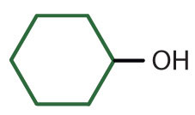
Table 23.1a.
Table 23.1a. Classification and Nomenclature of Some Alcohols
Condensed Structural Formula | Class of Alcohol | Common Name | IUPAC Name
CH₃OH | — | methyl alcohol | methanol
CH₃CH₂OH | primary | ethyl alcohol | ethanol
CH₃CH₂CH₂OH | primary | propyl alcohol | 1-propanol
(CH₃)₂CHOH | secondary | isopropyl alcohol | 2-propanol
CH₃CH₂CH₂CH₂OH | primary | butyl alcohol | 1-butanol
CH₃CH₂CHOHCH₃ | secondary | sec-butyl alcohol | 2-butanol
(CH₃)₂CHCH₂OH | primary | isobutyl alcohol | 2-methyl-1-propanol
(CH₃)₃COH | tertiary | tert-butyl alcohol | 2-methyl-2-propanol
 | secondary | cyclohexyl alcohol | cyclohexanol
Image Credits: Introduction to Chemistry: GOB (V. 1.0)., CC BY-NC-SA 3.0.

Slide 12
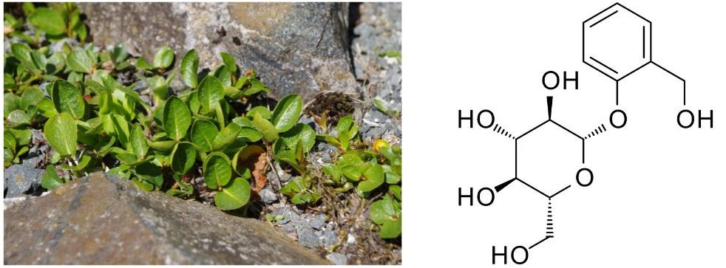
Figure 23.1i
Figure 23.1i. Dwarf willow (Salix herbacea) (left). Salicin molecule (right) (credit left: Image by El Grafo, CC BY-SA 3.0; right: Image by Fuse809; PDM).

Slide 13
Figure 23.2a
Figure 23.2a. Structure of water (left) and alcohol (right) (credit: Intro Chem: GOB (V. 1.0)., CC BY-NC-SA 3.0).

Slide 14
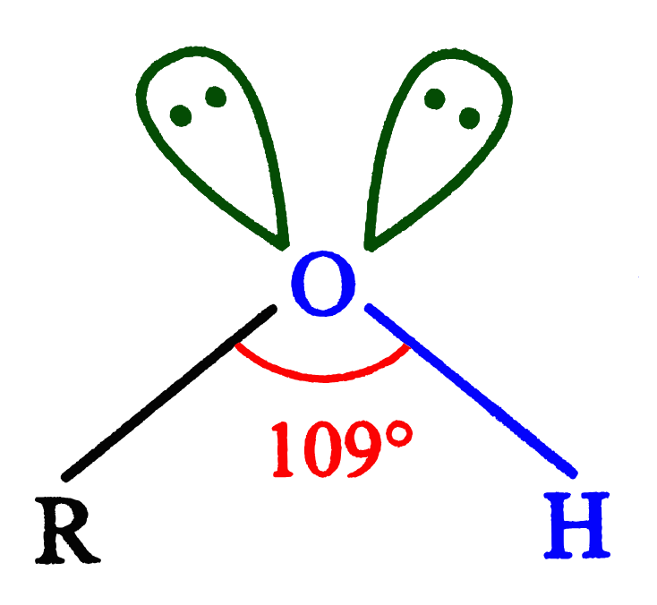
Figure 23.2b
Figure 23.2b. Bent structure of alcohol showing the presence of two lone pairs of electrons on the oxygen atom and the carbon-oxygen-hydrogen bond angle of 109° (credit: Image by RamaKrishnaHare, CC BY-SA 4.0).

Slide 15
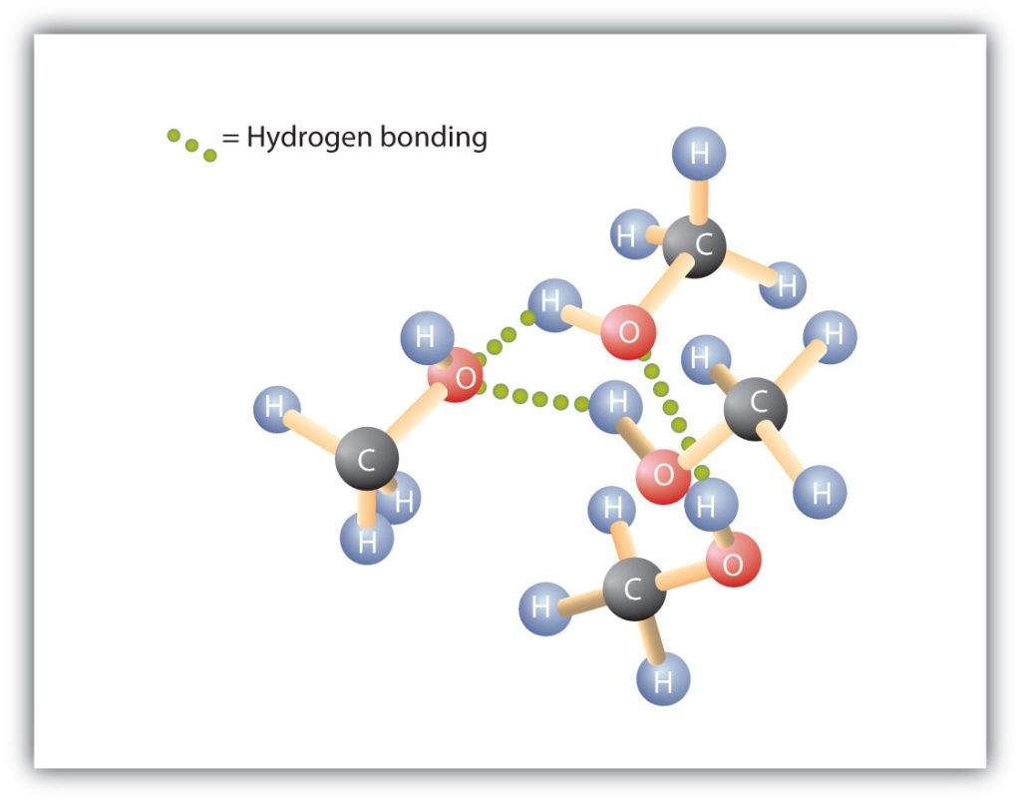
Figure 23.2c
Figure 23.2c. Intermolecular hydrogen bonding in methanol. The OH groups of alcohol molecules make hydrogen bonding possible (credit: Intro Chem: GOB (V. 1.0)., CC BY-NC-SA 3.0).

Slide 16
Table 23.2a.
Table 23.2a. Comparison of Boiling Points and Molar Masses
Formula | Name | Molar Mass | Boiling Point (°C)
CH₄ | methane | 16 | –164
HOH | water | 18 | 100
C₂H₆ | ethane | 30 | –89
CH₃OH | methanol | 32 | 65
C₃H₈ | propane | 44 | –42
CH₃CH₂OH | ethanol | 46 | 78
C₄H₁₀ | butane | 58 | –1
CH₃CH₂CH₂OH | 1-propanol | 60 | 97
Image Credits: Introduction to Chemistry: GOB (V. 1.0)., CC BY-NC-SA 3.0.

Slide 17
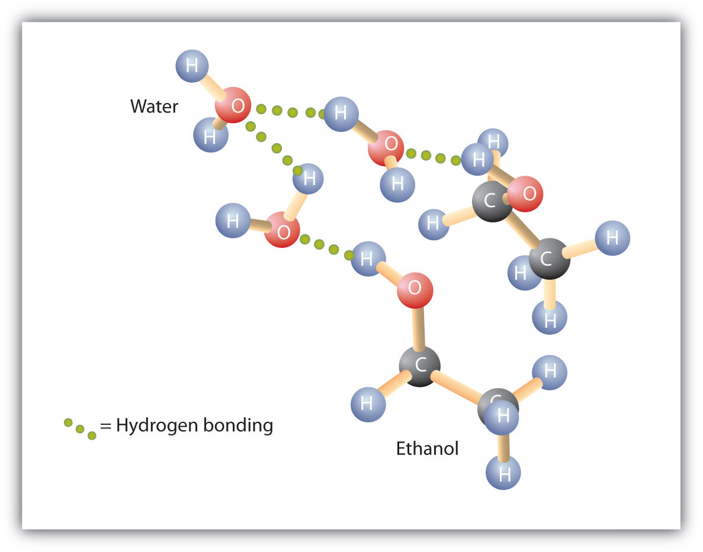
Figure 23.2d
Figure 23.2d. Intermolecular hydrogen bonding between ethanol (an alcohol) and water molecules. The OH groups of alcohol molecules allow for the hydrogen bonding to occur with the water molecules. (Credit: Introduction to Chemistry: GOB (V. 1.0)., CC BY-NC-SA 3.0.)

Slide 18
Figure 23.3a
Figure 23.3a. Preparation of methanol from carbon monoxide. (Credit: Introduction to Chemistry: GOB (V. 1.0)., CC BY-NC-SA 3.0.)

Slide 19
Figure 23.3b
Figure 23.3b. Preparation of ethanol from glucose using yeast (credit: Chemistry (OpenStax), CC BY 4.0).

Slide 20
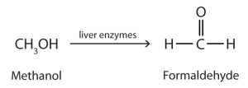
Figure 23.3c
Figure 23.3c. Conversion of methanol to formaldehyde (methanal). (Credit: Introduction to Chemistry: GOB (V. 1.0)., CC BY-NC-SA 3.0.)

Slide 21
Figure 23.3d
Figure 23.3d. Conversion of ethanol to acetaldehyde (ethanal). (Credit: Introduction to Chemistry: GOB (V. 1.0)., CC BY-NC-SA 3.0.)

Slide 22
Figure 23.3e
Figure 23.3e. Formation of ethanol from addition of water to ethene (ethylene). (Credit: Introduction to Chemistry: GOB (V. 1.0)., CC BY-NC-SA 3.0.)

Slide 23
Figure 23.3f
Figure 23.3f. Formation of 2-propanol (isopropyl alcohol) from addition of water to propene (propylene). (Credit: Introduction to Chemistry: GOB (V. 1.0)., CC BY-NC-SA 3.0.)

Slide 24
Figure 23.3g
Figure 23.3g. Alkyl halide substitution with sodium hydroxide to form primary alcohol. (credit: Samantha Sullivan Sauer / Biovia Draw, CC BY-NC 4.0)

Slide 25
Figure 23.3h
Figure 23.3h. Hydrolysis of an ester to produce an alcohol and a carboxylic acid (credit: Image by Ahazard.sciencewriter, CC BY-SA 4.0).

Slide 26
Figure 23.3i
Figure 23.3i. An aldehyde is reduced to a primary alcohol. A ketone is reduced to a secondary alcohol (Organic Chemistry, CC BY-NC-SA 4.0)

Slide 27
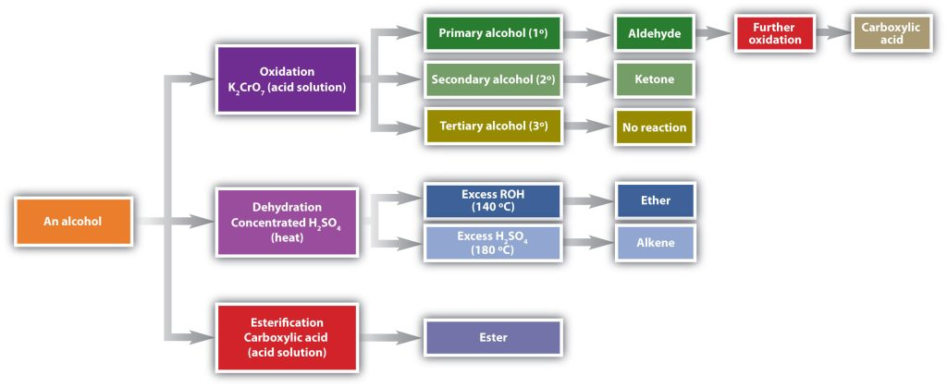
Figure 23.4a
Figure 23.4a. Reactions of Alcohols. (Credits: Introduction to Chemistry: GOB (V. 1.0)., CC BY-NC-SA 3.0.)

Slide 28
Figure 23.4b
Figure 23.4b. Oxidation of ethanol to ethanal (acetaldehyde). (Credit: Introduction to Chemistry: GOB (V. 1.0)., CC BY-NC-SA 3.0.)

Slide 29
Figure 23.4c
Figure 23.4c. Oxidation of propan-2-ol (isopropyl alcohol) to propanone (acetone) (Credit: Introduction to Chemistry: GOB (V. 1.0)., CC BY-NC-SA 3.0).

Slide 30
Figure 23.4d
Figure 23.4d. Oxidation of isocitrate to oxalosuccinate. (Credit: Introduction to Chemistry: GOB (V. 1.0)., CC BY-NC-SA 3.0).

Slide 31
Figure 23.4e
Figure 23.4e. Elimination of water (dehydration) from an alcohol to form an alkene. (Credit: Introduction to Chemistry: GOB (V. 1.0)., CC BY-NC-SA 3.0.)

Slide 32
Figure 23.4f
Figure 23.4f. Dehydration of unsymmetrical secondary alcohol showing major and minor product according to Zaitsev's rule. (credit: Supplemental Modules (Organic Chemistry), CC BY-NC-SA 4.0)

Slide 33
Figure 23.4g
Figure 23.4g. Elimination of water from two alcohol molecules to form an ether. (Credit: Introduction to Chemistry: GOB (V. 1.0)., CC BY-NC-SA 3.0.)

Slide 34
Figure 23.4h
Figure 23.4h. Dehydration of 2-phosphoglycerate into phosphoenolpyruvate. (Credit: Introduction to Chemistry: GOB (V. 1.0)., CC BY-NC-SA 3.0.)

Slide 35
Figure 23.4i
Figure 23.4i. Process of esterification which combines a carboxylic acid with an alcohol (credit: Organic Chemistry (Wade), CC BY-NC-SA 4.0).

Slide 36
Figure 23.4j
Figure 23.4j. Reaction of butanoic acid with methanol to form methyl butanoate (credit: Organic Chemistry (Wade), CC BY-NC-SA 4.0).

Slide 37
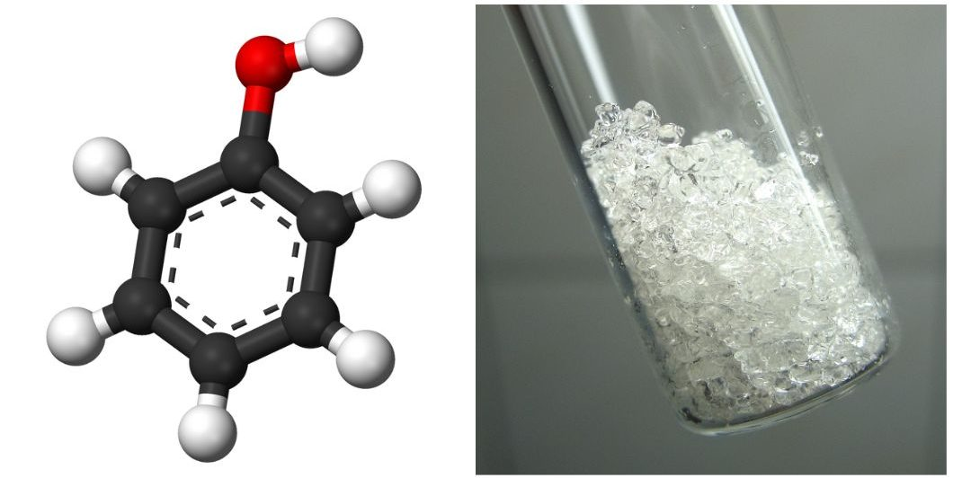
Figure 23.5a
Figure 23.5a. Structure of phenol (left). Crystal form of phenol (right). (credit: CHEM 1152: Survey of Chemistry II (GSU - Dr. Osborne), CC BY-NC-SA 4.0)

Slide 38
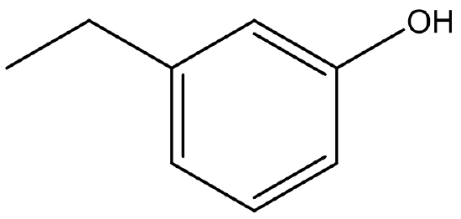
Figure 23.5b
Figure 23.5b. Structure of a substituted phenol (credit: CHEM 1152: Survey of Chemistry II (GSU - Dr. Osborne), CC BY-NC-SA 4.0)

Slide 39
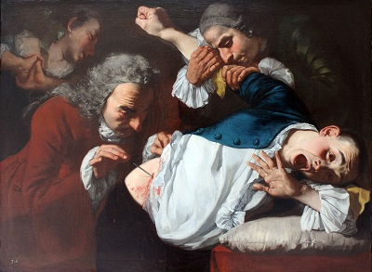
Figure 23.5c
Figure 23.5c. An operation in 1753, painted by Gaspare Traversi, of a surgery before antiseptics were used. (Credit: Oil Painting by Gaspare Traversi, Public Domain)

Slide 40
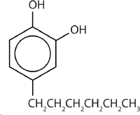
Figure 23.5d
Figure 23.5d. The compound 4-hexylresorcinol is mild enough to be used as the active ingredient in antiseptic preparations for use on the skin. (Credit: Intro Chem: GOB (V. 1.0)., CC BY-NC-SA 3.0., edited by (Ball et al.) CC BY-NC-SA 4.0. )

Slide 41
Figure 23.6a
Figure 23.6a. a) General structure of ethers, b) condensed structure of methoxymethane (dimethyl ether) and c) ball and stick model of methoxymethane (dimethyl ether) (credit left: Image by Hbf878, CC0; middle: Image by B Levin13, CC BY-SA 3.0; right: Image by Benjah-bmm27, PDM)

Slide 42
Table 23.6a
Table 23.6a. Comparison of Boiling Points of Alkanes, Alcohols and Ethers
Condensed Structural Formula | IUPAC Name | Common Name | Molar Mass | Boiling Point (°C) | Intermolecular Hydrogen Bonding in Pure Liquid?
CH₃CH₂CH₃ | propane | propane | 44 | –42 | no
CH₃OCH₃ | methoxymethane | dimethyl ether | 46 | –25 | no
CH₃CH₂OH | ethanol | ethyl alcohol | 46 | 78 | yes
CH₃CH₂CH₂CH₂CH₃ | pentane | pentane | 72 | 36 | no
CH₃CH₂OCH₂CH₃ | ethoxyethane | diethyl ether | 74 | 35 | no
CH₃CH₂CH₂CH₂OH | butan-1-ol | butyl alcohol | 74 | 117 | yes
Source: "14.8: Ethers" In Basics of GOB (Ball et al.), CC BY-NC-SA 4.0.

Slide 43
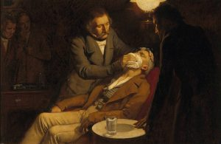
Figure 23.6b
Figure 23.6b. William Morton, a Boston dentist, introduced diethyl ether into surgical practice in 1846. This painting shows an operation in Boston in 1846 in which diethyl ether was used as an anesthetic. Inhalation of ether vapor produces unconsciousness by depressing the activity of the central nervous system. (Image credit: Oil painting (V0018140) by Ernest Board, PDM).

Slide 44
Figure 23.6c
Figure 23.6c. These three modern, inhalant, halogen-containing, anesthetic compounds (halothane, enflurane, and isoflurane) are less flammable than diethyl ether. (Credit: Intro Chem: GOB (V. 1.0)., CC BY-NC-SA 3.0.)

Slide 45
Figure 23.6d
Figure 23.6d. Formation of ether from intermolecular dehydration of two alcohol molecules (credit: General Chemistry 1 & 2, CC BY 4.0).

Slide 46
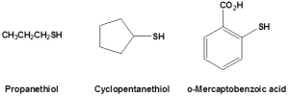
Figure 23.7a
Figure 23.7a. Thiol structures of propanethiol, cyclopentanethiol and o-mercaptobenzoic acid (credit: Organic Chemistry (Wade), CC BY-NC-SA 4.0).

Slide 47
Figure 23.7b
Figure 23.7b. Mild oxidation of thiol to disulfide (credit: Organic Chemistry (Wade), CC BY-NC-SA 4.0).

Slide 48
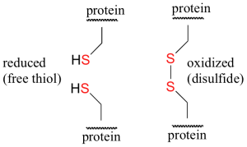
Figure 23.7c
Figure 23.7c. Difference between thiol and disulfide in protein structures (credit: Organic Chemistry (Wade), CC BY-NC-SA 4.0).

