Slide 1
Chapter 22
Alkenes, Alkynes and Aromatics
Slides to accompany Organic and Biochemistry Supplement to Enhanced Introductory College Chemistry by Gregory Anderson, Jen Booth, Caryn Fahey, Adrienne Richards, Samantha Sullivan Sauer, and David Wegman
Slide design and template by Revathi Mahadevan
Except where otherwise noted, images, tables & diagrams are reused from Organic and Biochemistry Supplement to Enhanced Introductory College Chemistry
Slides are licensed under CC-BY 4.0, Except while otherwise noted

Slide 2
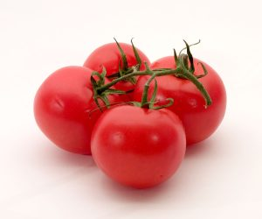
Figure 22.0a
Figure 22.0a. Tomatoes (Credit: Tomato by Softeis, CC BY-SA 3.0)

Slide 3
Figure 22.0b
Figure 22.0b: The bright red colour of tomatoes is due to lycopene - a polyene. (credit: Image by Jeff Dahl, PDM).

Slide 4
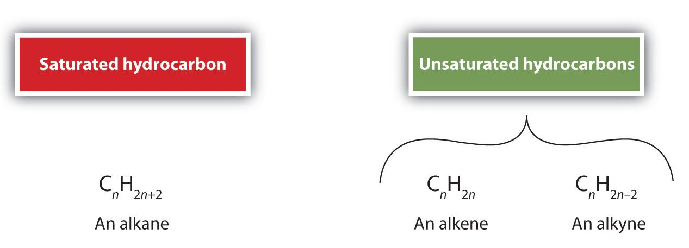
Figure 22.1a
Figure 22.1a. The general formulas of alkanes, alkenes and alkynes (credit: Intro Chem: GOB (V. 1.0)., CC BY-NC-SA 3.0).

Slide 5
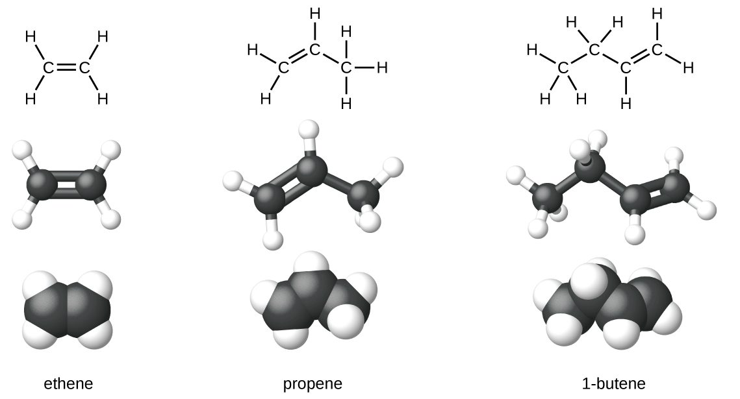
Figure 22.1b
Figure 22.1b. Expanded structures, ball-and-stick structures, and space-filling models for the alkenes ethene, propene, and 1-butene are shown. (credit: Chemistry (OpenStax), CC BY 4.0)

Slide 6
Table 22.1a
Table 22.1a. Physical Properties of Some Selected Alkenes
IUPAC Name | Molecular Formula | Condensed Structural Formula | Melting Point (°C) | Boiling Point (°C)
ethene | C₂H₄ | CH₂=CH₂ | –169 | –104
propene | C₃H₆ | CH₂=CHCH₃ | –185 | –47
1-butene | C₄H₈ | CH₂=CHCH₂CH₃ | –185 | –6
1-pentene | C₅H₁₀ | CH₂=CH(CH₂)₂CH₃ | –138 | 30
1-hexene | C₆H₁₂ | CH₂=CH(CH₂)₃CH₃ | –140 | 63
1-heptene | C₇H₁₄ | CH₂=CH(CH₂)₄CH₃ | –119 | 94
1-octene | C₈H₁₆ | CH₂=CH(CH₂)₅CH₃ | –102 | 121
Source: "13.1: Alkenes: Structures and Names" In Basics of GOB Chemistry (Ball et al.), CC BY-NC-SA 4.0.

Slide 7
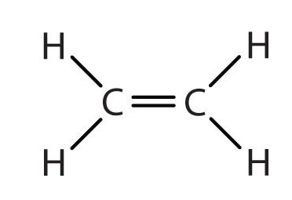
Figure 22.1c
Figure 22.1c. The structural representation of CH₂=CH₂ (credit: Intro Chem: GOB (V. 1.0)., CC BY-NC-SA 3.0).

Slide 8
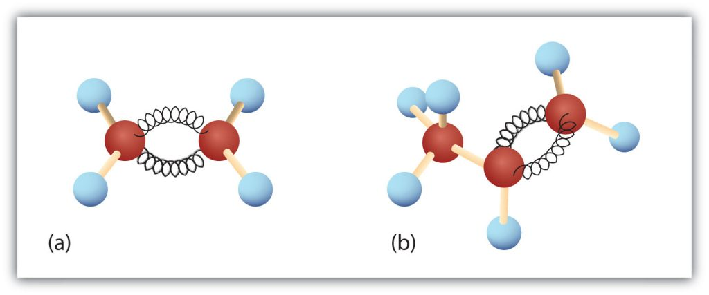
Figure 22.1d
Figure 22.1d. Ethene and Propene. The ball-and-spring models of ethene/ethylene (a) and propene/propylene (b) show their respective shapes, especially bond angles. (credit: Intro Chem: GOB (V. 1.0)., CC BY-NC-SA 3.0).

Slide 9
Figure 22.1e
Figure 22.1e. Finding the longest chain in an alkene using pentene as the example. (credit: Organic Chemistry (OpenStax), CC BY-NC-SA 4.0)

Slide 10
Figure 22.1f
Figure 22.1f. Numbering the carbon atoms in the chain to ensure the double-bond carbons receive the lowest possible numbers. (credit: Organic Chemistry (OpenStax), CC BY-NC-SA 4.0)

Slide 11
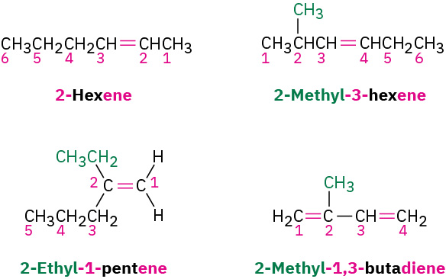
Figure 22.1g
Figure 22.1g. Examples when numbering substituents within an alkene chain or when you have more than one double-bond present. (credit: Organic Chemistry (OpenStax), CC BY-NC-SA 4.0)

Slide 12
Figure 22.1h
Figure 22.1h. Examples of naming cycloalkenes. (credit: Organic Chemistry (OpenStax), CC BY-NC-SA 4.0)

Slide 13
Figure 22.1i
Figure 22.1i. The molecular structure of linalool (credit: Image by Capaccio, CC BY-SA 3.0).

Slide 14
Figure 22.1j
Figure 22.1j. The molecular structure of ethyne. (credit: Chemistry (OpenStax), CC BY 4.0)

Slide 15
Figure 22.1k
Figure 22.1k. Numbering the alkyne at the end nearer the triple bond. (credit: Organic Chemistry (OpenStax), CC BY-NC-SA 4.0)

Slide 16
Figure 22.1l
Figure 22.1l. Examples of naming alkynes when numbering the double bond receives lower numbers than triple bonds. (credit: Organic Chemistry (OpenStax), CC BY-NC-SA 4.0)

Slide 17
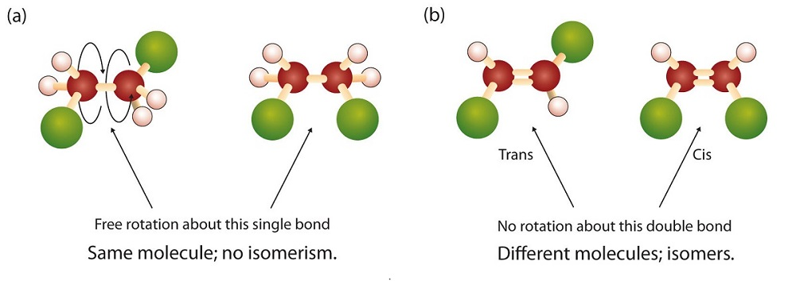
Figure 22.2a
Figure 22.2a. Rotation about Bonds. In 1,2-dichloroethane (a), free rotation about the C–C bond allows the two structures to be interconverted by a twist of one end relative to the other. In 1,2-dichloroethene (b), restricted rotation about the double bond means that the relative positions of substituent groups above or below the double bond are significant. (Credit: Intro Chem: GOB (V. 1.0)., CC BY-NC-SA 3.0 ; edited by Ball et al.)

Slide 18
Figure 22.2b
Figure 22.2b.1, 2-dichloroethane on the left (a) and 1.2-dichloroethane on the left (b). (Credit: Intro Chem: GOB (V. 1.0)., CC BY-NC-SA 3.0)

Slide 19
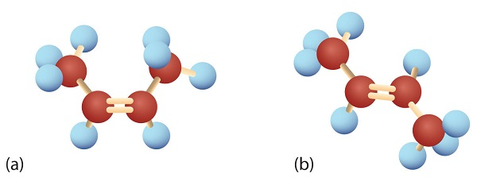
Figure 22.2c
Figure 22.2c. Ball-and-Spring Models of (a) Cis-2-Butene and (b) Trans-2-Butene. Cis-trans isomers have different physical, chemical, and physiological properties. (Credit: Intro Chem: GOB (V. 1.0)., CC BY-NC-SA 3.0 ; edited by Ball et al.)

Slide 20
Figure 22.2d
Figure 22.2d. Models of (left) Cis-2-Butene and (right) Trans-2-Butene. (Credit: Intro Chem : GOB (V. 1.0)., CC BY-NC-SA 3.0).

Slide 21
Figure 22.2e
Figure 22.2e. Different views of the propene molecule (flip vertically). These are not isomers. (Credit: Intro Chem: GOB (V. 1.0)., CC BY-NC-SA 3.0).

Slide 22
Figure 22.2f
Figure 22.2f. Cis-1,2-dimethylcyclopropane and trans-1,2-dimethylcyclopropane. (Credit: Intro Chem: GOB (V. 1.0)., CC BY-NC-SA 3.0).

Slide 23
Figure 22.3a
Figure 22.3a. Addition reaction of ethylene with hydrogen to produce ethane. (Credit: Intro Chemistry: GOB (V. 1.0)., CC BY-NC-SA 3.0).

Slide 24
Figure 22.3b
Figure 22.3b. The halogenation of ethylene and bromine to produce 1,2-dibromoethane. (Credit: Intro Chemistry: GOB (V. 1.0)., CC BY-NC-SA 3.0).

Slide 25
Figure 22.3c
Figure 22.3c. Hydration of ethylene and water to produce ethanol (Credit: Intro Chemistry: GOB (V. 1.0)., CC BY-NC-SA 3.0).

Slide 26
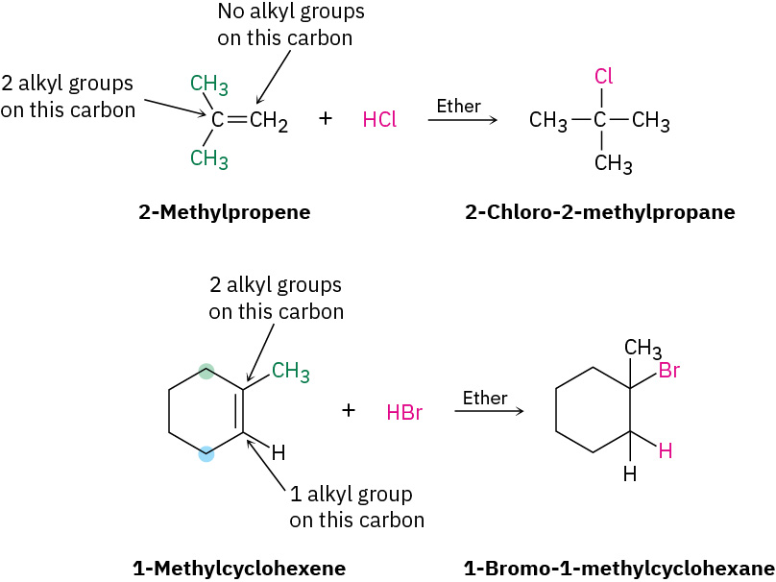
Figure 22.3d
Figure 22.3d. Addition reactions using Markovnikov's rule for the reactions of 2-methylpropene with HCl (top) and 1-methylcylcohexene with HBr (bottom). (credit: Organic Chemistry (OpenStax), CC BY-NC-SA 4.0).

Slide 27
Figure 22.3e
Figure 22.3e. Addition reaction when the double-bonded carbon has the same degree of substitution as shown when 2-pentene reacts with HBr. (credit: Organic Chemistry (OpenStax), CC BY-NC-SA 4.0).

Slide 28
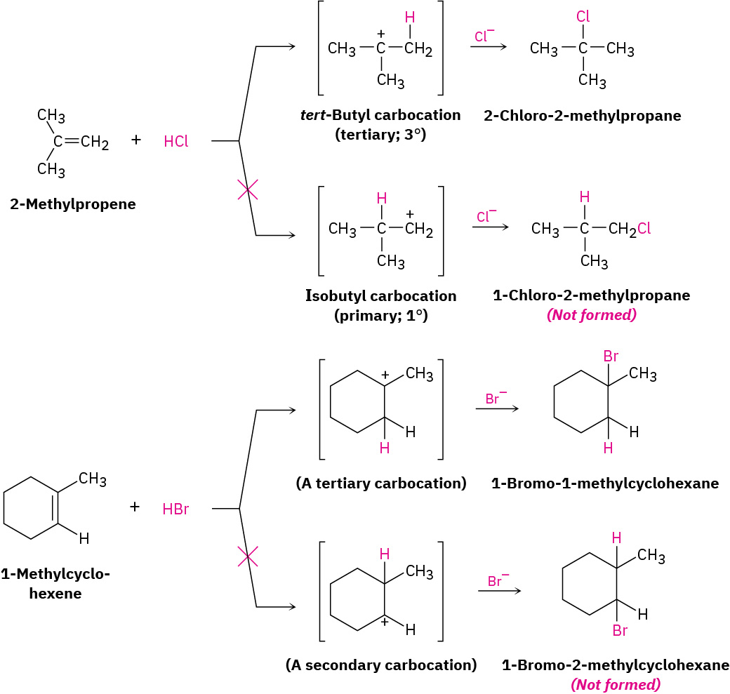
Figure 22.3f
Figure 22.3f. Addition reaction involving the addition of H⁺ to 2-methylpropene to yield intermediate tertiary carbocation (credit: Organic Chemistry (OpenStax), CC BY-NC-SA 4.0).

Slide 29
Figure 22.3g
Figure 22.3g. Addition reaction involving acetylene and bromine (credit: Chemistry: Atoms First 2e (OpenStax), CC BY 4.0)

Slide 30
Figure 22.3h
Figure 22.3h. HBr addition to 1-hexyne (top) and HCl addition to 3-hexyne (bottom). (credit: Organic Chemistry (OpenStax), CC BY-NC-SA 4.0).

Slide 31
Figure 22.3i
Figure 22.3i. Br₂ addition to 1-butyne. (credit: Organic Chemistry (OpenStax), CC BY-NC-SA 4.0).

Slide 32
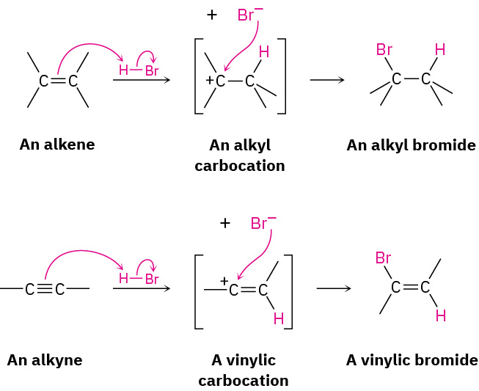
Figure 22.3j
Figure 22.3j. The mechanism of alkene and alkyne addition involving carbocation intermediate. (credit: Organic Chemistry (OpenStax), CC BY-NC-SA 4.0).

Slide 33
Figure 22.3k
Figure 22.3k. Hydration of 1-hexyne to produce 2-hexanone. (credit: Organic Chemistry (OpenStax), CC BY-NC-SA 4.0).

Slide 34
Figure 22.3l
Figure 22.3l. Reduction of alkyne with H₂ over a metal with an alkene intermediate catalyst. (credit: Organic Chemistry (OpenStax), CC BY-NC-SA 4.0).

Slide 35
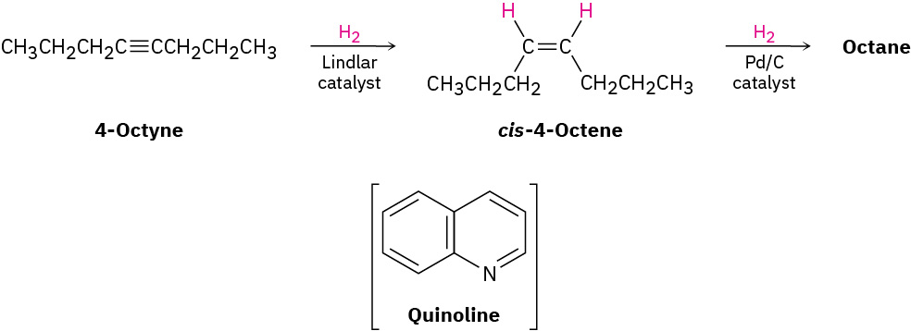
Figure 22.3m
Figure 22.3m. Complete reduction of 4-octyne. (credit: Organic Chemistry (OpenStax), CC BY-NC-SA 4.0).

Slide 36
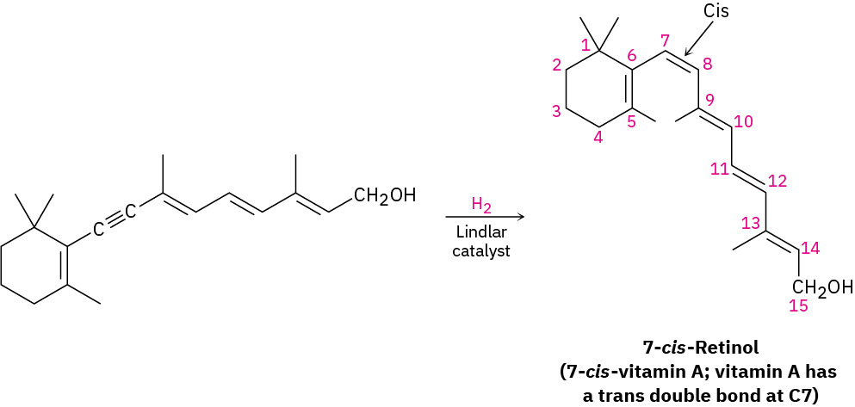
Figure 22.3n
Figure 22.3n. The cis isomer of vitamin A produced initially on hydrogenation is converted to the trans isomer by heating (credit: Organic Chemistry (OpenStax), CC BY-NC-SA 4.0).

Slide 37
Figure 22.3o
Figure 22.3o. 5-decyne gives trans-5-decene on treatment with lithium in liquid ammonia. (credit: Organic Chemistry (OpenStax), CC BY-NC-SA 4.0).

Slide 38
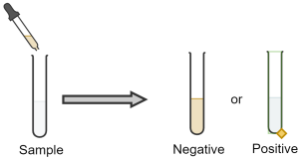
Figure 22.3p
Figure 22.3p. Bromine test for presence of double or triple carbon-carbon bond. Positive result is a colourless solution. Negative result is a brownish-red solution (credit: Samantha Sullivan Sauer, Created with Chemix, Chemix license)

Slide 39
Figure 22.3q
Figure 22.3q. Bromine test for presence of unsaturated hydrocarbons (credit: Samantha Sullivan Sauer, using Biovia Draw, CC BY-NC 4.0)

Slide 40
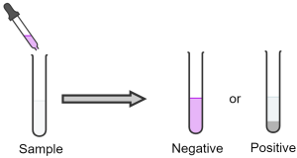
Figure 22.3r
Figure 22.3r. Permanganate test for presence of double or triple carbon-carbon bond. Positive result is a black precipitate. Negative result is a purplish solution (credit: Samantha Sullivan Sauer, Created with Chemix, Chemix license)

Slide 41
Figure 22.3s
Figure 22.3s. Permanganate test for presence of unsaturated hydrocarbons (credit: Samantha Sullivan Sauer, using Biovia Draw, CC BY-NC 4.0)

Slide 42
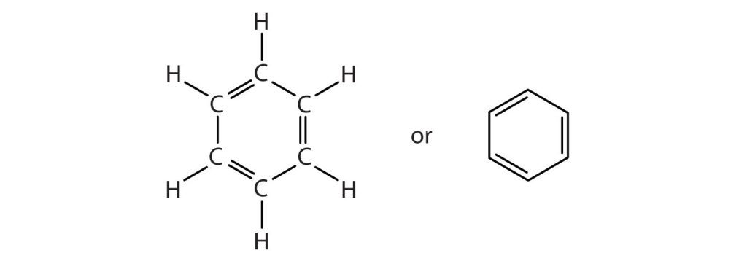
Figure 22.4a
Figure 22.4a. Benzene ring structural arrangement versions (credit: Intro Chem: GOB (V. 1.0)., CC BY-NC-SA 3.0).

Slide 43
Figure 22.4b
Figure 22.4b. Benzene ring represented as a hexagon with an inscribed circle (credit: Intro Chem: GOB (V. 1.0)., CC BY-NC-SA 3.0).

Slide 44
Table 22.4a
Table 22.4a. Some Representative Aromatic Compounds
Name | Structure | Typical Uses
aniline | C₆H₅–NH₂ | starting material for the synthesis of dyes, drugs, resins, varnishes, perfumes; solvent; vulcanizing rubber
benzoic acid | C₆H₅–COOH | food preservative; starting material for the synthesis of dyes and other organic compounds; curing of tobacco
bromobenzene | C₆H₅–Br | starting material for the synthesis of many other aromatic compounds; solvent; motor oil additive
nitrobenzene | C₆H₅–NO₂ | starting material for the synthesis of aniline; solvent for cellulose nitrate; in soaps and shoe polish
phenol | C₆H₅–OH | disinfectant; starting material for the synthesis of resins, drugs, and other organic compounds
toluene | C₆H₅–CH₃ | solvent; gasoline octane booster; starting material for the synthesis of benzoic acid,
Source: "13.8: Structure and Nomenclature of Aromatic Compounds" In Basics of GOB Chemistry (Ball et al.), CC BY-NC-SA 4.0.

Slide 45
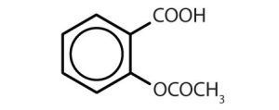
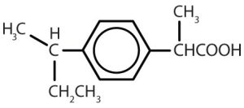
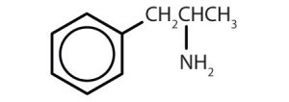
Table 22.4b
Table 22.4b. Some Drugs that Contain a Benzene Ring
Name | Structure
aspirin
acetaminophen
ibuprofen
amphetamine
sulfanilamide
Image Credits: Intro Chem: GOB (V. 1.0)., CC BY-NC-SA 3.0

Slide 46
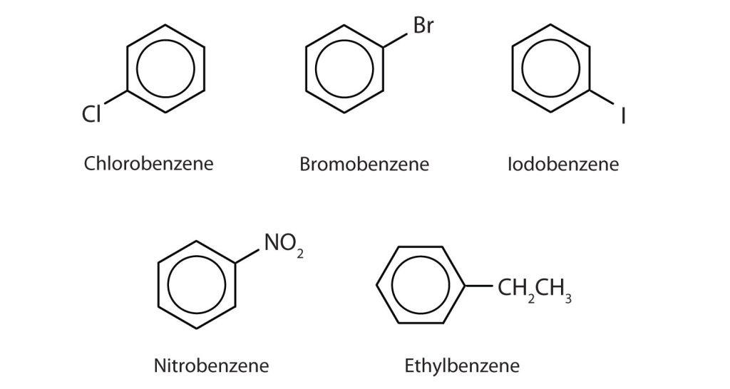
Figure 22.4c
Figure 22.4c. Some Benzene Derivatives. These compounds are named in the usual way with the group that replaces a hydrogen atom named as a substituent group: Cl as chloro, Br as bromo, I as iodo, NO₂ as nitro, and CH₃CH₂ as ethyl (credit: Intro Chem: GOB (V. 1.0)., CC BY-NC-SA 3.0).

Slide 47
Figure 22.4d
Figure 22.4d. Common aromatic structures representing toluene, phenol and aniline (credit: Intro Chem: GOB (V. 1.0)., CC BY-NC-SA 3.0).

Slide 48
Figure 22.4e
Figure 22.4e. The three isomeric dichlorobenzenes (credit: Intro Chem: GOB (V. 1.0)., CC BY-NC-SA 3.0).

Slide 49
Table 22.4c.
Table 22.4c. Physical Properties of Dichlorobenzenes
Compound | Chemical Formula | Molecular Weight | Boiling Point | Melting Point
1,2-dichlorobenzene (o-dichlorobenzene) | C₆H₄Cl₂ | 147.00 g/mol | 180ºC | -17ºC
1,3-dichlorobenzene (m-dichlorobenzene) | C₆H₄Cl₂ | 147.00 g/mol | 173ºC | -25ºC
1,4-dichlorobenzene (p-dichlorobenzene) | C₆H₄Cl₂ | 147.00 g/mol | 174ºC | 53ºC
Data sources credit: National Center for Biotechnology Information, 2024a, b, c

Slide 50
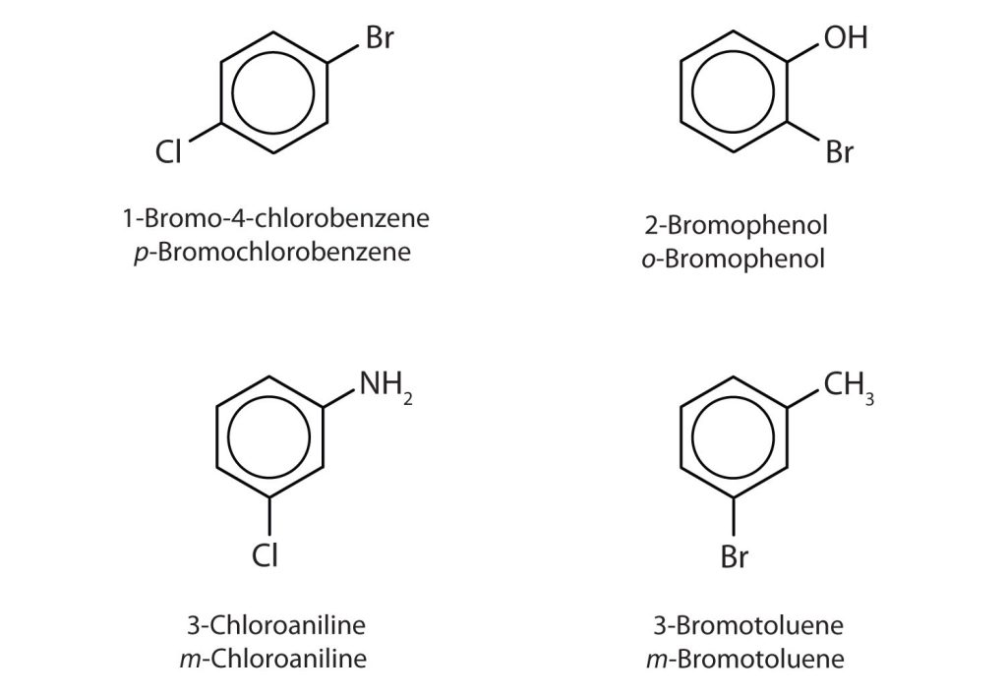
Figure 22.4f
Figure 22.4f. Common names using ortho, meta and para and where the carbon atom that bears the group responsible for the name is given the number 1 (credit: Intro Chem: GOB (V. 1.0)., CC BY-NC-SA 3.0).

Slide 51
Figure 22.4g
Figure 22.4g. Different ways to represent the phenyl group using a condensed structure, line structure and phenyl as a substituent (credit: Intro Chem: GOB (V. 1.0)., CC BY-NC-SA 3.0).

Slide 52
Figure 22.4h
Figure 22.4h. Examples of polycyclic aromatic compounds naphthalene, anthracene and phenanthrene. (credit: Intro Chem: GOB (V. 1.0)., CC BY-NC-SA 3.0).

Slide 53
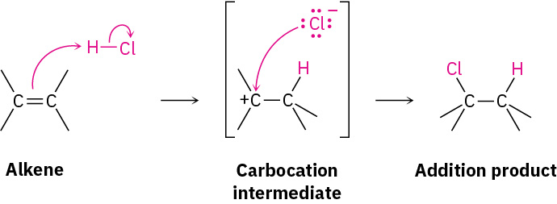
Figure 22.5a
Figure 22.5a. Electrophilic substitution of ethene with HCl gives a carbocation intermediate. (credit: Organic Chemistry (OpenStax), CC BY-NC-SA 4.0)

Slide 54
Figure 22.5b
Figure 22.5b. The bromination of benzene using FeBr₃ as a catalyst yielding three resonance forms of nonaromatic carbocation intermediate. (credit: Organic Chemistry (OpenStax), CC BY-NC-SA 4.0)

Slide 55
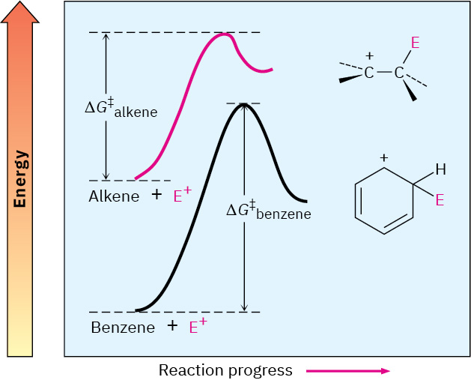
Figure 22.5c
Figure 22.5c. A comparison of the reactions of an electrophile (E⁺) with an alkene and with benzene to see the ∆G‡ difference. (credit: Organic Chemistry (OpenStax), CC BY-NC-SA 4.0)

Slide 56
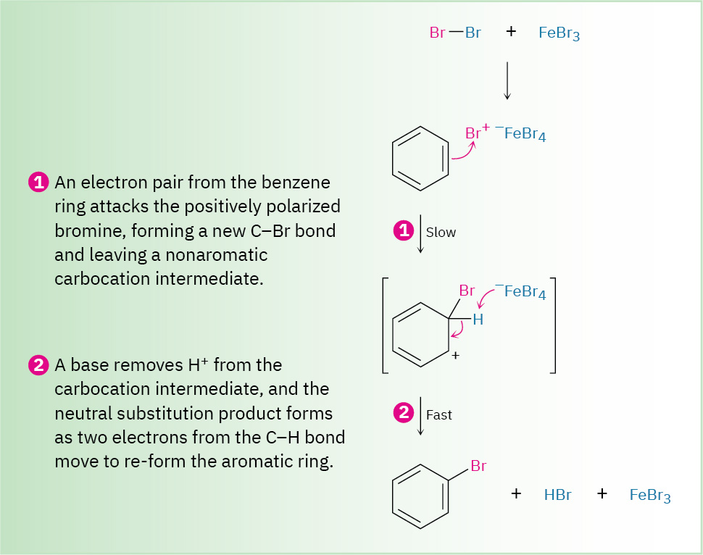
Figure 22.5d
Figure 22.5d. Overall mechanism of the bromination of benzene using FeBr₃ as a catalyst to yield bromobenzene, HBr and FeBr₃. (credit: Organic Chemistry (OpenStax), CC BY-NC-SA 4.0)

Slide 57
Figure 22.5e
Figure 22.5e. General electrophilic aromatic substitution of benzene with Br₂ using FeBr₃ as a catalyst yields bromobenzene. (credit: Samantha Sullivan Sauer / Biovia Draw, CC BY-NC 4.0.)

Slide 58
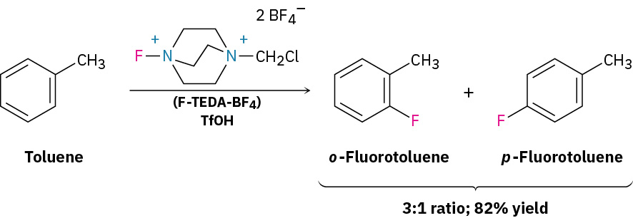
Figure 22.5f
Figure 22.5f. Electrophilic substitution of toluene using F-TEDA-BF₄ as a catalyst to yield o-fluorotoluene and p-fluorotoluene in a 3:1 ratio respectively. (credit: Organic Chemistry (OpenStax), CC BY-NC-SA 4.0)

Slide 59
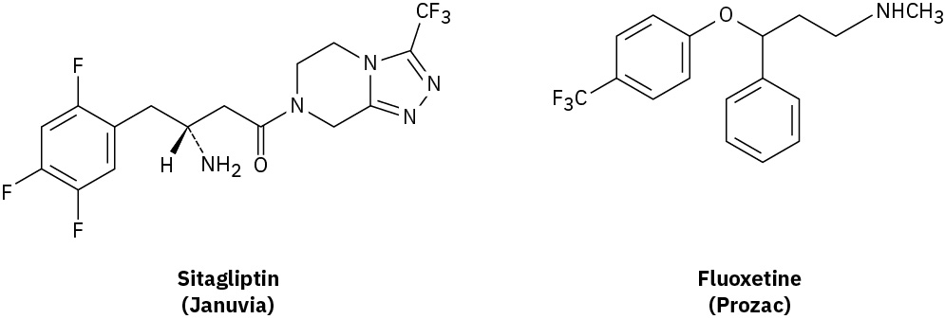
Figure 22.5g
Figure 22.5g. Structural representations of Sitagliptin (Januvia) and fluoxetine (Prozac). (credit: Organic Chemistry (OpenStax), CC BY-NC-SA 4.0)

Slide 60
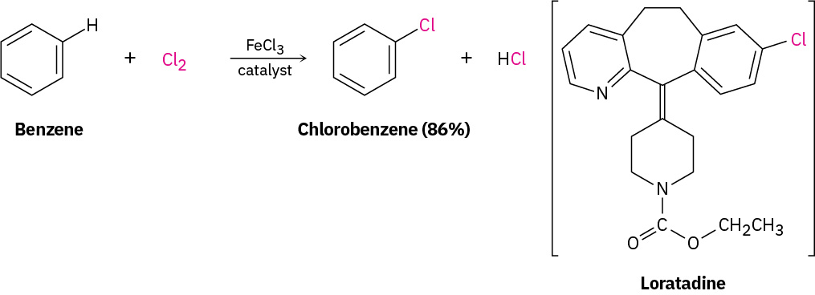
Figure 22.5h
Figure 22.5h. Benzene reacting with Cl₂ in the presence of FeCl₃ catalyst to yield chlorobenzenes (left). This process is also used to synthesize loratadine, marketed as Claritin (right). (credit: Organic Chemistry (OpenStax), CC BY-NC-SA 4.0)

Slide 61
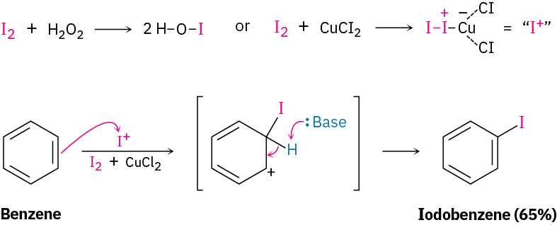
Figure 22.5i
Figure 22.5i. Benzene reacting with iodine in the presence of an oxidizing agent copper salt (CuCl₂) to yield iodobenzene. (credit: Organic Chemistry (OpenStax), CC BY-NC-SA 4.0)

Slide 62
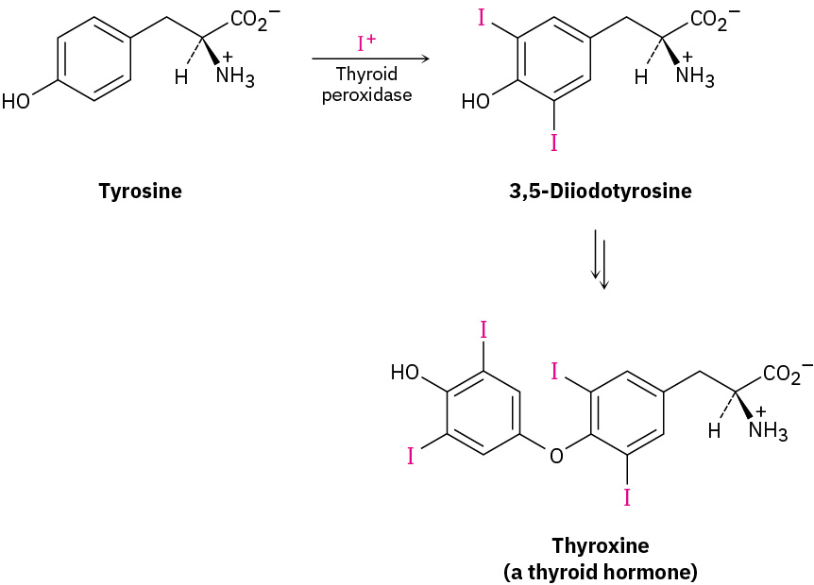
Figure 22.5j
Figure 22.5j. Tyrosine is iodinated with thyroid peroxidase to produce thyroxine (a thyroid hormone). (credit: Organic Chemistry (OpenStax), CC BY-NC-SA 4.0)

Slide 63
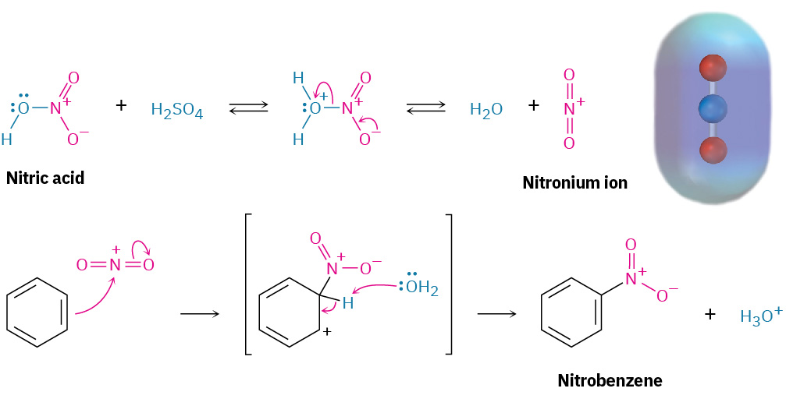
Figure 22.5k
Figure 22.5k. Nitration of benzene occurs with a mixture of sulfuric acid and nitric acid to yield nitrobenzene. (credit: Organic Chemistry (OpenStax), CC BY-NC-SA 4.0)

Slide 64
Figure 22.5l
Figure 22.5l. Electrophilic nitration of nitrobenzene in the presence of Fe, H₃O⁺ and OH⁻ to yield aniline. (credit: Organic Chemistry (OpenStax), CC BY-NC-SA 4.0)

Slide 65
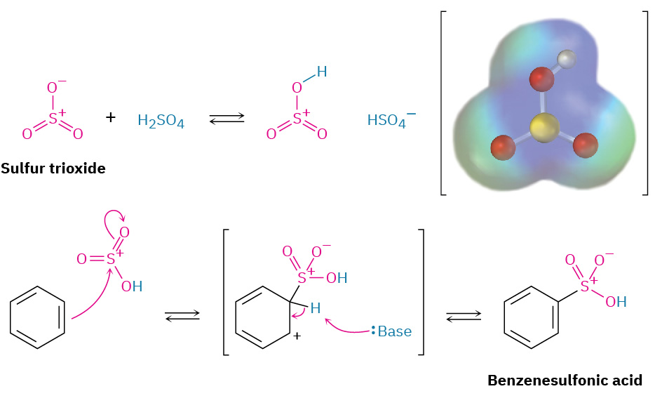
Figure 22.5m
Figure 22.5m. Sulfonation of benzene using a mixture of sulfur trioxide and sulfuric acid yields benzenesulfonic acid. (credit: Organic Chemistry (OpenStax), CC BY-NC-SA 4.0)

Slide 66
Figure 22.5n
Figure 22.5n. The molecular structure of sulfanilamide (an antibiotic). (credit: Organic Chemistry (OpenStax), CC BY-NC-SA 4.0)

Slide 67
Figure 22.5o
Figure 22.5o. Hydroxylation of p-hydroxyphenylacetate to give 3,4-dihydroxyphenylacetate as example of a biological pathway. (credit: Organic Chemistry (OpenStax), CC BY-NC-SA 4.0)

Slide 68
Figure 22.5p
Figure 22.5p. Butylbenzene is oxidized by aqueous KMnO₄ to give benzoic acid. (credit: Organic Chemistry (OpenStax), CC BY-NC-SA 4.0)

Slide 69
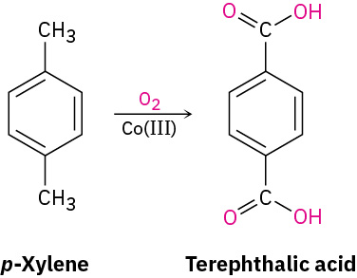
Figure 22.5q
Figure 22.5q. Preparation of the terephthalic acid by oxidation of p-xylene, using air as the oxidant and Co(III) salts as catalyst (credit: Organic Chemistry (OpenStax), CC BY-NC-SA 4.0)

Slide 70
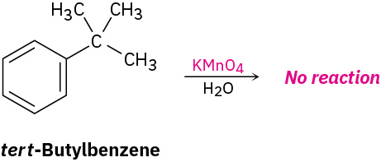
Figure 22.5r
Figure 22.5r. tert-Butylbenzene given it has no benzylic hydrogens produces no reaction. (credit: Organic Chemistry (OpenStax), CC BY-NC-SA 4.0)

Slide 71
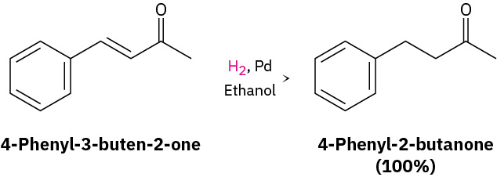
Figure 22.5s
Figure 22.5s. 4-phenyl-3-buten-2-one is reduced to 4-phenyl-2-butanone using a palladium catalyst at room temperature and atmospheric pressure and there is no effect on the benzene ring. (credit: Organic Chemistry (OpenStax), CC BY-NC-SA 4.0)

Slide 72
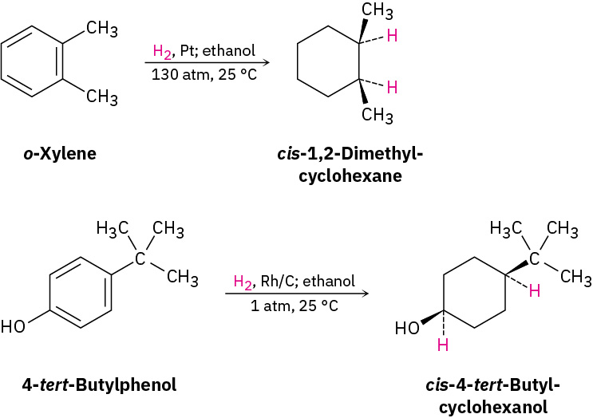
Figure 22.5t
Figure 22.5t. Hydrogenation of aromatic compounds o-xylene yields 1,2-dimethylcyclohexane (top) and 4-tert-butylphenol yields 4-tert-butylcyclohexanol (bottom). (credit: Organic Chemistry (OpenStax), CC BY-NC-SA 4.0)

Slide 73
Figure 22.5u
Figure 22.5u. Benzene reacts with CH₃COCl and aluminum chloride as the catalyst to produce phenylethanone. (credit: Supplemental Modules (Organic Chemistry), CC BY-NC 4.0).

Slide 74
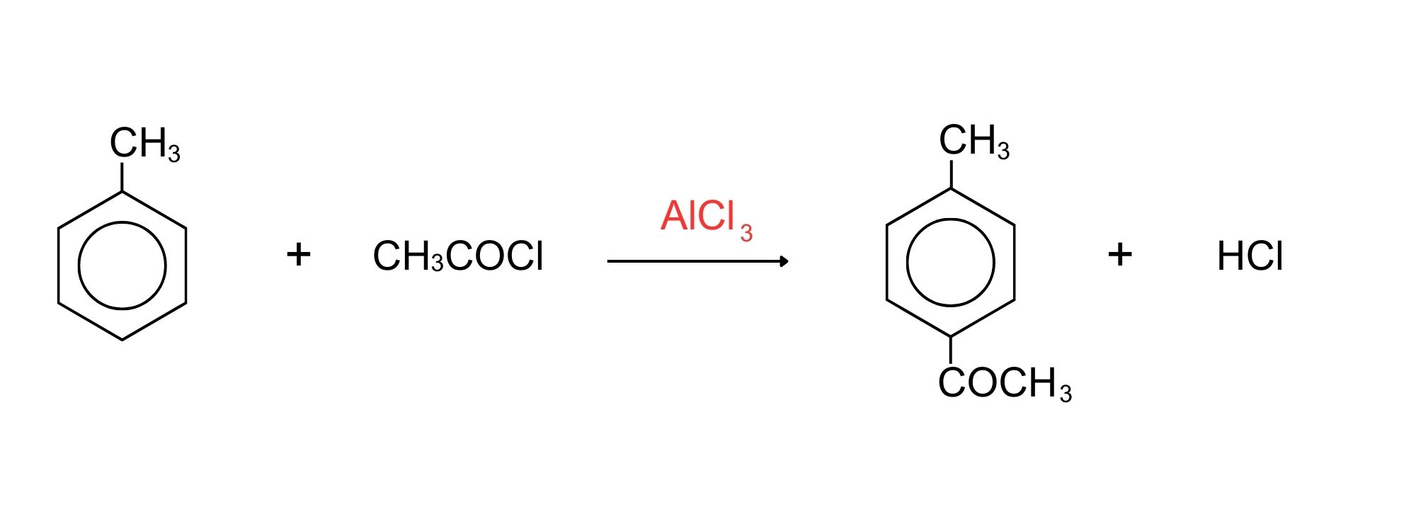
Figure 22.5v
Figure 22.5v. The reaction of methylbenzene with CH₃COCl and aluminum chloride as the catalyst to move the new group into the 4-position. (credit: Supplemental Modules (Organic Chemistry), CC BY-NC 4.0).

Slide 75
Figure 22.5w
Figure 22.5w. The reaction of chloromethane with benzene and aluminum chloride as the catalyst to produce an alkylated benzene.(credit: Supplemental Modules (Organic Chemistry), CC BY-NC 4.0).

Slide 76
Figure 22.5x
Figure 22.5x. The reaction of benzene with ethene to produce ethylbenzene using a catalyst. (credit: Supplemental Modules (Organic Chemistry), CC BY-NC 4.0).

