Slide 1
Chapter 21
Advanced Theories of Covalent Bonding
Slides to accompany Organic and Biochemistry Supplement to Enhanced Introductory College Chemistry by Gregory Anderson, Jen Booth, Caryn Fahey, Adrienne Richards, Samantha Sullivan Sauer, and David Wegman
Slide design and template by Revathi Mahadevan
Except where otherwise noted, images, tables & diagrams are reused from Organic and Biochemistry Supplement to Enhanced Introductory College Chemistry
Slides are licensed under CC-BY 4.0, Except while otherwise noted

Slide 2
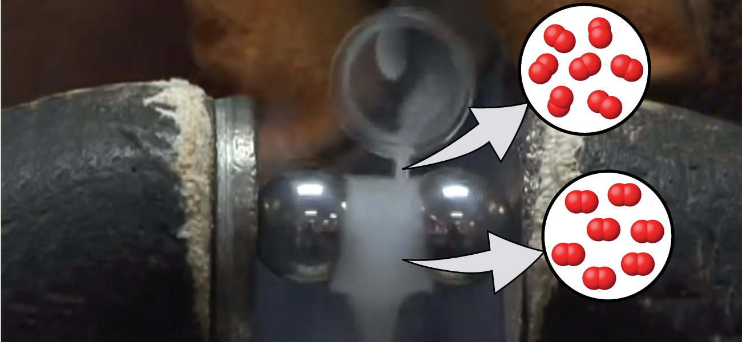
Figure 21.0a
Figure 21.0a. Oxygen molecules orient randomly most of the time, as shown in the top magnified view. However, when we pour liquid oxygen through a magnet, the molecules line up with the magnetic field, and the attraction allows them to stay suspended between the poles of the magnet where the magnetic field is strongest. Other diatomic molecules (like N2) flow past the magnet. The detailed explanation of bonding described in this chapter allows us to understand this phenomenon. (credit: modification of work by Jefferson Lab)

Slide 3
Figure 21.0b
Figure 21.0b. Lewis structure of nitrogen molecule and oxygen molecule showing multiple bonds and lone pairs of electrons (credit: Chemistry (Open Stax), CC BY 4.0).

Slide 4
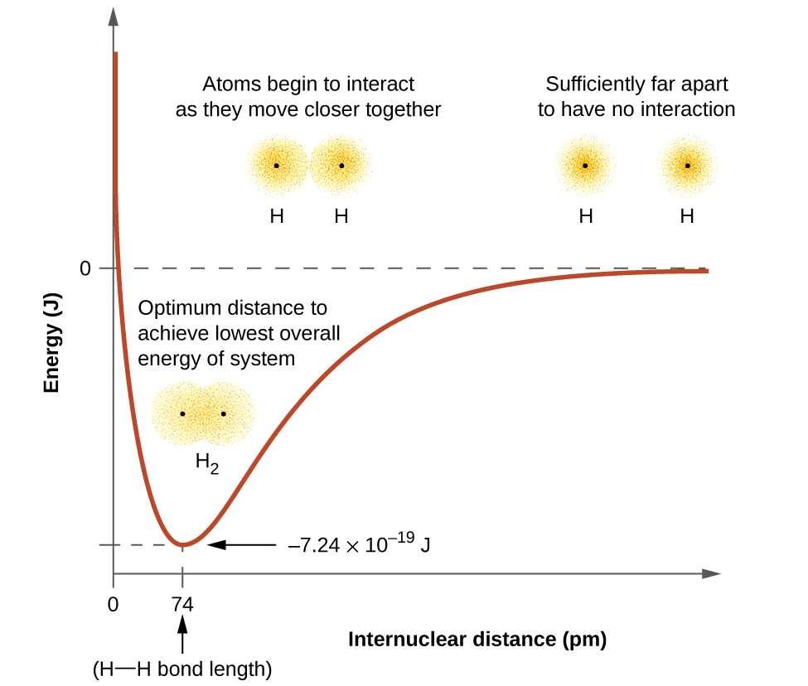
Figure 21.1a
Figure 21.1a. (a) The interaction of two hydrogen atoms changes as a function of distance. (b) The energy of the system changes as the atoms interact. The lowest (most stable) energy occurs at a distance of 74 pm, which is the bond length observed for the H₂ molecule (credit: Chemistry (OpenStax), CC BY 4.0).

Slide 5
Table 21.1a
Table 21.1a. Representative Bond Energies and Lengths
Bond | Length (pm) | Energy (kJ/mol) | Bond | Length (pm) | Energy (kJ/mol)
H–H | 74 | 436 | C–O | 140.1 | 358
H–C | 106.8 | 413 | C=O | 119.7 | 745
H–N | 101.5 | 391 | C≡O | 113.7 | 1072
H–O | 97.5 | 467 | H–Cl | 127.5 | 431
C–C | 150.6 | 347 | H–Br | 141.4 | 366
C=C | 133.5 | 614 | H–I | 160.9 | 298
C≡C | 120.8 | 839 | O–O | 148 | 146
C–N | 142.1 | 305 | O=O | 120.8 | 498
C=N | 130.0 | 615 | F–F | 141.2 | 159
C≡N | 116.1 | 891 | Cl–Cl | 198.8 | 243
Source: Table 8.1 in "8.1 Valence Bond Theory" in Chemistry (OpenStax), CC BY 4.0

Slide 6
Figure 21.1b
Figure 21.1b. (a) The overlap of two p orbitals is greatest when the orbitals are directed end to end. (b) Any other arrangement results in less overlap. The dots indicate the locations of the nuclei (credit: Chemistry (OpenStax), CC BY 4.0).

Slide 7
Figure 21.1c
Figure 21.1c. Sigma (σ) bonds form from the overlap of the following: (a) two s orbitals, (b) an s orbital and a p orbital, and (c) two p orbitals. The dots indicate the locations of the nuclei (credit: Chemistry (OpenStax), CC BY 4.0).

Slide 8
Figure 21.1d
Figure 21.1d. Pi (π) bonds form from the side-by-side overlap of two p orbitals. The dots indicate the location of the node within the nuclei (credit: Chemistry (OpenStax), CC BY 4.0).

Slide 9
Figure 21.1e
Figure 21.1e. Examples of single bond (one sigma bond), double bond (one sigma bond and one pi bond) and triple bond (one sigma bond and two pi bonds) (credit: Chemistry (OpenStax), CC BY 4.0).

Slide 10
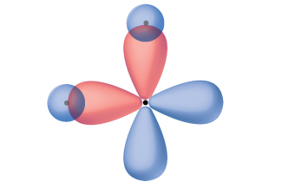
Figure 21.2a
Figure 21.2a. The hypothetical overlap of two of the 2p orbitals on an oxygen atom (red) with the 1s orbitals of two hydrogen atoms (blue) would produce a bond angle of 90°. This is not consistent with experimental evidence (credit: Chemistry (OpenStax), CC BY 4.0).

Slide 11
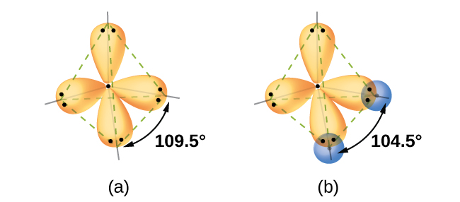
Figure 21.2b
Figure 21.2b. (a) A water molecule has four regions of electron density, so VSEPR theory predicts a tetrahedral arrangement of hybrid orbitals. (b) Two of the hybrid orbitals on oxygen contain lone pairs, and the other two overlap with the 1s orbitals of hydrogen atoms to form the O–H bonds in H₂O. This description is more consistent with the experimental structure (credit: Chemistry (OpenStax), CC BY 4.0).

Slide 12
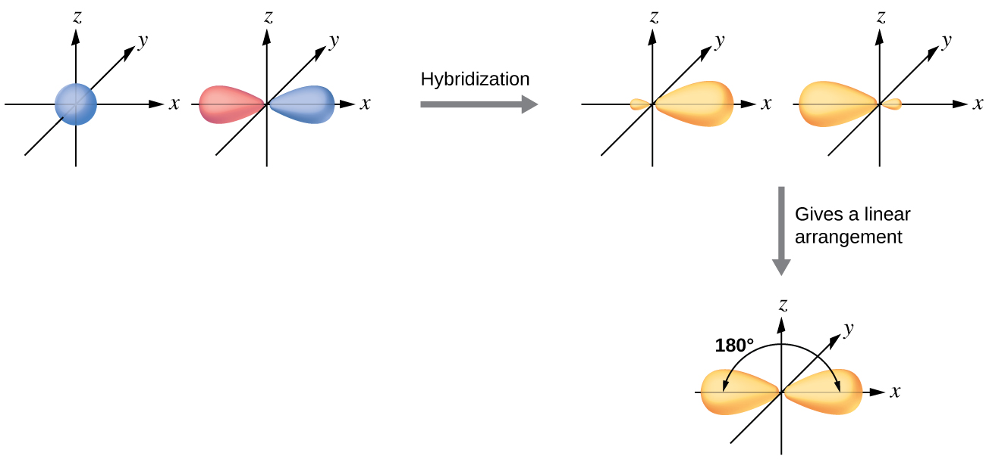
Figure 21.2c
Figure 21.2c. Hybridization of an s orbital (blue) and a p orbital (red) of the same atom produces two sp hybrid orbitals (purple). Each hybrid orbital is oriented primarily in just one direction. Note that each sp orbital contains one lobe that is significantly larger than the other. The set of two sp orbitals are oriented at 180°, which is consistent with the geometry for two domains (credit: Chemistry (OpenStax), CC BY 4.0).

Slide 13
Figure 21.2d
Figure 21.2d. This orbital energy-level diagram shows the sp hybridized orbitals on Be in the linear BeCl₂ molecule. Each of the two sp hybrid orbitals holds one electron and is thus half filled and available for bonding via overlap with a Cl 3p orbital (credit: Chemistry (OpenStax), CC BY 4.0).

Slide 14
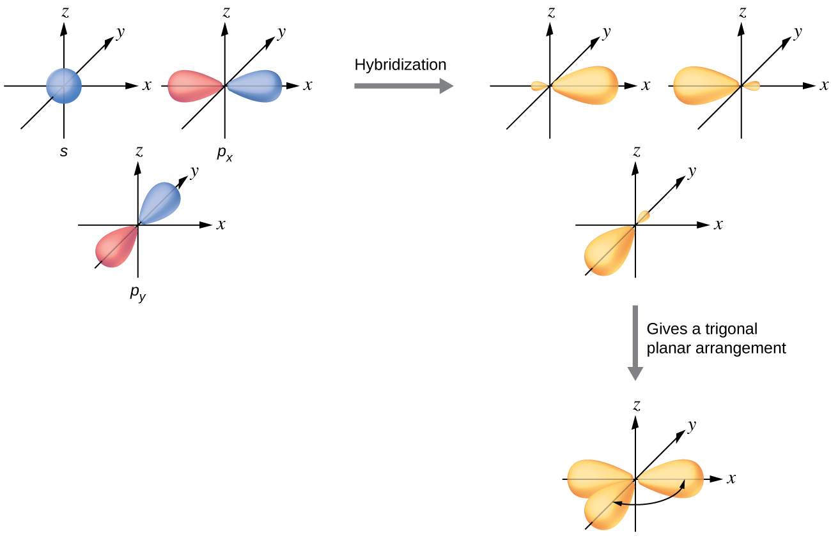
Figure 21.2e
Figure 21.2e. The hybridization of an s orbital (blue) and two p orbitals (red) produces three equivalent sp² hybridized orbitals (purple) oriented at 120° with respect to each other. The remaining unhybridized p orbital is not shown here, but is located along the z axis (credit: Chemistry (OpenStax), CC BY 4.0).

Slide 15
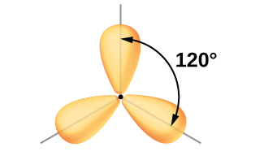
Figure 21.2f
Figure 21.2f. This alternate way of drawing the trigonal planar sp² hybrid orbitals is sometimes used in more crowded figures (credit: Chemistry (OpenStax), CC BY 4.0).

Slide 16
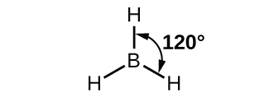
Figure 21.2g
Figure 21.2g. BH₃ is an electron-deficient molecule with a trigonal planar structure (credit: Chemistry (OpenStax), CC BY 4.0).

Slide 17
Figure 21.2h
Figure 21.2h. In an isolated B atom, there are one 2s and three 2p valence orbitals. When boron is in a molecule with three regions of electron density, three of the orbitals hybridize and create a set of three sp² orbitals and one unhybridized 2p orbital. The three half-filled hybrid orbitals each overlap with an orbital from a hydrogen atom to form three σ bonds in BH₃ (credit: Chemistry (OpenStax), CC BY 4.0).

Slide 18
Figure 21.2i
Figure 21.2i. The central atom(s) in each of the structures shown contain three regions of electron density and are sp² hybridized. As we know from the discussion of VSEPR theory, a region of electron density contains all of the electrons that point in one direction. A lone pair, an unpaired electron, a single bond, or a multiple bond would each count as one region of electron density (credit: Chemistry (OpenStax), CC BY 4.0).

Slide 19
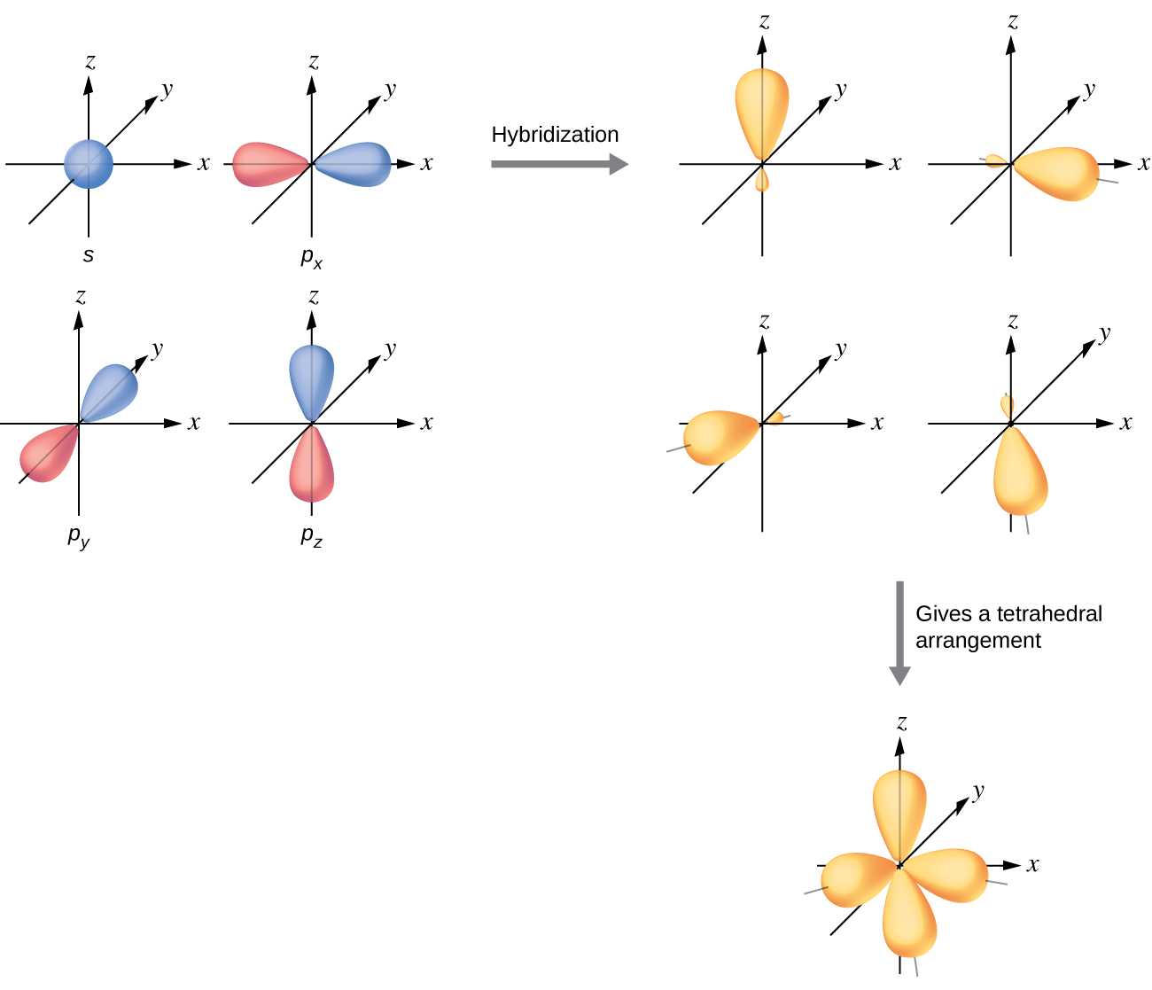
Figure 21.2j
Figure 21.2j. The hybridization of an s orbital (blue) and three p orbitals (red) produces four equivalent sp³ hybridized orbitals (purple) oriented at 109.5° with respect to each other (credit: Chemistry (OpenStax), CC BY 4.0).

Slide 20
Figure 21.2k
Figure 21.2k. The four valence atomic orbitals from an isolated carbon atom all hybridize when the carbon bonds in a molecule like CH₄ with four regions of electron density. This creates four equivalent sp³ hybridized orbitals. Overlap of each of the hybrid orbitals with a hydrogen orbital creates a C–H σ bond (credit: Chemistry (OpenStax), CC BY 4.0).

Slide 21
Figure 21.2l
Figure 21.2l. (a) In the ethane molecule, C₂H₆, each carbon has four sp³ orbitals. (b) These four orbitals overlap to form seven σ bonds (credit: Chemistry (OpenStax), CC BY 4.0).

Slide 22
Figure 21.2m
Figure 21.2m. The three compounds pictured exhibit sp³d hybridization in the central atom and a trigonal bipyramid form. SF4 and ClF₄⁺ have one lone pair of electrons on the central atom, and ClF₃ has two lone pairs giving it the T-shape shown (credit: Chemistry (OpenStax), CC BY 4.0).

Slide 23
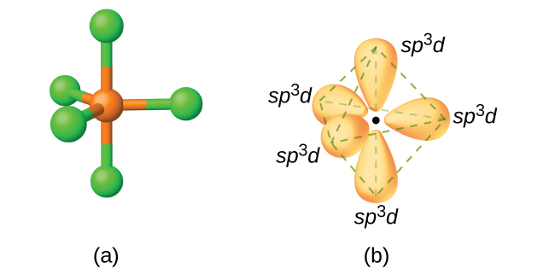
Figure 21.2n
Figure 21.2n. (a) The five regions of electron density around phosphorus in PCl₅ require five hybrid sp³d orbitals. (b) These orbitals combine to form a trigonal bipyramidal structure with each large lobe of the hybrid orbital pointing at a vertex. As before, there are also small lobes pointing in the opposite direction for each orbital (not shown for clarity) (credit: Chemistry (OpenStax), CC BY 4.0).

Slide 24
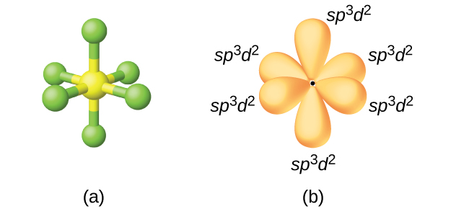
Figure 21.2o
Figure 21.2o. (a) Sulfur hexafluoride, SF₆, has an octahedral structure that requires sp³d² hybridization. (b) The six sp³d² orbitals form an octahedral structure around sulfur. Again, the minor lobe of each orbital is not shown for clarity (credit: Chemistry (OpenStax), CC BY 4.0).

Slide 25
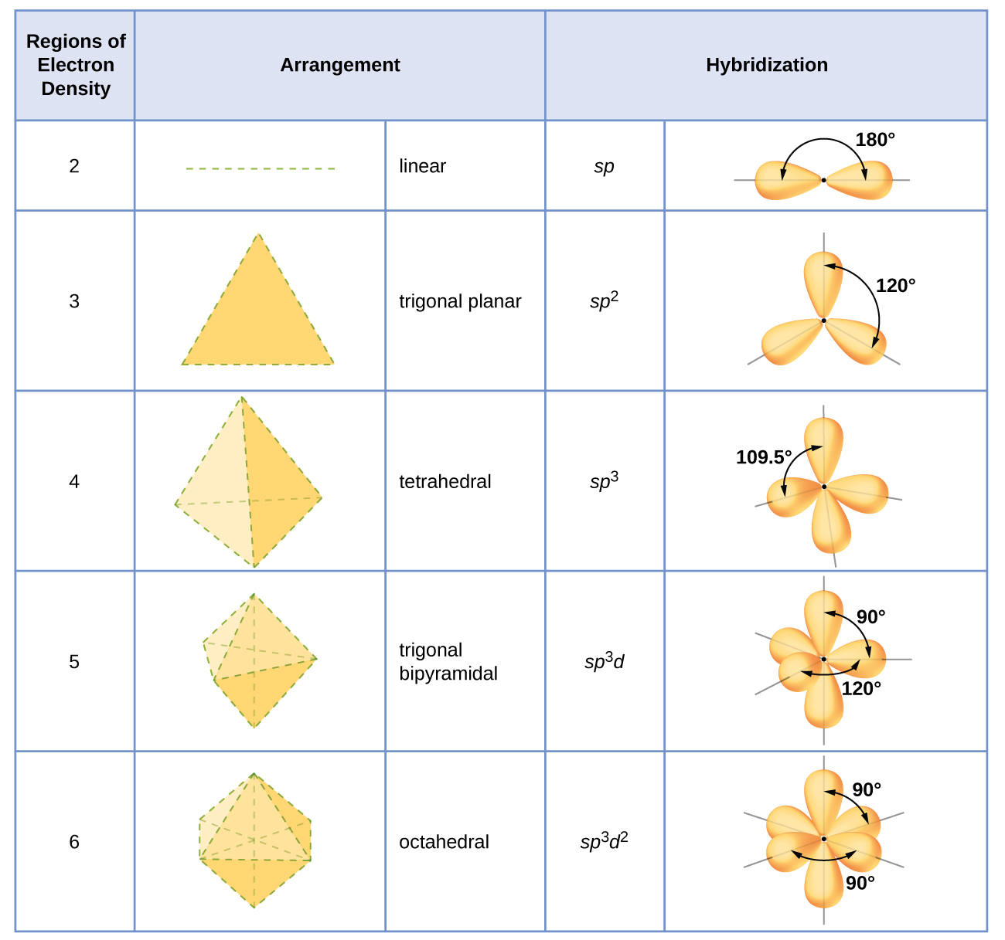
Figure 21.2p
Figure 21.2p. The shapes of hybridized orbital sets are consistent with the electron-pair geometries. For example, an atom surrounded by three regions of electron density is sp² hybridized, and the three sp² orbitals are arranged in a trigonal planar fashion (credit: Chemistry (OpenStax), CC BY 4.0).

Slide 26
Figure 21.2q
Figure 21.2q. Bond angle in H₂O (104.5º), H₂S (92.1º), and H₂Te (90º). (credit: Chemistry (OpenStax), CC BY 4.0).

Slide 27
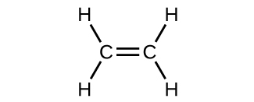
Figure 21.3a
Figure 21.3a. Lewis structure of ethene (credit: Chemistry (OpenStax), CC BY 4.0).

Slide 28
Figure 21.3b
Figure 21.3b. In ethene, each carbon atom is sp² hybridized, and the sp² orbitals and the p orbital are singly occupied. The hybrid orbitals overlap to form σ bonds, while the p orbitals on each carbon atom overlap to form a π bond (credit: Chemistry (OpenStax), CC BY 4.0).

Slide 29
Figure 21.3c
Figure 21.3c. In the ethene molecule, C₂H₄, there are (a) five σ bonds. One C–C σ bond results from overlap of sp² hybrid orbitals on the carbon atom with one sp² hybrid orbital on the other carbon atom. Four C–H bonds result from the overlap between the C atoms' sp² orbitals with s orbitals on the hydrogen atoms. (b) The π bond is formed by the side-by-side overlap of the two unhybridized p orbitals in the two carbon atoms. The two lobes of the π bond are above and below the plane of the σ system (credit: Chemistry (OpenStax), CC BY 4.0).

Slide 30
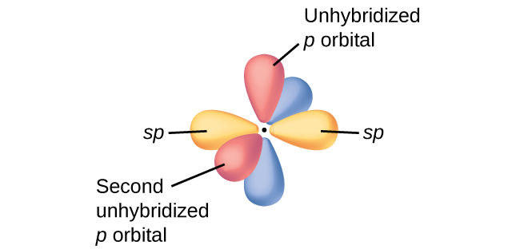
Figure 21.3d
Figure 21.3d. Diagram of the two linear sp hybrid orbitals of a carbon atom, which lie in a straight line, and the two unhybridized p orbitals at perpendicular angles (credit: Chemistry (OpenStax), CC BY 4.0).

Slide 31
Figure 21.3e
Figure 21.3e. (a) In the acetylene molecule, C₂H₂, there are two C–H σ bonds and a C≡C triple bond involving one C–C σ bond and two C–C π bonds. The dashed lines, each connecting two lobes, indicate the side-by-side overlap of the four unhybridized p orbitals. (b) This shows the overall outline of the bonds in C₂H₂. The two lobes of each of the π bonds are positioned across from each other around the line of the C–C σ bond (credit: Chemistry (OpenStax), CC BY 4.0).

Slide 32
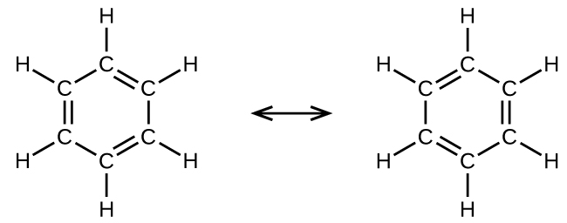
Figure 21.3f
Figure 21.3f. Each carbon atom in benzene, C₆H₆, is sp² hybridized, independently of which resonance form is considered. The electrons in the π bonds are not located in one set of p orbitals or the other, but rather delocalized throughout the molecule (credit: Chemistry (OpenStax), CC BY 4.0).

Slide 33
Figure 21.4a
Figure 21.4a. Lewis structure of oxygen diatomic molecule (credit: Chemistry (OpenStax), CC BY 4.0).

Slide 34
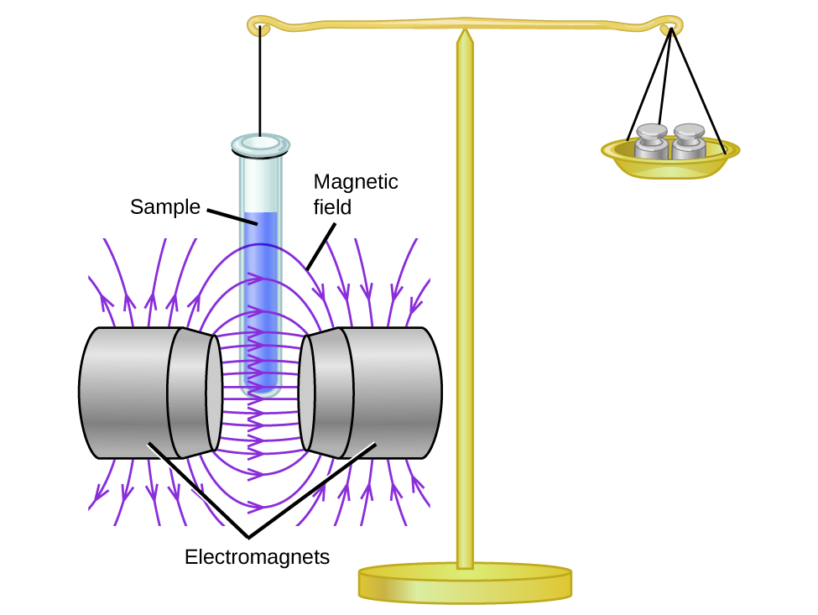
Figure 21.4b
Figure 21.4b. A Gouy balance compares the mass of a sample in the presence of a magnetic field with the mass with the electromagnet turned off to determine the number of unpaired electrons in a sample (credit: Chemistry (OpenStax), CC BY 4.0).

Slide 35
Table 21.4a
Table 21.4a. Comparison of Bond Theories
Valence Bond Theory | Molecular Orbital Theory
considers bonds as localized between one pair of atoms | considers electrons delocalized throughout the entire molecule
creates bonds from overlap of atomic orbitals (s, p, d…) and hybrid orbitals (sp, sp², sp³…) | combines atomic orbitals to form molecular orbitals (σ, σ*, π, π*)
forms σ or π bonds | creates bonding and antibonding interactions based on which orbitals are filled
predicts molecular shape based on the number of regions of electron density | predicts the arrangement of electrons in molecules
needs multiple structures to describe resonance
Source: Table 8.2 in "8.4 Molecular Orbital Theory" in Chemistry (OpenStax), CC BY 4.0

Slide 36
Figure 21.4c
Figure 21.4c. (a) When in-phase waves combine, constructive interference produces a wave with greater amplitude. (b) When out-of-phase waves combine, destructive interference produces a wave with less (or no) amplitude (credit: Chemistry (OpenStax), CC BY 4.0).

Slide 37
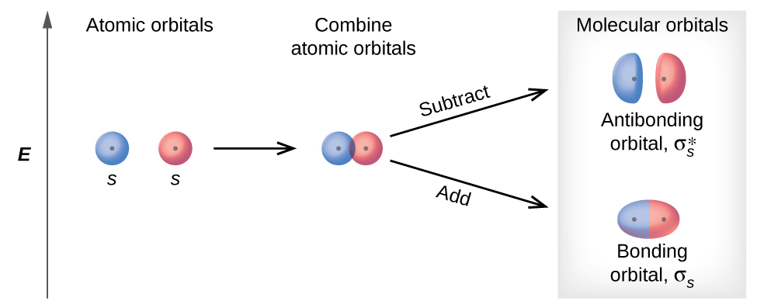
Figure 21.4d
Figure 21.4d. Sigma (σ) and sigma-star (σ*) molecular orbitals are formed by the combination of two s atomic orbitals. The plus (+) signs indicate the locations of nuclei (credit: Chemistry (OpenStax), CC BY 4.0).

Slide 38
Figure 21.4e
Figure 21.4e. Combining wave functions of two p atomic orbitals along the internuclear axis creates two molecular orbitals, σ_{p} and σ*_{p}. (credit: Chemistry (OpenStax), CC BY 4.0).

Slide 39
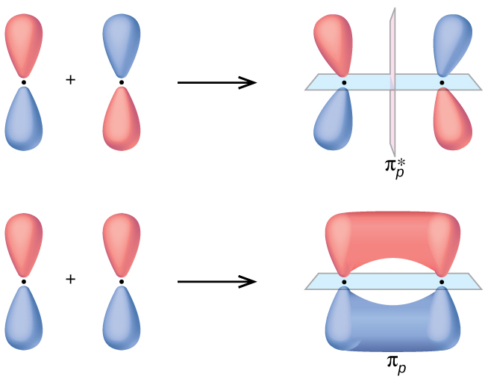
Figure 21.4f
Figure 21.4f. Side-by-side overlap of each two p orbitals results in the formation of two π molecular orbitals. Combining the out-of-phase orbitals results in an antibonding molecular orbital with two nodes. One contains the internuclear axis, and one is perpendicular to the axis. Combining the in-phase orbitals results in a bonding orbital. There is a node (blue) containing the internuclear axis with the two lobes of the orbital located above and below this node (credit: Chemistry (OpenStax), CC BY 4.0).

Slide 40
Figure 21.4g
Figure 21.4g. Walter Kohn developed methods to describe molecular orbitals. (credit: image courtesy of Walter Kohn, (Chemistry (OpenStax), CC BY 4.0.)

Slide 41
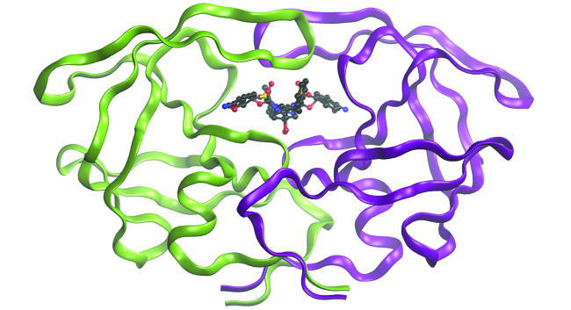
Figure 21.4h
Figure 21.4h. The molecule shown, HIV-1 protease, is an important target for pharmaceutical research. By designing molecules that bind to this protein, scientists are able to drastically inhibit the progress of the disease (credit: Chemistry (OpenStax), CC BY 4.0).

Slide 42
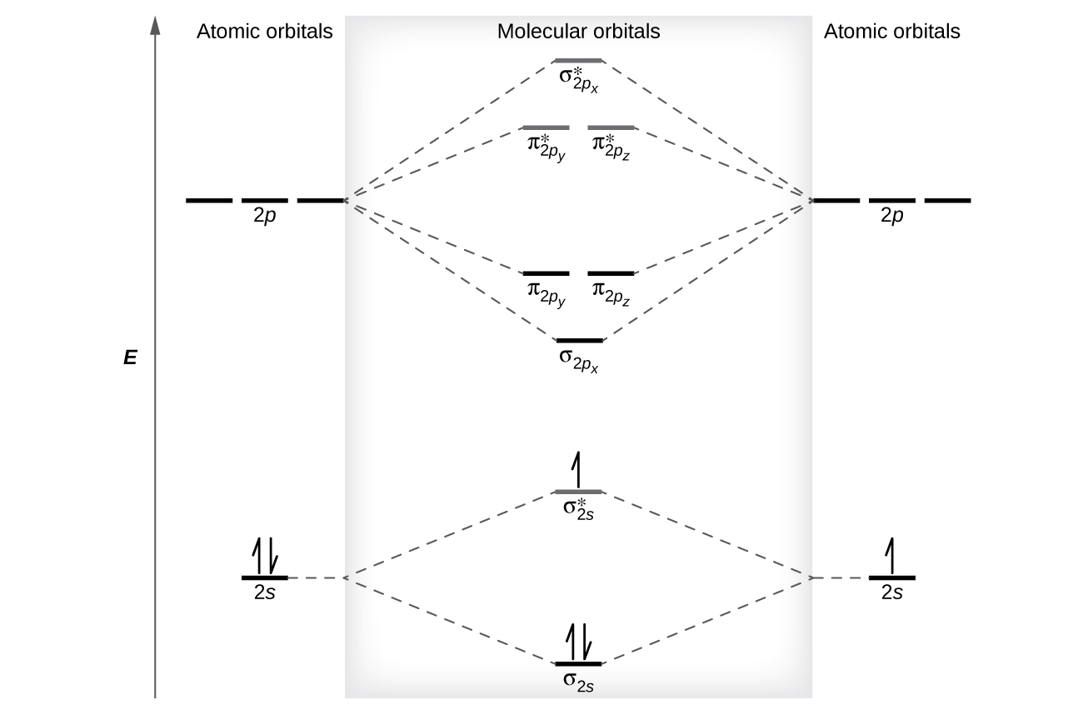
Figure 21.4i
Figure 21.4i. This is the molecular orbital diagram for the homonuclear diatomic Be₂⁺, showing the molecular orbitals of the valence shell only. The molecular orbitals are filled in the same manner as atomic orbitals, using the Aufbau principle and Hund’s rule (credit: Chemistry (OpenStax), CC BY 4.0).

Slide 43
Figure 21.4j
Figure 21.4j. The molecular orbital energy diagram predicts that H₂ will be a stable molecule with lower energy than the separated atoms (credit: Chemistry (OpenStax), CC BY 4.0).

Slide 44
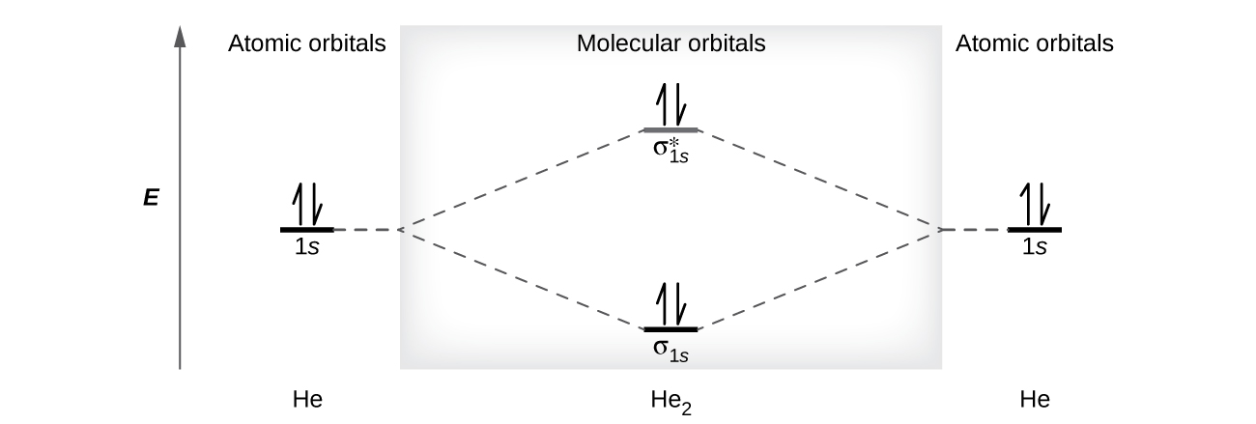
Figure 21.4k
Figure 21.4k. The molecular orbital energy diagram predicts that He₂ will not be a stable molecule, since it has equal numbers of bonding and antibonding electrons (credit: Chemistry (OpenStax), CC BY 4.0).

Slide 45
Table 21.4b
Table 21.4b. Electron Configuration and Bond Order for Molecular Orbitals in Homonuclear Diatomic Molecules of Period Two Elements
Molecule | Electron Configuration | Bond Order
Li₂ | (σ_{2s})² | 1
Be₂ (unstable) | (σ_{2s})²(σ_{2s}*)² | 0
B₂ | (σ_{2s})²(σ_{2s}*)²(π_{2py}, π_{2pz})² | 1
C₂ | (σ_{2s})²(σ_{2s}*)²(π_{2py}, π_{2pz})⁴ | 2
N₂ | (σ_{2s})²(σ_{2s}*)²(π_{2py}, π_{2pz})⁴(σ_{2px})² | 3
O₂ | (σ_{2s})²(σ_{2s}*)²(σ_{2px})²(π_{2py}, π_{2pz})⁴(π*_{2py}, π*_{2pz})² | 2
F₂ | (σ_{2s})²(σ_{2s}*)²(σ_{2px})²(π_{2py}, π_{2pz})⁴(π*_{2py}, π*_{2pz})⁴ | 1
Ne₂ (unstable) | (σ_{2s})²(σ_{2s}*)²(σ_{2px})²(π_{2py}, π_{2pz})⁴(π*_{2py}, π*_{2pz})⁴(σ_{2px})² | 0
Source: Table 8.3 in "8.4 Molecular Orbital Theory" in Chemistry (OpenStax), CC BY 4.0

Slide 46
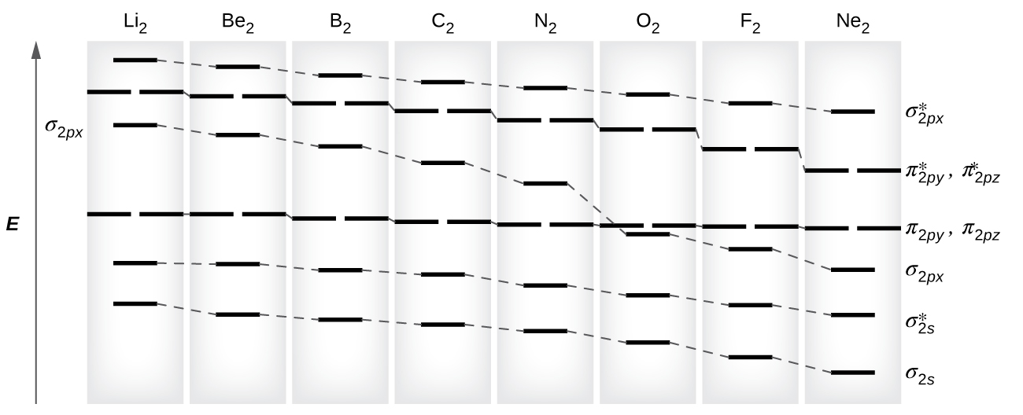
Figure 21.4l
Figure 21.4l. This shows the MO diagrams for each homonuclear diatomic molecule in the second period. The orbital energies decrease across the period as the effective nuclear charge increases and atomic radius decreases. Between N₂ and O₂, the order of the orbitals changes (credit: Chemistry (OpenStax), CC BY 4.0).

Slide 47
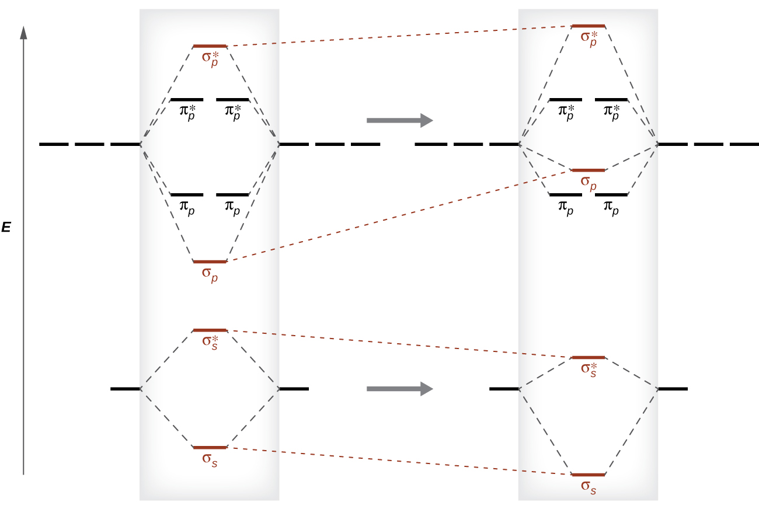
Figure 21.4m
Figure 21.4m. Without mixing, the MO pattern occurs as expected, with the σ_{p} orbital lower in energy than the σ_{p} orbitals. When s-p mixing occurs, the orbitals shift as shown, with the σ_{p} orbital higher in energy than the π_{p} orbitals (credit: Chemistry (OpenStax), CC BY 4.0).

Slide 48
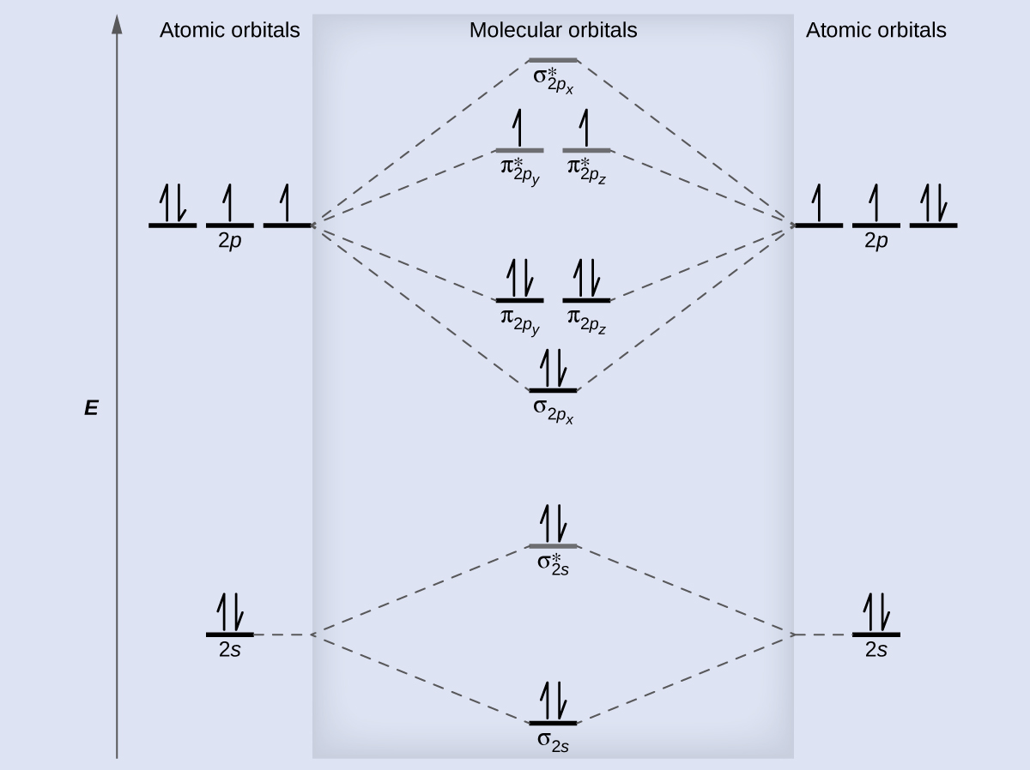
Figure 21.4n
Figure 21.4n. The molecular orbital energy diagram for O₂ predicts two unpaired electrons (credit: Chemistry (OpenStax), CC BY 4.0).

Slide 49
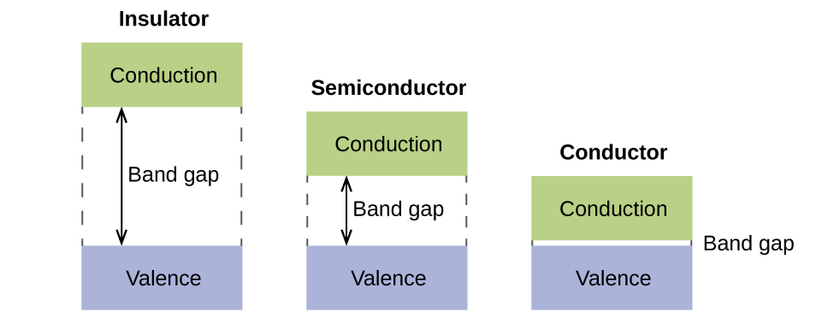
Figure 21.4o
Figure 21.4o. Molecular orbitals in solids are so closely spaced that they are described as bands. The valence band is lower in energy and the conduction band is higher in energy. The type of solid is determined by the size of the “band gap” between the valence and conduction bands. Only a very small amount of energy is required to move electrons from the valance band to the conduction band in a conductor, and so they conduct electricity well. In an insulator, the band gap is large, so that very few electrons move, and they are poor conductors of electricity. Semiconductors are in between: they conduct electricity better than insulators, but not as well as conductors (credit: Chemistry (OpenStax), CC BY 4.0).

