Slide 1
Chapter 20
Alkanes and Alkyl Halides
Slides to accompany Organic And Biochemistry Supplement to Enhanced Introductory College Chemistry by Gregory Anderson, Caryn Fahey, Jen Booth, Adrienne Richards, Samantha Sullivan Sauer, and David Wegman
Slide design and template by Revathi Mahadevan
Except where otherwise noted, images, tables & diagrams are reused from Organic and Biochemistry Supplement to Enhanced Introductory College Chemistry
Slides are licensed under CC-BY 4.0, Except while otherwise noted

Slide 2
Figure 20.0a
Figure 20.0a. The Three Simplest Alkanes (credit: Intro Chem: GOB (V. 1.0). ,CC BY-NC-SA 3.0.)

Slide 3
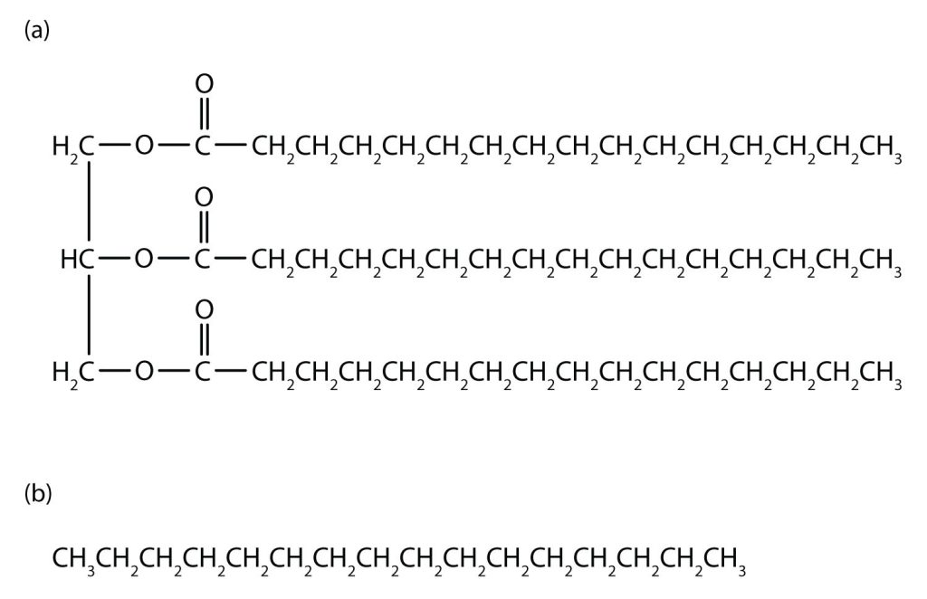
Figure 20.0b
Figure 20.0b. Tripalmitin (a), a typical fat molecule, has long hydrocarbon chains typical of most lipids. Compare these chains to hexadecane (b), an alkane with 16 carbon atoms (credit: Intro Chem: GOB (V. 1.0). ,CC BY-NC-SA 3.0).

Slide 4
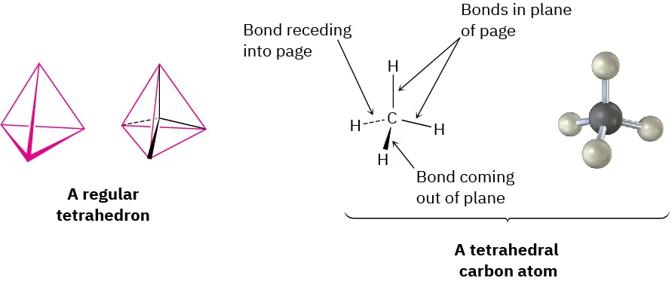
Figure 20.1a
Figure 20.1a. A representation of van’t Hoff’s tetrahedral carbon atom. The solid lines represent bonds in the plane of the paper, the heavy wedged line represents a bond coming out of the plane of the page toward the viewer, and the dashed line represents a bond going back behind the plane of the page away from the viewer (credit: Organic Chemistry (OpenStax), CC BY-NC-SA 4.0).

Slide 5
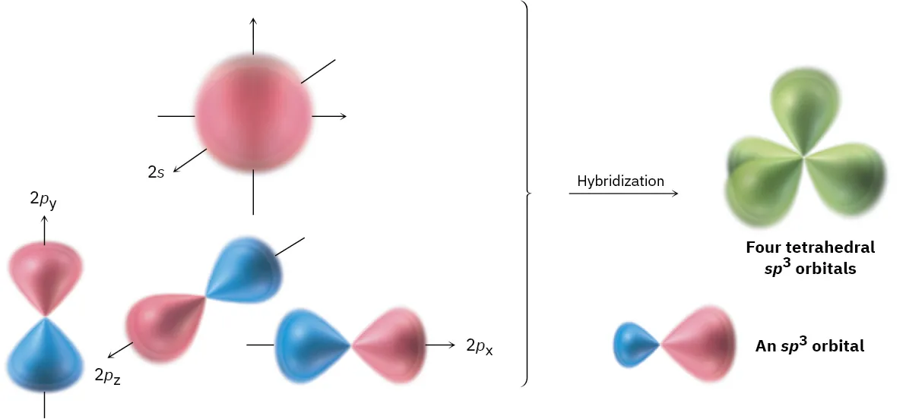
Figure 20.1b
Figure 20.1b. Four sp³ hybrid orbitals, oriented toward the corners of a regular tetrahedron, are formed by the combination of an s orbital and three p orbitals (red/blue). The sp³ hybrids have two lobes and are unsymmetrical about the nucleus, giving them a directionality and allowing them to form strong bonds to other atoms (credit: Organic Chemistry (OpenStax), CC BY-NC-SA 4.0).

Slide 6
Figure 20.1c
Figure 20.1c. The structure of methane, showing its 109.5° bond angles. (credit: Organic Chemistry (OpenStax), CC BY-NC-SA 4.0).

Slide 7
Figure 20.1d
Figure 20.1d. The Tetrahedral Methane Molecule (credit: Intro Chemistry: GOB (V. 1.0)., CC BY-NC-SA 4.0).

Slide 8
Figure 20.1e
Figure 20.1e. The Three Simplest Alkanes (credit: Intro Chemistry: GOB (V. 1.0)., CC BY-NC-SA 4.0).

Slide 9
Table 20.1a
Table 20.1a. The First 10 Straight-Chain Alkane Formulas
Name | Molecular Formula (C_{n}H_{2n + 2}) | Condensed Structural Formula
methane | CH₄ | CH₄
ethane | C₂H₆ | CH₃CH₃
propane | C₃H₈ | CH₃CH₂CH₃
butane | C₄H₁₀ | CH₃CH₂CH₂CH₃
pentane | C₅H₁₂ | CH₃CH₂CH₂CH₂CH₃
hexane | C₆H₁₄ | CH₃CH₂CH₂CH₂CH₂CH₃
heptane | C₇H₁₆ | CH₃CH₂CH₂CH₂CH₂CH₂CH₃
octane | C₈H₁₈ | CH₃CH₂CH₂CH₂CH₂CH₂CH₂CH₃
nonane | C₉H₂₀ | CH₃CH₂CH₂CH₂CH₂CH₂CH₂CH₂CH₃
decane | C₁₀H₂₂ | CH₃CH₂CH₂CH₂CH₂CH₂CH₂CH₂CH₂CH₃
Source: "12.2: Structures and Names of Alkanes" In Basics of GOB Chemistry (Ball et al.), CC BY-NC-SA 4.0.

Slide 10
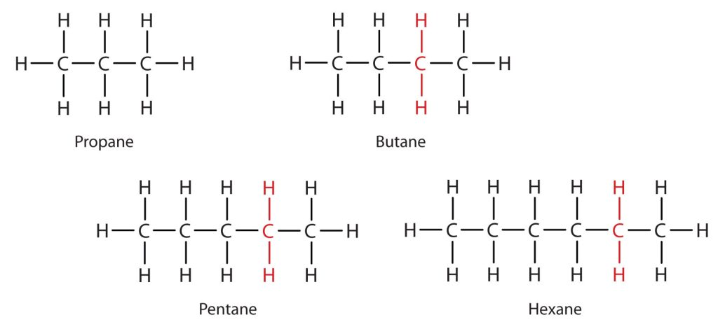
Figure 20.1f
Figure 20.1f. Members of a Homologous Series. Each succeeding formula incorporates one carbon atom and two hydrogen atoms more than the previous formula(credit: Intro Chemistry: GOB (V. 1.0)., CC BY-NC-SA 4.0).

Slide 11
Table 20.1b
Table 20.1b. Physical Properties of Some Alkanes
Molecular Name | Formula | Melting Point (°C) | Boiling Point (°C) | Density (20°C)* | Physical State (at 20°C)
methane | CH₄ | –182 | –164 | 0.668 g/L | gas
ethane | C₂H₆ | –183 | –89 | 1.265 g/L | gas
propane | C₃H₈ | –190 | –42 | 1.867 g/L | gas
butane | C₄H₁₀ | –138 | –1 | 2.493 g/L | gas
pentane | C₅H₁₂ | –130 | 36 | 0.626 g/mL | liquid
hexane | C₆H₁₄ | –95 | 69 | 0.659 g/mL | liquid
octane | C₈H₁₈ | –57 | 125 | 0.703 g/mL | liquid
decane | C₁₀H₂₂ | –30 | 174 | 0.730 g/mL | liquid
*Note the change in units going from gases (grams per liter) to liquids (grams per milliliter). Gas densities are at 1 atm pressure.
Source: "12.6: Physical Properties of Alkanes" In Basics of GOB Chemistry (Ball et al.), CC BY-NC-SA 4.0.

Slide 12
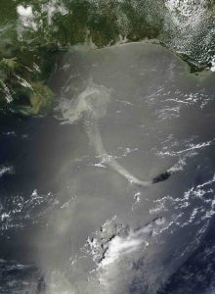
Figure 20.1g
Figure 20.1g. Oil Spills. Crude oil coats the water’s surface in the Gulf of Mexico after the Deepwater Horizon oil rig sank following an explosion. The leak was a mile below the surface, making it difficult to estimate the size of the spill. One liter of oil can create a slick 2.5 hectares (6.3 acres) in size. This and similar spills provide a reminder that hydrocarbons and water don’t mix. (Credit: NASA Goddard / MODIS Rapid Response Team, NASA terms of use).

Slide 13
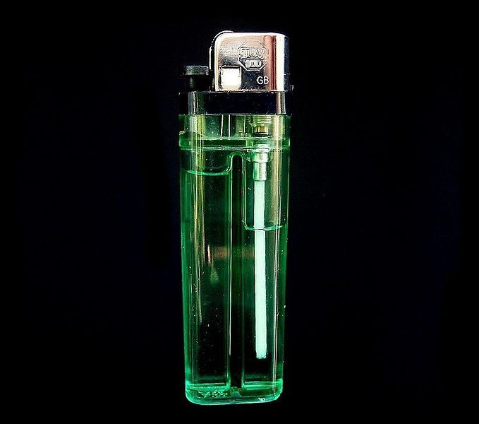
Figure 20.1h
Figure 20.1h. Butane is a hydrocarbon with the formula [latex]ce{C4H10}\) and is a gas at room temperature and atmospheric pressure. Under excess pressures, it can be liquidized like the fuel shown in this butane lighters. (Credit: work by Frank Vincentz, CC BY-SA 3.0)

Slide 14
Table 20.2a
Table 20.2a. The First 10 Straight-Chain Alkane Molecular Formulas
Name | Molecular Formula (C_{n}H_{2n + 2})
methane | CH₄
ethane | C₂H₆
propane | C₃H₈
butane | C₄H₁₀
pentane | C₅H₁₂
hexane | C₆H₁₄
heptane | C₇H₁₆
octane | C₈H₁₈
nonane | C₉H₂₀
decane | C₁₀H₂₂
Source: "12.2: Structures and Names of Alkanes" In Basics of GOB Chemistry (Ball et al.), CC BY-NC-SA 4.0.

Slide 15
Figure 20.2a
Figure 20.2a. Structural and condensed formula for butane (credit: Intro Chem:GOB (V. 1.0), CC BY-NC-SA 4.0.)

Slide 16
Figure 20.2b
Figure 20.2b. Line structure for pentane and isopentane (credit: Intro Chem:GOB (V. 1.0), CC BY-NC-SA 4.0.)

Slide 17
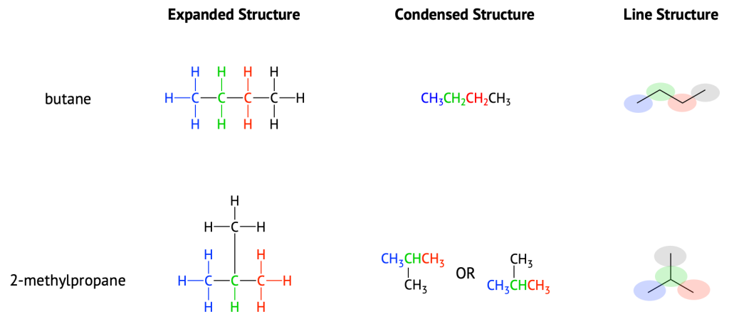
Figure 20.2c
Figure 20.2c. Structural representations for butane and its isomer, 2-methylpropane. (The colours are used to help identify carbons and do not represent any special properties.) (credit: Fundamentals of GOB ( McMurry et al.), CC BY-NC-SA 3.0)

Slide 18
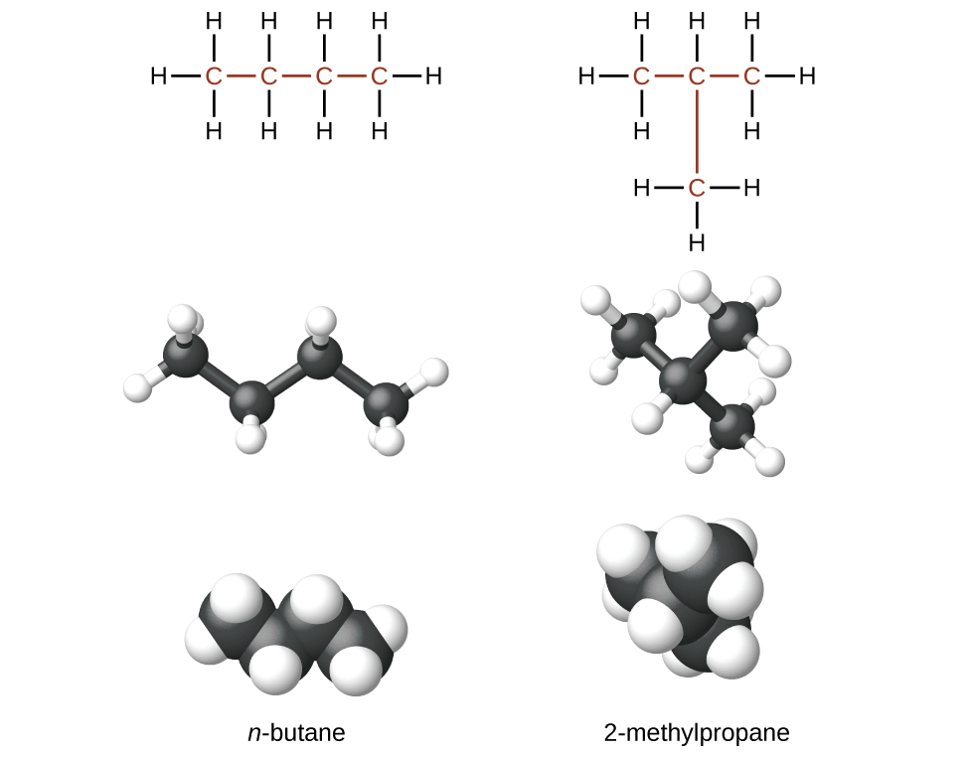
Figure 20.3a
Figure 20.3a. Structural and ball-and-stick formulas for butane and 2-methylpropane (credit: General Chemistry 1 & 2 , CC BY 4.0).

Slide 19
Table 20.3a
Table 20.3a. The First 10 Straight-Chain Alkane Formulas and Isomers
Name | Molecular Formula (C_{n}H_{2n + 2}) | Condensed Structural Formula | Number of Possible Isomers
methane | CH₄ | CH₄ | —
ethane | C₂H₆ | CH₃CH₃ | —
propane | C₃H₈ | CH₃CH₂CH₃ | —
butane | C₄H₁₀ | CH₃CH₂CH₂CH₃ | 2
pentane | C₅H₁₂ | CH₃CH₂CH₂CH₂CH₃ | 3
hexane | C₆H₁₄ | CH₃CH₂CH₂CH₂CH₂CH₃ | 5
heptane | C₇H₁₆ | CH₃CH₂CH₂CH₂CH₂CH₂CH₃ | 9
octane | C₈H₁₈ | CH₃CH₂CH₂CH₂CH₂CH₂CH₂CH₃ | 18
nonane | C₉H₂₀ | CH₃CH₂CH₂CH₂CH₂CH₂CH₂CH₂CH₃ | 35
decane | C₁₀H₂₂ | CH₃CH₂CH₂CH₂CH₂CH₂CH₂CH₂CH₂CH₃ | 75
Table source: "12.2: Structures and Names of Alkanes" In Basics of GOB Chemistry (Ball et al.), CC BY-NC-SA 4.0.

Slide 20
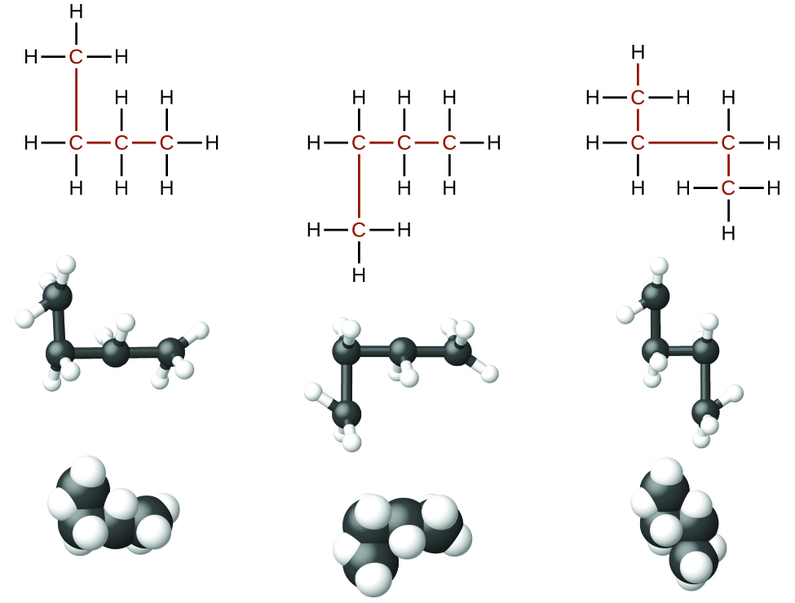
Figure 20.3b
Figure 20.3b. These three representations of the structure of n-butane are not isomers because they all contain the same arrangement of atoms and bonds (credit: General Chemistry 1 & 2 , CC BY 4.0.)

Slide 21
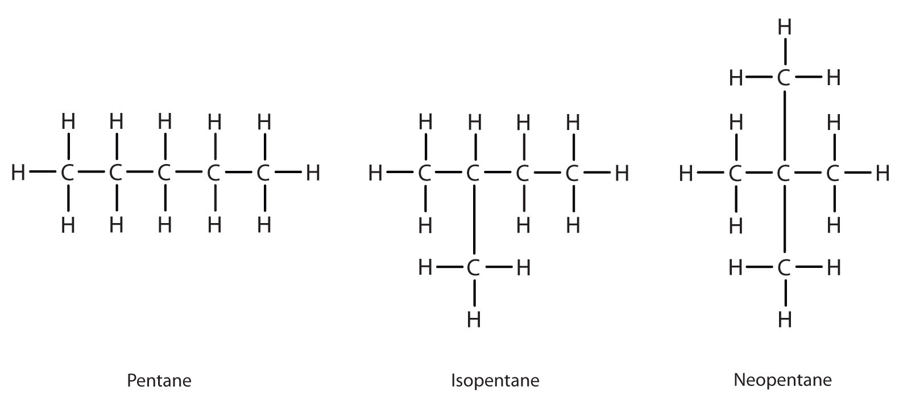
Figure 20.3c
Figure 20.3c. Structural formulas representing 3 isomers of pentane. (Credit: Introduction to Chemistry: GOB (V. 1.0). ,CC BY-NC-SA 3.0.)

Slide 22
Table 20.3b
Table 20.3b. Stems That Indicate the Number of Carbon Atoms in Organic Molecules
Stem | Number
meth- | 1
eth- | 2
prop- | 3
but- | 4
pent- | 5
hex- | 6
hept- | 7
oct- | 8
non- | 9
dec- | 10
Source: "12.5: IUPAC Nomenclature" In Basics of GOB Chemistry (Ball et al.), CC BY-NC-SA 4.0.

Slide 23
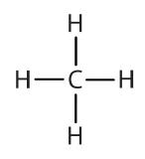
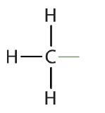
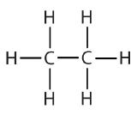
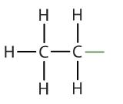
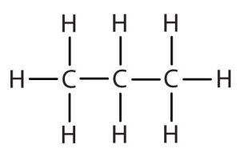
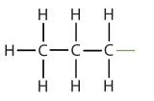
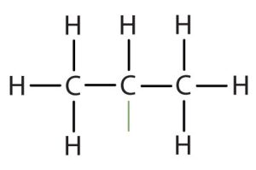
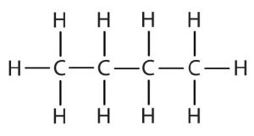
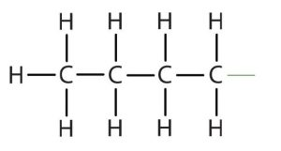
Table 20.3c
Table 20.3c. Common Alkyl Groups
Parent Alkane | Parent Structure | Alkyl Group | Alkyl Structure | Condensed Structural Formula
methane |  | methyl |  | CH₃–
ethane |  | ethyl |  | CH₃CH₂–
propane |  | propyl |  | CH₃CH₂CH₂–
 |  | isopropyl |  | (CH₃)₂CH–
butane |  | butyl* |  | CH₃CH₂CH₂CH₂–
Note: *There are four butyl groups, two derived from butane and two from isobutane. We will introduce the other three where appropriate. (Image credits: Introduction to Chemistry: GOB (V. 1.0). , CC BY-NC-SA 3.0).

Slide 24
Figure 20.3d
Figure 20.3d. An example showing that finding the longest carbon chain does not have to be in a straight line. (Credit: Introduction to Chemistry: GOB (V. 1.0). ,CC BY-NC-SA 3.0.)

Slide 25
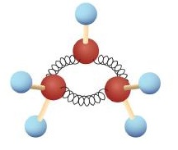
Figure 20.4a
Figure 20.4a. Ball-and-Spring Model of Cyclopropane. The springs are bent to join the carbon atoms. (Credit: Intro Chem: GOB (V. 1.0). ,CC BY-NC-SA 3.0)

Slide 26
Figure 20.4b
Figure 20.4b. The line structure and geometric shapes of cyclopropane and cyclohexane. (Credit: Intro Chem: GOB (V. 1.0). ,CC BY-NC-SA 3.0.)

Slide 27
Figure 20.4d
Figure 20.4d. The chemical structure shown is Prostaglandin E₁ which shows a substituted cyclopentane (credit: Organic Chemistry (OpenStax), CC BY-NC-SA 4.0).

Slide 28
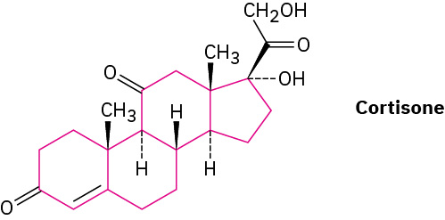
Figure 20.4e
Figure 20.4e. The chemical structure shown is Cortisone which shows four substituted rings joined together. There are three cyclohexanes and one cyclopentane (credit: Organic Chemistry (OpenStax), CC BY-NC-SA 4.0).

Slide 29
Figure 20.4f
Figure 20.4f. Alkyl substituted cycloalkanes methylcyclopentane and 1-cyclopropyl butane. (credit: Organic Chemistry (OpenStax), CC BY-NC-SA 4.0)

Slide 30
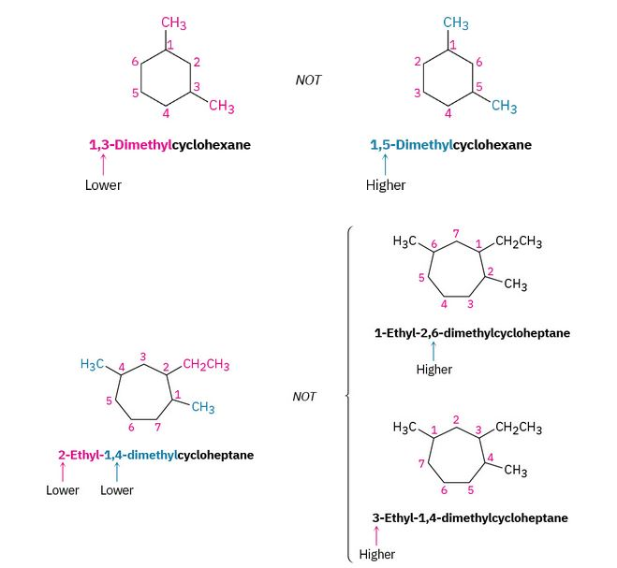
Figure 20.4g
Figure 20.4g. Numbering the substituents on a cycloheptane by selecting the lower combination of numbers. (credit: Organic Chemistry (OpenStax), CC BY-NC-SA 4.0)

Slide 31
Figure 20.4h
Figure 20.4h. Naming alkyl groups in alphabetical order within a cyclopentane (credit: Organic Chemistry (OpenStax), CC BY-NC-SA 4.0)

Slide 32
Figure 20.4i
Figure 20.4i. Naming halogens like that of alkyl groups on a cyclobutane (credit: Organic Chemistry (OpenStax), CC BY-NC-SA 4.0)

Slide 33
Figure 20.4j
Figure 20.4j. Examples of additional substituted cycloalkanes (credit: Organic Chemistry (OpenStax), CC BY-NC-SA 4.0)

Slide 34
Figure 20.4k
Figure 20.4k. Bond rotation in ethane and cyclopropane. (a) Rotation occurs around the carbon–carbon bond in ethane, but (b) no rotation is possible around the carbon–carbon bonds in cyclopropane without breaking open the ring.(credit: Organic Chemistry (OpenStax), CC BY-NC-SA 4.0)

Slide 35
Figure 20.4l
Figure 20.4l. There are two different 1,2-dimethylcyclopropane isomers, one with the methyl groups on the same face of the ring (cis) and the other with the methyl groups on opposite faces of the ring (trans). The two isomers do not interconvert (credit: Organic Chemistry (OpenStax), CC BY-NC-SA 4.0).

Slide 36
Figure 20.4m
Figure 20.4m. The figure demonstrates the difference between constitutional isomers and stereoisomers (credit: Organic Chemistry (OpenStax), CC BY-NC-SA 4.0

Slide 37
Figure 20.4n
Figure 20.4n. The cis and trans isomers are shown through cis-1, 3-Dimethylcyclobutane and trans-1-Bromo-3-ethylcyclopentane (credit: Organic Chemistry (OpenStax), CC BY-NC-SA 4.0).

Slide 38
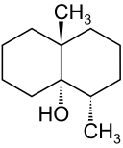
Figure 20.4o
Figure 20.4o. The molecular structure of geosmin. (credit: Image by Xplus1, PDM).

Slide 39
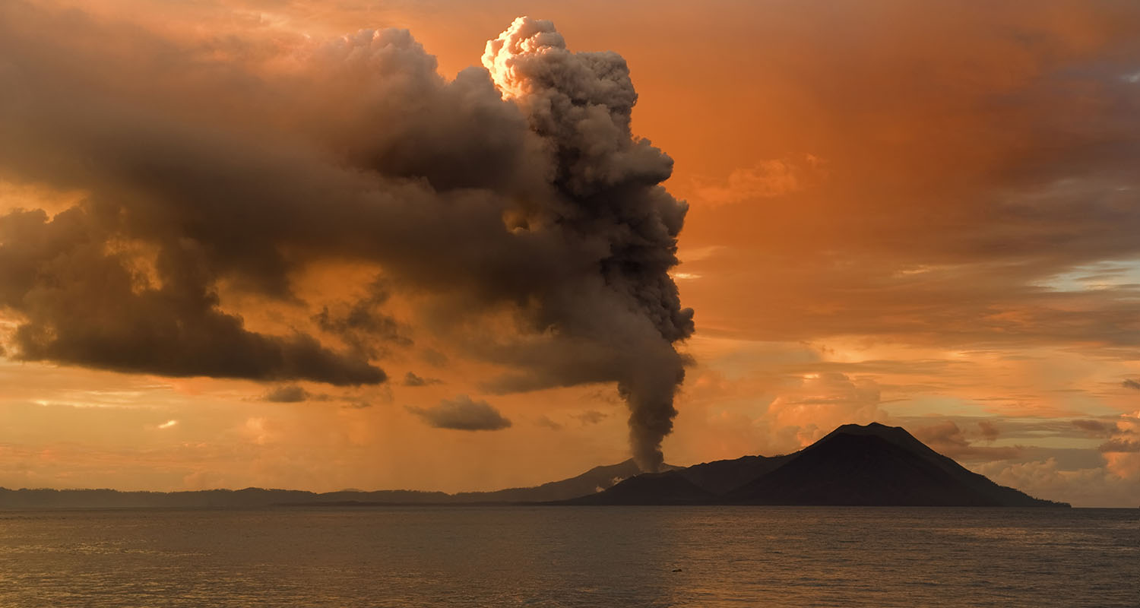
Figure 20.5a
Figure 20.5a. The gases released during volcanic eruptions contain large amounts of organohalides, including chloromethane, chloroform, dichlorodifluoromethane, and many others. (credit: modification of “Tavurvur volcano” by Taro Taylor edit by Richard Bartz, CC BY 2.0).

Slide 40
Figure 20.5b
Figure 20.5b. Examples of halogen containing compounds trichloroethylene (a solvent), halothane (an inhaled anesthetic), tetrafluoropropene (a refrigerant), and bromomethane (a fumigant) (credit: Organic Chemistry (OpenStax), CC BY-NC-SA 4.0).

Slide 41
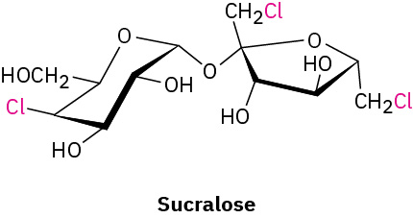
Figure 20.5c
Figure 20.5c. Structural formula of sucralose (credit: Organic Chemistry (OpenStax), CC BY-NC-SA 4.0).

Slide 42
Figure 20.5d
Figure 20.5d. Condensed formulas of halogenated compounds involving chlorine and bromine atoms. (Credit: Introduction to Chemistry: GOB (V. 1.0). ,CC BY-NC-SA 3.0.)

Slide 43
Figure 20.5e
Figure 20.5e. The ball-and-stick model of perfluorooctanesulfonic acid. (credit: Image by Jynto, CC0)

Slide 44
Figure 20.5f
Figure 20.5f. Numbering the carbon chain using 5-Bromo-2,4-dimethylheptane and 2-Bromo-4,5-deimethylheptane as examples (credit: Organic Chemistry (OpenStax), CC BY-NC-SA 4.0).

Slide 45
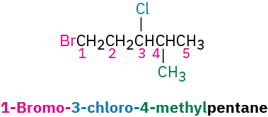
Figure 20.5g
Figure 20.5g. Numbering the carbon chain 1-Bromo-3-chloro-4-methylpentane (credit: Organic Chemistry (OpenStax), CC BY-NC-SA 4.0).

Slide 46
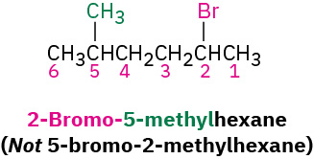
Figure 20.5h
Figure 20.5h. An example of alphabetical precedence of 2-Bromo-5-methylhexane (credit: Organic Chemistry (OpenStax), CC BY-NC-SA 4.0).

Slide 47
Figure 20.5i
Figure 20.5i. Naming alkyl halides iodomethane, 2-chloropropane and bromocyclohexane (credit: Organic Chemistry (OpenStax), CC BY-NC-SA 4.0).

Slide 48
Table 20.5a
Table 20.5a. Some Halogenated Hydrocarbons
Formula | Derived from | Common Name | IUPAC Name | Some Important Uses
CH₃Cl | CH₄ | methyl chloride | chloromethane | refrigerant; the manufacture of silicones, methyl cellulose, and synthetic rubber
CH₂Cl₂ | CH₄ | methylene chloride | dichloromethane | laboratory and industrial solvent
CHCl₃ | CH₄ | chloroform | trichloromethane | industrial solvent
CCl₄ | CH₄ | carbon tetrachloride | tetrachloromethane | dry-cleaning solvent and fire extinguishers (but no longer recommended for use)
CBrF₃ | CH₄ | halon-1301 | bromotrifluoromethane | fire extinguisher systems
CCl₃F | CH₄ | chlorofluorocarbon-11 (CFC-11) | trichlorofluoromethane | foaming plastics
CCl₂F₂ | CH₄ | chlorofluorocarbon-12 (CFC-12) | dichlorodifluoromethane | refrigerant
CH₃CH₂Cl | CH₃CH₃ | ethyl chloride | chloroethane | local anesthetic
ClCH₂CH₂Cl | CH₃CH₃ | ethylene dichloride | 1,2-dichloroethane | solvent for rubber
CCl₃CH₃ | CH₃CH₃ | methylchloroform | 1,1,1-trichloroethane | solvent for cleaning computer chips and molds for shaping plastics
Source: "12.8: Halogenated Hydrocarbons" In Basics of GOB Chemistry (Ball et al.), CC BY-NC-SA 4.0.

Slide 49
Figure 20.5j
Figure 20.5j. Chemical structure of halomon (credit: Organic Chemistry (OpenStax), CC BY-NC-SA 4.0).

